Slide 1

ELDER ABUSE
Ms. Varsha Hun
ASST.PROFESSOR
SNC

Slide 2

ELDER ABUSE
Definition
“A non-accidental act or omission ,which undermines the life, the physical and psychological integrity of an older person or harms the development of his/her personality or damage his/her financial security”

Slide 3
TYPES OF ELDER ABUSE
Physical abuse: the infliction of pain or injury, physical coercion, or physical restraint.
Psychological or emotional abuse: the infliction of mental anguish.
Financial or material abuse: the illegal or improper exploitation or use of funds or resources of the older person.
Sexual abuse: nonconsensual sexual contact of any kind with the older person.

Slide 4


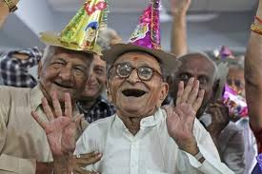
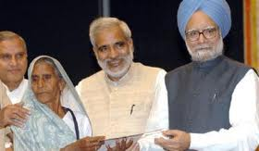
WELFARE OF THE OLD PEOPL
pension

Slide 5
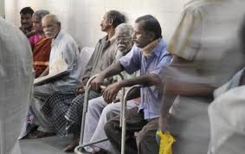

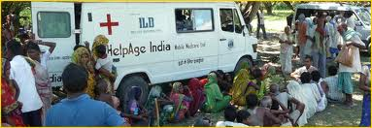
Medical care at concessional rate :-

Slide 6
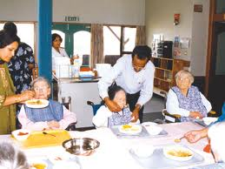
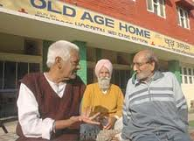
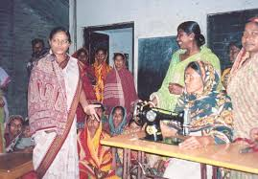

Old age home:

Slide 7
Voluntary organization:
Help age India :
The activities are:
Creating awareness about the needs of aged in society.
Conducts various events such as debates, painting etc.
Training to individuals who are engaged in old programmes.
Manages mobile Medicare unit.
Setting up training research and development centers to study the problems and issues related to old age and age care in its present and changing context.

Slide 8
Age care India :
It is a voluntary organization to provide services to aged males and females above 50 years through:
Domiciliary, residential, and institutional services.
Educational, recreational, social, cultural and spiritual services.
Medical services.
Part time employment.
Tours, trips for old age.
Professional consultancy services for taxes, duties, pension etc.
Research and studies on old age problems.
Creation of understanding and providing suitable environment for old age.

Slide 9
Other benefits for old age:
Railway travelling concession.
Preference in hospital for medical services. In other words, separate sections or counters for registration in O.P.D. and preference to old age for providing services.
Separate counters for paying taxes, getting tickets for railway and bus journey.

Slide 10
A Systematic Review of Interventions for Elder Abuse
Abstract
The purpose of this study was to use rigorous systematic review methods to summarize the effectiveness of interventions for elder abuse. Only eight studies met our inclusion criteria. Evidence regarding the recurrence of abuse following intervention was limited, but the interventions for which this outcome was reported failed to reduce, and may have even increased, the likelihood of recurrence. Elder abuse interventions had no significant effect on case resolution and at-risk caregiver outcomes, and had mixed results regarding professional knowledge and behavior related to elder abuse. The included studies had important methodological limitations that limit our ability to draw conclusions about the effectiveness of these interventions.
http://www.tandfonline.com/doi/abs/10.1080/08946560902997181
level of evidence;
evidence I

Slide 11
PROBLEM | INTERVENTION | COMPARISON | OUTCOME
A Systematic Review of Interventions for Elder Abuse | The purpose of this study was to use rigorous systematic review methods to summarize the effectiveness of interventions for elder abuse. Only eight studies met our inclusion criteria. | NIL | Elder abuse interventions had no significant effect on case resolution and at-risk caregiver outcomes, and had mixed results regarding professional knowledge and behavior related to elder abuse.
Level of Evidence: VI

