Slide 1
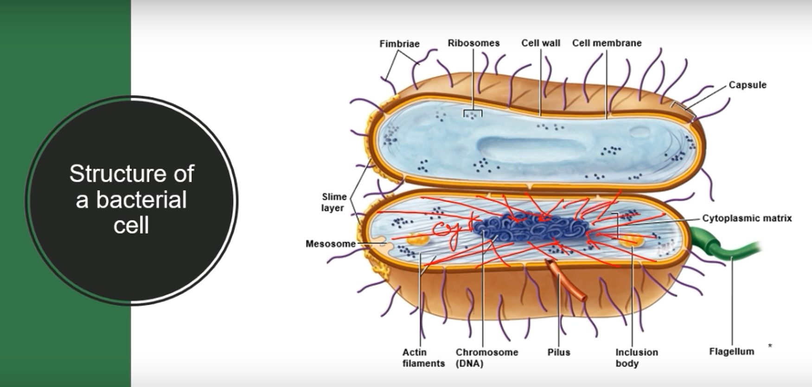

Slide 2
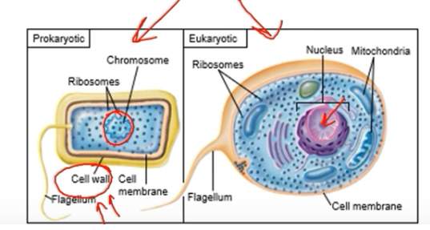
CHARACTERISTICS OF LIFE
PROKARYOTIC CELL- examples:bacteria and archea
No nucleus or other membrane bound organelles
EUKARYOTIC CELL- examples: Animal,Plant ,fungi,protist.
Contain membrane bound organelles that compartmentalize the cytoplasm and perform specific functions.
Contain double bound membrane bound nucleus with DNA and Chromosomes.

Slide 3
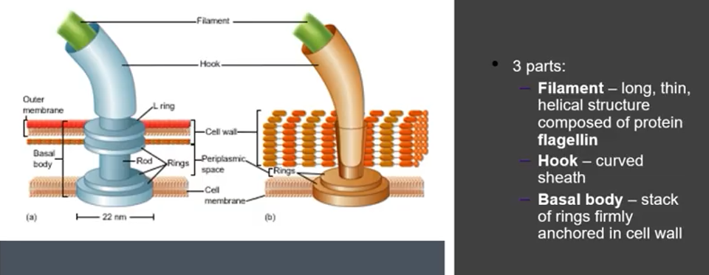
Flagella

Slide 4
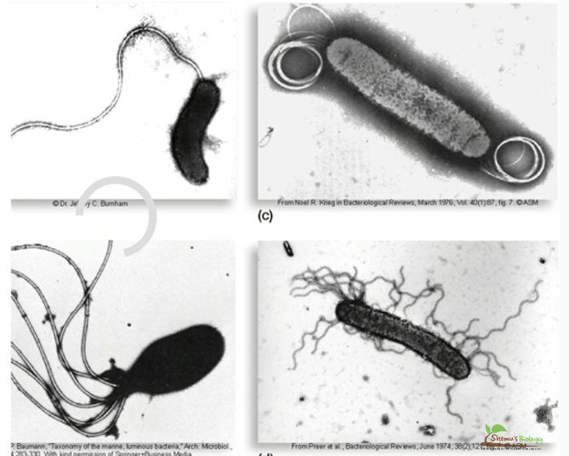
Flagella
Monotrichous
Amphitrichous
Lophotrichous
Peritrichous

Slide 5
STRUCTURE OF CELL WALL
Distinguishing Gram Positive bacteria from gram Negative Bacteria
Gram Positive Bacterial Cell Wall
Gram Negative Bacterial Cell Wall

Slide 6
Classification criteria based on Cell Wall Include:
Gram Positive bactetia
Gram Negative bacteria
Bacteria Without Cell walls
Bacteria with Chemically unique cell wall

Slide 7
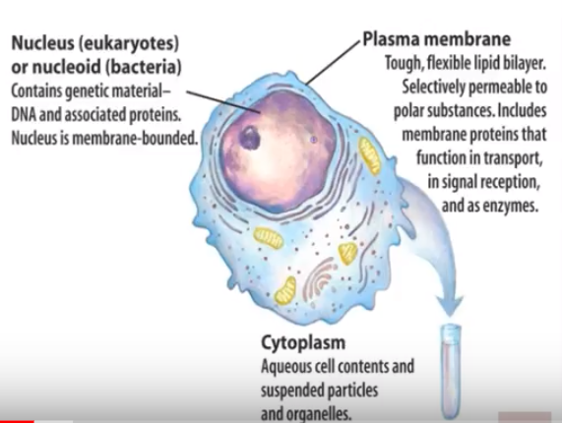
Both Prokaryotic and Eukaryotic Cell Features

Slide 8
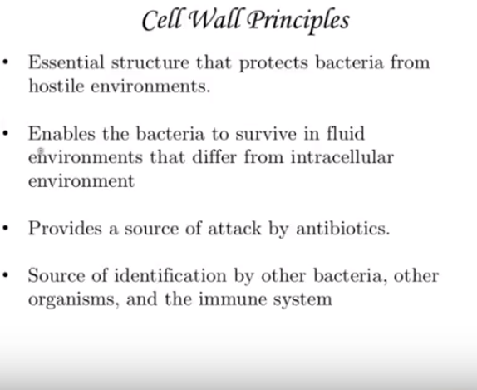

Slide 9
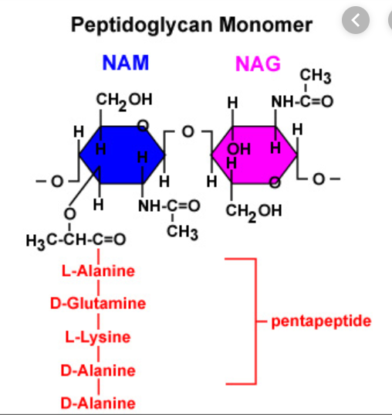
Peptidoglycan
Peptidoglycan is the Primary Component
Peptidoglycan is unique macromolecule composed of repeating framework of long glycan-chain cross linked by short peptide fragments.
If external to the cell,will cause gram staining.

Slide 10
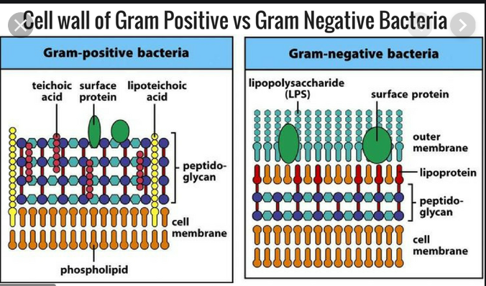
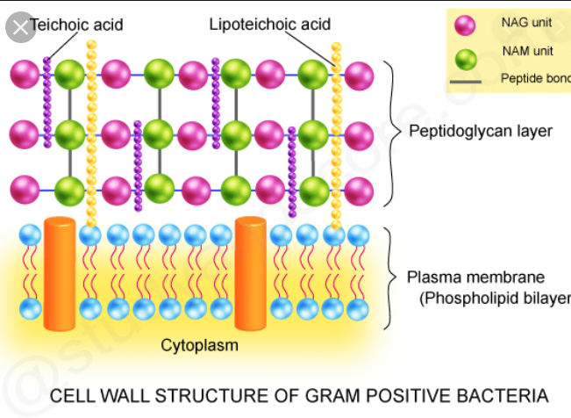
20-80nm Thick Peptidoglycan
Includes Teichoic acid and lipoteichoic acid: function in cell wall maintainance and enlargement during cell division:move cations across the cell envelope:stimulate a specific immune response.
Some cells have Periplasmic space between cell membrane and cell wall.

Slide 11
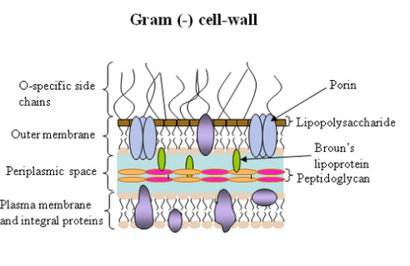
Gram Negative Cell Wall
Gram Negative bacteria have membranes external to peptidoglycan –More Complex
Outer Membrane provides a barrier to certain antibiotics (Penicillin),lysozymes,detergents,heavy metal etc.
Outer membrane contains lipid A,a endotoxin ,that is released when bacteria die.

Slide 12
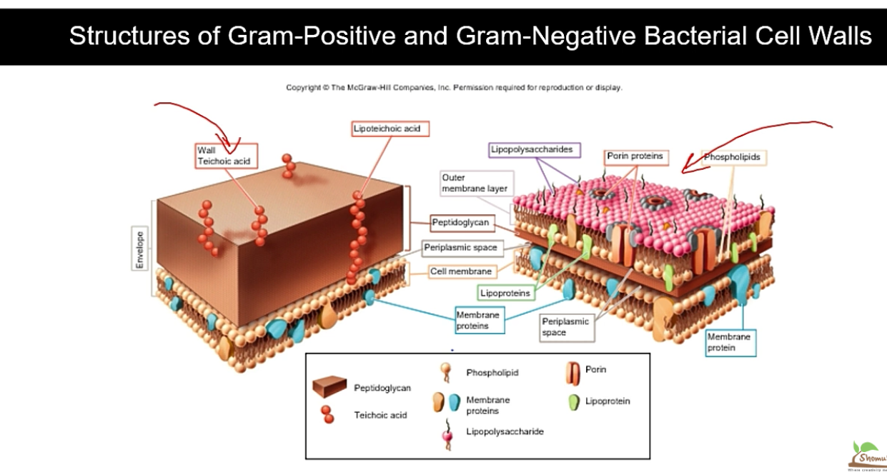

Slide 13
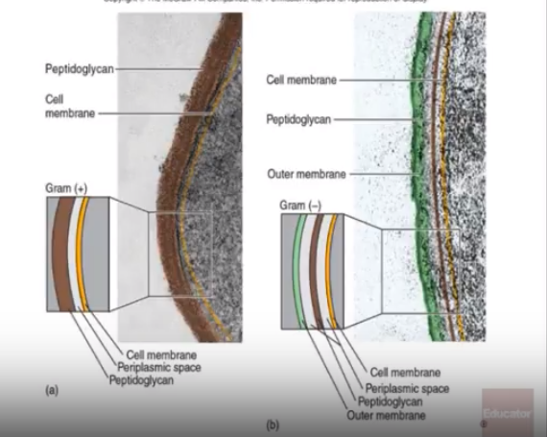
Gram Positive and Gram Negative Cell Wall

