Slide 1

Nursing management of child with Meningitis
PRESENTED BY:
MR. NIRMAL RAJ EV
ASSOCIATE PROFESSOR
DEPT OF CHILD HEALTH NURSING
SUMANDEEP NURSING COLLEGE
SUMANDEEP VIDYAPEETH DEEMED TO BE UNIVERSITY
PIPARIA, WAGHODIA, VADODARA

Slide 2
Objectives
By the end of this session, students will be able to:
Review the anatomy and physiology of central nervous system.
Define meningitis
State the classifications of meningitis
Discuss the pathophysiology of meningitis.
State the clinical manifestations of meningitis.

Slide 3
Objectives
Describe the diagnostic tests required for patients with meningitis.
Describe the prevention ways of meningitis.
Describe the medical management provided to patients with meningitis.
Define encephalitis.
Discuss the pathophysiology of encephalitis.

Slide 4
Objectives
State the clinical manifestations of encephalitis.
Describe the diagnostic tests required for patients with encephalitis.
Explain the medical management provided to patients with encephalitis.
Explain the nursing management for the patients with meningitis & encephalitis.

Slide 5
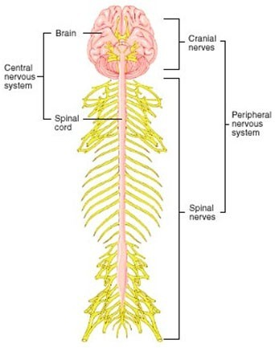
Anatomy and physiology
The nervous system consists of two divisions:
  The central nervous system (CNS)
^{ν} The Brain and spinal cord
  The peripheral nervous system

Slide 6
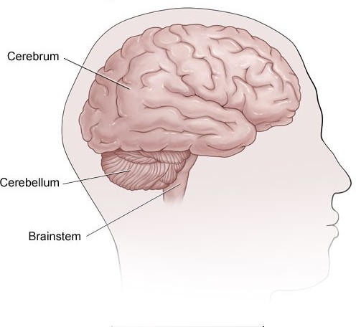
Anatomy and physiology
Brain divided into three major areas
  The cerebrum
  The brain stem
  The cerebellum

Slide 7
Anatomy and physiology
The cerebrum
Composed of two hemispheres, thalamus, hypothalamus, and the basal ganglia.
Has connections for the olfactory and optic nerves.
The cerebral hemispheres are divided into pairs of frontal, parietal, temporal, and occipital lobes.

Slide 8
Anatomy and physiology
The brain stem
  Midbrain, pons, medulla, and connections for cranial nerves II and IV through XII.
The cerebellum
  Located under the cerebrum and behind the brain stem.

Slide 9
Anatomy and physiology
Structures protecting the brain are
  Rigid skull
  The meninges (fibrous connective tissues that cover the brain and spinal cord)
    Dura mater- the outermost layer.
    Arachnoid – the middle membrane.
    Pia mater- the innermost membrane.

Slide 10
Anatomy and physiology
CSF
  Clear and colorless fluid
  Produced in the ventricles
  Circulated around the brain and the spinal cord through the ventricular system.
  The composition is similar to other extracellurla fluids, but the concentrations of the various constituents are different

Slide 11
Anatomy and physiology
Blood-brain barrier
  Formed by endothelial cells of the brain’s capillaries, which forms continuous tight junctions, creating a barrier to macromolecules and many compounds.
  Has protective function but can be altered by trauma, cerebral edema, and cerebral hypoxemia.

Slide 12
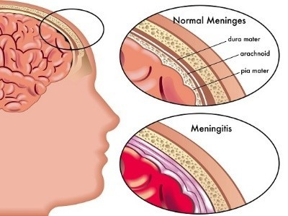
Meningitis
^{ν} An inflammation of the pia mater, the arachnoid, and the cerebrospinal fluid (CSF)-filled subarachnoid space.

Slide 13
Classifications
Septic:
  Caused by bacteria.
  most common pathogens are streptococcus pneumonia and Neisseria meningitidis
Aseptic: caused by viral or secondary to lymphoma, leukemia, or HIV

Slide 14
Pathophysiology
infections generally originate in one of two ways:
  through the bloodstream as a consequence of other infections
  or by direct spread, such as might occur after a traumatic injury to the facial bones or secondary to invasive procedure

Slide 15
Once the causative organism enters the blood stream, it crosses the blood-brain barrier and proliferates in the CSF.
The host immune response stimulates the release of cell wall fragments and lipopolysaccharides, facilitating inflammation of the subarachnoid and pia mater.

Slide 16
Because the cranial vault contains little room for expansion, the inflammation may cause increased intracranial pressure (ICP).
CSF circulates through the subarachnoid space, where inflammatory cellular materials from the affected meningeal tissue enter and accumulate

Slide 17
CSF studies demonstrate decreased glucose, increased protein levels, and increased WBCs count.
The prognosis pf bacterial meningitis depends on the causative organism, the severity of the infection and illness, and the timeliness of treatment.

Slide 18
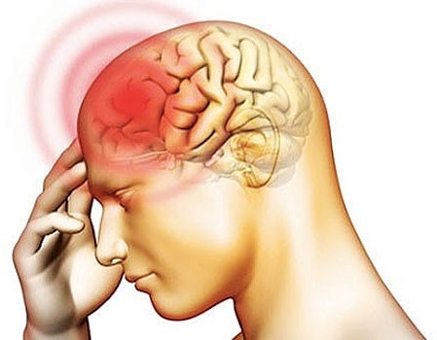
Clinical Manifestations
Initial symptoms:
  Headache
    either steady or throbbing and very severe as a result of meningeal irritation.
  Fever
    tends to remain high throughout the course of illness.

Slide 19
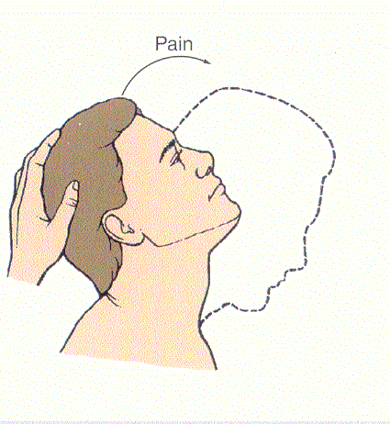
Clinical Manifestations
Meningeal irritation signs:
  Nuchal rigidity:
    Early sign
    Any attempts at flexion of the head are difficult because of spasm in the muscles of the neck.
    Forceful flexion causes severe pain

Slide 20
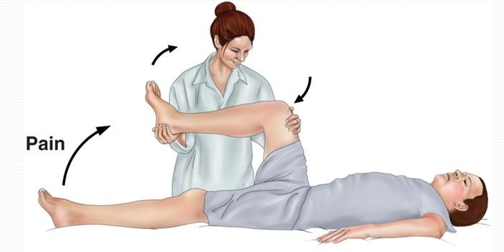
Clinical Manifestations
Meningeal irritation signs:
  Positive kernig’s sign:
^{ν} When the patient is lying with the thigh flexed on the abdomen, the leg can’t be completely extended.

Slide 21
Clinical Manifestations
Meningeal irritation signs:
  Positive Brudziniski’s sign
    When the patient’s neck is flexed, flexion of the knees and hips is produced
    When the lower extremity of one side is passively flexed, a similar movement is seen in the opposite extremity
    More sensitive indicator of meningeal irritation than Kernig’s sign.

Slide 22
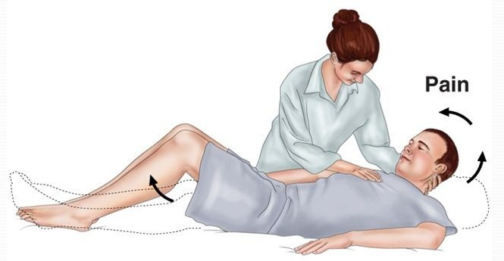
Clinical Manifestations
Meningeal irritation signs:
  Positive Brudziniski’s sign

Slide 23
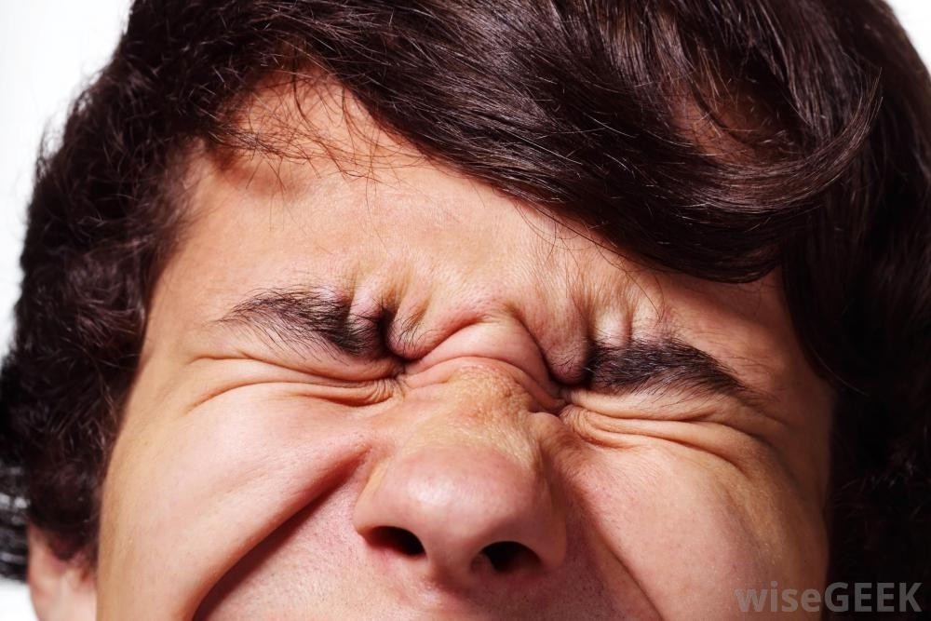
Clinical Manifestations
Meningeal irritation signs:
  Photophobia (extreme sensitivity to light)

Slide 24
Clinical Manifestations
Rash
disorientation and memory impairment
seizures
  occur in 30% of adults with S. pneumonea meningitis
  the result of areas of irritability in the brain

Slide 25
Clinical Manifestations
Signs of increased ICP
  Decrease level of consciousness
  Focal motor deficit
  Brain stem herniation
Signs of overwhelming septicemia

Slide 26
Diagnostic findings
Bacterial culture and gram staining of CSF and blood are key diagnostic tests
The presence of polysaccharide antigen in CSF further supports the diagnosis of bacterial meningitis

Slide 27
Prevention
Vaccination against meningococcal meningitis
Antimicrobial chemoprophylaxis for the people who is in direct contact with patients with meningococcal meningitis
Prophylactic therapy should be started with 24 hours of exposure

Slide 28
Medical Management
Antibiotics that cross the blood-brain barrier into subarachnoid space
  Penicillin antibiotics or one of the cephalosporins
  If resistant strains of bacteria identified, vancomycin hydrochloride alone or in combination with rifampin may be used

Slide 29
Medical Management
Dexamethasone as adjunct therapy
  5 -20 minutes before the first dose of antibiotic, and every 6 hours for the next 6 days
Fluid volume expanders to treat hock an dehydration
Phenytoin to treat the seizure

Slide 30
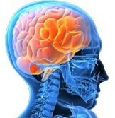
Encephalitis
an acute inflammatory process to the brain tissue
Herpes simplex virus (HSV) is the most common cause

Slide 31

Pathophysiology
Herpes Simplex Virus 1
Retrograde intraneuronal path from olfactory and trigeminal nerves to the brain
Viruses reactivate in the brain tissue
Encephalitis

Slide 32
Clinical Manifestations
Fever, headache, and confusion are the initial symptoms
Focal neurologic symptoms reflect the areas of cerebral inflammation and necrosis and include behavioral changes, focal seizures , dysphasia, hemiparesis, and altered level of consciousness

Slide 33
Diagnostic Tests
Neuroimaging studies (MRI shows the edema in the temporal lobe)
EEG (demonstrates periodic high-voltage spikes originating in the temporal lobe)
CSF examination
  lumber puncture reveals a high opening pressure and low glucose and high protein level in CSF samples
  Polymerase chain reaction (PCR)

Slide 34
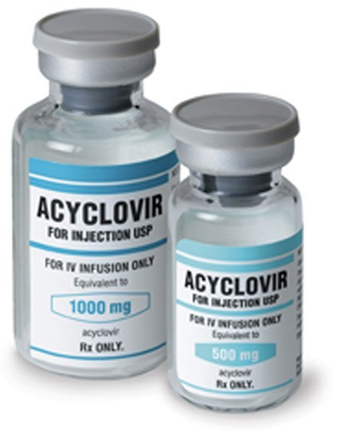
Medical Management
^{ν} Acyclovir (antiviral agent)

Slide 35
Nursing management
Assessment
Nursing diagnosis
Acute pain related to meningeal irritation
Objective Intervention
evaluation
Headache, 8 on scale
Headache will be reduced within 2 hours
Dimming the lights
Limiting noise
Headache is reduced from 8 to 2 on scale
-
Administerin g analgesic agents and prescribed

Slide 36
Nursing management
Assessment
Nursing diagnosis
Risk for ineffective cerebral tissue perfusion related to increased ICP
Objective Intervention
evaluation
Headache
-Body weakness
Decreased level of consciousnes s
The patient returned to the state of the neurological status before the illness.
Increased patient awareness and sensory function.
Bed rest with supine sleeping position without a pillow
Monitor the signs of neurologic status with GCS.
Monitor vital signs
Provide treatment in accordance with physician advice.
Headache is reduced
Vital signs are within normal limits.
Increased awareness.
No signs of increased intracranial pressure.

Slide 37
Nursing management
Assessment
Nursing diagnosis
Risk for Injury R/T general weakness and risk of seizure attacks.
Objective Intervention
evaluation
General weakness
To prevent the patient from having seizures or other injuries within 8 hours
Monitor the twitching of the hands, feet and mouth or other facial muscles.
Provide security for patients by providing assistance on the bed and use the side rails.
Give medication as indicated
No signs of seizure
No any injuries
Improved patient’s clinical status

Slide 38
Nursing management
Assessment
Nursing diagnosis
Interrupted Family Process R/T critical nature of situation and uncertain prognosis
Objective Intervention
evaluation
Inappropriate and poor family communicatio n
Enhance family coping and functioning
Inform family about patient’s condition and permit family to see patient at appropriate intervals.
Family express understandi ng of mutual problems
Family provide information regarding stressful situations

Slide 39
Summary
Meningitis is an inflammation to meninges while encephalitis is an inflammation to the brain tissue itself.
Meningeal irritation signs are Meningeal Nuchal, Positive kernig’s sign, Positive Brudziniski’s sign, and Photophobia
CSF and blood culture is the main diagnostic test.
Antimicrobials and antivirals are medical management.
Nurses play a significant role in providing care for patients with meningitis.

Slide 40
Assignment
Write around 2 pages about brain herniation; the classifications, signs and symptoms, and the treatment..
  Date of submission, Tuesday 24th Nov, 2015.

Slide 41
Reference
^{ν} Brunner & Suddarth’s Textbook of Medical-Surgical Nursing, 2013. Lippictt Williams & Wilkins.

Slide 42

Thanks

