Slide 1
BIOCHEMICAL CHARACTERIZATION

Slide 2
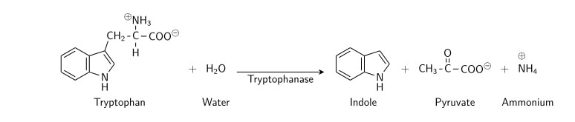
1. INDOLE TEST a crystalline organic compound with an unpleasant odour, present in coal tar and in faeces.
Principle
To determine the ability of an organism to decompose aminoacid tryptophan into indole.Tryptophan is decomposed by an enzyme tryptophanase produced by certain bacteria.

Slide 3
PROCEDURE
Indole production is detected by inoculating the test bacterium into peptone water (tryptophan rich) and incubating it at 37˚ C or 48-96 hours.
Add 0.5ml of Kovac’s reagent to the bacterial growth and gently shake.

Slide 4
Reagents Used in Indole Test
Ingredients per liter:*
p-Dimethylaminocinnamaldehyde (DMACA) | 10.0 gm
Hydrochloric Acid, 37% | 100.0 ml
Deionized Water | 900.0 ml
Indole Kovacs Reagent:
p-Dimethylaminobenzaldehyde | 50.0 gm
Hydrochloric Acid, 37% | 250.0 ml
Amyl Alcohol | 750.0 ml

Slide 5
Procedure of Indole Test
Take a sterilized test tubes containing 4 ml of tryptophan broth.
Inoculate the tube aseptically by taking the growth from 18 to 24 hrs culture.
Incubate the tube at 37°C for 24-28 hours.
Add 0.5 ml of Kovac’s reagent to the broth culture.
Observe for the presence or absence of ring.

Slide 6
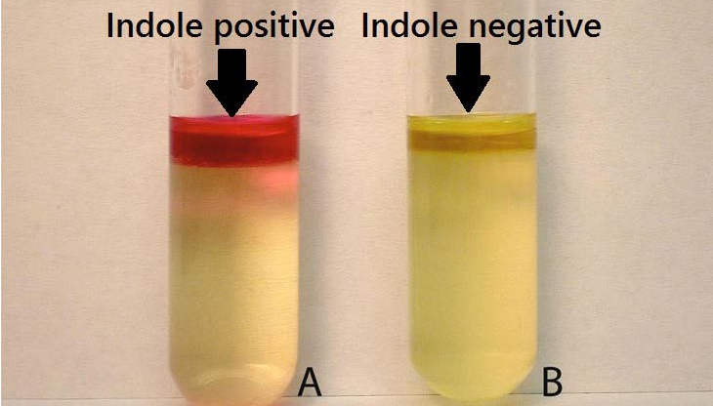
INTERPRETATION

Slide 7

2.UREASE PRODUCTION
PRINCIPLE- To determine the ability of an organism to produce an enzyme urease which splits urea to ammonia.
Urea is a diamide of carbonic acid. It is hydrolyzed with the release of ammonia and carbon dioxide.
Many organisms especially those that infect the urinary tract, have an urease enzyme which is able to split urea in the presence of water to release ammonia and carbon dioxide. The ammonia combines with carbon dioxide and water to form ammonium carbonate which turns the medium alkaline, turning the indicator phenol red from its original orange yellow color to bright pink.

Slide 8
Procedure:
1)The broth medium is inoculated with a loopful of a pure culture of the test organism; the surface of the agar slant is streaked with the test organism.
2) Leave the cap on loosely and incubate the test tube at 35 °C in ambient air for 18 to 24 hours; unless specified for longer incubation.

Slide 9
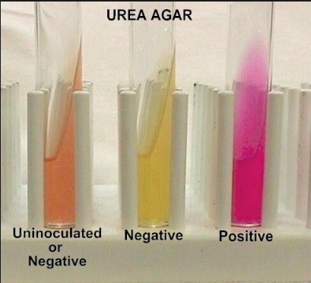
Organisms that hydrolyze urea rapidly (e.G. Proteus spp) may produce positive reactions within 1 or 2 hours; less active species (e.G. Klebsiella spp) may require 3 or more days.
Urease Negative- Esherichia coli
In routine diagnostic laboratories the urease test result is read within 24 hours.
If organism produces urease enzyme, the color of the slant changes from light orange to magenta.
If organism do not produce urease the agar slant and butt remain light orange (medium retains original color).
INTERPRETATIONS

Slide 10
Diagnostic utility of Urease test
Urease test is used for the presumptive evidence of the presence of Helicobacter pylori in tissue biopsy material. This is done by placing a portion of crushed tissue biopsy material directly into urease broth. A positive urease test is considered presence of Helicobacter pylori. Commercially available urease agar kits are also available.
Rapid Urease test is can be used to differentiate between the yeasts, Candida albicans and Cryptococcus neoformans. A presumptive identification of C. neoformans may be based on rapid urease production, whereas Candida albicans do not.
Urea breath test: A common noninvasive test to detect Helicobacter pylorialso based on urease activity. This is highly sensitive and specific test.

Slide 11
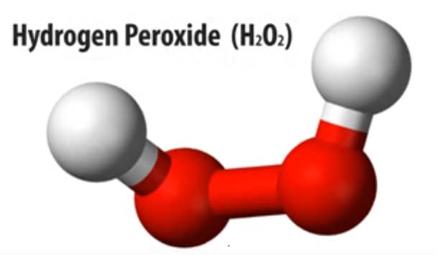
Catalase is an common enzyme, which is found in all living organism that are exposed to oxygen. During Aerobic Respiration, microorgnaisms produce hydrogen peroxide and some superoxide
Accumulation of these substances will result in death of microorganism unless they are enzymatically degraded.
The catalase enzyme neutralizes the bactericidal effects of hydrogen peroxide and protects them. Anaerobes generally lack the catalase enzyme.
Catalase mediates the breakdown of hydrogen peroxide H₂O₂ into oxygen and water.
Catalase Test

Slide 12
PROCEDURE- To find out if a particular bacterial isolate is able to produce catalase enzyme, small inoculum of bacterial isolate is mixed into hydrogen peroxide solution (3%) and is observed for the rapid elaboration of oxygen bubbles occurs.
The lack of catalase is evident by a lack of or weak bubble production.

Slide 13
Sugar Fermentation
It determines the ability of an organism to ferment a specific carbohydrate (Sugar) incorporated in a medium producing acid or acid with gas.

Slide 14
Positive- Pinkish Red
Negative- Yellow to colorless
Gas Production can be seen as bubbles in Durham’s tube

Slide 15
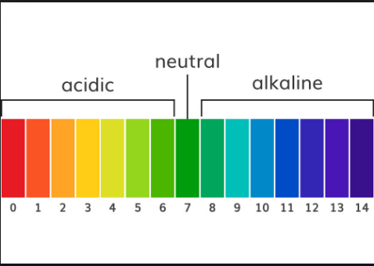
CITRATE UTILISATION TEST
This test detects the ability of an organism to utilise citrate as the sole source of carbon for its Growth, with resulting alkalinity.

Slide 16
Citrate utilization test is commonly employed as part of a group of tests, the IMViC (Indole, Methyl Red, VP and Citrate) tests, that distinguish between members of the Enterobacteriaceae family based on their metabolic by-products. Citrate utilization can be used to distinguish between coliforms such as Enterobacter aerogenes (+ve) which occur naturally in the soil and in aquatic environments and fecal coliforms such as Escherichia coli (-ve) whose presence would be indicative of fecal contamination.

Slide 17
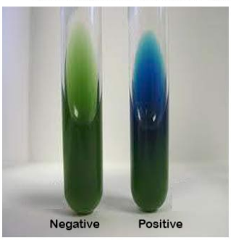
INTERPRETATION
Simmons Citrate Medium
Positive- Growth with an intense blue colour on the slant. Blue colour is due to the alkaline Ph.
Negative- No growth with no change in color.

Slide 18
OXIDASE TEST
It determines the presence of an enzyme cytochrome oxidase which catalysis the oxidation of reduced cytochrome by molecular oxygen.
Cytochrome oxidase. An oxidizing enzyme that contains iron and a porphyrin and is found in the mitochondrial membrane, where it catalyzes the transfer of electrons to oxygen as part of the electron transport chain, ultimately leading to the formation of ATP.

Slide 19
Procedure:
Take a filter paper soaked with the substrate tetramethyl-p-phenylenediamine dihydrochloride
Moisten the paper with a sterile distilled water
Pick the colony to be tested with wooden or platinum loop and smear in the filter paper
Observe inoculated area of paper for a color change to deep blue or purple within 10-30 seconds
Precaution to be taken while performing oxidase test:
Do not use Nickel-base alloy wires containing chromium and iron (nichrome) to pick the colony and make smear as this may give false positive results

Slide 20
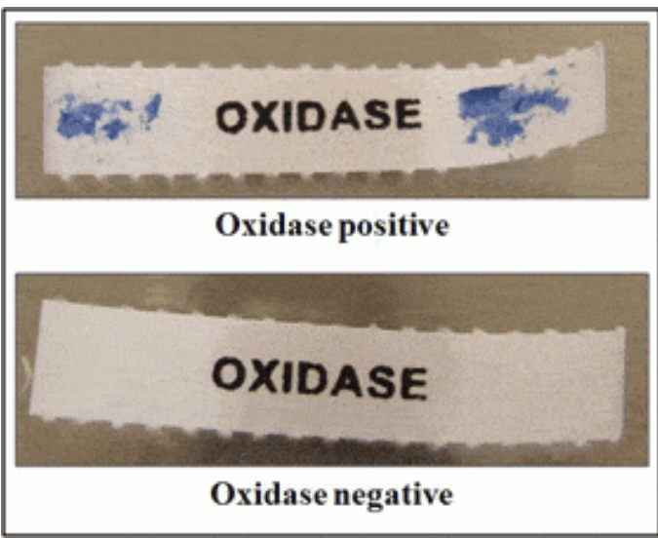

Slide 21
METHYL RED TEST
Methyl Red (MR) test determines whether the microbe performs mixed acids fermentation when supplied glucose.

Slide 22
Some bacteria have ability to perform mixed acid fermentation of glucose in MR-VP medium.
The products of mixed-acid fermentation are a complex mixture of acids, particularly lactate, acetate, succinate and formate as well as ethanol and equal amounts of H2 and CO2.
This causes the medium to acquire an acidic pH. Methyl Red is a pH indicator, which remains red in color at a pH of 4.4 or less

Slide 23
Procedure
1)By using sterile inoculating loop, inoculate the unknown microorganism into the fresh, sterile medium.
2) Leave the other broth uninoculated (this will be a control).
3)Incubate the inoculated tube at 35-37C for two to five days.
4)After incubation, obtain the broths from the incubator and add 5 drops of Methyl Red reagent to the broth.
5)Observe the color.

Slide 24
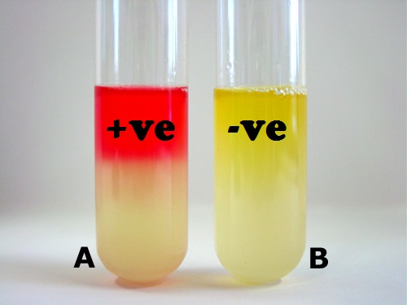
Development of red color is taken as Positive.
Development of yellow color (No color change) after addition of reagent is taken as Negative.

Slide 25
MR Positive: When the culture medium turns red after addition of methyl red, because of a pH at or below 4.4 from the fermentation of glucose.
MR Negative: When the culture medium remains yellow, which occurs when less acid is produced (pH is higher) from the fermentation of glucose.

Slide 26
COAGULASE TEST
Some bacteria produce coagulase, which is an enzyme that converts fibrinogen to fibrin, which means that it can coagulate plasma. The ability to produce coagulase is assumed to be associated to the virulence of staphylococci. The test is used to distinguish between coagulase positive and coagulase negative staphylococci.
Method
Suspend one colony from the suspected pure culture in 0.5 ml of plasma from horse, rabbit or man.
Incubate at 37ºC.
Read the test after 4 h. If the result is negative (see below), continue with the incubation.
Perform the final read after 24 h.

Slide 27
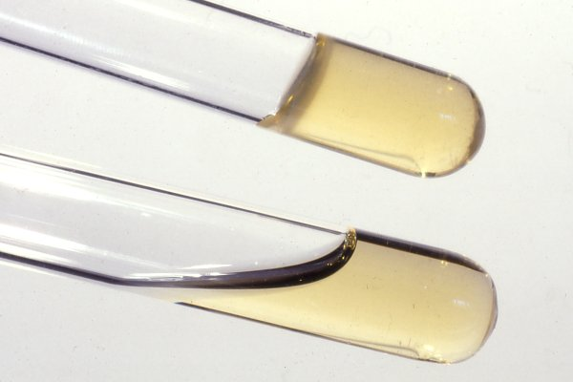
Positive reaction if the plasma coagulates and the coagulate is stable. It must not be dissolved upon stirring.
Negative reaction if the plasma does not coagulate or if the coagulate is dissolved again upon stirring.

Slide 28
DNase test
Many bacteria have enzymes that break down nucleic acids. The bacteria can then use the resulting nucleotides to build up their own nucleic acids. DNase is such an enzyme, which thus hydrolyzes DNA.
Method
Presence of DNase can be determined by cultivation on an agar plate, which contains DNA. If the bacterium has DNase and if the bacteria are allowed to grow over night, the DNA will be hydrolyzed into the constituting nucleotides. Diluted hydrochloric acid (HCl) is then poured onto the plate and there will be a clear zone close to the colonies or the streak, because individual nucleotides are soluble in diluted HCl, but not DNA, which precipitates in the rest of the plate.
Use
The test is useful to distinguish between:
Serratia spp. and Enterobacter spp.
Staphylococcus aureus (most strains are coagulase positive) and coagulase negative Staphylococcus spp.

Slide 29
