Slide 1

Menstrual Hygiene In Adolescent Girls
PRESENTED BY:
MR. NIRMAL RAJ EV
ASSOCIATE PROFESSOR
DEPT OF CHILD HEALTH NURSING
SUMANDEEP NURSING COLLEGE
SUMANDEEP VIDYAPEETH DEEMED TO BE UNIVERSITY
PIPARIA, WAGHODIA, VADODARA

Slide 2
Potential risks to health of poor menstrual hygiene
1. Unclean sanitary
pads/materials Bacteria may
cause
the
local infections or travel up the vagina and enter
uterine cavity
1. Changing pads infrequently Wet pads can cause skin irritation which can then become infected if the skin becomes broken.
2.
Insertion of unclean potentially have
material
into vagina Bacteria to
easier
access
the cervix and the
uterine cavity.

Slide 3
Unsafe disposal of used sanitary materials Risk of infecting others, especially with Hepatitis B (HIV and other or blood Hepatitis viruses do not survive for long outside the body and pose a minimal risk except where there is direct contact with blood just leaving

Slide 4
How to dispose of the cloth, pad, cotton or tissue?
If you are re-using a cloth, put it into a plastic bag until you can wash it with hot water and soap and then dry it in the sunshine or iron it.
  If you are using a pad, tissue or cotton, or want to dispose of your cloth, wrap it in paper to make a clean package and put it in the bin so it can be burned later.
  If there is no other option, drop it straight in the latrine pit as long as it is not a water seal pour flush pan as this could easily become blocked.

Slide 5
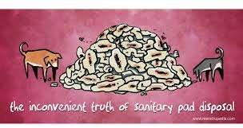
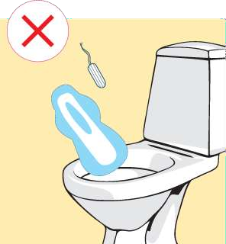
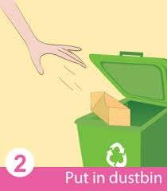

Slide 6
How to keep yourself clean during your period?
Every day (morning and evening if possible) wash your genitals with soap and water.
  Keep unused cloths and pads clean (wrapped in tissue or plastic bag) for further use.
  Pat the area dry with a cloth, and put a fresh
cloth (such as a langa, sari or other cloth), pad, cotton or tissue on your underwear.
Always wipe from front to back after defecation.
local
Never douche (washing out the vagina with water).

Slide 7
How to manage the stomach pain from your period?
You can put a bottle with hot water on your stomach area when you are resting.
Try to do some exercises and keep your body active.
You can take painkiller medicines every four to six hours on the most painful days.

Slide 8
To manage menstruation hygienically,
it is essential that women and girls have access to water and sanitation.
They need somewhere private to change sanitary cloths or pads;
clean water for washing their hands and used cloths;
And facilities for safely disposing of used materials or a place to dry them if reusable.
There is also a need for both men and women to have a greater awareness of menstrual hygiene.

Slide 9
The End

