Slide 1

NEONATAL CONVULSIONS
PRESENTED BY:
MR. RAJESH P JOSEPH
ASSOCIATE PROFESSOR
DEPT OF CHILD HEALTH NURSING
SUMANDEEP NURSING COLLEGE
SUMANDEEP VIDYAPEETH DEEMED TO BE UNIVERSITY
PIPARIA, WAGHODIA, VADODARA

Slide 2
INTRODUCTION
⎫
A seizure is a paroxysmal manifestation of neurological dysfunction
⎫Incidence(overall):2 in 1000 to 14 in 1000 live births

Slide 3
PATHOPHYSIOLOGY
⎫
Excessive depolarisation (excitation) of
neurons within the CNS.

Slide 4
Probable Mechanisms of Some Neonatal Seizures
⎫Failure of sodium potassium pump mechanism leading to depolarisation due to inward migration of sodium and repolarisation due to efflux of potassium
⎫Relative excess of excitatory neurotransmitters
⎫Deficit of inhibitory neurotransmitters

Slide 5
⎫variable clinical manifestations.
⎫often the first sign of neurologic dysfunction
⎫predictors of long-term cognitive and developmental impairment.

Slide 6
TYPES OF NEONATAL SEIZURES
5 main seizure types
⎫Subtle
⎫Tonic
⎫Clonic
⎫Myoclonic
⎫Spasms

Slide 7
SUBTLE SEIZURES
Transient eye deviations (term)
Nystagmus , fixed stare (preterm)
Abnormal extremity movements ( rowing, pedaling , swimming)
Apnea , fluctuations in heart rate

Slide 8
TONIC SEIZURES
May be focal or generalized
Focal seizures –persistent posturing of a limb or trunk with persistent horizontal eye deviation
generalized seizures-bilateral tonic limb extension or tonic flexion of upper extremities with tonic extension of lower extremities

Slide 9
CLONIC SEIZURES
Repetitive , rhythmic contractions of muscle groups of the limbs , face or trunk
Consciousness may be preserved Signals focal cerebral injury
⎫
⎫
⎫

Slide 10
MYOCLONIC SEIZURES
rare
random , single , rapid contractions of muscle groups of the limbs , face or trunk
⎫Typically not repetitive or may recur at a slow rate

Slide 11
SPASMS
⎫Sudden generalized jerks lasting 1-2 sec and are usually associated with a single , very brief, generalized discharge

Slide 12
D/Ds
⎫Jitteriness
must be differentiated from seizures in neonates.
⎫ rapid motor activities such as a tremor or shake
⎫
jitteriness is not associated with ocular
deviation.
-is stimulus sensitive (eg, easily stopped with passive movement of the limb)

Slide 13
ETIOLOGY
⎫Hypoxic-ischemic encephalopathy
⎫Intracranial Hemorrhage
subarachnoid hemorrhage
germinal matrix –intraventricular hemorrhage subdural hemorrhage
⎫Metabolic disorders(hypoglycemia/ hypocalcemia /hypomagnesemia/hyponatremia)

Slide 14
CONTD..
⎫Intracranial infections bacterial meningitis TORCH infections
⎫ Pyridoxine dependency
⎫Benign neonatal seizures

Slide 15
DIAGNOSIS
HISTORY:
⎫Family history may suggest genetic syndrome
⎫Many of these syndromes are benign
⎫ In the absence of other etiologies, family history of seizures may suggest good prognosis

Slide 16
⎫Antenatal history is important
⎫History of fetal distress, preeclampsia , maternal infections or maternal diabetes

Slide 17
⎫Delivery history
⎫Type of delivery and antecedent events
⎫Apgar scores offer some guidance
⎫Low Apgar score without the need for resuscitation and subsequent neonatal intensive care is unlikely to be associated with neonatal seizures

Slide 18
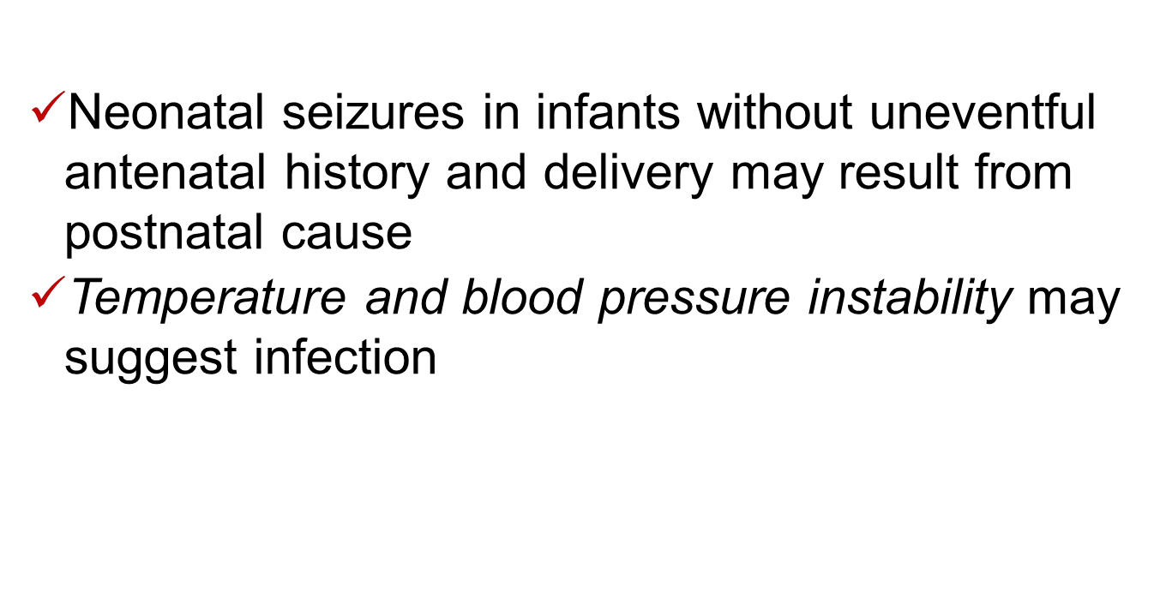

Slide 19
INVESTIGATIONS:
⎫ Lab studies
-Blood count
-Blood, urine & CSF culture
-Serum IgM & IgG-specific TORCH titres
-Blood biochem.->evaluation of Glu, Ca, Mg,
electrolytes
-Blood gas levels to detect acidosis & hypoxia.

Slide 20
⎫EEG:
Main tool for diagnosis
It is useful to confirm a clinically doubtful
convulsion , to locate an epileptic focus and and to determine its anatomical basis
⎫
Ultrasonography and CT scan of head:
To detect subarachnoid /intraventricular hemorrhage

Slide 21
TREATMENT
⎫The principles of Rx are:
⎫To control convulsions
⎫To treat the underlying pathology

Slide 22
To control convulsion:
⎫I.V. phenobarbitone 20 mg/kg body weight over a period of 10-15 min
⎫Maintenance dose-> 2.5 to 4 mg/kg b.w. per day given orally or I.M. for a pd. of 2 wks or longer.
⎫In resistant cases-> I.V. phenytoin 20 mg/kg
b.w @ 1 mg/kg/min

Slide 23
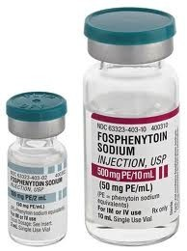
⎫Maintenance dose of 5-8 mg/kg/day divided 12 hourly.
⎫Fosphenytoin is preferred.

Slide 24
To treat the underlying pathology
⎫Hypoglycemia : Glucose infusion 2 ml per kg of 10% glucose, through an I.V. line is given over 2- 3 min
⎫Hypomagnesemia: MgSO4(0.4-0.8 mEq/kg); given IV every 12 hours until Mg level is normal.
⎫Infection: Appropriate antibiotics

Slide 25
⎫Hypocalcemia: I.V administration of 2 ml/kg of Calcium gluconate given over 5 min.
- To be followed by oral Calcium Chloride 250 mg with each feed for few days.
⎫Pyridoxine deficiency: IV administration of 50 mg pyridoxine is effective.

Slide 26
PROGNOSIS:
⎫Varies with etiology.
⎫Hypocalcemic convulsions have an excellent prognosis.
⎫Neurological sequelae are still around 30-40%

Slide 27
References:
⎫Nelson textbook of pediatrics (19th edition)
⎫ Averys diseases of newborn(8th edition)
⎫D.C.Dutta textbook of obstetrics(7th edition)

Slide 28


