Slide 1

RESTRAINTS IN CHILDREN
PRESENTED BY:
MR. RAJESH P JOSEPH
ASSOCIATE PROFESSOR
DEPT OF CHILD HEALTH NURSING
SUMANDEEP NURSING COLLEGE
PIPARIA, WAGHODIA, VADODARA

Slide 2
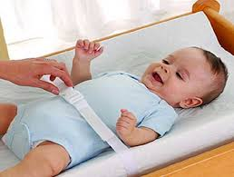
DEFINITION
A device which limits or prevent the freedom of movement.

Slide 3
PURPOSES
To limit the child’s movement during procedure.
To provide constant immobilization.
To facilitate examination of child or a procedure.

Slide 4
PRINCIPLES
Used only when necessary.
Cannot be used on continuous base.
If used, reason should be specified and explained to the child’s parents.
Check the baby frequently.

Slide 5
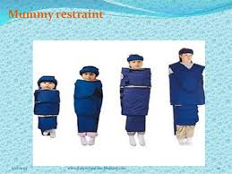
TYPES OF RESTRAINTS
MUMMY RESTRAINTS:
Purposes: To immobilize arm or leg.
During the examination of head & neck.

Slide 6
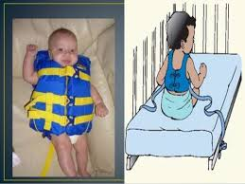
JACKET RESTRAINTS
To help the baby remain flat in bed.
To prevent the baby from falling down.
Age group- Infant & Toddler

Slide 7
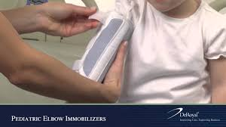
ELBOW RESTRAINTS
To keep the elbow in extended position.
After the surgery of child’s face.

Slide 8
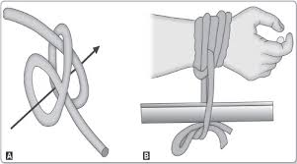
EXTREMITY RESTRAINTS
CLOVE HITCH RESTRAINTS
To immobilize one or more extremities.
Same as elbow restraints.

Slide 9
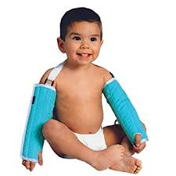
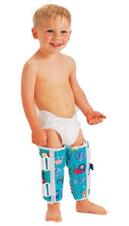
ARM & LEG RESTRAINTS
Age group- Neonate/ Infant/ Toddler/ Pre-schooler.

Slide 10
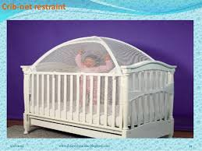
CRIB RESTRAINTS
If the infant or toddler is capable of climbing over the crib.

Slide 11
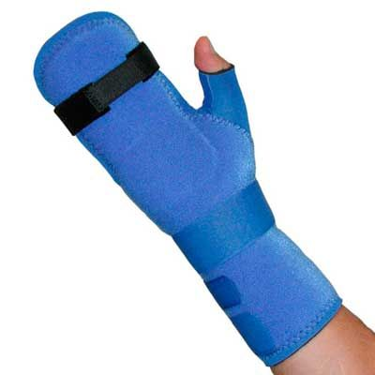
MITTENS
Used for infants to prevent the self-injury by hands.

Slide 12
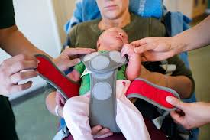
ABDOMINAL RESTRAINTS
This hold the infant in a supine position.
Keep in mind that child’s respiratory system are adequate.

Slide 13
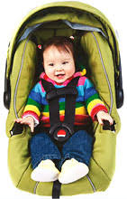
CAR SEAT
Car seat or seat belt can be consider as a restraints.

Slide 14
NURSING MANAGEMENT
Explain to the parents the need, purpose, positive & negative aspects of restraints.
Restraints must be checked every 15 to 30 min. for respiration & circulations.
Periodically, at least every 2 hourly the child should be removed from the restraints.

Slide 15
