Slide 1

CHALLENGED CHILDREN
CLASSIFICATION,MANAGEMENT, REHABILITATION
PRESENTED BY:
Dr. DAYANAND BELAGAVI
ASSOCIATE PROFESSOR
DEPT OF CHILD HEALTH NURSING
SUMANDEEP NURSING COLLEGE
SUMANDEEP VIDYAPEETH DEEMED TO BE UNIVERSITY
PIPARIA, WAGHODIA, VADODARA

Slide 2
INTRODUCTION
A handicapped condition makes the normal functions of the individual very difficult & leads to dependency. These conditions are increasing day by day due to changing life style & complicated environment. It is a social problem.

Slide 3
DEFINITION
Handicap is defined as disadvantage for a given individual resulting from impairment or a disability that limits & prevents the fulfillment of a role which is normal for that individual, depending on age, sex, social & cultural factor.

Slide 4
CONCEPT OF DISABILITY
According to WHO, the sequence of events leading to disability & handicapped conditions are-
Disease or injury impairment disability handicapped.

Slide 5
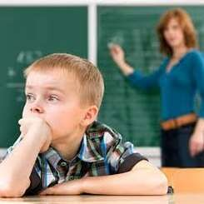
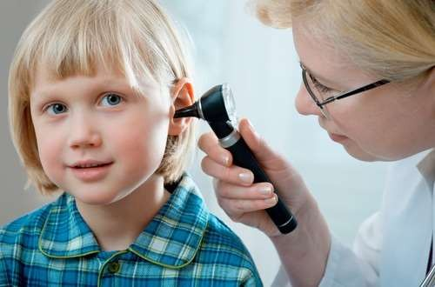
Impairment-
It is defined as any loss or abnormality of psychological, physiological or anatomical structure or function. E.g. loss of vision, loss of hearing etc.

Slide 6
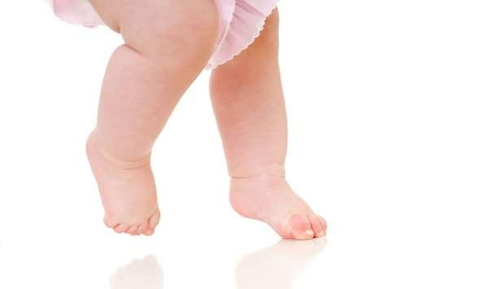
Disability-
It develops as the consequence of impairment. It is the inability to carry out certain activities which are considered as normal for the age & sex. E.g. loss of limbs results in inability to walk.

Slide 7
Handicapped-
Handicapped children refer to those with presence of impairment or other circumstances that are like to interfere with normal growth & development or with capacity to learn.

Slide 8
CLASSIFICATION
Physically handicapped children
Mentally handicapped children
Socially handicapped children

Slide 9
PHYSICALLY HANDICAPPED
This group includes the children with blindness, deaf & dumb, congenital malformations like cleft lip, cleft palate, club foot, congenital heart disease, etc.
The most important cause of physically handicaps is birth defects, malnutrition, infection & accidents.

Slide 10
Physically handicapped children can be grouped according to affected part of body. These include-
Orthopedically handicapped- children are having congenital bony defect, amputation, accidental injury, fracture, rickets, leprosy etc.
Sensory handicapped- children present with blindness, hearing loss, stammering etc.

Slide 11
Neurologically handicapped- children include cerebral palsy, mental retardation, convulsion disorders, hydrocephalus, spina bifida etc.
Handicapped condition due to chronic systemic disease, e.g. heart disease, bronchial asthma, diabetes mellitus, muscular dystrophy, etc.

Slide 12
MENTALLY HANDICAPPED
Mental retardation is the significantly sub average general intellectual functioning existing concurrently with deficits in adaptive behaviour manifested during the developmental period.
It includes low learning abilities, poor malnutrition & social mal adjustment in combination.
Mental handicaps are caused by multiple factors like genetic, social & physiological.

Slide 13
SOCIALLY HANDICAPPED
These children are having
disturbed opportunities for healthy personality
development due to social factors leading to non- achievement of full potentialities. These children include orphan child, child labor, maternal deprivation, emotional deprivation, etc.

Slide 14
CAUSES
Congenital anomalies
Genetic disorder
Poliomyelitis
Other communicable disease
Perinatal condition
Malnutrition
Accidental injury
Socio- cultural factors.

Slide 15
PREVENTION
Improvement of
maternal health &
adequate care during peri conceptional, prenatal
& intranatal period.
Genetic counseling.
Genetic screening prevent
of ‘at risk’ people to
like
inherited
diseases
chromosomal or sex linked congenital anomalies.

Slide 16
Reduction of consanguineous marriages by creating health awareness.
Universal immunization.
Improvement of nutritional status of mother & children.
Prevention of iodine deficiency & folic acid deficiency condition in periconceptional period.

Slide 17
Essential care in antenatal, intranatal & neonatal periods.
Avoidance of teratogenic agents in antenatal periods & special care in high- risk mothers.
Medical termination of pregnancy of malformed fetus.
Improvement of health awareness.

Slide 18
MANAGEMENT
The aim of management is to safeguard against or halt the progression of disease process from impairment to disability.
Early diagnosis & treatment of particular cause of handicapped.
Correction of deformities.

Slide 19
Regular medical
supervision &
developmental assessment help to identify the abnormal condition in initial stage.
Treatment conditions
of particular handicapped by medical & surgical
management.
Counselling & guidance to parents for continuation of care.
Referral for welfare services for assistance of aids & appliances, for special training & education, rehabilitation.

Slide 20
Physiotherapy & exercise to improve physical conditions.
Occupational therapy according to the child’s ability & that should be provided with music, painting, weaving etc.
Speech therapy to improve communication ability.
Use of prosthetics.
Special care for mentally handicapped children with love, warmth, patience, tolerance.

Slide 21
REHABILITATION
The goal is to reduce the fallout of disability and handicapped conditions.
Strengthening the individual actively participate in welfare of community

Slide 22
It should involve the following aspects-
Medical rehabilitation includes restoration of functions by prosthesis, artificial limbs etc.
Social rehabilitation includes restoration of family & social relationship by replacement in the family.
Educational rehabilitation includes specialized training & educational facilities.
Psychological rehabilitation includes restoration of personal dignity & confidence during period of growth & development.
Vocational rehabilitation includes restoration of the capacity to earn a livelihood.

Slide 23
Welfare institutes for handicapped at national level-
National institute for orthopedically handicapped, Culcutta.
National institute for mentally handicapped, Hyderabad.
National institute for visually handicapped, New Delhi.
National institute for physically handicapped, New Delhi.

Slide 24
CONCLUSION
A handicapped is a major problem in pediatric health today. Disability occurs as a part of the continuum of health and illness which can influence quality of pediatric life today. Disability occur as a result of the disease, congenital or genetic condition or some type of impairment of health or physical function of children.

Slide 25


