Slide 1

Nursing Management of child with Hirschsprung’s Disease
PRESENTED BY:
Dr. DAYANAND BELAGAVI
ASSOCIATE PROFESSOR
DEPT OF CHILD HEALTH NURSING
SUMANDEEP NURSING COLLEGE
SUMANDEEP VIDYAPEETH DEEMED TO BE UNIVERSITY
PIPARIA, WAGHODIA, VADODARA

Slide 2
DEFINITION
Congenital absence of the parasympathetic nerve ganglion cells in the muscle wall of the intestinal tract(mesenteric plexus of the distal bowel)
area proximal to the aganglionic portion becomes hypertrophied and greatly dilated

Slide 3
Ganglionic cells are located throughout the GI tract from the mouth down to the rectum.

Slide 4
INCIDENCE:
One in 5000 live births
Male-to-female ratio of 4:1
In 90 % are mature newborns
In 1-6 % are familia

Slide 5
PATHOPHYSIOLOGY AND ETIOLOGY
An arrest in the embryonic development affecting the parasympathetic innervation of the intestine.
Normally nerve cells migrate to the upper end of the alimentary tract and then proceed in the caudal direction, with migration to the distal colon complete by 12 weeks.

Slide 6
The process of aganglionosis continuous is almost always continuous within the affected segment
Intermittent aganglionosis is also reported but unusual
Most commonly affected site is rectosigmoid colon(long - segment disease)

Slide 7
Long-segment disease extends to the descending and transverse colon(10%- 15%)
Occasionally through the entire colon, involving the small bowel(5%)
Total aganglionosis involving the entire small and large bowel is rare.

Slide 8
No peristalsis occurs in the affected portion
Affected portion is spastic and contracted
The section is usually narrow, therefore no faecal material passes through it.

Slide 9
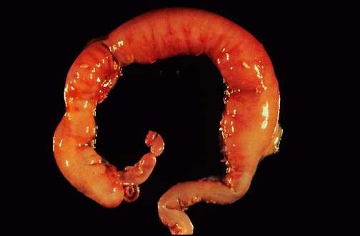
Congenital disorder of nerve cells in lower colon

Slide 10
Proximal narrow section of the colon is dilated
Filled with faecal material and gas
Hypertrophy of muscle
Ulceration of mucosa can be seen in neonates
The internal rectal sphincter fails to relax, evacuation of faecal material and gas is prevented. Abdominal distension and constipation results.

Slide 11
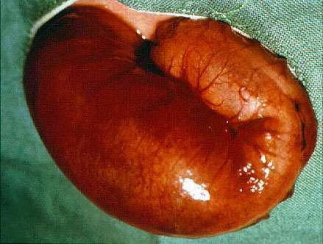

Slide 12
CLINICAL SYMPTOMS
Symptoms in neonate –symptoms appearing at birth or within first week of life
Fail to pass meconium (in 24 hours of life)
Abdominal distension, but the abdomen is palpable
Vomiting bile stained or faecal
The rectal tube can’t be put easily
After irrigation the signs and symptoms return again in a few days
Over-flow type of diarrhoea
Dehydration
Temporary relief of symptoms with enema.

Slide 13
Symptoms in newborn age(enterocolitis)
Hirschsprung’s disease
Life-threatening condition
Explosive Diarrhea: it can be an early sign
megacolon
Abdominal distension
Bile-stained vomiting
Fever and signs of dehydration
Rectal tube:explosive expulsion of gas and foul- smelling stools
Rectal bleeding
Lethargy

Slide 14
Symptoms in infants
Constipation
Meteorism( distension of the abdomen with air or gas causing resonance on percussion of abdomen)
Palpable faecaloma
diarrhea
Ulceration, bleeding

Slide 15
Hirschsprung’s disease
Symptoms in childhood
Dilated drumlike belly
Long history of constipation
Defecation in 7-10 days
Multiple fecal masses
The stimulus of defecation is missing
Rectum is empty and narrow
Ribbon like, fluid like or pellet like stools

Slide 16
Peristalsis observable over abdomen
Constipation unresponsive to remedies
Failure to thrive

Slide 17
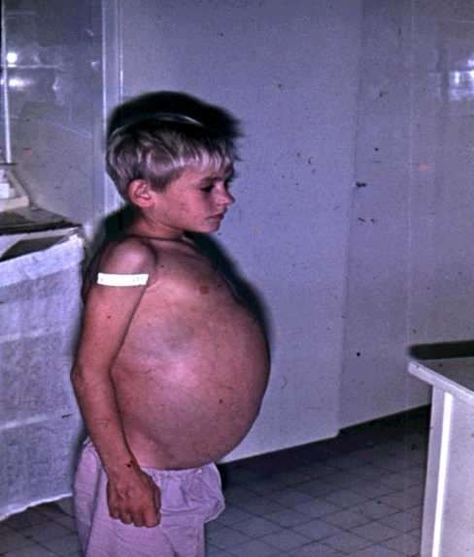
Hirschsprung’s disease

Slide 18
DIAGNOSTIC EVALUATION:
History and PE
Digital rectal examination- narrow and empty rectum and rush of stools in short segment disease
Barium Enema

Slide 19
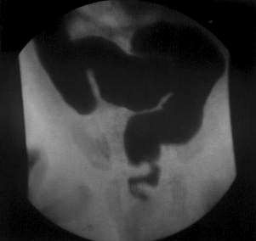
Hirschsprung’s disease

Slide 20
Anorectal manometry ( contractility in the anus and rectum)
Anorectal pressure is elevated and a pressor sensor at the the internal anal sphincter to measure the presence or absence of the recto sphincter reflexes

Slide 21
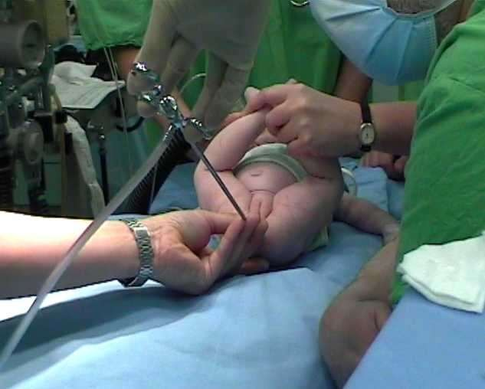
Hirschsprung’s disease
Biopsy

Slide 22
Hirschsprung’s disease
Treatment:
Decompression: introduce a rectal tube and irrigation
Colostomy/ileostomy to decompress intestine and to divert faecal stream
Closing of the stoma

Slide 23
Swenson procedure
The aganglionic segment is resected down to the sigmoid colon and rectum and oblique anastomosis is performed between the normal colon and the low rectum.

Slide 24
Soave procedure-Transanal Endorectal Pull- Through
It can be performed safely in infant
Generally one-stage surgery
Here the ganglionic segment is pulled through the aganglionic muscle cuff, preserving the internal sphincter.

Slide 25
Hirschsprung’s disease
Long-term outcome
If started in time under adequate treatment .

Slide 26
In older child whose symptoms are chronic, but not severe.-
Rx-
Isotonic Enemas Stool softeners

Slide 27
Rx of Enterocolitis- Antibiotics –IV or oral
Colonic irrigation or decompression with saline
Surgical decompression colostomy

Slide 28





