Slide 1

Exclusive Breastfeeding
PRESENTED BY:
MS. RUPAL PATEL
ASSISTANT PROFESSOR
DEPT OF CHILD HEALTH NURSING
SUMANDEEP NURSING COLLEGE
SUMANDEEP VIDYAPEETH DEEMED TO BE UNIVERSITY
PIPARIA, WAGHODIA, VADODARA

Slide 2
Breastfeeding
Breastfeeding is the feeding of an infant or young child with breast milk directly from female human breasts (i.e., via lactation) rather than from a baby bottle or other container.

Slide 3
Babies have a sucking reflex that enables them to suck and swallow milk.
It is recommended that mothers breastfeed for six months or more, without the addition of infant formula or solid food.
After the addition of solid food, mothers are advised to continue breastfeeding for at least a year, and can continue for two years or more.

Slide 4
Human breast milk is the healthiest form of milk for babies.
There are few exceptions, such as
when the mother is taking certain drugs or
is infected with human T-lymphotropic virus, HIV, or
has active untreated tuberculosis

Slide 5
Breast milk is made from nutrients in the mother's bloodstream and bodily stores.
Breast milk has just the right amount of fat, sugar, water, and protein that is needed for a baby's growth and development.
Because breastfeeding uses an average of 500 calories a day it helps the mother lose weight after giving birth.

Slide 6
The quality of a mother's breast milk may be compromised by smoking, alcoholic beverages, caffeinated drinks, marijuana, methamphetamine, heroin, and methadone.

Slide 7
Types of Breast Milk
Colostrum
transitional milk
mature milk
Foremilk
Hind milk
Preterm milk

Slide 8
Colostrum
The first stage of milk that develops during pregnancy is called colostrum.
Thick and yellow in color, colostrum lasts a few days after the baby is born.
This milk is rich in protein, antibodies, vitamins and minerals.

Slide 9
transitional milk
Approximately two to four days after the baby is born, transitional milk replaces colostrum.
Transitional milk is thin and white, and contains high quantities of fat, calories, protein, lactose and vitamins.
Many mothers notice the quantity and consistency of their milk changing about two to three days after their baby’s birth.

Slide 10
mature milk
It is secreted usually from 10 to 12 days after delivery.
It is watery and contains all nutrients for optimal growth of the baby.

Slide 11
Foremilk
It is secreted t the starting of the regular breast feeding. It is more watery to satisfy the baby thirst

Slide 12
Hind milk
It is secreted towards the end of the regular breast feeding and contains more proteins , energy

Slide 13
BENEFITS OF Breastfeeding
Benefits for the infant
Greater immune health
Fewer infections
Reduced sudden infant death syndrome
Less diabetes
Less childhood obesity
Less tendency to develop allergic diseases (atopy)
Less necrotizing enterocolitis in premature infants

Slide 14
Benefits for mothers
Bonding
Hormone release
Weight loss
Natural postpartum infertility
Long-term health effects
Less risk of breast cancer, ovarian cancer, and endometrial cancer.
mothers who breastfeed longer than eight months benefit from bone re-mineralisation.Breastfeeding diabetic mothers require less insulin
Reduced risk of metabolic syndrome
Reduced risk of post-partum bleeding

Slide 15
Early breastfeeding
In the half hour after birth, the baby's suckling reflex is strongest, and the baby is more alert, so it is the ideal time to start breastfeeding

Slide 16
Time and place for breastfeeding
Breastfeeding at least every two to three hours helps to maintain milk production.
Newborn babies may feed more often than this: 10 to 12 breastfeeding sessions every 24 hours is common,
some may even feed 18 times a day

Slide 17
Latching on
Correct positioning and technique for latching on can prevent nipple soreness and allow the baby to obtain enough milk.
The "rooting reflex" is the baby's natural tendency to turn towards the breast with the mouth open wide;
mothers sometimes make use of this by gently stroking the baby's cheek or lips with their nipple in order to induce the baby to move into position for a breastfeeding session,

Slide 18
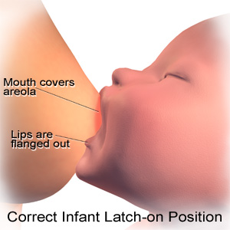

Slide 19


Slide 20

Breast FEEDING POSITIONS

Slide 21


Slide 22
Breast FEEDING POSITIONS
cradle hold position
Cross cradle hold
Football hold position
lying position
Saddle hold (Australian hold)

Slide 23


Slide 24
cradle hold position
The cradle hold position is the most common nursing position of them all.
This position is best for the older baby who already has control over his head and neck and can latch on easily
If you want to try this position with a newborn you will need baby’s head resting on your forearm, you will need to keep baby close with skin on skin contact.

Slide 25
Step by step cradle hold for newborn
- Make sure that your back is supported
- Put the base of baby’s head in the crook of your arm
- Tuck baby’s lower arm under his body.
- Baby’s tummy should be against your tummy. His face and knees should be facing your body.
- Use a U hold to hold the breast, when positioning your breasts, make sure that your fingers are not touching your areola, this is so that they do not get in the way when baby is trying to latch on.

Slide 26
Cross cradle hold
The cross cradle hold for breastfeeding allows a mom complete control during breastfeeding. This position is used for the newborn and only until baby has learned to latch on correctly.
Step by step cross cradle breastfeeding hold
- Use a breastfeeding pillow for support
Your arm should be supporting the length of baby’s back
- Your baby’s head should be supported with your thumb and forefinger just behind baby’s ears
- Baby should be held tummy to tummy

Slide 27

Cross cradle hold

Slide 28
With your free hand you must hold your breast in a U shape (making sure that your fingers are out of the way for a good latch on)
- Tickle baby’s lips with your nipple until he opens his mouth wide, then quickly push his body towards you and latch on
Baby should have all of the nipple and most of the lower areola in his mouth. Your nipple should be quite far back in his mouth. If the latch feels uncomfortable or painful you can break the seal by placing your fingers in the corner of baby’s mouth and try again.

Slide 29
This is a really great breast feeding position for mothers who:
- Have small babies
- Have large breasts
- Have inverted nipples
- Have babies with latching on problems

Slide 30
Football hold position
The football breastfeeding hold also called the underarm hold or clutch hold.
With this nursing position you will be holding baby on either one of your sides.
This is a great position for mothers who have just had a cesarean section

Slide 31
Step by step breastfeeding football hold
- You will need a pillow to support baby. Baby should be at breast height.
- Tuck baby in, under the same arm as the breast that is being fed to baby.
- Moms forearm should be positioned up the length of baby’s back.
- Baby’s head supported by moms thumb and forefinger, behind baby’s ears just like when you hold baby in the cross cradle position.
- Again hold your breast with your other hand...in a U shape with your fingers away from the areola.

Slide 32
The lying positions:
The lying breastfeeding position is the easiest position breastfeeding for many moms.
Breastfeeding lying down is nice for moms that sleep with their babies.

Slide 33

The lying position

Slide 34
How it’s done:
- Lie on your side and support your head and your back with pillows.
- Lie baby next to you so that your tummies are touching. If your baby is still very young you can place something behind his back to prevent him from rolling backwards.

Slide 35
Your baby will be drinking from the breast that is against the mattress.
- After your baby has securely latched on, you can use your lower arm to support your own head
- When you wish to give baby your other side you only need to cuddle him over your chest, and gently roll yourselves over.
- This position is great for moms who have has a c-section delivery

Slide 36
Saddle hold (Australian hold):
The Saddle Hold is a fun way to easily nurse babies who are sitting up.
It also works well if your baby has a runny nose or a sore ear.
This is a great position for breastfeeding toddlers

Slide 37

Saddle hold (Australian hold):

Slide 38
How it's done
- Have your baby sitting upright with his legs over your one leg

Slide 39
Exclusive breastfeeding
Exclusive breastfeeding is defined as "an infant's consumption of human milk with no supplementation of any type (no water, no juice, no nonhuman milk, and no foods) except for vitamins, minerals, and medications."

Slide 40
Exclusively breastfed infants feed anywhere from 6 to 14 times a day.
Newborns consume from 30 to 90 ml (1 to 3 US fluid ounces) per feed.
After the age of four weeks, babies consume about 120ml (4 US fluid ounces) per feed.
Each baby is different, but as it grows the amount will increase

Slide 41
Expressed breast milk (EBM)
When direct breastfeeding is not possible, a mother can express (artificially remove and store) her milk. With manual massage or using a breast pump, a woman can express her milk and keep it in freezer storage bags, a supplemental nursing system, or a bottle ready for use

Slide 42
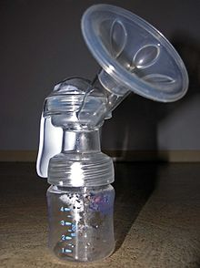
breast pump

Slide 43
PROBLEMS OF BREAST FEEDING
SORE NIPPLE
BREAST ENGORGEMENT
INVERTED NIPPLE
BREAST ABSCESS
BABY WHO DOES NOT SUCK
MASTITIS

Slide 44
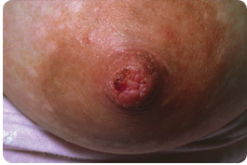
SORE NIPPLE

Slide 45

BREAST ENGORGEMENT

Slide 46
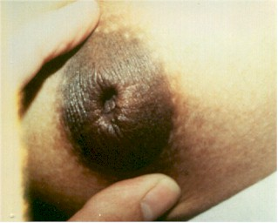
INVERTED NIPPLE

Slide 47
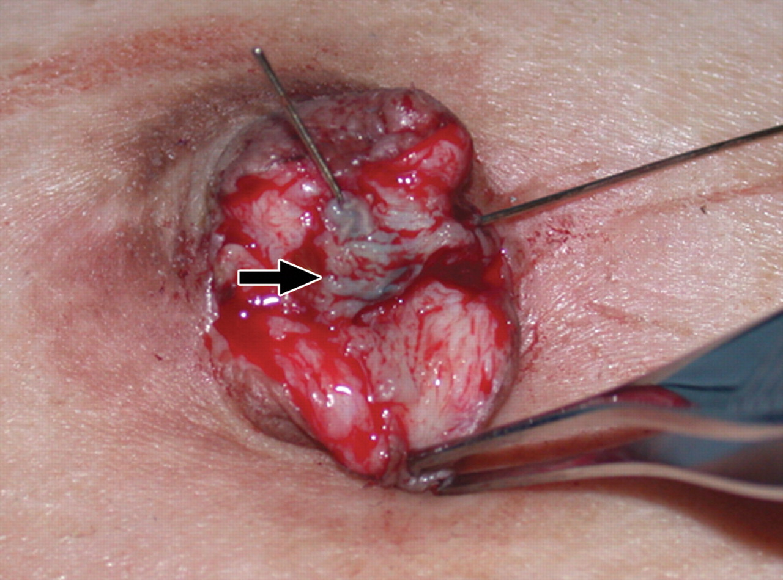
BREAST ABSCESS

