Slide 1


NURSING MANAGEMENT OF ACUTE GLOMERULONEPHRITIS, HYDRONEPHROSIS
PRESENTED BY:
MS. RUPAL PATEL
ASSISTANT PROFESSOR
DEPT OF CHILD HEALTH NURSING
SUMANDEEP NURSING COLLEGE
SUMANDEEP VIDYAPEETH DEEMED TO BE UNIVERSITY
PIPARIA, WAGHODIA, VADODARA

Slide 2
Acute glomerulonephritis is a common disease in children and it is one of the diseases that are presented commonly with hematuria which means red urine (blood in urine). Acute Glomerulo Nephritis in all probabilities results secondary to a proceeding streptococcal (beta-hemolyticus type 12) infection of throat or skin. A history of upper respiratory infection.

Slide 3

Acute Nephritis or glomerulonephritis is an infective renal disease characterized by sudden onset of hematuria, oliguria, edema and hypertension.

Slide 4

Acute glomerulonephritis is an immune – mediated inflammatory disease of the capillary loops in the renal glomeruli. The antigen – antibody complex deposition within the glomeruli results in glomerular injury which is manifested as hematuria, oliguria, edema and hypertension.

Slide 5

Presumed cause – antigen – antibody reaction secondary to an infection in the body.
Initial infection:
Usually either an upper respiratory infection or a skin infection, usually one to 3 weeks before the onset of symptom

Slide 6
Most cases are post infectious and have been associated with
-Pneumococcal
-Viral infection
-Acute post streptococcal glomerulonephritis is the most common of the post infectious renal disease in childhood.
-Streptococcal pharyngitis is more common in the winter.

Slide 7
Urinary symptoms:
Decreased urine output
Bloody or brown – coloured urine.
Oedema:
Present in most patients Usually mild.
Often manifested by Periorbital oedema in the morning
May appear only as rapid weight gain.
May be generalized and influenced by posture.

Slide 8
Hypertension:
Present in over 50 per cent of patients.
Usually mild.
Rise in blood pressure may be sudden.
Usually appears during the first four to five days of the illness.
Malaise
Mild headache
Gastrointestinal disturbances, especially anorexia and vomiting, often with abdominal and long pain.
Pallor
Irritability
Lethargy
Dysuria
Fever

Slide 9
History of illness and physical examination help in clinical diagnosis.
The confirmation of diagnosis is done by the following:
Urine examination:
It shows increased specific gravity, smoke dirty brown colour urine with reduced total amount in 24 hrs. Mild to moderate or severe albuminuria is detected.

Slide 10
Blood examination:
Blood examination demonstrates increased level of urea, creatine, ESR. There is decreased level of Hb%, serum complement and albumin in blood. Hyponatremia and hyperkalemia may occur in persistent oliguria.
Throat swab culture:
Throat swab culture may show presence of beta – hemolyticus streptococcus in some children.
Chest X-ray:
It may show pulmonary congestion

Slide 11
Monitoring:
The patient should be monitored closely for the presence of hematuria, decreased urinary output, and signs of volume overload like edema, hypertension and congestive heart failure.

Slide 12
Daily record the general condition, edema, consciousness level, weight, heart rate, respiratory rate, blood pressure, fluid intake and urinary output.
The kidney function tests must be monitored at regular intervals.
Bed rest:
It is rarely indicated except during the acute phase when complications of acute renal failure may be present.
Protect the child from fatigue and contact with other respiratory infections.
Position:
In congestive heart failure or hypertension, make the patient lie in a propped up position and provide oxygen.

Slide 13
Diet:
Diet should be arranged with restriction of protein, salt and fluid intake, till oliguria and increased blood urea level persist.
Carbohydrate containing food to be allowed freely.
The diet of the patient need not be restricted routinely.
Fluid intake should be allowed in a calculated amount Daily weight recording is important to assess the increase and decrease of edema.

Slide 14
Fluid balance:
Regular measurement of vital signs, body weight and intake and output is essential to monitor the disease’s progress and detect complications that may appear at any time during the course of the disease.
A record of daily weight is the most useful means to assess fluid balance and should be kept for children treated at home and for those who are hospitalized.
Sodium and water restriction is useful when the output is significantly reduced (< 2 to 3 dl/24hr.)

Slide 15
Hypertension:
Acute hypertension must be anticipated and identified early.
Blood pressure measurements are taken every 4 to 6 hrs.
Significant but not severe hypertension is controlled with loop diuretics.
Other antihypertensive drugs, such as calcium channel blockers, beta blockers, or angiotensin – converting enzyme inhibitors, may be needed in severe cases.
Dialysis:
May be required in patient with severe and prolonged oliguria or anuria,and renal failure.

Slide 16
Penicillin:
Administered of antibiotic (preferably Penicillin) is needed for 7 to 10 days to eradicate streptococci in the throat or skin.
Anti hypertensive (nifedipine, atenolol) and diuretics are used to control hypertension and its consequences.
Magnesium sulphate may be prescribed in the encephalopathy to reduce cerebral edema.
Sedatives (diazepam) may be required in restless patients.
Management of complication like CCF, hypertensive encephalopathy, etc should be done promptly to prevent life threatening outcome. Dopamine infusion, steroid therapy and respiratory support may require for some patients.

Slide 17
Impaired urinary elimination related to glomerular dysfunction.
Infection related to group A beta- haemolytic streptococcus pharyngitis, upper respiratory infection.
Fluid volume excess related to altered renal function (or) diminished glomerular filtration increased Na⁺ retention.
Activity intolerance related to edema.
Altered skin integrity related to edema
Altered nutritional, less than body requirement, related to albuminuria and GI disturbances.
Fear and anxiety related to disease processes.
High risk for seizure activity related to hypertensive encephalopathy.
Knowledge deficit regarding care of the child with renal disease and continuation of care at home.

Slide 18


Slide 19

Hydronephrosis is a condition in which one or both of the kidneys become stretched and swollen. This is usually because:
There is a blockage somewhere in the urinary system which is the usual cause, or urine is flowing from the bladder back to the kidneys
It can sometimes cause a pain in the side, or there may be no symptoms at all.

Slide 20

Hydronephrosis is distension and dilation of the renal pelvis and calyces, usually caused by obstruction of the free flow of urine from the kidney, leading to progressive atrophy of the kidney.

Slide 21
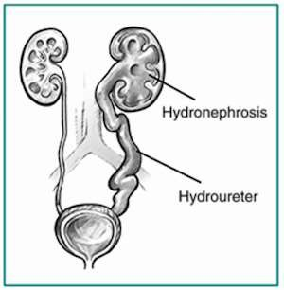

Slide 22
The signs and symptoms of Hydronephrosis depend upon whether the obstruction is acute or chronic, partial or complete, unilateral or bilateral. Unilateral Hydronephrosis may occur without any symptoms.
Asymptomatic (in some cases)
Pain is felt in the renal area
Hematuria
Urinary infection, dysuria frequency
Renal calculi
Azotemia
Some large Hydronephrosis can be palpable

Slide 23
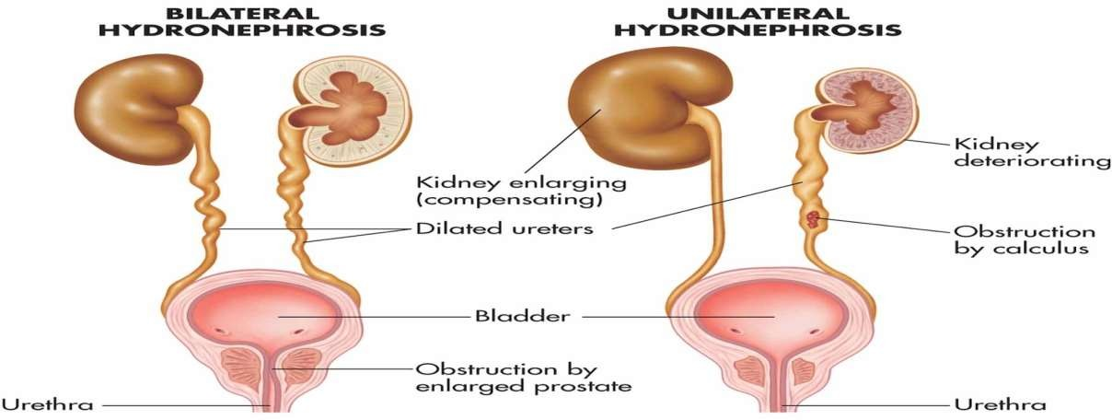

Slide 24
History collection
Physical examination: An enlarged kidney may be palpable on examination. Suprapubic tenderness along with a palpable bladder is strongly suggestive of acute urinary retention
Blood tests can show raised Creatinine and electrolyte imbalance.
Urinalysis may show an elevated pH due to the secondary destruction of nephrons within the affected kidney.
Ultrasound allows for visualization of the ureters and kidneys and can be used to assess the presence of Hydronephrosis .

Slide 25
IVU (intravenous urogram) is useful for assessing the position of the obstruction.
CT 99% of stones are visible on CT and therefore CT is becoming a common choice of initial investigation.

Slide 26

MEDICAL MANAGEMENT
Treatment of Hydronephrosis focuses upon
The removal of the obstruction
Drainage of the urine that has accumulated behind the obstruction.
The antibiotics are used to prevent the Hydronephrosis from causing kidney infections.

Slide 27
Nephrostomy
Acute obstruction of the upper urinary tract is usually treated by the insertion of a Nephrostomy (an artificial opening created between the kidney and the skin which allows for the drainage of urine directly from the upper part of the urinary system) tube.
Ureteric Stent
Chronic upper urinary tract obstruction is treated by the insertion of a Ureteric stent (a thin tube inserted into the ureter to prevent or treat obstruction of the urine flow from the kidney)

Slide 28

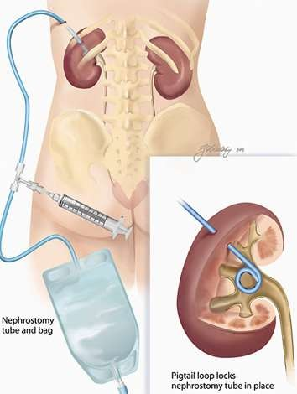
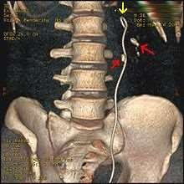
Nephrostomy
Ureteric Stent

Slide 29
Pyeloplasty
Pyeloplasty is the surgical reconstruction of the renal pelvis to drain and decompress the kidney. Most commonly it is performed to treat an uretero-pelvic junction obstruction if residual renal function is adequate.
Suprapubic Catheter
Lower urinary tract obstruction is usually treated by insertion of a urinary catheter or a suprapubic catheter.
Fetal surgery for congenital Hydronephrosis.
Fetal surgical treatment is done for the correction of posterior urethral valve obstruction and ureteropelvic junction obstruction.

Slide 30
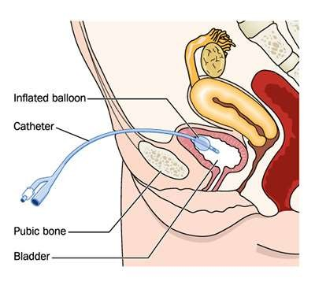
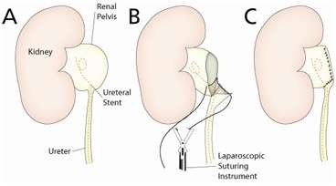
Pyeloplasty
Suprapubic Catheter

Slide 31
ASSESSMENT
History
Elicit a careful history about urinary patterns to determine a history of burning sensations, abnormal color, and frequency of urination.
Determine any recent history of mild or severe renal or flank pain that radiates to the groin.
Ask about vomiting, nausea, or abdominal fullness. Ask a male patient if he has had prostate difficulties and urinary difficulties.
Physical Examination
Inspect the flank area for asymmetry, which indicates the presence of a renal mass.
Inspect the male urethra for stenosis, injury, or phimosis.

Slide 32
Inspect and palpate for vaginal, uterine, and rectal lesions in females. When the flank area is palpated, you may feel a large fluctuating soft mass in the kidney area that represents the collection of urine in the renal pelvis.
Palpate the abdomen to help identify tender areas.
If the Hydronephrosis is the result of bladder obstruction, markedly distended urinary bladder may be felt.
Gentle pressure on the urinary bladder may result in leaking urine from the urethra because of bladder overflow.

Slide 33
PRE-OPERATIVE NURSING DIAGNOSIS
Hyperthermia related to infectious process.
Impaired nutritional status less than body requirement related to hospitalization.
Disturbed elimination pattern incontinence of urine and related to retention of urine
Deficient knowledge of parents related to the plan of treatment, surgical procedure and prevention of complications.
Disturbed family process related to hospitalization of the child.
High risk for urinary tract infection related to presence of urinary obstruction.

Slide 34
POST-OPERATIVE NURSING DIAGNOSIS
Ineffective airway clearance related to effects of anesthesia, and pain
Acute pain related to incision, and the surgical procedure
Impaired physical mobility of the upper extremities related to surgery
Risk for imbalanced fluid volume related to the surgical procedure
Deficient knowledge of home care procedures
Risk for infection related to the presence of surgical wound.

Slide 35

Teach the importance of adequate fluids.
Explain the importance of notifying the physician at the first signs of inability to void or of urinary infection, such as burning or painful urination, cloudy urine, rusty or smoky urine, blood-tinged urine, foul odor, flank pain, or fever.

Slide 36

Early detection and prompt treatment has good prognosis. Left untreated, bilateral obstruction (occurring to both kidneys rather than one) has a poor prognosis.

Slide 37
Text book of pediatric nursing, editors by “wong and whaley’s”, published by “n.r.broyhers”, 4th edition, page no:1242-1246.
Dorothy r. marlow, “text book of pediatric nursing” 6th edition, published by elsevien, page no: 284-290.
Text book of “essential pediatric nursing”, editors by “piyush gupta”, published by “a.p. jain and co”, 1st edition, page no: 300- 301.
The short text book of “pediatric nursing”, editors by “suraj gupte”, published by “jaypee brothers”, 10th edition, page no: 433-434.

Slide 38
A text book of pediatric nursing, editor by “parul datta”, published by “ jaypee”, 2nd edition, page no: 362-364
The lippincott manual of pediatric nursing, editor by “barbara f. weller”, published by “chapman and hall”, 8th edition, page no: 777-778.
Nursing care plans for newborns and children, editor by “ micheke knoll puzas”, published by “ mosby”, page no: 355 – 357.
Assuma beevi.t.m., “text book of pediatric nursing”, published by elsevien, page no: 307-308

