Slide 1

Nursing Management of child with GERD
PRESENTED BY:
MS. RUPAL PATEL
ASSISTANT PROFESSOR
DEPT OF CHILD HEALTH NURSING
SUMANDEEP NURSING COLLEGE
SUMANDEEP VIDYAPEETH DEEMED TO BE UNIVERSITY
PIPARIA, WAGHODIA, VADODARA

Slide 2
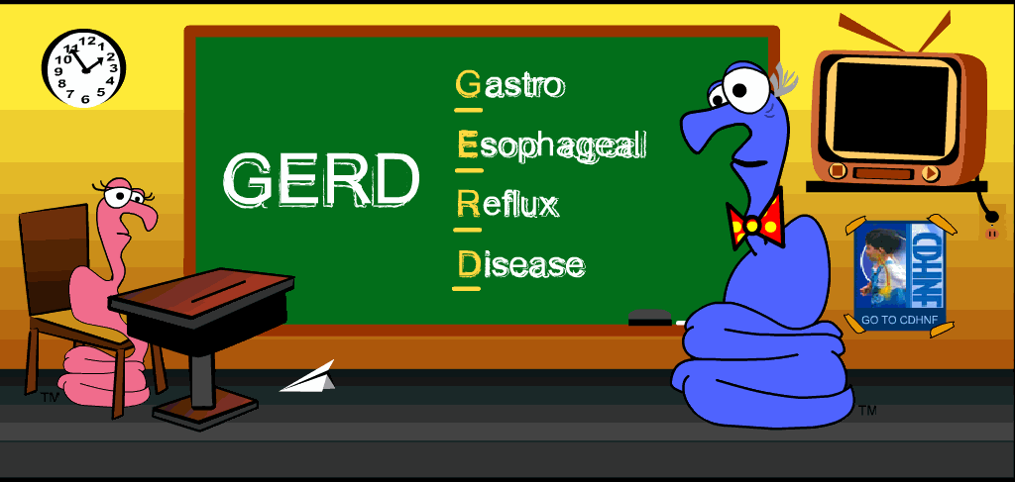

Slide 3
GASTROESOPHAGEAL REFLUX DISEASE
Gastroesophageal reflux, also called acid reflux, occurs when the stomach contents back up (reflux) into the esophagus or mouth.
Acid reflux is a normal process that occurs in healthy infants, children, and adults.
When we eat, food is carried from the mouth to the stomach through the esophagus, a tube-like structure .
The esophagus is made of lining tissue with muscles that open and squeeze to move food to the stomach.

Slide 4
At the lower end of the esophagus, where it joins the stomach, there is a circular ring of muscle called the lower esophageal sphincter (LES).
When food reaches the LES, it relaxes so that food enters the stomach.
The muscle then squeezes shut to prevent food and acid from backing up into the esophagus.

Slide 5
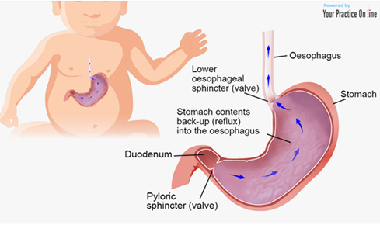

Slide 6
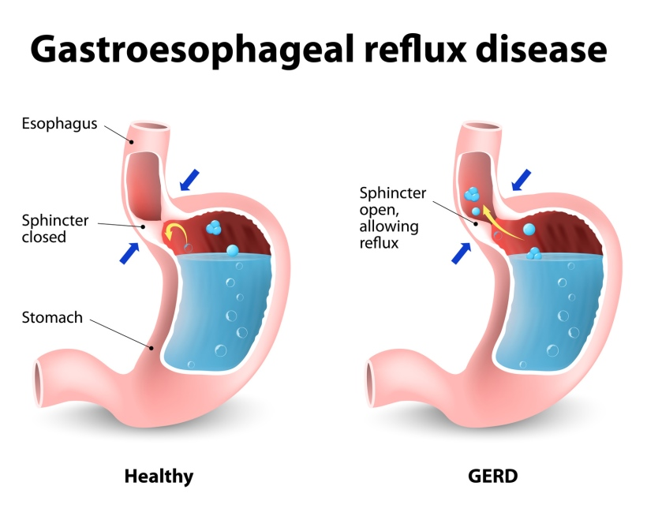

Slide 7
Causes
Babies lying flat most of the time
An almost completely liquid diet
Babies being born prematurely
Pyloric stenosis
A valve between the stomach and the small intestine is narrowed, preventing stomach contents from emptying into the small intestine.
Food intolerance
A protein in cow's milk is the most common trigger
Eosinophilic Esophagitis
A certain type of white blood cell (eosinophil) builds up and injures the lining of the esophagus.

Slide 8
symptoms
frequent regurgitation or vomiting, especially after meals
choking or wheezing (if the contents of the reflux get into the windpipe and lungs)
wet burps or wet hiccups
spitting up that continues beyond a child's first birthday (when it stops for most babies)
irritability or inconsolable crying after eating
refusing to eat or eating only small amounts
Heart burn

Slide 9
Preschool — Symptoms of acid reflux in preschool-age children can include:
Vomiting or feeling stomach acid or food in the throat or mouth
Less commonly, there can be wheezing, particularly in children with asthma
Lack of interest in eating (because of pain with eating)
Poor growth

Slide 10
Older children and adolescents
Tasting stomach acid in the throat
Nausea
Pain or burning in the upper chest (heartburn)
Discomfort or pain with swallowing
Awakening at night with nausea or abdominal pain

Slide 11
Diagnostic evaluation
History collection
Physical examination
Barium swallow
Upper endoscopy
Milk scans
24 hour esophageal pH study

Slide 12
Barium swallow
This is a special X-ray that can show the refluxing of liquid into the esophagus, any irritation in the esophagus, and abnormalities in the upper digestive tract.
For the test, child must swallow a small amount of a chalky liquid (barium). This liquid appears on the X-ray and shows the swallowing process.

Slide 13
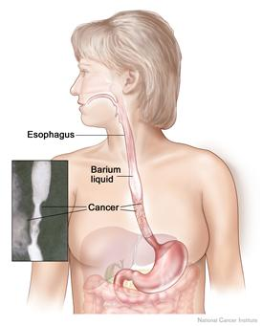

Slide 14
24-hour esophageal pH study
This is considered the most accurate way to detect reflux and the number of reflux episodes.
A thin, flexible tube is placed through the nose into the esophagus.
The tip rests just above the esophageal sphincter to monitor the acid levels in the esophagus and to detect any reflux

Slide 15
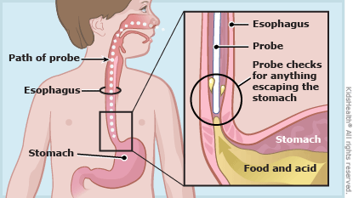

Slide 16
Milk scans (Gastro-esophageal Scintigraphy)
This series of X-ray scans tracks a special liquid as a child swallows it.
The scans can show whether the stomach is slow to empty liquids and whether the refluxed liquid is being inhaled into the lungs.

Slide 17
Upper Endoscopy
In this test, doctors directly look at the esophagus, stomach, and a portion of the small intestines using a tiny fiber-optic camera.
During the procedure, they also may biopsy the lining of the esophagus to rule out other problems and see whether GER is causing other complications.

Slide 18
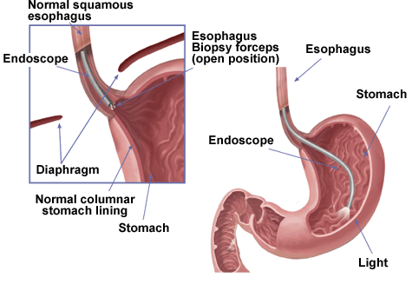

Slide 19
TREATMENT
1. Avoiding certain foods
including caffeine, chocolate, and peppermint, can relax the muscle in the esophagus, allowing acid to reflux.
Acidic foods and drinks, including colas, orange juice, and spicy foods, may also cause more symptoms.
Foods that are high in fat, such as pizza and french fries, may also increase reflux by slowing stomach emptying.
These foods should be avoided if they seem to cause more symptoms, and particularly if the child is overweight.

Slide 20
2. Raising the head of the bed 6 to 8 inches
Although some people only have heartburn for the two to three hours after meals, others wake up at night with heartburn.
Raising the head of the bed might help to reduce nighttime heartburn.
This raises the head and shoulders higher than the stomach, allowing gravity to prevent acid from backing up into the esophagus.

Slide 21
3. Losing weight
In children who are very overweight, losing weight might help reduce reflux.
4. Avoiding tobacco smoke
Smoking or being around tobacco smoke reduces the amount of saliva in the mouth and throat, which can worsen reflux.
Saliva helps to neutralize acid.
Tobacco smoke also provokes coughing, causing frequent episodes of acid reflux in the esophagus.

Slide 22
5. Avoiding lying down after eating
Lying down with a full stomach makes it easier for acid to reflux.
By eating three or more hours before bedtime, you are less likely to have acid reflux while sleeping. Also avoid eating before exercising.
6. Chewing gum
Chewing gum can increase the amount of saliva, which can help to neutralize stomach acid that has entered the esophagus.
However, gum is not recommended for children who are less than four years old.

Slide 23
MEDICAL MANAGEMENT
1. Proton pump inhibitors
(PPIs) are a type of medicine that works in the stomach to block acid. PPIs are more effective than other medicines in relieving symptoms, reducing acid secretion, and healing esophagitis.
Omeprazole
Lansoprazole
Esomeprazole
Pantoprazole
Rabeprazole
Taking the medicine on an empty stomach (30 minutes before breakfast) followed by food will help the medicine to work best

Slide 24
2. Histamine blockers
The histamine blockers also reduce acid in the stomach, they are somewhat less effective than PPIs.
Ranitidine (Zantac)
Famotidine (Pepcid)
Cimetidine (Tagamet)
Nizatidine (Axid)

Slide 25
3. Antacids
Antacids are commonly used for short-term relief of symptoms of GER in adults.
antacids work for a very short time after each dose, so they are not very effective.
Antacids are not recommended for infants or young children.
With a doctor or nurse's approval, school-age children and adolescents can use antacids, if needed.
In all age groups, antacids are not recommended for long-term treatment because they do not work as well as other medicines.

Slide 26
Surgery (Nissen fundoplication)
The lower oesophageal sphincter is surgically tightened to prevent acid from flowing back into the esophagus.
This procedure (Fundoplication) is usually done only when reflux is severe enough to prevent growth or to interfere with baby's breathing.

Slide 27
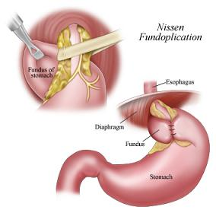

Slide 28
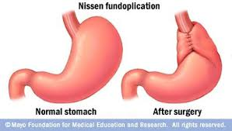

Slide 29
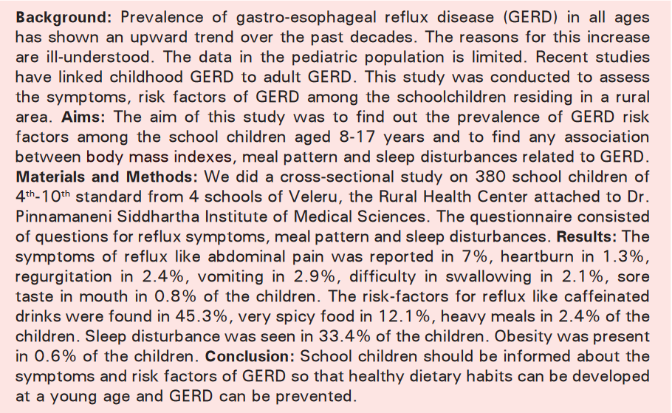

Slide 30
P | I | C | O
Assess the symptoms, riskfactors of GERD among school children | No intervention | No comparison | Risk factors were caffienated drinks, spicy food, heavy meals and symptoms were abdominal pain, heart burn, vomiting, regurgitation, difficulty in swallowing

