Slide 1

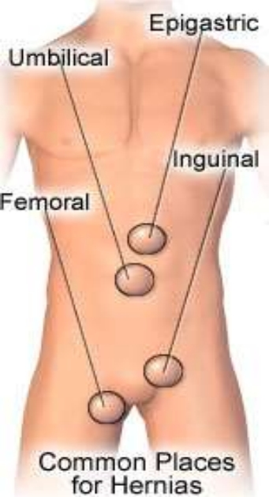

Nursing Management of child with Hernia
PRESENTED BY :
Ms. Rupal Patel
Assistant Professor
Child Health Nursing
Sumandeep Nursing College
1

Slide 2


What is Hernia?
• a condition in which part of an organ is displaced and protrudes through the wall of the cavity containing it (often involving the intestine at a weak point in the abdominal wall)
• The most important elements in the development of a hernia are congenital or muscle weakness and increased of the intra-abdominal pressure
3

Slide 3
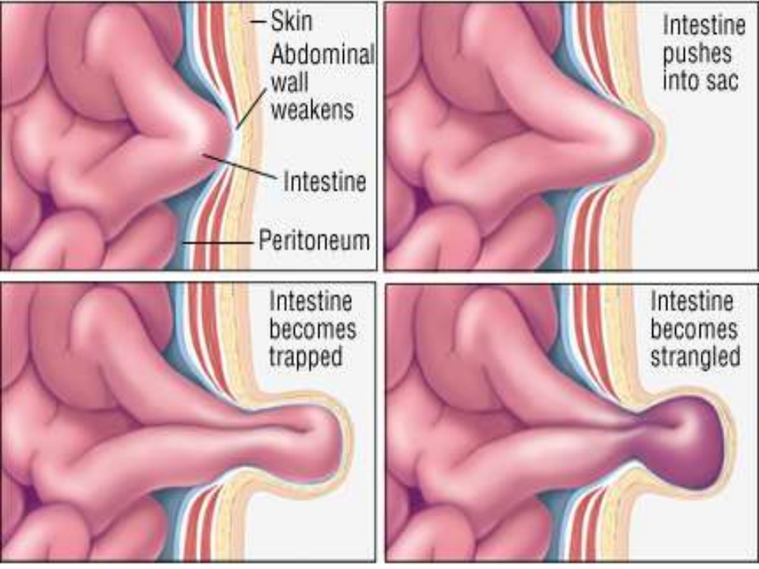
5

Slide 4


TYPE OF HERNIA
1.) Inguinal hernia
i.)Indirect inguinal hernia
ii.)Direct inguinal hernia(in contrast)
2.) Hiatal Hernia
3.)Femoral hernias(protrude through the
femoral ring)
4.) Umbilical hernia(congenital/acquire)
5.) Incisional/ventral hernias(occur at he site of previous surgical incision)
6

Slide 5
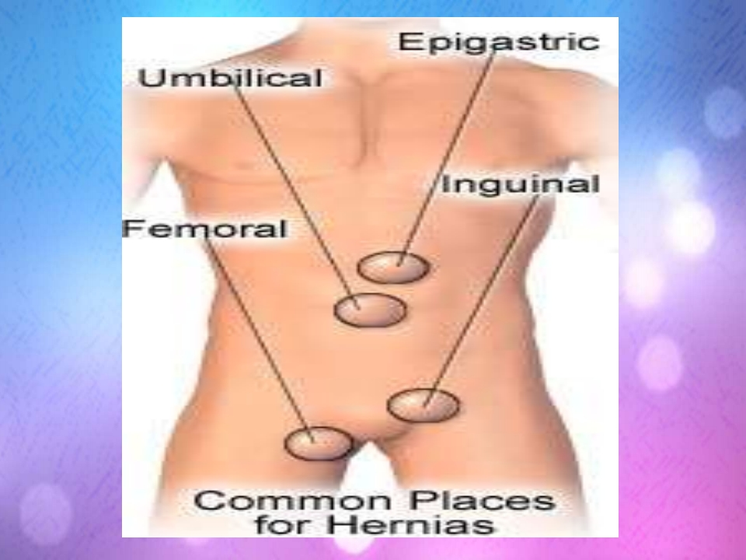
7

Slide 6
TYPE OF HERNIA
1.) Inguinal Hernia
-The intestine push through a weak or tear into the lower abdominal wall
- 75% of all abdominal wall hernias
- Occurs 25% more often in men than women
- 2 type :
i.) Indirect inguinal hernia
ii.) Direct inguinal hernia
8

Slide 7
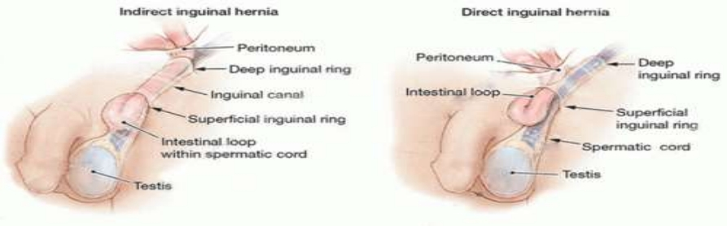
i.) Indirect ingunal hernia
- Muscle weakness at the inguinal ring causes failure closure of the deep inguinal ring
- When increased intra-abdominal pressure and dilatation of inguinal ring allow abdominal contents to enter the channel
- The protrusion passes through the deep inguinal ring and is located lateral to the inferior epigastric artery
9

Slide 8
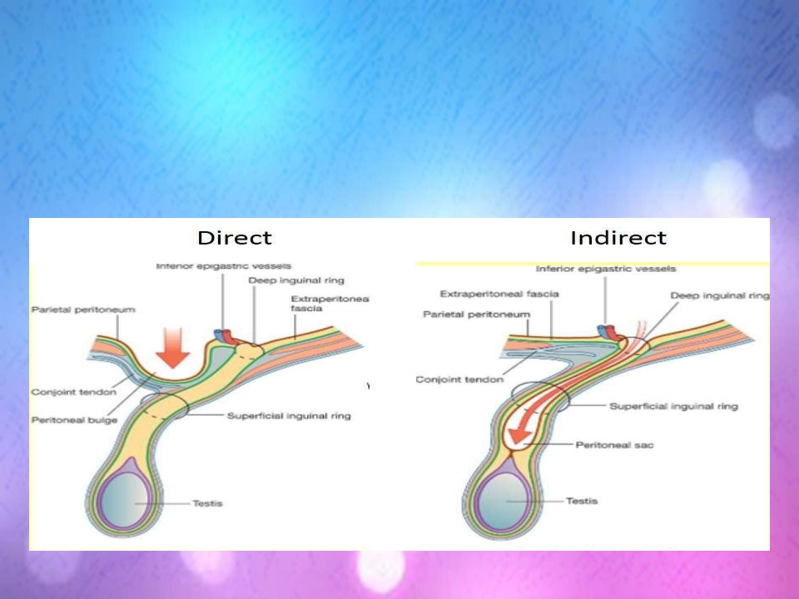
ii.) Direct inguinal hernia(in contrast)
-it pass through a weak point in the fascia of abdominal wall and at the medial to
the inferior epigastric artery
10

Slide 9
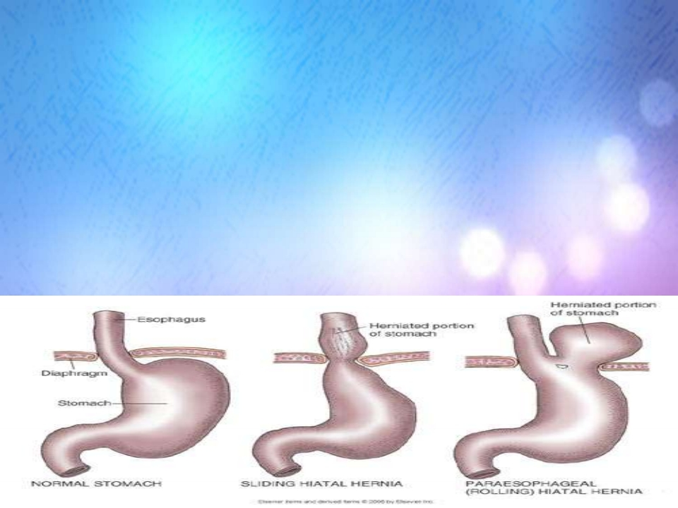
2.) Hiatal Hernia
- Part of the stomach protrudes up diaphragm into the chest
- 2 types hiatal hernia
i.) Sliding Hiatus Hernia
- The distal oesophagus and cardia slides into the thorax with an intact gastro-oesophageal junction and therefore usually asymptomatic
ii.) Rolling Hiatus Hernia
- Most of the stomach rolls into the thorax, the stomach may also undergo a twist
12

Slide 10
3.) Femoral hernia(protrude through the femoral ring)
-a plug of fats in the femoral canal enlarged and pull the peritoneum and often the urinary bladder into the sac
-More frequently in women because of the wider of the female pelvis
-Common in obese or pregnant women
13

Slide 11
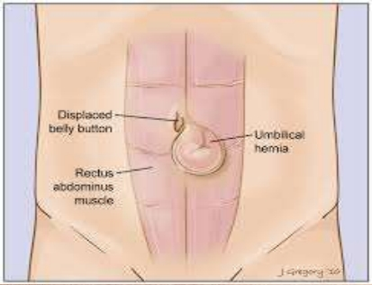
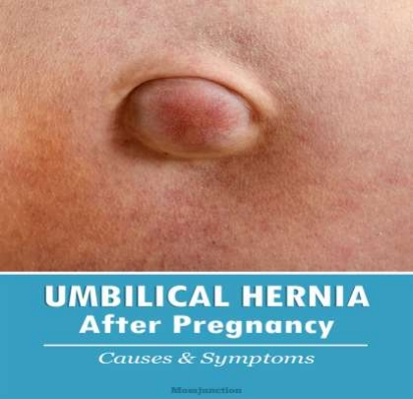
4.) Umbilical
hernia(congenital/acquire)
-An umbilical hernia occurs when intestine, fat, or fluid pushes through a weak spot in the belly
-This causes a bulge near the belly button, or navel
-congenital-appear in infancy -acquired- increased in intra-
abdominal pressure
common seen in obese or pregnant women
14

Slide 12
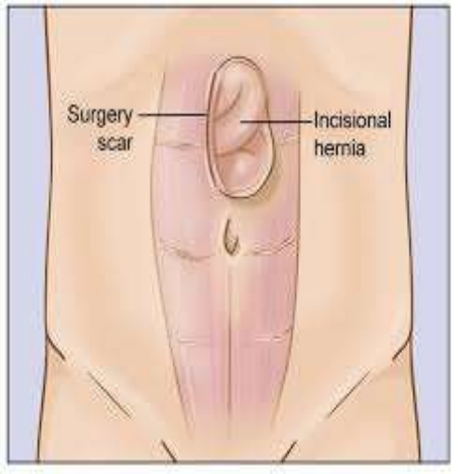
5.) Incisional/ ventral
hernia(occur at the site
of previous surgical
incision)
- results from inadequate
healing of the incision
- cause be postoperative
wound infection, inadequate
nutrition, and obesity
15

Slide 13

Obesity
pregnancy
constipation
Heavy
Smoking
weight
Risk
lifting
factor
Congenital
Muscle
defect
weakness
Damage
from
Chronic
injury or
cough
surgery
16

Slide 14
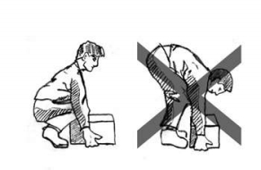

Causes/ Etiology
• a) Any condition that is increases pressure on abdominal cavity :
- Combination of muscle weakness and strain
- Obesity
- Heavy Lifting
- Persistant coughing or sneezing
- Pregnancy
- Straining during bowel movement or urination
• b) Family History
17

Slide 15













Pathophysiology
Congenital
Defects in
muscular
Obesity
walls
Hernia
Pregnancy
Increased
Intra-
abdominal
Trauma
pressure
18

Slide 16
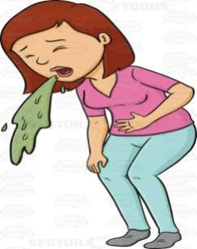

Sign and symptoms
• Small to moderate size hernia don’t usually causes any symptoms.
• Large hernia may be noticeable and cause same discomfort.
- Pain when lifting heavy object
- Tenderness
- Bulging
• Severe symptoms
- Severe and sudden pain
- Nausea
- Vomiting
- Constipation
19

Slide 17

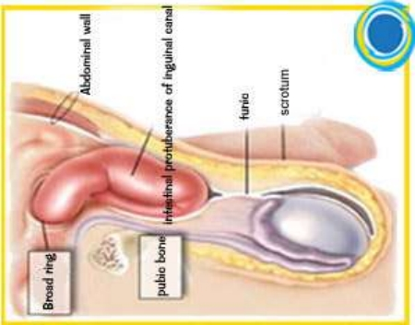
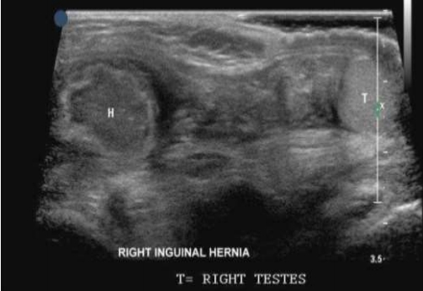
Investigation
➢ Physical examination
• health care provider may ask the patient to stand and cough or strain so the health care provider can feel for a bulge caused by the hernia as it moves into the groin or scrotum. The health care provider may gently try to massage the hernia back into its proper position in the abdomen
➢ Ultrasound
• A ultrasound may be ordered to diagnose
a hernia or to characterize the contents of
a hernia and determine its reducibility

Slide 18
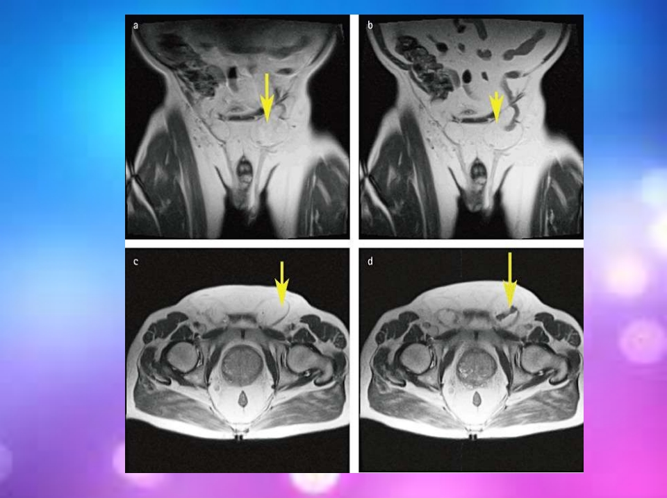
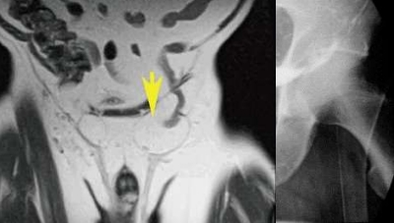
➢ Barium swallow
• Barium is a non-toxic chemical, that shows up clearly on x-ray. You will be fast for 6 hours
➢ MRI
• MRI has more contrast resolution, which means can see the anatomy of the groin in high details and also very sensitive for small areas of inflammations

Slide 19
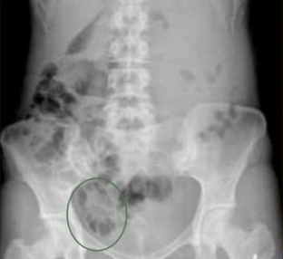
➢ X-ray abdomen
• abdominal X-rays may be ordered
to determine if a bowel obstruction
is present
➢ Blood test
▪ CBC
• Your doctor may recommend a complete blood count to check for anemia due to blood loss due to hiatal hernia
▪ WBC
• detect inflammation, infection and presence of tissue necrosis

Slide 20

• Medical PharmacologyMANAGEMENTtreatment 1.) Antibiotic
(used if the patient has strangulated
hernia)
i) IV cefoxitin (Mefoxin) 1 g 6-8hourly
ii.) Cap.Ampicilin 250-500mg 6hourly
2.) H2 receptor blocker
( used if the patient with hiatal hernia)
i.) Tab.famotidine 40mg dly
ii.) Tab. ranitidine 150mg BD
23

Slide 21
3.) PPI
( used if the patient with hiatal hernia)
I.) Tab.lansoprazole (prevacid) 15-30mg dly
ii.) Cap.osomeprazole (nexium) 20-40mg dly
iii.) Cap.omeprazole (prilosec) 20-40mg dly
iv.) Tab.Pantoprazole ( Controloc) 20-40mg dly
4.) Antianxiety Agents
(indicated for patients who may experience significant anxiety before a surgery)
i.) Tab. Dormicum 7.5-15 mg PRN
5.) Nonsteroidal Anti-Inflammatory Drugs (NSAIDs) (for patients with mild to moderate pain)
i.) Tab.Ibuprofen (Advil) 100mg 6hourly
ii.) Tab.Ketoprofen 50-75mg 6hourly
24

Slide 22
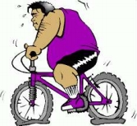

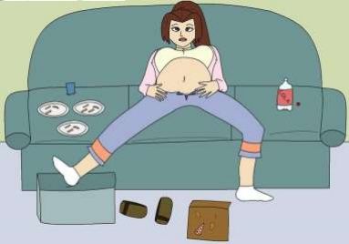

• Non-pharmacological management
1.) Avoid food that cause acid reflux or heartburn such as spicy food
2.) Don’t lie down or bend over after a meal 3.) Exercise
4.) stop smoking
5.) Avoid gassy drinks
6.) Avoid lift heavy object
25

Slide 23
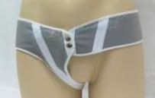
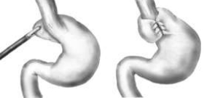
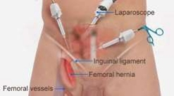
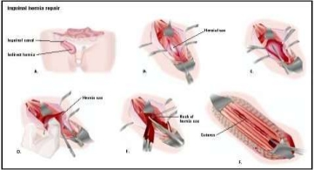
Non-Surgical Management
• Truss (Inguinal hernia)
- a pad made with firm material that will held in place over the hernia with belt to help keep the abdominal contents from protruding into the hernia sac
Surgical Management
Nissen fundoplication Laparoscopic (LEP)
Herniorrhaphy(hernia repairs)
26

Slide 24
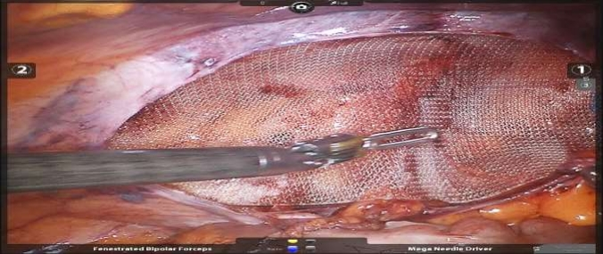
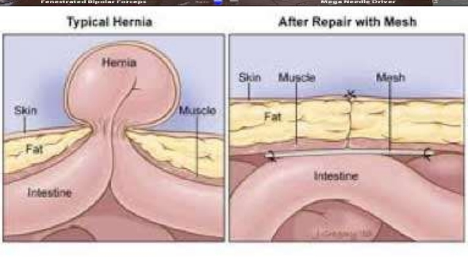
27

Slide 25

Assessment
History
1. Age of patient. (65 and above more risk)
2. Duration of hernia.(1 saw)
st
3. Height and weight. (obesity more risk)
4. Pain at the hernia place. (score/ type/ duration/ specific )
5. Ask about the previous history of surgical .Post- operative complications (especially wound infection and/or dehiscence)
6. Smoking
7. Bowel movement (constipation )
8. Chronic cough
9. Family history of hernia
28

Slide 26
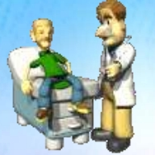
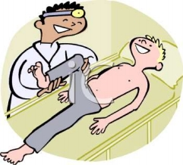
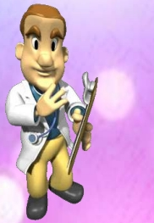
Physical examination
1. Palpate the bulge area ( standing and lying ) 2. Check for the skin fragile
3. Type of hernia
Investigation
1. Ultrasound scan
2. X-ray abdomen
3. Barium swallow
4. MRI
5. Blood test
29

Slide 27

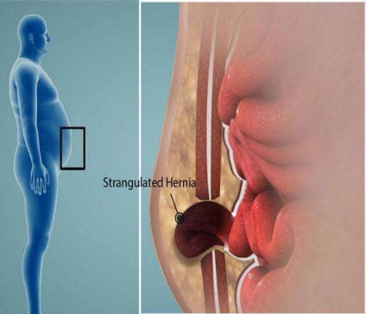
COMPLICATION
• Post herniarrhaphy pain syndrome/ inguinodynia
•
Hernia recurrence
•
Wound Infection
•
Ischemia
•
Necrosis
30

Slide 28

NURSING
DIAGNOSIS
HEALTH
EDUCATION
&
31

Slide 29
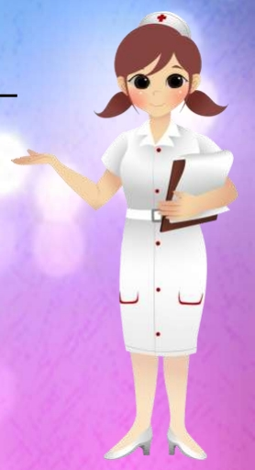
NURSING DIAGNOSES
PRE-OPERATIVE FOR HERNIA REPAIR 1) Fear and anxiety related to undergoing
surgery
POST-OPERATIVE FOR HERNIA REPAIR 2) Acute pain related to surgical intervention
3) Risk of infection related to surgical site HIATAL HERNIA
Risk for aspiration related to reflux of gastric content
32

Slide 30
Nursing Diagnosis : Fear and anxiety related to undergoing surgery
Goal : Patient’s fear and anxiety had reduced Intervention :
1) Assess patient’s level of anxiety either mild,
moderate ,severe or panic by interviewing the
patient to assess patient in an effective way to provide nursing care
2) Encourage patient to express his feeling or concern about the surgery due to acknowledgement of his feeling can reduce anxiety
3) Explain the details of surgery that patient will undergoing to reduce his fear and anxiety
33

Slide 31
4)Emphasize doctor’s explanation to the patient to makes patient more clear and acknowledge about the procedure
5) Explain the possible outcomes about the surgery so patient have preparation of facing it after the surgery
6) Encourage patient to use therapeutic touch techniques to promote comfort vice versa
7) Encourage patient listen to the smooth music to reduce the anxiety level

Slide 32
8) Encourage patient’s relatives stay by patient’s side before the day of surgery to give emotional and spiritual support to the patient , so patient will reduce the feeling of fear
9) Administer relaxant medication such as Tab. Dormicum 7.5mg PRN to the patient to reduce fear and anxiety.
Evaluation : The patient’s level of anxiety towards surgery is reduced
35

Slide 33
Nursing diagnosis: pain related to surgical site
Goal : Patient’s pain score reduced from 10 to 3 during hospitalization
1. Assess patient vital sign such as blood pressure, temperature, pulse & respiration as high blood pressure may indicate patient having pain
2. Assess patient for the pain score using numerical pain score to evaluate the severity of the pain
3. Teach patient to put pillow at the surgical site while coughing to reduce pain and pressure to the area
36

Slide 34
4. Teach patient deep breathing exercise and do frequent turning to relax the muscle & promote venous return
5. Encourage patient to take high fiber and drink 1-2 liter per day if no contraindication to prevent patient from constipation which can contribute pain during pass motion
6. Administer analgesic as ordered by the doctor. E.g. IM Pethidine 50-150 mg 3-4hr or PRN helps to minimize pain
37

Slide 35
7. Plan & limit patient’s activity to reduce the movement as more movement can cause friction at the area
8. Assess patient’s surgical site for signs symptoms of infection as severe itchiness, purulent exudates, redness & swelling and worsening pain indicates infection
9. Place patient in Trendenlenberg’s position to promote venous return & reduce pressure on the hernia
38

Slide 36
10. Encourage patient reduce weight to minimize abdominal pressure from excess fats
11. In male a jock strap or suspensory bandage may be used it helps to provide support to the area
13. Apply truss only after a hernia has been reduced. For best result apply it in the morning before patient gets out of bed it provide support
14. Apply powder for protection surround the truss to prevent friction which can irritated the skin area
Evaluation : Patient pain has reduced by evidence patient’s pain score has reduced from 8 to 4
39

Slide 37
Nursing diagnosis : High Risk of infection related to surgical incisions
Goal : Reduced the risk of infection during hospitalization
Intervention
1) Assess patient vital sign such as temperature, BP, pulse, respiration & SPO2. To detect if patient has fever which may indicates infection
2) Monitor the sign & symptoms of infection such as severe redness, swelling, itchiness, warmth & excessive discharged to provide further treatment to the patient
3) Take swabs specimen for culture & sensivity as ordered by the doctor to detect the type of bacteria that caused infection.
40

Slide 38
4) Maintain strict aseptic technique when perform dressing to decrease the spreading of infection
5) Make sure to changed the dressing when it’s fully soaked with blood, pus or when necessary to prevent accumulation of the bacteria causes infections
6) Educate patient to perform effective hand wash after toileting, before meals & after self-care as it can reduce the number of microorganisms
7) Encourage patient to take food high in protein & vitamin c to promote wound healing & boost immune system
41

Slide 39
7) Ask patient to complete the course of antibiotic as doctor prescribed to prevent risk from getting infections
8) Educate patient don’t exposed dressing unnecessarily & do not scratch the incision site to prevent further tissue injuries & invading of microorganisms
9) Educate patient do not apply any lotion or powder that is not prescribed by the doctor to prevent infections to the surgical site
10) Educate patient sign & symptoms of infection. Eg. severe & unbearable itchiness.
Evaluation
Patient free from infection during hospitalization
42

Slide 40
Risk for aspiration related to reflux of gastric content ( Hiatal hernia )
Goal : client be able to fully understand and implement ways to prevent regurgitation and aspiration
1) Assess patient usual ways after meal to know and possibly correct improper way that leads to regurgitation
2) Monitor client’s weight under standard condition to know and plan for necessary weight reduction regime
3) Assess patient routine meal timing and amount to make necessary adjustment
43

Slide 41
4) Teach patient deep breathing exercise when feeling nauseated to help relax the muscle on tension during forceful backing of gastric materials
5) Encourage patient to take high protein and low fat diet to minimize the episodes of heartburn. Eg fish, steam chicken
6) If patient dependent, assist patient in elevate head of bed during meals and 30minutes to an hour after meal to facilitate movement of food & prevent possibilities of backflow
44

Slide 42
7) Advice patient to take small but frequent meals to facilitate complete gastric empty
8) Advice patient to take warm water or soup during meals to promote flushing of digested material down the alimentary canal
9) Encourage patient to avoid taking meals 2hour before sleep. This is to prevent backflow of the stomach content to the trachea
45

Slide 43
12) Administer antacids as ordered by doctor to minimize heartburn, gastric hyperacidity & reduce regurgitation. Eg gaviscon 10mls tds
10) Encourage to reduce weight to minimize abdominal pressure from excess fats
11) Encourage patient not to wear tight clothes & pants to minimize abdominal pressure
Evaluation : client able to understand the ways to prevent regurgitation and aspiration
46

Slide 44

1.) Educate patient to assess for any signs and symptoms of infection such as redness, severe itchyness and condition at the surgical site
2.) Advise patient come for follow-up to monitor patient progress/condition
3.) Educate patient to avoid wearing tight clothing to minimize abdominal pressure
47

Slide 45
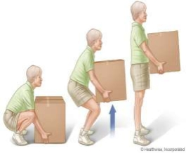
4.) Encourage patient avoid lifting heavy object or doing heavy exercise at least 6 weeks
5.) Use proper lifting technique
6.) Lose weight
7.) Exercise regularly
8.) Advice patient to eat a vitamin-rich diet such as vitamin C and protein to promote wound healing
9.) Encourage patient to take high fiber food to prevent constipation
48

Slide 46

Summary
• Is a portusion of a viscus through an abnormal opening or weakened area in the wall of the cavity in which normally contained
• Hernia can be classified into 3 stage : i.) Reducible
ii.) Irreducible
ii.) Strangulated
• There are 5 type of hernia:
i.) Hiatal iv.) Femoral
ii.) Umbilical v.) Incision
iii.) Inguinal
49

Slide 47
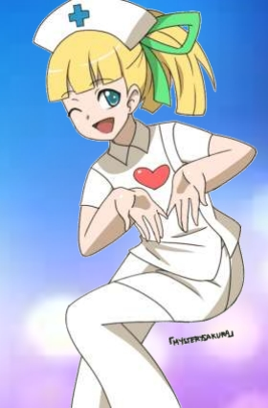
THANK YOU !!!
HAVE A NICE DAY
50

