Slide 1


Eye Injuries/Emergencies
(Glaucoma, Retinal Detachment)
By:-
Mr. Swapnil Vitthal Rahane
Department of Medical Surgical Nursing
Sumandeep Nursing College
2019-20

Slide 2
Outline of Seminar
Anatomy and physiology of eye.
Definition of Eye Injury.
Enlist the various eye injuries or emergencies.
Causes and management of the Eye injuries.
Glaucoma and its causes, pathophysiology, clinical manifestations.
Glaucoma types, diagnostics investigation, medical &surgical management.
Retinal detachment and its classification with signs and symptoms.
Retinal detachment management.

Slide 3
Eye Injury.
The eye is protected from direct injury by lids, eyelashes and the projecting margins of the orbit. However, it can be injured in a variety of ways; by chemicals, heat, radiation and mechanical trauma.
Eye injury it is most common emergency.
Leading cause of blindness, irrespective of age, sex and geographical status. (40% of monocular blindness)
Male & young age group is greater in incidence rate.
Efficient referral expected from the professionals.
Every persons should know about the importance of quick response to an ocular injury.
Prophylactic measure is always better than management.

Slide 4
Classification Eye Injuries or Emergencies
Classification of Eye Injuries or Emergencies.
Traumatic Eye Injury
Burn Eye Injury
Non Traumatic Eye Injury
Ecchymosis of the eyelids
Lacerations of the eyelids
Orbital hemorrhage
Fracture of the ethnocide bone
Blowout fracture of the floor
Corneal abrasions
Corneal foreign body injury
Alkali burn
Acid burn
Thermal burn
Burn due to ultraviolet radiations
Acute dacrocystitis
Acute dacryoadenitis
Acute Hordeolum
Conjunctivitis
Hyphema
bacterial corneal ulcer
Pre septal cellulitis
Retinal hemorrhage
Central retinal he moorage
Optic neuritis
Orbital cellulitis
Glaucoma
Retinal detachment

Slide 5
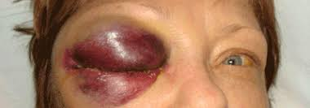
Traumatic Eye Injury
Ecchymosis of the eyelids
Ecchymosis is commonly known as black eye, usually happens from the blunt types of the trauma to the eye. Trauma causes tissue around to the eye and become bruised.
Management of the Ecchymosis of the eyelids:-
Cold compression to eye for the first 24 hours.
Warm compression to the eye after first 24 hours.
Continued compression until swelling stopped.
Keep head elevated to decreased the swelling .

Slide 6
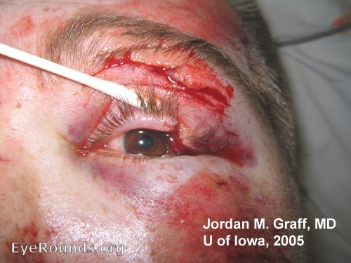
Laceration of eyelids
Laceration are caused by the sharp objects such as scissors ,knifes, sticks, fishhooks and projectile such as fireworks.
Most common are involved cornea and eyelids.
Management of laceration of eyelids:-
Close the ye and small icepack applied.
Check visual acuity if client able to open the eye and cleaning of eye.
Symptoms:-
Severe pain
Photophobia
Tearing and decreased visual acuity.

Slide 7
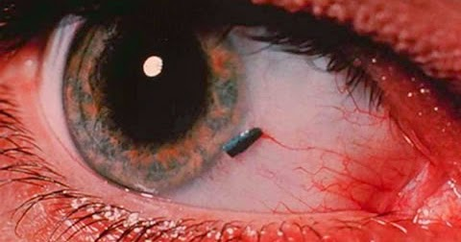
Foreign Bodies
Eyelashes ,dust, fingernails, dirt and airborne particles can cause to then conjunctiva and produce abrasion or irritation.
Symptoms:-
Client complaints about sensation of the foreign body.
Pain , Tearing, Photophobia.
Redness and swelling .
Management :-
Evaluation of the vision.
Eye examination by fluorescein followed by the eye irrigation with normal saline.

Slide 8
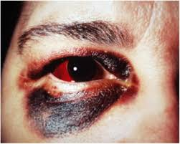
Contusion
A contusion to the eye ball or surrounding tissue is produced by the traumatic contact with blunt object the forces of the contact push the eye back in the orbit, may chance of globe compression.
Symptoms :-
Eyelids edema
Hyphema
Sub conjunctiva hemorrhage
Corneal edema
Ecchymosis
Diplopia.

Slide 9
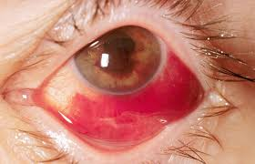
Hyphema
Presence of the blood in the anterior chamber.
It may obstruct the pupils and reduce the visual acuity’
Pain and photophobia present.
Increased intraocular pressure.
Treatment:
    Place the pt. upright to allow inferior settling of blood
    Exclude ruptured globe
    Dilate the pupil with atropine
    Measure intraocular pressure – if > 30 mmHg apply topical Timolol
    Emergent Optho evaluation.

Slide 10
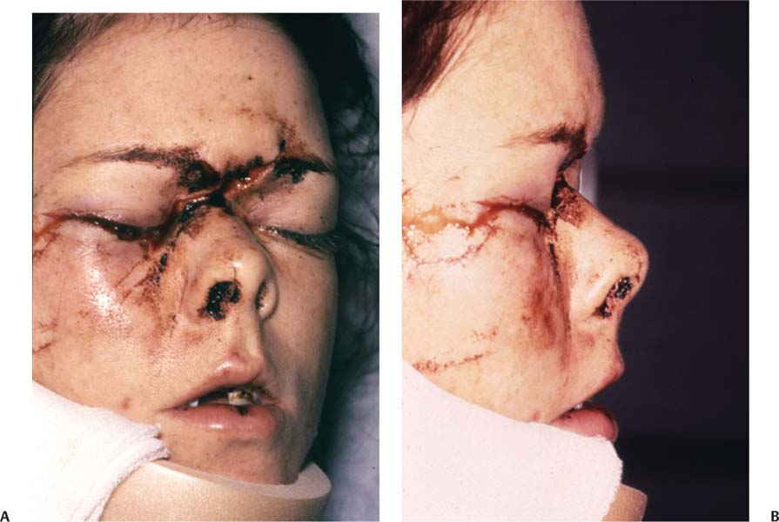
Fracture of the ethmoid bone.
Ethmoid fractures typically result from a forceful blow to the central aspect of the mid face. Motor vehicle accidents are the most common source of injury, followed by assault.
Fracture of the lamina papyracea, the lateral plate of the ethmoid labyrinth bone, permits communication between the nasal cavity and the ipsilateral orbit through the inferomedial orbital wall, resulting in orbital emphysema. Increased pressure within the nasal cavity, and leads to temporary exophthalmos.
Scarring, particularly in patients with male-pattern baldness
Bleeding, Infection
External deformity (e.g. telecanthus, nasal deformity)
Exophthalmos, diplopia, blindness, Epiphora
Anosmia
CSF leak, meningitis
Sinusitis

Slide 11
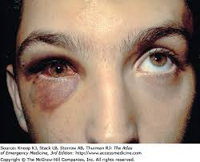
Orbital Blowout Fracture
Orbital blowout fracture is a traumatic deformity of the orbital floor or medial wall, typically resulting from impact of a blunt object larger than the orbital aperture, or eye socket.
causes :-
Direct orbital blunt injury
Sports injury (squash ball, tennis ball etc.)
Motor vehicle accidents.
signs and symptoms include:-
Orbital pain
Eyes displaced posteriorly into sockets (exophthalmos)
Limitation of eye movement
Loss of sensation (hypoesthesia) along the trigeminal (V2) nerve distribution
Seeing-double when looking up or down (vertical diplopia)
Orbital and lid subcutaneous emphysema, especially when blowing the nose or sneezing
Nausea and bradycardia due to oculocardiac reflex

Slide 12
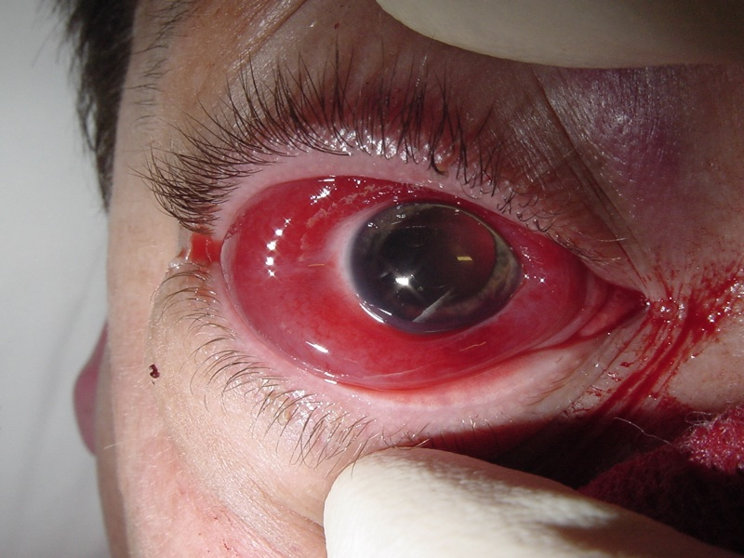
Orbital Hemorrhage
Orbital hemorrhage or Retrobulbar hemorrhage (RBH) is a rare, rapidly progressive, sight-threatening emergency that results in an accumulation of blood in the retrobulbar space.
The blood accumulation can lead to an increased IOP that may result in stretching of the optic nerve and blockage of ocular perfusion leading to venous or arterial occlusive process.
Symptoms -Pain, periorbital ecchymosis, eyelid hematoma, proptosis, visual loss, subconjunctival hemorrhage, nausea, and vomiting.

Slide 13
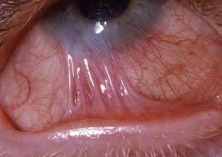
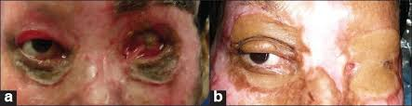
Eye Burn Injuries
Liquid Ammonia ,Caustic Soda, Caustic Potash, Lime Etc. cause to eye for alkali burn.
Sulphuric acid, hydrochloride acid, nitric acid, acetic acid cause the acidic eye burn injury.
Alkali Eye Burn injury –
Acidic Eye Burn injury - Eye Burn

Slide 14
Signs and Symptoms
Alkali burn cause more serious damage to eye than acid burn.
Signs and Symptoms
Acute phase (up to 1 week)-
Conjunctival chemosis , congestion and discharge.
Perilimbal ischemia
Increased IOP
2. Early Reparative Phase (1-3 Weeks) –
Corneal opacity
iridocyclitis
3. Late Reparative Phase (3 weeks – several months ) –
Irregulars caring of cornea
Dry eye, cyclitic membrane formation
Catractous changes of the lens.
Hypotony , trichiasis

Slide 15
Treatment
First and Immediate Treatment-
Irrigation with ocular plain water , normal saline.
Removal of particles carefully with the help of the sterile swab.
Assessment of the chemical burn grade.
2. Acute Phase Treatment –
I ,II Treat at OPD and III and IV should be admitted.
Antibiotics drops , cycloplegics, topical corticosteroids .
3. Intermediate Treatment –
Bandaging, Conjunctival flap
4. Surgical Rehabilitation –
Conjunctival transplantation for severe dry eye .
Penetrating keratoplasty.
keratoprosthesis

Slide 16
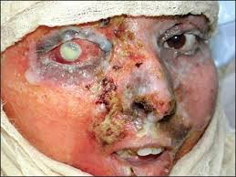
Thermal Burn
Thermal injuries to the eye are potentially blinding eye injuries and constitute true emergencies. Thermal injuries to the eye are less common than chemical injuries, with very different forms of ocular insult, post-injury problems, and treatment approaches.
Thermal injuries are of importance due to increased occurrence during festival and festivities.
Symptoms .:-
Red eyes.
Severe pain
Watering or Epiphora.
Foreign body sensation.
Blurring of vision.
Reduced visual acuity.
Photophobia (increased sensitivity to light).
Blepharospasm.

Slide 17
Thermal injuries result from accidents associated with firework explosion, steam, boiling water, or molten metal.
Thermal burns include those caused by a flame, which are usually severe with deep tissue injury, and those caused by flash accidents, such as explosions or electrical arcs, which are usually more superficial but may be extensive.
Eye thermal burn injuries divided into:
Flame burns: Flame burns are secondary to fire. They tend to be deep dermal or full thickness.
Scalds: Scalds may be caused by spilling hot drinks or liquids or being exposed to hot bathing water. Scalds tend to cause superficial to superficial dermal burns.
Contact burns: Contact burns are the result of direct exposure to a hot object. Contact burns tend to be deep dermal or full thickness.

Slide 18
Management:-
Medical therapy:
Immediate management of thermal injuries requires:
Removal of any dirt and debris.
Gentle removal of sloughed skin.
Cold, moist compresses.
Subsequent management:
Trimming of eyelashes:
Management of wound:
Surgical management :-
Temporary suture tarsorrhaphy:
Surgical tarsorrhaphy:
Masquerade procedure:
Split-thickness dermal graft:
Eyelid graft

Slide 19
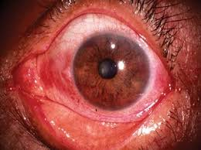
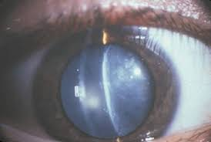
Radiational Burn
Ultraviolet (U-V) rays:-
Photokertitis or snow blindness,
photophthalmia.
Infra red rays :- (700 nm)
Glass blowers cataract.

Slide 20
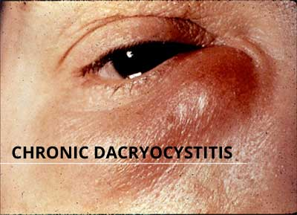
Non-Traumatic Eye Injury
Dacrocystitis is an infection of the lacrimal sac secondary to obstruction of the nasolacrimal duct at the junction of the lacrimal sac.
It is most commonly caused by staphylococcus and streptococcus pneumonia.
Sign and symptoms:-
Pain swelling ,redness over the lacrimal sac at the media canthus.
Tearing ,crusting ,fever.
Acute Dacrocystitis :-

Slide 21
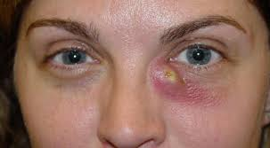
Treatment:
  Oral antibiotics.
  Warm compress.
  Relief of nasolacrimal duct obstruction by Dacryocystorhinostomy

Slide 22
Acute Dacryoadenitis :-
Dacryoadenitis is inflammation of the lacrimal glands (the tear-producing glands).
Causes:-
Acute dacryoadenitis is most commonly due to viral or bacterial infection. Common causes include mumps, virus, staphylococcus, and gonococcus.
Chronic dacryoadenitis is usually due to noninfectious inflammatory disorders. Examples include sarcoidosis, thyroid eye disease, and orbital pseudotumor.

Slide 23
Diagnosis
examination of the eyes and lids.
Special tests such as a CT scan may be required to search for the cause.
Sometimes biopsy will be needed to be sure that a tumor of the lacrimal gland is not present.
Prevention
Mumps can be prevented by immunization.
Gonococcus, bacteria can be avoided by the use of condoms. Most other causes cannot be prevented.
Treatment
If the cause of dacryoadenitis is a viral condition such as mumps, simple rest and warm compresses may be all that is needed. For other causes, the treatment is specific to the causative disease.

Slide 24
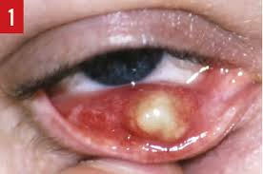
Hordeolum
A stye, also known as a Hordeolum, is a bacterial infection of an oil gland in the eyelid.
Cause:-
a bacterial infection by
Staphylococcus aurous.

Slide 25
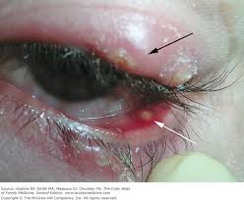
Signs and symptoms:-
A lump on the top or bottom eyelid.
Localized swelling of the eyelid
Localized pain
Redness
Tenderness
Burning in the eye
Droopiness of the eyelid
Scratchy sensation on the eyeball (itching)
Blurred vision
Mucous discharge in the eye
Irritation of the eye
Light sensitivity
Tearing
Discomfort during blinking
Sensation of a foreign body in the eye

Slide 26
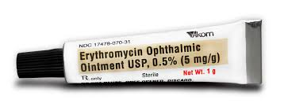
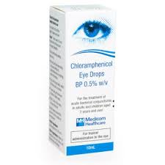
Treatment
Antibiotics
Erythromycin ophthalmic ointment is recommended.
Antibiotics, such as chloramphenicol or amoxicillin may also be used.
Chloramphenicol is also used
Antibiotics are normally given to people with multiple styes or with styes that do not seem to heal, and to people who have blepharitis or rosacea.

Slide 27
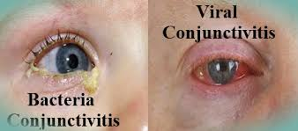
Conjunctivitis
Conjunctivitis it is an inflammation or infection of the conjunctiva.
It is result from the exposure of the allergens' or irritants.
Infectious conjunctivitis occurs from frequently a result of the bacterial or viral infection.

Slide 28
Causes
1) Viral
Adenoviruses is the most common cause of viral conjunctivitis (adenoviral keratoconjunctivitis).
Herpetic keratoconjunctivitis (caused by herpes simplex viruses) can be serious and requires treatment with acyclovir.
Acute hemorrhagic conjunctivitis is a highly contagious disease caused by one of two enteroviruse.
2) Bacterial
Staphylococcus aureus, Streptococcus pneumonia, and Haemophilus influenzae
3) Allergic
pollen, perfumes, cosmetics, smoke dust mites, , and eye drops.

Slide 29
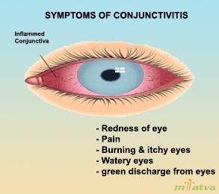
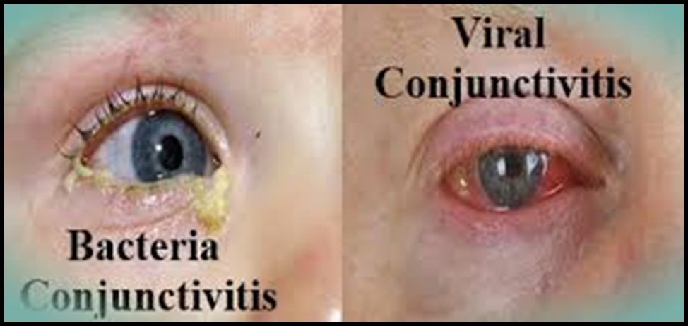
Symptoms of conjunctivitis

Slide 30
Management
Viral
Antihistamines (e.g., diphenhydramine)
Allergic
For the allergic type, cool water transferred over the face with the head inclined downward constricts capillaries, and artificial tears sometimes relieve discomfort in mild cases.
In more severe cases, no steroidal anti-inflammatory medications and antihistamines may be prescribed. Persistent allergic conjunctivitis may also require topical steroid drops.
Chemical
Conjunctivitis due to chemicals is treated via irrigation with Ringer's lactate or saline solution.

Slide 31
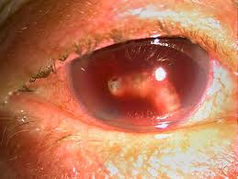
Hyphema
Hyphema is blood in the front (anterior) chamber of the eye.
Causes:-
Injury
Intraocular surgery, blunt trauma, and lacerating trauma.
Abnormal growth of blood vessels (neovascularization), tumors of the eye (retinoblastoma or iris melanoma), uveitis, or vascular anomalies (juvenile xanthogranuloma).

Slide 32
Treatment
The main goals of treatment are to decrease the risk of rebreeding within the eye, corneal blood staining, and atrophy of the optic nerve.
Pain management- acetaminophen
tranexamic acids are used in Hyphema.

Slide 33
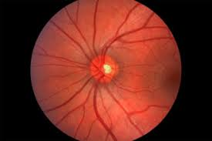
Optic Neuritis
Optic neuritis is an inflammation or demyelination disorder of the optic nerve.
Causes:-
Idiopathic
Demyelination of multiple sclerosis.
Post viral
Granulomatous inflammation like sarcoidosis, tuberculosis or syphilis.
Metabolic disturbances like DM ,anemia in Pregnancy vitamin B deficiency.

Slide 34
Sign and Symptoms:-
Vision loss progress rapidly.
Discomfort or pain behind the eye ball when eye is moving.
Treatment:-
Oral prednisolone.(1 -1.5 kg /day)
Steroids-ACTH Injection
Injection hydroclobalamine

Slide 35
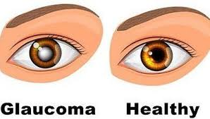
Glaucoma
Glaucoma is a group of ocular conditions characterized by optic nerve damage. The optic nerve damage is result due to the increased IOP caused by congestion of aqueous humor in the eye.
Risk factors:-
Family history of glaucoma.
Older age
Diabetes mellitus.
Cardiovascular diseases
Migraine syndrome.
Eye trauma
Near sightedness
Prolonged use of topical steroids.

Slide 36
Pathophysiology
Increased IOP (> 23mmhg)
Hyper production of aqueous humor or obstruction outflow
Aqueous fluid accumulation on the eye
Decreased blood supply of the retina & optic nerve
Tissue ischemia
Gradually loss of functions (Blurred Vision, Vision Loss)

Slide 37
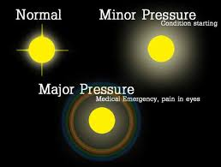
Clinical Manifestation
Increased IOP (>23mmhg)
Rainbow hallow around light.
Loss of blood supply to the retina
Severe pain, blurred vision, vision loss.

Slide 38
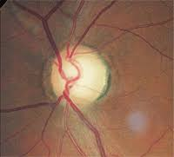
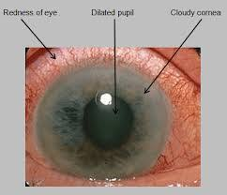

Atrophy (pale color) Corneal cloudiness
Blind spot
                experience nausea and vomiting.

Slide 39
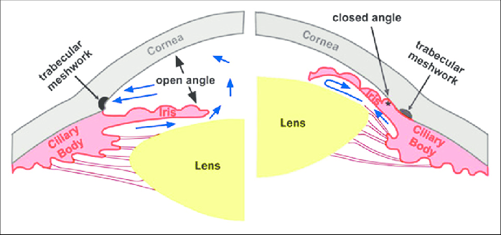
Types of Glaucoma
Glaucoma
Open Angle Glaucoma
Angle Closer Glaucoma
(Pupillary Block)

Slide 40
Open Angle Glaucoma
Usually bilateral, but one eye may be more severely affected than the other. In all three types of open angle glaucoma, the anterior chamber angle is open and appears normal.
COAG
NORMAL TENSION GLACUMA
OCULAR HYPERTENSION
Optic nerve damage
Visual field defect
IOP>21mmhg
Ocular pain
Headache
Halos.
IOP<21mmhg
Optic nerve damage
Visual field defect
Elevated IOP
Ocular pain
headache

Slide 41
Angle Closure Glaucoma
Obstruction in aqueous humor outflow due to the complete or partial closure of the angle from the forward sift of the peripheral iris to the trabecular.
Obstruction result in increased IOP.
ANGLE CLOSURE GLACUMA TYPES:-
ACUTE ANGLE CLOSUREGLACUMA:-
In this glaucoma rapidly progressive visual impairment and ocular pain occurs nausea and vomiting.
Profuse sweating, severely elevated IOP, Corneal edema, pupil are fixed in semi dilated position.

Slide 42
2) Sub acute angle closure glaucoma:-
Transient burning vision, halos around lights, temporal headache and ocular pain.
3) Chronic angle glaucoma :-
Visual loss and IOP elevated sometimes normal, ocular pain and headache.

Slide 43
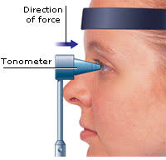
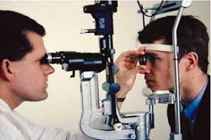
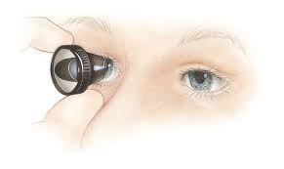
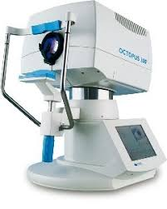
Diagnostic investigations:-
Assess the optic nerve damage and formulate treatment plan.
Tonometry to measure IOP.
Ophthalmoscopy to inspect the optic nerve.
Gonioscopy to examine the angle of the anterior chamber.
Perimeter to assess the visual field.

Slide 44
Management :-
Goal:-
To reduce the intraocular pressure.
To prevent the optic nerve damage.
Pharmacological Management:-
Cholinergic agents- ex. Pilocarpine, Miotics, Carbachol.
Adrenergic agonists:- Dipirefin ,Epinephrine.
Beta blockers:- Betaxolol, Timolol,
Alpha adrenergic blockers:- Apraclonidine, Brimonidine.

Slide 45
Surgical Management:-
Laser Trabeculoplasty
Laser Iridotomy
Filtering Procedure
Drainage Implants.

Slide 46
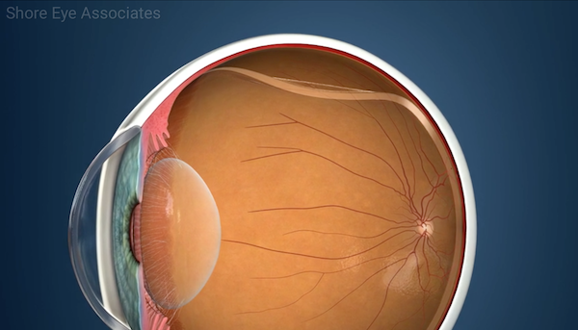
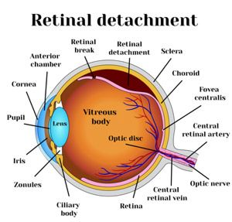
Retinal Detachment:-
It is the separation of the sensory retina from the retinal pigmentory epithelium by sub retinal fluid.

Slide 47
Classification of Retinal Detachment:-
A) Rhegmatogenous (Primary)
B) Non-rhegmatogenous (secondary)
Tractional.
Exudative.

Slide 48
A) Rhegmatogenous (Primary)
Sub retinal fluid derived from the fluid vitreous gains access into the rhegmatogenous RD may be traumatic or spontaneous.
Causes:-
Truma
Myopia
Peripheral retinal detachment

Slide 49

Signs and Symptoms:-
Photopia
Floaters
Visual filed defect
Loss of central vision
In fresh RD
Intraocular pressure is low
Mild anterior uveitis.
In long standing RD
Retinal thinning
Secondary intraretinal cyst

Slide 50
Non-rhegmatogenous (secondary)
Tractional :-
The sensory retina pulled away from the retinal peripheral epithelium by the vireo retinal membranes.
Signs and symptoms:-
Photopia
Slow and progression vision loss

Slide 51
Non-rhegmatogenous (Secondary)
Exudative:-
SRF derived from the choroid gains access to the sub retinal space through the damaged RPE exudative RD may be due to choroid tumors and immflamation.
Signs and Symptoms:-
Floaters are present occasionally.
Photopia is absent.
Sudden and rapid loss of visual field.

Slide 52
Diagnostic investigations:-
Indirect ophthalmoscopy
Slit lamp
Stereo fundus photography
Florescent angiography
Tomography.

Slide 53
Management :-
Goal:-
To find out the break and seal it.
To relive vitreo retinal traction.
To drain the sub retinal fluid.
Pharmacological management same as glaucoma
Surgical Management:-
Sealing the retinal breaks
Scleral bulking
Viredectomy
Pneumatic retinopexy

Slide 54
Nursing Management :-
Promote comforts patient
Assess the pain level of the patient
Teaching patient self care :-
Medication program and side effect and specially eye drops.
Loss of vision
Instruct about complications
Reassurance and psychological support

Slide 55
Nursing Diagnosis:-
Chronic pain r/t to increased intraocular pressure
Impaired sensory perception ,visual r/t to interference in admission, disease condition or organ status.
Anxiety r/t psychological factors changes in health status ,pain, possibility of vision loss fear.
Knowledge deficient r/t prognosis and treatment to low exposure, less source ,misinterpretation

Slide 56
Summary
Anatomy and physiology of eye.
What is Eye Injury.
various eye injuries or emergencies.
Causes and management of the Eye injuries.
Glaucoma and its causes, pathophysiology, clinical manifestations.
Glaucoma types, diagnostics investigation, medical &surgical management.
Retinal detachment and its classification with signs and symptoms.
Retinal detachment management.
Nursing management of eye disorders patients.

Slide 57
Awareness and Knowledge of Emergent Ophthalmic Disease Among Patients in an Internal Medicine Clinic
Joshua H. Uhr, BA¹; Kapil Mishra, BS¹; Chen Wei¹; et alAlbert Y. Wu, MD, PhD^{1,2}
JAMA Ophthalmol. 2016;134(4):424-431. doi:10.1001/jamaophthalmol.2015.6212
Objective :-
To assess public awareness and knowledge of 4 emergent ophthalmic diseases.
Design, Setting, and Participants :-
This cross-sectional study was conducted from June 1 to July 30, 2015, in the waiting rooms of the outpatient internal medicine resident clinic at Mount Sinai Hospital.

Slide 58
written survey was administered to evaluate awareness and knowledge of retinal detachment, acute angle-closure glaucoma, giant cell arteritis, and central retinal artery occlusion.
Awareness of each disease was assessed by whether participants knew what the diseases were (yes or no).
Knowledge was evaluated by responses to 3 questions for each disease, including 1 question about basic pathophysiologic features, 1 question about basic symptoms, and 1 question about basic treatment options.
237patient completed by the survey. Demographic information, including age, sex, race, income, and educational level, was collected. Data were assessed from August 1 to 7, 2015.

Slide 59
Results :-
Two hundred thirty-seven patients (of 227 who gave complete demographic information, 76 men [33.5%], 151 women [66.5%].
Awareness of each of the diseases studied was low; 61 of 220 respondents (27.7%; 95% ci, 21.8%-33.6%) were aware of retinal detachment;
32 of 219 respondents (14.6%; 95% ci, 9.9%-19.3%), acute angle-closure glaucoma;
11 of 216 respondents (5.1%; 95% ci, 2.2%-8.0%), giant cell arteritis;
And 10 of 218 respondents (4.6%; 95% ci, 1.8%-7.4%), central retinal artery occlusion.

Slide 60
Conclusions and relevance :-
levels of awareness and knowledge of emergent ophthalmic diseases are low.
These results indicate a need to educate the public about these acutely vision-threatening entities to ensure early medical presentation, to achieve the best possible visual prognosis, and to preserve quality of life.

Slide 61
Different causes of referral to ophthalmology emergency room
Author:-Mohammad Reza Akbari, and Hojat Salmasian
J Emerg Trauma Shock. 2012 Jan-Mar; 5(1): 16–22.
doi: 10.4103/0974-2700.93104
PMCID: PMC3299147
Aim:
To identify the major causes of referrals to eye emergency ward in patients with eye-related complaints in an eye referral Hospital in Iran.
Settings and Design:
In a cross-sectional study, 3150 patients who referred to Farabi Hospital emergency ward, Tehran, Iran, from January to December 2007.
Materials and Methods:
The patients’ demographic data, medical history and final diagnosis were recorded in a questionnaire

Slide 62
Results:
2380 patients (75.6%) were males. While 299 patients (9.5%) were referred for non-urgent reasons, work-related injuries were the most common cause of referral (955 patients; 30.3%).
Work-related injuries occurred in 955 patients (49%) and occurred accidentally (by chance) in 819 patients (42%).
The majority of patients referred with traumatic injuries were males (1708 patients; 87.6% versus 242 patients; 12.4%).

Slide 63
The most common etiologies of eye trauma (1950 patients) were metal filings (814 patients; 41.8%), blunt trauma (338 patients; 17.3%), fireworks (236 patients; 12.1%) and sharp objects (222 patients; 11.4%). Globe injury was diagnosed in 1865 patients (95.7%) of trauma cases.
In patients referred due to non-traumatic reason (1200 patients), eye infection occurred in 482 patients (40.2%) and 299 patients (24.9%) were referred for non-urgent reasons.

Slide 64
Conclusion
Nurses are greatly able to assist in providing referrals to patients who need subspecialty services and subsequently, this will contribute to saving health-care expenditures since patients would receive proper management.
Ophthalmic nurses could play a significant role in the process of teaching people, providing proper diagnoses, administration and even management of many cases of medical conditions.

Slide 65
BIBLIOGRAPHY
Suzanne C.S., Brenda G.B., Janice L.H., Kerry H. C., Brunner & Suddarth’s Textbook of Medical-Surgical Nursing, Vol. 2, 12th edi., Wolters Kluwer Pvt. Ltd., Page No. 2049-2057.
Joyce M.B., Jane H.H., Medicsal-Surgical Nursing, Clinical Management for Positive Outcome, Vol.-2, 8th edi., Page No. 1933- 1948.
Chintamani, Mrinalini M., Harindarjeet G., Lewi’s Medical-Surgical Nursing, Assessment & Management of Clinical Problems, Replika Press Pvt., Ltd., Page No. 1444-1451.
Samar K. basak.Essentials of ophthalmology.3rd edition,current book of international,kolkata.page no-203-231.
EYE EMERGENCY MANUAL An Illustrated Guide Second Edition, First Edition February 2007 Second Edition May 2009

Slide 66


