Slide 1

EUTHANASIA
By –
Mr. Swapnil Rahane
Assistant Professor
Department of Medical Surgical Nursing
Sumandeep Nursing College

Slide 2

OBJECTIVES:
Define the term Euthanasia.
Describe classification of Euthanasia.
Enlist ways of Euthanasia.
Explain who can choose Euthanasia.
Discuss the arguments for voluntary euthanasia.
Understand the nurse’s role in euthanasia.

Slide 3
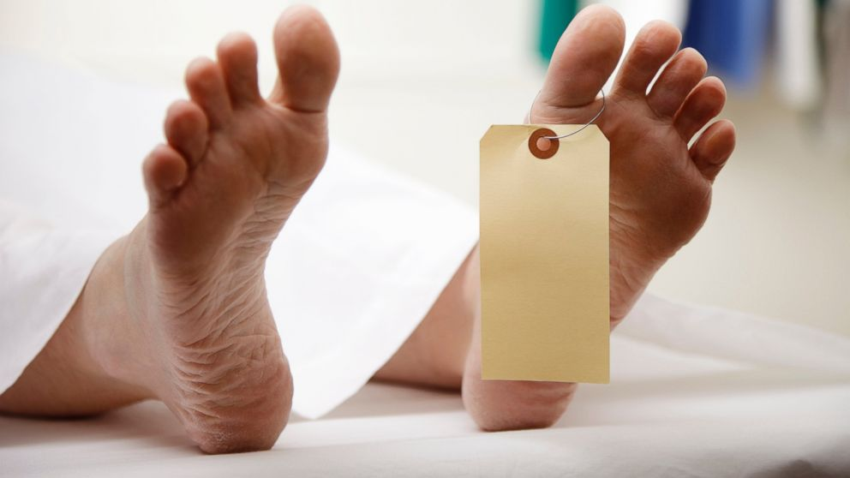
DEFINITION:
Euthanasia is also known as assisted suicide, physician-assisted suicide (dying), doctor-assisted dying (suicide), & more loosely termed mercy killing, means to take a deliberate action with the express intention of ending a life to relieve intractable suffering.

Slide 4
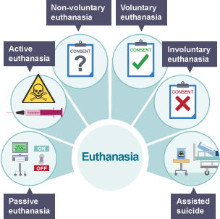
CLASSIFICATION OF EUTHANASIA:
Active or positive Euthanasia
Passive or negative Euthanasia
Voluntary Euthanasia
Involuntary Euthanasia
Non-voluntary Euthanasia

Slide 5
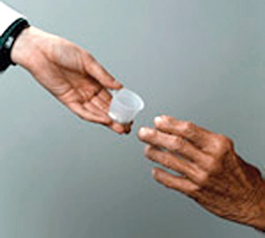

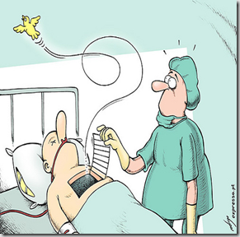
ACTIVE EUTHANASIA:
Doctor administer lethal dose of medication to a patient.

Slide 6
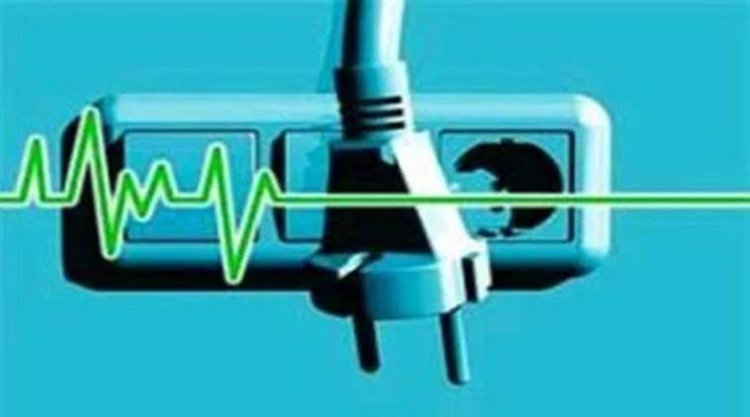
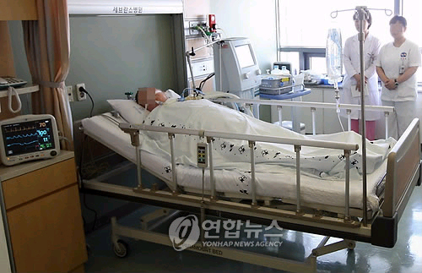
PASSIVE OR NEGATIVE EUTHANASIA:
Treatment that sustains the life of the patient is held off and the patient dies.

Slide 7
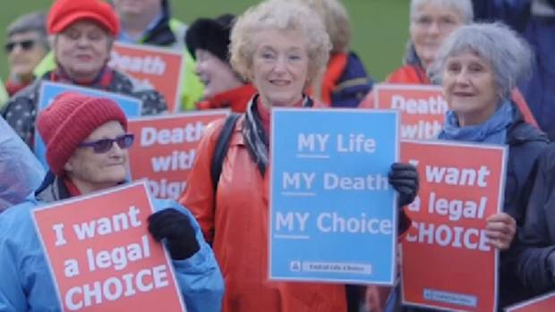
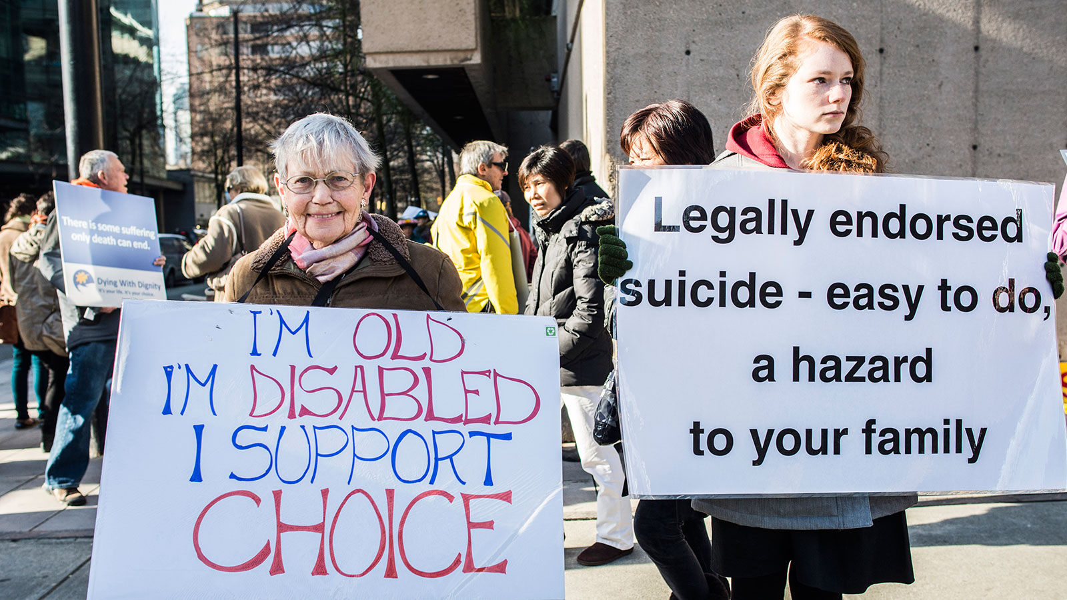
VOLUNTARY EUTHANASIA:
Practiced with the expressed desire and consent of the patient.

Slide 8
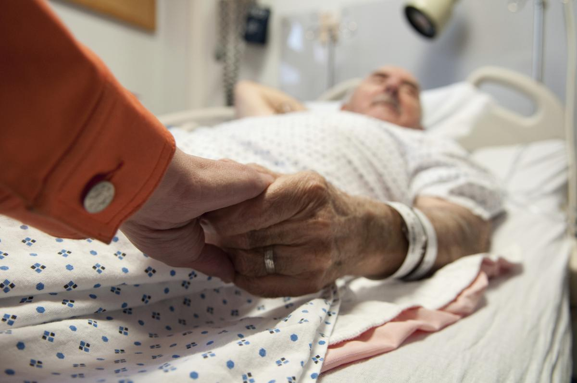
INVOLUNTARY EUTHANASIA:
When the patient is killed without an expressed wish to this effect, it is a form of involuntary euthanasia. It refers to cases wherein a competent patient’s life is brought to an end against the wishes of that patient that oppose euthanasia; and would clearly amount to murder.

Slide 9
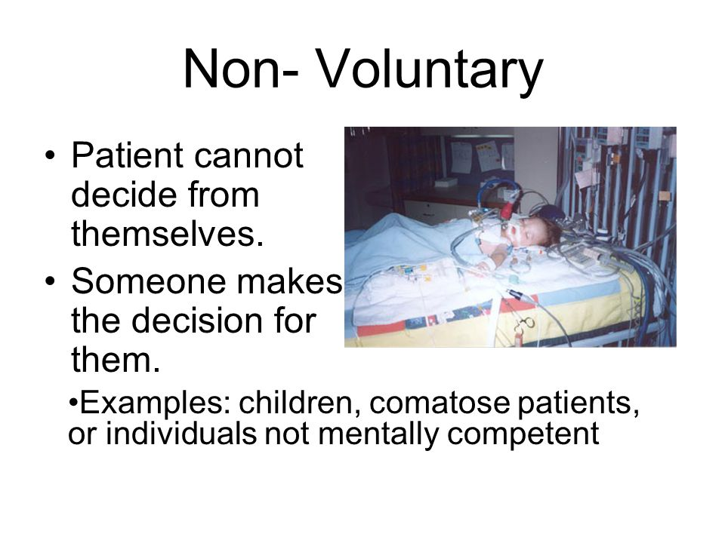
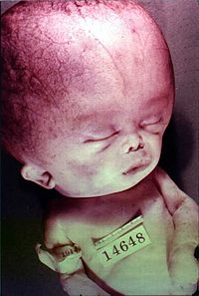
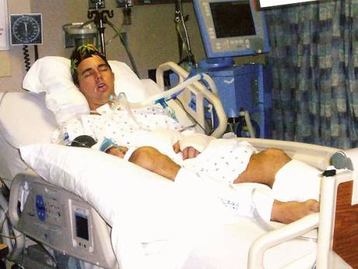
NON-VOLUNTARY EUTHANASIA
It refers to ending the life of a person who is not mentally competent to make an informed request to die.
In Non-Voluntary euthanasia the patient has left no such living will. In cases of non voluntary euthanasia, it is often the family members, who make the decision.

Slide 10
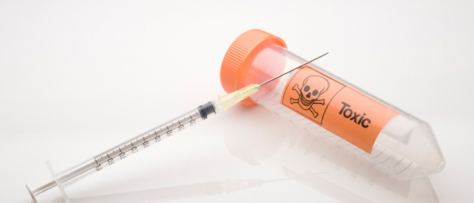
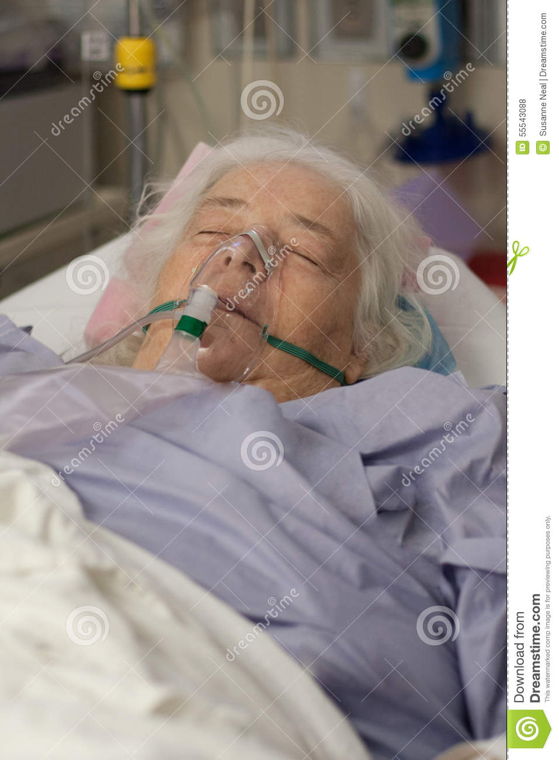
WAYS OF EUTHANASIA:
Lethal injection - Injection of a lethal dose of a drug, such as a known poison, KCl, Sodium pentothal etc.
Asphyxiation –
The most popular gas used is Carbon monoxide (CO). Organophosphate nerve gases like sarin & tabun etc. are also added in small amounts to fully ensure death.

Slide 11
WHO OPT FOR EUTHANASIA:
In most regions, men opted for assisted suicide more often than women (except in Switzerland)
The age group most commonly opting for euthanasia was the 60-85-year-olds, followed by 40-59-year-olds
Most people who chose an assisted death were married, followed by widowed, then divorced
The disease most commonly found in euthanasia cases was cancer - other diseases included amyotrophic lateral sclerosis (ALS), multiple sclerosis and cardiovascular disease
The Netherlands reported the highest number of assisted deaths - 3,695 in 2011 (roughly 2.5% of all deaths)
Overall, in states and countries where euthanasia is legal, between 0.1% and 2.9% of all deaths were assisted.

Slide 12

LEGAL ASPECTS OF EUTHANASIA IN INDIA
Intention on the part of the doctor to kill the patient, such cases would clearly fall under clause first of Section 300 of the Indian Penal Code, 1860.
Right to suicide is not an available “right” in India – it is punishable under the India Penal Code, 1860.
Voluntary euthanasia that would attract Exception 5 to Section 300. Cases of non-voluntary and involuntary euthanasia would be struck by proviso one to Section 92 of the IPC and thus be rendered illegal.
Right to life is an important right enshrined in Constitution of India.

Slide 13
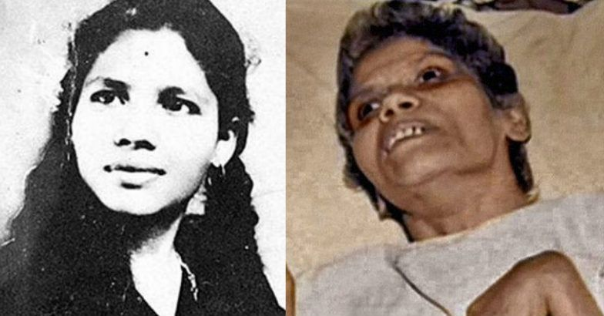
ARUNA’S CASE
Aruna Ramchandra Shanbaug was in a Persistent Vegetative State (P.V.S.) and virtually a dead person and has no state of awareness and her brain was virtually dead.
Passive euthanasia is permissible under supervision of but active euthanasia is not permitted under the law.

Slide 14
GUIDELINES LAID DOWN BY THE COURT ARE:
A decision has to be taken to discontinue life support either by the parents or the spouse or other close relatives, or in the absence of any of them, such a decision can be taken even by a person or a body of persons acting as a next friend. It can also be taken by the doctors attending the patient. However, the decision should be taken bonafide in the best interest of the patient.
Hence, even if a decision is taken by the near relatives or doctors or next friend to withdraw life support, such a decision requires approval from the High Court concerned as laid down in Airedale’s case (supra) as this is even more necessary in our country as we cannot rule out the possibility of mischief being done by relatives or others for inheriting the property of the patient.

Slide 15
Article 226 of the Constitution which can grant approval for withdrawal of life support to such an incompetent person.
A bench of medical authorities/medical practitioners are constituted.

Slide 16
ARGUMENTS ON EUTHANASIA:

Slide 17

FOR:
Choice
Quality of life
Dignity
Witnesses
Drain on resources
Public opinion
Humane
Loved ones
We already do it
Prolongation of dying.

Slide 18
AGAINST:
The doctor’s role
Moral religious argument
Competence
Guilt
Slippery slope
The patient’s might recover
Palliative care.

Slide 19

LIVING WILL:
Also known as, advance healthcare directive, personal directive, advance directive, medical directive or advance decision.
Legal document.
In one form: you leave instructions for treatment.
Another form: there is power of attorney or health care proxy.

Slide 20
What is included:
Medical procedures in life-threatening situations.
Organ & tissue donation.
Life Sustaining care.

Slide 21
NURSE’S ROLE:
Autonomy
Freedom
Beneficence
Nonmalfeasance
Veracity
Confidentiality/privacy
Fidelity
Justice.

Slide 22
RESEARCH ARTICLE:
TITLE:
Euthanasia: the perceptions of nurses in India.
AUTHORS:
Poreddi V¹, Nagarajaiah, Konduru R, Math SB
AUTHORS INFORMATION:
Department of Nursing, National Institute of Mental Health and Neurosciences, Deemed University, Bangalore, 560 029, India.
SOURCE:
Int J Palliat Nurs. 2013 Apr;19(4):187-193.

Slide 23
SAMPLE SIZE:
214 Nurses
SETTING:
Nurses working in tertiary care centre
OBJECTIVE:
To examine nurses' perceptions of the practice of euthanasia as well as factors influencing those perceptions.
METHODOLOGY:
A non-probability quantitative, cross-sectional design
DATA COLLECTION:
Data was collected through self-reported questionnaires at the nurses workplace.

Slide 24
INTRODUCTION:
Euthanasia provokes controversies in various domains, such as the moral, ethical, legal, religious, scientific, and economic. India legalised passive euthanasia (withdrawal of life support) for patients with brain death or who are in a permanent vegetative state in 2011.
FINDINGS:
The findings revealed mixed opinions on euthanasia among the nurses. However, the majority of the participants did not agree with the practice of euthanasia.

Slide 25

SUMMARY:

Slide 26

CONCLUSION:
To conclude my topic, all types of euthanasia are important subjects that have been taking the government and people’s concerns for the past decades.
There are some people choose to die, while others choose to live.
Some people keep fighting for survival, while others lose hope and give up. In the end, everyone’s life is doomed to end, and God is the only one with the power to allow that to happen.
Life is a journey with holes and gaps that we have to jump over, and if we happen to fall into one of these holes, we have to try our best to climb out and see the light again.

Slide 27

BIBLIOGRAPHY:
Shebeer P. Basher. “Advanced Nursing Practice”, EMMESS Medical publisher page no.-223 to 230
Kozier B., Fundamental of Nursing, 7th edition, New Delhi: Dorling Kindersley (India) Pvt. Ltd.
Potter Perry, Fundamental of Nursing, 6th Edition, Mosby 2005, Pg.no. 453.
https://www.researchgate.net/publication/259485727_POSITION_OF_EUTHANASIA_IN_INDIA_-_AN_ANALYTICAL_STUDY
https://www.medicalnewstoday.com/articles/182951.php
https://www.lawteacher.net/free-law-essays/medical-law/is-assisted-suicide-ethical-and-moral-nursing-management-and-professional-concepts-law-medical-essay.php
https://en.wikipedia.org/wiki/Advance_healthcare_directive

