Slide 1

Management of Patient with
DENGUE
Presented BY:
MS.SONAL PATEL
Assistant Professor
Sumandeep Nursing College
Sumandeep Vidyapeeth Deemed to be university

Slide 2
Introduction:
Dengue fever is a viral illness caused by infectionWith 1 of 4 types of the dengue virus. Dengue is transmitted by several species of mosquito within the genusAedes, principally A. aegypti. The virus has five different types; infection with one type usually gives lifelong immunity to that type, but only short-term immunity to the others. Subsequent infection with a different type increases the risk of severe complications. As there is no commercially available vaccine, prevention is sought by reducing the habitat and the number of mosquitoes and limiting exposure to bites.

Slide 3
EPIDERMIOLOGY:
Dengue fever is important disease in tropics and subtropics. Based on clinical description, disease is to be existence over two countries. In India, the fever has documented from early part of the last century. The virus was first isolated in calcutta in 1945. Several outbreaks from different parts of the country has been reported during last 50 years. For very long, dengue was recognized exclusively as an urban disease, but now it is also considered an important disease in rural area.

Slide 4
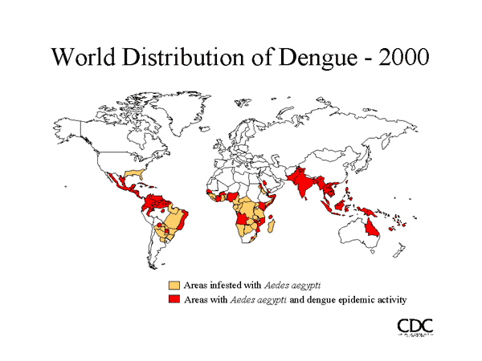

Slide 5
DEFINITION:
“an acute infectious disease caused by a flavivirus (speciesDengue virus of the genus Flavivirus), transmitted by aedes mosquitoes, and characterized by headache, severe joint pain, and a rash —called also breakbone fever, dengue fever”

Slide 6
“Dengue fever also known as break bone fever, is an infectious tropical disease caused by the dengue virus. Symptoms include fever, headache, muscle and joint pains, and a characteristic skin rash that is similar to measles. In a small proportion of cases the disease develops into the life-threatening dengue hemorrhagic fever, resulting in bleeding, low levels of blood platelets and blood plasma leakage, or into dengue shock syndrome, where dangerously low blood pressure occurs.”

Slide 7
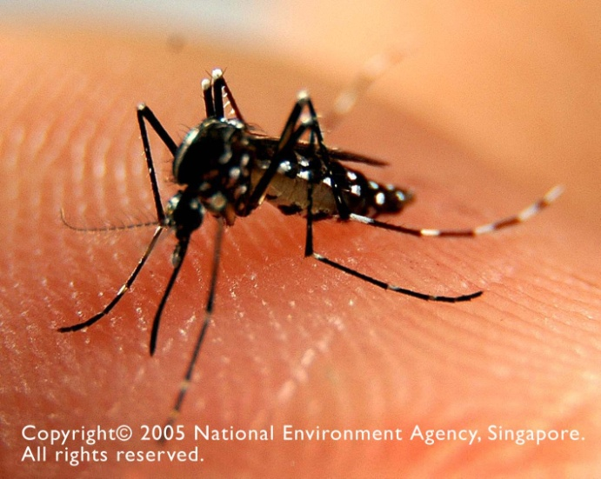
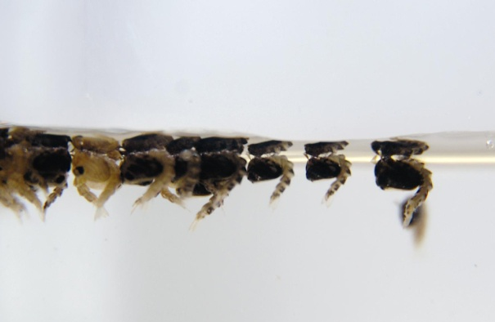
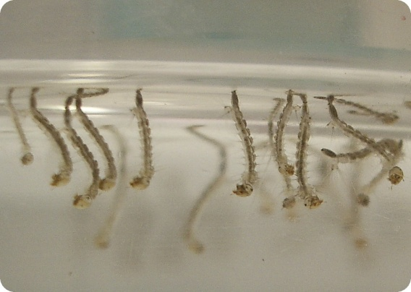
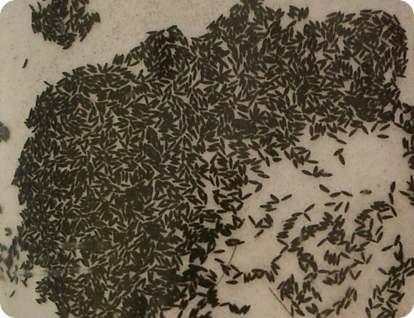
Life cycle of the Aedes Mosquito
1-2 days
Pupae
Larvae
Eggs
4-5 days
2-3 days
Stagnant water

Slide 8

How Do Aedes Mosquitoes Transmit Diseases...
Mosquito bites and sucks blood containing the virus from an infected person.
And passes the virus to healthy people when it bites them
Virus is carried in its body.

Slide 9

TYPES OF DENGUE VIRUS:
Types of dengue virus: DEN-1, DEN-2, DEN-3, and DEN-4. You can be infected by at least two if not all four types at different times during your life time, but once by the same time

Slide 10

RISK FACTORS:
Age: all groups are affected Pre-existing anti –dengue antibody,either caused by previous infection or to maternal antibodies passed to infants Higher risk in secondary infections Higher risk inlocations with two or more seroypes circulating simultaneously at high levels Living or traveling in tropical areas Prior infection with a dengue fever virus

Slide 11
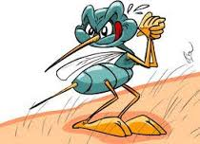
causes

Slide 12
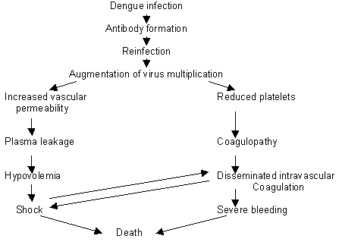
PATHO-PHYSIOLOGY

Slide 13
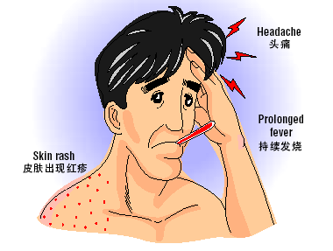
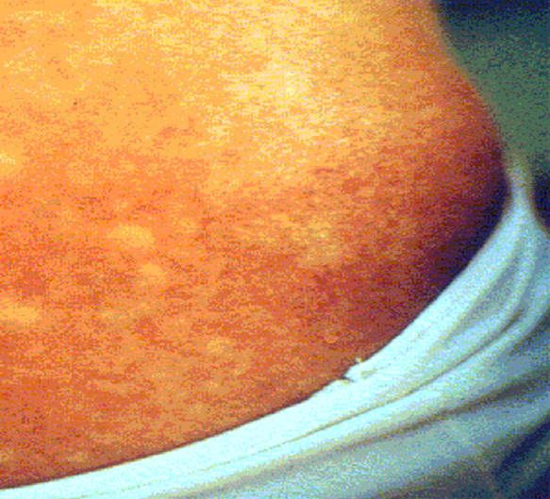
Symptoms of Dengue Fever
Example of a skin rash due to dengue fever

Slide 14
CLINICAL MENIFESTATION: [Simple/classicle dengue fever]
Sudden onset of high fever with feeling chills Severe headache, pain in muscle and joint Pain behind the eyeballs especially on passing the eyes or on moving the eyeballs Extremes weakness, loss of appetite Feeling of nausea Pain in abdomen by itself or on touching Mild pain in throat Swollen glands (lymphedenopathy) Patient feels generally depressed and very sick. Rash on the skin: pinkish red rash appears on the skin in the form of diffuse flushing.

Slide 15
Dengue Hemorrhagic fever: It should be suspected if with above mentioned symptoms of classical(simple) dengue fever, one or more of the following symptoms appears – Bleeding (hemorrhagic) manifestations: bleeding from nose, gums, blood in stool in vomiting, bleeding spot on the skin which are seen In as dark bluish-black, small or large patches. If health workers carry out a tourniquet tests, it is positive. Certain laboratory investigations carried out on a blood samples carried out on a blood sample also conformed DHF.

Slide 16
Dengue shock syndrome(DSS) A symptoms as mentioned above DHF are present plus the patient also develop a condition called as “shock” symptoms of shock in a dengue fever case are- The person is very restless and the skin feels cold and clammy despite high fever. The person may start losing consciousness. If you examine the pulse rate of the patient, it is weak and rapid. Similarly blood pressure getting low.

Slide 17
MANAGEMENT:
If it is the classical (simple) dengue fever, the patient can be managed at home. As it is self limiting disease, the treatment is purely supportive and symptomatic. Because dengue fever is caused by a virus, there is no specific medicine or antibiotic to treat it. For typical dengue, the treatment is purely concerned with relief of the symptoms (symptomatic). Rest and fluid intake for adequate hydration is important. Ringer’s solution or 5% dextrose in normal saline solution.

Slide 18
Aspirin and nonsteroidal anti-inflammatory drugs should be taken under a doctor’s supervision because of the possibility of worsening hemorrhagic complication. Acetaminophen (tylenol) and codeine may be given for severe headache and for the joint and muscle pain (myalgia). In case you suffers from dengue hemorrhagic fever, hospitalization is the only operation its where supportive treatments like intravenous fluid are administered to prevent the shock. In sever shock colloid fluid should be given at rate 10-20ml kg body/ weight/hour.

Slide 19
TREATMENT:
Mainly Supportive No hemorrhagic manifestations & well hydrated: patient sent home with instructions for “follow up” If hemorrhagic manifestations/hydration status borderline-patient observed in hospitals If warning signs are present even without evidence of shock or if DSS present-hospitalized Intravenous fluids with Electrolyte balance Antipyretics-acetaminophen(aspirin and NSAIDS should be avoided as they interfere with platelet function) H2 blockers, antiemetics (Domperidone)

Slide 20
Platelet and FFP transfusion when needed
Monitoring of BP, urine output, platelet count and hematocrit
Soft,balanced nutritious diet
Monitor CBC, LFTs, S/E, PT/APTT
When pulse pressure is ≤ 10 mmHg or when elevation of Hct persists after replacement of fluids; plasma or colloids are indicated
FFP & platelets for bleeding
No role of corticosteroids
Look for evidence of complications
Avoid hypervolaemia

Slide 21

DENGUE PREVENTION:
Do the 10-Minute Mozzie Wipe-out everyday.
Change water in vases on alternate days.

Slide 22
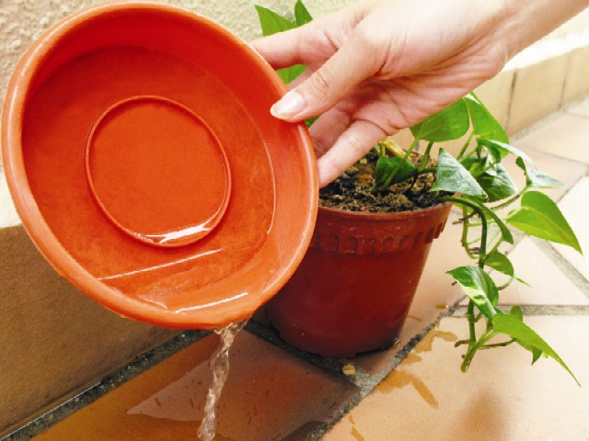
Remove water from flowerpot plates on alternate days.

Slide 23
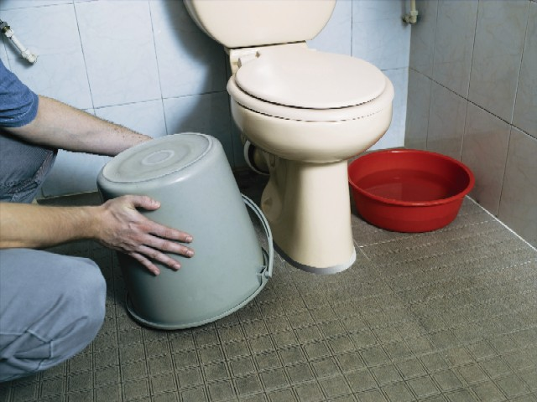
Turn over all pails and water storage containers.

Slide 24
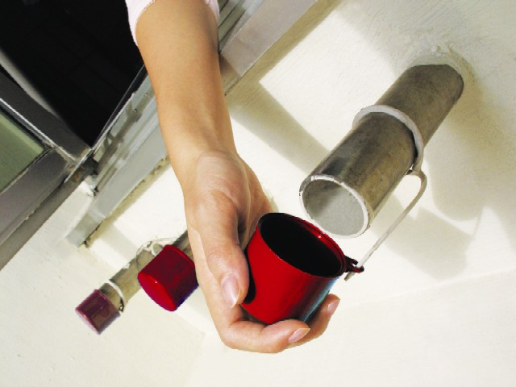
Cover bamboo pole holders when not in use.

Slide 25

Clear blockages and put Bti insecticide in roof gutters monthly.

Slide 26


Unwanted items
Do not litter. Rubbish such as cups and bottles can collect rain water and breed mosquitoes.

Slide 27
Nursing diagnosis: The increase in body temperature related to the process of dengue virus infection. Deficit fluid volume related to the migration of intravascular fluid in to extravascular. Impaired nutrition less than body requirement related to the decreased appetite. Fluid volume deficit related to active fluid loss. Hypovolumic shock related to hemorrhage. Risk for bleeding related to thrombocytopenia. Deficient knowledge: about the disease process related to lack of information.

Slide 28

Take good care of your health and avoid contract with Dengue Fever.
Good Health! Thank you!

