Slide 1

INTRODUCTION
Presented By:
MS.SONAL PATEL
Assistant Professor
Sumandeep Nursing College
Sumandeep Vidyapeeth Deemed to be university

Slide 2
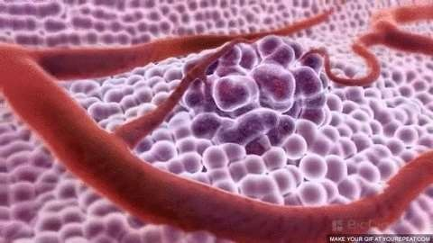
ONCOLOGICAL DISORDERS

Slide 3
MEANING
A serious disease
the body grow in a way that is uncontrolled
that is caused when cells in
and
not normal.
A disease caused by an uncontrolled division of abnormal cells in a part of the body.

Slide 4
Cancer can involve any tissue of the body and have many different forms in each body area.
Most cancers are named for the type of cell or organ in which they start.

Slide 5
DEFINITION:
An abnormal growth of cells which tend to proliferate in an uncontrolled way and, in some cases, to metastasize (spread).
A term for diseases in which abnormal cells divide without control and can invade nearby tissues.

Slide 6
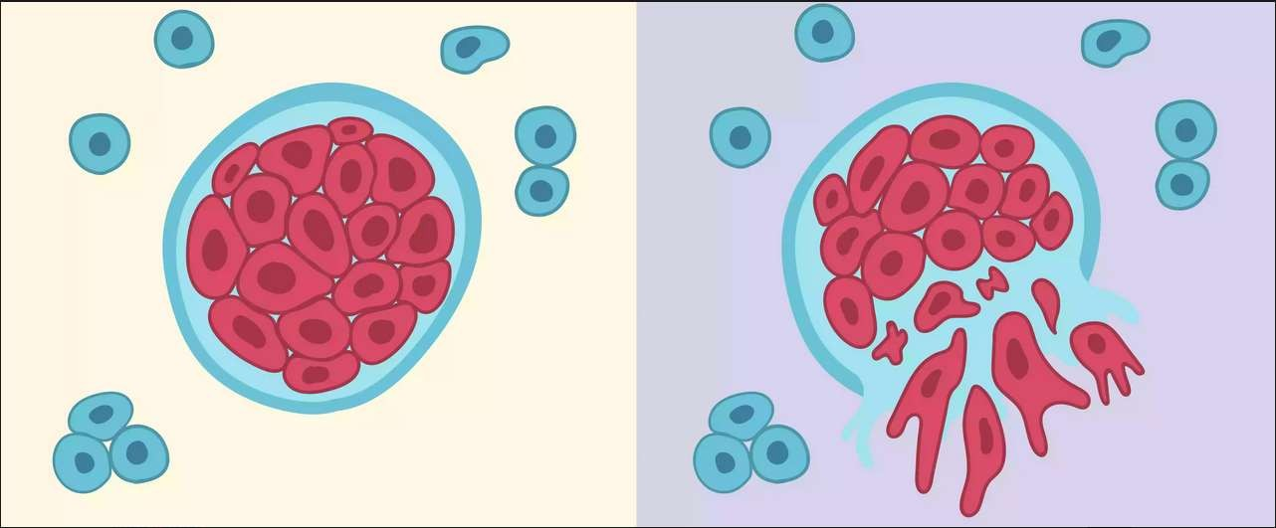
BENIGN / MALIGNANT

Slide 7
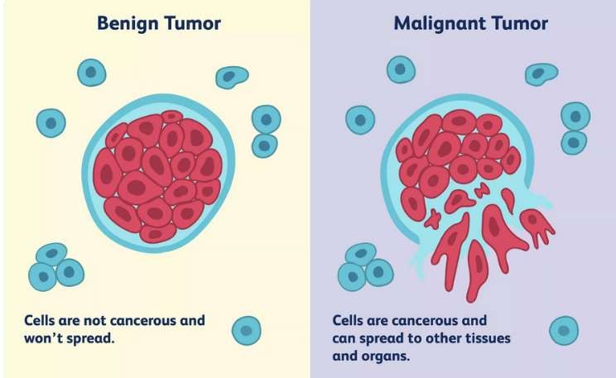

Slide 8
C H A R A C T E R I S T I C S O F B E N I G N A N D M A L I G N A N T
C A N C E R

Slide 9
CHARACTERISTICS OF BENIGN TUMORS
Cells tend not to spread
Most grow slowly
Do not invade nearby tissue
Do not metastasize (spread) to other parts of the body
Tend to have clear boundaries

Slide 10
Under a pathologist's microscope, shape, chromosomes, and DNA of cells appear normal
Do not secrete hormones or other substances (an exception: pheochromocytomas of the adrenal gland)
May not require treatment if not health threatening
Unlikely to recure if removed or require further treatment such as radiation or chemotherapy

Slide 11
CHARACTERISTICS OF MALIGNANT TUMORS
Cells can spread
Usually grow fairly rapidly
Often invade basal membrane that surrounds healthy tissue
Can spread via bloodstream or lymphatic system.
nearby

Slide 12
May recur after removal, sometimes in areas other the original site
Cells have abnormal chromosomes and DNA characterized by large, dark nuclei; may have abnormal shape
Can secrete substances that cause fatigue and weight loss (paraneoplastic syndrome)
May require aggressive treatment, including surgery, radiation, chemotherapy, and immunotherapy medications

Slide 13
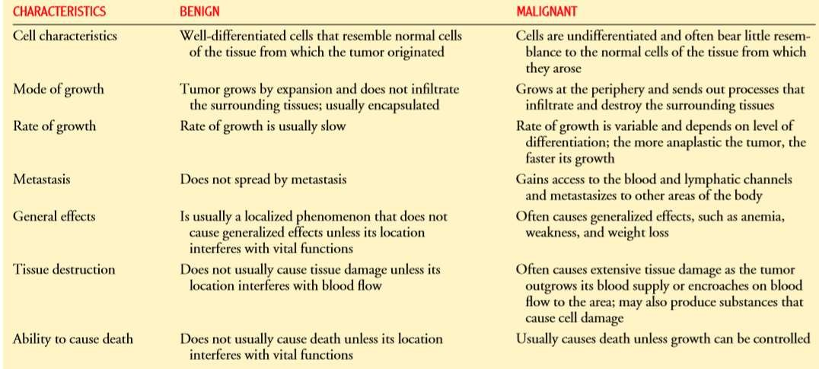

Slide 14
T U M O R S A N D T I S S U E T Y P E S

Slide 15
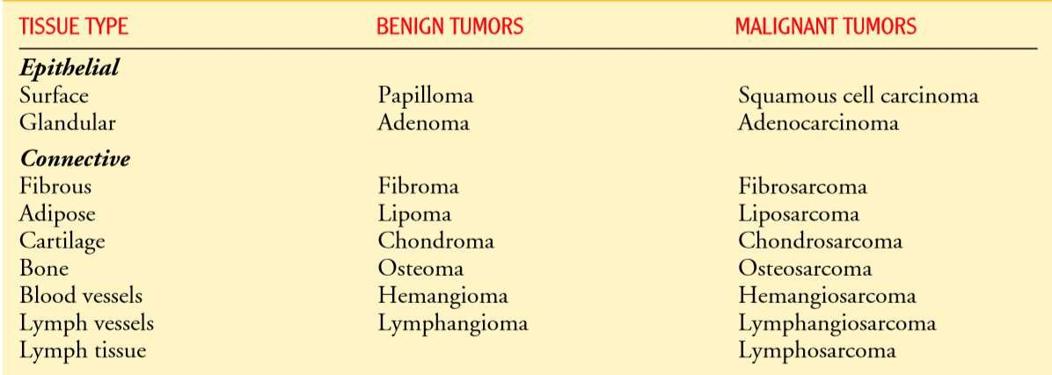

Slide 16
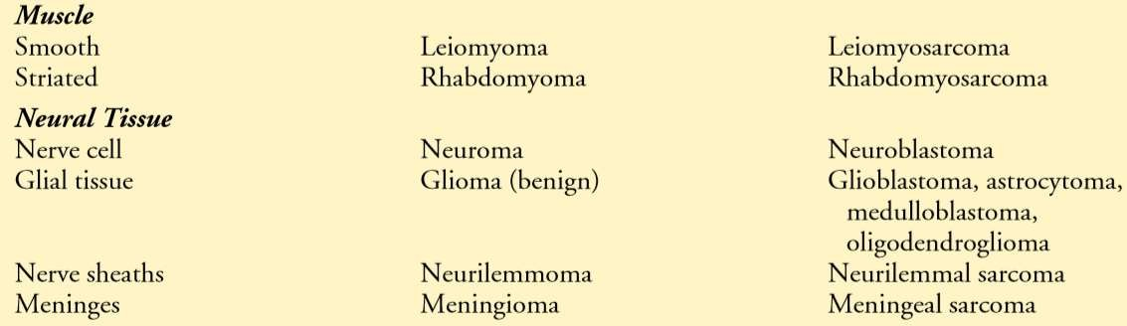

Slide 17
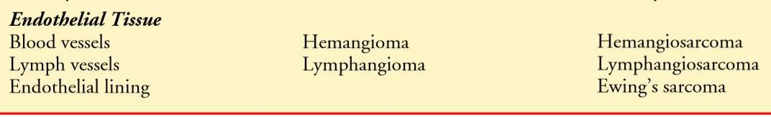

Slide 18
A M E R I C A N C A N C E R S O C I E T Y R E C O M M E N D A T I O N S F O R
E A R L Y D E T E C T I O N O F
C A N C E R I N A S Y M P T O M A T I C , A V E R A G E - R I S K P E O P L E

Slide 19
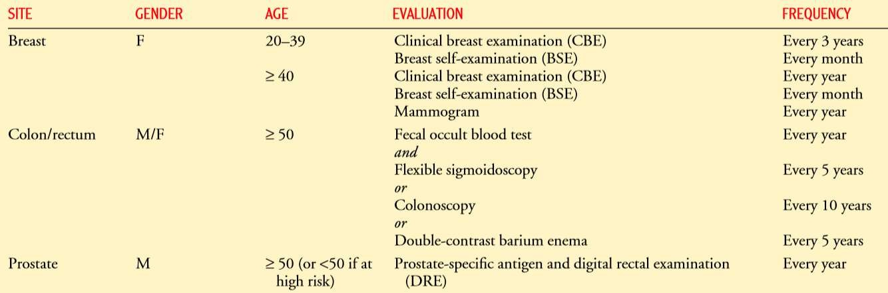

Slide 20
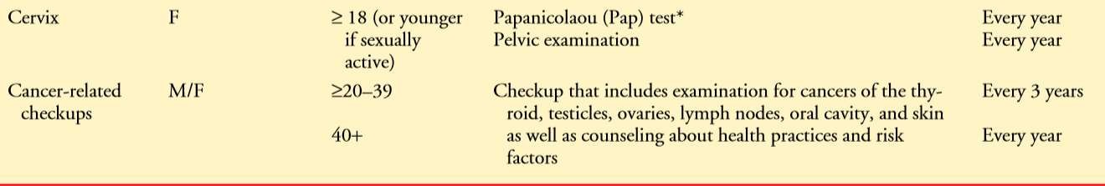

Slide 21
IMAGING TESTS USED TO DETECT CANCER
TEST : Tumor marker identiﬁcation
DESCRIPTION : Analysis of substances found in the blood or other body ﬂuids that are made by the tumor or by the body in response to the tumor
DIAGNOSTIC USES : Breast, colon, lungs, ovaries, testes, protest

Slide 22
TEST : Magnetic resonance imaging (MRI)
DESCRIPTION : Use of magnetic ﬁelds and radiofrequency signals to create sectioned images of various body structures
DIAGNOSTIC USES : Neurologic, pelvic, abdominal, thoracic cancers

Slide 23
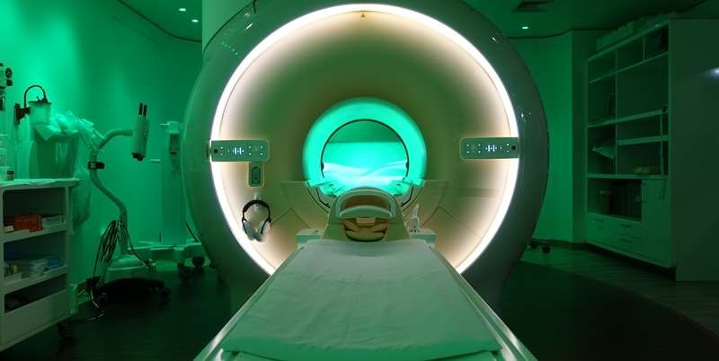

Slide 24
TEST : Computed tomography (CT scan)
DESCRIPTION : Use of narrow beam x-ray to scan successive layers of tissue for a cross-sectional view
DIAGNOSTIC USES : Neurologic, pelvic, skeletal, abdominal, thoracic cancers

Slide 25
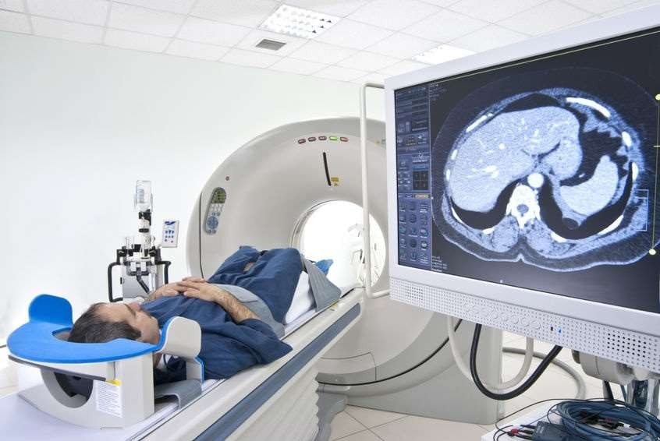

Slide 26
TEST : Fluoroscopy
DESCRIPTION : Use of x-rays that identify contrasts in body tissue densities; may involve the use of contrast agents
DIAGNOSTIC USES : Skeletal, lung, gastrointestinal cancers

Slide 27
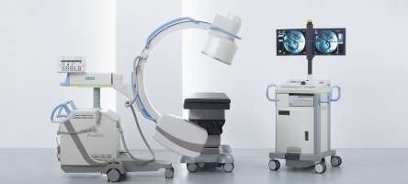

Slide 28
TEST : Ultrasonography (ultrasound)
DESCRIPTION : High-frequency sound waves echoing off body tissues are converted electronically into images; used to assess tissues deep within the body
DIAGNOSTIC USES : Abdominal and pelvic cancers

Slide 29
TEST : Endoscopy
DESCRIPTION : Direct visualization of a body cavity or passageway by insertion of an endoscope into a body cavity or opening; allows tissue biopsy, ﬂuid aspiration and excision of small tumors; both diagnostic and therapeutic
DIAGNOSTIC USES : Bronchial, gastrointestinal cancers

Slide 30
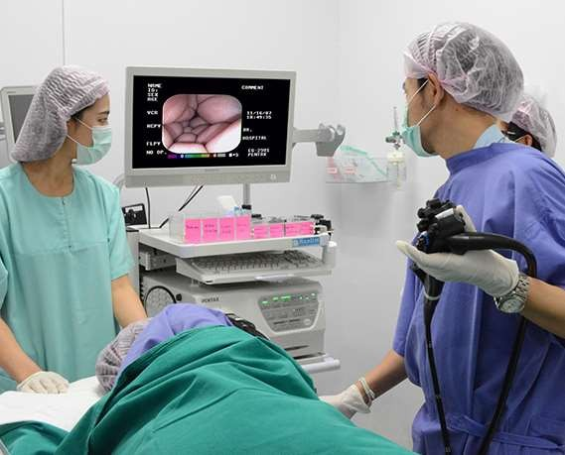

Slide 31
TEST : Nuclear medicine imaging
DESCRIPTION : Uses intravenous injection or ingestion of radioisotope substances followed by imaging of tissues that have concentrated the radioisotopes
DIAGNOSTIC USES : Bone, liver, kidney, spleen, brain, thyroid cancers

Slide 32
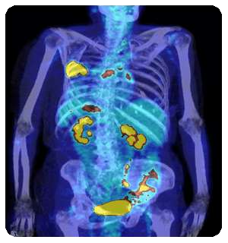

Slide 33
TEST : Positron emission tomography (PET scan)
DESCRIPTION : Computed cross-sectional images of increased concentration of radioisotopes in malignant cells provide information about biologic activity of malignant cells; help distinguish between benign and malignant processes and responses to treatment
DIAGNOSTIC USES : Lung, colon, liver, pancreatic, breast, esophagus cancers; Hodgkin’s and non-Hodgkin’s lymphoma and melanoma

Slide 34
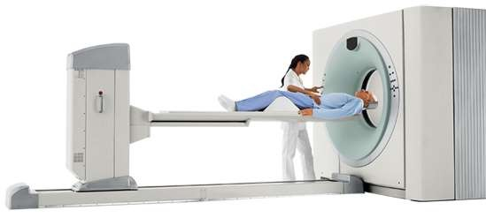

Slide 35
TEST : Radioimmunoconjugates (Radio-immuno-conjugates)
DESCRIPTION : Monoclonal antibodies are labeled with a radioisotope and injected intravenously into the patient; the antibodies that aggregate at the tumor site are visualized with scanners
DIAGNOSTIC USES : Colorectal, breast, ovarian, head and neck cancers; lymphoma and melanoma

Slide 36
WA R N I N G S I G N S O F C A N C E R

Slide 37

C A U T I O N

Slide 38
Change in bowel or bladder habits
A sore that does not heal
Unusual bleeding or discharge
Thickening or lump in the breast or elsewhere
Indigestion or difficulty in swallowing
Obvious change in a wart or mole
Nagging cough or hoarseness

Slide 39
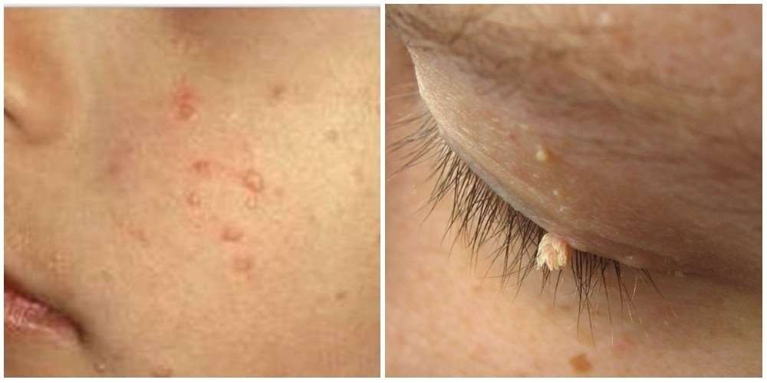

S

