Slide 1

SCHIZOPHRENIA
Prepared by:
Mrs. Bhoomika Patel
Assistant Professor
Department of Mental health nursing
Sumandeep Nursing college

Slide 2
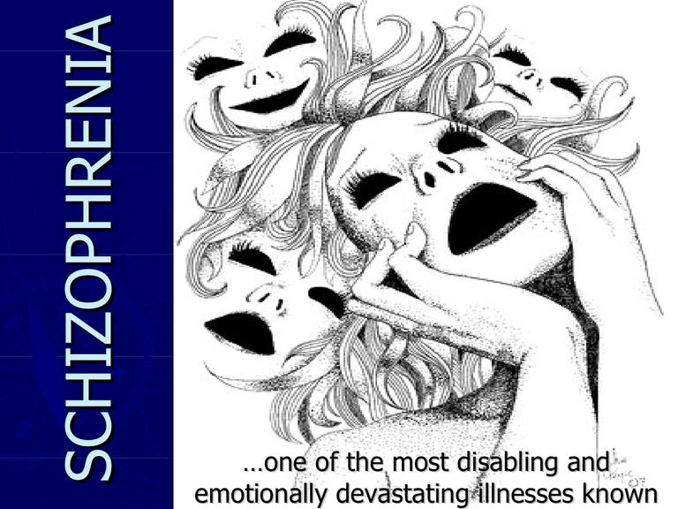

Slide 3
What is schizophrenia?
A chronic severe brain disorder; often they hear voices, believe media are broadcasting their thoughts to the world or may believe someone is trying to harm them.
In men it usually develops in teen years and early 20s; in women it usually develops in 20s and 30s.

Slide 4
History
Eugen Bleuler: He renamed the dementia praecox as schizophrenia (1911); he recognized the cognitive impairment in this illness, which he named as a “splitting“ of mind.
The term Schizophrenia origin from Greek roots SKHIZEN- Split and phren- mind
This disorder mainly affect cognition but also usually contributes to chronic problems with behavior and emotion.

Slide 5
DEFINITIONS
The schizophrenic disorders are characterized in general by fundamental and characteristic distortions of thinking and perception, and affects that are inappropriate or blunted. Clear consciousness and intellectual capacity are usually maintained although certain cognitive deficits may evolve in the course of time.

Slide 6
Schizophrenia is defined by
A group of characteristic positive and negative symptoms deterioration in social, occupational, or interpersonal relationships continuous signs of the disturbance for at least 6 months

Slide 7
Etiology of Schizophrenia
1. Biological
Biochemical, neurostructural, genetic and perinatal risk factors
A. Genetic:
  The disease is more common among people born of consanguineous marriage.
It is accepted, that schizophrenia which origin is multi factorial:
  internal factors – inborn, biochemical
  external factors – trauma, infection of CNS, stress
Twin and adoption study

Slide 8
B. biochemical - Dopamine Hypothesis
Excessive dopamine release
Mesolimbic system
  Increased level of dopamine in Mesolimbic system of brain. Or hyperactivity on this pathway is associated with positive symptoms of schizophrenia.
Mesocortical pathway:
  Deficit in dopamine in this pathway is associated with negative and cognitive symptoms of schizophrenia.

Slide 9
Nigrostriatal pathway:
  This is the part of extrapyramidal system and its controls motor movements.
  Blockade of D2 receptors cause deficiency in dopamine in this pathway leads to movement disorders such as Parkinson’s disease.
  Hyperkinetic disorder such as Tardive Dyskinesia.
Tuberoinfundibular pathway:
  Increased neuronal activity of this pathway inhibits Prolactin Release.

Slide 10
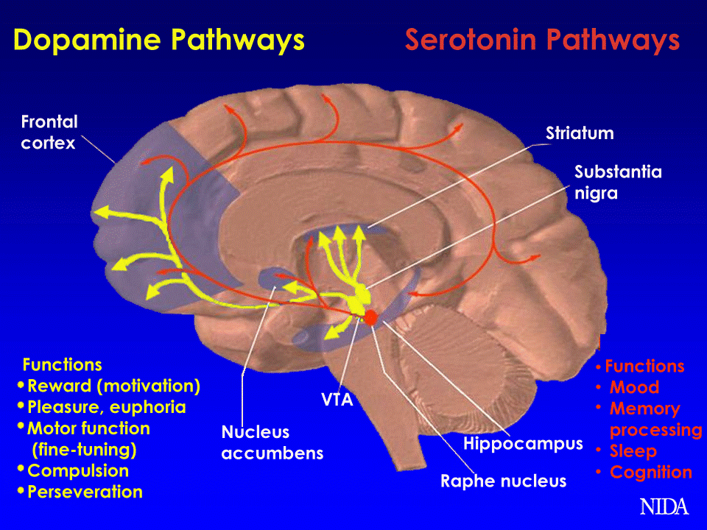

Slide 11
  Serotonin, nor epinephrine, serotonin, acetylcholine and Gaba, Neuroregulators (Prostaglandin, Endorphins)
C. NEUROSTRUCTURAL:
Prefrontal cortex and limbic cortex
Decreased brain volume, larger third and lateral ventricles, atrophy in frontal lobe, cerebellum and limbic structures.
Increased size of sulci on the surface
D. PERINATAL RISK FACTORS
Maternal influenza, birth during late winter or early spring, complications in delivery
Physical condition

Slide 12
2. PSYCHODYNAMIC
DEVELOPMENTAL THEORIES: Regression to the oral stage of psychosexual development by using Denial, projection and reaction formation. Poor ego, superego dominency, id behaviour
FAMILY THEORIES: MOTHER CHILD RELATIONSHIP, DYSFUNCTIONAL FAMILY SYSTEM, DOUBLE BLIND COMMUNICATION
3. VUNERABILITY STRESS MODEL
4. SOCIAL FACTORS

Slide 13
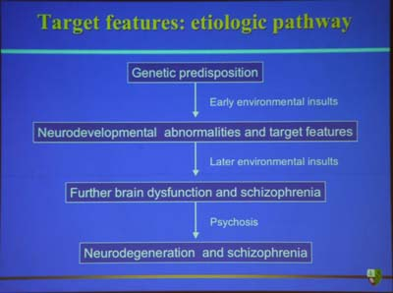

Slide 14
SCHINEIDER’S SYMPTOMS- 1959
AUDIBLE TTHOUGHTS OR THOUGHT ECHO
HALLUCINATORY VOICES
THOUGHT WITHDRAWAL
THOUGHT INSERTION
THOUGHT BROADCASTING
DELUSIONAL PERCEPTION
SOMATIC PASSIVITY
MADE VOLITION OR ACT, MADE IMPULSES
MADE FEELINGS OR AFFECT

Slide 15
SYMPTOMS: Bleuler’s four A- 1857-1939
AFFECTIVW DISTURBANCES
AUTISTIC THINKING
AMBIVALENCE
ASSOCIATIVE LOOSNESS

Slide 16
OTHER SYMPTOMS
Signs and symptoms of schizophrenia generally are divided into three categories — positive, negative and cognitive.

Slide 17
Positive symptoms
  Positive symptoms are psychotic behaviors not seen in healthy people. People with positive symptoms often "lose touch" with reality. These symptoms can come and go. Sometimes they are severe and at other times hardly noticeable, depending on whether the individual is receiving treatment.

Slide 18
POSITIVE SYMPTOMS
In schizophrenia, positive symptoms reflect an excess or distortion of normal functions. These active, abnormal symptoms may include:
DELUSIONS
HALLUCINATIONS
EXCITEMENT OR AGITATION
AGGRESSIVE BEHAVIOUR
SUSPICIOUSNESS
SUCIDAL TENDENCIES

Slide 19
Negative symptoms
Negative symptoms are associated with disruptions to normal emotions and behaviors. These symptoms are harder to recognize as part of the disorder and can be mistaken for depression or other conditions.
ALOGIA (POVERTY OF SPEECH)
AFFECTIVE FLATTENING
ANHEDONIA (INABILITY TO EXPERIENCE THE PLEASURE)
ASSOCIALITY (LACK OF DESIRE TO FORM RELATIONSHIP)
AVOLITION (LACK OF MOTIVATION)
ATTENTION IMPAIRMENT

Slide 20
"Flat affect" (a person's face does not move or he or she talks in a dull or monotonous voice)
Lack of pleasure in everyday life
Speaking little, even when forced to interact.
People with negative symptoms need help with everyday tasks. They often neglect basic personal hygiene. This may make them seem lazy or unwilling to help themselves, but the problems are symptoms caused by the schizophrenia.
Negative symptoms respond less well to medication comparatively to the positive symptoms.

Slide 21
Cognitive symptoms
Cognitive symptoms are subtle. Like negative symptoms, cognitive symptoms may be difficult to recognize as part of the disorder. Often, they are detected only when other tests are performed. Cognitive symptoms include the following:
Poor "executive functioning" (the ability to understand information and use it to make decisions)
Trouble focusing or paying attention
Problems with "working memory" (the ability to use information immediately after learning it).

Slide 22
Types of Schizophrenia
Paranoid
Hebephrenic
Catatonic
Residual
Schizoaffective
Undifferentiated

Slide 23
Paranoid Schizophrenia
Persons are very suspicious of others and often have grand schemes of persecution at the root of their behavior.
For example, they may believe that others are deliberately:
Cheating them
Harassing them
Poisoning them
Spying upon them
DELUSION OF PERSECUTION, JEALOUSY, GRANDIOSITY, HALLUCINATORY VOICES

Slide 24
Hebephrenic Schizophrenia (or) Disorganized Schizophrenia
Disorganized schizophrenia; characterized by emotionless, incongruous, or silly behavior, intellectual deterioration, frequently beginning insidiously during adolescence.
May be verbally incoherent and may have moods and emotions that are not appropriate to the situation.
SENSLEES GIGGLING, MIRRORGAZING,GRIMACING,MANNERISMS
Hallucinations not usually present, WORST PROGNOSIS

Slide 25
Catatonic Schizophrenia
Person is extremely withdrawn, negative and isolated.
People with this type of schizophrenia can be clumsy and uncoordinated. They may also show involuntary movements, grimacing, or unusual mannerisms. They may repeat certain motions over and over or, in extreme cases, may become catatonic.
IT INCLUDE CATATONIC STUPOR, CATATONIC EXCITEMENT AND ALTERNATING BETWEEN TWO.

Slide 26
CATATONIC EXCITMENT
INCREASE IN PSYCHOMOTOR ACTIVITY
INCREASE IN SPEECH PRODUCTION
LOOSENING OF ASSOCIATION
SOMETIMES RIGIDITY, HYPERTHERMIA, AND DEHYDRATION LEADS TO DEATH
KNOWN AS ACTUAL LETHAL CATATONIA OR PERNICIOUS CATATONIA

Slide 27
CATATONIC STUPOR
MUTISM
RIGIDITY
NEGATIVISM
POSTURING
STUPOR
ECHOLALIA
ECHOPRAXIA
WAXY FLEXIBLITY
AMBITENDENCY
AUTOMATIC OBEDIENCE

Slide 28
Schizoaffective Disorder
There will be symptoms of schizophrenia as well as mood disorder (depression, bipolar, mixed mania).

Slide 29
Undifferentiated Schizophrenia
Conditions meeting the general diagnostic criteria for schizophrenia but not conforming to any of the previous types.
Exhibits more than one of the previous types without a clear dominance of one.

Slide 30
Residual Schizophrenia
Lacks motivation and interest in day-to-day living.
Person is not usually having delusions, hallucinations or disorganized speech.

Slide 31
With this schizophrenia type, a person no longer shows positive symptoms (hallucinations, delusions, disorganized speech, and grossly disorganized or catatonic behavior), but still shows negative symptoms, which can include:
Flat affect (for example, immobile facial expression and monotonous voice)
Lack of pleasure in everyday life
Diminished ability to initiate and sustain planned activity
Speaking infrequently, even when forced to interact.
People with residual schizophrenia often neglect basic hygiene and need help with everyday living activities.

Slide 32
SIMPLE SCHIZOPHRENIA
EARLY AND INSIDIOUS ONSET
NEGATIVE SYMPTOMS, BAGUE HYPOCHONDRICAL FEATURES, WANDERING TENDENCY, AIMLESS ACTIVITY
NO ANY EPISODE OF PROMINENT SYMPTOMS
THE PROGNOSIS IS VERY POOR

Slide 33
Tests and diagnosis
When doctors suspect someone has schizophrenia, they typically ask for medical and psychiatric histories, conduct a physical exam, and run medical and psychological tests and exams. These tests and exams generally include:
Laboratory tests. These may include a complete blood count (CBC), other blood tests that may help to rule out other conditions with similar symptoms, screening for alcohol and drugs, and imaging studies, such as an MRI or CT scan.

Slide 34
Psychological evaluation.
A doctor or mental health provider will check mental status by observing appearance and demeanor and asking about thoughts, moods, delusions, hallucinations, substance abuse, and potential for violence or suicide.

Slide 35
Diagnostic criteria for schizophrenia
To be diagnosed with schizophrenia, a person must meet the criteria spelled out in the Diagnostic and Statistical Manual of Mental Disorders (DSM). This manual is published by the American Psychiatric Association and is used by mental health providers to diagnose mental conditions.
Diagnosis of schizophrenia involves ruling out other mental health disorders and determining that symptoms aren't due to substance abuse, medication or a medical condition. In addition, a person must:

Slide 36
Have at least two of the common symptoms of the disorder — delusions, hallucinations, disorganized speech, disorganized or catatonic behavior, or presence of negative symptoms for a significant amount of time during one month
Experience significant impairment in the ability to work, attend school or perform normal daily tasks
Have had symptoms for at least six months

Slide 37
There are several subtypes of schizophrenia, but not everyone easily fits into a specific category. The five most common subtypes are:
Paranoid. Characterized by delusions and hallucinations, this type generally involves less functional impairment and offers the best hope for improvement.
Catatonic. People with this subtype don't interact with others, get into bizarre positions, or engage in meaningless gestures or activities.

Slide 38
Disorganized. Characterized by disorganized thoughts and inappropriate expressions of emotion, this type generally involves the most functional impairment and offers the least hope for improvement.
Undifferentiated. This is the largest group of people with schizophrenia, whose dominant symptoms come from more than one subtype
Residual. This type is characterized by extended periods without prominent positive symptoms, but other symptoms continue.

Slide 39
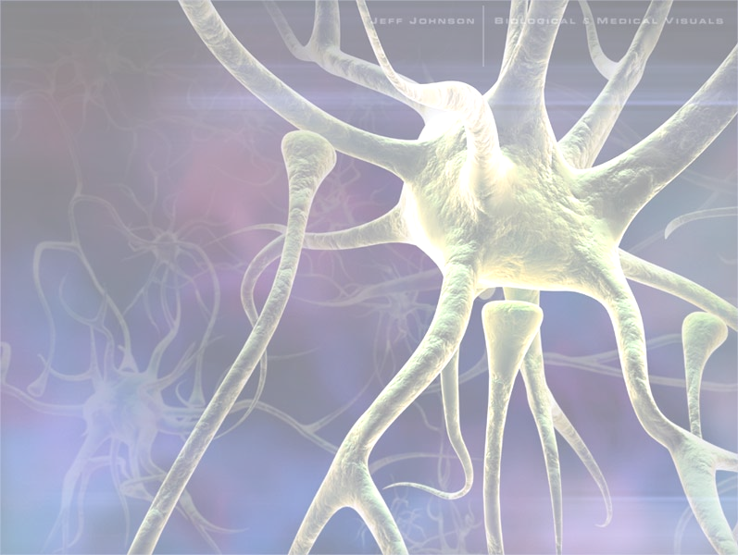
Management of schizophrenia
Typical Antipsychotics
  Dopamine antagonists
Atypical Antipsychotics
  5-hydroxytryptamine effect, also effect dopamine
Combination Drugs

Slide 40
Typical
Tend to produce Extrapyramidal side effects:
  Parkinsonism – tremors, rigidity, slowness of movement, temporary paralysis
  Dystonia
  Akathisia
  Tardive dyskinesia – involuntary movements of the mouth, lips, and tongue
    Chewing, grimacing, etc.

Slide 41
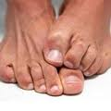
Akathisia

Slide 42
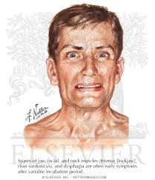
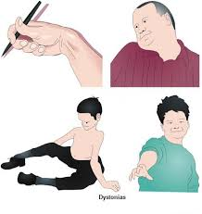
Dystonia

Slide 43
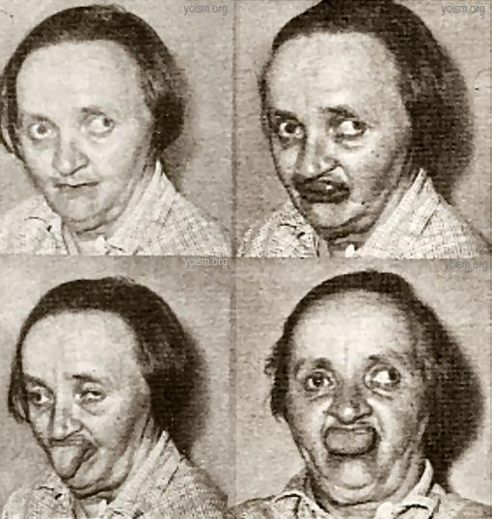
Tardive dyskinesia

Slide 44
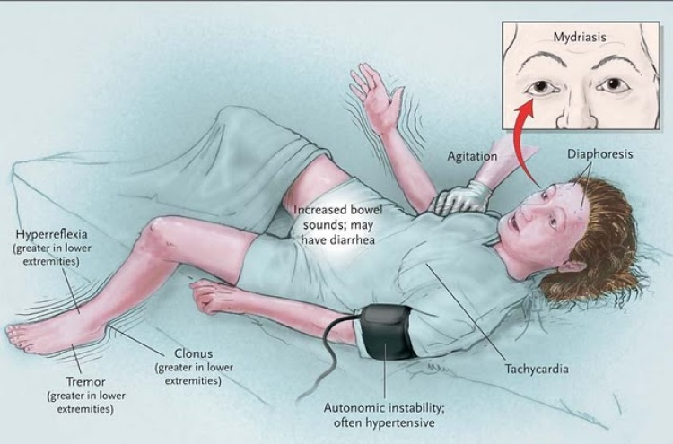
Neuroleptic malignant syndrome

Slide 45
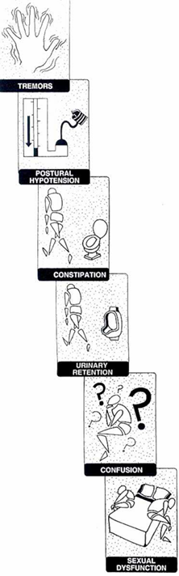
Others

Slide 46
Typical - Phenothiazines
Dopamine D2 receptor antagonists
Chlorpromazine first developed from promethazine, first tricyclic antihistamine
Haloperidol
Used in 1970s almost exclusively
No anticholinergic effects – therefore used in patients with delirium

Slide 47
Atypicals
Tablets | Trade Name | Usual daily dose (mg) | Max. daily dose (mg)
Amisulpride | Solian | 50-800 | 1200
Aripiprazole | Abilify | 10-30 | 30
Clozapine | Clozaril | 200-450 | 900
Olanzapine | Zyprexa | 10-20 | 20
Quetiapine | Seroquel | 300-450 | 750
Risperidone | Risperdal | 4-6 | 16
Sertindole | Serdolect | 12-20 | 24
Zotepine | Zoleptil | 75-200 | 300

Slide 48
Atypicals
Atypicals do not induce EPSE
Block D2 receptors and 5-HT seratonin receptors (decreases EPSE)
As opposed to typicals, these are more loosely bound to D2 receptors
  Easier dissociation
  Shown that higher occupation of D2 receptors by drug, higher incidence of EPSE

Slide 49
5-HT seratonin receptors
Blocking 5-HT seratonin receptors decreases negative symptoms and EPSE
  Mechanism is unknown
  Seratonin inhibits dopamine release
  Positive symptoms associated with hyperdopaminergic condition in limbic lobe – more D2 receptors here, so D2 blocking prevails
  Negative symptoms associated with hypodopaminergic condition in frontal lobe – more 5-HT receptors here, so seratonin inhibits dopamine release – stabilizes dopamine level

Slide 50
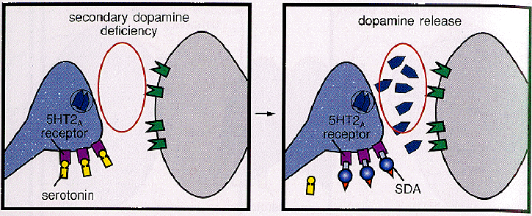

Slide 51
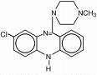
Clozapine
First atypical (1990)
Most dangerous atypical: risk of agranulocytosis (severe decrease in WBC count)
Most effective in reducing EPSE, also in reducing negative symptoms
  Increases Fos-positive neurons in the prefrontal cortex (shown to affect negative symptoms)

Slide 52

Risperidone
Low doses needed
Predominantly blocks D2, then 5-HT
  Does not exhibit multireceptor action
Lacks anticholinergic activity – makes it better for youth, elderly
Problem – increases prolactin levels (shouldn’t give to people with breast cancer)

Slide 53
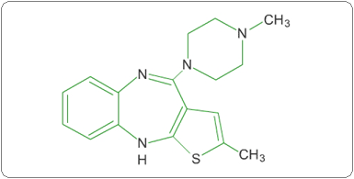
Olanzapine
Zyprexa is number one antipsychotic in sales (Eli Lilly)
Exhibits multireceptor action
Good for controlling mood symptoms
Problems: Sedation and
weight gain

Slide 54
Combinations
Example is Symbyax
  Combination of olanzapine and fluoxetine (Prozac)
  Can also treat bipolar disorder
Combination of ziprasidone and clozapine
  Can be used to combat treatment resistance
Combination of aripriprazole and clozapine
Eletroconvulsive therapy

Slide 55
Psychological therapies
Group therapy (Social interaction)
behavior therapy (To increase appropriate behavior)
Social skill training (Training behavior such as eye to eye contact, facial expression etc through Role play)
Cognitive thinking (reducing distractibility and correcting judgment)
Family therapy (A brief program of family education about schizophrenia )

Slide 56
Psychosocial rehabilitation
This includes the activity therapy to develop the work habit, training in a new vocation or retraining in the previous skills.

Slide 57
Nursing diagnosis
Disturbed thought process related to inability to trust, panic anxiety, heredity or biochemical factors as evidenced by delusional thinking.
Disturbed sensory perception (Auditory) related to panic anxiety or biochemical factors as evidenced by inappropriate responses.
Ineffective health maintenance related to inability to trust, extreme suspiciousness as evidenced by poor intake of food.

Slide 58
Self-care deficit related to withdrawal, regression, panic anxiety, cognitive impairment, inability to trust evidenced by difficulty in carry out the task, hygiene, dressing, eating and sleeping.
Potential for violence, self directed or at others related to command hallucination evidenced by physical violence.
Risk for self-inflicted related to command hallucination evidenced by suicidal ideas.

Slide 59
Social isolation related to inability to trust, panic anxiety, delusional thinking as evidenced by withdrawal.
Impaired verbal communication related to panic anxiety, unrealistic thinking evidenced by poor eye to eye contact.
Ineffective family coping related to impaired family communication as evidenced by neglectful care of patient.

Slide 60
Thank
you

