Slide 1
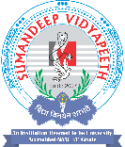
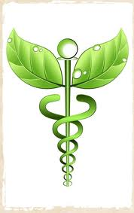
Altenative modalities of care, alternative system of heaLth and complimentory therapy
PRESENTED BY:
PARITA JAYSWAL

Slide 2
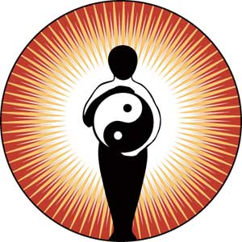
Altenative modalities of care, alternative system of heaLth and complimentory therapy

Slide 3
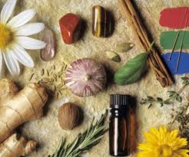
HISTORY
History has it that alternative
medicine goes back 5000 years to Chinese traditional medicine, Indian (Ayuryedic medicine) and similar healing traditions in many cultures.
The common belief was that the energy of the body had to be in harmony with the mind, body and spirit..
One of the oldest of medication that has been prevalent in the ancient world for thousands of years is "Alternative Medicine
The concepts of alternative medicines were mentioned in the ancient scriptures of India, China, Egypt and almost all ancient civilizations of the world.

Slide 4
Alternative Medicine in the East
In India, the alternative medicines were known as Vedic medicines or Ayurveda.
medicine was practiced for centuries and its concept is based on Taoist philosophy.
In China, "acupuncture" is used to treat various orthopedic and neurological ailments and is popular even today
Alternative Medicine in the west
In the western world, alternative medicine is divided into European alternative medicinal practice and American therapy.
The alternative medicine was practiced in Europe as herbalism, hydrotherapy using water and naturopathy.
A German doctor Samuel Hahnemann introduced homeopathy in the 19th century.
Alternative medicine therapies were practiced in American also. A health movement known as "herbalism" prevailed in this continent around 500 years ago.

Slide 5
GENERAL TERMS
  The term "alternative medicine" is generally used to describe practices used independently or in place of conventional medicine.
  Term "complementary medicine" is primarily used to describe practices used in conjunction with or to complement conventional medical treatments.
  Alternative/Complementary modalities have been defined as treatment techniques whose goals are to evoke healing, taking into account the body-mind-spirit connection of every individual - Dossey, 1995
  It is a group of diverse medical and health care system, practices, therapies and procedures that are not presently considered to be part of conventional medicine.
  “Complementary and Alternative Medicine (CAM) is a broad domain of resources that encompasses health systems, modalities, and practices and their accompanying theories and beliefs, other than those intrinsic to the dominant health system of a particular society or culture in a given historical period

Slide 6
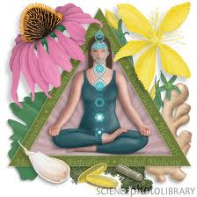
Reasons to use alternative therapies:
    Poor prognosis
    Focus of care is comfort not cure
    Desire to be more active in one’s
    own health care
    Reduce side effects of treatment
    Reduce side effects of disease
    Desire to cover all the options
    Suggestions be family, friends and society
    Philosophical or cultural orientation
    Less expensive than conventional medicine
    Easier access to health food stores than physician
    Dissatisfaction with or loss of trust in conventional medicine
    Desire to treat the disease in a natural way
    Decrease the feelings of hopelessness and helplessness
    Improve the immune system
    Improve the quality of life

Slide 7
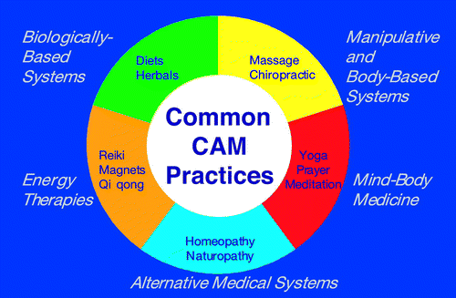
Classification

Slide 8
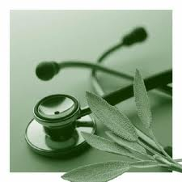
AYUSH
Ayush Annual Kavach –
The Annual Health Kavach is
a year long health plan that protects you, the authentic way.
A combination of diet and lifestyle advice with therapeutic yoga and a range of cleansing and balancing therapies customized to correct imbalances in your body.
These imbalances are caused by the changing seasons and build up of stress due to your hectic lifestyle

Slide 9
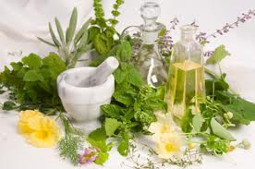
AYURVEDA
two words, Ayu and Veda. Ayu
means life and Veda means
knowledge or science.
Ayurveda is a science dealing not only with treatment of some diseases but is a complete way of life.
Ayurvedic Medicine has become an increasingly accepted alternative medical treatment in America during the last two decades. Two ancient books on palm leaves are first books written for Ayurveda (i.e. Charak Samhita, Charak susruta)
Ayurveda and variations of it have also been practiced for centuries in Pakistan, Nepal, Bangladesh, Sri Lanka, and Tibet

Slide 10
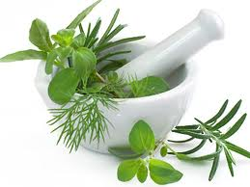
indications
Ayurvedic treatment is non-invasive and non-toxic, so it can be used safely as an alternative therapy or alongside conventional therapies.
Ayurveda has been used to treat acne, allergies, asthma, anxiety, arthritis, chronic fatigue syndrome, colds, colitis, constipation, depression, diabetes, flu, heart disease, hypertension, immune problems, inflammation, insomnia, nervous disorders, obesity, skin problems, and ulcers.

Slide 11
Constitution (Prakriti) and health
Vata dosha;
combination of the elements space and air.
Most powerful dosha because it controls very basic body processes such as cell division, the heart, breathing, and the mind
People with vata dosha are more susceptible to skin, neurological and mental diseases.
Pitta dosha:
Elements fire and water.
Control hormones and the digestive system.
People with Pitta are more susceptible to heart diseases and arthritis.
Kapha dosha:
Elements water and earth
Help to keep up strength and immunity and to control growth
People with kapha dosha are more susceptible to gallbladder problems, stomach ulcers, and respiratory illnesses such as asthma.

Slide 12
Concept and Principles
The Body Matrix
The living man is a conglomeration of three humours (Vata, Pitta &Kapha), seven basic tissues (Rasa, Rakta, Mansa, Meda, Asthi, Majja & Shukra) and the waste products of the body such as faeces, urine and sweat. Thus the total body matrix comprises of the humours, the tissues and the waste products of the body.
Panchamahabhutas
composed of five basic elements (Panchamahabhutas) namely, earth, water, fire, air and vacuum(ether).
Health and Sickness
Health or sickness depends on the presence or absence of a balanced state of the total body matrix including the balance between its different constituents
Treatment
Panchkarma procedures, medicines, suitable diet, activity and regimen for restoring the balance and strengthening the body mechanisms to prevent or minimize future occurrence of the disease.

Slide 13
Types of Treatment
Shodhana therapy (Purification Treatment)
Shamana therapy (Palliative Treatment)
Pathya Vyavastha (Prescription of diet and activity)
Nidan Parivarjan (Avoidance of disease causing and aggravating factors)
Satvavajaya(Psychotherapy)
Rasayana therapy(use of immunomodulators and rejuvenation medicines)

Slide 14
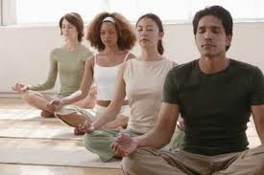
YOGA:
YOGA:
Derived from Sanskrit word: Yuj- to unite or to control.
includes postures (asana), breathing exercises (pranayama), and cleansing practices (kriyas)Yoga is an ancient Indian practice using physical postures to obtain a harmony of mind, body and spirit.
BENEFITS
Increased oxygenation of the blood
Muscle toning throughout the body
A clearer and more relaxed mind
Improved posture
Improved circulation of blood and
lymph
Regulation of bodily functions

Slide 15
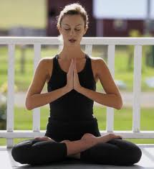
Goal
It range from improving health and fitness, to reaching Moksha.
Main branches of Yoga:
Hatha Yoga- Yoga of purifying physical and mind
Karma Yoga- Yoga of action
Jhana Yoga- Yoga of knowledge
Bhakti Yoga- Yoga of devotion
Raja Yoga- Yoga of controlling mind.
Eight Limbs of yoga practice are:
Yama Niyama
Asna Pranama
Pratyahara Dharna
Dhyana Samad

Slide 16
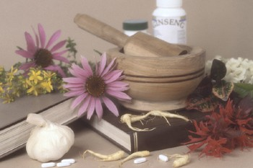
Unani
It is influenced by Islam.
'Unani' means medicines which are a symbol of life. The name is derived from the word 'Ionian' which originated in Greece. 'Tibb' means the knowledge of the states of the human body in health and decline of health, or in other words, medicine
Unani medicine believes that diseases can be kept at bay by the use of clean and fresh water, breathing clean air and consuming fresh food.

Slide 17
Specialized branches of Unani medicine –
Internal medicine ( Moalijat )
Gynecology including Obstetrics and Pediatrics
Diseases of the head and neck
Toxicology
Psychiatry
·Rejuvenation Therapy including Geriatrics
Sexology
Regimental Therapy
· Dietotherapy
· Hydrotherapy

Slide 18
7 natural and basic components
Arkan (Elements)
Mizaj (Temperament)
Akhlaat (Humours)
Aaza (Organs)
Arwah (Vital forces or Neuro)
Quwa (Faculties)
· Afaal (Functions)

Slide 19
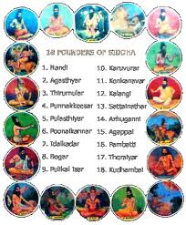
SIDDHA
a traditional medical system of India.
It is of Dravidian origin and has its entire
literature in Tamil language. The basic
concepts of the Siddha medicine are the same
as those of Ayurveda.
The tantrik siddhi was thought of in different forms such as janmaja (due to birth), osadhija (due to some medical elixirs), mantraja (due to magical incantations), tapoja (due to penance) and samadhija (due to meditation).
. According to tradition, there were 18 Siddhars among them Agasthiyar (Agastya) was the topmost
In the Siddha medicine system use of metals, minerals and chemical products is predominant
Siddha system which was connected with the Tantrik culture, aimed at perfection of man not only at the spiritual level but also at the physical level. The use of human urine in medicine also started with the Tantrik culture and became popular in the medieval period
Notes:
According to the tradition, Lord Shiva conveyed the knowledge of medicine to his wife Parvati. The knowledge was passed from her to Nandi and finally it was given to the Siddhas. The word Siddha denotes one who has achieved some extraordinary powers (siddhi). This achievement was related to the discipline of mind and its superiority over body, and was accomplished through both yoga and medicine. Thus siddhars (practitioners of Siddha) became the symbols of psychosomatic perfection and so the Siddha medicine became a combination of medicine and yoga.

Slide 20
The drugs used by the Siddhars
It could be classified into three groups:
thavaram (herbal product),
thathu (inorganic substances) and
jangamam (animal products).
Concept of Treatment
The treatment in Siddha medicine is aimed at keeping the three humors in equilibrium and maintenance of seven elements. So proper diet, medicine and a disciplined regimen of life are advised for a healthy living and to restore equilibrium of humors in diseased condition.

Slide 21
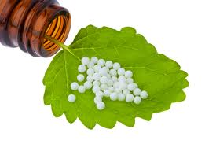
    HOMEOPATHIC MEDICINE
The treatment is based on the principle, “Like cures like”.
Homeopathic medicine are taking original substance from plants, animals and minerals and highly diluting them. It is believed that body’s own healing ability is stimulated by these medicines. They are sold over the counter without prescription. They are so light that they are considered to have very less side effects.

Slide 22
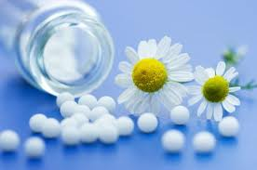
HISTORY
Homeopathy's roots emerge from the findings, teachings and writings of Dr. Samuel Hahnemann (1755-1843). Hahnemann graduated from medical school in 1779 and started his own medical practice. He soon began his first homeopathic experiments in 1790, as a result of his disillusionment with such common medical practices of the day as purging, bloodletting, and the use of toxic chemicals.

Slide 23
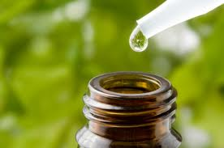
Preparation of medicine
Homeopathic remedies are
Prepared serial dilution with shaking
by forceful striking on an elastic body, which homeopaths term "succussion". Each dilution followed by succussion is assumed to increase the effectiveness. Homeopaths call this process "potentization". Dilution often continues until none of the original substance remains.^{[6]} Apart from the symptoms, homeopaths examine aspects of the patient's physical and psychological state,^{[7]} then homeopathic reference books known as "repertories" are consulted, and a remedy is selected based on the totality of symptoms.

Slide 24
TRADITIONAL CHINESE MEDICINE
TCM view the people as ecosystem in miniature.
Diagnosis is based on examination of the person’s complexion, tongue, radial pulse and detection of scent in the body, and the treatment is geared towards correcting the imbalance and is given with acupuncture and herbal therapy.

Slide 25
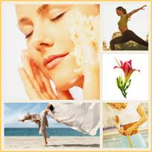
NATUROPATHIC MEDICINE
It cures the disease by harnessing the
body’s own natural healing powers. Rejecting synthetic drugs and invasive procedures, it stresses the restorative powers of nature. It takes seriously the motto, “First, do no harm.” It relies on natural healing approaches such as herbs, nutrition, and movement and manipulation of the body.
Naturopathy – such as the importance of diet, clean fresh water, sunlight, exercise and stress management

Slide 26
Naturopathy aims to
Minimise acute symptoms
Support the body’s vital force (capacity to self-heal)
Re-balance the system so that illness is less likely to occur in the future
Educate the patient to look after their own health and the health of their family.
Commonly treated disorders
Basic Principles
The body has a natural drive to maintain the equilibrium, symptoms of disease are viewed and indications that the body is striving to heal it.
The root cause of all diseases is the accumulation of waste product and toxin due to lifestyle habits.
The body contains the wisdom and power to heal itself, provided serves to enhance its power.

Slide 27
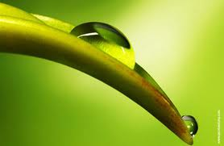
The range of disorders commonly treated by naturopaths includes:
Fatigue
Digestive complaints
Mood disorders and depression
Allergy and sensitivities
Behavioural problems
Chronic fatigue syndrome
Degenerative illnesses, such as arthritis
Cardiovascular problems-blood pressure
Fertility problems
10. Hormonal imbalances, such as
premenstrual tension and
menopause.

Slide 28
Non-Invasive Treatment
Nutrition and dietary advice – This is one of naturopathy’s foundations. A poor diet stops the body from functioning well and a build-up of toxins can contribute to a range of illnesses. Whole, fresh and unprocessed foods are recommended.
Herbal medicine – herbs are as potent as pharmaceutical drugs and can be used to great effect.
Homeopathy – homeopathic treatments are used to stimulate the immune system.
Hydrotherapy (water therapy) – another foundation of naturopathy. For instance, the use of hot and cold compresses might be used for certain disorders to influence the flow of blood and body heat.
Physical therapies – such as massage, acupressure, bio-puncture or mechanotherapy. Kinesiology and integrated bio-dynamics (IBD).

Slide 29
    AMERICAN INDIAN/NATIVE MEDICINE:
A system of healing. Physical illness is attributed to spiritual causes or spirit. The healing involves activities that appease the spirits, rid the individual of impurities and restore them to a healthful, spiritually pure state.
The central figure in American Indian medicine is the medicine man (healer, sorcerer, seer, educator and priest), often called as Shaman. Shaman and trained spiritual healers who seek to drive the evil spirit out.
Shamanistic methods include
Incantations
Charms
Prayers
Dances
Shaking a rattle
Beating of drum
Sucking to remove the disease

Slide 30
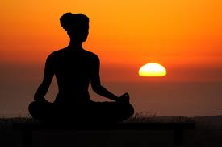
Mind body intervention
Meditation:
Self directed practice for relaxing the
body and calming the mind. State of consciousness in which individual eliminates environmental stimuli from awareness, producing a state of relaxation and stress relief.
Meditation evokes a restful state, lowers oxygen consumption, a reduction in respiratory rate and heart rate and subjective reports of reduced anxiety.
Various forms of meditation techniques ,but all of them can be grouped into two which include mindfulness meditation and concentrative meditation.
Notes:
What are the indications?
In what conditions meditations are effective?

Slide 31
Indications for meditation
Anxiety or tension
Chronic bereavement
Chronic fatigue syndrome
Drug abuse
Irritability
Hypertension
Mild depression
Low self esteem or self blame
Sleep disorders and Psychological disorders
Limitations:
Some may have hypersensitivity to mediation and require less time than average 15-20mts.
Over meditation in a patient with history of psychosis may precipitate psychoses episode.
It augments the effect of certain medications.
Notes:
Precautions should be taken to alter the dose of medicines.

Slide 32
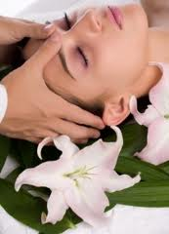
RELAXATION THERAPY:
It is the releasing of physical and mental
tensions. Relaxation is the state of
generalized decreased cognitive, physiological or behavioral arousal. The process of arousal elongates the muscles, reduces the neural impulses sent to brain and thus decreases the activity of brain as well as other body systems.
Types:
Progressive relaxation: one learns to detect the subtle localized sensations of muscle tension in one muscle group and then multiple muscle groups.
Passive relaxation: involves teaching the individual to relax muscles passively
Notes:
This therapy will lead the person to relaxing state.

Slide 33
Clinical applications of relaxation therapy:
Lowering HR,RR and muscle tension
Improving well being and reducing symptom distress
In combination with imagery, yoga etc known to reduce pain, improve emotional wellbeing and immune functions.
Limitations of relaxation therapy:
fear of loss of control, feeling like they are floating
In advance diseased patients relaxation therapy would not be appropriate.

Slide 34
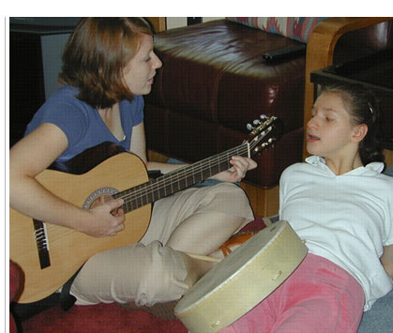
MUSIC THERAPY:
Use of musical or rhythmic
interventions specifically selected by a
music therapist.
Many experts suggest that it is the rhythm of the music or the beat that has the calming effect on us although we may not be very conscious about it.
Among the first stress-fighting changes that take place when we hear a tune is an increase in deep breathing. The body's production of serotonin also accelerates.
The Older Americans Act authorizes grants to states to provide music therapy as a supportive service to enable older persons to attain and maintain well-being.
Notes:
It is an emerging therapy in our health care system.
It can be provided by trained personal because structured knowledge is require to know what kind of music can be provided in what condition.

Slide 35
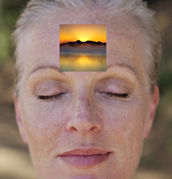
IMAGERY:
Formation of mental concepts, figures
and ideas applied therapeutically to
decrease anxiety. Mental process and a
variety of procedures to encourage changes
in attitudes, behavior, or physiologic reactions.
Two types:
self directed ( individual creates his own mental images)
guided ( practitioner leads the individual through the particular scenario)
Notes:
It is the process of incorporating the power of mind to assist the body to heal, to maintain the health and to relax by involving all senses,. Touch taste smell, light sound

Slide 36
Technique of guided Imagery:
A common guided imagery technique is a general relaxation process asking the person to slowly close their eyes and focus on their breathing
They are encouraged to relax, clear their mind, and surround themselves in images that are peaceful and calm.
Guided imaginary may be practiced independently,wirh coach or with an audio or videotape.

Slide 37
Clinical applications
Control or relief of pain
Decrease blood pressure
Decrease blood glucose levels (Diabetes)
Decrease allergy and respiratory symptoms
Decrease the severity of headaches
Achieve calmness and serenity
Treatment of chronic conditions as asthma, hypertension and GI disorders
Limitations of guided imagery
Least clearly defined intervention, can range from being highly structured to consisting of day dreaming by the individual.

Slide 38
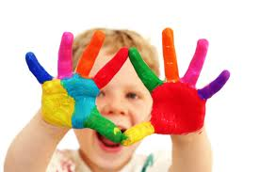
ART THERAPY
A form of expressive therapy that uses art materials, such as paints, chalk and markers. Based on the belief that the creative process of art is both healing and life-enhancing.
Advantages
Increase insight and judgment,
Cope better with stress,
Increase cognitive abilities,
Have better relationships with family and friends.

Slide 39
Uses:
For managers and staff under pressure
For people who are generally stressed and overworked
For people with mental health problems
For people with severe learning difficulties
For children and young people who have problems conforming in school and with personal problems at home
For people who feel they are problem free but would like the opportunity to explore issues within themselves

Slide 40
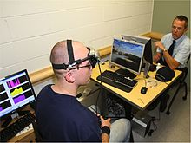
BIOFEEDBACK
It involves measuring a person’s bodily processes using machinery that translates physiological functions into audio or video signals conveying that information to him in a real time in order to raise his awareness or conscience of the related physiological functions.
Types of instrument used to do the measurement are:
    EEG
    ECG
    EMG
    Galvanic skin response
    training
Uses - anxiety, migraine, raynaud’s syndrome and other GI disorders.
Notes:
You might have came across to this word.
It helps the individual to controll the physiological functions that are most difficult to control. E.g. in stroke patients muscle recovery.

Slide 41

LAUGHTER THERAPY:
How it works:
By ensuring the inhalation of more
oxygen, it makes people feel better
It decreases stress leading to lowered stiffness of muscles - muscle relaxation
Gives a sense of well being because of release of endorphins and neuropeptides
Very useful for patients of hypertension
It also improves the immunity (increases level of interferon)
Decrease incidences of cough and cold.

Slide 42
Types of therapy:
Humor therapy : books, shows, movies, or stories to encourage spontaneous discussion of the patients own humorous experiences)
Clown therapy: clowns perform some role with the use of magic, music, fun, joy
Laughter therapy : client's laughter triggers are identified

Slide 43
Benefits
Laughter has innumerable other benefits.
It proves a potent anti-stress factor, decreases asthmatic attacks, increases stamina, relives arthritic pain, ensures good sleep and elevates mood.
Since the serotonin levels go up after laughter, it is an effective antidote for depression too.
Positive qualities are cultivated, thereby removing negative emotions as jealousy, fear, guilt and anger.

Slide 44
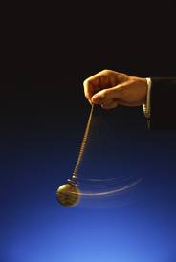
HYPNOSIS
defines hypnosis as hypnotism, or
any similar act or process which
produce in any person in any form of
induced sleep or trance in which the
susceptibility of the person's mind to suggestion or direction is increased where such a condition is used in the treatment of any human ill, disease, injury, or for any other therapeutic purpose.

Slide 45
Hypnosis phases
Preparation:- The first phase typically involves having the subject sit or lie down and getting comfortable.
Induction:- Induction takes the subject from normal awareness to a state of enhanced relaxation.
Deepening:- The deepening phase takes the subject from a very relaxed state into the fully "hypnotized" state, where conscious thinking is minimized
Awakening:-The awakening phase is when the subject is taken out of the hypnotic state. If the session is to try to alleviate insomnia, then the subject is encouraged to sleep, otherwise the subject is brought back to a state of awareness with the conscious mind fully reengaged.
Notes:
It has been helpful in the management of pain dyspnea, anxiety and phobias
Contraindicated in persn with cognitie impairement

Slide 46
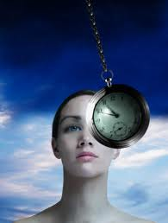
Applications
Cessation of smoking (often in a single session) and
The aid of weight loss (body sculpting).
Psychologists and psychiatrists use hypnosis predominantly for the treatment of Dissociative disorders,
Phobias,
Habit change,
Depression and
Post-traumatic syndromes
Medicine and dentistry
Education
Surgery
Entertainment

Slide 47
Self-hypnosis
Hypnosis in which a person hypnotizes himself or herself without the assistance of another person to serve as the hypnotist
Most often used to help the self-hypnotist stay on a diet, overcome smoking or some other addiction, or to generally boost the hypnotized person's self-esteem.
Walking hypnosis
Naturally occurring trance that one can enter while performing a monotonous repetitive task, such as walking or gardening, or in sedentary pursuits such as listening to a lecture or reading, in which one's attention drifts from the task into a trance-like state, often known as "zoning out".

Slide 48
  BIOLOGICALLY BASED THERAPIES
HERBALISM
A traditional medicinal or folk medicine
practice based on the use of plants and
plant extracts.Also called as herbal medicine, herbology, and phytotherapy.A number of traditions dominate the practice of herbal medicine. Homeopathy, Naturopathy, the Ayurvedic medicine system from India and Chinese herbal medicine
Some herbs may cause negative effect
Alkaloids: - dramatic effect of CNS (e.g. caffeine provides a mild lift, Datura cause severe intoxication and even death.
Quinine from Chincona, Morphine and Codeine from the Poppy, and Digoxin from the Foxglove are toxic and cause harmful effect to the body.

Slide 49
Mode of uses of herbs
Herbal bath:- with hot water disperse the qualities of herbs.
Herbal wrap: - body is enveloped in warm linen sheets which have been soaked in a special blend of herbs.
Aloe vera: -heals burn wounds;stimulates cell regeneration and has antifungal, antibacterial and antiviral properties.
Ginger:- cleanses the colon and useful for bowel disorders.

Slide 50
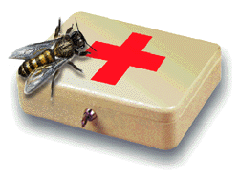
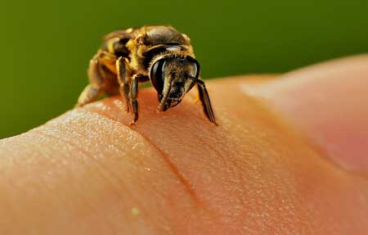
Apitherapy
Medical use of honey bee products. This can include the use of honey, pollen, propolis, royal jelly and bee venom .Bee venom is the most commonly used product, in treatment of:
Arthritis, bursitis, tendonitis
Autoimmune diseases
Dissolving scar tissue (e.g. keloids)
Herpes zoster (shingles), etc
Mode of action:
Contains active component melittin, which has a powerful anti-inflammatory action Administered either by live bees stings or through injection.Caution needs to be taken for any anaphylactic reaction.

Slide 51
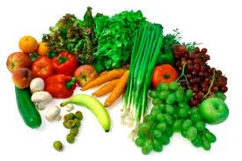
FOOD THERAPY
The four food groups in the Chinese diet are grains, fruits, meats and vegetables. Dairy products, especially cow's milk, are not considered suitable for humans.
The Nature of Food
Chinese medicine defines the natures of foods as hot, cold, warm, cool, wet and neutral. It is the same definition as our body constitution.
Yang Yin
Hot < Warm < Neutral > Cool > Cold
Notes:
Knowing your body's constitution and the nature of foods are necessary to eat right for your type. When the body is in balance, it is in good health and is more resistance to disease and external evils.

Slide 52
Special diet therapies, megadose of vitamins or minerals
Good nutrition can help with adaptation to the inevitable stress of life , promoting healthy body and feeling of well-being.the imbalance in body system can be regulated by nutrition supplements.
For example, a depression may be cause by amino acid imbalance or vitamins deficiency. The B vitamins omega-3 fatty acids and folic acid are helpful for regulating stress and balancing mood.

Slide 53
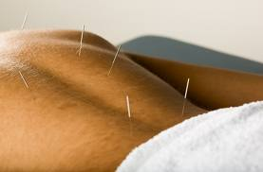
4. MANIPULATIVE AND BODY
BASED THERAPIES:
ACUPUNTURE
The term "acupuncture" describes a
family of procedures involving the stimulation of anatomical points on the body using a variety of techniques
Concept:
Qi: represents the body’s vital energy which flow through meridian or channels, Life force proposed to regulate a person's spiritual, emotional, mental, and physical health and to be influenced by the opposing forces of yin and yang.
Yin and yang: The concept of two opposing yet complementary forces described in traditional Chinese medicine. Yin represents cold, slow, or passive aspects of the person, while yang represents hot, excited, or active aspects.A major theory is that health is achieved through balancing yin and yang and disease is caused by an imbalance leading to a blockage in the flow of qi.

Slide 54
Technique of acupuncture:
It involves penetrating the skin with thin, solid, metallic needles that are manipulated by the hands or by electrical stimulation. People experience acupuncture differently, but most feel no or minimal pain as the needles is inserted. Some people feel energized by treatment, while others feel relaxed.
Mode of action: It is thought that acupuncture needling releases endorphins and other nerurotransmitters in the brain.
Duration: Treatment may take place over a period of several weeks or more.
Uses: in vomiting and pain relief of cancer patients.

Slide 55
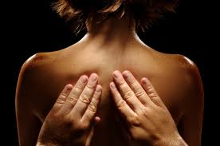
ACUPRESSURE:
It is pressing of the single point or specific
points to relieve pain and stress in a
particular area of the body.
Concept: it is based on the same concept as that of the acupuncture but unlike acupuncture, acupressure does not involve the use of needles to stimulate energy points along the meridians, but employs pressure from the fingers and hands for the same purpose. In stimulating the energy points in this way, acupressure aims to remove energy blocks which produce health problems.
Uses
It is used as an adjunct therapy to either acupuncture or massage.
It promotes relaxation and comfort.
Caution: should not be applied near areas of fractures, broken bones or near blood clots, wounds, sore and bruises.

Slide 56
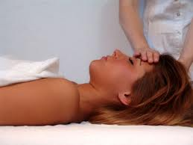
MASSAGE THERAPY
Acting and manipulating the patient's body
soft tissue - the skin, muscles, tendons,
ligaments, and fascia with pressure, tension, motion, or vibration done manually or with mechanical aids.
Used in
Pain relief (e.g. back pain, headache)
Reducing anxiety
Depression and
Temporarily reduction in blood pressure, heart rate, and state anxiety etc.
Encourage healing by
Promoting the flow of blood and lymph,
Relieving tension,
Stimulating nerves, and
Stretching and loosening muscles and connective tissue to keep them elastic.

Slide 57
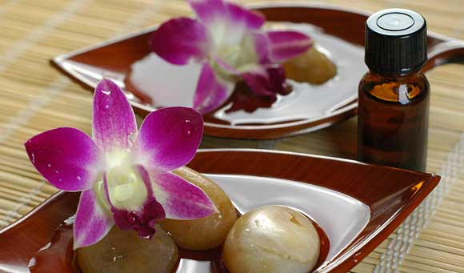
AROMATHERAPY:
Aroma - fragrance or smell; therapy – treatment
"Treatment using scents”
"It is a holistic treatment of caring for the body with pleasant smelling botanical oils such as rose, lemon, lavender and peppermint.
Uses: Volatile liquid plant materials, known as essential oils (Essential oils are aromatic essences extracted from plants, flowers, trees, fruits, bark, grasses and seeds).
Modes of application:
Skin application (bath, massage)
Inhaled directly
Diffused to scent an entire room
Oral, rectal, vaginal interfaces

Slide 58
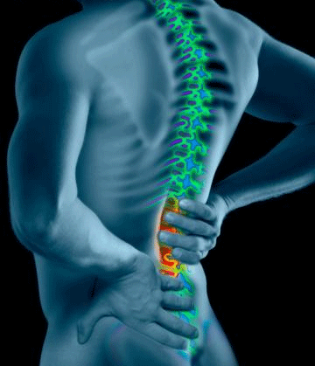
CHIROPRACTIC:
Combines the Greek words cheir (hand) and praxis (action) to describe a treatment done by hand.
Hands-on therapy–especially adjustment of the spine–is central to chiropractic care. Misalignments of the spine can interfere with the flow of energy needed to support health.
Focuses on the relationship between the body's structure–mainly the spine–and its functioning.
Is based on these key concepts:
Body has a powerful self-healing ability
Body's structure (primarily that of the spine) and its function are closely related, and this relationship affects health.
Therapy aims to normalize this relationship between structure and function and assist the body as it heals.

Slide 59
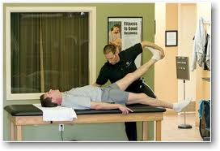
Chiropractors may combine the use of spinal adjustments with several other treatments:
Heat and ice
Electrical stimulation
Rest
Rehabilitative exercise
Counseling about diet
Side effects
Temporary headaches, Tiredness or Discomfort in parts of the body.

Slide 60
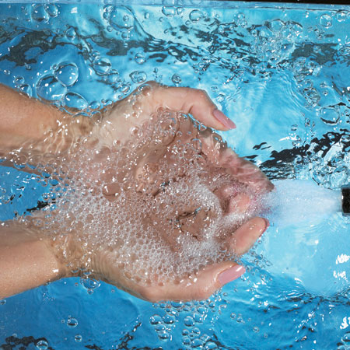
HYDROTHERAPY:
Treatment of disease by the use of water. Specifically a method of treatment that attempts to cure all diseases by the external (bath) or internal (colonic irrigation) use of much water.Water can be in the form of ice, vapor, or liquid. It Can be hot or cold water which is used.
Types
Packing
Hot air baths (Saunas)
General baths
Local baths
Compress

Slide 61
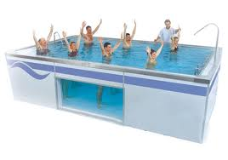
Uses
Musculoskeletal disorders
(arthritis, ankylosing spondylitis).
Spinal cord injuries and
In patients suffering burns, spasticity, stroke or paralysis
Mech. of action:
Heat is soothing, easing muscle tension and relieving pain. Heat also improves circulation.
Cold can either be stimulating or soothing.

Slide 62
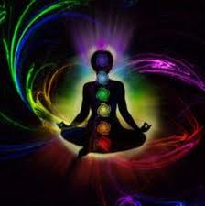
POLARITY THERAPY:
A holistic health system developed by Randolph Stone .Polarity Therapy is a comprehensive health system involving energy-based bodywork, diet, exercise and self-awareness.
Human Energy Field is affected by touch, diet, movement, sound, attitudes, relationships, life experience, trauma and environmental factors. Works on many different levels, influencing the nervous, musculoskeletal, cardiovascular,
respiratory, gynecological and
digestive systems, as well as mental
and emotional health
Notes:
Dr. Stone called his therapy 'polarity' because it balances the electromagnetic currents of energy, which flow backwards, and forwards between the positive and negative poles of the human body, which is like a living magnet. Without polarity we can have no life on this material plane, no energy flow, no breathing in and breathing out, no feelings of hot or cold, pleasure or pain, love or hate. For life to flow there must be poles for it to flow between, just as planet Earth needs it's North Pole and South Pole.

Slide 63
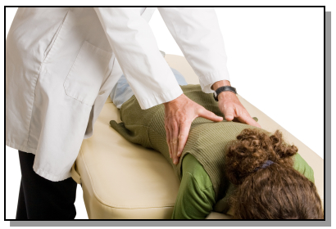
SHIATSU
Uses thumb pressure and work along the same energy meridians as acupressure and incorporates stretching.
Diagnosis and Therapy combined” is the ability of the practitioner to use his sensory organs (palms, fingers, and thumbs) to detect irregularities, such as stiffness of the surface of the body, and to promptly correct or heal these problems.
Uses in anxiety, headache, premenstrual syndrome etc.
Notes:
Shiatsu technique refers to the use of fingers and palm of one's hand to apply pressure to particular sections on the surface of the body for the purpose of correcting the imbalances of the body, and for maintaining and promoting health. It is also a method contributing to the healing of specific illnesses."

Slide 64
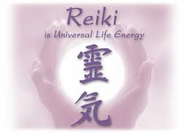
Reiki – energy therapy
Derived Chinese word, rei- unseen or spiritual and ki- life force or energy. (Universal life energy)A form of spiritual practice. It is derived from ancient Buddhist practices.Practitioner places his hands on or above the body area and transfers, “universal life energy” to the patient.

Slide 65
Technique:
Hands are kept either in direct contact or few centimeters away from the body.
Kept in the same position for about 5 mts and then moved to next position.
Total it takes around 45 mts.
Practitioners state that energy flows through their palms.
This energy provides strength, harmony and balance to treat the health disturbances.
It can be given with direct exposure or from distance by means of some symbols.

Slide 66
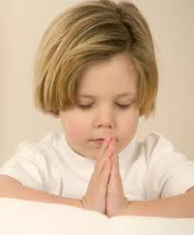
others
Prayer and spirituality
Spirituality is generally described as an awareness
of something greater than the individual self.
It is often expressed through religion and/or prayer, although there are many other paths of spiritual pursuit and expression.
Prayer can decrease the negative effects of disease, speed recovery, and increase the effectiveness of medical treatments. Faith and religious beliefs are also thought to improve coping and provide comfort during illness.
Group therapy
Group therapy is a treatment in which carefully selected people who are emotionallay ill meet in a group guided by trained therapiest and help one another affect personality change.
Notes:
Attendance at religious events and services is sometimes linked with improvement of various health conditions such as heart disease, hypertension, stroke, colitis, uterine and other cancers, and overall health status.

Slide 67
IMPORTANCE OF ALTERNATIVE SYSTEMS OF MEDICINES
The most important reason is allopathic therapy disturb and agitate the mind of the people.people are getting afraid of increasing side effects' of allopathic medicine and such effects.
The second most important consideration is the cost of the allopathic medicine.
The third reason is that when people are frustrated and not getting the desired cures of their ailments from the orthodox medicine they look for some alternative forms of healing that will bring solace and relief. Hence an Interest In alternative medicine is seen.
Notes:
In many societies, especially In rural areas, there are cultural links to the traditional medical systems. Hence it is easier for the rural folk to accept It.
The simplicity of these practices also attract some people.
There are some Individuals that have religious or philosophical aversion to certain western medical practices.

Slide 68
SALIENT FEATURES OF ALTERNATIVE MODALITIES OF TREATMENT
It considers the health of a person as a whole.
It believes the maintenance of health is by following healthy life styles
Simplicity
less or no side effects
The time tested traditional system of medicine has a reasonable alternative and answer to most of the diseases
Faith

Slide 69

