Slide 1

PLACENTA PREVIA
Prepared by:
Parita Jayswal
S.Y.M.Sc.
Mrs. Parita Maru, Assistant professor, Dept of OBG Nsg, SNC, SVDU

Slide 2
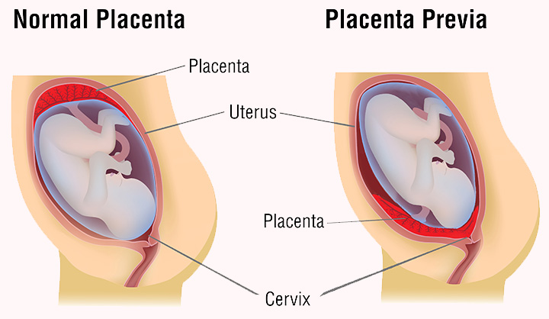
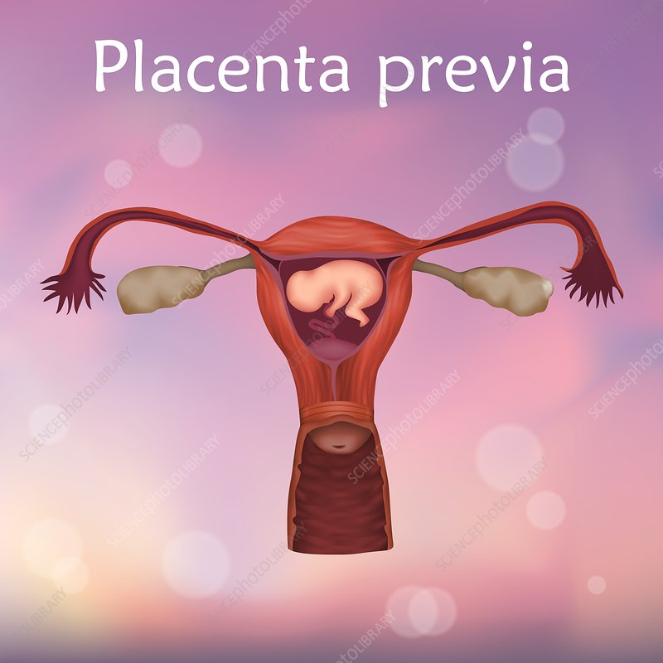

Slide 3
Placenta previa
The placenta is located low in the uterine cavity, partially or completely covering the opening of the cervix. The anterior location is less serious than posterior placenta praevia places the mother and fetus at high risk and its constitute obstetrical emergencies.
As the lower portion of the uterus stretches and dilates during the latter weeks of pregnancy, portions of the placenta may be torn from their attachment to the wall of the uterus. This leads to variable amounts of bleeding, ranging from light to profuse. In some instances bleeding may be precipitated by PV examination, coitus or external version

Slide 4
Degree / Types Of Placenta Praevia
Type-I (low lying)
Type-II (marginal
Type-III (incomplete or partial]
Type-IV (central):

Slide 5
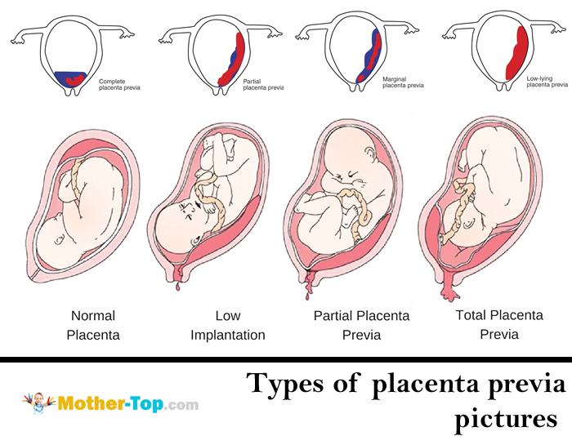

Slide 6
ETIOLOGY
Dropping down theory: fertilized ovum drop down and is implanted in lower uterine segment
large placenta from twins
multiple pregnancy
Advanced maternal age
Increased parity (number of pregnancies)
Previous uterine surgery, including cesarean section (regardless of incision type)
Previous placenta praevia, caesarean delivery or D&C

Slide 7
PATHOPHYSIOLOGY

Slide 8

SIGN AND SYMPTOMS
Sudden, painless, causeless and recurrent vaginal bleeding
Bleeding:This bleeding often starts mildly and may increase as the area of placental separation increases. Praevia should be suspected if there is bleeding after 24 weeks of gestation.
Bleeding is unassociated with pain unless labour starts simultaneously
Uterus size is proportionate to
period of gestation.
Uterus non-tender and relaxed

Slide 9
CONTI…..
Persistence of malpresentation like breech or transverse lie. Head is floating in contrast to the period of gestation
Anemia
Vulval inspection: bright red bleeding. PV should not be done outside of the O.T. it should be done only in O.T under anesthesia keeping ready for caesarean.

Slide 10
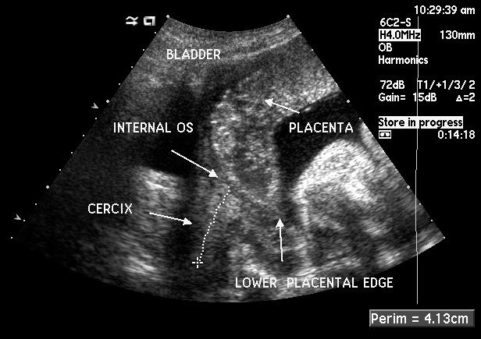
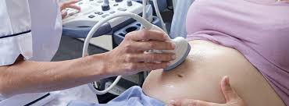
Diagnosis
2. clinical
  By internal examination
  Direct visualization during cesarean section
  Examination of placenta following vaginal delivery.
1. Localization of placenta (Placentography):
  Sonography:

Slide 11
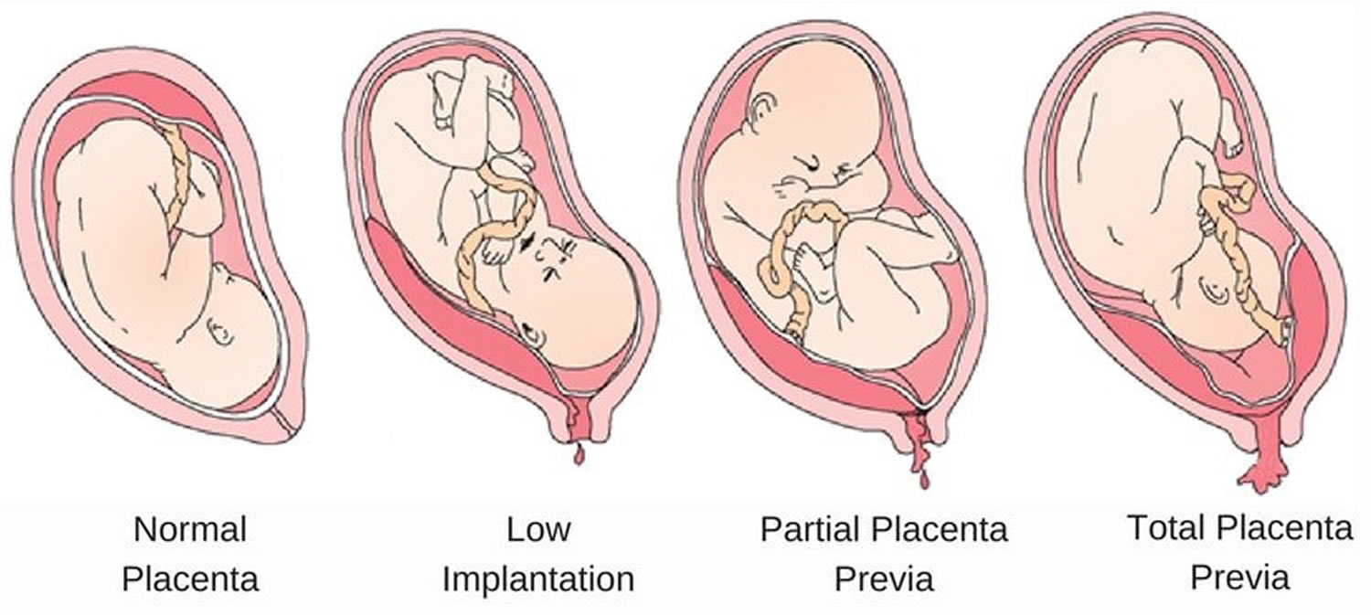
Complication of placenta praevia
  Related to mother:
    Ante partum hemorrhage
    Malpresentation
    Premature labour
    Premature rupture of membrane
    Cord prolapse
    Slow dilation
    Intra partum hemorrhage
    Post partum hemorrhage
    Infection
    Subinvolution

Slide 12
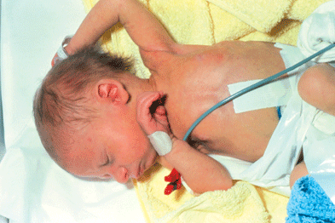
  COMPLICATION RELATED TO BABY:
  Fetal hypoxia
  Low birth weight
  Intra uterine death
  Intra uterine growth retardation
  Asphyxia
  Anomalies
  Birth injury

Slide 13

TREATMENT AND MANAGEMENT:
MEDICAL MANAGEMENT
REST
DIET
CONSTANT FETAL MONITORING
INDUCTION OF LABOR
SURGICAL MANAGEMENT

Slide 14
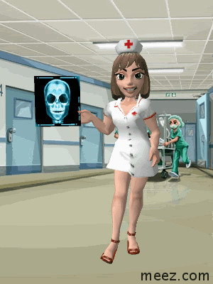
Nursing management:
Altered Tissue Perfusion related to excessive bleeding causing fetal compromise
Fluid volume deficit related to excessive bleeding
Risk for infection related to excessive blood loss
Anxiety related to excessive bleeding and outcome of pregnancy after episodes of bleeding
Knowledge deficits related to disease condition and management
Ensure the fetal and maternal wellbeing

Slide 15


Slide 16

`

