Slide 1


PREPARED BY:
PARITA JASWAL

Slide 2
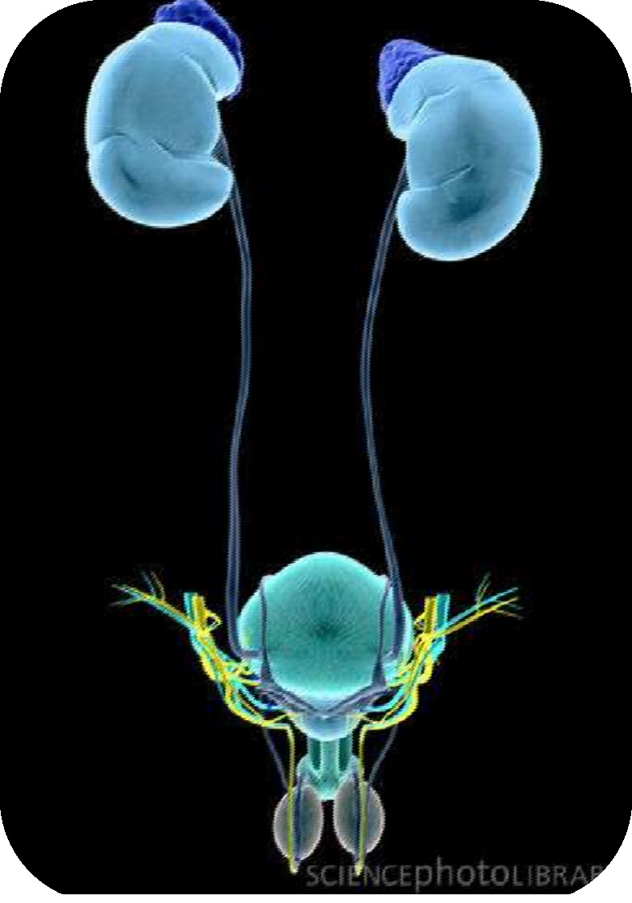
Introduction
Symptomatic presence of micro organisms within the urinary tract
i.e., kidney, ureters, bladder and urethra.
Associated with inflammation of urinary tract.

Slide 3
Urinary Tract Infection (UTI)
Background
1. Bacterial infections of urinary tract are a very common reason to seek health services
2. Common in young females and uncommon in males under age 50
3. Common causative organisms
a. Escherichia coli (gram-negative enteral bacteria) causes most community acquired infections
b. Staphylococcus saprophyticus, gram-positive organism causes 10 – 15%
c. Catheter-associated UTI’s caused by gram-negative bacteria: Proteus, Klebsiella, Seratia, Pseudomonas

Slide 4
Urinary Tract Infection (UTI)
Normal mechanisms that maintain sterility of urine
a. Adequate urine volume
b. Free-flow from kidneys through urinary meatus
c. Complete bladder emptying
d. Normal acidity of urine
e. Peristaltic activity of ureters and competent ureterovesical junction
f. Increased intravesicular pressure preventing reflux
g. In males, antibacterial effect of zinc in prostatic fluid

Slide 5
Significant bacteriuria: presence of at least
10⁵ bacteria/ml of urine.
Asymptomatic bacteriuria : bacteriuria with
no
symptoms.
Urethritis: infection of anterior urethral tract
*dysuria, urgency and frequency of urination.
Cystitis: infection to urinary bladder
*dysuria, frequency and urgency, pyuria and haematuria.

Slide 6
Acute pyelonephritis: infection of one/both kidneys; sometimes lower tract also.
*pyuria, fever, painful micturition
Chronic pyelonephritis: particular type of pathology of kidney; may/may not be due to infection.

Slide 7
UTI - Terminology
Uncomplicated: UTI without underlying renal or neurologic disease.
Complicated: UTI with underlying structural,
medical or neurologic disease.
Recurrent : > 3 symptomatic UTIs within 12 months following clinical therapy.
Reinfection: recurrent UTI caused by a different pathogen at any time
Relapse: recurrent UTI caused by same species
causing original UTI within 2 wks after therapy.

Slide 8






Upper
UTI
Lower
Acute pyleonephritis
Chronic pyleonephriitis
Interstitial pyleonephritis
  Renal abscess
Perirenal abscess
Cystitis
Prostatitis
  Urethritis
Both upper & lower UTI are further divided into complicated and uncomplicated.

Slide 9
Epidemiology
Seen in all age groups
Infants up to 6 months – 2/1000
More common in boys than girls
Women – at greater risk than men; prevalence 40-50% in women and 0.04% in men.
10% women have recurrent UTI in their life
7 million new cases of lower UTI / year
1 million hospitalizations / year
Incidence of UTI increases in old age; 10% of men and 20% of women are infected.

Slide 10
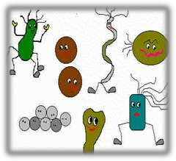
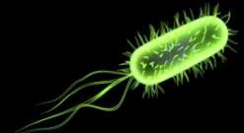
Etiology
Acute uncomplicated UTI:
Escherichia coli – cause about 80% of UTI
20% of UTI caused by-
Gram negative enteric bacteria – Klebsiella,
Proteus
Gram positive cocci – Streptococcus faecalis
Staphylococcus saprophyticus
S.saprophyticus – restricted to infections in young sexually active women.

Slide 11
CAUSES
Escherichia coli – 80% of cases
Gram negative enteric organisms
Other organisms include Proteus, pseudomonas, klebsiella, staphylococcus aureus, haemophilus etc.
Anatomic and physical factors
Structure of lower urinary tract accounts to bacteriuria in females
- Short urethra in young girls (2cm) & immature women (4cm) provides pathway for organism to invade

Slide 12
(UTI) Pathophysiology
Pathogens which have colonized urethra, vagina, or perineal area enter urinary tract by ascending mucous membranes of perineal area into lower urinary tract
Bacteria can ascend from bladder to infect the kidneys
Classifications of infections
Lower urinary tract infections: urethritis, prostatitis, cystitis
Upper urinary tract infection: pyelonephritis (inflammation of kidney and renal pelvis)

Slide 13
Complicated UTI:
Pseudomonas aeruginosa, Enterobacter & Serratia
Isolated in hospital acquired infections and catheter associated UTI.
Viruses - Rubella, Mumps and HIV
Fungi - Candida, Histoplasma capsulatum
Protozoa - T. vaginalis, S. haematobium

Slide 14
Pathogenesis
4 routes of bacterial entry to urinary
tract.
  Ascending infection
  Blood borne spread
  Lymphatogenous spread
  Direct extension from other organs

Slide 15






Ascending Infection:
  most common route.
  organisms ascend through urethra into
bladder.
organism
Colonize in perineal and
periurethral areas
Ascend to bladder, kidney
UTI

Slide 16

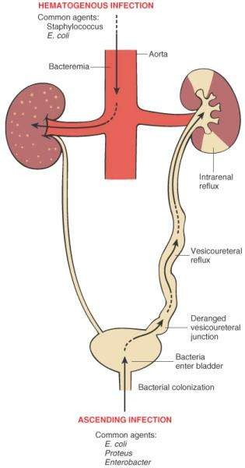
Hematogenous
spread:
Blood borne
spread to kidneys.
Occurs in bacteraemia mostly S.aureus.

Slide 17
Lymphatogenous spread:
  Men- through rectal and colonic lymphatic vessels to prostrate and bladder.
  Women- through periuterine lymphatics to urinary tract.
Direct extension from other organs:
  Pelvic inflammatory diseases
  Genito-urinary tract fistulas

Slide 18
The organism:
  E.coli – many strains present but only few cause infection.
  Virulence factors:
    fimbriae
    resistance to serum bactericidal activity
; increased amounts of capsular K antigen activity
    toxin production
    production of urease enzyme (proteus sps)

Slide 19
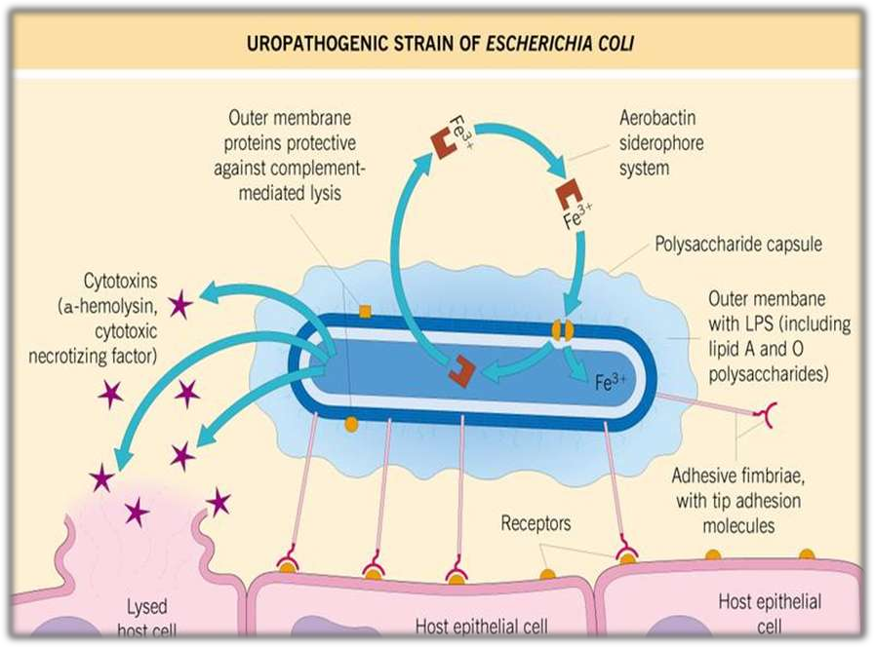

Slide 20
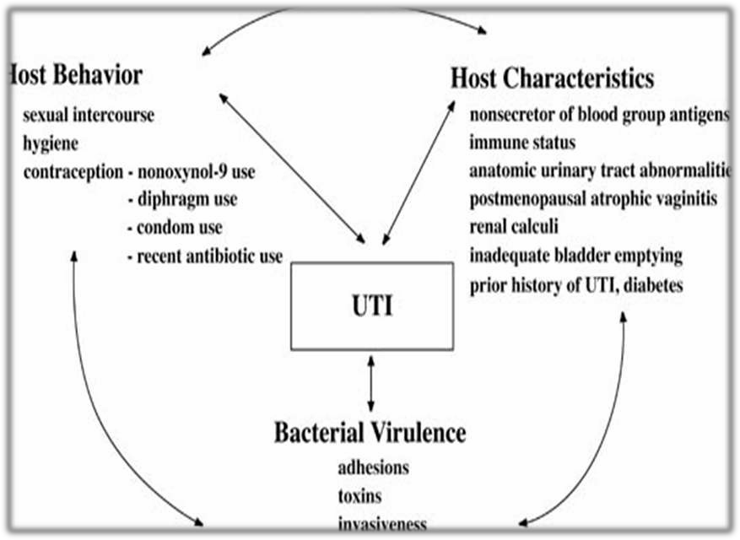
Vesiculourethral reflux

Slide 21
UTI – RISK FACTORS
Aging: diabetes mellitus
urine retention
impaired immune system
Females: shorter urethra
sexual intercourse
contraceptives
incomplete bladder emptying with age
Males: prostatic hypertrophy
bacterial prostatis age

Slide 22
UTI-CLINICAL PRESENTATION
Clinical manifestations depending on site of infection
Clinical manifestations depending on age of patient

Slide 23
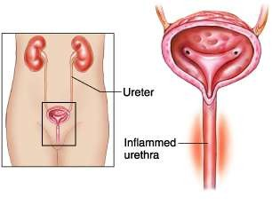
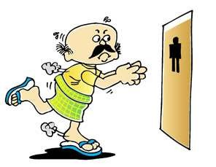
Clinical manifestations depending on site of infection
Urethritis:
  Discomfort in voiding
  Dysuria
  Urgency
  frequency

Slide 24
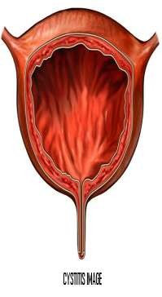

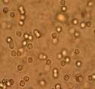
Cystitis:
  dysuria, urgency and frequen urination
  Pelvic discomfort
  Abdominal pain
  Pyuria
Hemorrhagic cystitis:
  Visible blood in urine.
  Irritating voiding symptoms
t

Slide 25
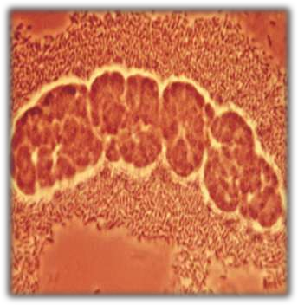
Pyleonephritis:
  Invasive nature
  Suprapubic tenderness
  Fever and chills
  White blood cell casts in urine
  Back pain
  Nausea and vomiting
Complications include sepsis, septic shock
and death.

Slide 26
Clinical manifestations depending on age
Babies and infants:
  Failure to thrive
  Fever
  Apathy
  Diarrhoea
Children:
  Dysuria, urgency, frequency
  Haematuria
  Acute abdominal pain
  Vomiting

Slide 27
Adults:
  Lower UTI- frequency, urgency, dysuria,
haematuria
  Upper UTI- fever, rigor and lion pain and symptoms of lower UTI.
Elderly patients:
  Mostly asymptomatic
  Not diagnostic as the symptoms are
common with age.

Slide 28
UTI- DIAGNOSIS
Microscopic examination of urine
Urinalysis
Urine culture
Imaging techniques – CT scan and MRI

Slide 29
Laboratory examination
Uncontaminated, midstream urine sample used.
Methods for urine collection:
  stick on bags
  catheterization
  suprapubic aspiration(SPA) –
gold standard for urine collection

Slide 30
Laboratory findings
Abnormal findings
pH – Alkaline ( increases)
Appearance – cloudy
Color - deep amber
Odor – foul smelling
Blood – maybe present
Leukocyte esterase - present
WBC- present
Bacteria- present
Normal Findings
pH - 4.6 – 8.0
Appearance- clear
Color – pale to amber yellow
Odor – aromatic
Blood – none
Leukocyte esterase – none
WBC- absent
Bacteria- absent

Slide 31


Urinalysis :
Presence of pus, white blood cells, red blood cells
Bacterial count > 10⁵ /ml – significant bacteriuria
Leukocyte esterase dipstick test – WBC in urine
Nitrite dipstick test- pink colour

Slide 32
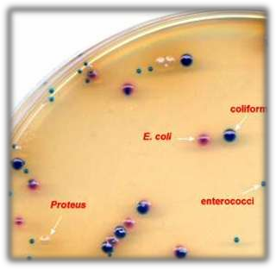
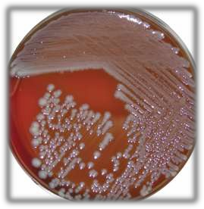
Urine culture :
For pyelonephritis
Not a rapid diagnostic tool
>10⁵ bacteria /ml
Differential leukocyte count- increased neutrophils
Urine culture

Slide 33
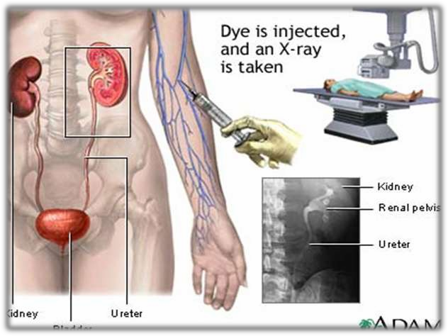
Diagnostic tests for adults with recurrent UTI
Intravenous pyelography/excretory Urography

Slide 34
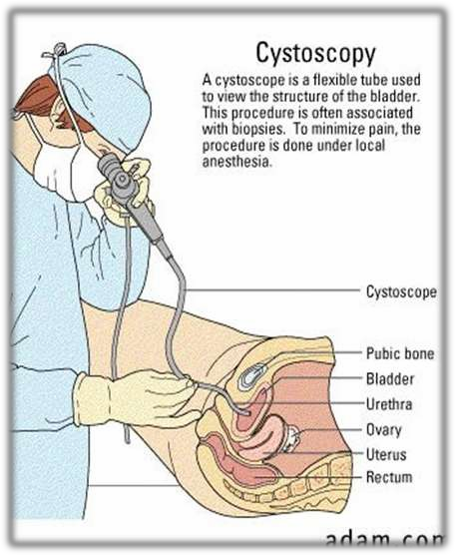
Voiding cystourethrography
Cystoscopy
Manual pelvic and prostrate examination

Slide 35







urinalysis
UTI
Urine microscopy and culture
Further investigation
pyelonephriti s Complicated
Adult female Lower UTI
Male Any UTI
Children Any UTI
Treat without further investigation
Blood cultures CT scan
Check renal
Ultrasound cystoscopy
cystourethro graphy

Slide 36
UTI - management
Symptomatic UTI- antibiotic therapy
Asymptomatic UTI- no treatment required
except in special situations.
Non- specific therapy:
  more water intake.
  Maintaining acidity of urine by fluids like
canberry juice.

Slide 37
Anti-microbial therapy
Goals of therapy:
  Elimination of infection
  Relief of acute symptoms
  Prevention of recurrence and long term complications
Decision to hospitalize ??
Treatment considerations ??

Slide 38


THERAPEUTIC MANAGEMENT
Goals
-eliminate current infection
-Identify contributing factors and reduce risk of occurrence
-prevent systemic spread of infection
-preserve renal function
Antibiotic therapy based on:
 identification of pathogen
 history of antibiotic use
 location of infection
Antimicrobial drugs (sometimes it will not be effective due to resistance of organism)
Anti-infective agents
 penicillin, sulfonamide, cephalosporin, nitrofurantoin

Slide 39
NURSING MANAGEMENT
 Careful history taking regarding voiding habits, stooling pattern
 Caution the parents in suspected cases
 Collect appropriate specimen
 Checking diaper half hourly for straining, dripping of small amounts of urine.
 Explanation of procedure according to their age
 Administer proper dosage of medications
 Increase the fluid intake

Slide 40
PREVENTION:
Simple hygienic habits should be followed
 Practice habit of voiding soon as they feel the urge
 Adolescent girls are advised to urinate soon after an intercourse
 Reinforce parents and older children the importance
of compliance
 Circumcision in males
 Plenty of oral fluids
 Treatment of constipation, pinworms

Slide 41
for uncomplicated UTI
Not for patients with
  past history of complicated UTI
  history of antibiotic resistance
  history of relapse with single dose
advantages: compliance, cost, less side effects, less resistance
Disadvantages: increased recurrence or
relapse

Slide 42


Antibiotic | Dose | Side effects | contraindications
Co-amoxiclav | 375mg every 8hr | nausea, diarrhea, rashes, hepatitis | Penicillin hypersensitivity
Trimethoprim | 200mg every 12hr | Nausea, vomiting, pruritis, rashes | Severe renal failure, neonates
Ciprofloxacin | 250mg every 12hr | Nausea, vomiting, dizziness, convulsions, hallucinations, hepatitis, blood disorders, photosensitivity | CNS disorders Pregnancy Children G6PD deficiency
Nitrofurantoin | 100mg every 12hr | Nausea, vomiting, peripheral neuropathy, pulmonary reactions | Renal failure Neonates Porphyria G6PD deficiency

Slide 43


