Slide 1

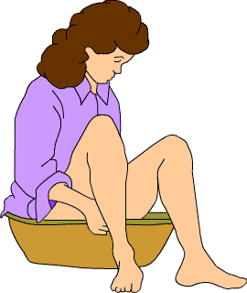
“The Healing power of Water”
PROCEDURE ON :
SITZ BATH
Presented By:
Rachana Joshi, Assistant Professor, Sumandeep Nursing College, SVDU

Slide 2
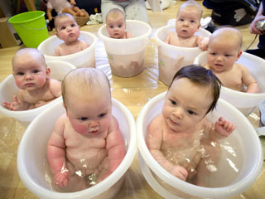
“The Healing power of Water”

Slide 3
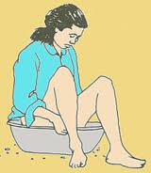
INTRODUCTION:
German Word-Sitzbad
Sitzen =Sits
Bad
=bath
A sitz bath is a hip-bath, that is, a bath in which a person sits covered with water up to the hips.
Hip baths were originally a European custom, although nowadays sitz baths are used mainly for therapeutic purposes.

Slide 4

A sitz bath is used to relieve discomfort and pain in the lower part of the body.
It works by keeping the affected area clean and increasing the flow of blood to it.

Slide 5

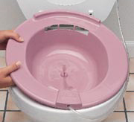
Sitz bath Tub:
Is Plastic tub
At Home: Tub that fits over the toilet and can be filled with water & Solution

Slide 6
DEFINITON:
A sitz bath or hip bath is a bath in which a person sits in water up to the hips. It is used to relieve discomfort and pain in the lower part of the body”
It is a local application of moist heat to the pelvic organs.
The patient is usually immersed from the mid thigh to the iliac crests.
The temperature of the water should be 110 degree ferenhite to 115 degree ferenhite (43 degree Celsius to 46 degree Celsius).
Duration of the bath is 15 to 30 minutes

Slide 7
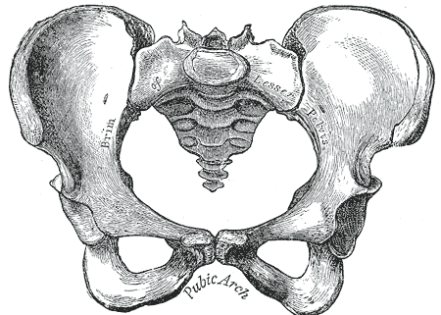
Pelvis

Slide 8
ANATOMY AND PHYSIOLOGY:
The pelvic cavity is a bony cavity that is bounded by the bones of the pelvis
The perineum is the diamond shaped area medial to the thigh and buttocks of both males and females.
It contains the external genitals and anus. The perineum is bounded anteriorly by the pubic symphysis, laterally by the ischial tuberosities, and posteriorly by the coccyx.
A transverse line drawn between the ischial tuberosities divides the perineum into an anterior urogenital triangle that contains the external genitalia and posterior anal triangle that contains the anus

Slide 9
The pelvis contains the lower urinary tract, reproductive system, lower digestive tract, major arteries and veins, muscle systems, nerve systems and bone systems.
FUNCTIONS
Urinary tract- urine excretion
Reproductive organs- reproduction and child birth
Lower Digestive tract - elimination

Slide 10
How Heat Works??..
Moist heat is more effective than dry heat, because water transfers heat more quickly than air.
heat dilates the blood vessels
stimulates blood circulation
reduces muscle spasms.
In addition, heat alters the sensation of pain.

Slide 11
HEALING:
The increased blood flow to the affected area provides proteins, nutrients, and oxygen for better healing.
reducing inflammation, edema

Slide 12
VASODILATATION:
refers to the widening of blood vessels.
It results from relaxation of smooth muscle cells within the vessel walls
Heat creates higher tissue temperatures, which produces vasodilatation that increases the supply of oxygen, and nutrients and the elimination of carbon dioxide and metabolic waste

Slide 13
Vasodilatation
(by increased blood supply)
Reduced blood viscosity
Reduced muscle tension
Increased capillary permeability and tissue metabolism

Slide 14
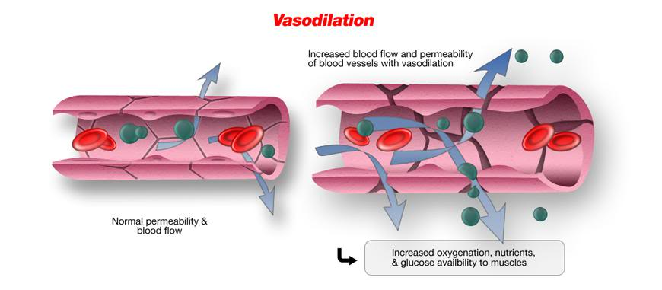

Slide 15
How Heat Helps Pain:
When heat is applied to the skin, it causes more blood to flow into the area. Heat affects the skin as well as the underlying tissues.
Heat helps to relax muscles, which can decrease some types of pain sensations.
The sensation of heat on the skin also provides something called an analgesic effect

Slide 16
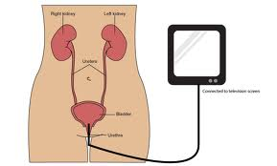
PURPOSE OF SITZ BATH:
To relieve congestion of the pelvic organs e.g. in treating dysmenorrhoea
To relieve pain following cystoscopy
To reduce inflammation and pain (e.g. in haemorrhoids, cystitis)
To relieve pain in retention and painful urination
To promote wound healing by cleaning it off discharge and debris

Slide 17
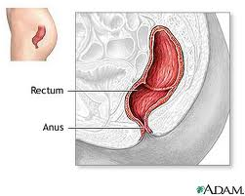


INDICATION:
INDICATION:
After rectal surgery
For haemorrhoids
For women after surgery or delivery
For neutropenic care in cancer patients

Slide 18
Sitz bath is Used:
Sitz bath
Hemorrhoids
Anal Fissures
Rectal surgery
Episiotomy
Uterine cramps
Inflammatory bowel disease
Infections

Slide 19
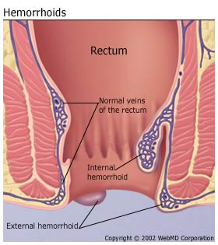
Hemorrhoids
Hemorrhoids are swollen blood vessels of the rectum
The hemorrhoid veins are located in the lowest area of the rectum and the anus.

Slide 20
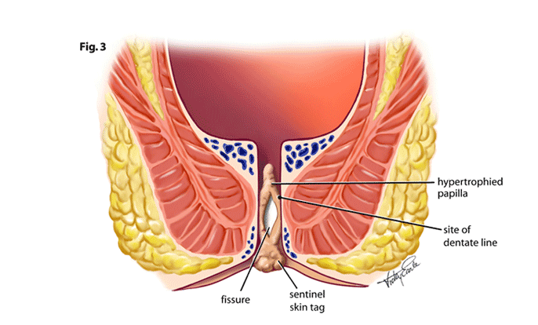
Anal Fissures
An anal fissure is a tear in the lining of the anus. fissures can be extremely painful when passing a stool.

Slide 21
Rectal surgery
Any surgery related to lower end of the large intestine.
Sitz bath is used to reduce the risk of infection and aid in the healing of tissues.

Slide 22
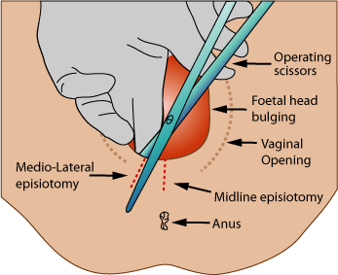
Episiotomy
Episiotomy is a procedure in which the perineum is cut as a means of enlarging the vaginal opening for ease of childbirth.

Slide 23
Cont..
Sitz bath Help to aid the healing of the incisions.
A sitz bath is also sometimes used after a normal delivery to help relieve pain, swelling, itching or muscle spasms in the rectal or vaginal area.

Slide 24
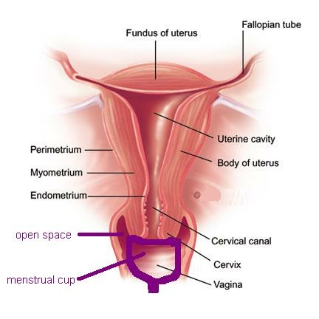
Uterine cramps
A painful spasmodic muscular contraction in the Uterus.
Large no. of women & teens suffer from menstrual pain
Cramps occurs because the uterus contracts to expel the uterine lining.

Slide 25
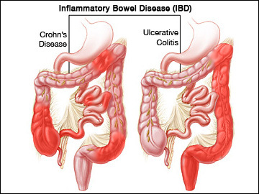
Inflammatory bowel disease
IBD cause chronic inflammation of the intestinal tract.
Small and large intestine covered
Result in pain, abdominal cramps Bleeding and Diarrhea

Slide 26
Infections
Infections of the bladder, prostate or vagina
Sitz bath help to reduce swelling, relieves discomfort or itching of any infected area.
According to U.C. Davis-
a sitz bath is an effective method of perineal hygiene, which refers to the cleansing of the area between the anus and the genital organs.

Slide 27
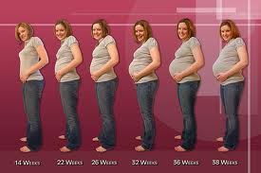

CONTRAINDICATION:
During pregnancy
Menstruation
Renal inflammation
Increased irritability of the genital organs

Slide 28
RISKS:
Very low risk, but the patient is at risk for drowning.
However, because hot baths cause blood vessels to dilate, on rare occasions some people can feel dizzy or have palpitations (rapid or abnormal heartbeat). Individuals prone to such occurrences are advised to have someone standing by to assist them.

Slide 29
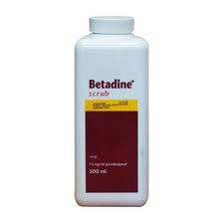
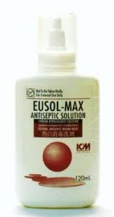
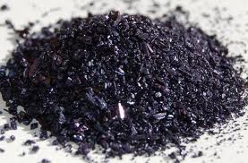
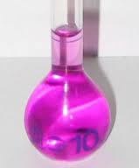
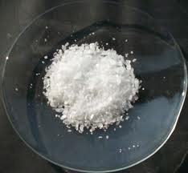
SOLUTIONS USED ARE:
Potassium Permanganate solution (1:5000)
Boric acid (1 dram to 1 pint)
Eusol solution
Dettol (1:40)
Betadine (1:20)

Slide 30
SCIENTIFIC PRINCIPLES:
Application of heat may cause vasodilation.
The local response to hot applications depends on length of time.
Short application usually cause vasodilation.
Prolonged application may cause vasoconstriction.
The increased blood supply resulting from vasodilation tends to increase the exchange of cellular nutrients and waste products in the tissues

Slide 31
The effects of hot applications result from stimulation of the temperature receptors in the skin
Impulses are carried via the somatic afferent fibres to the hypothalamus and the cerebral cortex
Impulses conveyed to the cerebral cortex arouse the conscious sensation of temperature
The temperature receptors adjust quickly to mind stimulation, so that the sensation of either warmth and coldness decrease

Slide 32
Tissue tolerance to temperature varies in different skin area of the same individual
In different individuals according to such factors as age and condition of the vascular and nervous systems
With the length of exposure time
With the size of skin area involved
Tissue injury occurs with extremes of temperature, but the exact point at which injury begins varies with the individual
Water is a more efficient conductor of heat than air.

Slide 33
Cold application conduct heat from the tissues
Heat increases the speed of chemical reactions
Low surface tension tents to increase the penetration ability of a solution
Following trauma to an area, cold applications are usually used (intermittently) for the first 24 hours to minimize oedema by vasoconstriction and reduced circulation. After the first 24 hours, warm application are used to cause vasodilation and to speed removal of waste products and provide nutrients for healing

Slide 34
Local application of heat or cold for 20 to 30 minutes is usually sufficient to achieve the therapeutic effect of increased or decreased circulation.
If an open wound exist, sterile techniques should be used for the application of heat and cold to prevent infection or cross contamination
Because environmental temperature can, by conduction, affect body temperature, hot or cold applications may be used to raise or lower body temperature

Slide 35
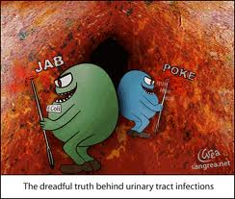
MICROBIOLOGY:
The application of heat or cold to open wound or to lesions that may rupture demands a sterile technique.
If the application is for thermal effect and there is no wound, the materials and solution must be clean but not sterile. The nurse’s hands are carefully washed before the application to reduce transfer of bacteria by this route.

Slide 36
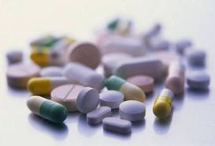
PHARMACOLOGY:
The addition of a drug reinforces the effect desired from the hot application.
Moist heat for 15 to 20 minutes three to four times daily with the addition of chemicals or appliances will achieve as much benefit as more complex treatments
Potassium permanganate- disinfectant
Dettol-disinfectant
Betadine solution-anti bacterial

Slide 37
PHYSICS:
Water has a great heat capacity and undergoes change more slowly than does any other substance. It also gives off more heat than any other substance.
The immediate effect of an application of heat is purely physical- a rise in temperature in the tissues. The degree and extent of this effect will vary according to the source of the heat, its intensity, and its length of application.
Heat may be transferred from one place to another by conduction, convection, or radiation

Slide 38
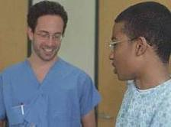
PSYCHOLOGY:
Provide privacy to the patient
Explain the procedure to the patient
Be with the patient during procedure

Slide 39
ARTICLES REQUIRED:
A bed screen if treatment is to be done at bedside
A suitable bath tub or basin
A bath thermometer
A jug with warm water
A bed side stool

Slide 40
STEPS OF THE PROCEDURE:
Explain the purpose of the procedure to the patient.
Fill the tub with water about half full at a temperature of 105 degree ferenhite or 40 degree Celsius.
Add the desire amount of solution that is potassium permanganate or betadine solution.
Screen the patient if at the bedside or wheel him to the bathroom in a chair if his condition permits.
Assist the patient to undress, avoid unnecessary exposure. Stand directly at the patients back; help the patient to sit down in the tub with the feet flat on the floor. There should be no pressure on the sacrum or thighs.
Be sure that the thighs, buttocks and lower abdomen are immersed in the solution.

Slide 41
Drape the patient’s legs and thighs. Wrap a bath blanket around the patient’s shoulders to protect him from chills.
Observe the patient closely for any signs of weakness and fatigue. Discontinue the bath if the patient has any signs of fatigue, pallor, rapid pulse and nausea.
Test the water in the tub several times and keep it at the desired temperature 105 degree ferenhite or 40 degree ferenhite. Additional hot water may be added by pouring it slowly from the jug.
Allow the patient to remain in the basin for 15 to 30 minutes.

Slide 42
Do not leave the patient alone unless it is absolutely certain that it is safe to do so.
Help the patient to come out of the basin when the bath is completed. Stand in front of him. Place the hand under the axilla and partially lift him from the tub to the stool.
Dry the patient with the bath towel and cover him adequately. Assist him into the bed.
Avoid chill

Slide 43
AFTER CARE
Rinse the basin, scrub well with soap, rinse, dry and replace.
Leave the patient comfortable, leave the bathroom in order. Remove the bedside stool.
Record time, duration, type of solution used reaction of the patient.

Slide 44
CONCLUSION:
Sitz baths may either be warm or cool. Warm baths are recommended for reducing the itching, pain and discomfort associated with conditions such as hemorrhoids and genital problems. An ordinary bathtub can be filled with 3 to 4 inches (7.6 to 10 cm) of hot water (about 110 °F (43 °C)), and sat in for 15–20 minutes or until the water cools down. Alternatively, a large basin can be used, and there are specially built devices that fit into toilet bowls.

Slide 45
Cont..
Cool sitz baths are said to be helpful in easing constipation, inflammation and vaginal discharges, and, in cases of fecal or urinary incontinence, in toning the muscles. Some people find that alternating three to five times between a hot bath for 3–4 minutes and an ice-cold bath for 30–60 seconds is soothing. A towel soaked in cold water can be used in place of a cold bath.
NOTE: Use aseptic technique if there is lesion or in the area, disinfect tub.

Slide 46

THANK YOU

