Slide 1

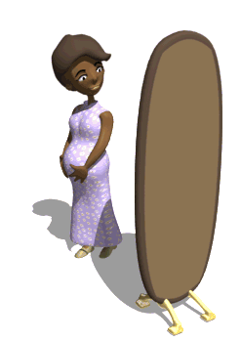
MINOR AILMENTS IN PREGNANCY AND ITS MANAGEMENT
.
Presented By:
Ms. Rachana Joshi
Assistant Professor
Sumandeep Nursing College,
SVDU

Slide 2


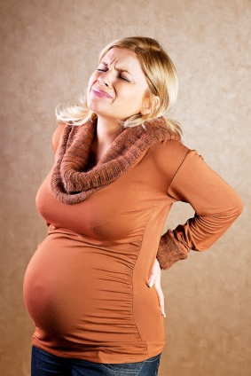
"‘Pregnancy is special, let make it as safe’’

Slide 3

Pregnancy brings a lot of emotional and physical changes that are not always easy to manage! We will talk about all the worries and common ailments that pregnant women go through before the big day!

Slide 4

Pregnancy is a very exciting time, but often the minor ailments associated with
Pregnancy can cause discomfort.
The discomfort can be overcome by making small adjustments to your lifestyle, thereby ensuring that you have a healthy and comfortable pregnancy.

Slide 5
MINOR AILMENTS

Slide 6
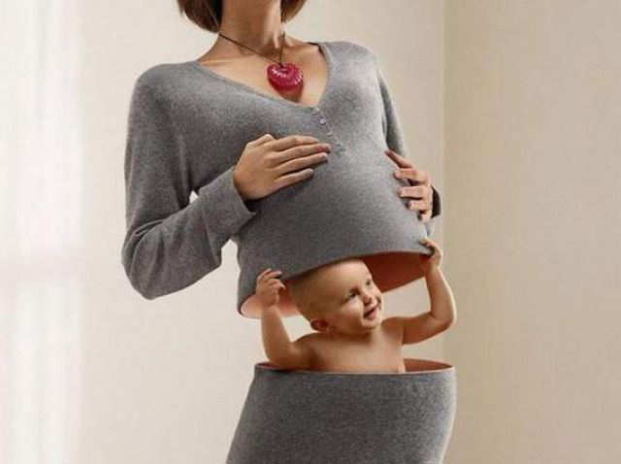
AILMENT
An often persistent bodily disorder or disease; a cause for complaining, a physical disorder or illness, esp. of a minor or chronic nature.

Slide 7
DEFINITION
During the course of pregnancy period many changes occur in a woman’s body as a result of hormonal influences and adaptation to the gestational process. Thereby, they experience a variety of physiological and psychological symptoms such as nausea, vomiting, backache , giddiness , heartburn and anxiety etc. These are termed as minor ailments or discomforts of pregnancy.

Slide 8
CAUSES:
Hormonal
Accommodations
Metabolic
Postural

Slide 9


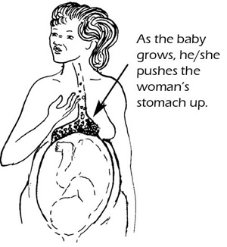
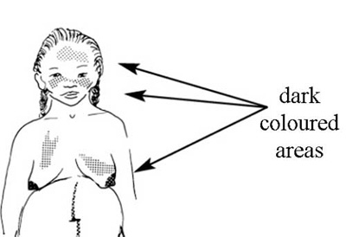
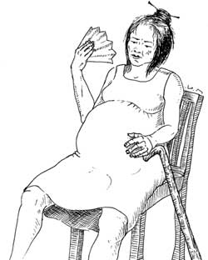
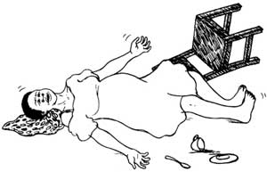
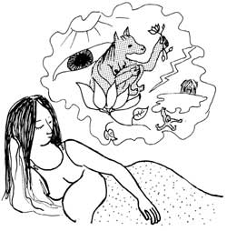
MINOR DISORDERS OF PREGNANCY AND ITS MANAGEMENT ACCORDING TO SYSTEMS

Slide 10
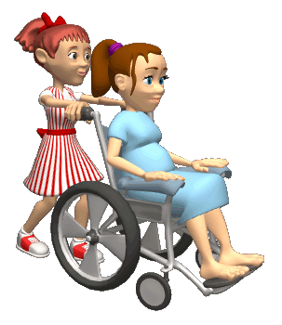
1 DIGESTIVE SYSTEM
2 CIRCULATORY SYSTEM
7 URINARY SYSTEM
8REPRODUCTIVE SYSTEM
3RESPIRATORY SYSTEM
4INTEGUMENTARY SYSTEM
5MUSCULOSKETAL SYSTEM
6NERVOUS SYSTEM

Slide 11
DIGESTIVE SYSTEM
Nausea and vomiting
Pica
Excessive salivation
tender gum
Bloating Belching
Hemorrhoid
Constipation
Flatulence
Heart burn/Pyrosis

Slide 12

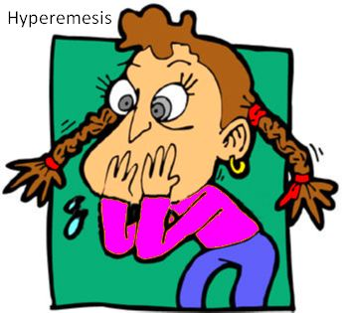
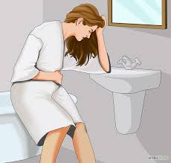
NAUSEA AND VOMITING
Usually last 4-16 weeks
It is usually common in primigravida
vomiting occurs soon after getting out of bed
The cause of vomiting is not clear but increase Human chorionic gonadotrophin has been implicated to play a major role.

Slide 13

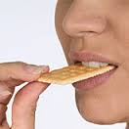

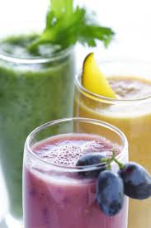
NURSING MEASURES :-
Assurance, Adequate rest & relaxation
Dry toast and biscuits
Small frequent feeds.
Avoid spicy and fatty food .
Protein diet.
Anti-emetics :
(Trifluoperazine,
Phenobarbitone).
Plenty of fluids(2.5 L /24 hrs) ,
Fruit juice.

Slide 14
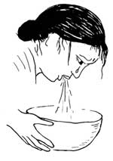
HYPEREMESIS GRAVIDARUM
“It is a severe type of vomiting of pregnancy which has got deleterious effect on the health of the mother and incapacitates her in day to day activities ”

Slide 15
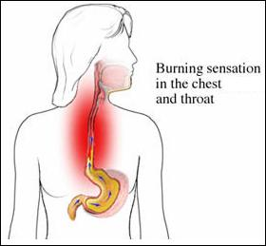
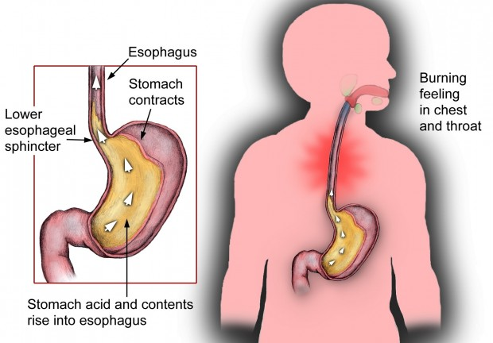
HEART BURN (PYROSIS)
from 20 weeks to term
This common complaint is the result
of reflux of acid contents of the stomach.
The relaxation of the esophageal sphincter due to effect of progesterone
weight effect of the pregnant uterus preventing stomach to empty are the causes for this reflux of acid contents.
Over eating , late eating alcohol and spicy foods contribute to the problem .
Hiatus hernia which is common during pregnancy is another cause of heart burn .

Slide 16
NURSING MEASURES:
Avoiding aggravating factors , e.g. citrus juice, spicy & fried food.
Drink fluid before and after meals, Use Milk
Smaller meals more often.
Propped up position after meals.
Avoid lying flat.
Wear loose clothes
Antacids (Aluminum hydroxide, Magnesium hydroxide )

Slide 17

EXCESSIVE SALIVATION
This occurs from 8th week of gestation and it is thought that the hormones of pregnancy are the cause for it.
Hyperactivity of the parotid gland
It may accompany heartburn.
Astringent mouth washes some time help ful.

Slide 18
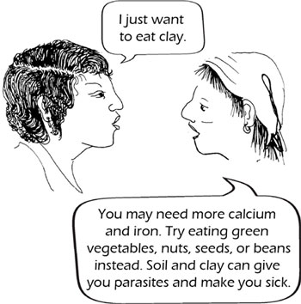

PICA
This is the term used when the mother craves certain foods or unnatural substances such as coal.
The cause is unknown but hormones and changes in metabolism are thought to contribute to this.
If the substances craved are harmful to the unborn baby the mother must be helped to seek medical advice.

Slide 19
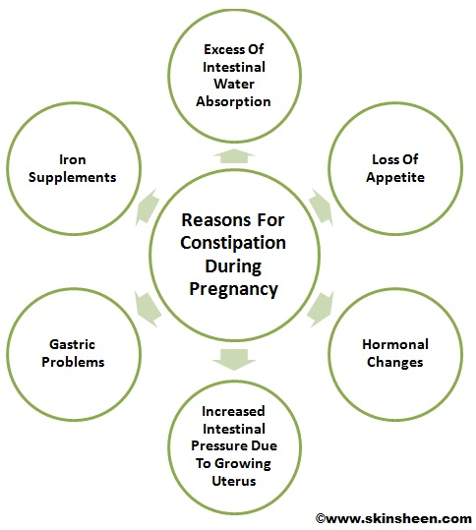
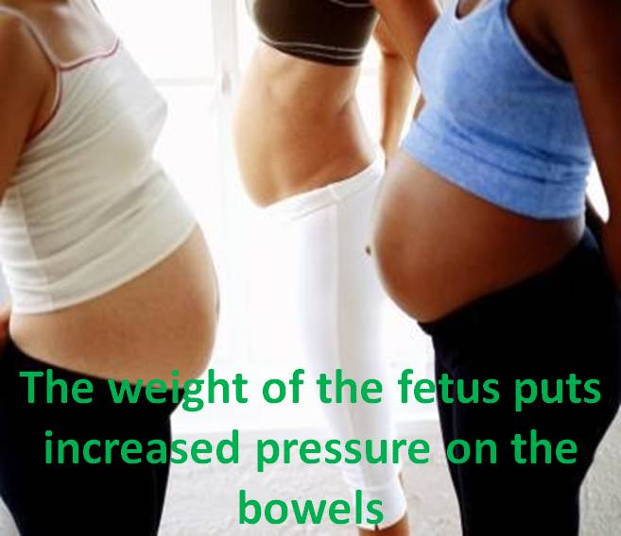
CONSTIPATION
Can last entire pregnancy , tends to get worse as pregnancy progresses
More common whose bowel pattern is not regulated.

Slide 20

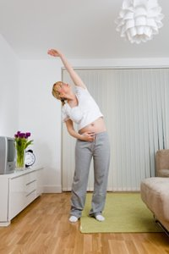
NURSING MEASURES :
Plenty of fluids , green leafy vegetables and fibers in diet (isabgul).
Drink glass of warm water at morning before tea that activates gut
Laxatives (surface itching) could prescribed by physician.
Regular exercises & walking.

Slide 21
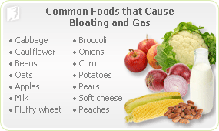
FLATULENCE
Due to reduced GI motility because of hormones, allowing time for bacterial action which produce gas.
To help relive this, eat small amounts and try to establish a daily bowel action.

Slide 22
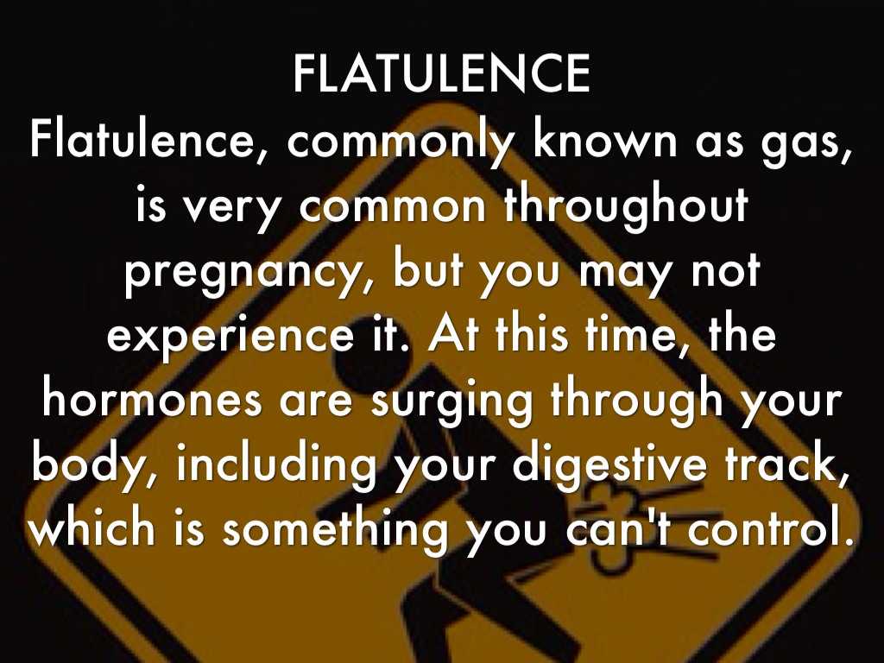

Slide 23
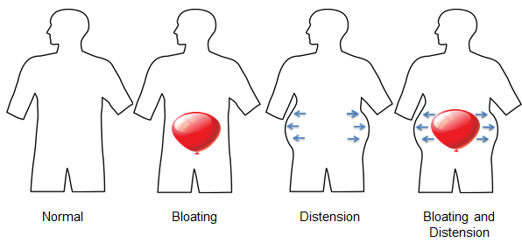
BLOATING BELCHING
This is partly caused by hormonal changes but usually occurs later in the pregnancy when the growing womb presses on the stomach.

Slide 24

NURSING MEASURES
Try eating smaller meals more often.
Sit up straight when you are eating as this takes the pressure off your stomach.
Avoid particular foods that make your symptoms worse, especially fatty and spicy food.

Slide 25
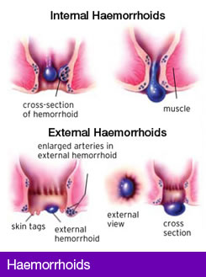
HAEMORRHOID
Laxity of the rectal vein by progesterone effect.
Pressure by the gravid uterus.
Tendency to constipation.

Slide 26
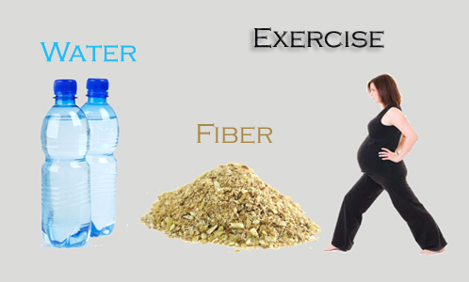
NURSING MEASURES :
Avoid constipation.
Local anesthetic.
Surgical & local injection treatment have to be avoided.

Slide 27
CIRCULATORY SYSTEM
FAINTING
ANKLE EDEMA
VARICOSE VEIN

Slide 28


Due to vasodilatation effect of progesterone.
Blood pressure sudden fall
NURSING MEASURES :-
Wear cooler, loose clothes.
Do not stand for too long.
Beware of hot, enclosed areas.
If you feel faint :-
Try to find somewhere to sit down.
Loosen tights clothes.
Put your head down.
Get into fresh air as soon as possible

Slide 29
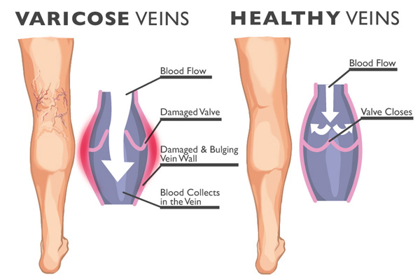
VARICOSE VEIN
16 weeks to term.
Varicose veins in the legs & vulva may appear for the first time or aggravate during pregnancy.
It is due to the destruction of the venous return by the weight of pregnancy uterus on the inferior vena cava.
It is also thought to be due to the relaxant effect of progesterone on the vascular smooth muscle.

Slide 30
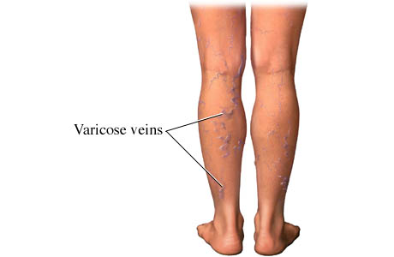
NURSING MEASURES :-
Applying elastic stocking or crape bandages
Avoid standing for long time
Avoid constipation
Exercise the calf muscles.

Slide 31
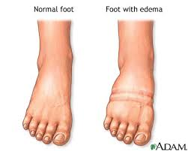
ANKLE EDEMA
As pregnancy advances the patient may notice swelling of their feet & ankles.
This is due to impediment of venous return from the lower limbs due to pressure effect on the gravid uterus on the lower limbs veins.
.
NURSING MEASURES
Frequent periods of rest with limb elevation for at least 15 minutes each time.
Avoiding long period of standing or sitting.
Diuretics should not be used

Slide 32
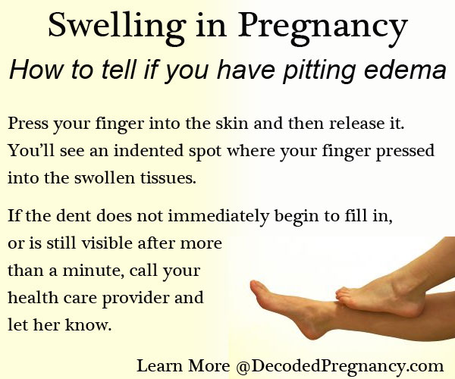

Slide 33
RESPIRATORY SYSTEM
NASAL STIFFNESS
DYSNEA
EPISTAXIS
SHORTNESS OF BREATH

Slide 34

NASAL STIFFNESS
Some mothers-to-be who develop “stuffy” noses find them difficult to get rid of. The problem may last until after the baby is born and may not be connected with a cold at all:
- Don’t take cold cures for it.
- Consult your Doctor if it is very irritating or gets worse.

Slide 35

EPISTAXIS
Nosebleeds are quite common in pregnancy
because of hormonal changes.
The nose bleeds are usually short but can be quite heavy.
To help the bleeding stop, press the sides of your nose together between your thumb and forefinger, just below the bony part of your nose, for 10 minutes. Repeat for a further 10minutes if this does not work.
If you have more than two bad nosebleeds (or lots of little ones), consult your GP.
Severe and frequent nosebleeds may contribute to anaemia, or may be a sign of underlying illness.

Slide 36

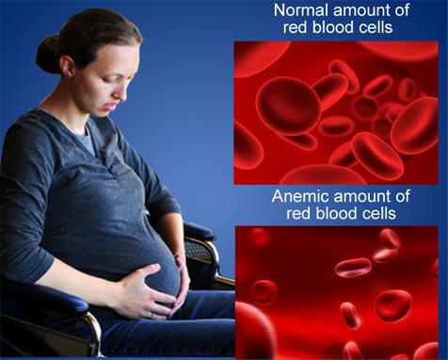
DYSNEA
SHORTNESS OF BREATH
It may occur early in pregnancy due to hyperventilation caused by progesterone.
Late in pregnancy, it occur due to pressure on the diaphragm by the pregnant uterus.
It occurs due to unfamiliarity with co2 tension in the alveolar capillaries

Slide 37
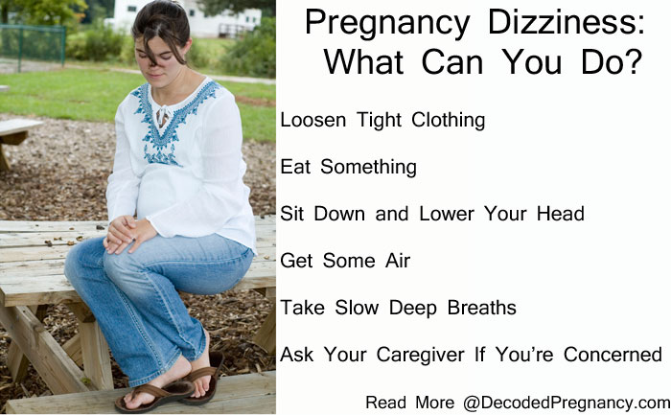

Slide 38
INTEGUMENTARY SYSTEM
SKIN CHANGES
LINEA NIGRA
CHLOASMA GRAVIDUM
LINEA ALBICANS &
STRAIEGRAVIDUM

Slide 39

SKIN CHANGES
Some mothers complain of generalized itching which often starts over the abdomen.
This occur due to liver’s response to the hormones in pregnancy with raised bilirubin level.
It clears after the baby is born and comfort can be gained from focal applications
An anti-histamine is prescribed .
Washing with mild soap
and wear cotton underwear .

Slide 40
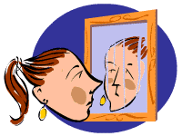
CHLOASMA GRAVIDUM
LINEA NIGRA
(Mask of pregnancy) a butterfly pigmentation on the cheeks & nose. It usually disappear few months after labor.
Reassure the mother that pigmentation in middle below the umbilicus is nor mal & after delivery there are some topical ointments that helps to remove this scar.

Slide 41
LINEA ALBICANS & STRAIEGRAVIDUM
Pigmentation in the lower abdomen, flanks, inner thigh, buttocks & breasts increases as pregnancy advances.
It starts pink (straie rubra) then becomes pale to become white (straie albicans) after delivery, white persists.
In Primigravida, the straie rubra present only.
In multigravida, both striae rubra & striae albicans present.

Slide 42
MUSCULOSKELETAL SYSYEM
LOW BACKACHE
LEG CRAMPS

Slide 43
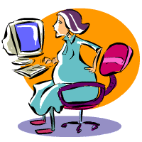
LOW BACKACHE
Usually lasts from 20 weeks to term.
During pregnancy there is laxity of spinal ligaments which along with the weight of pregnancy puts a strain on the joints of the lumbo sacral spine & pelvis resulting in lumber lordosis & consequent backache.

Slide 44
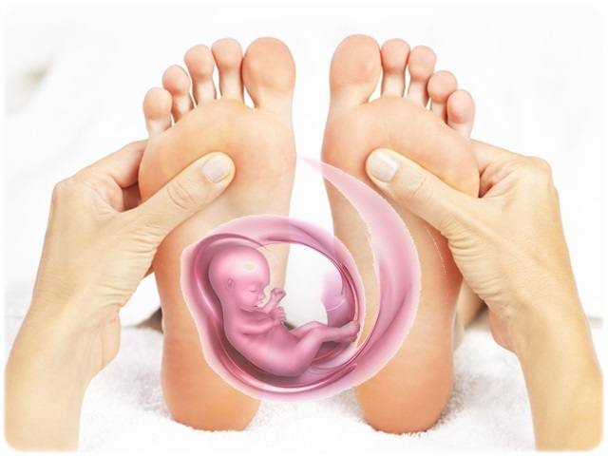
NURSING MEASURES :-
Maintenance of correct posture.
Avoiding lifting heavy objects.
Avoid high heels.
Regular physiotherapy.
Firm mattress to sleep on.
Enough rest particularly in later pregnancy.
Swimming often soothes backache.
Watch weight gain.
Avoiding standing for long hours of time.

Slide 45
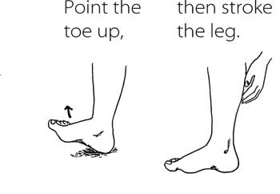
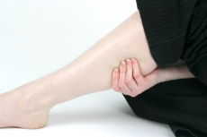
LEG CRAMPS
This is due to the deficiency of diffusible serum calcium or elevation of serum phosphorus.
NURSING MEASURES :-
Supplementary calcium therapy & vitamin B1(30mcg) daily.
Application of local heart & massage.
High doses of vitamin E (400mg) BD often proves beneficial.

Slide 46
NERVOUS SYSTEM
CARPAL TUNNEL SYNDROME
INSOMNIA OR
SLEEPLESSNESS

Slide 47
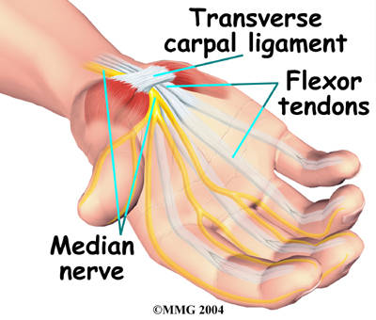
CARPAL TUNNEL SYNDROME
Mothers complain of numbness & pains & needles in their fingers & hands.
This usually happen in the morning, but it can occur at any time of the day.
It is caused by fluid retention, which create edema & pressure on the median nerve.
NURSING MEASURES
Wearing a spent at night, with hands resting on two or three pillows some times helps.
Restriction of salt intake.
Flexing the fingers while the arm is held above the head can be recommended.
Carpal tunnel syndrome usually resolves spontaneously following delivery.

Slide 48
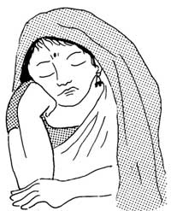
INSOMNIA OR SLEEPLESSNESS
NURSING MEASURES :-
Take rest in the afternoon.
Drink a glass of warm milk at bed time.
Tuck a pillow under the abdomen when lying in a lateral position.
Daily exercise.
Plenty of fresh air.
Avoid caffeine & multivitamin before sleep.
Warm milk drink or a warm bath help to allay anxiety & hence insomnia
28 Weeks to term.
It occurs due to
hormonal changes that occurs during pregnancy can be a major cause of anxiety in a pregnant mother.
Its late pregnancy, it caused by fetal movements pregnancy of micturition & difficulty in finding comfortable position.

Slide 49
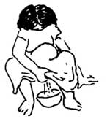
URINARY SYSTEM
FREQUENCY OF MICTURITION

Slide 50
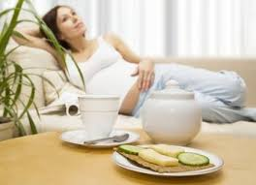
FREQUENCY OF MICTURITION
2nd trimester to term.
The pressure of the growing gravid uterus during the early part of pregnancy & the pressure of the fetal head when it engages the pelvic brim near full term cause irritation of the bladder base & predispose to urinary frequency

Slide 51
REPRODUCTIVE SYSTEM
LEUCORRHEA
BRAXTON HICKS CONTRACTION
BREAST

Slide 52
LEUCORRHEA
This is due to the increased transudation of fluids as a results of increased vascularity during pregnancy.
This discharge is clear & white & do not have unpleasant smell.
NURSING MEASURES
Assurance to the mother.
Local cleanliness.
Rule out any infection.
Wear cotton underwear & avoid tights.

Slide 53
BREAST
You may notice an increase in size and possibly some tenderness very early during your pregnancy and this can last for the entire pregnancy. You may need larger and more supportive bras.
Also some women will have a clear to milky discharge from their nipples and may need to use shields or nursing pads to protect their clothing.

Slide 54
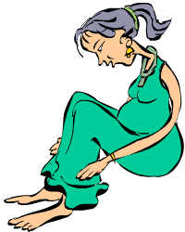
BRAXTON HICKS CONTRACTION
false labour' is an uncomfortable, irregular uterine contractions that occur periodically towards the end of labour. This is a sign that your uterus is preparing itself for labour. contractions begin at the top of your uterus and gradually spread downwards before relaxing.
‘false labour' will fade with a warm bath.
If you find it uncomfortable try practicing the breathing exercises or any other coping techniques which you have learned for use in labour.
If the contractions persist and you are not near full term - call your health provider.
If the contractions become regular, every five minutes and last sixty seconds each - call your healthcare provider.

Slide 55
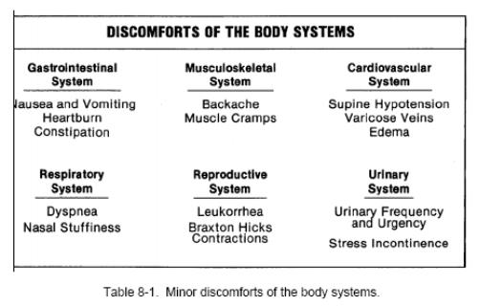
CONCLUSION

Slide 56
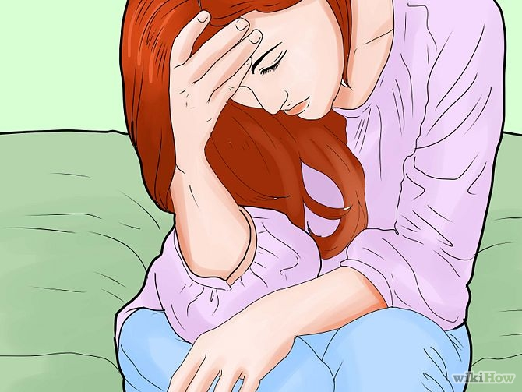
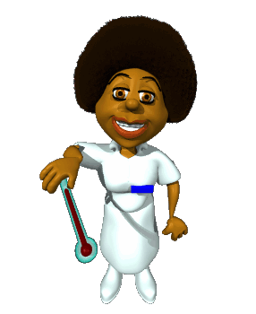
DIORDERS THAT REQUIRE IMMEDIATE ACTION
Vaginal bleeding
Reduced fetal movements
Frontal or recurring headaches
Sudden swelling/edema
Rupture of the membranes
Premature onset of contractions
Sudden nausea or sickness
Epigastric pain

Slide 57

SUMMARY
So far we have discussed regarding meaning, definition & minor ailments in pregnancy & its their management in detail.

Slide 58
NURSING MANAGEMENT
1.Altered nutrition less than body requirements related to nausea & vomiting as evidence by client reporting weight loss
2. Fatigue related to hormonal changes in 1st trimester as evidence by client complains
3. Constipation related to progesterone influence on GI tract as evidence by client report of altered pattern of elimination.
4. Knowledge deficit related to first pregnancy as evidence by client questions regarding further duration of pregnancy.

Slide 59


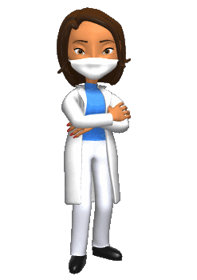

To ask

Slide 60
Memory Test:
Hyperemesis gravidarum is?
Heart burn is due to?
Reasons for Constipation are?
How to manage back pain?
Numbness, pain and tingling sensation in fingers & hands is known as?
How to manage varicose veins?

Slide 61

ASSIGNMENT:
You have to asses 5 individual antenatal mothers and list their common ailments during pregnancy…
Submit on coming Monday

Slide 62

Thank you
Best of luck
for
doing good for pregnant women.

