Slide 1


National Rular Health Mission
Mr. Adithya S.
Associate Professor
SNC
1

Slide 2
THE CONTENTS
National Rural Health Mission
States focused
Illustrative structure
Main approaches
Objectives
Functions of NRHM
Core strategies
Supplementary strategies
Components
RCH – II
Janani Suraksha Yojna
NRHM expected outcome
Innovations
Achievements of NRHM
Health Financing
Paradigm shift due to NRHM
Outcome indicators by NRHM
References
2

Slide 3
NATIONAL RURAL HEALTH MISSION
National Health Mission(NHM) is an umbrella mission launched on 1st May 2013, having two components : National Rural Health Mission(NHRM) and National Urban Health Mission(NHUM)
National Rural Health Mission was launched for a period of 7 years (2005-12).
NRHM initially had high focus on 18 States (8 EAG, 8 North East, Jammu & Kashmir and Himachal Pradesh), but now all the states are included.
RCH-II was an important component of NRHM.
3

Slide 4
DEFINITION
An effective healthcare to rural population throughout the country with special focus on 18 states, which have weak public health indicators, is called an national rural health mission.

Slide 5
STATES FOCUSSED INITIALLY UNDER NRHM
Assam
Bihar
Orissa
UP
MP
AP
Rajasthan Uttaranchal Mizoram Manipur Meghalaya Chattisgarh
Tripura Nagaland Gujarat
J & K HP
Sikkim
5

Slide 6
NRHM – ILLUSTRATIVE STRUCTURE
Block Level Hospital
Clusters of GPs – PHC level
Gram Panchayat – Sub health centre level
Village level –
ASHA, AWW, VH, SC
6

Slide 7









































The Institutional Structure
National mission steering
State health mission
District health mission
Dept. of women and child
Dept. of family welfare
Block coordination
Gram panchayat
Gram
VHC
Service provider
ANM
AWM
CLIENTS
ASHA
6

Slide 8

INSTITUTIONAL ARRANGEMETS UNDER NRHM
STATE LEVEL
State Health Mission chaired by Hon’ble Chief Minister.
State Health Society chaired by Chief Secretary.
Merger of all vertical societies into State Health Society.
State Level Planning and Monitoring Committee headed by Hon’ble Health Minister
DISTRICT LEVEL
District Health Mission chaired by Chairman Zila Parishad.
District Health Society chaired by Deputy Commissioner.
District Planning and Monitoring Committee headed by Zila Parishad Chairman.
7

Slide 9
INSTITUTIONAL ARRANGEMETS UNDER NRHM
BLOCK LEVEL
Block Planning and Monitoring Committees at Block PHC.
PHC Planning and Monitoring Committees at PHC level.
Rogi Kalyan Samities for CHCs
Village level
Village Health & Sanitation Committees in each village.
Accredited Social Health Activist (ASHA) for every 1000 population.

Slide 10

NRHM
MAIN APPROACHES
Communication
Village Health &
Sanitation Committee
ASHA
Panchayati Raj
Rogi Kalyan Samiti
Monitor progress against standard
IPHS Standard
Facility Surveys
Independent Monitoring Committee
Flexible Financing
Untied grants
NGOs as implementers
Risk Pooling
Money follows patient
More resources for more reforms
Improved management through capacity
DPMU/ BPMU
NGOs for capacity building
NHRC/ SHRC
Continuous skill
development
Innovations in Health Management
Additional manpower
Emergency services
Multi-skilling

Slide 11
OBJECTIVES OF THE MISSION
Universal access to public health services
Reduction in Child & Maternal mortality
Universal Access to
Immunization Programme

Slide 12
OBJECTIVES OF THE MISSION
Prevention & Control of
Communica ble
& Non- comm.
Diseases
Access to Integrated Primary Health Care
Population Stabilization
& Demographi c
Balance
Revitalize Local Health Tradition (AYUSH)

Slide 13
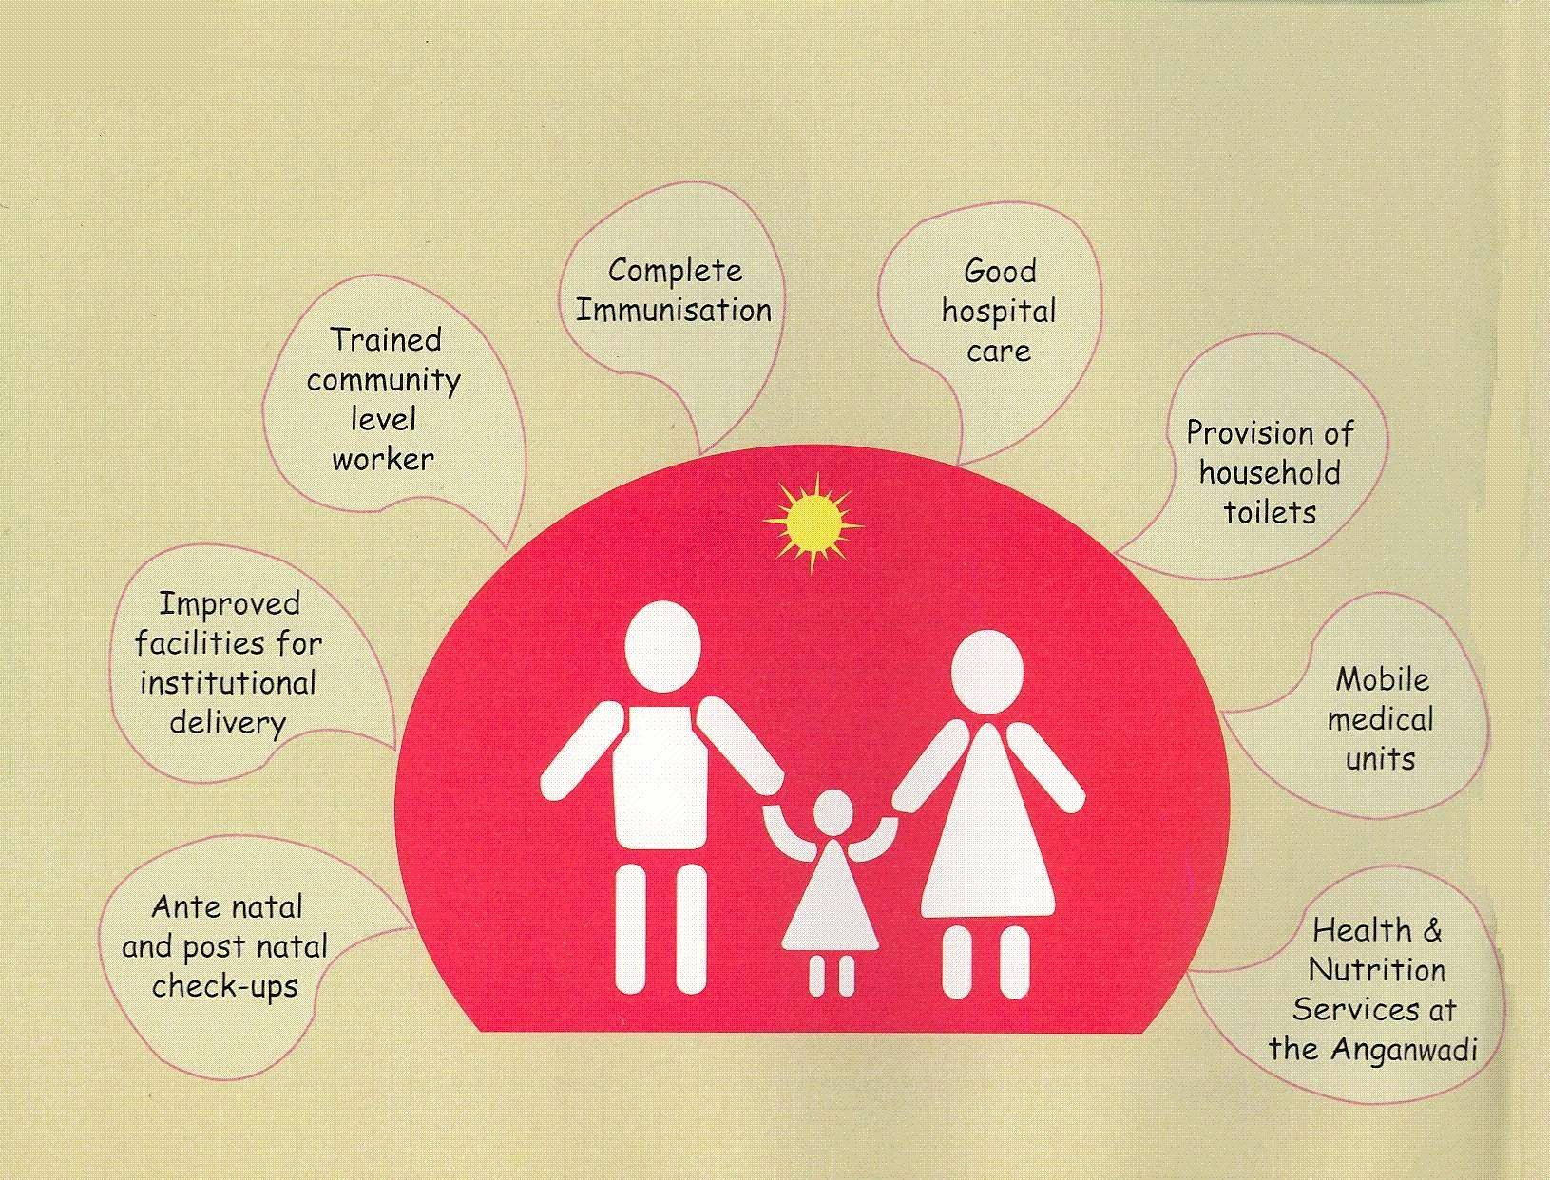

Slide 14
CORE STRATEGIES OF NRHM

Slide 15
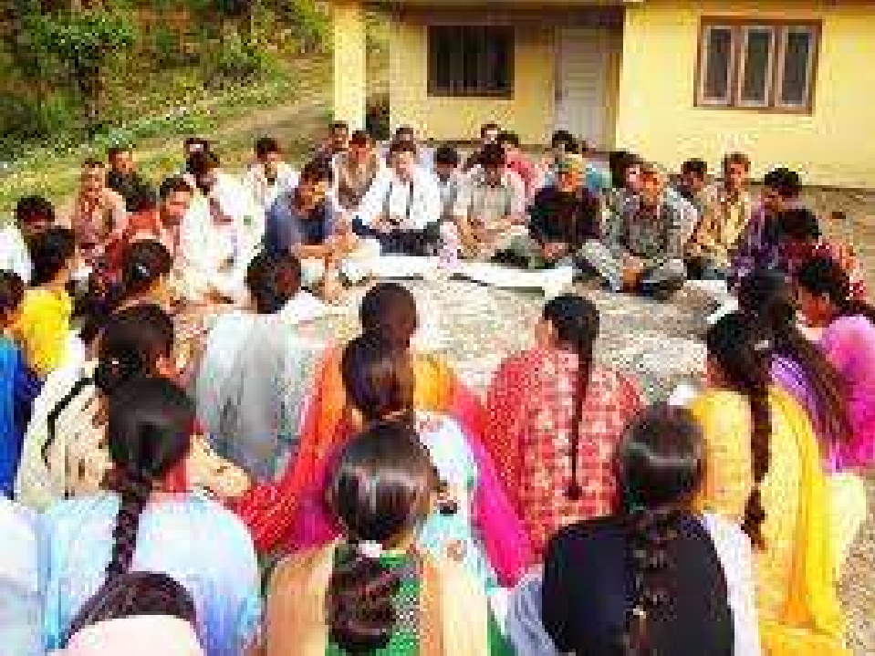
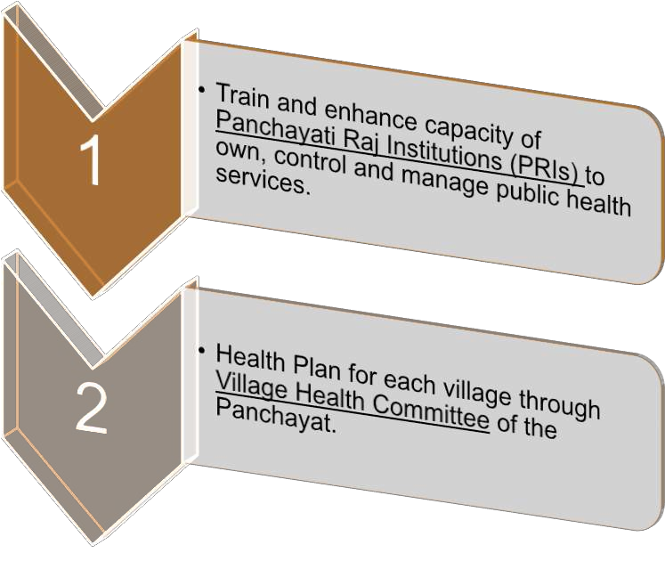

Slide 16
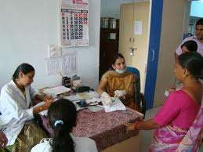
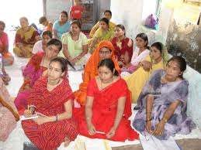
2. Strengthening Sub-Centre through better human resource development, untied fund to enable local planning and action and more Multi Purpose Workers (MPWS).
3. Promote access to improve healthcare at household level through the female health activist (Asha- Accredited Social Health Activist)

Slide 17
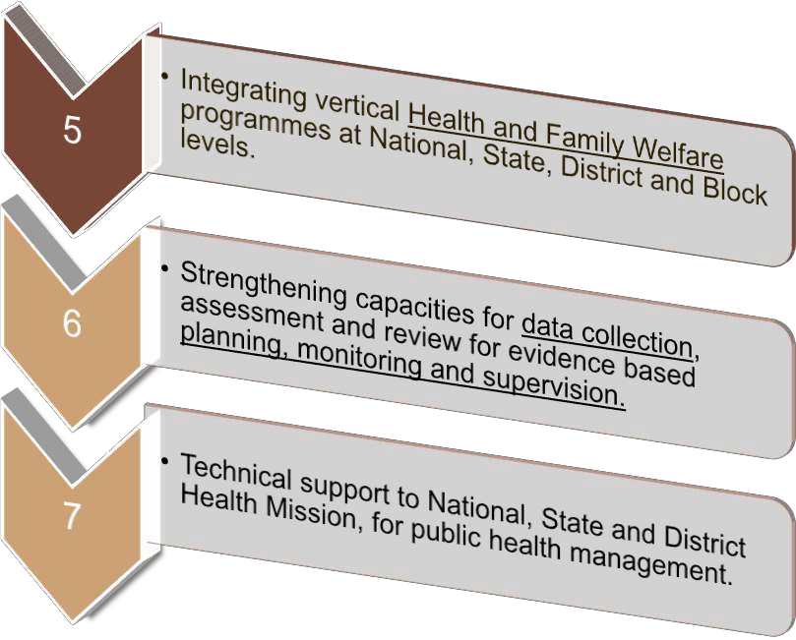

Slide 18
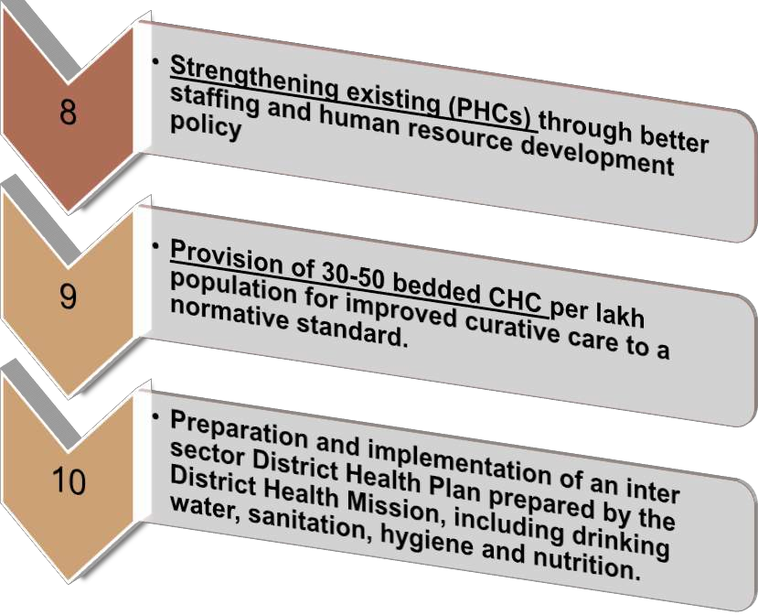

Slide 19
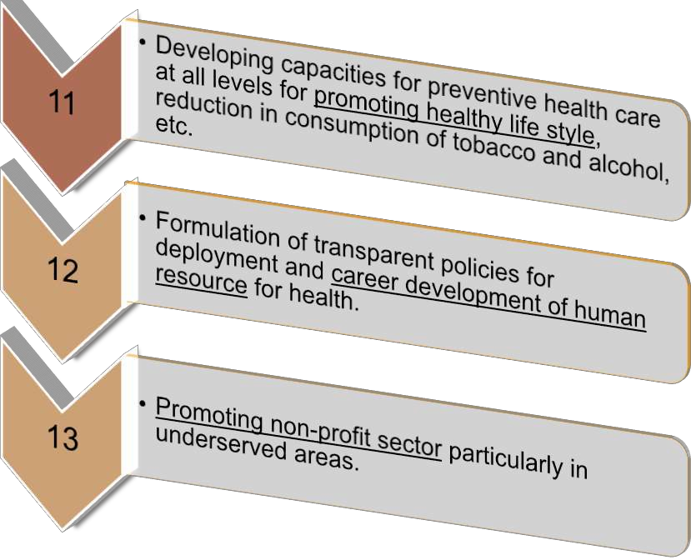

Slide 20
SUPPLEMENTARY STRATEGIES OF NHRM

Slide 21























Regulation for Private sector including the informal Rural Medical Practitioners (RMP) to ensure availability of quality service to citizens at reasonable cost.
Promotion of public private partnerships for achieving public health goals.
Mainstreaming AYUSH (Ayurveda, Yoga, Unani, Siddi, Homeopathy)

Slide 22

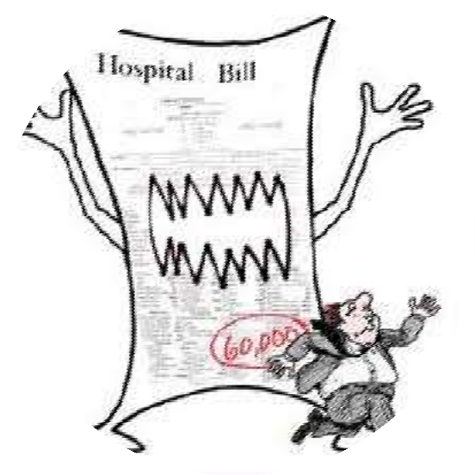
Reorienting medical education to support rural health issues including regulation of medical care and medical ethics.
Social health insurance to provide health security to the poor by ensuring accessible, affordable, accountable and good quality hospital care.

Slide 23
PLAN OF ACTION - COMPONENTS
ASHA
Strengthening of Sub-Centers
Strengthening of PHCs
Strengthening of CHCs for First referral
District Health Plan
Converging Sanitation & Hygiene under NRHM
Strengthening Disease control program
Public-private partnership for public Health goals, including regulation of private sector
New health financing mechanisms
Reorienting health/medical education to support rural health issues

Slide 24
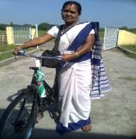
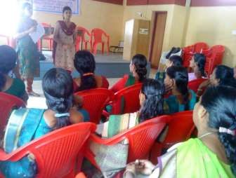
COMPONENT A: ASHA
Every village will have a female ASHA
Chosen by and accountable to the panchayat.
Prototype training material for ASHA to be developed at National level subject to State level modifications

Slide 25
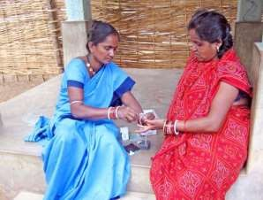
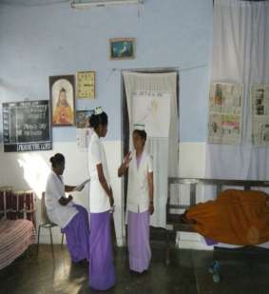
ASHA act as the interface between the community and the public health system.
She will facilitate preparation and implementation of the Village Health Plan along with
  Anganwadi worker
  ANM
  functionaries of other Departments Self Help Group members.
  She will be given a Drug Kit (generic AYUSH and allopathic formulations )for common ailments
24

Slide 26
RESPONSIBILITY OF ASHA
To create awareness among the community regarding nutrition, basic sanitation, hygienic practices, healthy living.
Counsel women on birth preparedness, importance of safe delivery, breast feeding, complementary feeding, immunization, contraception, STDs.
Encourage the community to get involved in health
related services.

Slide 27
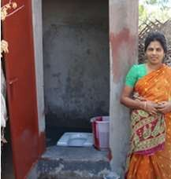
CONTD…
Escort/ accompany pregnant women, children requiring treatment and admissions to the nearest PHC’s.
Primary medical care for minor ailment such as diarrhea, fevers.
Provider of DOTS.
ASHA would be incentivized for promoting household toilets by the Mission.

Slide 28
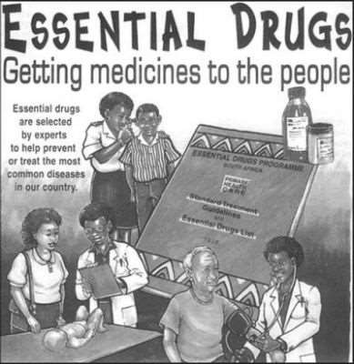
COMPONENT (B): STRENGTHENING SUB- CENTRES
Each sub-centre will have an Untied Fund for local action @ Rs. 10,000 per annum.
Supply of essential drugs, both allopathic and AYUSH, to the Sub- centres.

Slide 29
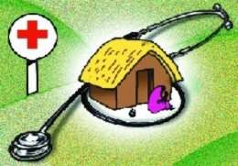
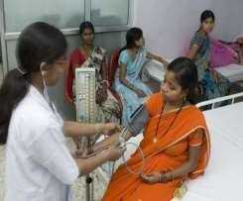
COMPONENT (C): STRENGTHENING PRIMARY HEALTH CENTRES
Adequate and regular supply of essential quality drugs and equipment to PHCs.
Provision of 24 hour service in 50% PHCs.
Intensification of ongoing communicable disease control programmes, new programmes for control of non- communicable diseases and provision of 2nd doctor at PHC level (I male, 1 female).

Slide 30
COMPONENT (D): STRENGTHENING CHCS FOR FIRST REFERRAL UNITS
Existing CHC (30-50 beds) as 24 Hour FRU, including posting of anaesthetists
Codification of new Indian Public Health Standards, setting norms for
 Infrastructure
 Staff
 Equipment
 Management
Promotion of Rogi Kalyan Samitis for hospital management.

Slide 31
COMPONENT (E): DISTRICT HEALTH PLAN
District becomes core unit of planning, budgeting and implementation
Health Program mes
“District Health Mission”
Family Welfare Program mes

Slide 32

COMPONENT (F): CONVERGING SANITATION AND HYGIENE UNDER NRHM
Total Sanitation Campaign (TSC) is presently implemented in 350 districts, and is proposed to cover all districts in 10th Plan.
Components of TSC include rural sanitary marts, individual household toilets, women sanitary complex, and School Sanitation Programme

Slide 33

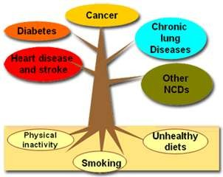
COMPONENT (G): STRENGTHENING DISEASE CONTROL PROGRAMMES

Slide 34
COMPONENT (G): STRENGTHENING DISEASE CONTROL PROGRAMMES
Disease surveillance system at village level would be strengthened.
Supply of generic drugs (both AYUSH & Allopathic).
Provision of a mobile medical unit at District level for improved Outreach services.

Slide 35


COMPONENT(H) PUBLIC-PRIVATE PARTNERSHIP FOR PUBLIC HEALTH GOALS, INCLUDING REGULATION OF PRIVATE SECTOR
75% of health services are provided by the
private sector.
Identifying areas of partnership, which are need based, thematic and geographic.
Public sector to play the lead role in defining the framework and sustaining the partnership.

Slide 36

COMPONENT (I): NEW HEALTH FINANCING MECHANISMS
Progressively the District Health Missions to move towards paying hospitals for services .
Standardization of services – outpatient, in- patient, laboratory, surgical interventions- and costs will be done periodically by a committee of experts in each state.
An ombudsman to be created to monitor the District Health Fund Management , and take corrective action.
The Central government will provide subsidies to cover a part of the premiums for the poor, and monitor the schemes.

Slide 37
COMPONENT (J): REORIENTING HEALTH/MEDICAL EDUCATION TO SUPPORT RURAL HEALTH ISSUES
While district and tertiary hospitals are necessarily located in urban centers, they form an integral part of the referral care chain serving the needs of the rural people.
Medical and Para-medical education facilities need to be created in states, based on need assessment.

Slide 38
REPRODUCTIVE CHILD HEALTH PROGRAMME
RCH-II is the Flagship programme under NRHM.
RCH-II started in 2005 and will continue till 2010 and beyond.
RCH is principal vehicle and major component of NRHM aimed at reducing Maternal Mortality Ratio to 100/1,00,000, infant mortality to 30/1000 live birth and total fertility to 2.1 by year 2010.
Components of RCH II :
Maternal health, MTP and JSY .
Child Health.
Family Planning.
Adolescent Reproductive and Sexual Health.
Urban RCH
Trial RCH
Vulnerable Groups
Institutional Strengthening.
Infection Management and Environment Plan at health facilities.

Slide 39
STRATEGIES :
Maternal Health – Institutional deliveries, BCC, Mobilization Strategies, improved coverage and quality of ANC, skilled care to Pregnant women, Post -partum care at Community level.
Child health - UIP, IMNCI.
Population Stabilization – contraceptive choice, private
sector intervention.
Urban and tribal health – similar initiatives with special focus disadvantages.

Slide 40
JANANI SURAKSHA YOJANA
Janani Suraksha Yojana (JSY) is a safe motherhood intervention under the NRHM being implemented with the objective of reducing maternal and neo- natal mortality by promoting institutional delivery among the poor pregnant women.
The Yojana, launched on 12th April 2005 is being implemented in all states and UTs. JSY is a 100% centrally sponsored scheme.
The Yojana has identified ASHA, as an effective link between the Government and the poor pregnant women.
The scheme focuses on the poor pregnant woman with special dispensation for states having low institutional delivery rate. Besides the maternal care, the scheme provides cash assistance to all eligible mothers for delivery care.

Slide 41
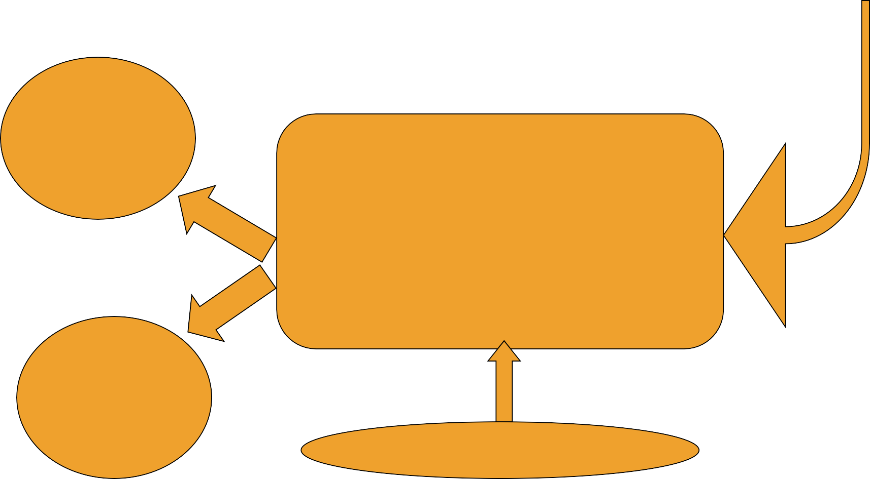
JANANI SURAKSHA YOJANA AND ASHA
NRHM
JSY
↓↓ all MMR
& IMR
Antenatal Check up
Institutional Care during delivery
Immediate post-partum
(coordinated care)
↑↑Institutional
Deliveries
in BPL families
Cash assistance

Slide 42
To reduce Maternal and Neonatal Mortality by promoting institutional delivery among beneficiaries from BPL, SC and ST family in rural and urban area.
Incentives for Institutional Delivery
RUR |  | AL |  | UR | BAN
 | Mother | ASHA | Total | Mother | ASHA | Total
LPS | 1400 | 600 | 2000 | 1000 | 200 | 1200
HPS | 700 | 200 | 900 | 600 | 200 | 800
HPS(n |  | 600
otified
tribal
area)
The eligible beneficiary is from Below Poverty Line and if she delivered at home in this case Rs. 500/-is paid . In case of L.S.C.S, Rs 1500/-is to be given to beneficiary

Slide 43
NRHM OUTCOMES EXPECTED
1. National Level
IMR : Reduced to 30/1000 Live Births
MMR : Reduced to 100/100,000
TFR : Brought to 2.1
MMRR : –50% upto 2010, Addl.10% by 2012
Kala Azar : to be Eliminated by 2010.
Filaria / Microfilaria Reduction Rate
: 70% by 2010, by 2012 80%
Elimination by 2015
Dengue Mortality Reduction Rate
: 50% by 2010 and Sustaining at
that Level Until 2012
Contd..
42

Slide 44
50% by 2010 and sustaining
at that Level Until 2012.
J..E Mortality Reduction
Cataract Operation
Leprosy Prevalence Rate
Tuberculosis DOTS Services
2000 Community Health
Centres to be Upgraded
Utilization of First Referral Units
250,000 Women to be England
❖
❖
Increase to 46 lakhs per year Until 2012.
❖
Brought to < 1 / 10,000.
❖
85% Cure Rate to be Maintained.
❖
Indian Public Health Standard.
❖
Increase from < 20% to 75% .
❖
Accredited Social Health Activists
44

Slide 45
COMMUNITY LEVEL
Availability of trained community level workers at village level, with a drug kit.
Health Day at Anganwadi level on a fixed day/month.
Availability of generic drugs for common ailments at subcentre and hospital level.
Good hospital care.
Improved access to Universal Immunisation.
Improved facilities for institutional delivery.
Provision of household toilets.
45

Slide 46
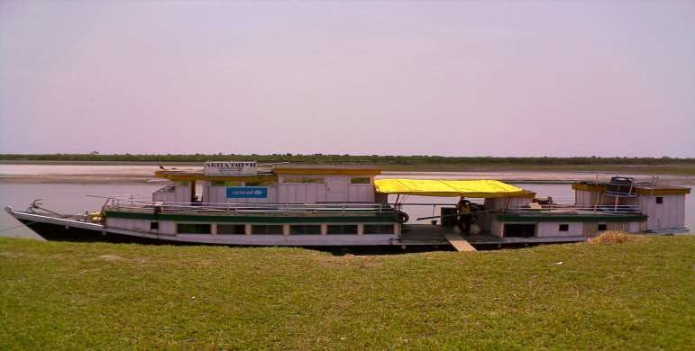
INNOVATIONS
Launched on 25th May 2005
Services offered: OPD services, ANC, Immunization, Family
planning, Minor operative procedures, Basic Laboratory
Services
Boat Clinic – Ship of Hope
46

Slide 47
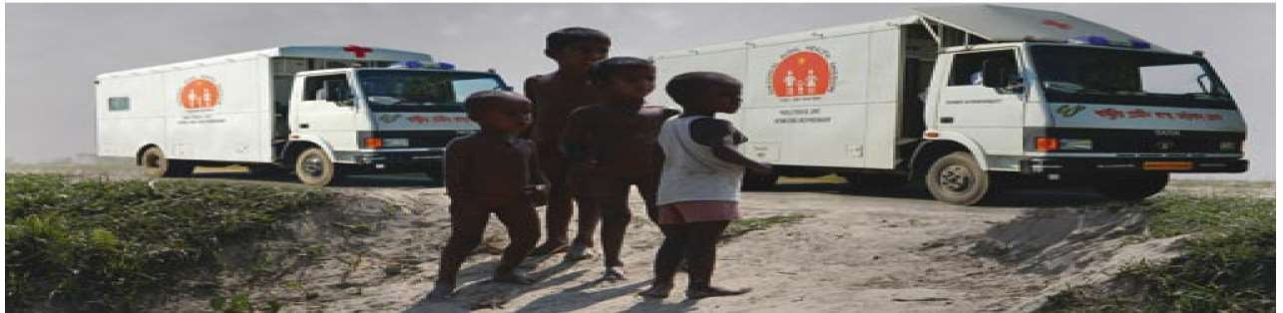
MOBILE MEDICAL UNIT HOSPITAL ON WHEELS
Launched on 11th November ’07
Operational in 27 districts
Equipped with Microscope, Semi Auto Analyzer, Portable X-ray, USG, ECG, Generator
2 MO, Nurses, Technicians…
47

Slide 48
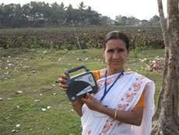
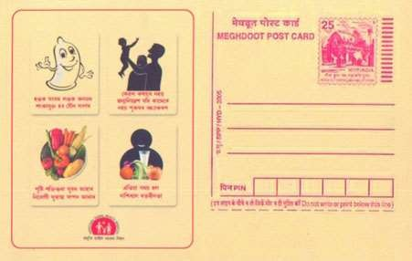
ASHA RADIO
Updating the ASHAs with new development and also informing them about the mission for upgrading the standard of life of the rural people in respect to health and hygiene and particularly promoting the healthy environment for mother and child.
Feedback Mechanism : Pre paid post cards with printed address of
office of the AIR, Each ASHA will be given 12 postcards.
48

Slide 49
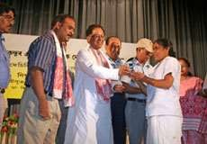
ANM MOBILE
Can report any suspected cases to the PHC to take immediate action before it results to outbreak.
Can also facilitate for the referral transport so that people can avail the facility as there are villages where public transportation facility is not available.
49

Slide 50
ACHIEVEMENTS OF NRHM
More than 8.3 lakh ASHAs are connecting households to health facilities.
NRHM has provided an opportunity to provide cashless hospitalized service to the poor through Rogi Kalyan Samiti resources.
Over 5 lakh village – health nutrition and sanitation committees have been constituted.
Subcentres have been strengthened by way of providing untied money of
Rs. 10,000 per annum and second ANM at Subcentre
NRHM has benefited below poverty line women for safe delivery.
Delivery huts have been constructed to promote safe delivery at village
level.
50

Slide 51
CONT.....
PHCs and CHCs have been strengthened by provision of untied fund of
Rs.25,000 per annum per PHC and Rs.50,000 per annum per CHC.
District level plans have been formulated by 636 districts.
District programme management units have been set up.
Upgrading of CHCs, PHCs and SCs as per Indian public health standards (IPHS).
District, state, national health mission constituted.
Public – private partnership with NGOs and private partnership has begun.
Indigenous system of medicine: AYUSH has been promoted and services
set – up at district level
First referral units (FRUs) for 24 – hour referral services and PHCs for 24 hour referral services are progressing.
50

Slide 52
HEALTH FINANCING
NOW
20% public expenditure (0.9% GDP), often inefficient and ineffective.
80% private expenditure, mostly out of pocket.
15-20% MoHFW expenditure – rest by States.
By 2012
40% public expenditure with improved accountability and efficiency ( 2-3% GDP).
Private expenditure by risk pooling/insurance.
40% GoI expenditure – rest by States.

Slide 53
PARADIGM SHIFT DUE TO NRHM
Moves From
Current public expenditure on health 0.9% of GDP.
Inflexible Financing
Dysfunctional health infrastructure.
No standards prescribed for quality.
Central Govt. Financing Confined to select Programmes or Programme disease centric.
TO
Increase Public expenditure 2-3% of GDP by 2012.
Flexible financing
Fully Functional Health Facilities
IPHS for physical infrastructure, human resources, equipment, drugs
Financing now is directed to Development of state health system.

Slide 54
CONT.....
Time consuming recruitment system and inadequate provision of human resources.
Low level community participation.
Poor management capacity.
Lack of coverage
10 Centralized planning and evaluation.
Contractual appointments, local residency and additional human resources.
Increasing community participation.
Improved management capacity.
Integrating vertical health and Family Welfare programme
Decentralized district health action plans.

Slide 55
OUTCOME INDICATORS BY 2017
Reduce infant mortality rate to 25.
Reduce maternal mortality rate to 100.
Reduction of total fertility rate to 2.1.
Reduce prevalence of under nutrition in children under 3 years to 27%.
Reduction of anaemia among women (15-49 years) to 28%.
Raise child sex ratio from 914 to 950.
Prevention and reduction of burden of communicable disease , non-communicable disease and injuries.

Slide 56
REFRENCES
Park’s textbook of Preventive and Social Medicine
Textbook of Community Medicine – Sunder Lal, Adarsh, Pankaj
www.nrhm.gov.in
www.upnrhm.gov.in
pglibrary-publichealth.wikispaces.com/file
www.nhm.gov.in

Slide 57






THANK YOU..

