Slide 1



JANANI SISHU SURAKSHA KARYAKRAM ( JSSK )
Mr. Adithya S.
Asst Professor
SNC

Slide 2

Contents
Introduction
Objectives
Entitlements under the scheme
Implementation of the initiative
Implementation status of Rohtak

Slide 3

Introduction
Maternal mortality is a global tragedy.
WORLD
INDIA
303000 Maternal deaths annually
99% - Developing countries
1% - Developed countries
67000 Maternal deaths annually

Slide 4
Introduction
Neonatal mortality :-
WORLD
INDIA
40 Lakhs Neonatal deaths annually
9 Lakhs Neonatal deaths annually
About 7 Lakhs die within first week of birth

Slide 5
Introduction
Reducing the Maternal and infant mortality is the key goal of Maternal and Child Health Care Programmes.
Evolution of MCH care Programmes :-
Family Welfare Programme(1979) :-
  Integration of family planning services with those of MCH
  Effective IEC to improve awareness
  Easy and convenient access to FW services free of cost

Slide 6
Introduction
2. Child Survival and Safe Motherhood Programme(1992) :-
FOR PREGNANT WOMEN
Early registration of pregnancy
Minimum three ANC check ups
Universal coverage with TT immunization
Detection of High risk pregnancies and prompt referral
Promotion of institutional deliveries
Birth spacing

Slide 7
Introduction
CSSM(contd.) :-
FOR CHILDREN
Proper new born care
High coverage levels under UIP
Diarrheal Disease Control Programme- Oral Rehydration
Therapy
ARI Control Programme

Slide 8
Introduction
Reproductive and Child Health Programme :-
  Phase-1, 1997
  Essential obstetric care
  24 hour delivery services at PHC/CHCs
  Essential newborn care
  Emergency obstetric care
  Medical termination of pregnancy
  Prevention of RTI and STDs

Slide 9
Introduction
Reproductive and Child Health Programme- II :-
  Started from April, 2005
  Essential Obstetric Care :-
    Institutional deliveries
    Skilled Birth Attendants(SBA) at delivery
  Emergency Obstetric Care :-
    Operationalising FRU
    Operationalising PHC and CHCs for round the clock
delivery services
  Strengthening referral system

Slide 10
Introduction
National Rural Health Mission :-
  Launched on 5th April, 2005
  Main aim is to provide equitable, accessible and affordable
health care
  Many initiatives were taken under NRHM to reduce the maternal mortality including Janani Suraksha Yojana
JSY
12 April, 2005
Centrally sponsored scheme
Cash assistance with institutional care

Slide 11
Introduction
Concerns of JSY
High out of pocket expenses
OPD fees
Diagnostic tests
Admission fees
Drugs and Consumables
Spending on Transport
Spending on Diet

Slide 12
Introduction
Janani Shishu Suraksha Karyakram(JSSK) :-
Launched on June 1, 2011.
From Mewat, Haryana.
Invokes a new approach to healthcare, placing , for the first time, utmost emphasis on entitlements and elimination of out- of-pocket expenses for both pregnant women and sick neonates.
Entitles all pregnant women delivering in public health institutions to absolutely free and no-expense delivery, including caesarian delivery.

Slide 13
Introduction
JSSK :-
Entitlements would include free drugs and consumables, free
diagnostics, free blood, free diet for the duration of woman’s
stay in the facility, expected to be three days in case of normal delivery and seven days in case of caesarian section.
Free transport from home to the facility, between facilities in case of referral, and also drop-back home after the delivery.
This initiative is estimated to benefit more than 1 crore pregnant women and newborns who access government health institutions every year in both urban and rural area.

Slide 14

Introduction
JSSK :-
Similar entitlements
newborns (upto 1 year).
for all sick
Free treatment
Free transport to the facility and
of
between the facilities, in case
referral and back to home from the facility.

Slide 15
Objectives
Eliminating the out-of-pocket expenses for the families of pregnant women and sick newborns in government health facilities.
To increase the access to health care for the pregnant women who still deliver at home ( estimated to be 70 lakh per year).
Timely access to health care for sick newborns.
Supplementing the cash assistance given to a pregnant woman under JSY.

Slide 16
Free Entitlements for pregnant women
Free and zero expense Delivery and caesarian section
Free Drugs and consumables
Free Essential Diagnostic tests (blood tests, urine tests, USG etc.)
Free Diet during the stay in the health institution
Free provision of Blood
Free Transport from home to Health institutions
Free Transport between facilities, in case of referral
Drop back to home from institutions after 48 hrs. of stay
Exemption from all kind of user charges

Slide 17
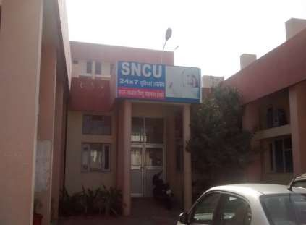
Free Entitlements for sick newborns
Free and zero expense treatment
Free Drugs and consumables
Free Essential Diagnostic tests
Free provision of Blood
Free Transport from home to Health institutions
Free Transport between facilities, in case of referral
Drop back to home from institutions
Exemption from all kinds of user charges

Slide 18
Implementation of the initiative
Actions at state level:-
Issue government order on free entitlements
Nominate a State Nodal Officer
Institute a grievance redressal mechanism
Ensure regular procurement and availability of drugs and consumables
Ensure functional lab facilities and diagnostic services
Establish and operationalise blood banks at District levels
and blood storage centers at identified FRUs

Slide 19
Actions at state level(contd.)
Establish district wise assured referral linkages
Provide required finances
Regularly monitor and report on designated formats at specified periodicity
Review the implementation status during district CMOs
meetings

Slide 20
Actions at District level
Nominate a District Nodal Officer
Circulate the government order on free entitlements to all facility in-charges
Widely publicise free entitlements in public domain
Institute a grievance redressal mechanism
Regularly review the stocks of drugs and consumables
Ensure functional lab facilities and diagnostic services
Prepare time bound action plans for establishing and
operationalising blood bank

Slide 21
Actions at District level(contd.)
Review referral linkages and their utilization by beneficiaries
Provide required finances to facility in-charges
Regularly monitor and report on designated formats at
specified periodicity
Review the implementation
meetings
status
during
Block MOs

Slide 22
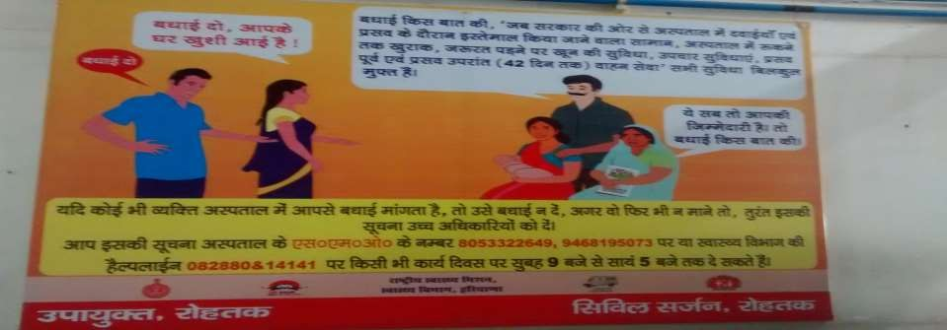
Dissemination of the entitlements in public domain
Publicise the entitlements in print and electronic media
Display them on adequate size hoardings and boards , which is clearly visible from distance in all government health facilities
IEC budget sanctioned under RCH/NRHM can be used

Slide 23
Ensure Drugs and Consumables
Essential drugs list to be notified for RCH services
Ensure regular procurement and availability
Daily availability of drugs to be displayed in health facility
Empower the head of the district/ health facility to procure drugs to prevent stock outs
Ensure the quality and shelf life of drugs
Ensure the proper inventory at each health facility
In charge Pharmacist of the facility to ensure the availability of drugs at dispensing points i.e. labour room, OT, casualty etc. after routine hours

Slide 24
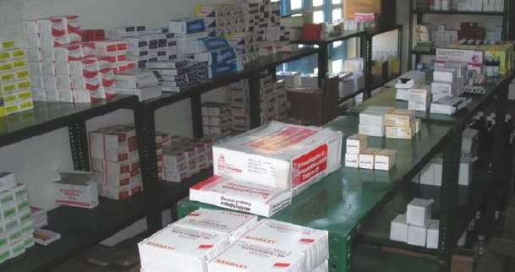
Ensure Drugs and Consumables
Ensure the ‘First In First Out ’ protocol
Ensure proper storage with drug stores clean and tidy with
adequate ventilation and cooling

Slide 25
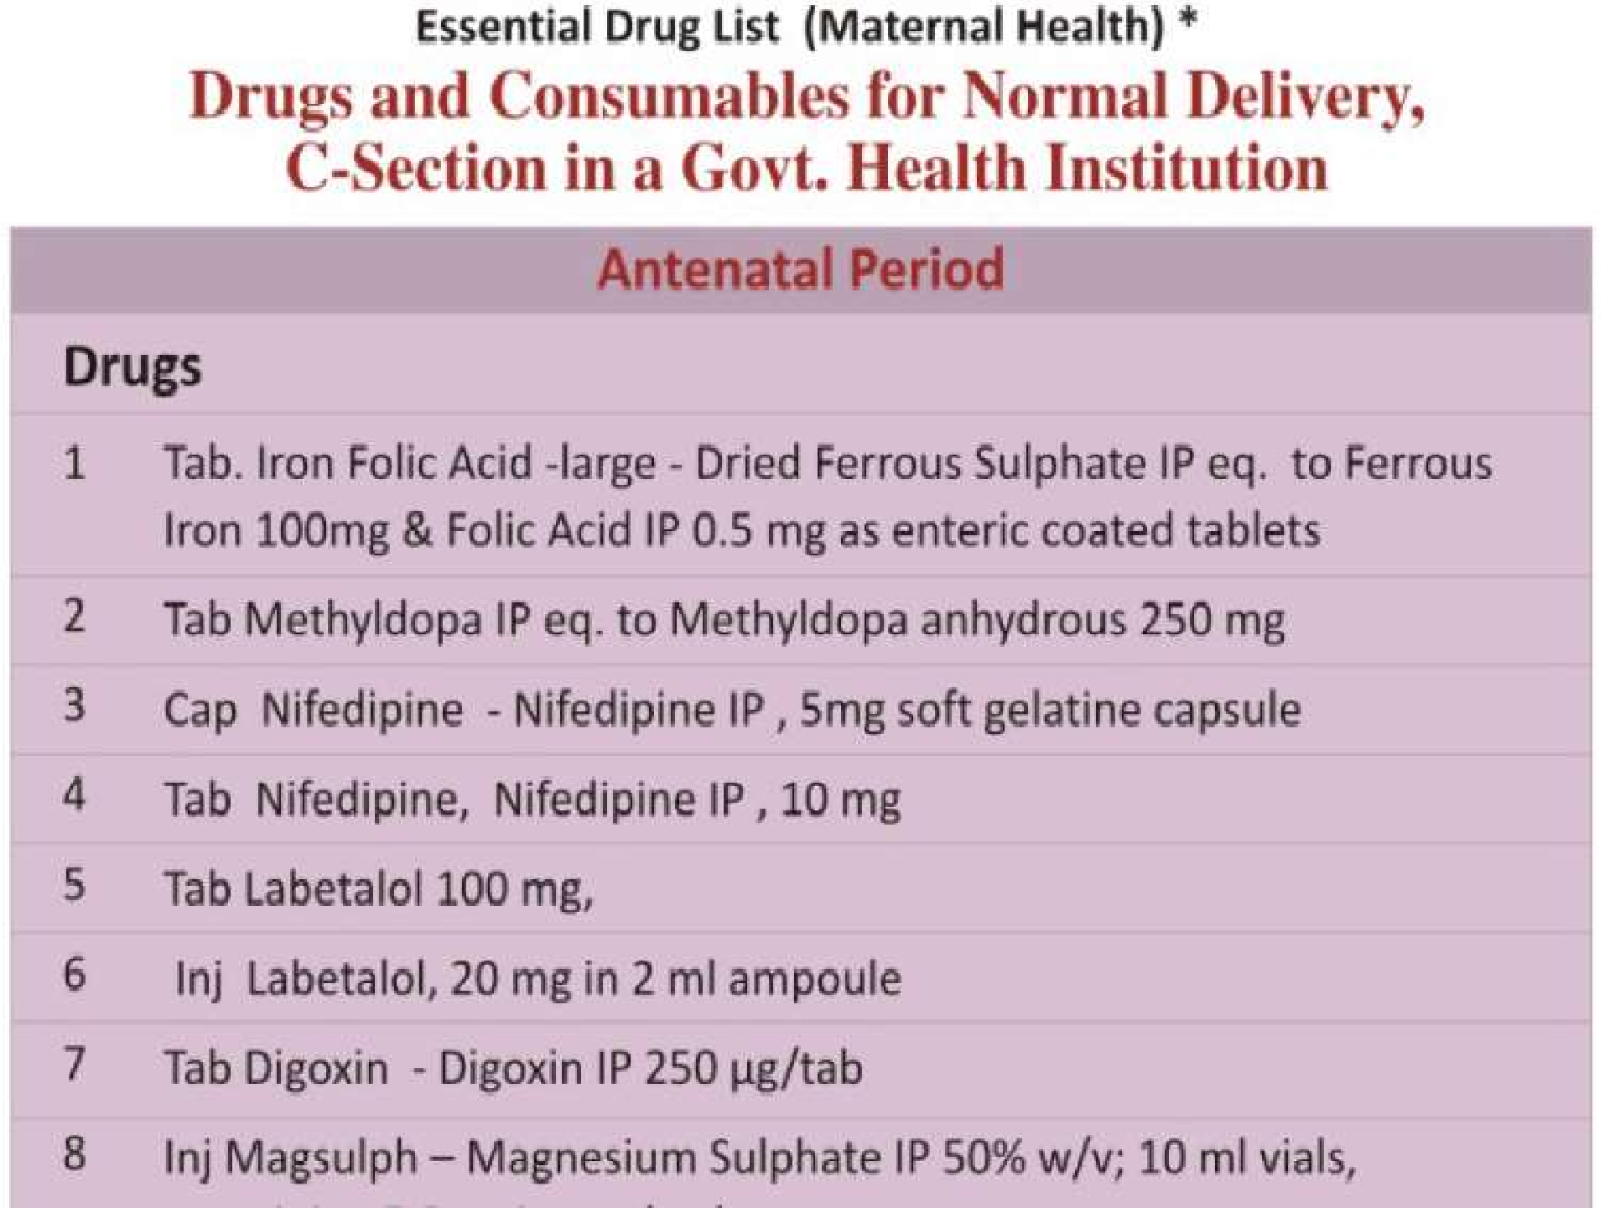

Slide 26
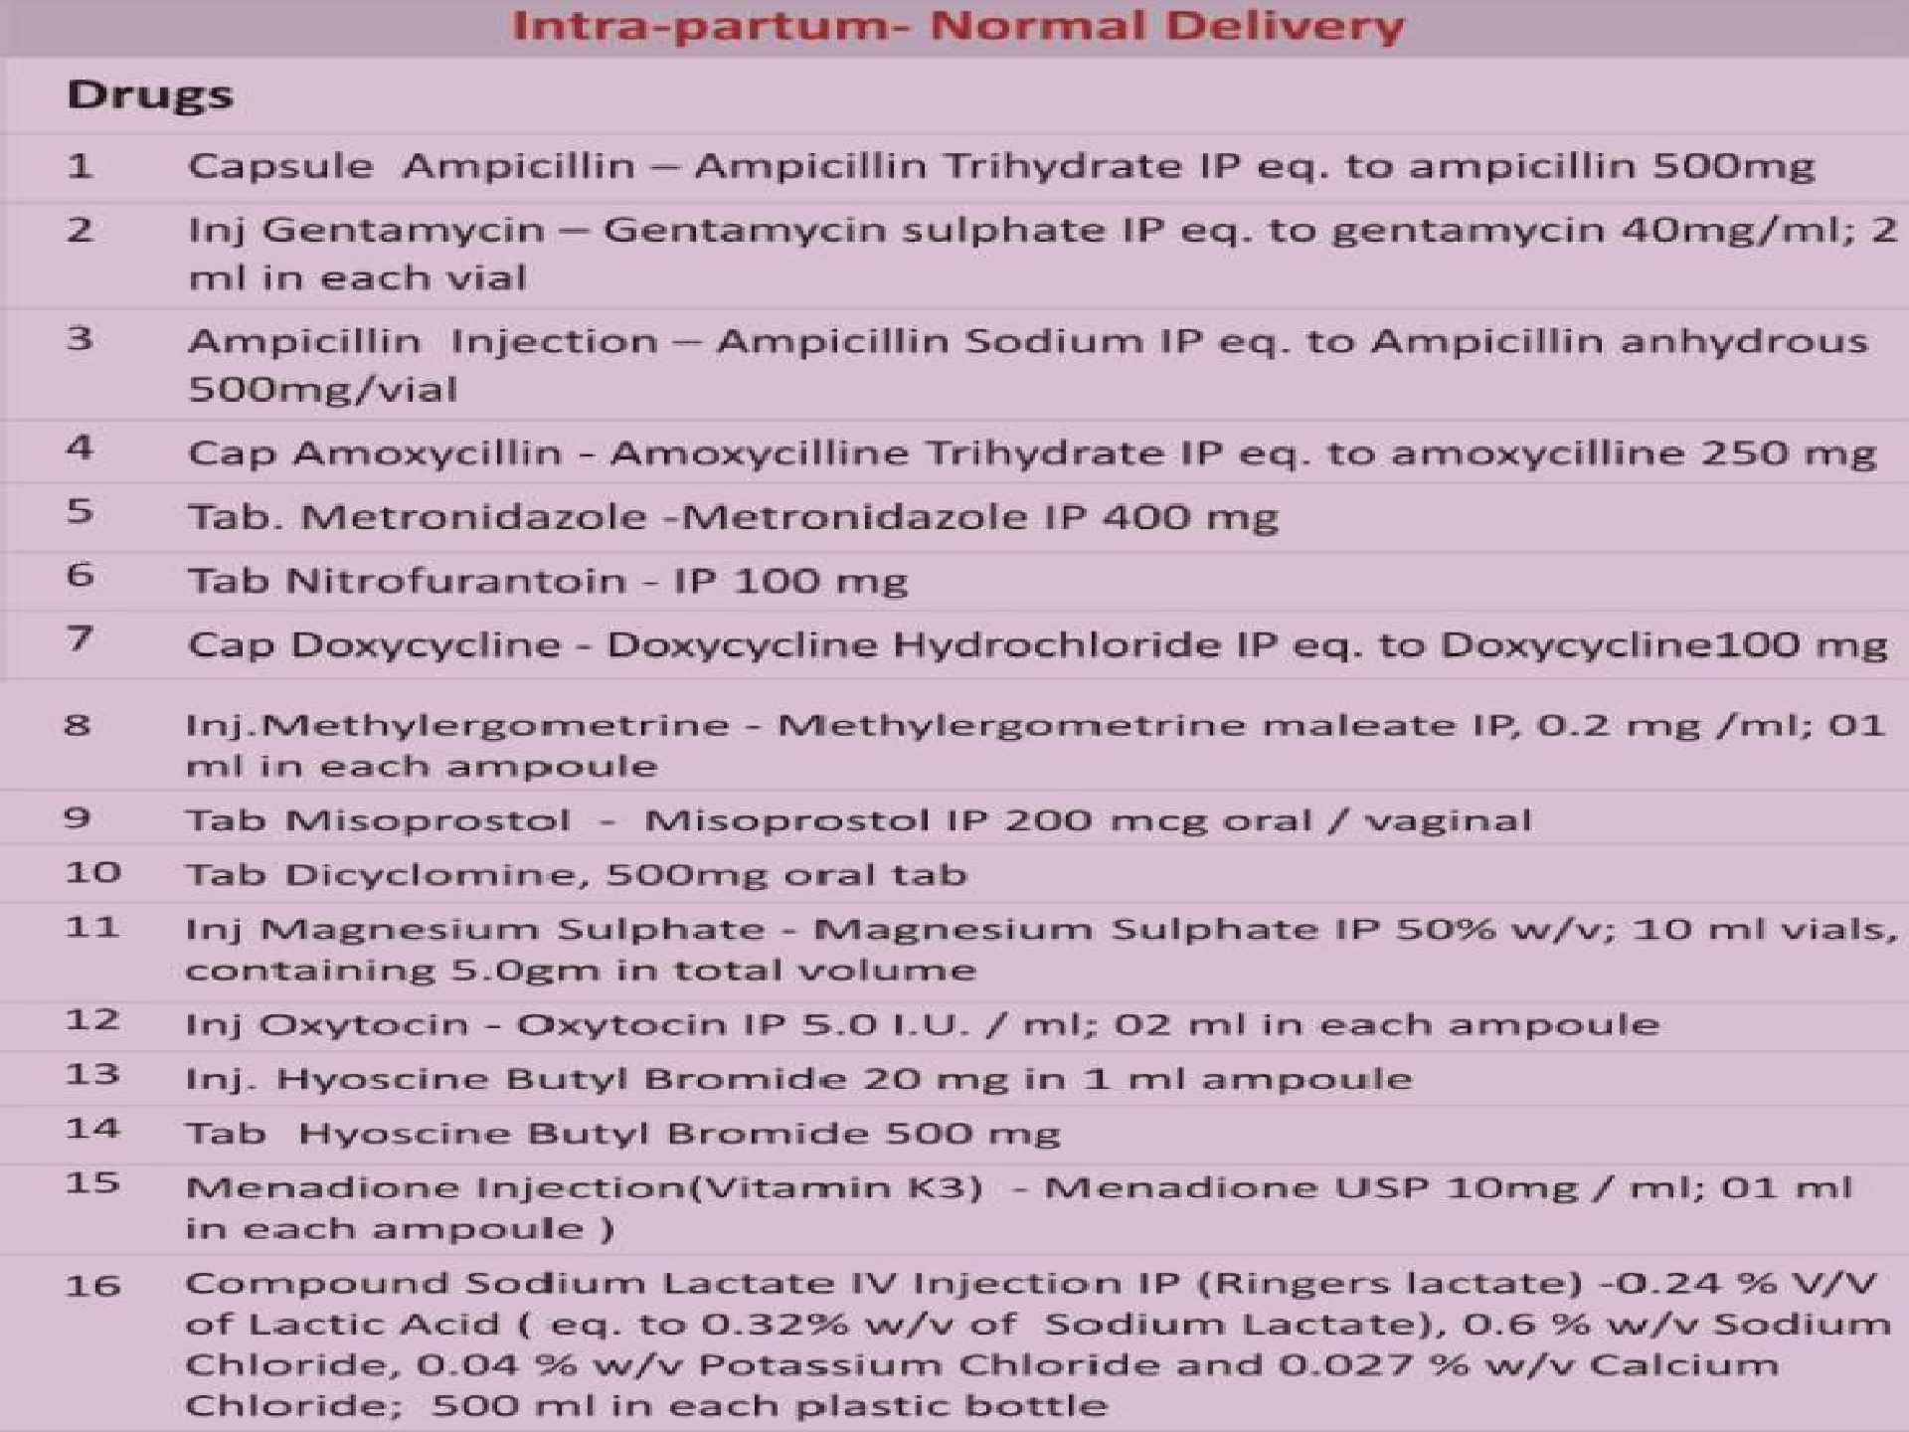

Slide 27
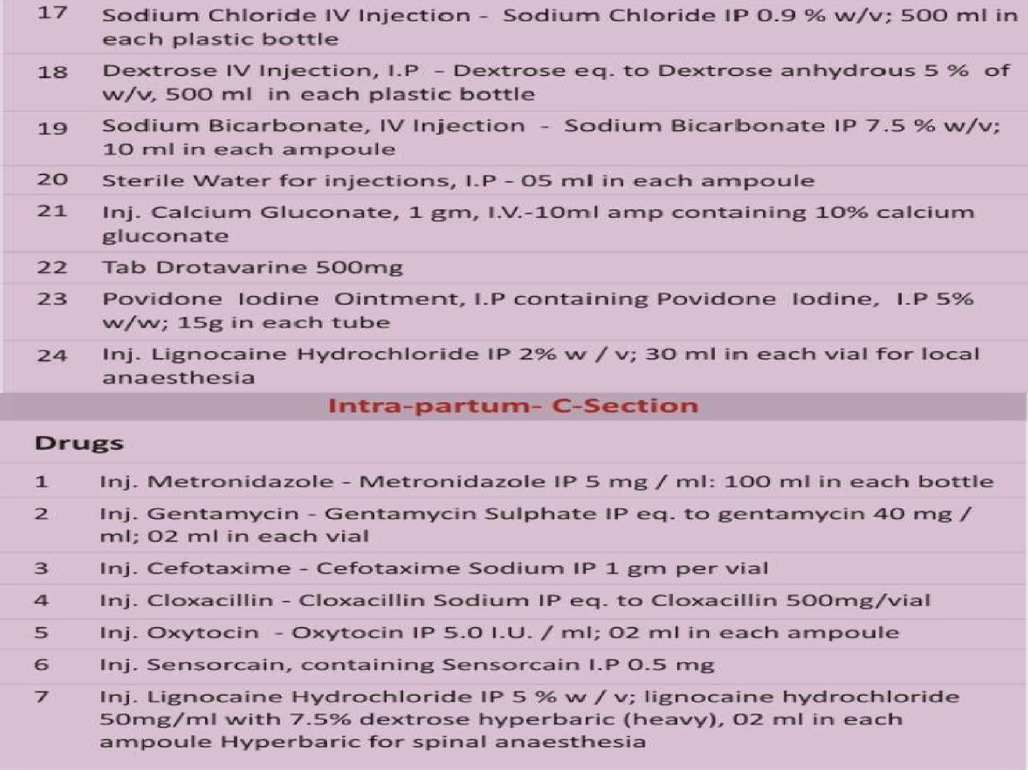

Slide 28
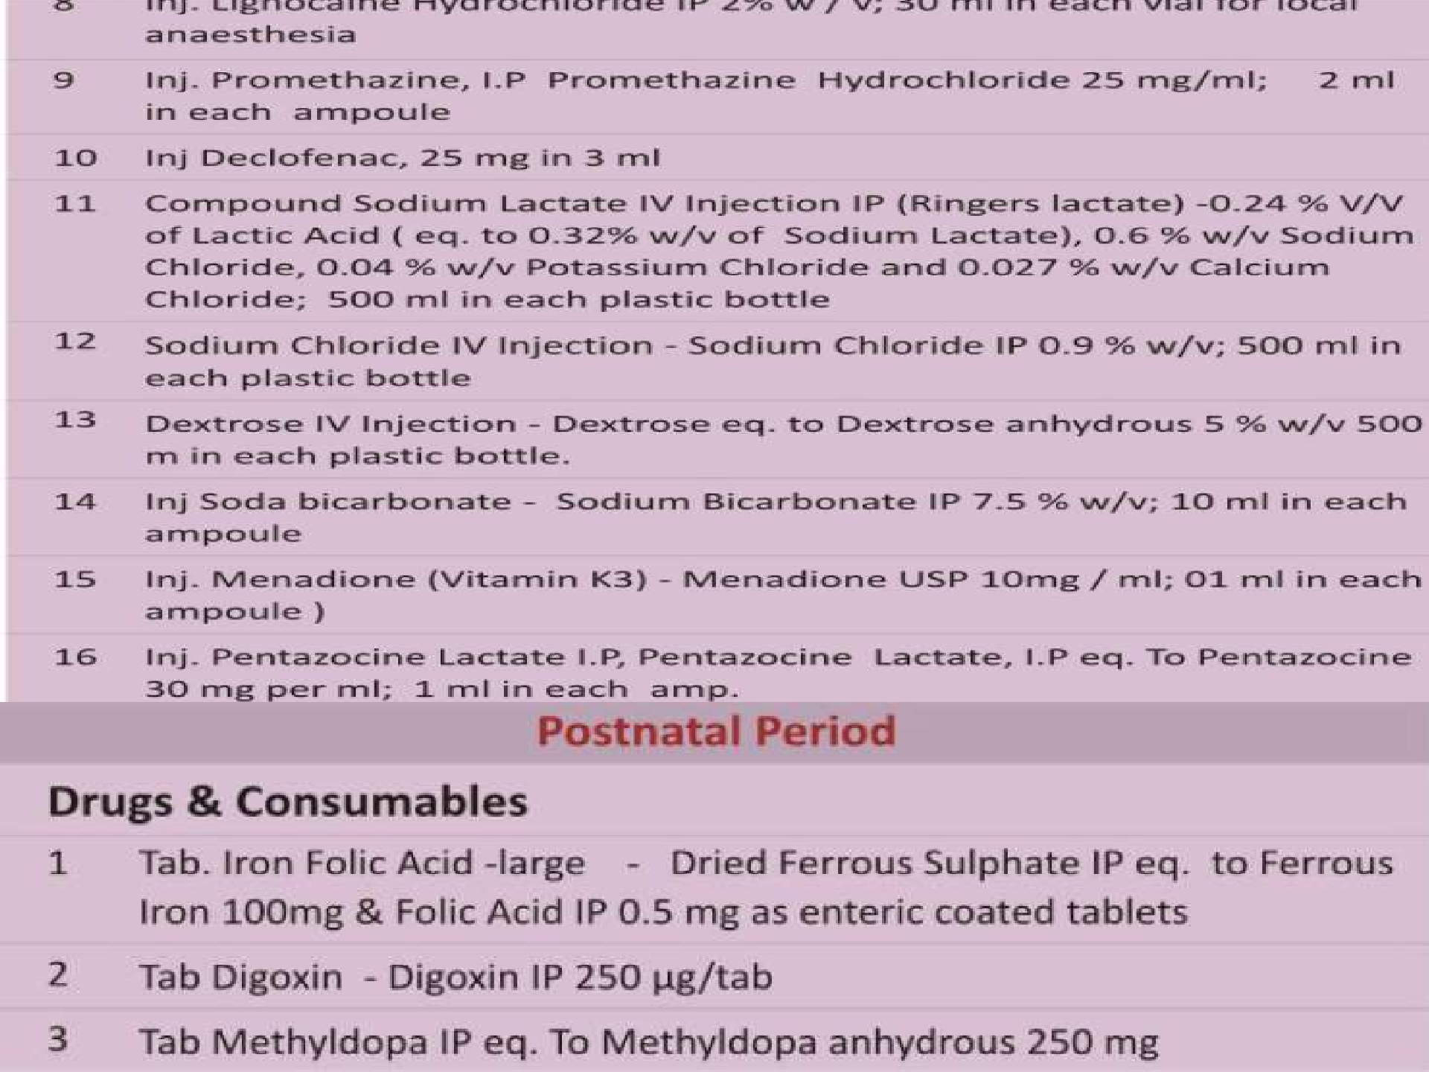

Slide 29
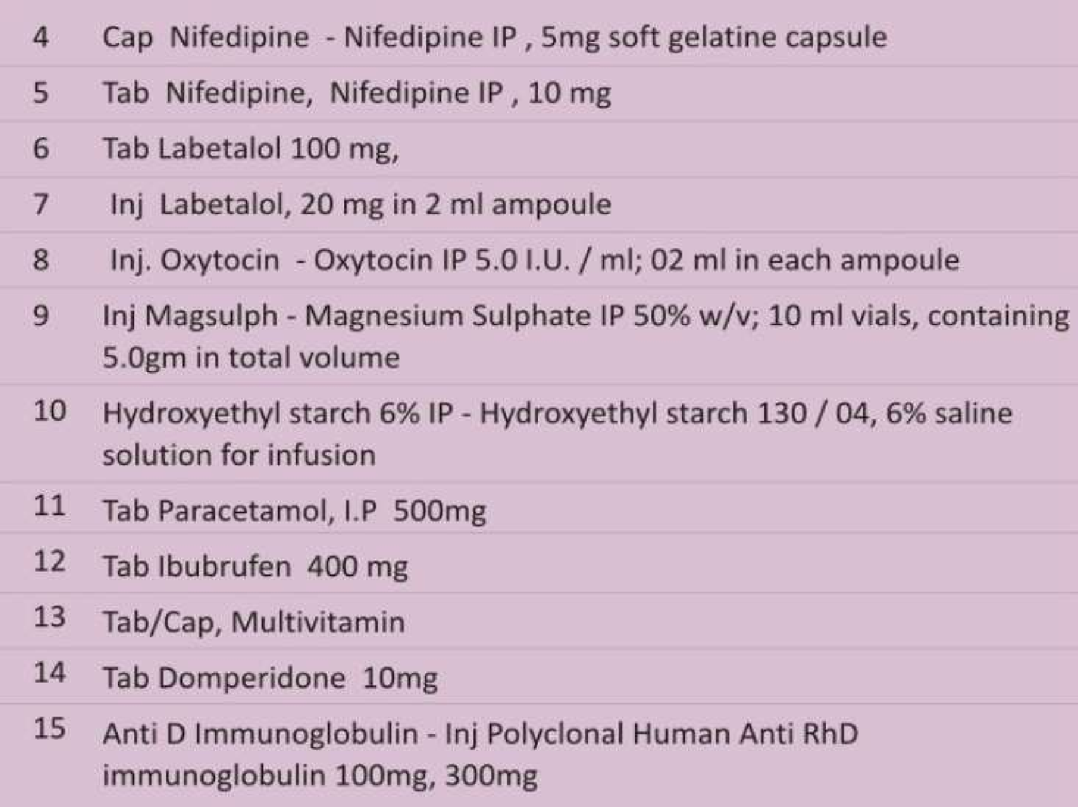

Slide 30
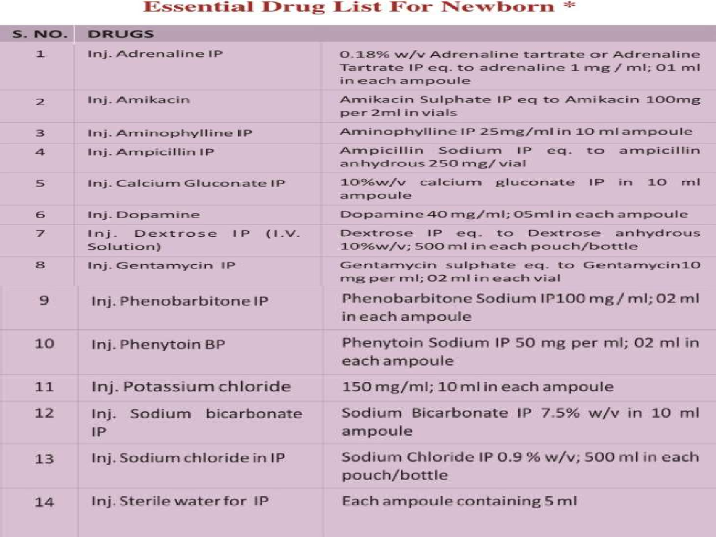

Slide 31
Ensure provision of Diet
Ensure provision of diet at each delivery points from District Hospital to PHC :-
For 3 days in case of normal delivery
For 7 days in case of caesarian section
If proper kitchen and manpower is not available, this service can be outsourced
Local seasonal foods, vegetables, fruits, milk and eggs
MO in-charge should monitor the quality
Health facility should receive funds in advance

Slide 32
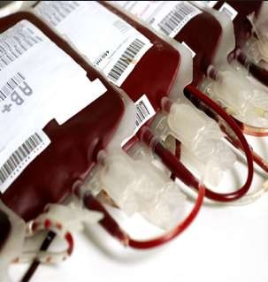
Ensure availability of Blood
Prepare time bound action plan to
establish and operationalise blood banks
Maintain adequate stock
Ensure availability of
reagents and
consumables
Ensure mandatory screening of blood and organise periodic voluntary blood donation camps
Provide adequate funds to blood bank

Slide 33

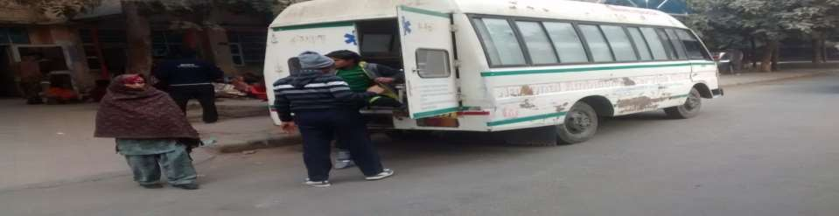
Referral transport
Ensure universal reach with 24 7 referral services
Establish call centers with a single toll free number at District and State level
May provide ambulances with GPS, for effective tracking and management
Publicise free transport in print and electronic media
Monitor and supervise services at all levels

Slide 34
Monitoring and follow up
National level
National Health Systems Resource Centre (NHSRC)
Maternal health division, Ministry of Health and Family Welfare(MoHFW)

Slide 35
Monitoring and follow up
State level
District level
State Nodal Officer
District Nodal Officer
In CMOs meeting at state level, the Mission Director and during MOs meeting at district level, CMO will review the progress of the scheme.

Slide 36
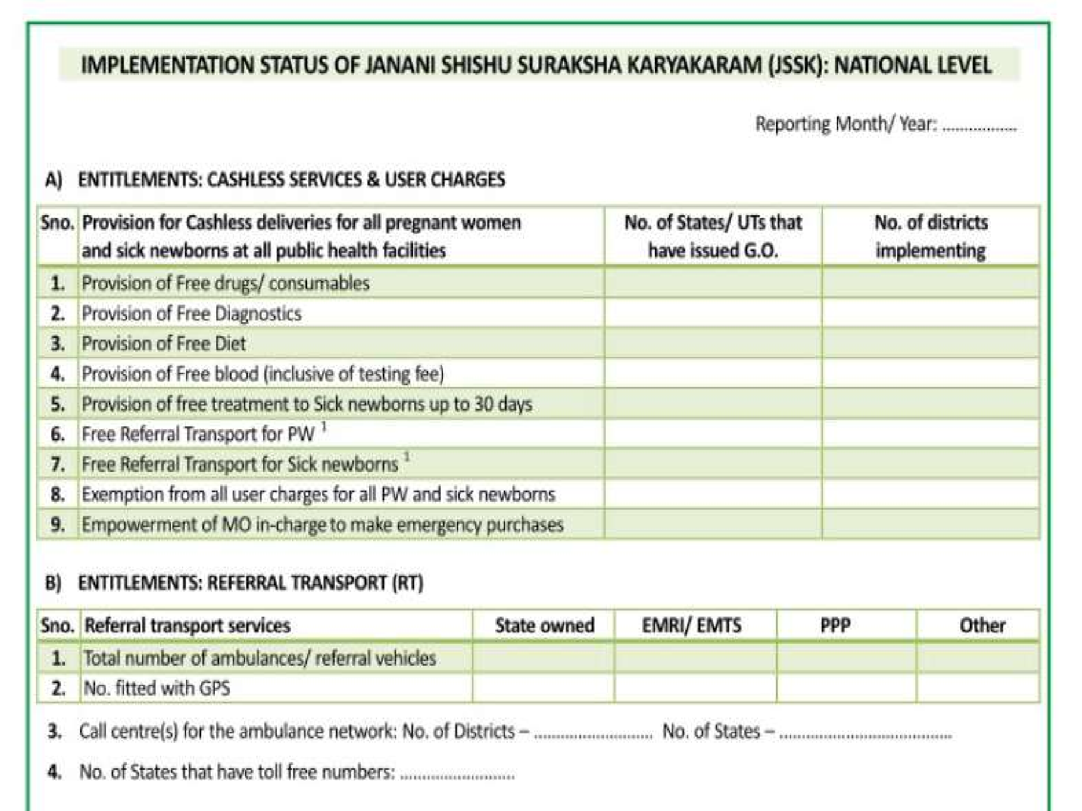

Slide 37
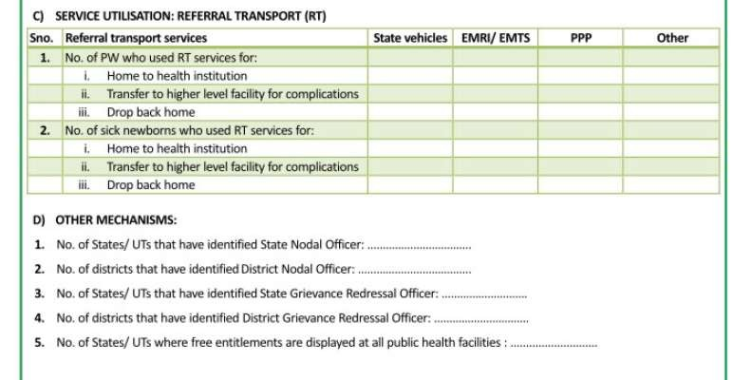

Slide 38
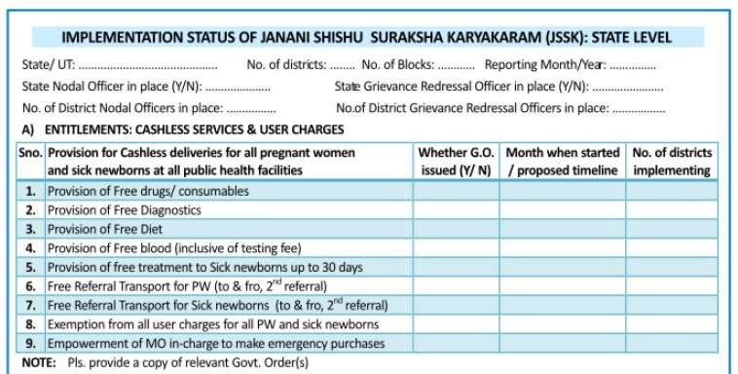

Slide 39
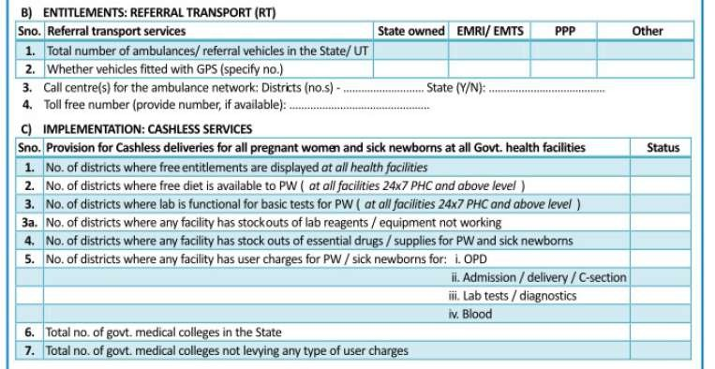

Slide 40
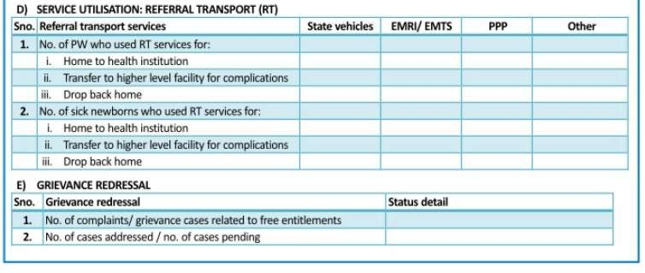

Slide 41
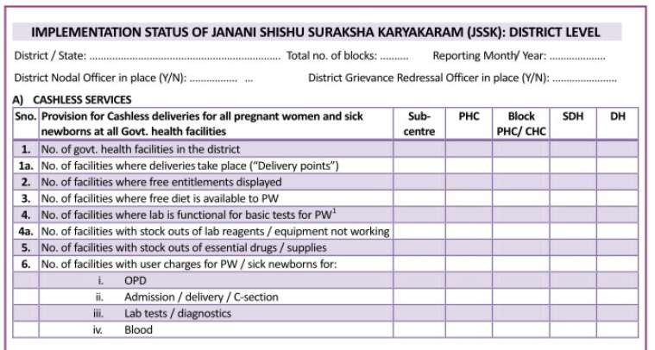

Slide 42
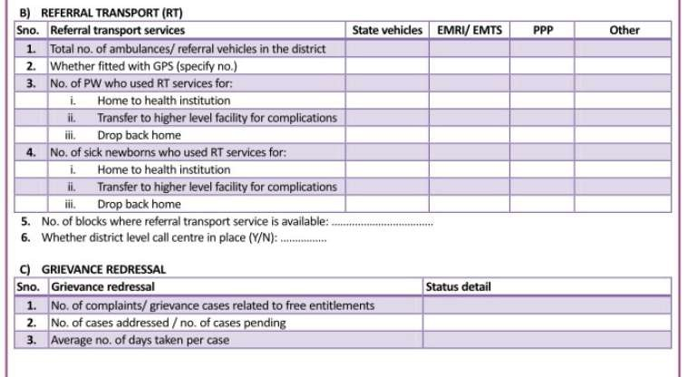

Slide 43
Thank You

