Slide 1

PRIMARY HEALTH CARE
Ms. Ekta M. Patel
Asst. Professor
Sumandeep Nursing College
Sumandeep Vidyapeeth Deemed To Be University
(Accredited ‘A’ Grade By Naac With A Cgpa Of 3.53 Out Of Four Point Scale)
Piparia, Waghodia, Vadodara, Gujarat

Slide 2
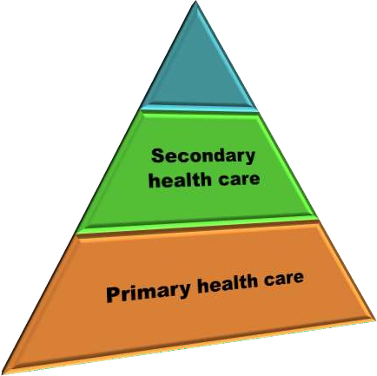
Levels of health care
Primary Health care
Provided at the community level
Tertiary health care
Secondary health care
Provided at PHC, CHC, DH etc.
Tertiary health care
Provided at hospitals

Slide 3
Alma-Ata international conference
In 1977, World Health Assembly decided to launch a movement called “Health for all by 2000”
Fundamental principle of this concept was equity, an equal health status for all the people in all countries
This is to be ensured by equitable distribution of health
resources
In 1978, the note of “Health for all” was reaffirmed and
marked as the major social goal for every country.
It was stated in the declaration that the best way to achieve HFA is by providing primary health care……
……… especially to vast size of underserved rural and urban poor

Slide 4
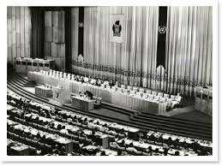
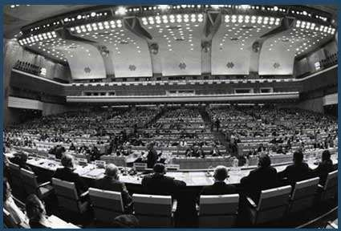
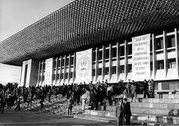
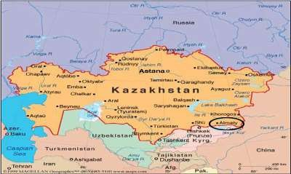
Alma-Ata conference, 1978

Slide 5
Alma-Ata Declarations
A main social target of governments, international organizations and the whole world community in the coming decades should be the attainment by all peoples of the world by the year 2000 of a level of health that will permit them to lead a socially and economically productive life. - “HEALTH FOR ALL BY 2000”
Primary health care is the key to attaining this target as part of development in the spirit of social justice.
Primary health care is essential health care based on practical, scientifically sound and socially acceptable methods and technology, made universally accessible to individuals and families in the community through their full participation and at a cost that the community and country can afford.

Slide 6
Alma-Ata Declaration
It forms an integral part of the country's health system, and of the overall social and economic development of the community.
It is the first level of contact of individuals, the family and community with the national health system.
All governments should formulate national policies, strategies and plans of action to launch and sustain primary health care as part of a comprehensive national health system and in coordination with other sectors.

Slide 7

Definition
Cont…
Primary health care is essential health care made universally accessible to individuals and acceptable to them through their full participation and at a cost the community and country can afford

Slide 8
Primary health care
Primary Health Care as defined by the World Health Organization (WHO) in 1978 is…
Essential health care; based on
  practical,
  scientifically sound, and
  socially acceptable method and technology….
…….made universally accessible to individuals and families of the community through their full participation….
……at a cost that community and country can afford to maintain every stage of their development in the spirit of self determination.
❑

Slide 9
Cont.…
It is the first level of contact with the health system to promote health, prevent illness, care for common illnesses, and manage ongoing health problems.
Primary Health Care involves concerted effort to provide rural population of developing countries with least bare minimum of health services.
Some services are also provided community and hospitals
Primary Health Care is different in each community depending upon:
  Needs of the residents;
  Availability of health care providers;
  The communities geographic location; &
  Proximity to other health care services in the area.

Slide 10

What is there in Primary Health Care..?????
Primary Health Care includes:
  Primary Care (physicians, midwives & nurses);
  Health promotion, illness prevention;
  Health maintenance & home support;
  Community rehabilitation;
  Pre-hospital emergency medical services… and…
  Coordination and referral to other areas of health care.

Slide 11

Elements of primary health care
Education about prevailing health conditions and methods to prevent and control them
Promotion of food supply and proper nutrition
Adequate water supply and basic sanitation
Maternal and child health care with family planning
Immunization against major infectious diseases
Prevention and control of locally endemic diseases
Appropriate treatment of common diseases and injuries
Provision of essential drugs

Slide 12




Principles of primary health care
Equitable distribution
Community participation
Intersectoral coordination
Appropriate technology

