Slide 1
DEVELOPMENTAL THEORIES
Presented By:
Mr. Nirmal Raj EV
Assistant Professor
Dept of pediatric nursing
Sumandeep nursing college
Sumandeep Vidyapeeth deemed to be University
Piparia, Waghodia, Vadodara

Slide 2
Cognitive development theory
comprehensive theory about the nature and development of human intelligence.
It was first created by the Swiss developmental psychologist Jean Piaget (1896–1980).

Slide 3
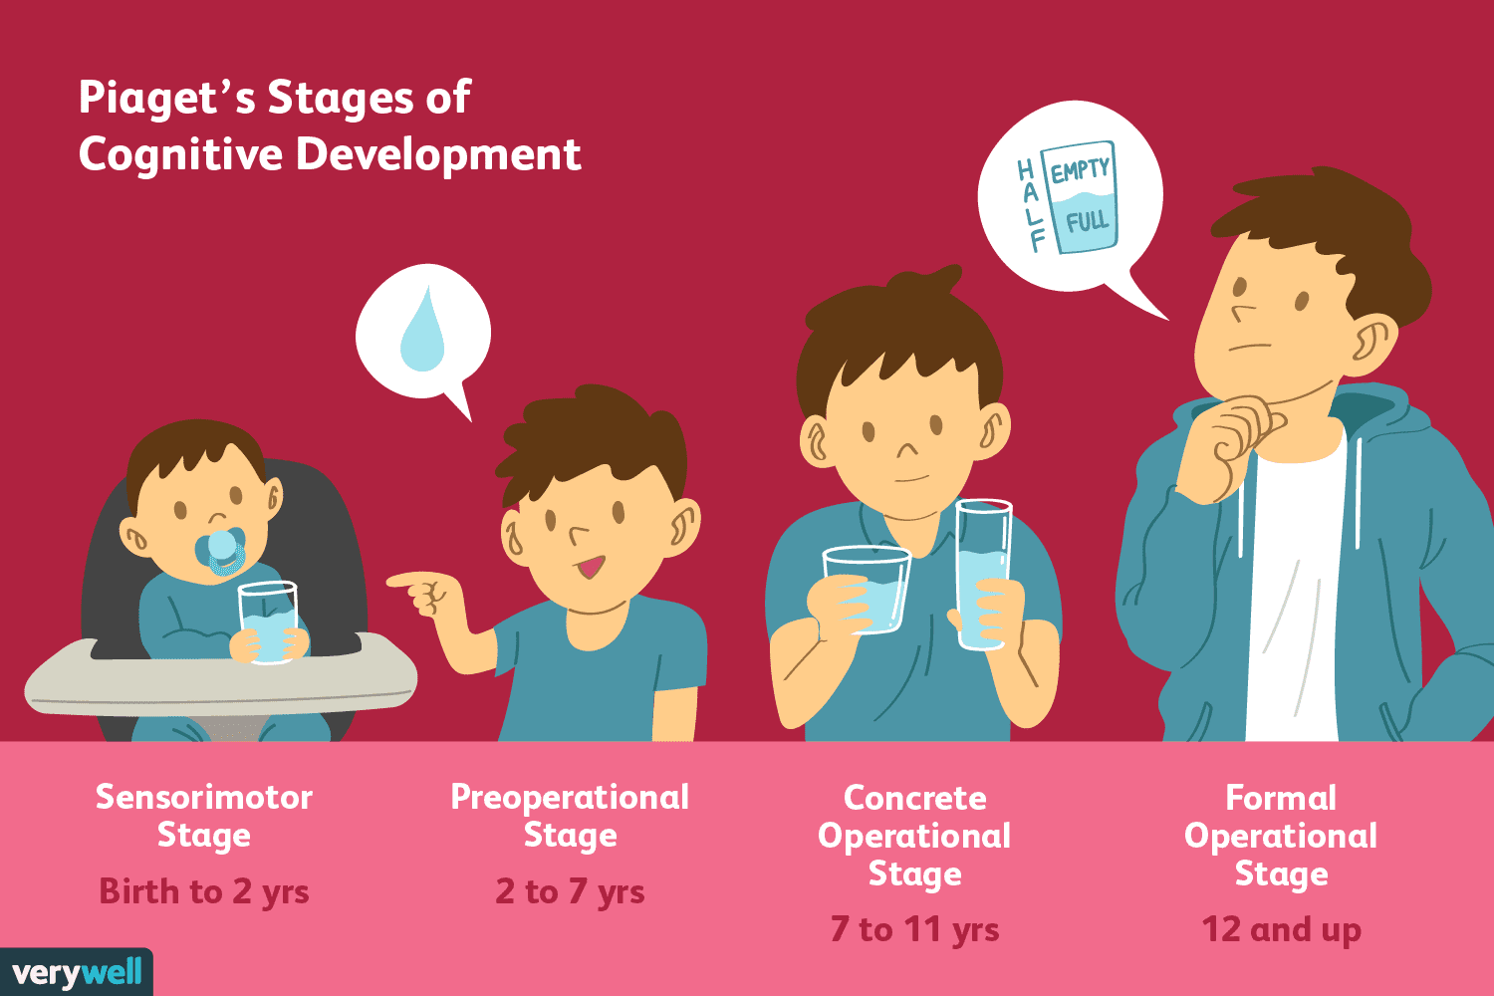

Slide 4
Basic components of the theory
Schemas (building blocks of knowledge)
Equilibrium
Assimilation
Accommodation

Slide 5
Schemas
Mental representation or mental template
Index card filed in the mind
A script
Sucking reflex – a schema

Slide 6
Equilibrium
When a child's existing schemas are capable of explaining what it can perceive around it, it is said to be in a state of equilibrium, i.e., a state of cognitive (i.e., mental) balance.

Slide 7
Assimilation
Which is using an existing schema to deal with a new object or situation.
Accommodation
This happens when the existing schema (knowledge) does not work, and needs to be changed to deal with a new object or situation.

Slide 8
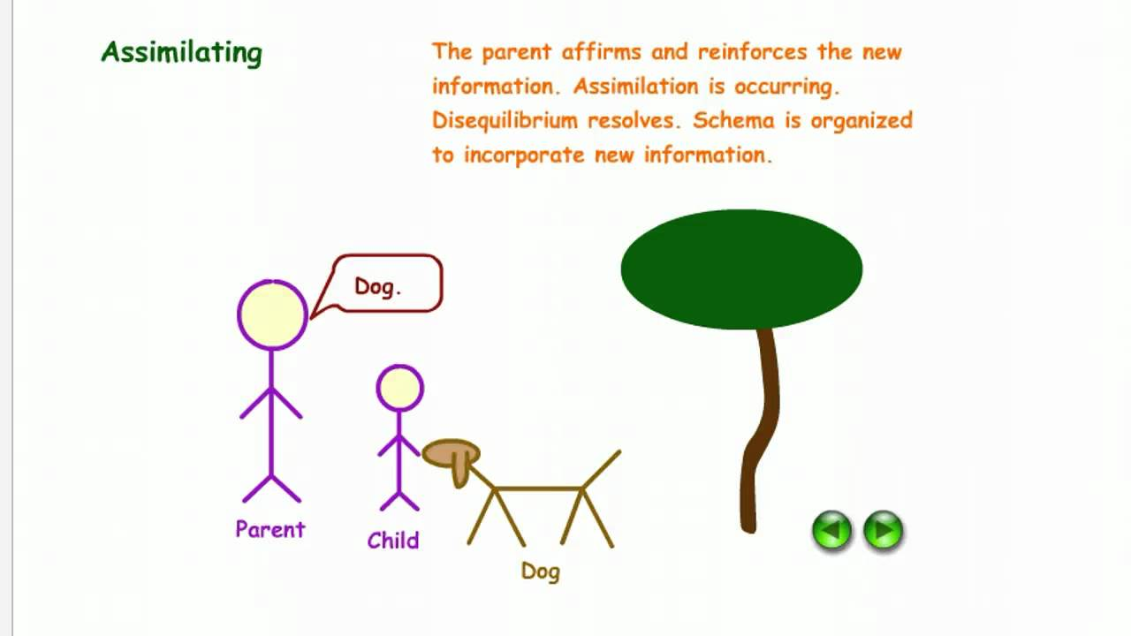

Slide 9


Slide 10
1. The sensori-motor stage (0 - 2 years)
Children will experience the world and gain knowledge through their senses and motor movements
This explains why babies love to put everything in their mouths, this is how they interpret objects
During the first month, infants will show signs of reflexes. These reflexes are innate and promote survival, some examples are rooting, sucking and grasping
Infants learn that things continue to exist even though they cannot be seen (object permanence)
They are separate beings from the people and objects around them
They realize that their actions can cause things to happen in the world around them

Slide 11
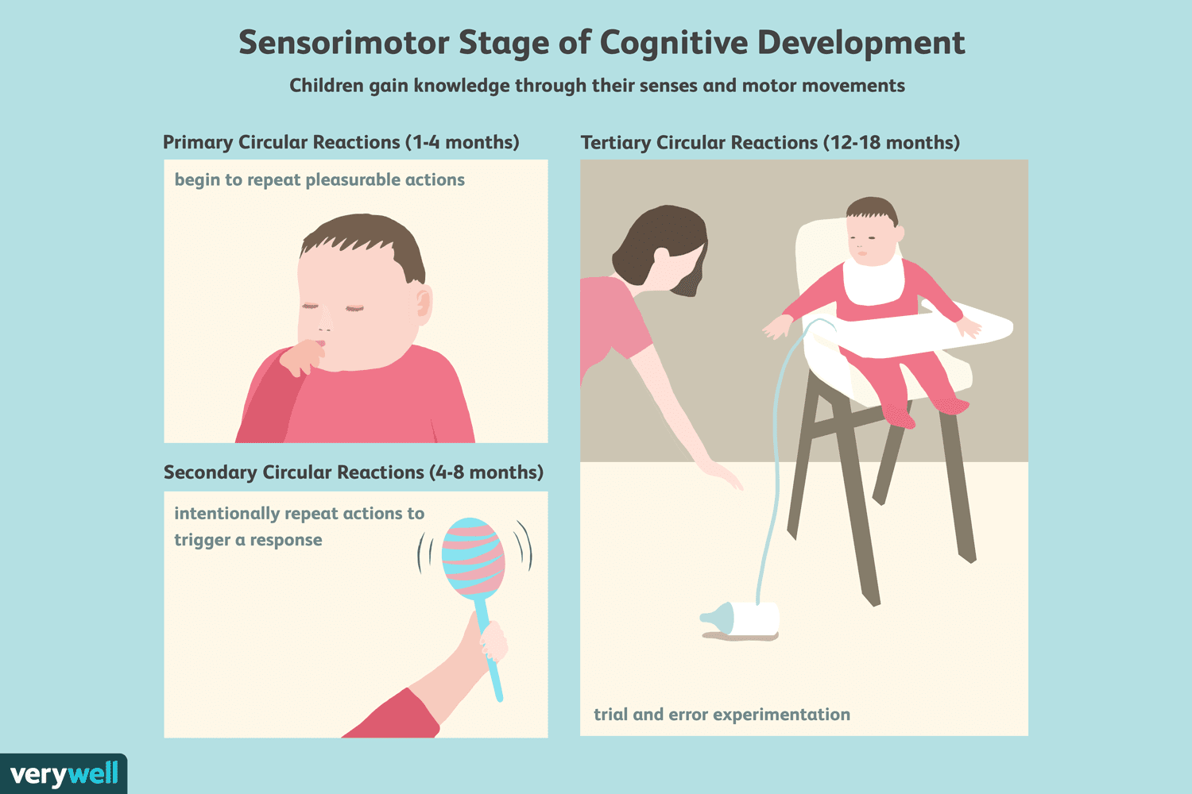

Slide 12
During this earliest stage of cognitive development, infants and toddlers acquire knowledge through sensory experiences and manipulating objects.
A child's entire experience at the earliest period of this stage occurs through basic reflexes, senses, and motor responses.
Object permanence is a child's understanding that objects continue to exist even though they cannot be seen or heard

Slide 13
2. The pre-operational stage (2-7 years)
Children begin to think symbolically and learn to use words and pictures to represent objects.
Children begin to engage in symbolic play and learn to use symbols as a way of communication.
Another well-known experiment involves demonstrating a child's understanding of conservation.
Piaget discovered that children in this stage do not yet understand concrete logic, can't mentally manipulate information, and can't understand different points of view people have, known as Egocentrism.

Slide 14
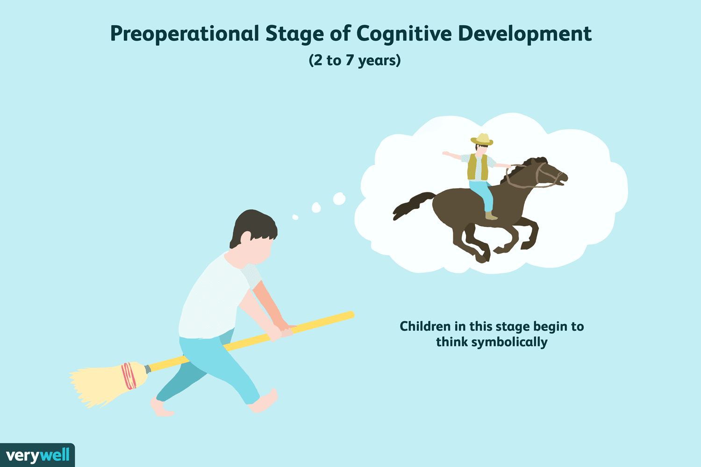

Slide 15


Slide 16


Slide 17
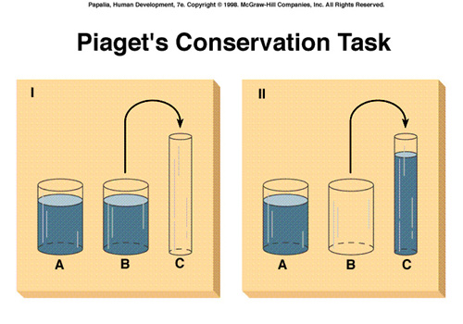

Slide 18


Slide 19
3. The concrete operational stage (7-11yrs)
use of inductive logic (inductive reasoning).
Inductive logic involves going from a specific experience to a general principle.
Eg: every time you are around a cat, you have itchy eyes, a runny nose, and a swollen throat.
A mental operation is the ability to accurately imagine the consequences of something happening without it actually happening.
understanding of reversibility, the awareness that actions are able to be reversed.
For example, a child might be able to recognize that his or her dog is a German Shepherd, that a German Shepherd is a dog, and a dog is an animal.

Slide 20


Slide 21
4. The formal operational stage
Age 12+
Deductive reasoning becomes important during this stage.
Deductive logic requires the ability to use a general principle to determine a certain outcome
This type of thinking involves hypothetical thinking and is usually used in math and science
Piaget also believe kids above the age of 11 developed metacognition
Metacognition is the ability to think about their own thoughts and other's thoughts.

Slide 22


