Slide 1


NURSING CARE OF A NORMAL NEWBORN

Slide 2
CARE OF NORMAL NEWBORN
The care babies receive and the bond they form with their parents during the first several weeks of life have many effects
These factors influence the growth and development of healthy infants and the closeness of the entire family
Nurse play a special role as a teacher and advocate
Care of newborn is broadly divided into :
1. Immediate newborn care
2. Essential newborn care

Slide 3
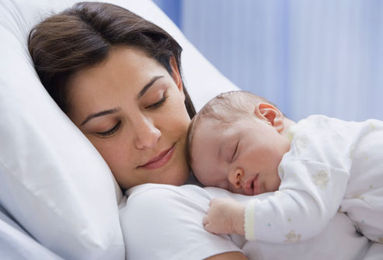
IMMEDIATE NEWBORN CARE

Slide 4
When the head is delivered wipe the mouth, and nose with gauze
When the baby is fully born place the baby on a clean, dry towel or blanket on the mothers abdomen
Note the time of birth and sex of the baby and announce them loudly enough to inform the mother
Wipe the eyes and face and thoroughly dry the baby
Stimulate the baby while drying by rubbing up and down along the baby’s spine
If the baby is not crying or breathing well within 30 seconds of birth clamp and cut the cord and begin resuscitation

Slide 5
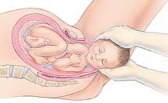
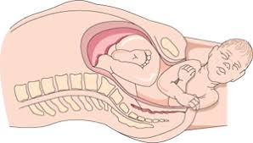

Slide 6
IMMEDIATE NEWBORN CARE
1.Establishment and maintenance of respiration
2.Stabilization and maintenance of body temperature
3. Prevention of infection and injury
4. Provision of optimal nutrition

Slide 7
1. Establishment and maintenance of respiration
it is necessary that the neonate cry lustily periodically
Failure to cry may be due to obstruction of the air passage by mucus
The oropharynx & nasopharynx are suctioned with a bulb syringe or a catheter connected to suction as soon as the head is delivered

Slide 8
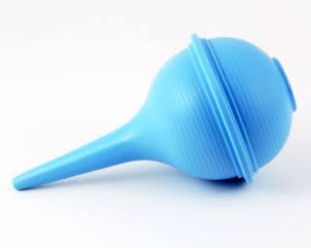
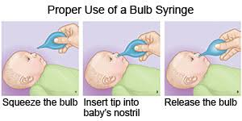

Slide 9
To establish and maintain respiration:
Wipe mouth and nose of secretions after delivery of the head.
Compress bulb syringe before inserting
Suction mouth first, then, the nose
Insert bulb syringe in one side of the mouth

Slide 10
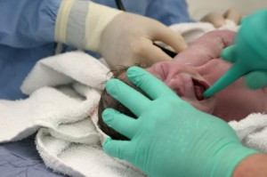
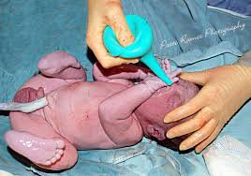

Slide 11
A crying baby is a breathing baby.
Stimulate the baby to cry if baby does not cry spontaneously, or if the cry is weak.
Do not slap the buttocks rather rub the soles of the feet.
Stimulate to cry after secretions are removed.
The normal infant cry is loud and husky.
Observe for the following abnormal cry:
  High pitched cry – indicates hypoglycaemia, increased intracranial pressure.
  Weak cry – prematurity
  Hoarse cry – laryngeal Stridor

Slide 12
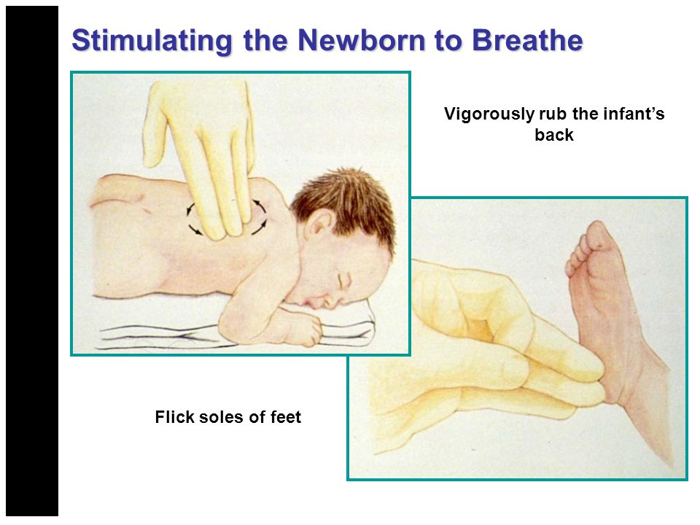

Slide 13
If the neonate is apnoeic or has gasping respirations, positive-pressure ventilation is needed. (PPV)
The heart rate is quickly assessed by grasping the base of the cord or by auscultating the left chest with a stethoscope.
It should be greater than 100 beats/min.
The newborn’s trunk and lips should be pink
Acrocyanosis is a normal finding

Slide 14
Neonatal asphyxia & Hypoxia
If an infant fail to establish adequate, sustained respiration after birth, the infant is said to have neonatal asphyxia
Hypoxia is defined as too little oxygen in the cells of the body
It can occur in the fetus or newborn
If the placenta fails to provide the fetus with enough oxygen hypoxia will result and cause fetal distress
Similarly, with failure to breathe well after delivery, the newborn will develop hypoxia
As a result heart rate falls, central cyanosis develops and the baby becomes hypotonic and unresponsive

Slide 15
APGAR SCORE
The very first test given to a newborn, occurs in the delivery or birthing room right after the baby’s birth
The test was designed to quickly evaluate a newborn’s physical condition and to see if there is an immediate need for extra medical or emergency care
The Apgar score was developed in 1952 by an anaesthesiologist named VIRGINIA APGAR

Slide 16
APGAR
A - Appearance (skin colour)
P – Pulse (heart rate)
G - Grimace (reflexes)
A – Activity (muscle tone)
R – Respiration (respiratory effort)

Slide 17
The Apgar test is usually given to a baby twice.
Once at 1 minute after birth and again at 5 minutes after birth.
Sometimes if there are concerns about the baby’s condition or the score at 5 minutes is low, the test may be scored for a third time at 10 minutes after birth.
Five factors are used to evaluate the baby’s condition and each factor is scored on a scale of 0 to 2, with 2 being the best score.

Slide 18
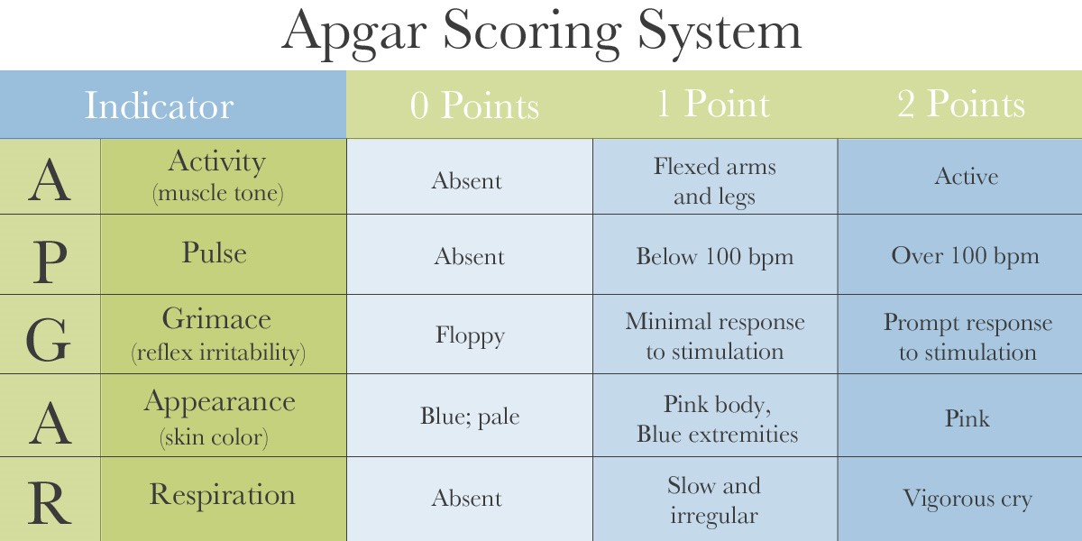

Slide 19
Apgar scoring.....
Total score = 10
No depression : 7-10
Mild depression : 4-6
Severe depression : 0-3

Slide 20
Causes of low Apgar score
1. Fetal distress due to hypoxia before delivery
2. Preterm infant
3. Difficult or traumatic delivery
4. Severe respiratory distress
All newborns with a 1 minute Apgar score below 7 require resuscitation

Slide 21
If stimulation, positioning, suctioning fail to start breathing, the infant needs mask ventilation.
Intubation and ventilation
Chest compression

Slide 22
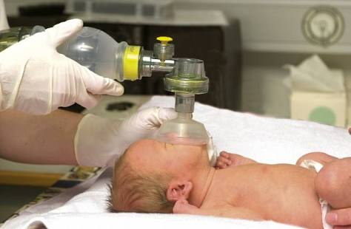
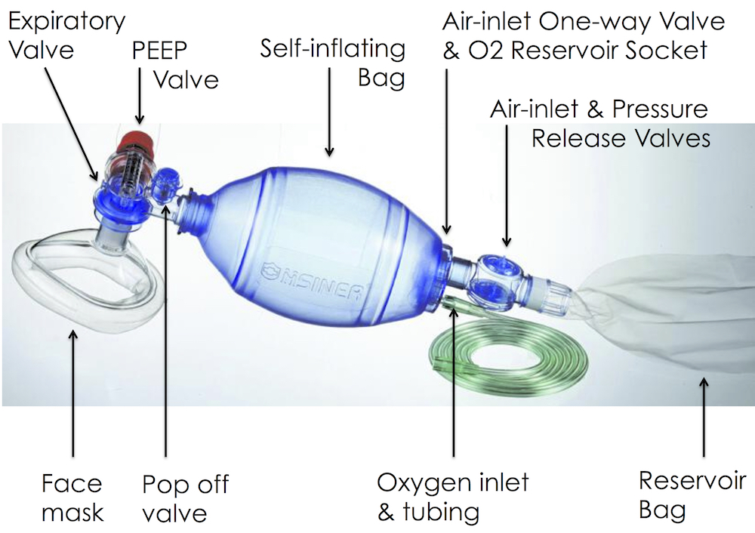

Slide 23
2. Stabilization and maintenance of body temperature
The temperature of the newborn usually drops immediately after birth
It is the responsibility of the nurse to stabilize and maintain neonate body temperature by achieving a balance between heat production and heat loss.

Slide 24
Brown fat
a type of fat present in newborns and rarely found in adults.
Brown fat is a unique source of heat energy for the infant because it has greater thermogenic activity than ordinary fat.
Brown fat deposits occur around the kidneys, neck, and upper chest.

Slide 25
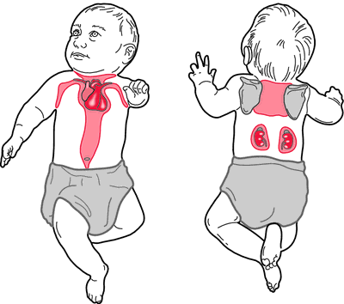

Slide 26
Body heat may be lost to the environment by
Evaporation
Radiation
Conduction
Convection

Slide 27
Evaporation
At birth amniotic fluid which covers the body of the newborn evaporates resulting in body heat loss
The nurse can prevent this heat loss by
drying the hair and skin with warm, soft, dry towels
placing the baby on the mother’s body by wrapping the neonate in blankets
or by putting the neonate into a heated environment such as a radiant warmer.
Bathing should not be done until the temperature is normal and stable

Slide 28
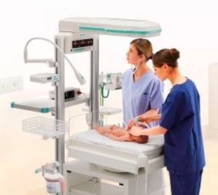
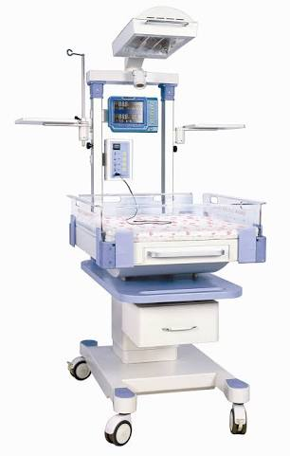
Radiant warmer

Slide 29
Radiation
Radiation occurs when the newborn is placed in a crib near a cold wall, window or air conditioner
If the neonate is placed on a cold surface during examination the baby loses heat by conduction
Placing the neonate in direct contact with cold air or air currents increases heat loss by convection

Slide 30
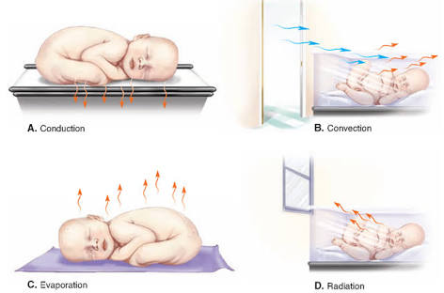
Methods of heat loss

Slide 31
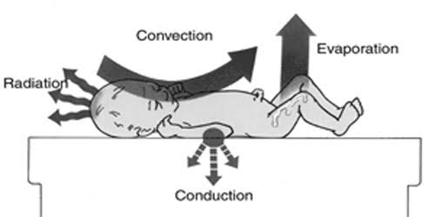

Slide 32
The nurse must attempt to maintain the temperature within a normal range 36.5 to 37.5 Celsius (97.7 to 99.9 ) rectally for normal or large newborns
35 to 36.5 Celsius (95 to 97.7 F) for those who weigh 1500 gm or less at birth
The newborn can be dressed in a shirt and diaper and covered with blankets as needed
The head can be covered with a cap and the foot with booties if heat loss is a problem.

Slide 33
3. Prevention of infection and injury
Identification of the baby
Eye care
Vitamin K administration
Hepatitis B vaccine administration
Bathing
Care of the umbilicus
Circumcision

Slide 34
Identification
The nurse must verify that identifying bands are securely fastened and verify the information such as
name
gender
mother’s admission number
date & time of birth against the birth records
Electronic tags that give off a radio frequency may also be used to prevent newborn abductions

Slide 35
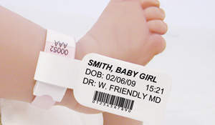
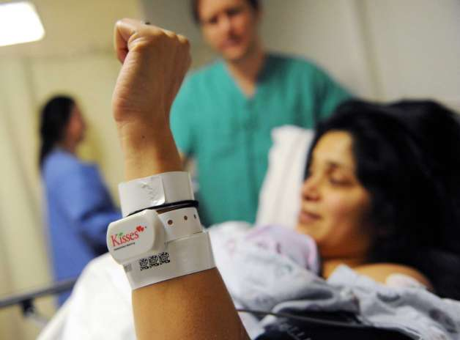

Slide 36
Eye care
Prophylactic eye treatment against opthalmia neonatorum, infectious conjunctivitis of the newborn includes
Silver nitrate 1 % solution
Erythromycin 0.5%
Tetracycline 1%
A 14 day course of oral erythromycin or an oral sulfonamide may be given for Chlamydia conjunctivitis

Slide 37
Vitamin K administration
After birth vitamin k is administered as a single intramuscular (vastus lateralis) dose of 0.5 to 1 mg to prevent hemorrhagic diseases of the newborn
Vitamin k is synthesised by the intestinal flora
The infants intestine is sterile at birth and because breast milk contains low levels of vitamin k, the supply is inadequate for at least the first 3 or 4 days

Slide 38
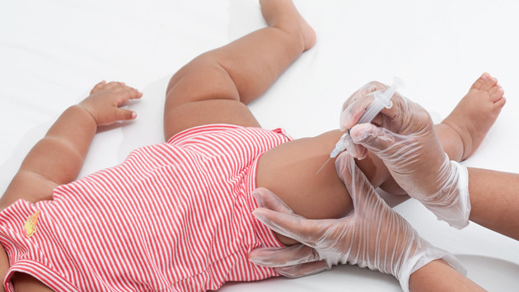

Slide 39
Hepatitis B vaccine administration
To decrease the incidence of hepatitis B virus in children and its serious consequences, cirrhosis and liver cancer in adulthood the first of three doses of hepatitis B vaccine is recommended soon after birth and before hospital discharge

Slide 40
Bathing
Bathing is usually performed after the vital signs have stabilized
Nurses should wear gloves when handling the newborn until blood and amniotic fluid are removed by bathing
Frequently normal variations such as Epstein pearls, Mongolian spots or stork bites cause parents much worry because they are unaware of the significance of such findings.

Slide 41
Bathing......
One of the most important considerations in skin cleansing is preservation of the skin’s Acid mantle
The infants skin surface has a pH of about 5 soon after birth and the bacteriostatic effects of this pH are significant
Consequently only plain warm water or soap with appropriate ph should be used for the bath.
Alkaline soaps, oils, powder and lotions are not used because they alter the acid mantle, thus providing a medium for bacterial growth

Slide 42
Care of the umbilicus
After delivery the umbilical cord is either clamped or tied before the cord is cut.
baby's umbilical cord stump will change from bluish white to black as it dries out and eventually falls off
The cord stump develops dry gangrene and falls off between 7 and 10 days after birth
The area should be washed gently with water and a mild soap and dried well

Slide 43
Parents should be taught the care of the cord and the possible problems that may arise.
Any indications of infection around the umbilicus such as a reddened area or a foul discharge should be reported promptly

Slide 44
Circumcision
It is the surgical removal of the foreskin on the glans penis

Slide 45
4. Provision of optimal nutrition
Selection of a feeding method is one of the major decisions faced by parents
In general there are three acceptable choices
Human milk (Breast milk)
Commercially prepared whole cow’s milk formula
Modified evaporated cow’s milk

Slide 46
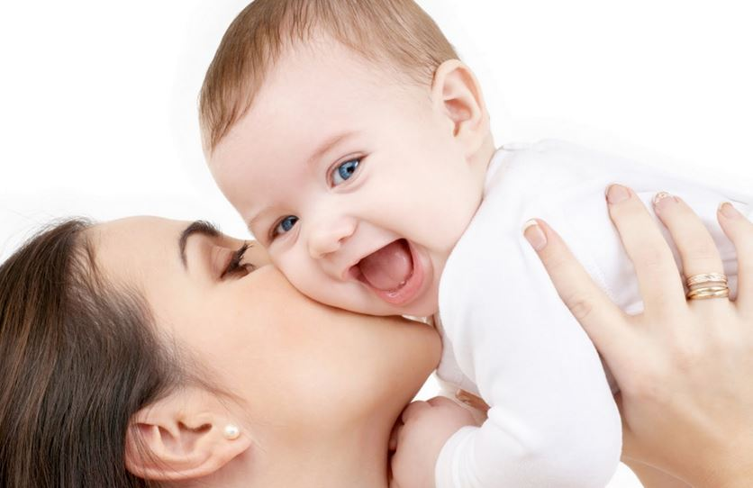
ESSENTIAL NEWBORN CARE

Slide 47
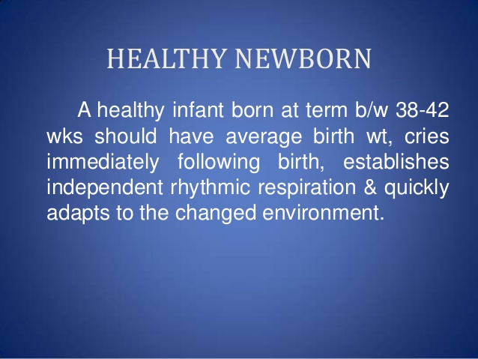

Slide 48
Essential newborn care (ENC)
ENC is a care that every newborn baby needs regardless of where it is born or its size.
ENC should be applied immediately after the baby is born and continued for at least the first 7 days after birth

Slide 49
CONCEPT OF ENC
Basic care – includes interventions for all infants to meet their physiological needs
Special care – required for a small group of newborns because diseases acquired before, during or after birth and/or because they are born too soon/small

Slide 50
The normal term babies should be kept with their mothers rather than in a separate nursery
Bedding-in or Rooming-in promotes :
better emotional bondage,
prevents cross infection
establishes breast feeding easily.

Slide 51
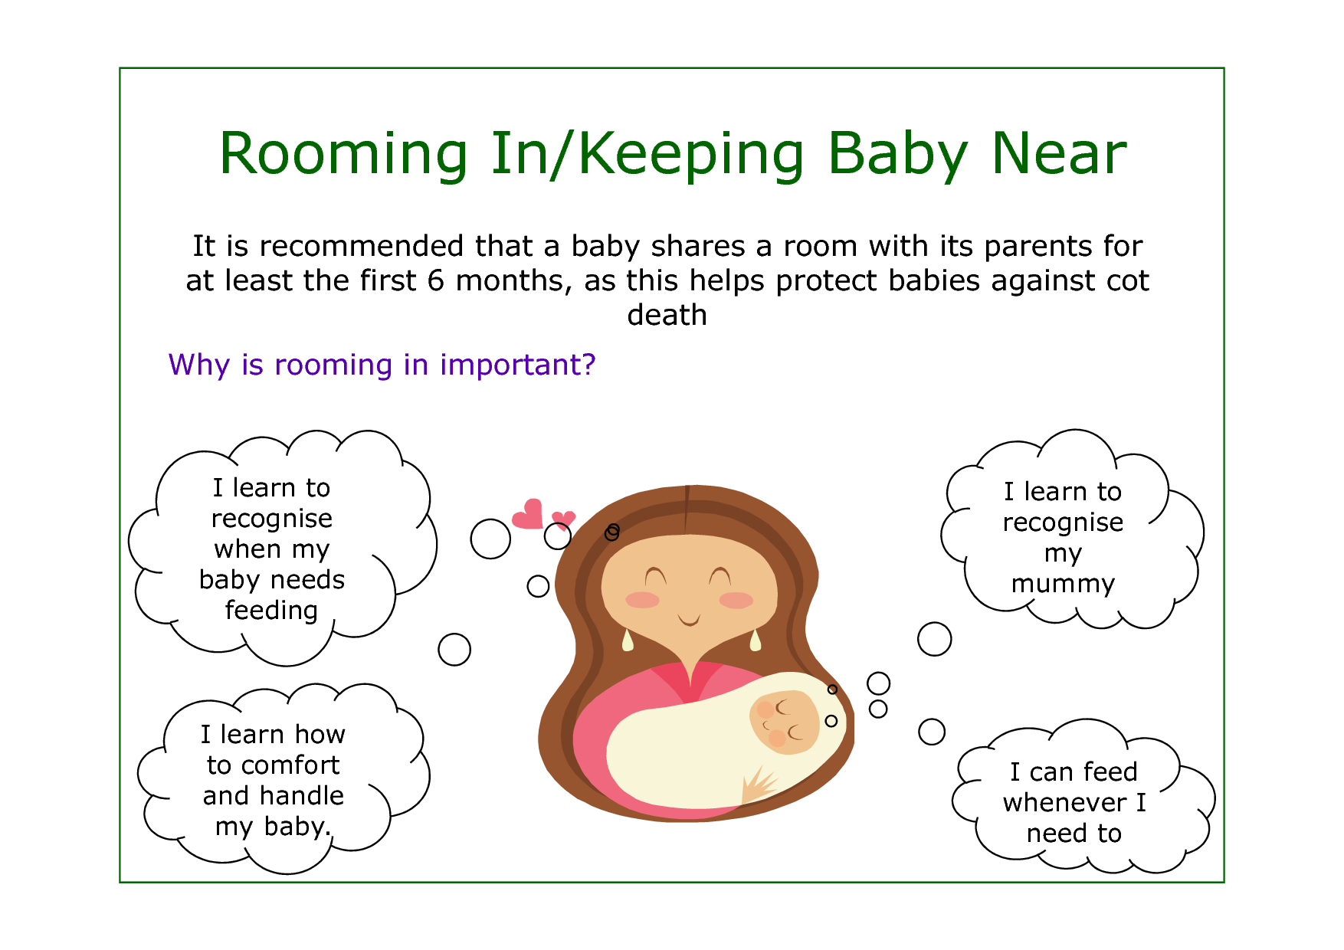

Slide 52
Sudden Infant Death Syndrome – SIDS (Cot death)
Sudden unexplained death of a child less than one year of age
It occurs during sleep for unknown cause
Associated with defects in the portion of an infant’s brain that controls breathing and arousal from sleep.
combination of physical and sleep environmental factors

Slide 53
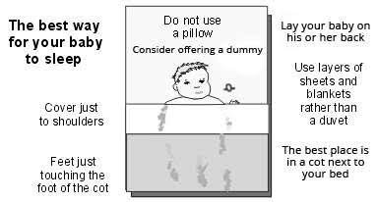

Slide 54
Daily routine care of Neonates
Warmth
Breastfeeding
Skin care
Baby bath
Care of the umbilical cord
Care of the eyes
General care
Observation
Weight recording
Immunization
Follow up and advice

Slide 55
Warmth
Keeping the baby dry
Wrapping the baby with adequate clothing in two layers
Baby should be kept by the side of the mother
Bathing is avoided to prevent hypothermia and infections

Slide 56
Breastfeeding
Baby should be put to the mother’s breast within half an hour of birth
Colostrum feeding must be offered
Initially the feeding should be given in short interval of 1 to 2 hours and then every 2 to 3 hours
Exclusive breastfeeding procedure should be explained to the mother and family members

Slide 57
Skin care
The baby must be cleaned off blood, mucus and meconium by gentle wiping before he or she is presented to the mother
No bath especially dip bath should be given till the umbilical cord has fallen off
No vigorous attempts should be made to remove the vernix caseosa as it provides protection to the delicate skin.

Slide 58
Baby bath
Bathing should be avoided in open place
It should be given using warm water in a warm room gently and quickly and gently
Use of olive oil or coconut oil can be allowed after 3 to 4 weeks of age.
Oil massage improves circulation and muscle tone
During winter months the baby should have sponge bath rather than dip bath to avoid cold stress or hypothermia

Slide 59
Care of the umbilical cord
The umbilical cord is cut about 2 to 3 cm from the naval with aseptic precautions during delivery
No dressing should be applied and the cord should be kept open and dry
The cord must be inspected for bleeding and signs of infection

Slide 60
Care of the eyes
Eyes should be cleaned at birth and once every day using sterile cotton swabs soaked in sterile water or normal saline
Application of kajal in the eyes must be avoided to prevent infection or lead poisoning
Eyes should be observed for redness, sticky discharge or excessive tearing

Slide 61
General care
Baby should be kept with the mother in a well ventilated room
No infected person should take care or touch the baby
General cleanliness to be maintained and surroundings to be kept clean
Wet nappies should be changed immediately

Slide 62
observation
The baby should be thoroughly observed twice daily for early detection of any abnormalities
Temperature, pulse, respiration, feeding behaviours, stool, urine and sleeping pattern should be assessed
Mouth, eyes, cord and skin should be looked for any infections

Slide 63
Weight recording
The average daily weight gain in healthy term babies is about 30 g/day in the first month of life
It is 20 g/day in the second month and 10 g/day afterwards during the first year of life
Most infants double their birth weight by 4 to 5 months

Slide 64
Immunization
In institutional delivery all neonates should be immunized with BCG vaccine and ‘O’ dose OPV, hepatitis B vaccine can be administered at birth as first dose and other two doses in one month and 6 months of age.
Mother should be informed about the recommended national immunization schedule

Slide 65
Follow-up and advice
Each infant should be followed up at least once every month for first 3 months and subsequently 3 months interval till one year of age
Follow up is necessary for assessment of growth and development, early detection and management of health problems and health education for prevention of childhood illnesses

