Slide 1
Nursing management of child with Respiratory distress syndrome
Presented By:
Mr. Nirmal Raj EV
Associstant Professor
Dept of Pediatric Nursing
Sumandeep nursing college
Sumandeep Vidyapeeth deemed to be University
Piparia, Waghodia, Vadodara

Slide 2
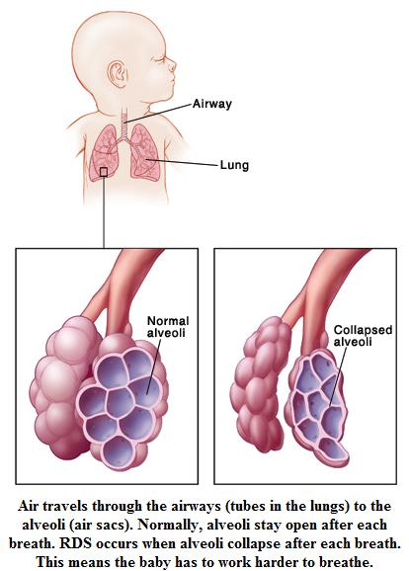
Respiratory Distress Syndrome (RDS)

Slide 3
Respiratory Distress Syndrome (RDS)
Respiratory distress syndrome is a breathing disorder of premature newborns in which the air sacs (alveoli) in a newborn’s lungs do not remain open because the production of a substance that coats the alveoli (surfactant) is absent or insufficient.

Slide 4
Alternative Names
Infant respiratory distress syndrome (IRDS)
Hyaline membrane disease
Surfactant deficiency disorder
Neonatal respiratory distress syndrome (NRDS)

Slide 5
Hyaline Membrane disease
The word "hyaline" comes from the Greek word "hyalos" meaning "glass or transparent stone such as crystal."
A membrane composed of proteins and dead cells lines the alveoli making gas exchange difficult or impossible

Slide 6
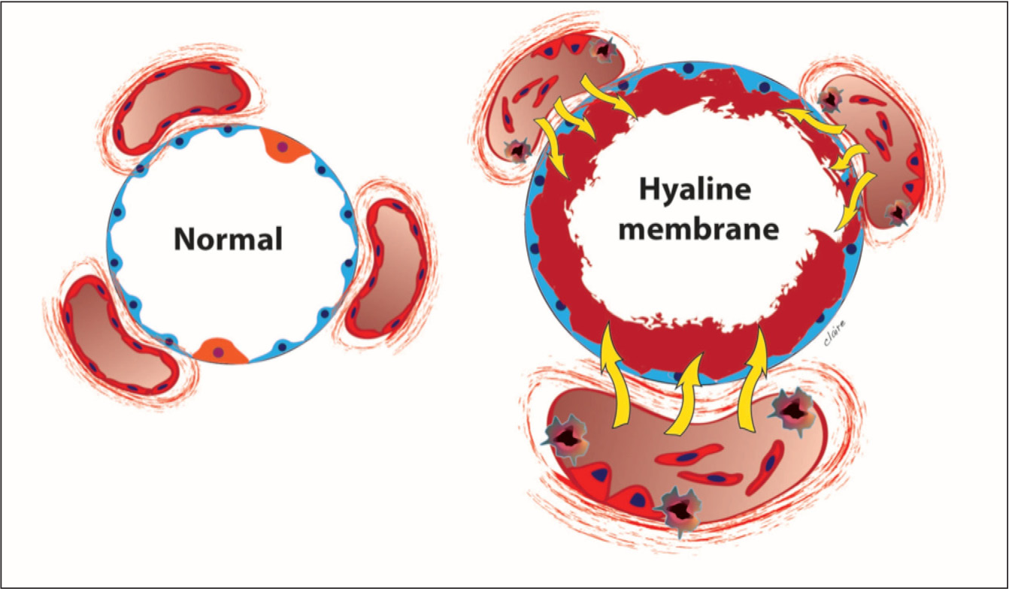

Slide 7
Surfactant deficiency Disorder
Surfactant is a mixture of phospholipids and lipoproteins secreted by type II pneumocytes (Lecithin & sphingomyelin 2:1)
Surfactant coats the surface of the air sacs, where it lowers the surface tension and allows the air sacs to remain open throughout the respiratory cycle
Production of surfactant begins after about 32 weeks of pregnancy
The more premature the newborn, the less surfactant is available

Slide 8
Etiology
Preterm babies
LBW babies
Little or no surfactant

Slide 9
Pathophysiology
surfactant deficiency
a greater pressure is needed to open the alveoli
Without adequate airway pressure, the lungs become diffusely atelectatic
triggering inflammation and pulmonary edema
Because blood passing through the atelectatic portions of lung is not oxygenated (forming a right-to-left intrapulmonary shunt),
the infant becomes hypoxemic
Lung compliance is decreased, thereby increasing the work of breathing
In severe cases, the diaphragm and intercostal muscles fatigue, and CO₂ retention and respiratory acidosis develop

Slide 10
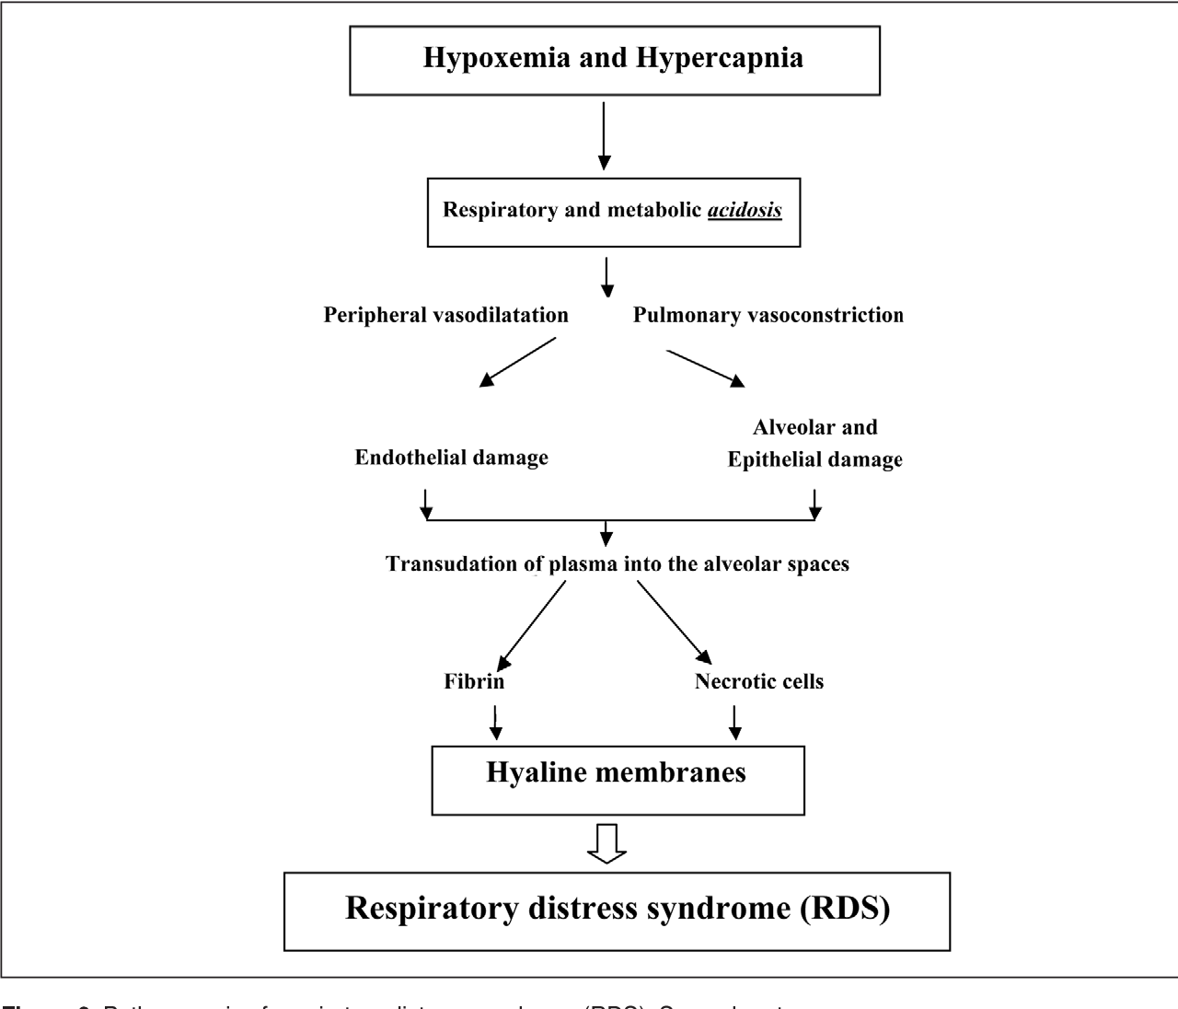

Slide 11
Clinical Manifestations
Visibly labored breathing
Sternal retraction
Flaring of the nostrils during breathing in and grunting while breathing out
Cyanosis
Hypercapnia or hypercarbia (CO2 retention)
Hypoxemia

Slide 12
Diagnostic Evaluation
Clinical evaluation
ABG (hypoxemia and hypercapnia)
Chest x-ray
Antenatal screening

Slide 13
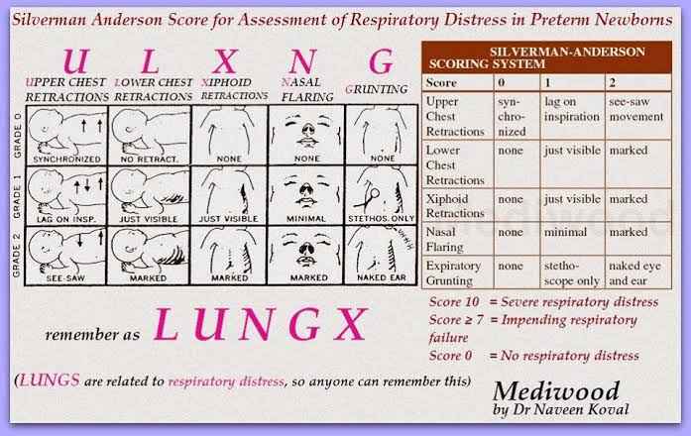

Slide 14
Antenatal screening
Amniotic fluid tests include the
Lecithin / sphingomyelin ratio (L/S Ratio)
Foam stability index test (Fetal Lung Maturity)
the more surfactant in amniotic fluid, the greater the stability of the foam that forms when the fluid is combined with ethanol and shaken
Surfactant/albumin ratio

Slide 15
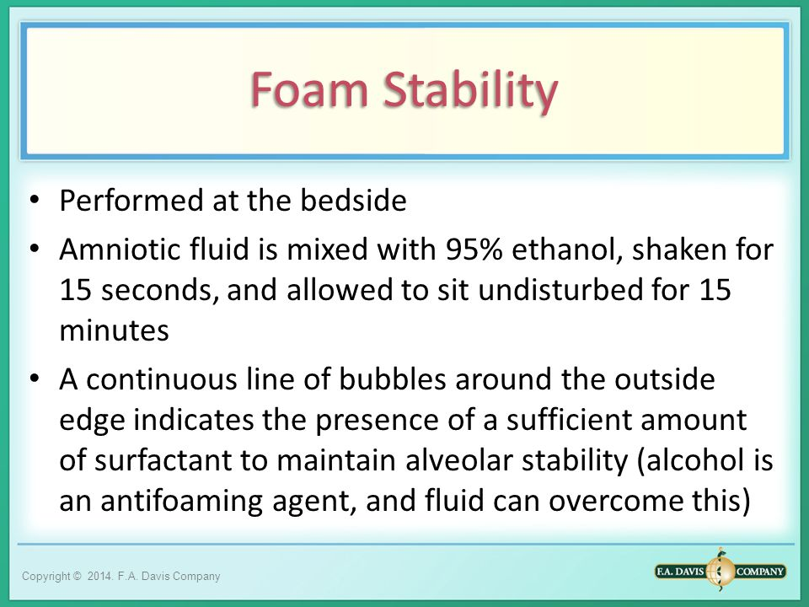

Slide 16
Risk of RDS is low when
Lecithin / sphingomyelin ratio is > 2
Phosphatidyl glycerol is present
Foam stability index = 47
Amniotic fluid Surfactant/albumin ratio is > 55 mg/g of albumin

Slide 17
Management
After delivery, newborns with mild respiratory distress syndrome may require only supplemental oxygen.
The oxygen is given through prongs placed in the newborn’s nostrils or through a small plastic hood (oxygen hood) filled with oxygen, which is placed over the head.
Newborns may require oxygen delivered by continuous positive airway pressure (CPAP)—a technique that allows newborns to breathe on their own while being given slightly pressurized oxygen or air given through prongs placed in both nostrils.

Slide 18
Endotracheal tube may need to be passed into the windpipe (intubation), and the newborn’s breathing may need to be supported with mechanical ventilation.

Slide 19
Surfactant therapy
Use of a surfactant preparation can be lifesaving and reduces complications, such as rupture of the lungs (pneumothorax).
Surfactant can be given through an endotracheal tube and may be given immediately after birth in the delivery room to attempt to prevent respiratory distress syndrome before symptoms develop or in the early hours after birth to premature newborns who already have symptoms of this disorder.

Slide 20
The risk of respiratory distress syndrome is greatly reduced if delivery can be delayed until the fetus’s lungs have produced sufficient surfactant.
When premature birth cannot be avoided, obstetricians may give the mother injections of a corticosteroid (betamethasone).
The corticosteroid goes into the fetus and accelerates the production of surfactant.
Within 48 hours after the injections are started, the fetal lungs mature to the point that respiratory distress syndrome is less likely to develop after delivery or, if it does develop, is likely to be milder.

Slide 21
Surfactant therapy
Beractant is a lipid bovine lung extract supplemented with proteins B and C, colfosceril palmitate, palmitic acid, and tripalmitin; dose is 100 mg/kg q 6 h prn up to 4 doses.
Poractant alfa is a modified porcine-derived minced lung extract containing phospholipids, neutral lipids, fatty acids, and surfactant-associated proteins B and C; dose is 200 mg/kg followed by up to 2 doses of 100 mg/kg 12 h apart prn.
Calfactant is a calf lung extract containing phospholipids, neutral lipids, fatty acids, and surfactant-associated proteins B and C; dose is 105 mg/kg q 12 h up to 3 doses prn.
Lucinactant is a synthetic surfactant with a pulmonary surfactant protein B analog, sinapultide (KL4) peptide, phospholipids, and fatty acids; dose is 175 mg/kg q 6 h up to 4 doses.

Slide 22
Prevention
When a fetus must be delivered between 24 wk and 34 wk, giving the mother 2 doses of Betamethasone 12 mg IM 24 h apart or 4 doses of Dexamethasone 6 mg IV or IM q 12 h at least 48 h before delivery induces fetal surfactant production and reduces the risk of RDS or decreases its severity.
Prophylactic Intra-tracheal surfactant therapy given to neonates who are at high risk of developing RDS (infants < 30 wk completed gestation especially in absence of antenatal corticosteroid exposure) has been shown to decrease risk of neonatal death and certain forms of pulmonary morbidity

