Slide 1

SUMANDEEP NURSING COLLEGE
Sub: CHN
TOPIC:FOOD ADULTERATION
PRESENTED BY:
Aadil Kadiwala
Assist.professor
SNC

Slide 2
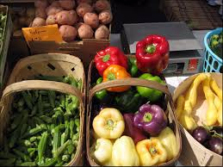

Slide 3
INTRODUCTION
Food adulteration has become a very common practice in our country and we are consuming these foods almost everyday, which have numerous harmful effects to our health. Every day we watch in the TV news how the unhygienic and spurious foods are entering into our houses. Adulteration of foods has many effects on individuals as well as on the community health.

Slide 4
DEFINITION
Food adulteration means anything adding or subtracting with food making it injurious to health. This adulteration may be done intentionally or unintentionally. Intentional adulteration is a criminal act and punishable offense. Or the process of lowering the nutritive value of food either by removing a vital component or by adding substances of inferior quality.

Slide 5
Types of adulteration
There are three types of adulteration namely:
1. Intentional adulterants:
2. Metallic contamination:
3. Incidental adulterants:

Slide 6
Intentional adulterants
Intentional adulterants are sand, marble chips, stone, mud, chalk powder, water, mineral oil and coal tar dyes. This adulteration cause harmful effects on the body.

Slide 7
Metallic contamination
Metallic contaminations include arsenic from pesticides, lead from water, and mercury from effluents of chemical industries, tin from cans.

Slide 8
Incidental adulterants
Incidental adulterants are pesticide , larvae in foods. Metallic contamination with arsenic lead, mercury can also occur incidentally. Pests such as rodents and insects intrude into the food at high degree and produce filth in the form of excreta, bodily secretions and spoilage through microorganisms. The most common incidental adulterants are pesticides, D.D.T residues present on the plant product.

Slide 9
FOOD ADULTERATION CATEGORIES
Replacement: Complete or partial replacement of a food ingredient or valuable authentic constituent with less expensive substitute with the intention of circumventing on “origin” and false declaration of the “process”.
Addition: Addition of small amounts of non-authenticated substances to mask inferior quality ingredient.

Slide 10
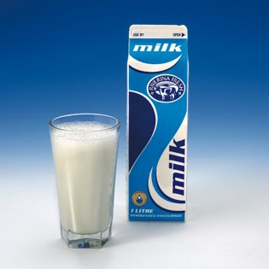
.
Some common adulterants and the diseases caused by them:
Milk : Cow/buffalo milk can be adulterated with starch, milk powder and urea
Health effect: Cancer or acute renal failure Food Adulterations.

Slide 11
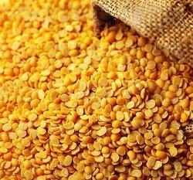
Tur dal, Turmeric powder, mixed spices, saffron
➢Adulterants: Metanil yellow, a non- permitted color is a common adulterant in food items like laddu, tur dal and turmeric.
➢Health effect: tumor and cancer.

Slide 12
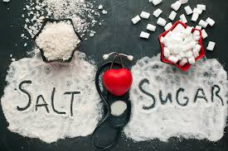
Sugar and Salt
Adulterants: With chalk powder and white sand
Health effect: Stomach disorder

Slide 13
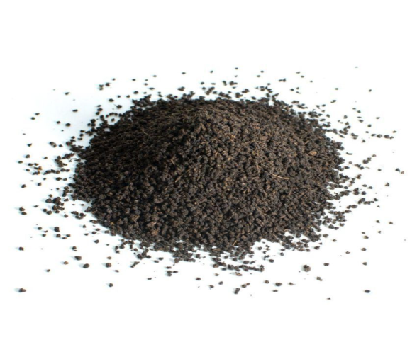
Tea powder
Adulterants : With used tea leaves, dye or artificial colour, iron fillings.
Tea- coloured tea leaves after removing the essence.
Health effect: Cancer, tetanus

Slide 14
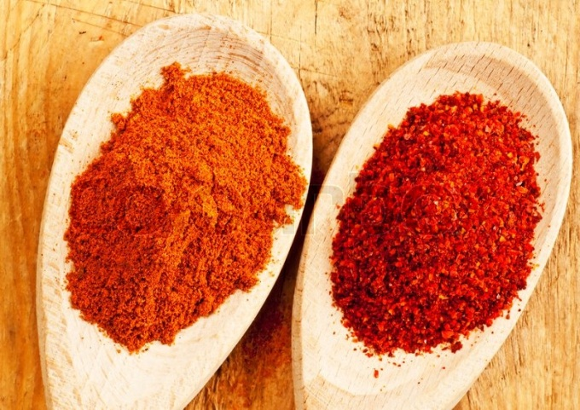
Chilli powder
Adulterants: Chilli powder: Sudan red, red brick powder, grit, sand, dirt, non-permitted colors, saw dust or use dry papaya seeds to obtain the required color.
Health effect: Stomach disorder Sudan dye is carsinogenic.

Slide 15
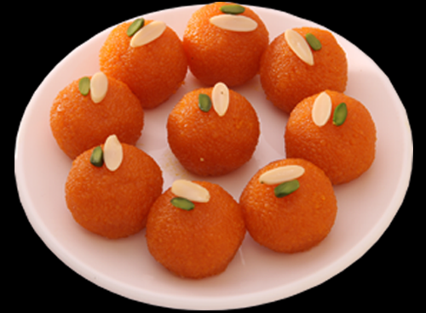
Sweets
Adulterants : Metanil yellow used to brighten the colour of pulses, turmeric powder and sweetmeats, is colours not permitted.
Health effect :tumor and cancer

Slide 16
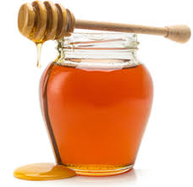
HONEY
Adulterants: Jaggery, Sugar, Corn syrup
Health effect: Obesity, Diabetes mellitus, Eyes and nerve damages
Adulteration on bakery items and dairy products may have tremendous effects on a child’s health. Such as cream-filled foods, cereal, cream sauces causes increased salivation, abdominal cramp, vomiting and prostration. Improperly processed milk and canned meat may cause food poisoning and abdominal pain.

Slide 17
Reasons for food adulteration are
To earn more profits
To increase the weight, adulterant is added.
To increase volume of trade by showing lower prices. When supply is less than demand
To cut down the product costs to meet the market competition.
Shortage of authentic ingredients at affordable prices.

Slide 18
Shortage of qualified personnel and no updation of processing techniques. Inadequate knowledge on the consequences and associated food safety risks.
Lack of awareness and updation of the information on the adulteration related food safety outbreaks.

Slide 19
Food Adulteration - Control Approach
Scientific Community:
To develop validated simple, quick and authentic test procedures to scan the ingredients, additives & processing aids for positive clearance.
To share the knowledge with the statutory bodies and industry.

Slide 20
Consumers/and users:
Proper understanding of the adulteration issues.
To know difference between the natural and aesthetic attributes
It is better to avoid adulterated cool drinks , instead you can have any fresh fruit juice and tender coconut.

Slide 21
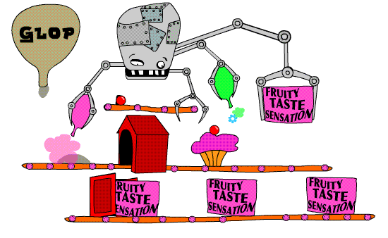
FOOD ADDITIVES

Slide 22
Food Additives
Food additives are chemical substances added to processed foods:
To enhance/retain quality attributes such as texture, physical properties, taste, flavour etc
To control the spoilage and enhance shelf life of the processed foods.

Slide 23
General Food Additives are:
Antioxidants
Emulsifiers/stabilizers
Acid regulator
Anti caking agents
Flavor enhancers
Artificial sweeteners

Slide 24
HEALTH HAZARDS OF FOOD ADDITIVES
The effects of food additives can be immediate or long-term:
Common reactions are urticaria, runny nose, headache, asthma,
Cause gastro-intestinal disturbances like diarrhea, infections
Bleeding, hyperactivity, irritability, contact dermatitis and skin eruptions.
Toxicity due to toxic sweeteners, additives, colours etc.

Slide 25
Long-term effects of food additives:
Damage too organs, birth defects and cancer.
Breaking of teeth and adverse effect on the lining of the digestive tract
Anemia.
Cardiac arrest and stomach or intestinal cancer.
Various abnormalities of bone, eyes, skin and lungs.
Lathrysim due to consumption of Kesaridal

Slide 26


