Slide 1
Nursing care of terminally ill child
Presented By:
Mr. Nirmal Raj EV
Assistant Professor
Department of pediatric Nursing
Sumandeep Nursing college,
Sumandeep Vidyapeeth deemed to be University
Piparia, Waghodia, Vadodara

Slide 2
UNIT - VIII
CRISIS & NURSING INTERVENTION
The hospitalized child
Terminal illness & death during childhood
Nursing intervention – counselling

Slide 3
TERMINAL ILLNESS & DEATH DURING CHILDHOOD
Terminal illness or end-stage disease is an incurable disease that cannot be adequately treated and is reasonably expected to result in the death of the patient.
This term is more commonly used for progressive diseases such as cancer or advanced heart disease than for trauma

Slide 4
Children understanding of
&
Reactions to Death

Slide 5
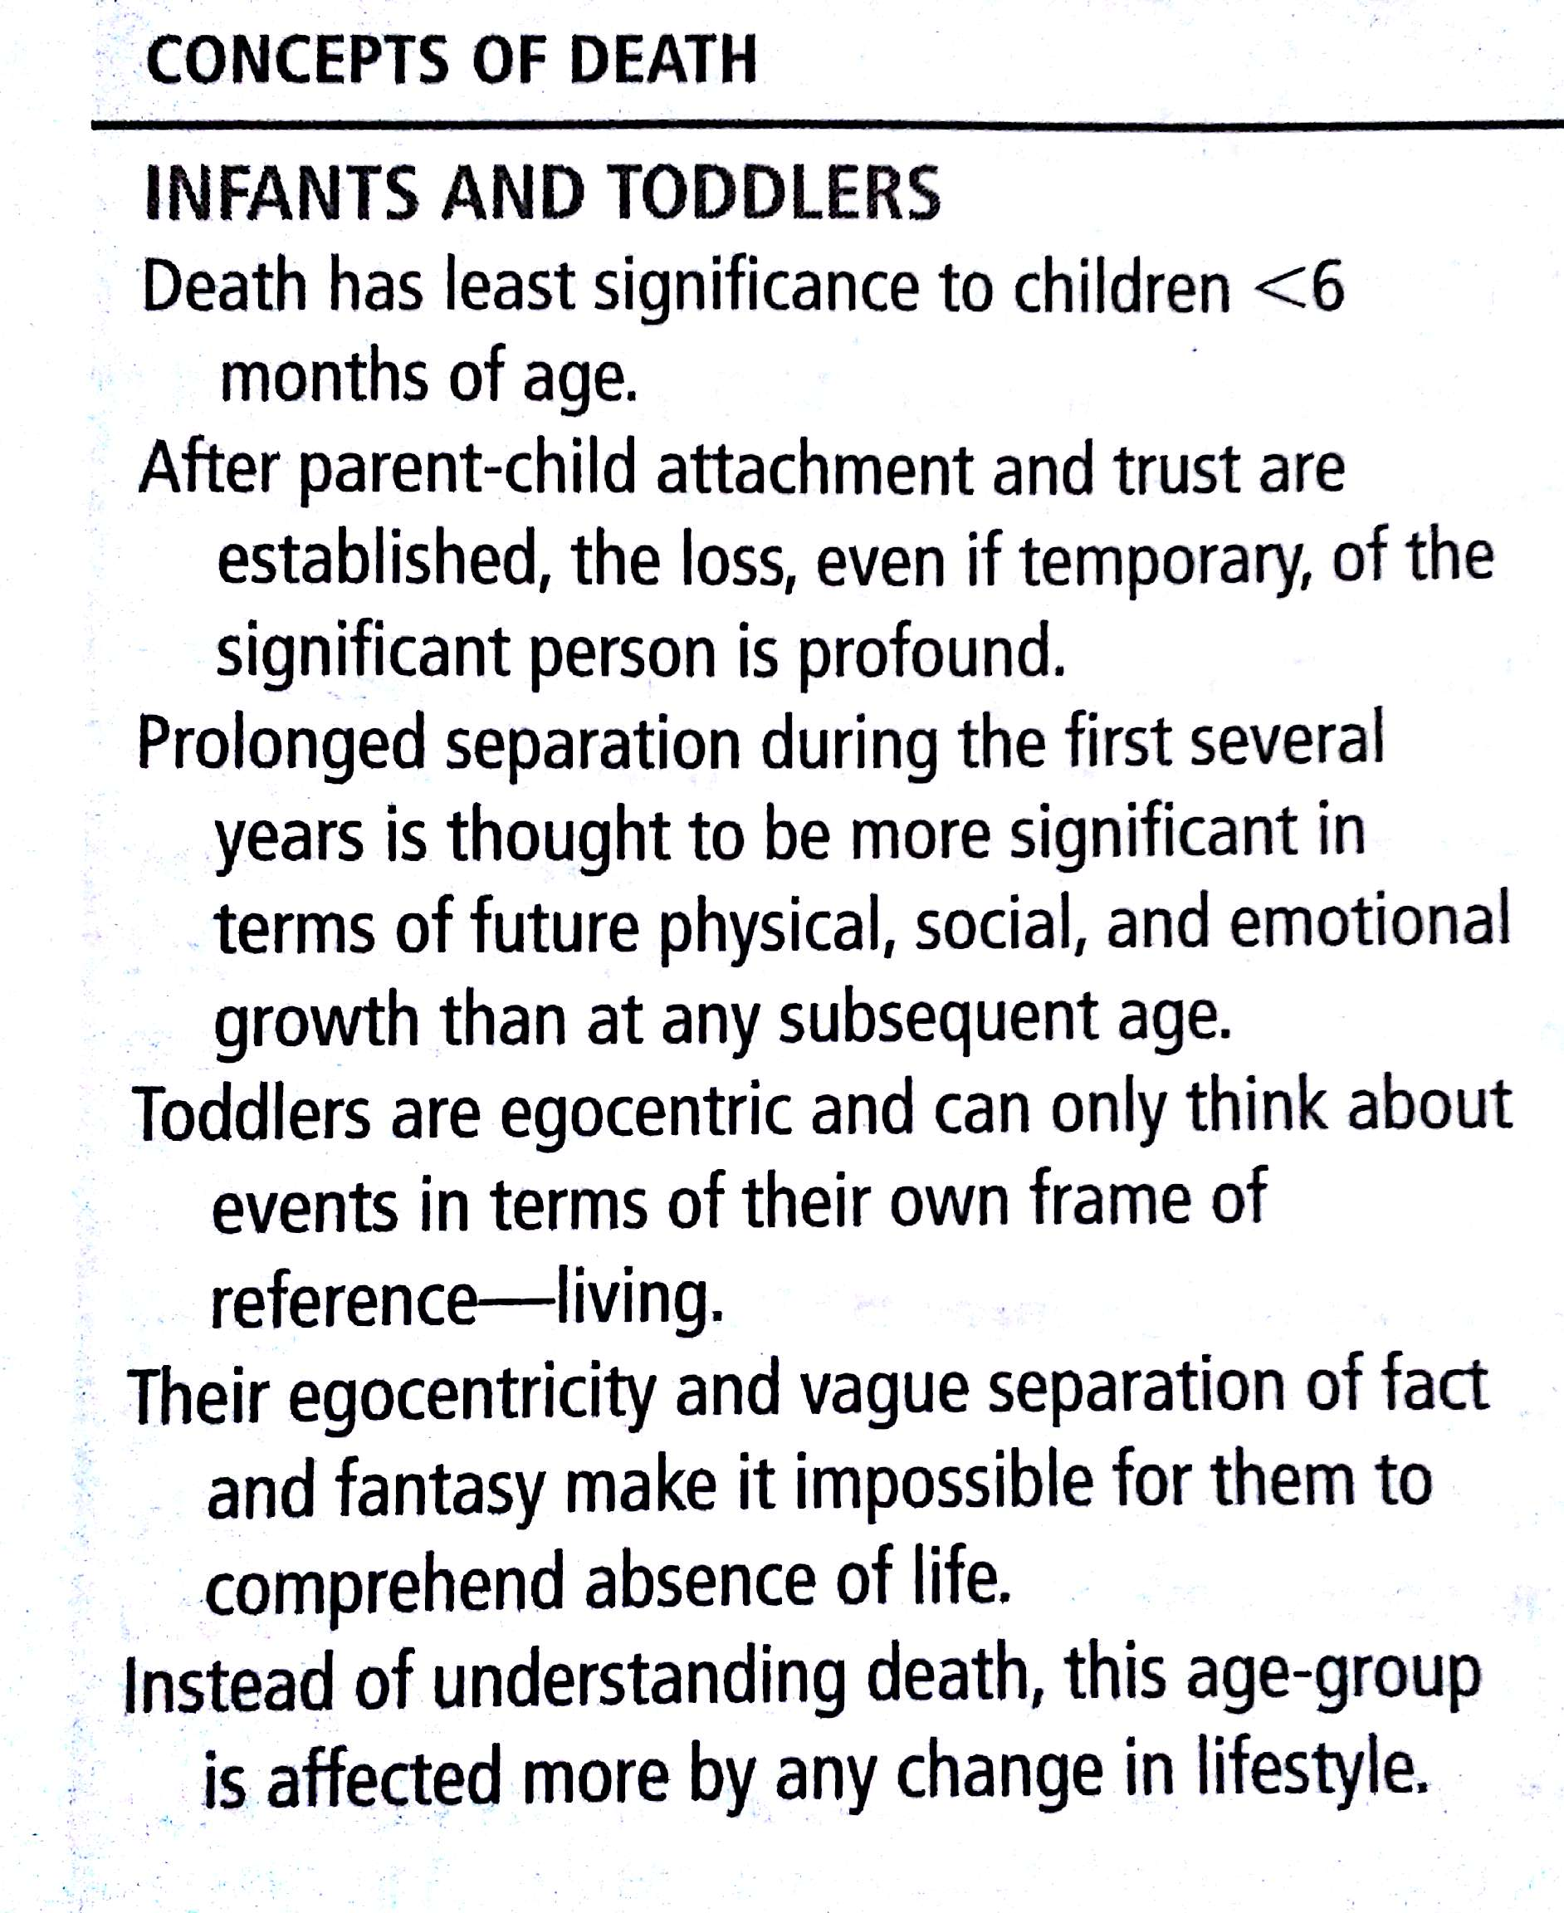

Slide 6
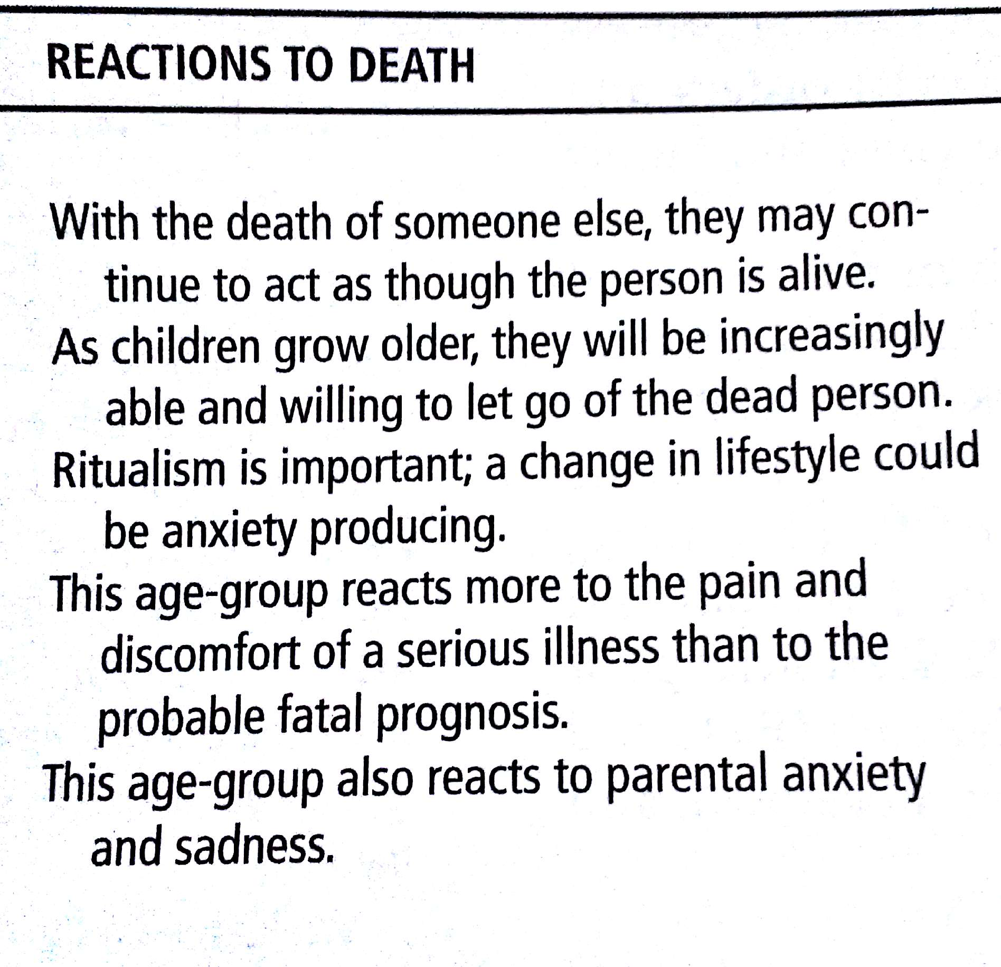

Slide 7
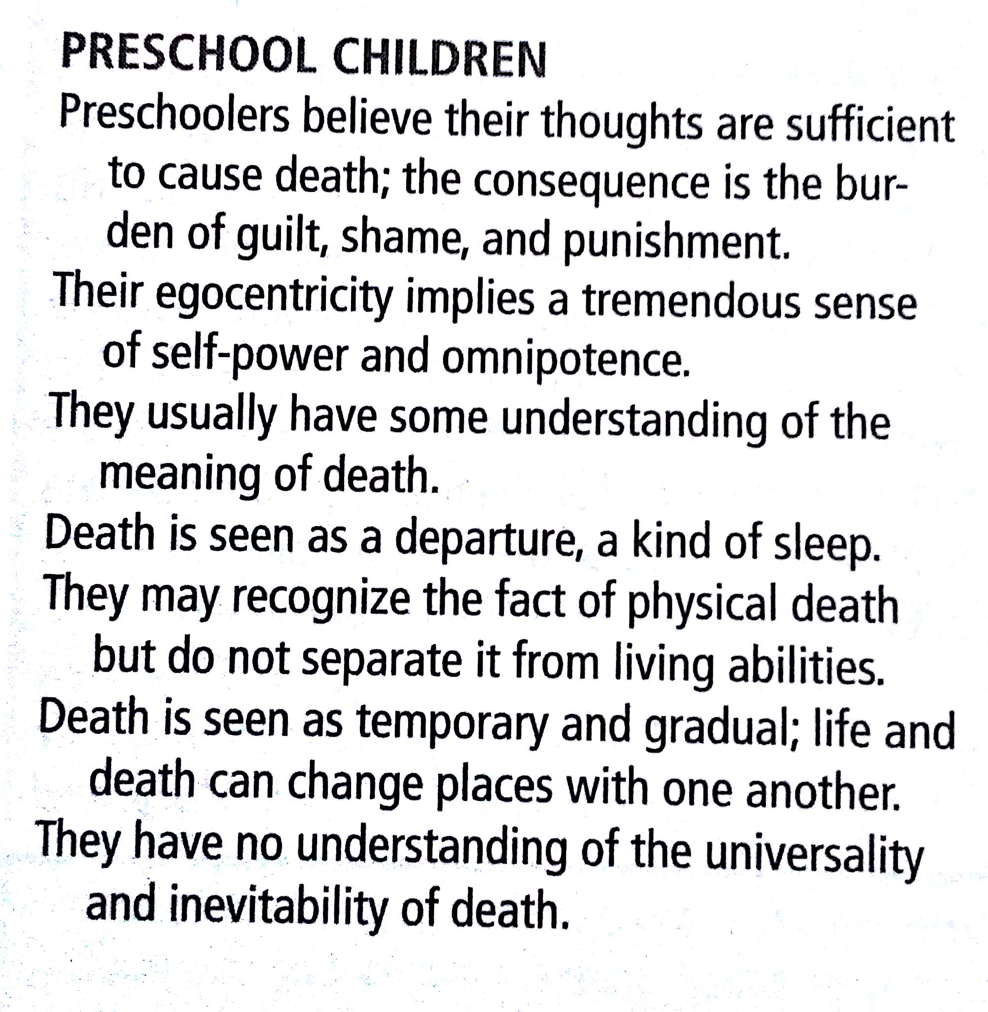

Slide 8
Preschool children reactions to death
They may feel guilty and responsible for the death of sibling
They conceive of the illness as a punishment
Greatest fear concerning death is separation from parents

Slide 9
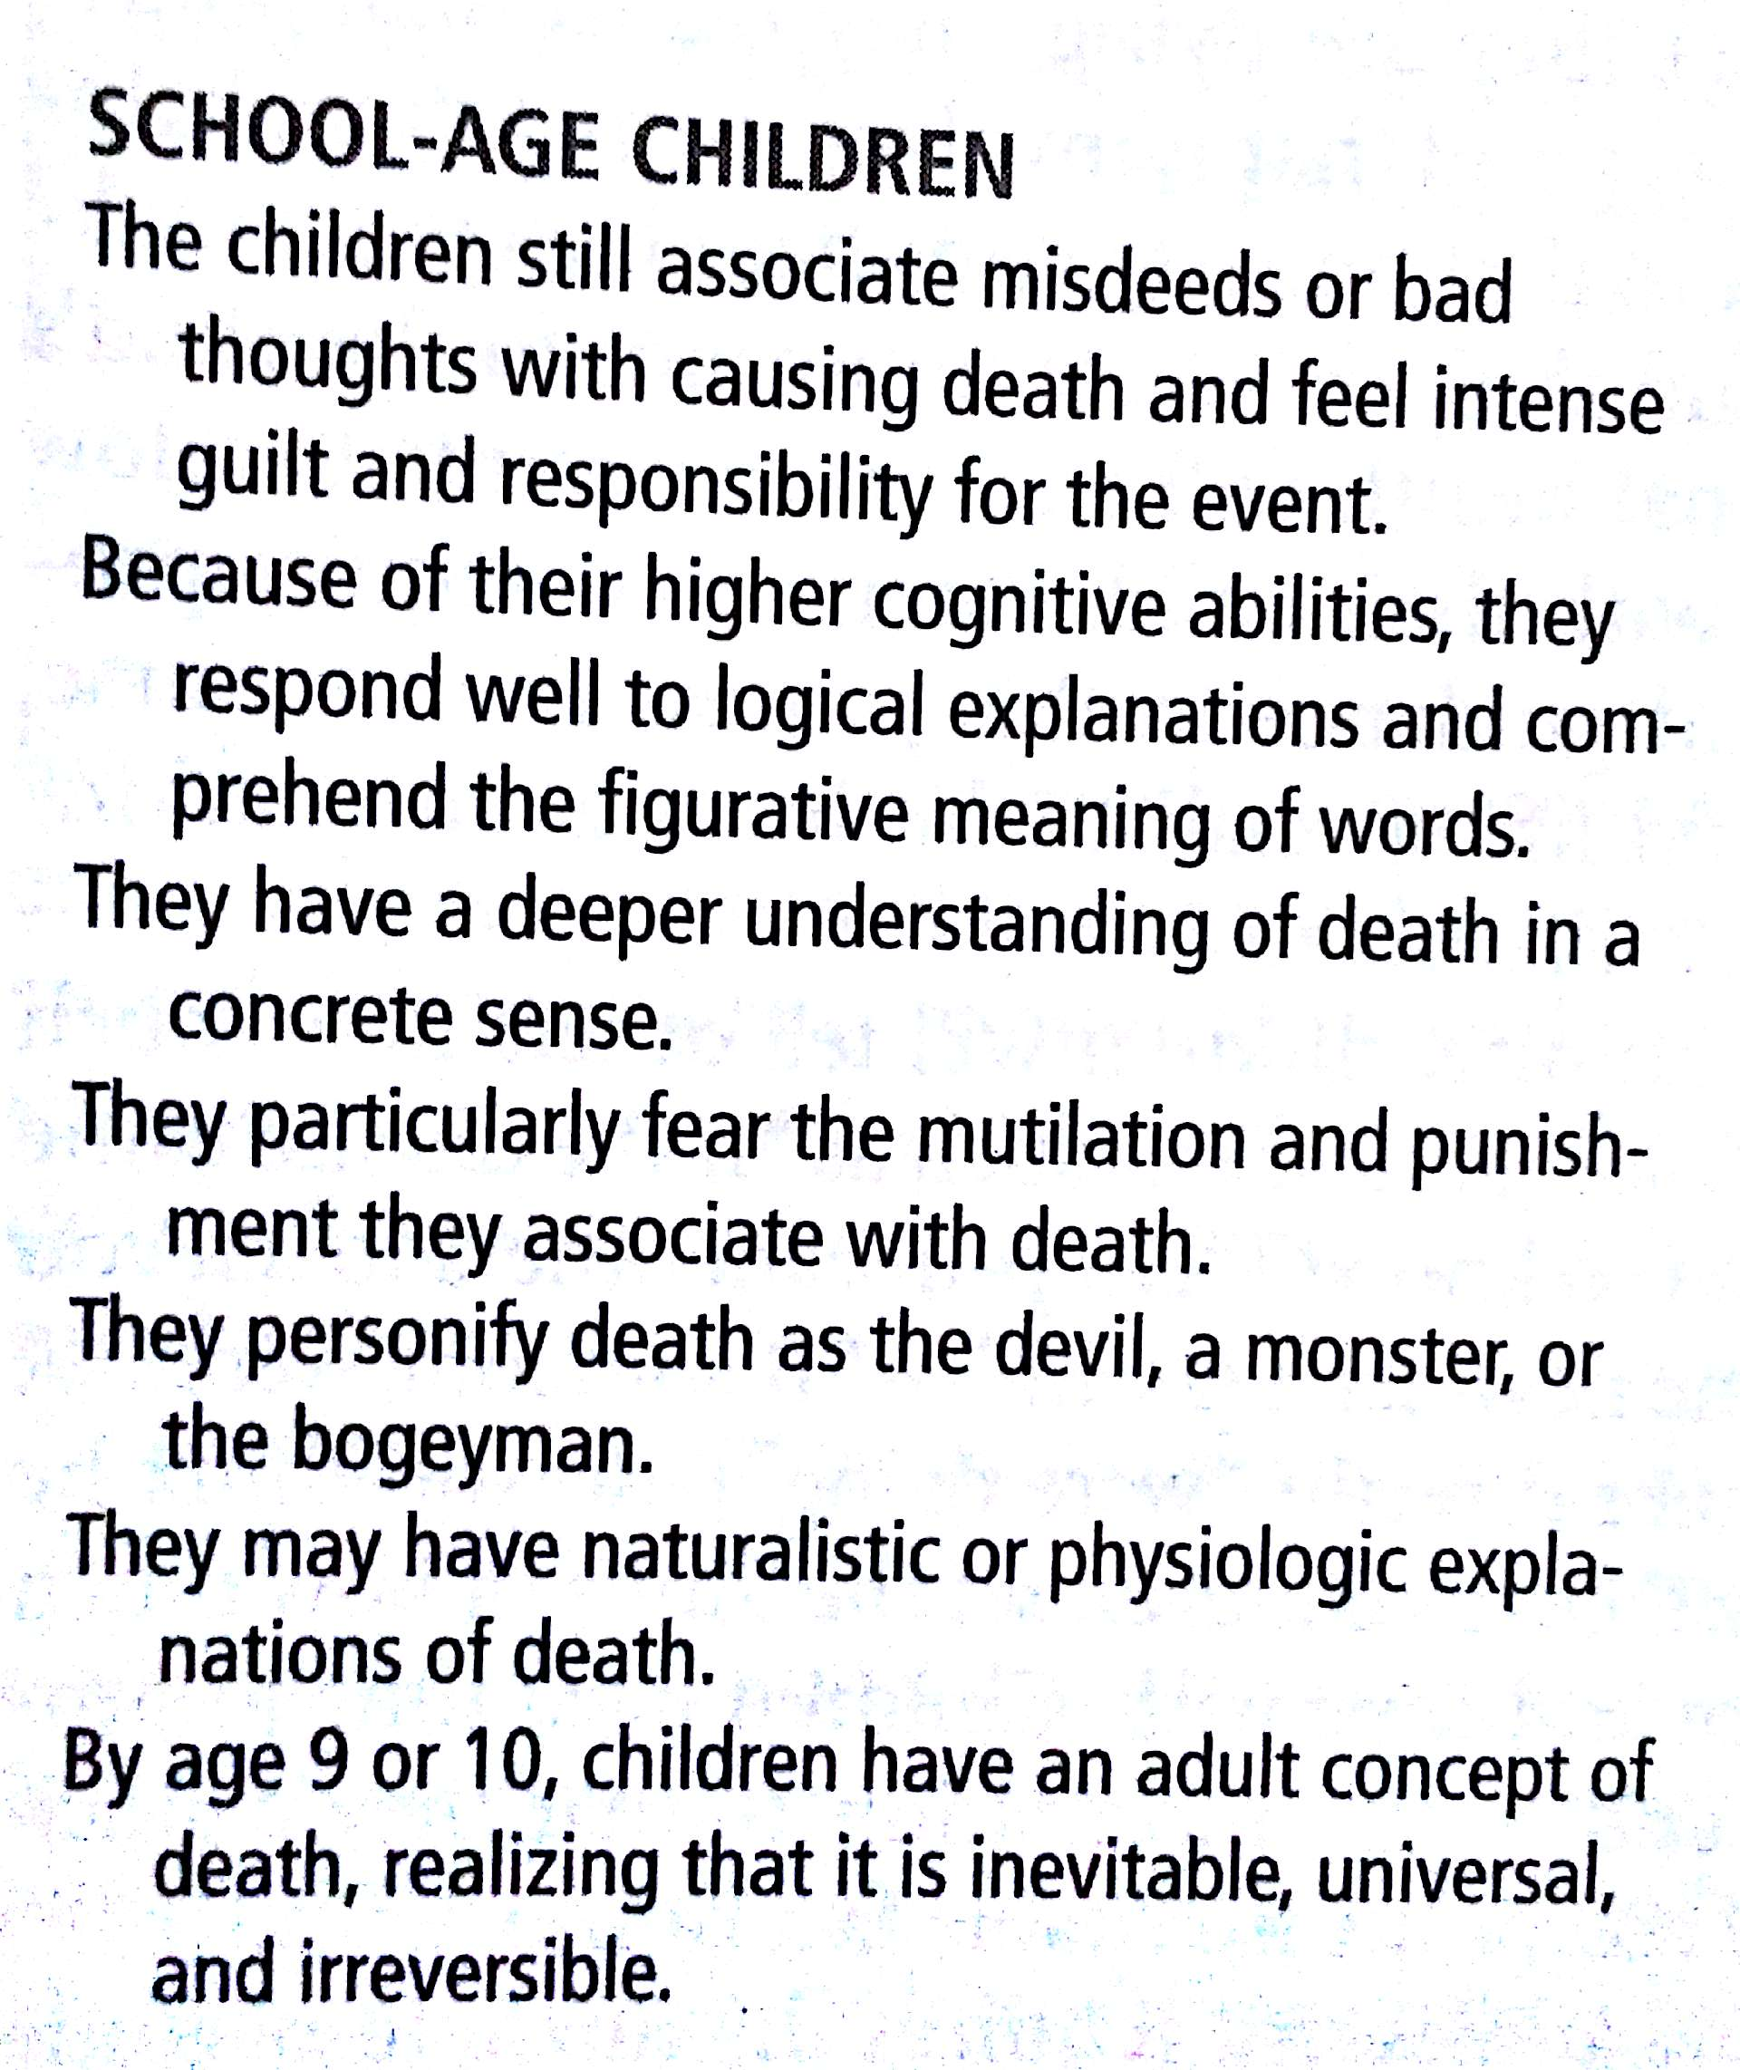

Slide 10
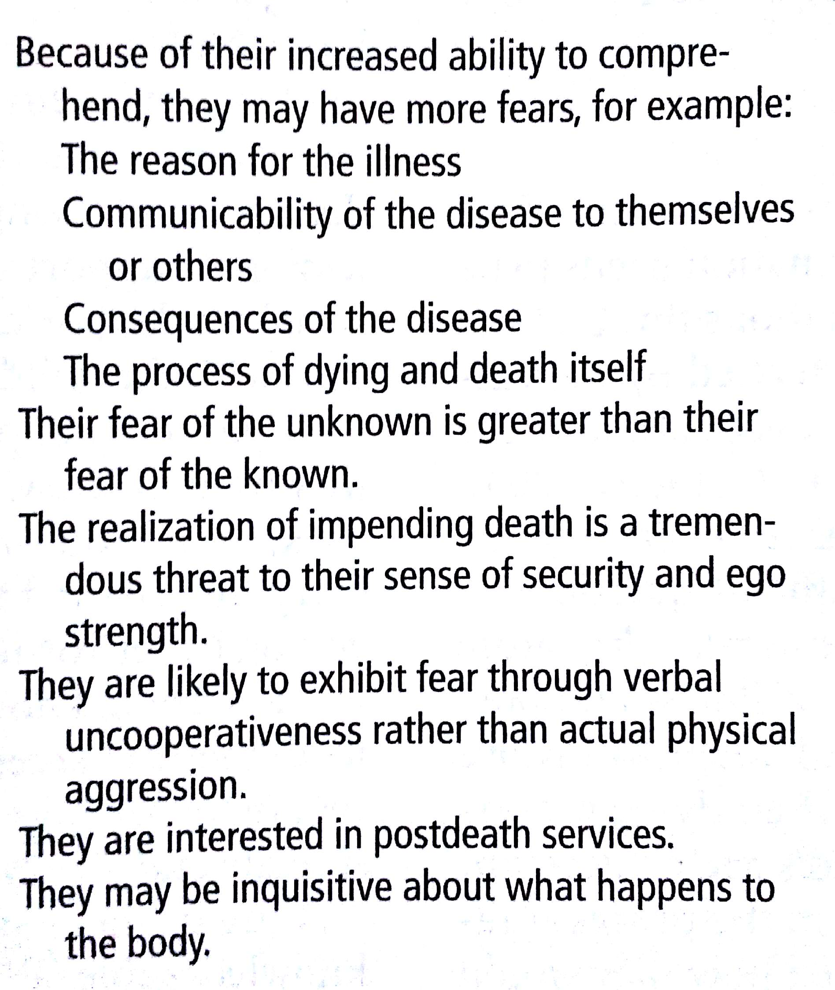
School child reactions to death

Slide 11
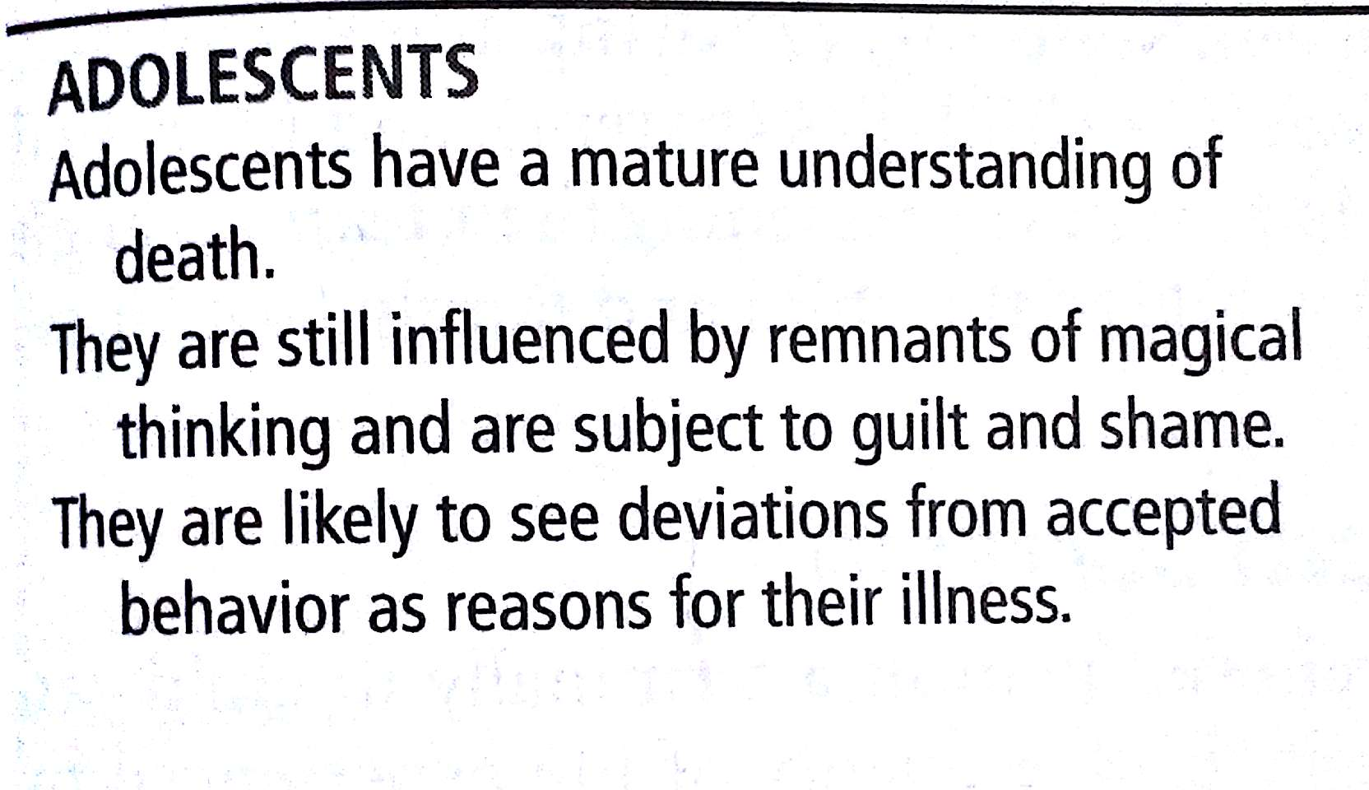

Slide 12
Adolescents reactions to death
They have the most difficulty in coping with death
They are least likely to accept cessation of life
Concern is for the present much more than for the past or future
Because of their idealistic view of the world they may criticise funeral rites as barbaric, money making and unnecessary

Slide 13
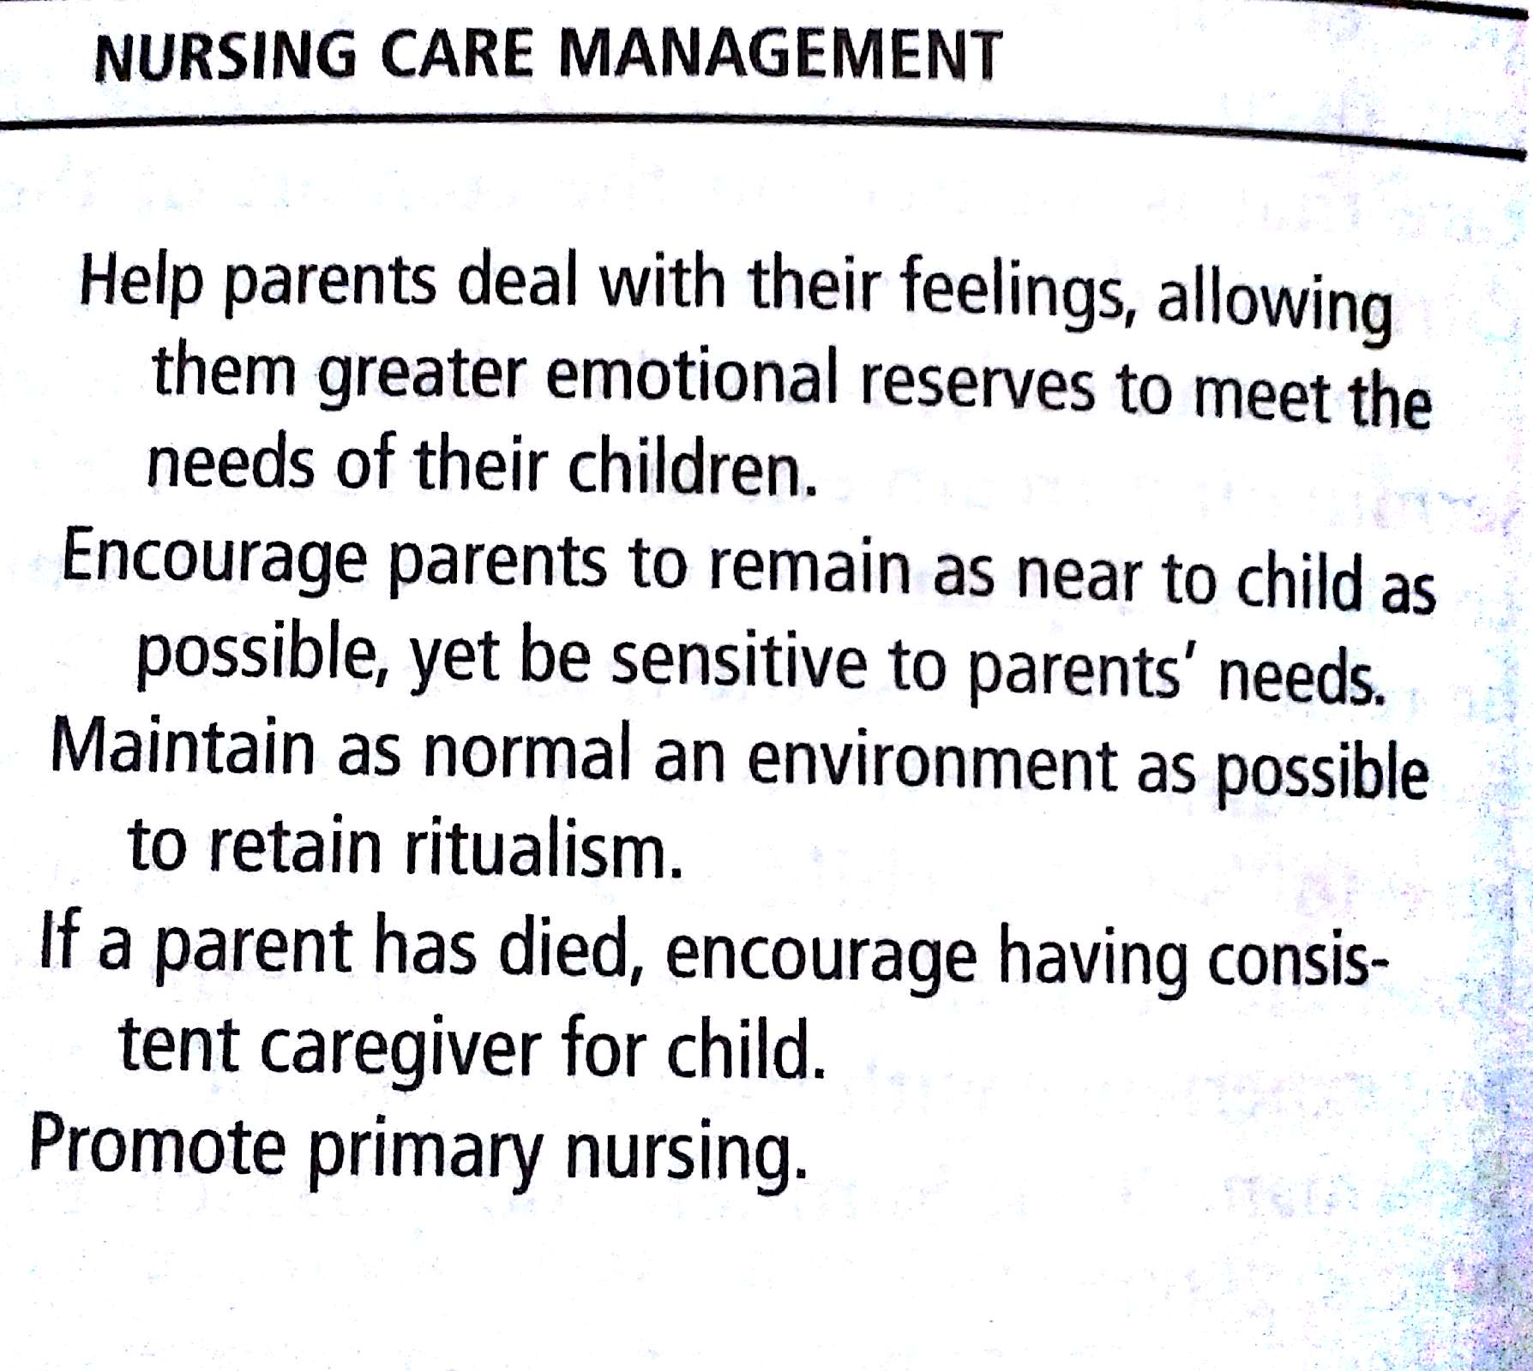

Slide 14
Nursing care management.......
Encourage children to talk about their feelings and provide aggressive outlets
Encourage parents to share their moments of sorrow with their children
Answer adolescents questions honestly, treating them as mature individuals and respecting their needs for privacy, and personal expression of emotions

Slide 15
Treatment options for terminally ill children
Hospital
Home care
Hospice care

Slide 16
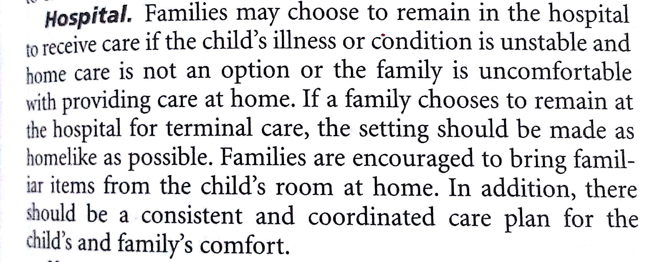

Slide 17
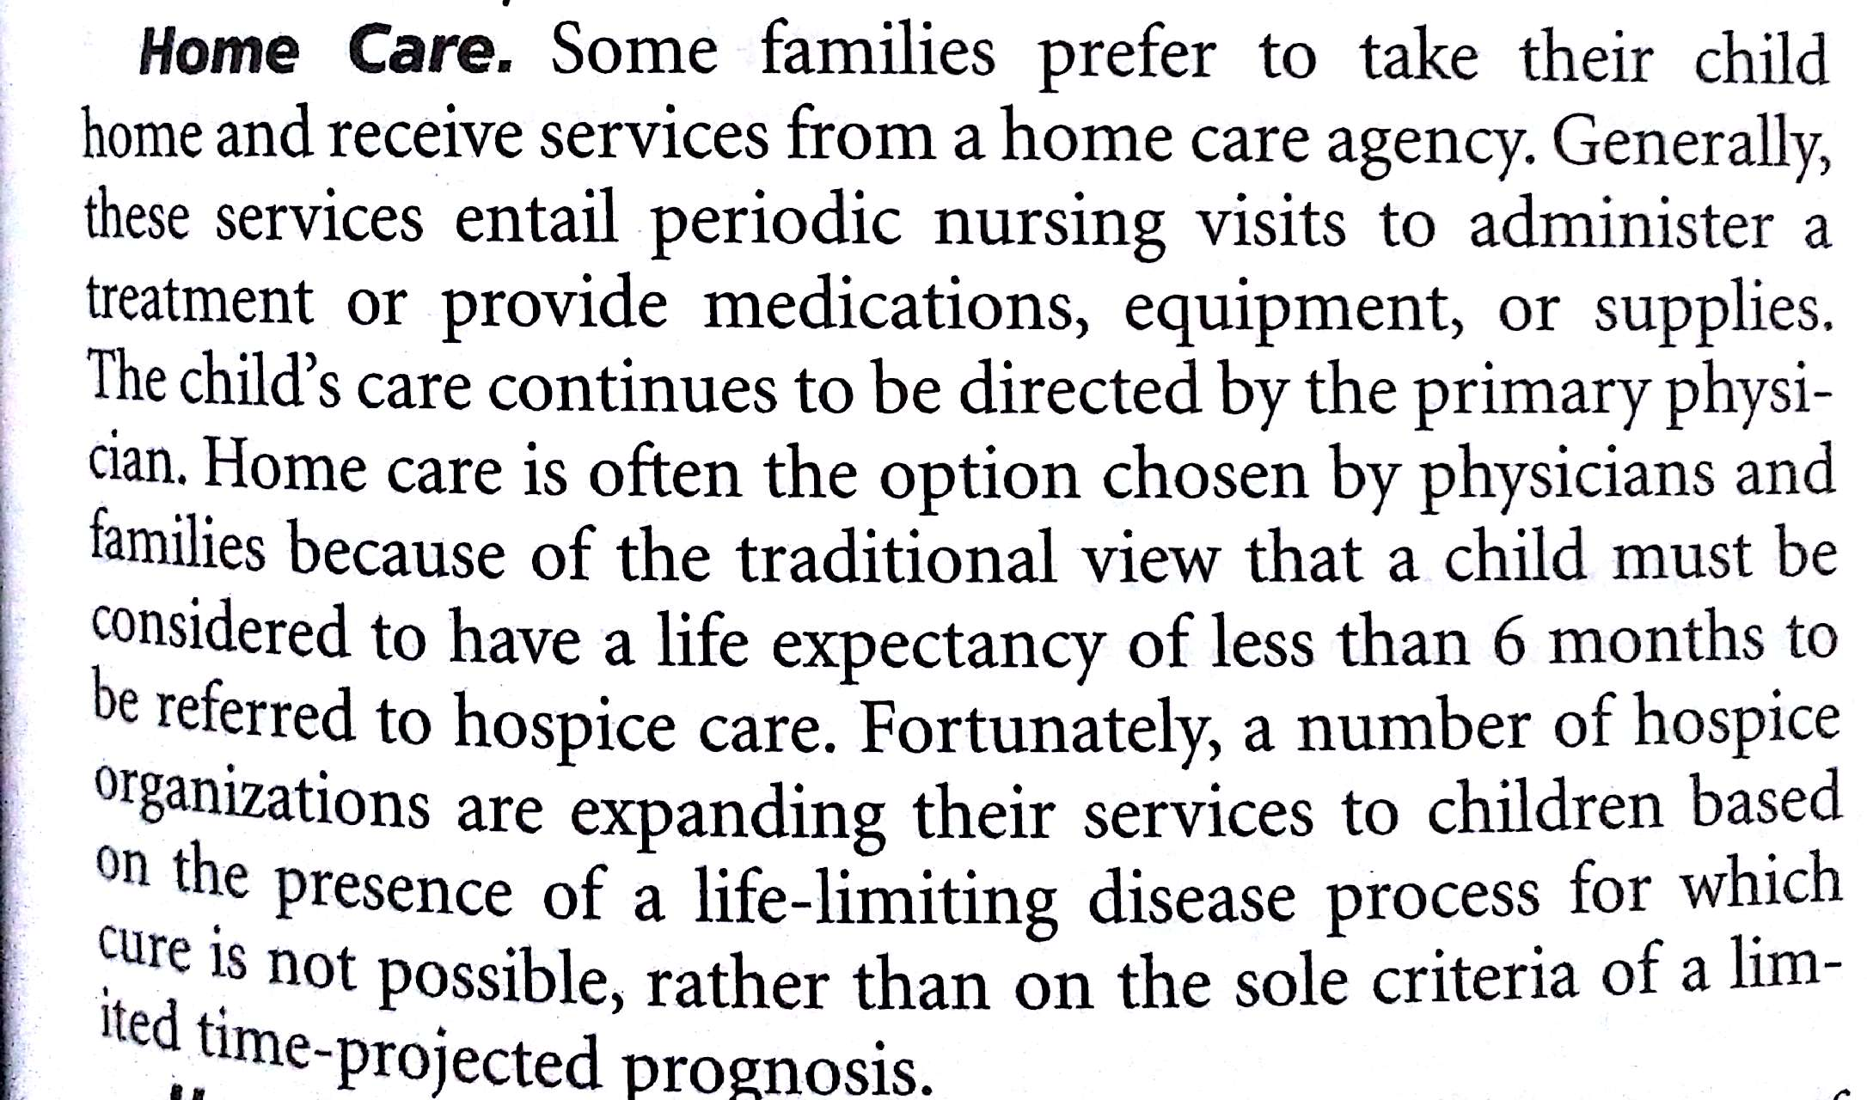
2. Home care

Slide 18
3. Hospice care
Parents should be offered the option of caring for their child at home during the final phases of an illness with the assistance of a hospice organization.
Hospice philosophy regards dying as a natural process and care of dying patients as including management of the physical, psychologic, social and spiritual needs of the patient and family.
Care is provided by a multidisciplinary group of professionals in the patients home or an inpatient facility

Slide 19
Nursing care of the child and family at the end of life
1. Fear of pain and suffering
Pain and symptom management
Parents and siblings need for education and support
2. Fear of dying alone or not being present when the child dies
3. Fear of actual death
Home deaths
Hospital deaths
4. Organ or tissue donation and autopsy
5. Grief and mourning
Parental grief
Sibling grief

