Slide 1
NURSING MANAGEMENT OF CHILD WITH ANORECTAL MALFORMATION
Presented by
Mr. Rajesh P Joseph
Assistant Professor
Sumandeep Nursing college
Sumandeep Vidyapeeth deemed to be university
Piparia, Waghodia, vadodara

Slide 2
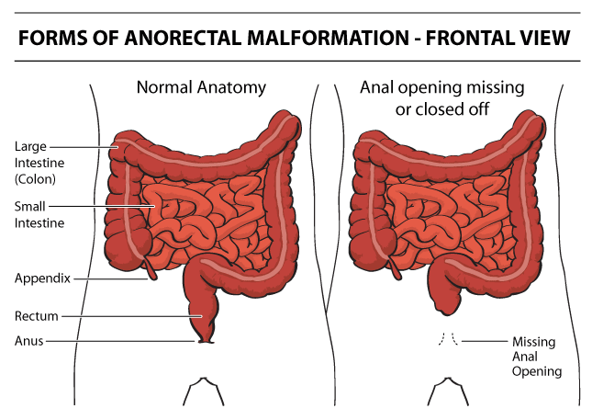

Slide 3
Imperforate anus (ARM)
An imperforate anus or Anorectal malformations (ARMs) are birth defects in which the rectum is malformed.
ARMs are a spectrum of different congenital anomalies in males and females, that varies from fairly minor lesions to complex anomalies

Slide 4
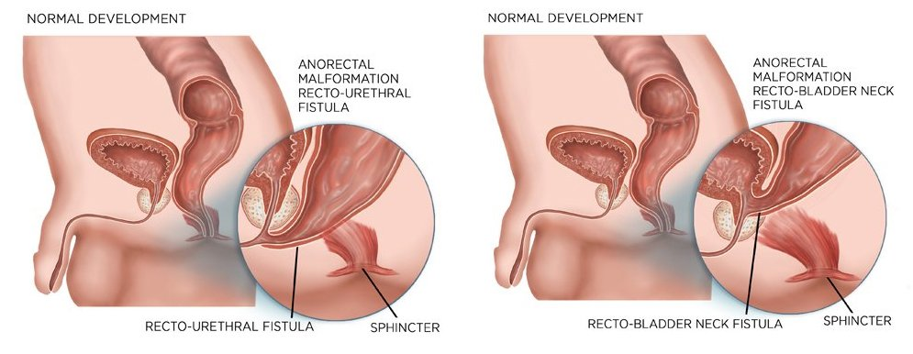

Slide 5
Anorectal malformations are birth defects
With this defect, the anus and rectum do not develop properly.
"Ano" refers to the anus, which is the opening at the end of the large intestine through which stool passes when a child has a bowel movement.
"Rectal" refers to the rectum, which is the area of the large intestine just above the anus.

Slide 6
During a bowel movement, stool passes from the large intestine to the rectum and then to the anus.
Muscles in the anal area help to control when we have a bowel movement.
Nerves in the area help the muscles sense the need for a bowel movement and also stimulate muscle activity.
With an Anorectal malformation, several abnormalities can occur, including the following:
The anal passage may be narrow
A membrane may be present over the anal opening
The rectum may not connect to the anus
The rectum may connect to part of the urinary tract or the reproductive system through a passage called a fistula

Slide 7
Classification of ARM’S
Level | Male | Female
High | Anorectal agenesis Rectal Artesia | Anorectal agenesis Rectal Artesia
Intermediate | Recto bulbar urethral fistula Rectal fistula | Recto- vestibular fistula Recto-vaginal fistula
Low | Agenesis without fistula Anocutaneous fistula Anal stenosis | Agenesis without fistula Anovestibular fistula Anocutaneous fistula Anal stenosis

Slide 8
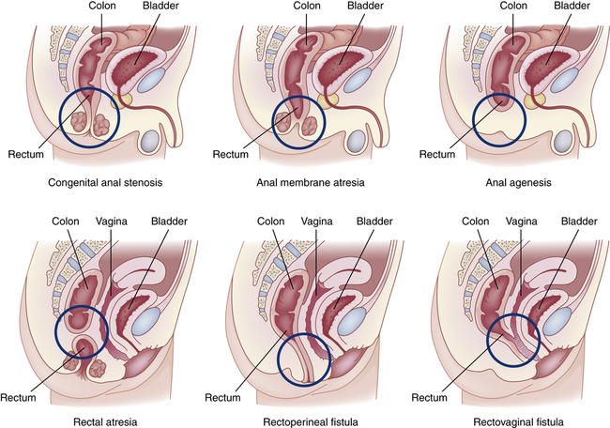

Slide 9
Pathophysiology
In a fetus, the lower portion of the large intestine and the urinary tract start off as one large mass of cells.
Certain steps have to take place in the first three months of gestation for the rectum and anus to separate from the urinary tract and form properly.
Sometimes, these steps do not occur as they should, and the rectum and/or anus may not develop normally.
Nothing that the mother did during pregnancy can be shown to have caused the malformation.

Slide 10
When the anal passage is narrow, a child may have a difficult time passing a bowel movement, causing constipation and possibly discomfort.
If there is a membrane over the anal opening, the baby may be unable to have a bowel movement.
When the rectum is not connected to the anus but there is a fistula present, stool will leave the baby's body through the fistula instead of the anus. This can cause infections.
If the rectum is not connected to the anus and there is not a fistula present, there is no way for stool to leave the intestine. The baby will be unable to have a bowel movement.

Slide 11
Diagnostic evaluation
Newborn assessment
Observations for passage of meconium
Inspection of the perineal area
Abdominal ultrasound
IV pyelogram
Voiding cystourethrogram

Slide 12
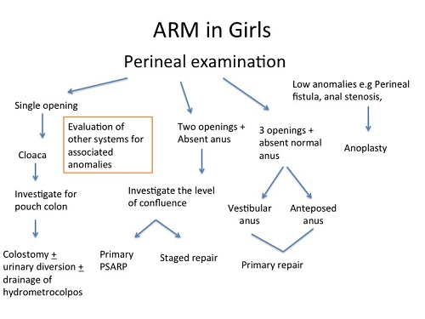

Slide 13
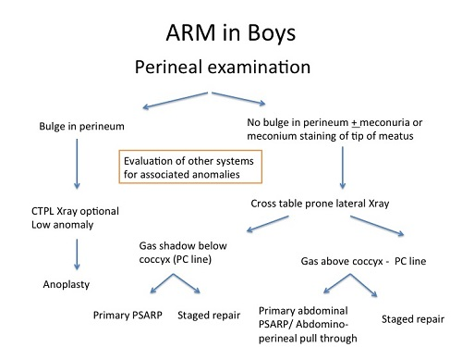

Slide 14
Diagnostic evaluation
Abdominal X-rays. Diagnostic test which uses invisible electromagnetic energy beams to produce images of internal tissues, bones, and organs onto film.
Abdominal ultrasound (also called sonography).
A diagnostic imaging technique which uses high-frequency sound waves and a computer to create images of blood vessels, tissues, and organs. Ultrasounds are used to view internal organs and to assess blood flow through various vessels.

Slide 15
Lower GI (gastrointestinal) series (also called barium enema).
A lower GI series is a procedure that examines the rectum, the large intestine, and the lower part of the small intestine.
A fluid called barium (a metallic, chalky, liquid used to coat the inside of organs so that they will show up on an X-ray) is given into the rectum as an enema.
An X-ray of the abdomen shows strictures (narrowed areas), obstructions (blockages), and other problems.

Slide 16
Upper GI (gastrointestinal) series (also called barium swallow).
Upper GI series is a diagnostic test that examines the organs of the upper part of the digestive system: the esophagus, stomach, and duodenum (the first section of the small intestine).
A fluid called barium (a metallic, chalky, liquid used to coat the inside of organs so that they will show up on an X-ray) is swallowed.
X-rays are then taken to evaluate the digestive organs.

Slide 17
Computed tomography scan (also called a CT or CAT scan). A diagnostic imaging procedure that uses a combination of X-rays and computer technology to produce horizontal, or axial, images (often called slices) of the body. A CT scan shows detailed images of any part of the body, including the bones, muscles, fat, and organs. CT scans are more detailed than general X-rays.
Magnetic resonance imaging (also called a MRI). A diagnostic procedure that uses a combination of large magnets, radiofrequencies, and a computer to produce detailed images of organs and structures within the body.

Slide 18
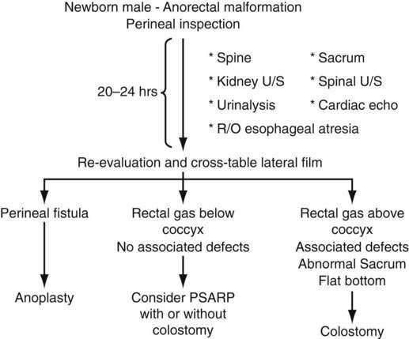

Slide 19
Surgical management
Anorectoplasty
Colostomy

Slide 20
Nursing management
Identification of undetected Anorectal malformation
A newborn who does not pass stool within 24 hrs of birth requires further assessment
Meconium that appears at an inappropriate orifice is reported
Preoperative care includes diagnostic evaluation, GI compression and IV fluids
After an Anorectoplasty is directed towards healing the surgical site without infection or complications
A temporary dressing and drain may be placed initially to manage the continuous passage of stool.

Slide 21
Nursing management.....
Protective ointments such as zinc oxide and occlusive dressings such as hydrocolloids decrease skin irritation from frequent loose stools
The preferred position is side lying prone position with the hips elevated or a supine position with the legs suspended at a 90 degree angle to the trunk to prevent pressure on perineal sutures
There may be an NG tube for abdominal decompression and IV feedings
The infant is given formula when normal peristalsis is noted
Care of the infant with a colostomy involves frequent dressing changes, meticulous skin care, and correct application of a collection device.

