Slide 1
Nursing Management of child with Nephrotic syndrome
Presented By:
Mr. Rajesh P Joseph
Assistant professor
Department of pediatric nursing
Sumandeep nursing college
Sumandeep Vidyapeeth deemed to be University
Piparia, Waghodia, vadodara

Slide 2
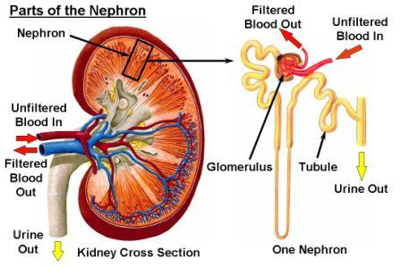
NEPHROTIC SYNDROME (Nephrosis)

Slide 3
Nephrotic Syndrome
It is a clinical state that includes massive Proteinuria, Hypoalbuminemia, Hyperlipidemia, and edema
The onset of MCNS can occur at any age but predominantly occurs in children between 2 and 7 years of age
It is rare in children younger than 6 months of age
Uncommon in infants younger than 1 year of age
Unusual after the age of 8 years
Patients with MCNS are twice as likely to be male

Slide 4
CLASSIFICATION
The disorder can occur as
When associated with primary glomerular disease It is termed Primary Nephrotic syndrome
when it occurs as a part of a recognised systemic disease or result from some evident cause it is termed Secondary Nephrotic syndrome
A congenital form inherited as an autosomal recessive disorder

Slide 5
Characteristics
The disorder is characterized by increased Glomerular permeability to plasma protein which results in massive urinary protein loss
Protein excretion greater than 3.5 g/24 hours
Hypoalbuminemia (less than 3 g/dL)

Slide 6
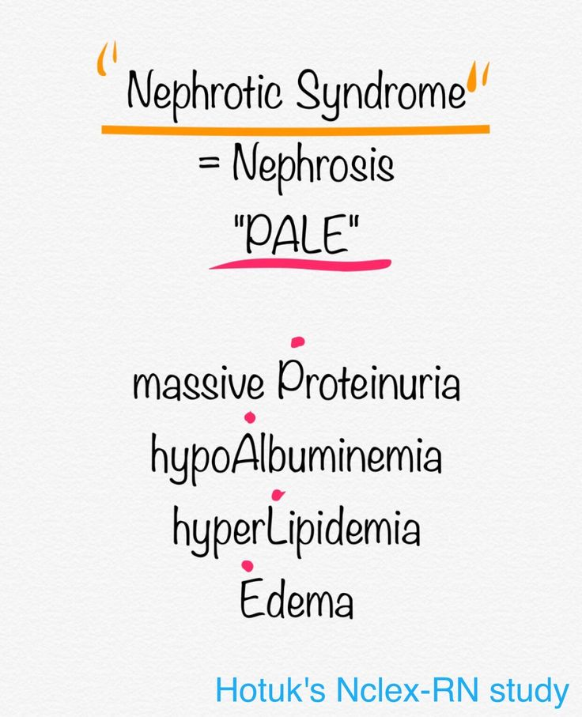

Slide 7
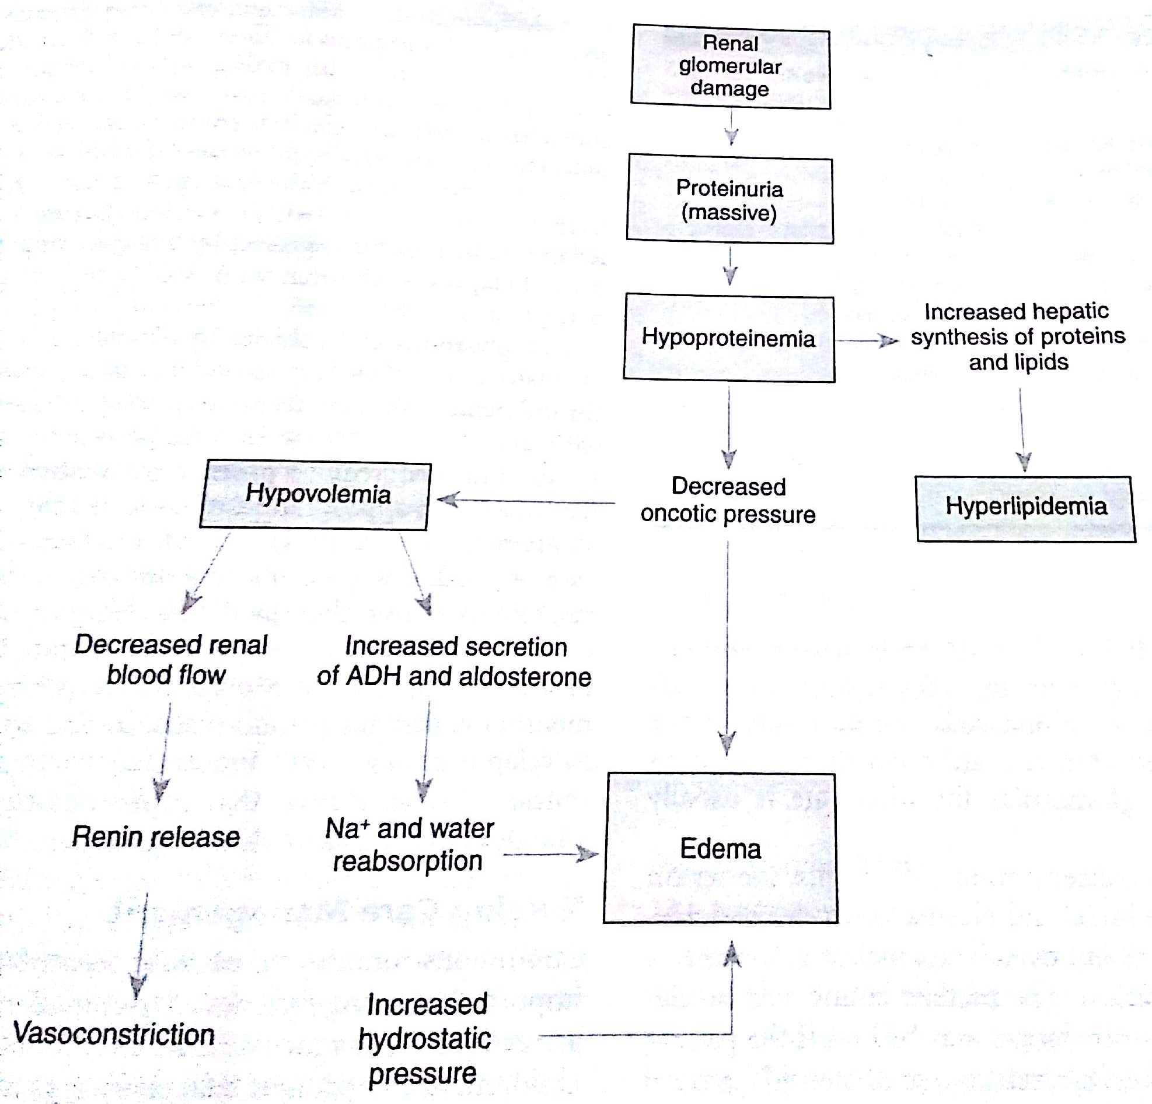

Slide 8
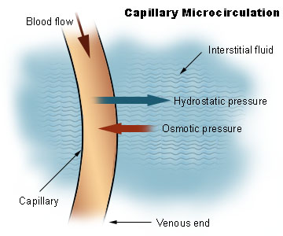

Slide 9
Clinical Manifestations
Anasarca with resulting respiratory distress
Diarrhoea due to edema of the intestinal mucosa
Weight gain
Puffiness of face (facial edema)
Abdominal swelling (Ascites)
Ankle or leg swelling
Easily fatigued
Lethargic
Decreased and frothy urine
Labial or scrotal swelling
Irritability
Susceptibility to infection

Slide 10
Diagnostic Evaluation
History collection
Physical examination
Urinalysis (dipstick test)
Complete blood count
Evaluation of serum electrolytes
Urine specific gravity (High)
Elevated serum cholesterol above 220 mg/dl
Renal biopsy (if not respond to steroid therapy)

Slide 11
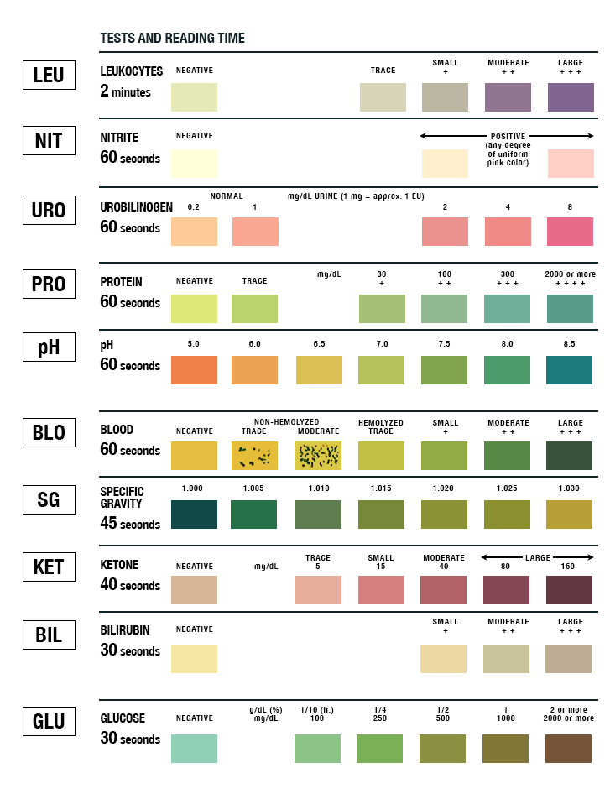
Urine Dipstick test

Slide 12


Slide 13
Therapeutic management
Objectives of therapeutic management
Reducing excretion of urinary protein
Reducing fluid retention in the tissues
Preventing infection
minimizing complication related to therapies

Slide 14
Management
Dietary restrictions include a low salt diet and in more severe cases fluid restriction
Well balanced, age appropriate diet rich in protein
Corticosteroids – Prednisone 2mg/kg/day for 6 weeks followed by 1.5 mg/kg every other day for 6 weeks
Proteinuria should disappear within the first weeks of therapy

Slide 15
Relapse
When children have relapse which is defined as the reappearance of Proteinuria (dipstick of 2+ or more) for 3 consecutive days
Alkylating agents such as Cyclophosphamide or Chlorambucil are effective in reducing the relapse

Slide 16
Nursing Management
Providing care during hospitalization
Administering medications
Maintaining proper fluid balance and assessing edema
Providing a nutritious diet
Preventing infection
Preventing skin breakdown
Promoting optimal psychosocial growth
Providing emotional support and education for all family members

