Slide 1
Nursing management of child with peptic ulcer disease
Presented by:
Mr. Rajesh P Joseph
Asistant professor
Department of pediatric nursing
Sumandeep nursing college
Piparia, Waghodia, vadodara

Slide 2
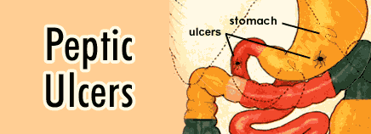

Slide 3
PEPTIC ULCER DISEASE (PUD)
A peptic ulcer is erosion of the lining of the stomach or small intestine (duodenum) due to excess stomach acid, breakdown of the stomach's protective lining, or both.
Peptic ulcers are much less common among children than adults.

Slide 4
Types
1. Acute peptic ulcer
2. Chronic peptic ulcer
3. Gastric ulcer
Involves the mucosa of the stomach
4. Duodenal ulcer
Involves the pylorus or duodenum
5. Stress ulcer
Children of any age can develop ulcers when they are extremely sick, such as after severe burns, injuries, and illnesses. These ulcers are referred to as stress ulcers

Slide 5
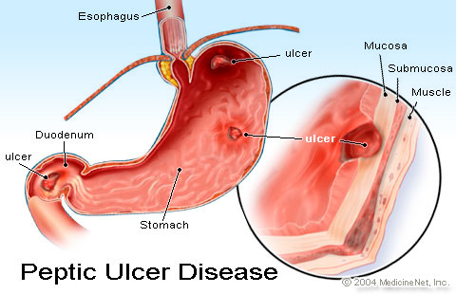

Slide 6
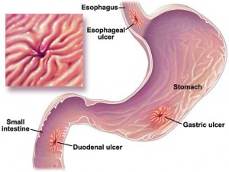

Slide 7
Etiology
Exact cause is unknown
Helicobacter pylori (through food, water, or close contact with an infected individual)
NSAIDS
increased secretion of pepsin & HCL in stomach
Adolescents who drink alcohol or smoke are also more likely to develop ulcers.

Slide 8
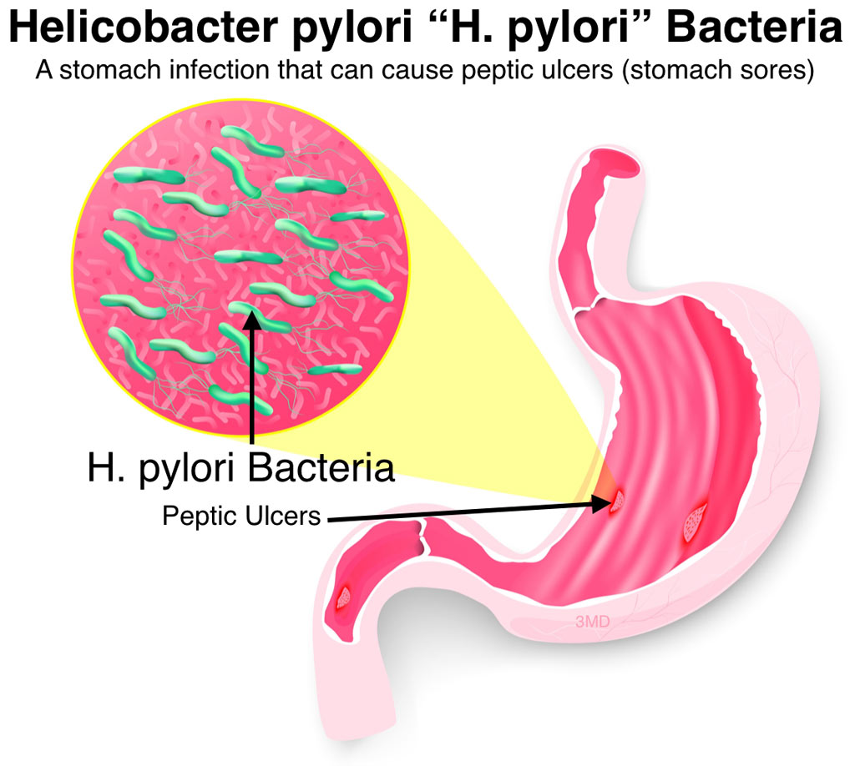

Slide 9
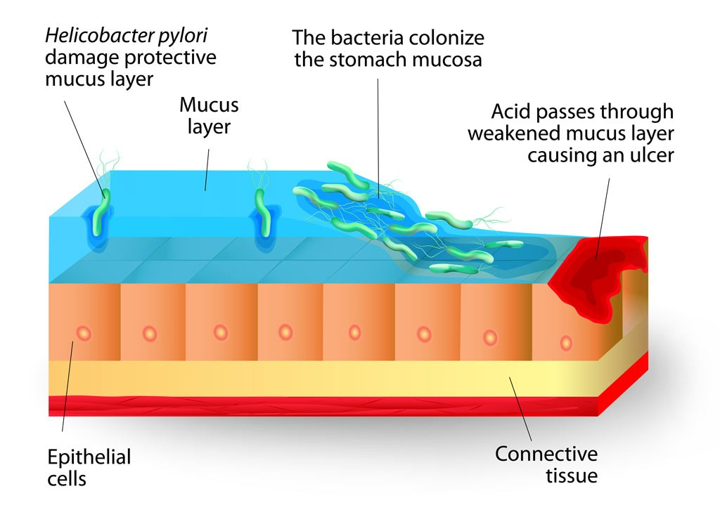

Slide 10
PATHOPHYSIOLOGY
DESTRUCTIVE FACORS
Acid
Pepsin
Medications
Bile acids
Infection
DEFENSIVE FACTORS
Mucus layer
Local bicarbonate secretion
Epithelial cell renewal
Mucosal blood flow

Slide 11
SYMPTOMS
Burning pain in the abdomen between the breast bone and the belly button
The pain often occurs between meals and in early in the morning. It may last from a few minutes to a few hours.
Epigastric pain
nausea
Hematemesis
loss of weight
Melena (passage of black, tarry stools)
Loss of appetite

Slide 12
Diagnostic Evaluation
Upper GI (gastrointestinal) X-ray series
examination of the esophagus, stomach and duodenum (the first section of the small intestine)
Upper Endoscopy
a test that uses an endoscope to examine the inside of part of the digestive tract.
Tissue samples from inside the digestive tract may also be taken for examination
Blood test
Stool test
Urea breath test

Slide 13
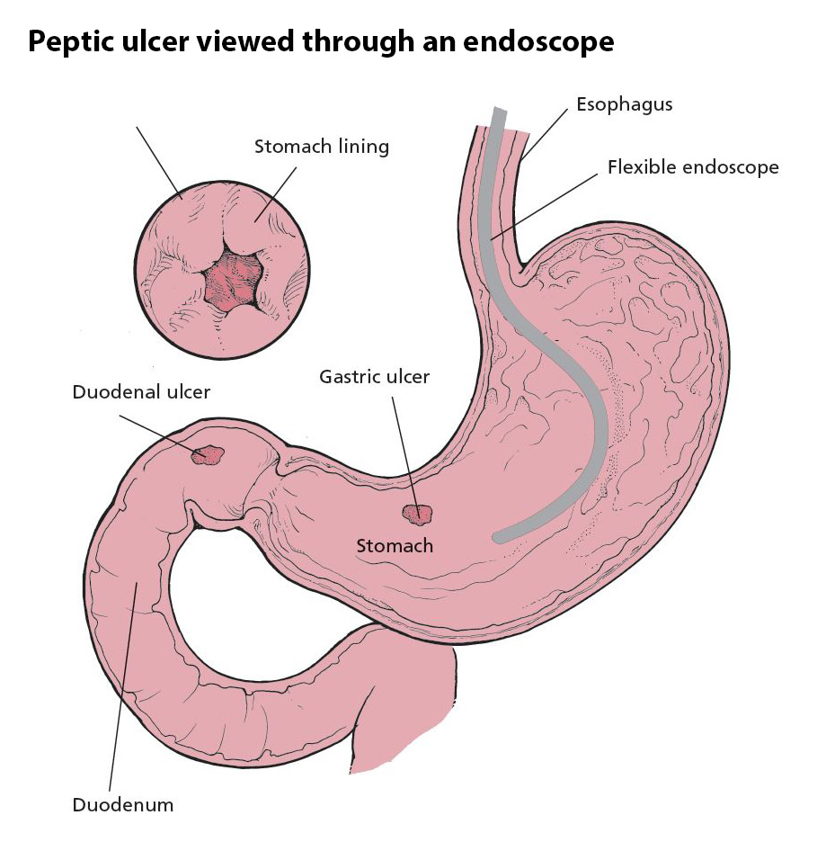

Slide 14
MEDICAL MANAGEMENT
Antibiotics
Antacids
Histamine receptor antagonists
Proton pump inhibitors
Mucosal protective agents (cytoprotective)
Eg. Sucralfate & bismuth compounds
Aluminium containing agents that forms a protective barrier over ulcerated mucosa to protect against acid & pepsin

Slide 15
Antacids
Aluminium hydroxide (amphogel) – 0.5 to 1.0ml/kg 1-3 hr after meals and at bed time
Calcium (alka - 2) - 0.5 to 1.0ml/kg 1-3 hr after meals and at bed time
Magnesium hydroxide (milk of magnesia) - 0.5 to 1.0ml/kg 1-3 hr after meals and at bed time
Combination antacids (contains 2 or more antacids)
Aluminium & magnesium
Gelusil, Maalox & Mylanta

Slide 16
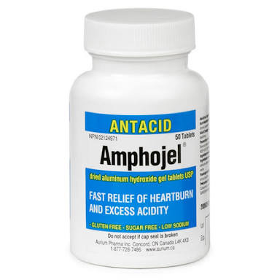
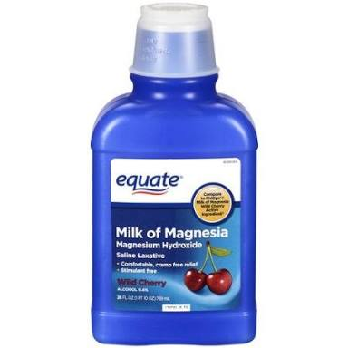

Slide 17
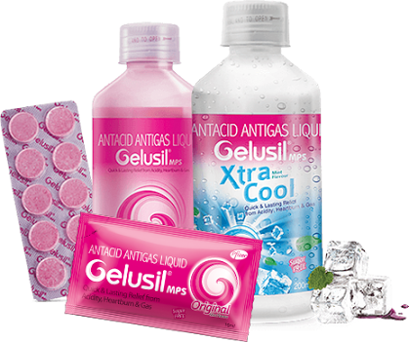

Slide 18
H2 RECEPTOR ANTAGONIST
Cimetidine
20-40 mg/kg/day
PO, IM, IV

Slide 19
Surgical management
Vagotomy
A procedure that involves cutting parts of the vagus nerve (a nerve that transmits messages from the brain to the stomach) to interrupt messages sent through it, therefore, reducing acid secretion.
Antrectomy (Billroth I)
An operation to remove the lower part of the stomach (antrum), which produces a hormone that stimulates the stomach to secrete digestive juices. Sometimes a surgeon may also remove an adjacent part of the stomach that secretes pepsin and acid.

Slide 20
Pyloroplasty
A surgical procedure that may be performed along with a vagotomy in which the opening into the duodenum and small intestine (pylorus) are enlarged, enabling contents to pass more freely from the stomach.

Slide 21
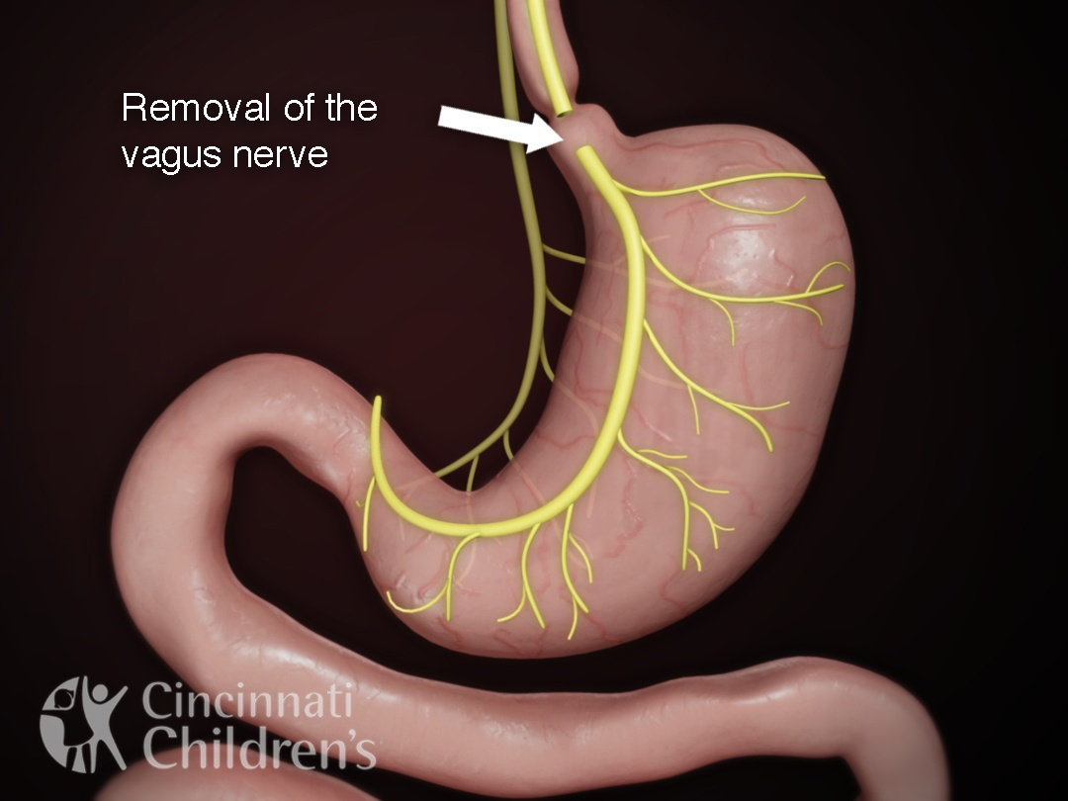

Slide 22
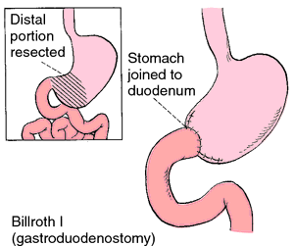

Slide 23
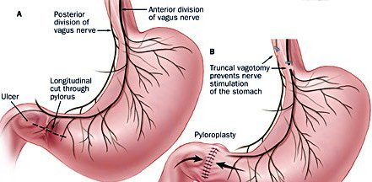

Slide 24
COMPLICATIONS
Bleeding
As the lining of the stomach or duodenal wall is eroded, blood vessels may also be damaged, causing bleeding.
Perforation
Sometimes a hole has worn through the wall of the stomach or duodenum, and bacteria and partially digested food can spill through the opening into the sterile abdominal cavity (peritoneum).

Slide 25
COMPLICATIONS……..
Narrowing and obstruction
Ulcers located at the end of the stomach (where the duodenum is attached) can cause swelling and scarring, which can narrow or close the intestinal opening.

Slide 26
Nursing management
Assess pain and methods used to relieve it.
Take a thorough history including a 72 hour food intake history
If patient has vomited determine whether emesis is bright red or coffee ground in appearance
Ask patient about usual food habits, alcohol, smoking in adolescents and use of NSAIDS
Palpate abdomen for localized tenderness
Advice to avoid alcohol and caffeinated beverages
Diet rich in milk and cream should be avoided

Slide 27
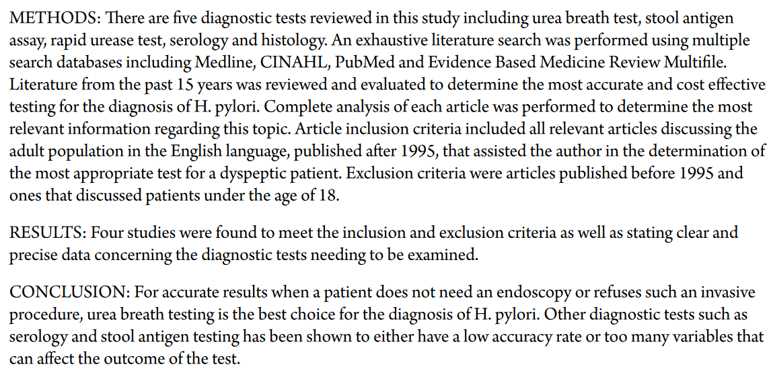

Slide 28
P | I | C | O
Diagnostic test for Helicibacter Pylori | Find out most accurate and cost effective method of diagnostic procedure | No comparison | Four studies were found meet the inclusion and exclusion criteria

Slide 29
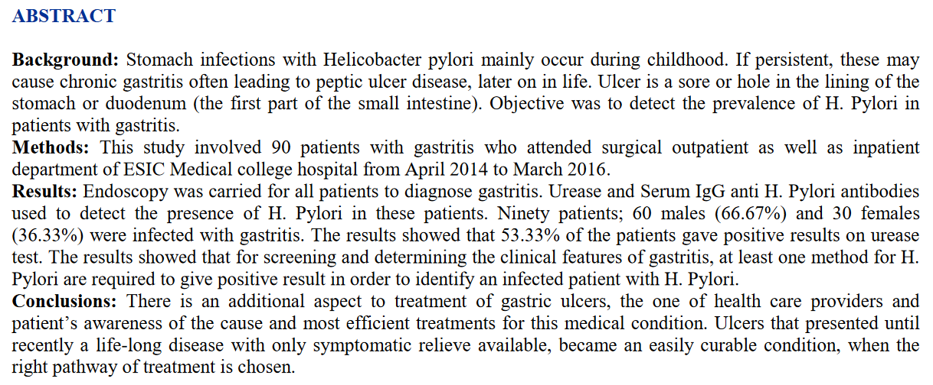

Slide 30
P | I | C | O
Prevalence of H. Pylori in patients with gastritis | Endoscopy | No comparison | 53.33% patients gave Positive results on urease test

