Slide 1
Management of foreign bodies in children
Presented By:
Mr. Nirmal Raj EV
Assistant Professor,
Dept of Pediatric Nursing
Sumandeep nursing college
Sumandeep Vidyapeeth deemed to be University
Piparia, Waghodia, vadodara

Slide 2
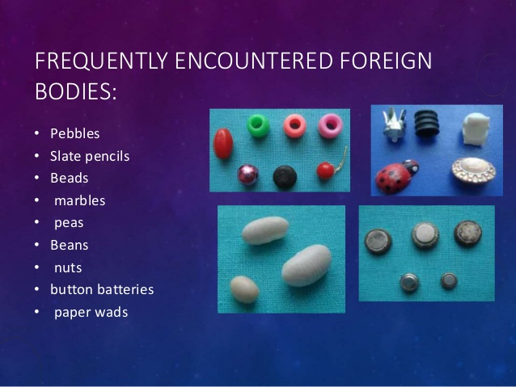

Slide 3
FOREIGN BODIES IN CHILD
Common areas of foreign body incidence
Eyes
Ear, Nose & Throat
Respiratory tract
Alimentary tract

Slide 4
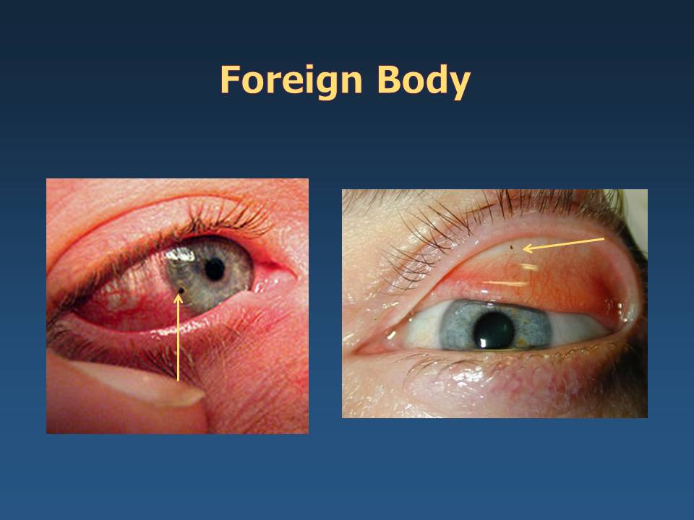

Slide 5
What are foreign bodies
Foreign bodies refer to any objects in the eye that are not meant to be there.
The foreign object may be in the conjunctiva (a thin membrane that covers the actual eye) or in the cornea (the clear, dome-shaped surface that covers the front of the eye).

Slide 6
Most common foreign bodies in the eyes
Dust
Dirt
Contact lenses
Sand
Cosmetics
Eye lashes
Metal particles
Glass shards

Slide 7
Symptoms
Sensation of a foreign object in the eye
Pain in the eye
Tearing of the eye
Pain when the child looks at a light
Excessive blinking
redness or a bloodshot eye

Slide 8
What to Do:
(sand, dirt, and other foreign bodies on the eye surface)
Wash your hands thoroughly before touching the eyelids to examine or flush the eye.
Do not touch, press, or rub the eye itself, and do whatever you can to keep your child from touching it.
Do not try to remove any foreign body except by flushing. Other methods can scratch the surface of the eye, especially the cornea
Flush for up to 15 minutes, checking the eye every 5 minutes to see if the foreign body has been flushed out.

Slide 9
Treatment
If a foreign body is seen in the eye, it may be removed with a small cotton applicator or by washing the eye out with saline.
An antibiotic ointment may be placed in the eye.
Referral to an ophthalmologist or optometrist may be necessary if the foreign body is hard to remove or is causing the child severe pain.

Slide 10
Treatment……..
If a corneal abrasion (a scratch or injury to the cornea) is detected, treatment may include:
A patch over the eye may be used to help decrease your child's level of discomfort.
A patch is usually required for 12 to 24 hours. A soft contact lens may be used in place of a traditional patch.
Close follow-up with your child's doctor is needed to ensure that the abrasion heals completely

Slide 11
Treatment……..
  Severe abrasions or cuts into the cornea will be managed by an eye specialist because of the increased risk of damage to the eye.
  An antibiotic ointment may be placed in the eye.
A tetanus shot may be given depending on the type of foreign body and the vaccination status of the child.

Slide 12
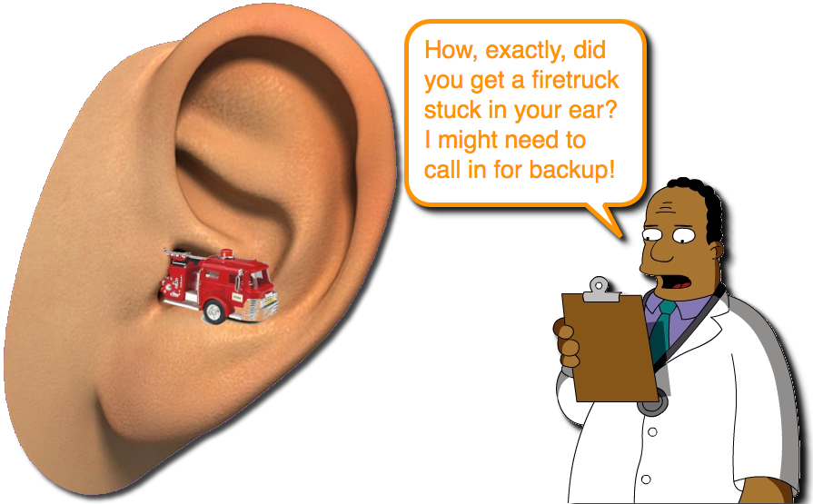
Foreign bodies in Ear

Slide 13
Foreign bodies in EAR
Getting an object stuck in the ear is a relatively common problem, especially in toddlers. The vast majority of items are lodged in the ear canal, which is the small channel that ends at the eardrum
Common objects found in ears include food material, beads, toys, and insects. Children often place items in their ears out of curiosity.
Although earwax (cerumen) is not technically a foreign body, it does frequently accumulate in the ear canal and can cause discomfort or decreased hearing just like other foreign bodies

Slide 14
Symptoms
Pain
Irritation to the ear canal
Bleeding or discharge
Erythema & swelling

Slide 15
Management
Don't probe the ear with a tool. Don't attempt to remove the foreign object by probing with a cotton swab, matchstick or any other tool. To do so risks pushing the object further into the ear and damaging the fragile structures of the middle ear.
Remove the object if possible. If the object is clearly visible, pliable and can be grasped easily with tweezers, gently remove it.
Try using gravity. Tilt the head to the affected side to try to dislodge the object.

Slide 16
Try using oil for an insect
If the foreign object is an insect, tilt the person's head so that the ear with the offending insect is upward.
Try to float the insect out by pouring mineral oil, olive oil or baby oil into the ear.
The oil should be warm but not hot. As you pour the oil, you can ease the entry of the oil by straightening the ear canal.
Pull the earlobe gently backward and upward for an adult, backward and downward for a child. The insect should suffocate and float out in the oil bath.
Don't use oil to remove any object other than an insect.

Slide 17
Try washing the object out (Irrigation)
Use a bulb ear syringe and warm water to irrigate the object out of the canal
Commonly used techniques include applying gentle suction to the object, small forceps, or instruments that have a loop or hook at the tip.
If the object is metallic, a long instrument may be magnetized to assist in gently pulling the object from the ear.

Slide 18

Foreign bodies in Nose

Slide 19
Foreign bodies in the Nose
Objects that are put into the child's nose are usually soft things.
These would include, tissue, clay, and pieces of toys, or erasers.
Sometimes, a foreign body may enter the nose while the child is trying to smell the object.
Children often place objects in their noses because they are bored, curious, or copying other children.

Slide 20
The most common symptom of a foreign body in the nose is nasal drainage.
The drainage appears only on the side of the nose with the object and often has a bad odor.
In some cases, the child may also have a bloody nose.

Slide 21
Symptoms
Difficulty breathing through the affected nostril
Feeling of something in the nose
Foul-smelling or bloody nasal discharge
Irritability, particularly in infants
Irritation or pain in the nose

Slide 22
First aid
DO NOT search the nose with cotton swabs or other tools. This may push the object further into the nose.
DO NOT use tweezers or other tools to remove an object that is stuck deep inside the nose.
DO NOT try to remove an object that you cannot see or one that is not easy to grasp. This can push the object farther in or cause damage.
Have the person breathe through the mouth. The person should not breathe in sharply. This may force the object in further.
Gently press and close the nostril that does NOT have the object in it. Ask the person to blow gently. This may help push the object out. Avoid blowing the nose too hard or repeatedly

Slide 23
Management
Avoid sticking cotton swabs or your fingers into your child’s nose. This can also push the object further into the nose.
Stop child from sniffing. Sniffing could cause the object to move farther up their nose and pose a choking hazard. Encourage your child to breathe through their mouth until the object is removed
treatments include instruments that will help them grasp or scoop out the object and machines that will suction the object out.
The doctor may place a topical anesthetic (spray or drops) inside the nose to slightly numb the area.
Doctor may prescribe antibiotics or nasal drops to treat or prevent an infection.

Slide 24
Foreign bodies in Throat
All pharyngeal foreign bodies are medical emergencies that require airway protection.
Because complete airway obstruction usually occurs at the time of aspiration and results in immediate respiratory distress, emergency intervention is essential.

Slide 25
The most common foreign bodies in the throat are
pieces of plastic
metal pins
Seeds
Nuts
Bones
coins
dental appliances

Slide 26
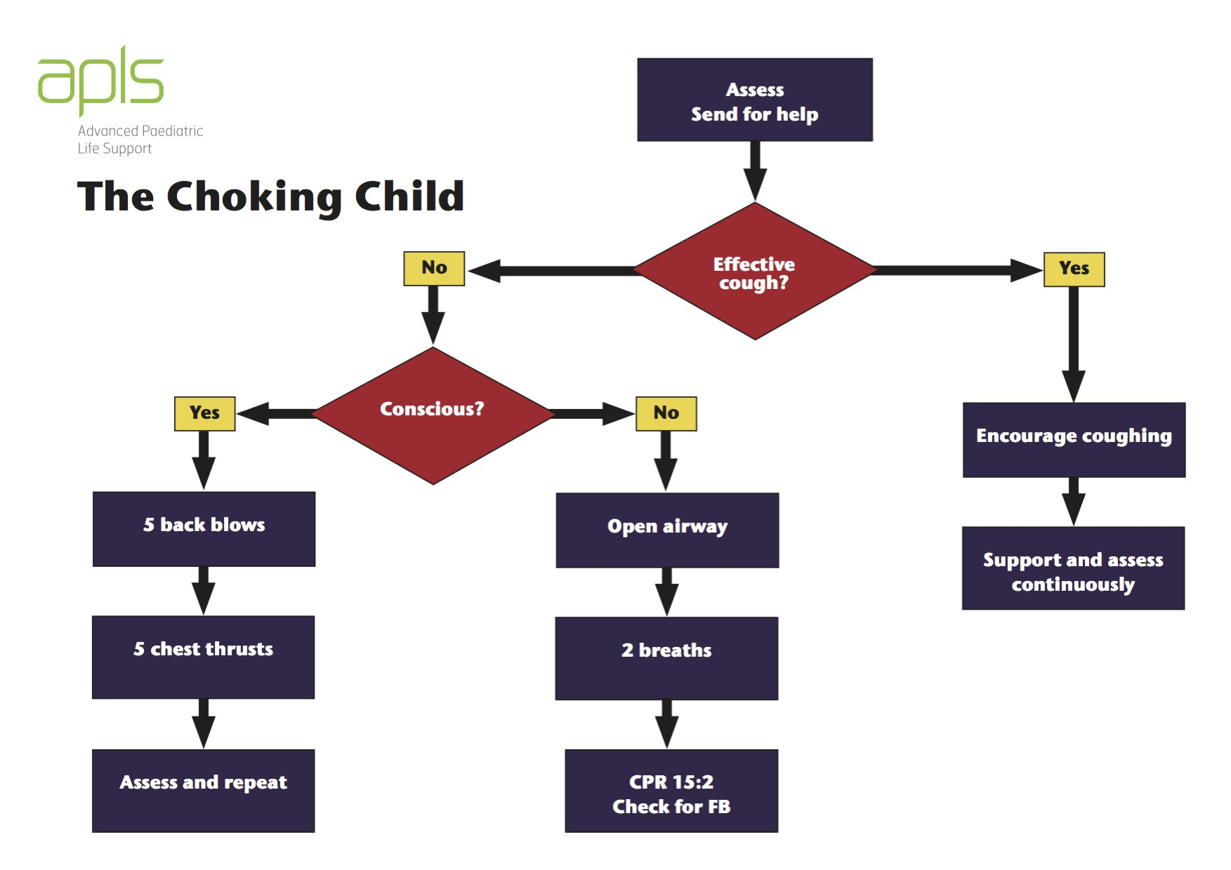

Slide 27
Management
Most foreign bodies in the throat require Otolaryngology intervention with sedation and endoscopic removal.
Complications include
airway obstruction
laryngeal edema
pushing the foreign body into the subglottic space, oesophagus, or trachea

Slide 28
Foreign bodies in the Respiratory tract
Tracheo-bronchial foreign body aspiration (FBA) is a potentially life-threatening event because it can block respiration by obstructing the airway, thereby impairing oxygenation and ventilation.
The problem is common in male toddlers

Slide 29
CAUSES
They lack molars for proper grinding of food.
They tend to be running or playing at the time of aspiration.
They tend to put objects in their mouth more frequently.
They lack coordination of swallowing and glottic closure.

Slide 30
Common foreign bodies of RT
Seeds
Nuts
Vegetable matters
Glass bead
Plastic piece (from toy, ball pen)
Stone
Screw

Slide 31
Symptoms of Inhaled foreign body
(in Respiratory tract)
Choking
coughing
noisy upper airway breathing (stridor)
inability to breathe or speak
chest pain
wheezing
There may be no symptoms initially, but later may develop symptoms of a lung infection (pneumonia).

Slide 32
Diagnostic evaluation
History collection
Physical examination
X-ray
CT Scan
MRI
Bronchoscopy

Slide 33
Emergency management
Hanging the child upside down
Thumping over the back
Groping with fingers in the pharynx
Chest thrusts
Back blow
Heimlich maneuver

Slide 34
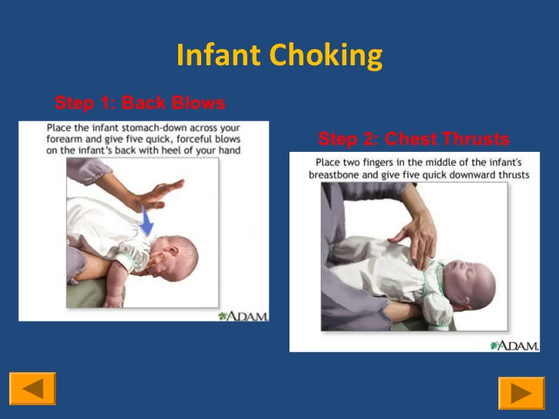
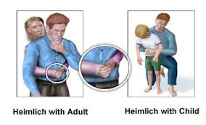
Chest thrusts & Back blow

Slide 35
Invasive & surgical Management
Rigid Bronchoscopy
is an invasive procedure that is utilized to visualize the oropharynx, larynx, vocal cords, and tracheal bronchial tree. It is performed for both the diagnosis and treatment of lung disorders.
Flexible Bronchoscopy
The flexible bronchoscope is used more often than the rigid bronchoscope because it usually does not require general anesthesia, is more comfortable for the person, and offers a better view of the smaller airways. It also allows the doctor to remove small samples of tissue (biopsy).
Bronchotomy

Slide 36
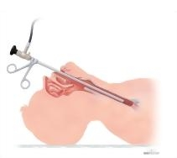
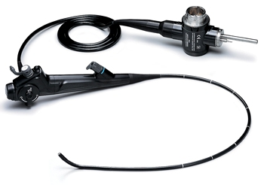
Rigid & flexible Bronchoscopy

Slide 37
Complications
Pneumonia
Atelectasis
Pneumothorax
Bleeding can occur from granulation tissue surrounding the foreign body or erosion into a major vessel.

Slide 38
Foreign bodies in the Alimentary Tract
Foreign body ingestion is a potentially serious problem that peaks in children aged six months to three years.
The majority of ingested foreign bodies are spontaneously passed in the stool .
Some may require endoscopic or operative removal.

Slide 39
Common ingested Foreign bodies
coins
small toys
pencils
pens and their tops
batteries
safety pins
needles
Hairpins
Cotton from cloths
Trichobezoar is a rare condition where hair ingestion leads to formation of a hair ball in the stomach.

Slide 40
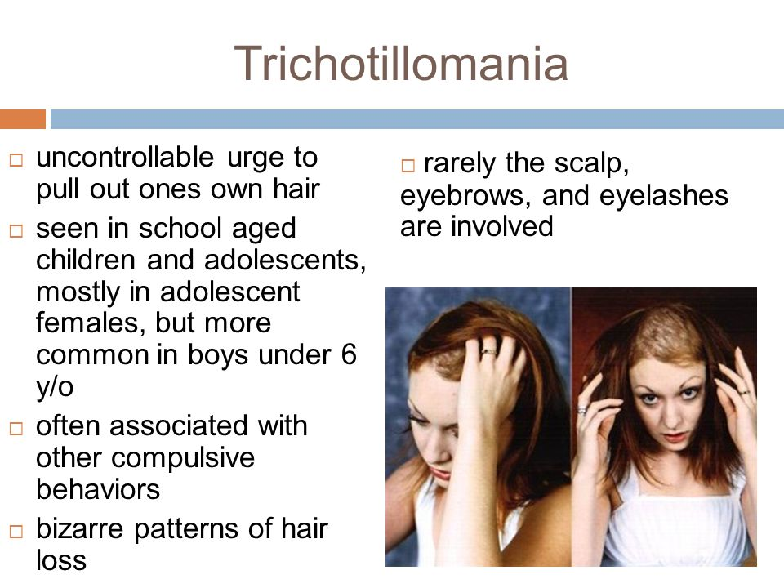

Slide 41
Food-related items such as
fish
chicken bones are more often ingested by older children

Slide 42
Symptoms
Dysphagia
Drooling of saliva
epigastric discomfort
Food refusal
Foreign body sensation in throat
Gagging
Irritability
Pain in neck, throat, or chest
Recurrent aspiration pneumonia
abdominal pain and tenderness
abdominal distension

Slide 43
Diagnostic evaluation
X-ray neck, chest or abdomen
CT scan
Endoscopy
Esophagoscopy
Ultrasonography
Barium studies

Slide 44
Management
Airway
Endoscopes
Retrieval devices
rat-tooth and alligator forceps
polypectomy snares
polyp graspers
Dormier baskets
retrieval nets
magnetic probes

Slide 45
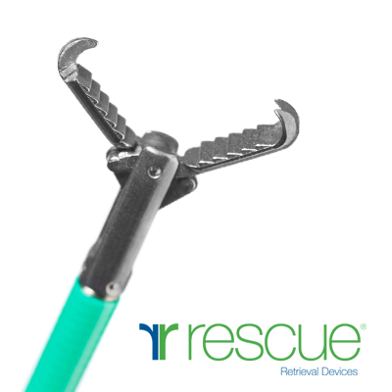
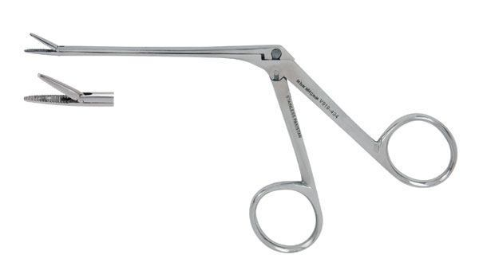
Rat tooth & alligator forceps

Slide 46
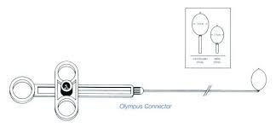
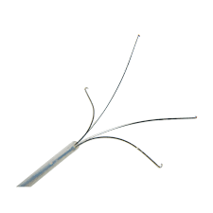
polypectomy snares & polyp graspers

Slide 47
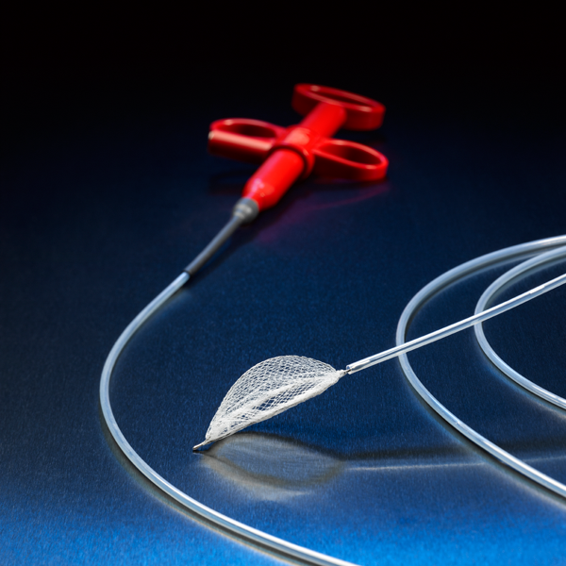
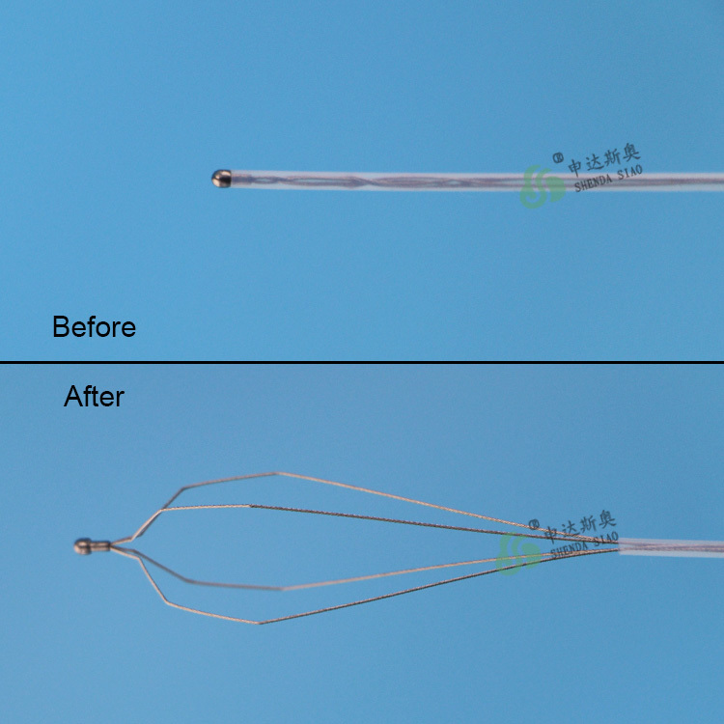
Retrieval nets & Dormier baskets

Slide 48
Management……….
Food bolus impaction
Glucagon (1.0 mg intravenously to induce relaxation of the distal esophagus)
Eating bulk of mashed potatoes or bananas
Normal diet with roughage should be given with adequate amount of water
Passage of foreign body in the stool should be checked

Slide 49
Complications
Oropharyngeal foreign bodies
Scratches and lacerations of Oropharyngeal mucosa
Perforation
Retropharyngeal abscess
Soft-tissue infection or abscess

Slide 50
Oesophageal foreign bodies
Scratches, lacerations or abrasions of mucosa.
Oesophageal necrosis
Oesophageal perforation
Oesophageal stricture
Gastric/small-intestine foreign bodies
Perforation leading to peritonitis and advanced sepsis.
Acute or sub acute small-intestinal obstruction

