Slide 1



Slide 2
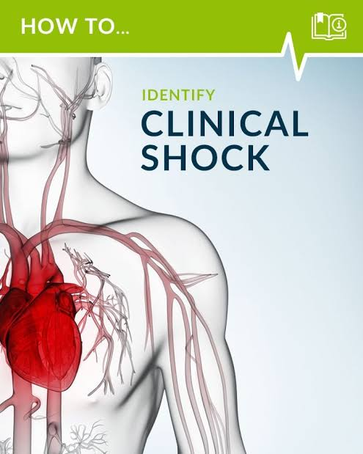
INTRODUCTION OF SHOCK
Shock is a complex clinical syndrome that results from inadequate tissue perfusion creating an imbalance between the delivery and requirement for oxygen and nutrients that support cellular function.

Slide 3
WHAT IS SHOCK
Flow = Perfusion
Adequate flow = Adequate Perfusion
Inadequate Flow = Inadequate Perfusion
= Hypoperfusion
SHOCK

Slide 4
pathophysiology
Inadequate blood supply
Anaerobic metabolism
Normal cell function cease
Cell membrane become more permeable
Sodium-potassium pump impaired
Mitochondria damage
Cell death

Slide 5
Stages of shock
Compensatory stage
Progressive stage
Irreversible stage

Slide 6
General management strategies in shock
Fluid replacement
Vasoactive medication therapy
Nutritional support

Slide 7
Types of shock
Hypovolemic
Cardiogenic
Circulatory/
Distributive

Slide 8
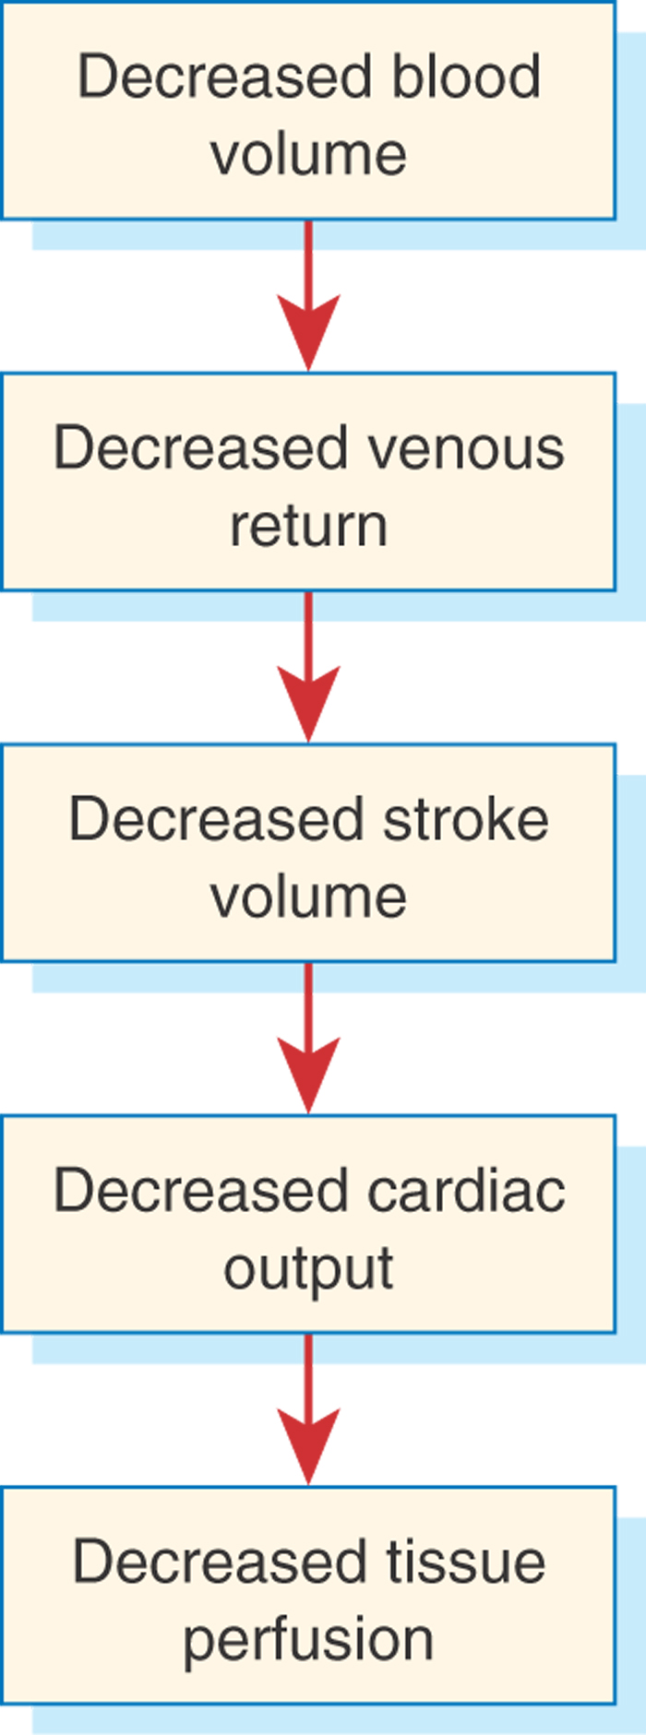
Pathophysiology of hypovolemic shock

Slide 9
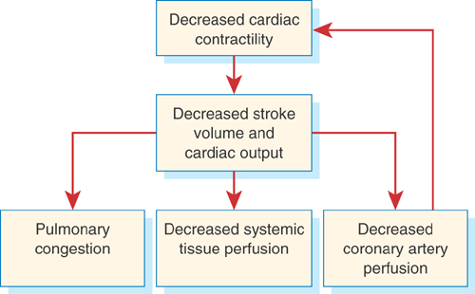
Pathophysiology of cardiogenic shock

Slide 10
Distributive shock
Septic shock
Neurogenic (spinal) shock
Anaphylactic shock

Slide 11
management of shock
Non invasive
Invasive

Slide 12
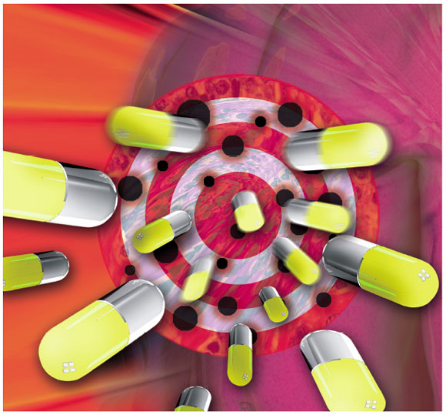
Pharmacological management

Slide 13
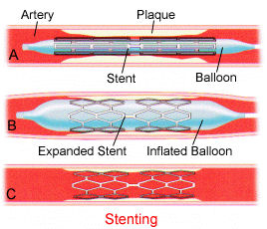
Surgical management
Wound debridement
Amputation
Angioplasty
tracheostomy

Slide 14
Nutritional therapy
Increased metabolic and energy requirements and prevent further catabolism due to depletion of glycogen.
Support with parenteral nutrition.
GI system should be used, if possible, to support its integrity.
Administration of glutamine
Administration of H₂ blockers or proton pump inhibitors

Slide 15
Nursing management
Maintain ABC of the patient.
Provide supplemental oxygen therapy to the patient.
Do not deliver more than 2 lt. of oxygen per minute if person has history of chronic pulmonary diseases.
Monitor for ABG value
Continuous monitoring of vital signs should be done.
Check for urine output.
Maintain nutritional status.
Administer prescribed medication.
Give psychological support

Slide 16
Nursing diagnosis
Ineffective tissue perfusion related to failing cardiac pump or inadequate venous return.
Decrease cardiac output related to hypovolemia, or peripheral vasodilation, myocardial disorder.
Disturbed thought process related to inadequate cerebral tissue perfusion, metabolic acidosis

Slide 17

Thank You

