Slide 1

DISSEMINATED INTRAVASCULAR COAGULOPATHY (DIC)
By-
Dr. Ravindra H.N
( Associate Professor, Department of Medical Surgical Nursing )
Sumandeep Nursing College

Slide 2
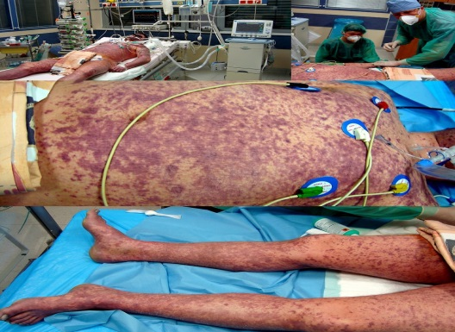
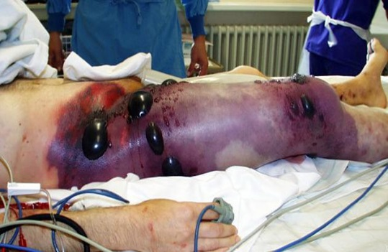
DEFINITION
Disseminated intravascular coagulation is a serious bleeding and thrombotic disorder that results from abnormally initiated and accelerated clotting.
It is basically a loss of balance between the clotting and lysing systems in the Body caused by simultaneous presence of thrombin and plasmin.

Slide 3
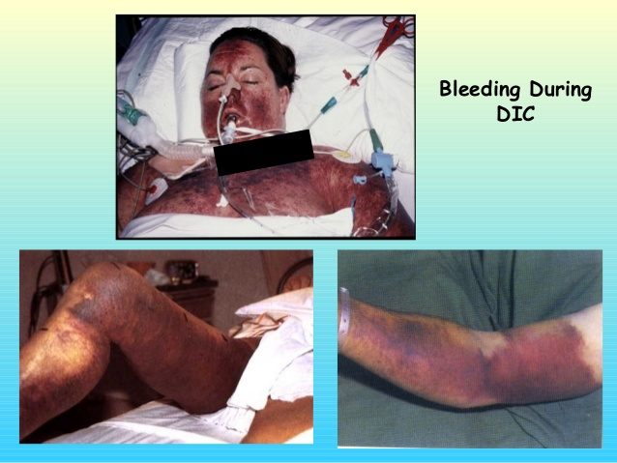
DIC KNOW AS
Diffuse intravascular coagulation.
Defibrination syndrome.
Consumption coagulopathy.
Intravascular coagulation – fibrinolysis syndrome.

Slide 4
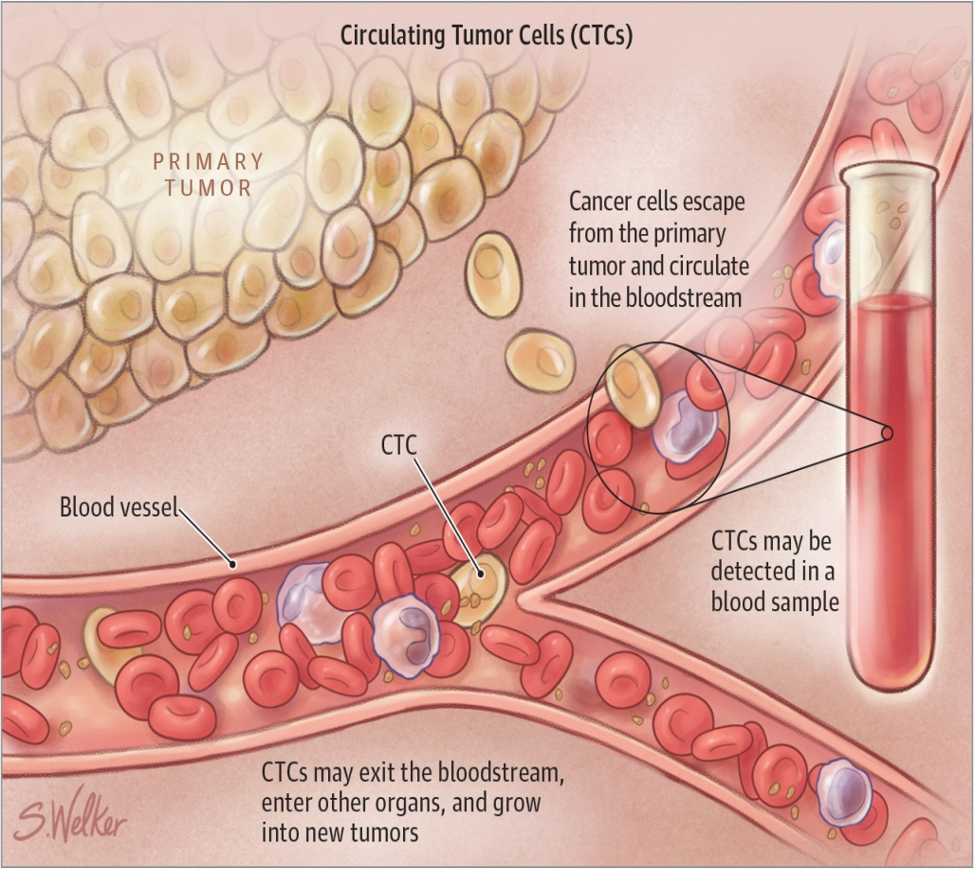
CAUSES OF DIC
Solid tumors and Blood cancer.
Obstetric Complication.

Slide 5
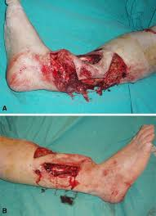
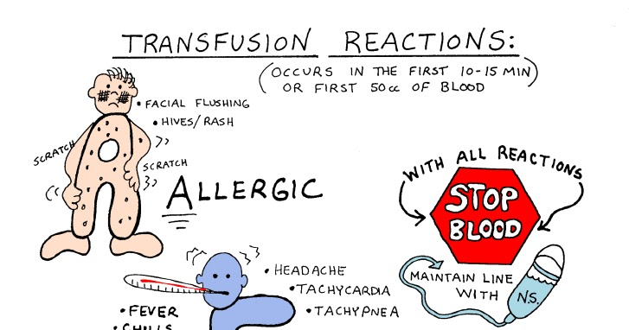
Cont…
Massive tissue Injury.
Gram Negative and Gram Positive Sepsis.
Transfusion reaction
Severe allergic or toxic reaction.

Slide 6
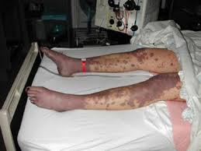
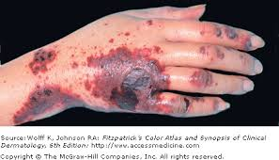
CLINICAL FEATURES IN DIC

Slide 7
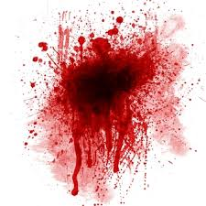
HEMORRHAGE
Obvious cutaneous Bleeding.
- Incision.
- Mucous membrane.
- Recent trauma site.
- Old trauma site.
- Petechiae.
- Purpura.
- Hematoma formation.

Slide 8
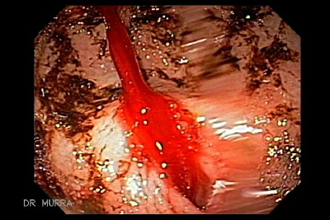
Cont…
Gastrointestinal tract active bleeding.
Genitourinary / Renal Active Bleeding.
- Hematuria.
- Pulmonary Interstitial bleeding.
- Adult respiratory distress syndrome.
Central nervous system Fatal hemorrhage.

Slide 9
THROMBOTIC
Cutaneous Ischemic
- Acral cyanosis
- Tissue necrosis.
Gastrointestinal tract.
- Diarrhoea.
- Abdominal pain.
Central nervous system.
- Convulsions
- Coma.

Slide 10
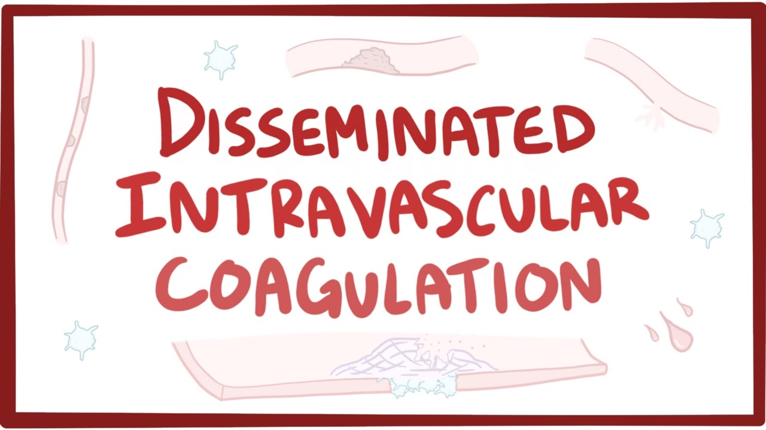
PATHOPHYSIOLOGY

Slide 11
PRECIPATING MECHANISM
TISSUE DAMAGE
ENDOTHELIAL DAMAGE
INCREASED TISSUE THROMBOPLASTIN
INTRINSIC PATHWAY OF COAGULATION
EXTRINSIC PATHWAY OF COAGULATION
INTRAVASCULAR COAGULATION

Slide 12
INTRAVASCULAR COAGULATION
PRODUCTION OF THROMBI
CONSUMPTION OF CLOTTING FACTOR
ACTIVATION OF FIBRINOLYTIC SYSTEM
BLEEDING
DIGESTION OF FIBRIN CLOTS
INHIBITION OF PLATELET FUNCTION

Slide 13
DIAGNOSTIC STUDIES FOR DIC
TEST | FINDING IN DIC
SCREENING TEST
Prothrombin time PT | Prolonged
Partial thromboplastic time (PPT) | Prolonged
Activated partial thromboplastin time (APTT) | Prolonged
Thrombin time | Prolonged
Fibrinogen | Reduced
Platelets | Reduced

Slide 14
Cont…..
TEST | FINDING IN DIC
SPECIAL TEST
Fibrin split products (FSPs) | Elevated
Antithrombin III ( AT III) | Reduced
Proteins C and S | Reduced
Tissue plasminogen activator | Reduced
Soluble fibrin monomer | Positive

Slide 15
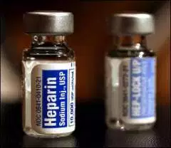
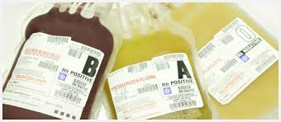
MEDICAL MANAGEMENT
Anticoagulation therapy.
Blood components therapy.
Other therapeutic measures.

Slide 16


Slide 17
NURSING DIAGNOSIS
Ineffective peripheral tissue perfusion related to bleeding and diminished blood flow secondary thrombosis.
Acute pain related to bleeding into tissue and diagnostic procedures.
Decreased cardiac output related to fluid volume deficit.

Slide 18
Cont…
Anxiety related to fear of the unknown disease process , diagnostic procedures and therapy.

Slide 19
NURSING IMPLEMENTATION
Assess the all body system for the effects of DIC.
Monitor appropriate laboratory values to determine treatment effectiveness and observe for manifestation of thrombosis.
To prevent further injury , avoid injection when possible , apply pressure to bleeding sites and turn and reposition the client frequent and gently.

Slide 20
Cont….
Monitoring the amount of bleeding and identify the system involved.
Watch for signs of thrombus formation. If thrombi develop , the symptoms will vary according to the system involved.
Intracranial bleeding may be identified by altered level of consciousness , orientation to person place and time, Pupil reaction and extremity movement.

Slide 21
Cont..
An additional responsibility is to administer blood products and medication correctly.

Slide 22


