Slide 1


LEGAL AND ETHICAL ISSUES IN NURSING
By-
Dr. Ravindra H.N
( Associate Professor, Department of Medical Surgical Nursing )
Sumandeep Nursing College

Slide 2

Notes:
Ethical - relating to moral principles or the branch of knowledge dealing with these.
Legal -relate to the law/ with permission

Slide 3

OBJECTIVES
Define legal aspects.
Define law.
Define the sources of law.
Define the types of law.
Enlist the importance of law in nursing.
Discuss legal issues in special practice area.
Explain the legal safeguards in nursing practice.
Explain the legal responsibilities of nurse.
Define ethics.
Explain the ethical principles .
Enlist the roles and functions of nurse in ethical issues

Slide 4
INTRODUCTION
Legislation-
It is the process of making laws. Legislation is a method of improving public services.
Legal Issues-
These are those issues that are decided by law.
Notes:
Legislation – collective form of laws

Slide 5
EVOLUTION OF LAW
The word law is derived from the Anglo-Saxon language, meaning that which is fixed down.
Black’s law dictionary defines ….
law as that which is laid down, or established, a body of rules of action or conduct prescribed by controlling authority and having binding legal force, and that which must be obeyed and followed by citizens subject to sanctions or legal consequences.

Slide 6
DEFINITIONS
The sum total of rules and regulations by which a society is governed. As such, law is created by people and exists to regulate all persons.
- GUIDO
The law is the body of principles recognized and applied by the state and the administration of justice.
-SALMAIND
The law is a system of rights and obligations which the state enforces.
- GREEN
Notes:
Obligation: duty or commitment.

Slide 7
SOURCES OF LAW
Constitutional Law
Common Law
Administrative Law
Notes:
Constitutional laws-is body of laws which defines the role, power and structure of different entitities within state .
Adminstartive law- is body of law governs the activities of administrative agencies of goverment

Slide 8
CONSTITUTIONAL LAW
It is the supreme law of the country, it is the law that governs the state. This law determines the structure of the state, its power and duties and it also determines the form of government and its relationship with the various agencies of the government.

Slide 9
COMMON LAW
It is the body of the legal principles that has evolved from the court decision . In other words, it is created by the judicial decision made in the court where cases are decided.

Slide 10
ADMINISTRATIVE LAW
It consists of the rules and regulations established by the administrative agencies that have been made by the executive branches of the government.
Eg: State boards of nursing writes rules and regulations to enforce and implement nurse practice act, which was created by statutory law
Statutory law:
Law enacted by any legislative body are called statutory law.
Eg- An officially elected body of people vested with the responsibility and power to make laws for a political unit, such as a state or unit.)
.

Slide 11
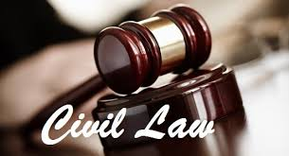

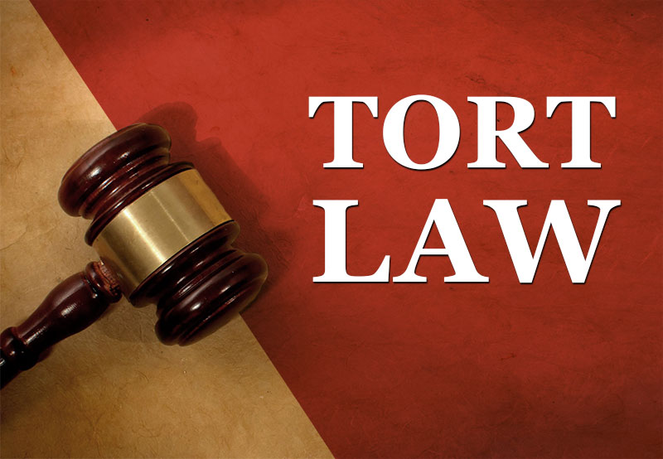
TYPES OF LAW

Slide 12
CIVIL LAW
It is the body of the law that deals with relationship among private individuals. Civil law causes harm to the individual but no grave to society.
Ex – Personal injuries, business disputes, land deals etc.

Slide 13
CRIMINAL LAW
Defines offence that affect the public welfare and security and imposes penalty. It refers to the body of law that deals with relationship between individuals and the government agencies. It deals with safety and welfare of the public.
Ex - Robbery , Homicide etc.

Slide 14
TORT LAW
Tort are wrong doing that are done by one party against another. As a result of the wrong doing , the injured person may take civil action against the other party.

Slide 15
TYPES OF TORT
Non Intentional Tort
Intentional Tort
Notes:
Tort -WORNGFUL ACT

Slide 16
NON INTENTIONAL TORT
Negligence : Negligence is a general term that donates conduct lacking in due care.
Ex-
Fall by an elderly person who is being cared by a nurse.
Failure to use aseptic technique where required.
Administering wrong medicine to patient.
Administering a care in such a manner that a patient suffers injury, eg. Improper handling of hot water bag, burns to patients.

Slide 17
MALPRACTICE
Malpractice is a negligence or carelessness by a professional person. It is a type of negligence, where a licensed professional fails to provide services as per standards set by the governing body.
Ex-
Failing to monitor the patient.
Failing to report a change in patient situation.
Restraining patient improperly.
Improper medication administration.
Using equipments incorrectly.
Fail to follow orders.
Give the patient incorrect information.

Slide 18
INTENTIONAL TORT
Assault
Battery
False Imprisonment
Conversion of property
Trespass to land
Invasion of privacy
Defamation of character

Slide 19
MEDICAL LEGAL CASE (M.L.C.)
A medico legal case is where a person is injured or harmed in any way and needs medical attention for it. Injury cases which suggest some criminal offense.
All cases of injuries(Fights, shooting, bomb blasts etc.)
Road traffic accidents.
All cases of burn.
Alleged cases of assault.
Rape victim.
All cases of suspected or evident of poisoning or intoxication.

Slide 20
Conti...
Cases of suspected or evident criminal abortion.
Cases of unconscious/comatose where its cause is not natural or not clear.
Cases brought dead/ dead on arrival/ sudden unexpected death etc.
Cases of suspected self inflicted injuries or at tempted suicide.

Slide 21
SOME IMPORTANT LAWS WHICH YOU NEED TO KNOW
Medical Council of India Act
Indian Nursing Council Act
Registration of birth and death.
Medical Termination of Pregnancy Act( MTP)
Narcotics and Psychotropic Substance Act
Mental Health Act
PCPNDT Act
Organ transplantation Act
Bio medical waste Management Act
Consumer Protection Act
Indian Penal Code

Slide 22
IMPORTANCE OF LAW IN NURSING
NURSING SERVICE-
Protects rights of patients.
Prohibits unlicensed individual to work under name of licensed nurse.
Updates the knowledge of the manager about legal controls affecting nursing.
Used to prevent a nurse who is below the standard set by the code.
Protects the nurse who is falsely accused of wrong doing.
Used as guide when legal action has to be taken in lawsuit.

Slide 23
NURSING RESEARCH
Advocates for and participates in processes that promote ethical and accountable research practices.
Ensures ethical guidelines are followed to protect research participants
Protect the vulnerable group and other study participants from harmful effects of the experimental interventions.
Participants are safeguarded from exploitation researchers.
Establish risk-benefit ratio for the study subjects.
Ensure the fullest respect, dignity, privacy, disclose of information and fair treatment for study subjects.
Build the capability of subjects to accept or reject participation in study and to have access to informed or written consent for participation in research.

Slide 24
NURSING EDUCATION
Educates others to learn about ethical and legal practice.
Educates others to provide care in a manner that preserves and protects client dignity.
Clearly and accurately represents self with respect to name, title and role.
Educates others to protect client privacy and confidentiality.

Slide 25
Conti
Treats colleagues, students and other health care workers in a respectful manner, educates others about respectful communication and ways to effect positive behavior change in the workplace.
Identifies the effect of own values, beliefs and experiences in carrying out educational activities, recognizes potential conflicts and takes actions to prevent or resolve.
Assists others in identifying ethical issues, consults with the appropriate person or body, takes action to prevent or resolve and evaluates the effectiveness of actions.

Slide 26

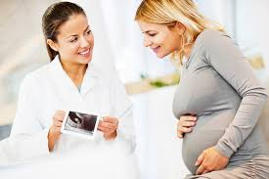
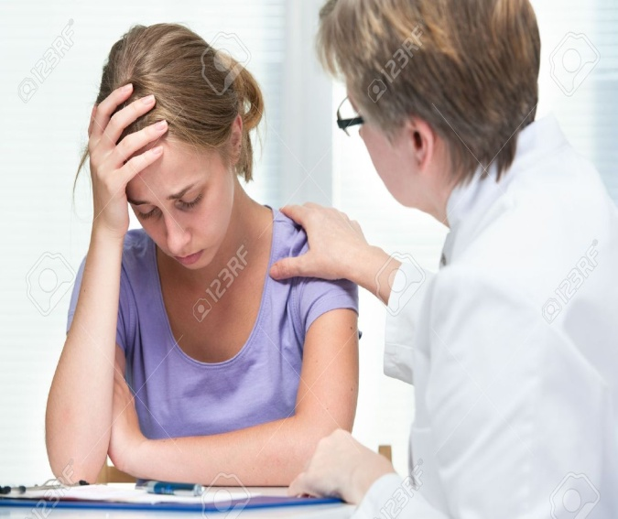
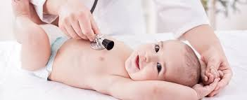
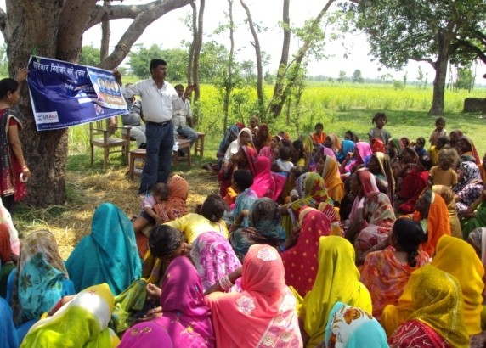
LEGAL ISSUES IN SPECIAL PRACTICE AREA

Slide 27
LEGAL SAFEGUARD IN NURSING PRACTICE
LICENSURE
All nurses, who are in practice , have to possesses a valid licensure issued by the respective State Nursing Council or INC. The purpose of professional licensure is to secure society the benefits which come from the services of a highly skilled group and on the other hand, to protect society from those who are not highly skilled yet professional.

Slide 28
GOOD SAMARITAN LAW
In response to health professionals, fear of malpractice claims, most states enacted ‘Good Samaritan laws’ that exempt doctors and nurses from liability when they render first aid during emergency. These laws limit liability and offer legal immunity for people helping in an emergency.

Slide 29

GOOD RAPPORT
Developing good rapport with the patient is very important to prevent malpractice. A lawsuit is often circumvented when the nursing staff treats the patient with warrants and caring.

Slide 30
STANDING ORDER
All professional practicing in the medical field are held to certain standards when administering care. Standards of care come from several sources including laws, organizational standards, and institutional policies and procedures.

Slide 31

CONTRACT
According to section 13 to the Indian Contract Act defines the word, saying that two or more persons are said to consent which they agree upon the same thing in the same sense. A contract is a written or oral agreement between two people in which the goods or services are exchanged.

Slide 32
CORRECT IDENTITY
The nurse or the midwife has the great responsibility to make sure that all babies born in hospital are correctly labeled at birth and to ensure that at no time they are placed in the wrong cot or handled to wrong mother.

Slide 33

COUNTING OF SPONGE, INSTRUMENTS AND NEEDLES
It is the responsibility of the nurse to count the number of sponges, instruments and needles during surgery in order to make sure that it may not left in the patient’s abdomen during surgery.

Slide 34

DRUG MAINTENANCE
Checking the unlawful use of narcotic drugs is liable to drug dependence. These drugs should be kept under lock and key.

Slide 35

SELF-DISCHARGE OF THE PATIENT
When the patient wants to discharge himself, then the nurse of duty should try to stop him and should inform the medical officer concerned with his care. E.g. DAMA

Slide 36

DOCUMENTATION
The nursing record is a legal document and admissible in the court as evidence. It enjoys a privileged status in that it is presumed to be an accurate record of what happened.

Slide 37

PATIENT’S PROPERTY
It is that department of health, social security requires hospital to inform all patients under its care that the hospital cannot accept the responsibility for valuable or money unless they have been handed over for safe keeping.

Slide 38
REPORTING
Nurses have obligation to report certain communicable diseases or criminal activities such as abuse, gunshot wound, suicide or rape case to appropriate authority.

Slide 39
NURSING AUDIT
Nursing audit refers to assessment of the quality of clinical nursing. It is an exercise to find out whether good nursing practices are followed.
Method of nursing audit :
1. Retrospective view
2. The concurrent review

Slide 40
LEGAL RESPONSIBILITIES OF NURSE
Responsibility of appointing and assigning.
Responsibility in quality control.
Responsibility for equipment.
Responsibility for observation and reporting.
Responsibility to protect public.
Responsibility for record keeping and reporting.
Responsibility for the death and dying.
Knowledge regarding institutional rules and policies.

Slide 41
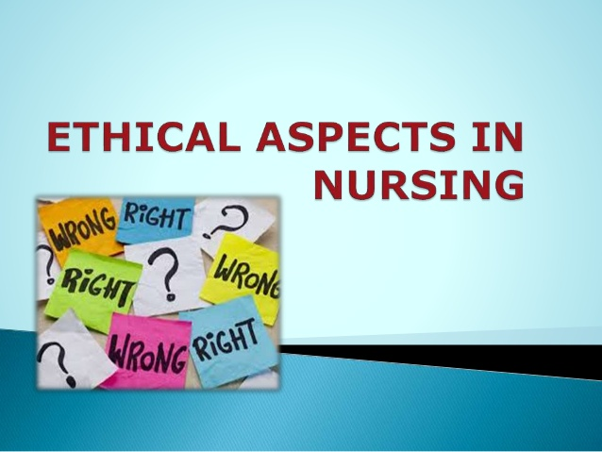

Slide 42

ETHICS
Ethics are the rules or principles that govern right conduct and are designed to protect the rights of human beings.

Slide 43
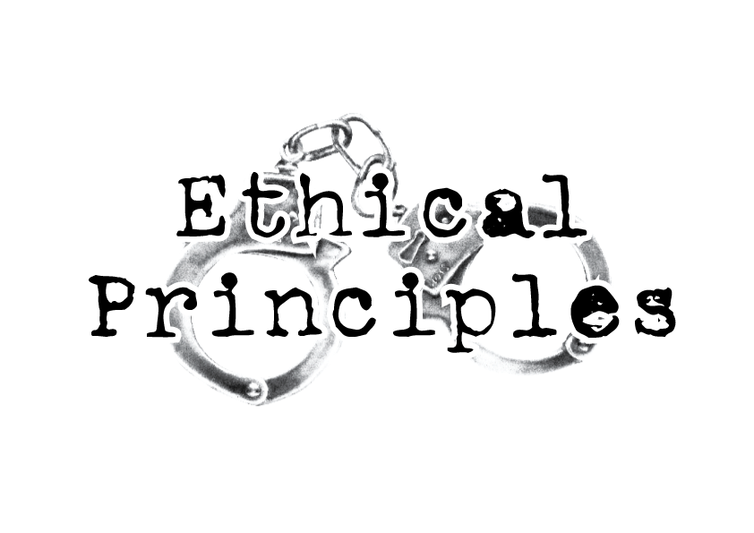

Slide 44
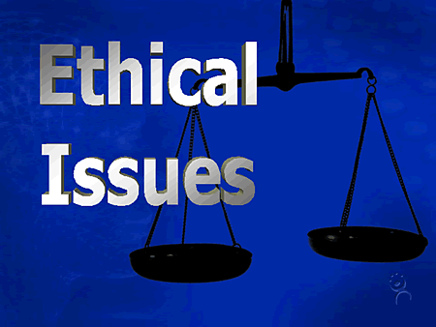
Nurses are often placed in situations where they are expected to be agents for patients, physicians and the organizations simultaneously, all of which may have conflicting needs, wants and goals.
In a review of nursing literature, Laabs (2005) found there were many terms to describe moral issues faced by nurses. These are as under :

Slide 45
MORAL UNCERTAINTY
When an individual is unsure which moral principles or values apply and may even include uncertainty as to what the moral problem is . This is also sometimes referred to as moral conflict, “When the duties and obligations of health care providers are unclear.”

Slide 46

MORAL DISTRESS
When the individual knows the right thing to do but organizational constraints make it difficult to take right course of action.

Slide 47

MORAL OUTRAGE
When an individual witnesses the immoral act of another but feels powerless to stop it.

Slide 48

MORAL/ ETHICAL DILEMMA
Most difficult of all ethical issues. It is described as choosing between two or more undesirable alternatives and attempting to select the least damaging from the choices available

Slide 49
ROLE AND FUNCTIONS OF NURSE IN ETHICAL ISSUES
He /She is self –aware regarding own values and basic beliefs about the rights, duties and goal of human beings.
Accepts that some ambiguity and uncertainty must be a part of all ethical decision-making.
Actively advocates for patients, subordinates and professionals.
Clearly communicates expected ethical standard of behavior.

Slide 50
Conti...
Identifies outcomes in ethical decision- making that should always be sorted or avoided.
Applies principles of ethical reasoning to define what beliefs or values from the basis of decision-making.
Take appropriate action when subordinates use unethical conduct.

Slide 51


Slide 52
A STUDY ON ETHICAL PROBLEMS IN NURSING MANAGEMENT: THE VIEWS OF NURSE MANAGERS
Elina Aitamaa, (May 10, 2015)
Aim : The aim of this study was to identify and describe ethical problems nurse managers encounter in their work to get more detailed and extensive view of these problems.
Method : The data consisted of nine interviews with nurse managers at different management levels in primary healthcare and specialized healthcare organizations,

Slide 53
Findings : Four main categories were found:
conflicts in practical situations,
lack of appreciation,
disregard of problems
and experienced inadequacy.
The findings correspond with results from earlier studies but add knowledge of the nature and details of nurse managers' ethical problems. New information is produced related to the ethical problems with nurse managers' own courage, motivation and values. Nurse managers identified a variety of different ethical problems in their work. This information is useful in the development of ethics in nursing management.

Slide 54
Legal Awareness and Responsibilities of Nursing Staff in Administration of Patient Care in A Trust Hospital
Hemant Kumar, Gokhale, Kalpana Jain, and D.R. Mathur
Published online 2013 Dec; 7
Aim : Present study was undertaken to assess the level of legal awareness and responsibilities of nursing staff in administration of patient care at a trust hospital.
Methods: An open ended questionnaire was prepared to assess the level of legal awareness among the nursing staff. The GNM and ANM nursing staff deployed at the nursing home and general wards only were randomly screened and specialty nurses were exempted.

Slide 55
Results: The nursing staff had poor knowledge on patients’ rights and also on their legal obligations towards patients. The GNM nurses fared better than ANM nurses. However, 46.67 % of nurses were found to be aware about cases of omission or commission.
Conclusion: This study substantiated the fact that nurses had poor knowledge on the law that governed their profession and that in days to come, it would become increasingly difficult for them to avoid law suits which were prepared against them, unless remedial actions were taken.

Slide 56
CONCLUSION
Nurses play an integral role in the healthcare system. This is why they have been correctly referred to as the heart of healthcare. Being a nurse is one of the most demanding professions in the world and needs a lot of dedication and commitment to the job.
Nurses have to juggle various roles. It is a nurse’s professional responsibility to remain safe and competent by being a lifelong learner and provide effective care to patient to avoid medico legal issues.

Slide 57
References

Slide 58
BOOKS:
1)Deepak K, A Comprehensive text book on nursing management, EMMESS medical publishers, Bangalore, 1st edition, 2015, pg no123-134
2) Clement. I, Management of nursing services and education, raj Kamal electric press publications, Haryana, pg114-122
3) Kaur Brar Navdeep, Textbook of advanced nursing practice, Jaypee brothers, New Delhi, 1st edition, 2015, pg16-27.
4)Vati Joginder, Principles and practice of nursing management and administration, Jaypee brothers, New Delhi, 1st edition, 2013, pg65-79.

Slide 59
WEBSITES:
http://www.nursingcenter.com/upload/static/403753/ch03.html
http://study.com/academy/lesson/legal-issues-in-nursing-concepts-and-terms.
http://what-when-how.com/nursing/legal-and-ethical-aspects-of-nursing-the-nature-of-nursing
https://www.ncbi.nlm.nih.gov/pmc/articles/PMC3919375

Slide 60
Thank You !!!

