Slide 1


Seminar on framework, trends and scope of nursing practice
by:
Ms. Sonal Patel
Assistant Professor
Sumandeep Nursing College
Sumandeep Vidyapeeth Deemed to be University

Slide 2
framework

Slide 3
Definition of nursing practice:
Advance nursing practice is an umbrella term describing an advance level of clinical nursing practice that maximizes the use of clinical nursing practice that maximize the use of graduate educational preparation, in depth nursing knowledge & expertise in meeting the needs of the individuals, families, groups, communications, and population.
It involves…
Analyzing and synthesize the knowledge.
Understanding, interpreting & nursing theory & research.
Developing & advancing nursing knowledge &the profession as the whole.

Slide 4
Characteristics of nursing practice
Provision of effective and efficient care delivered with high degree autonomy.
Demonstration of leadership and initiation of changes to improve client, organization and system outcomes.
Deliberate, purposeful and integrated use of in depth nursing knowledge, research and clinical practice.
Depth and breadth of knowledge that draws on a wide range of strategies to meet the needs of client needs of client and to improve access to improve access to quality of care.

Slide 5
Cont….
Understanding, development and dissemination of evidence- based nursing knowledge.
Ability to initiate or participate planning, coordinating, implementation and evaluating programmes to meet client’s needs and support nursing practice.
Demonstration of advanced judgment and decision making skill.
Critical analysis of and influence on healthy policy.
Ability to explain and apply the theoretical, empirical, ethical and experiential foundations of nursing practice.

Slide 6
Development of framework

Slide 7
Approval of framework

Slide 8
Art of nursing practice
Nurses demonstrate ethical, insightful, caring practice by focusing on the health and wellbeing of individuals, families and communities is health and communities is health and during episodes of illness and transition.

Slide 9
Attribute of nursing practice:
Autonomous professional practice in nursing in nursing requires taking personal responsibility for excellence in practice and effective collaboration with multidisciplinary team members in meeting in meeting the health needs of population.

Slide 10
Competence:
Nurse’s competence is grounded upon nursing theory,
Scientific knowledge and experience, and is
Reflected in everyday practice.
It is enhanced through continuous learning,
Shared through continuous learning,
Shared through mentorship and
Supported through intra and inter professional dialogue.

Slide 11
Personal commitment:

Slide 12
Implementation of framework:
Numerous sessions were held to familiarize nursing staff with the framework when it was first time launched.
Introduction to the framework is now routinely incorporate in to the orientation of all new nurses who join the regions.
The framework also gives the development of preceptors and changes nurses
The major elements of the framework have been linked to the expected RN, LPN and RPN competencies articulates in job description and application of the framework in practice is not incorporate in to nurses ongoing professionals developments and continuing education plans.
Further elaboration of framework will be ongoing for examples use of the framework has exposed the needs to clarify some of its terms, such has. Insightful practice.

Slide 13
Evaluation and research:

Slide 14
Scope of nursing practice:
Professional regulation
Establishing education system for advanced nursing practice
Developing sanders' of practice
Practice as a registered nurse
Purpose of the law remains consistent to protect the public

Slide 15

Nurses practice act:

Slide 16
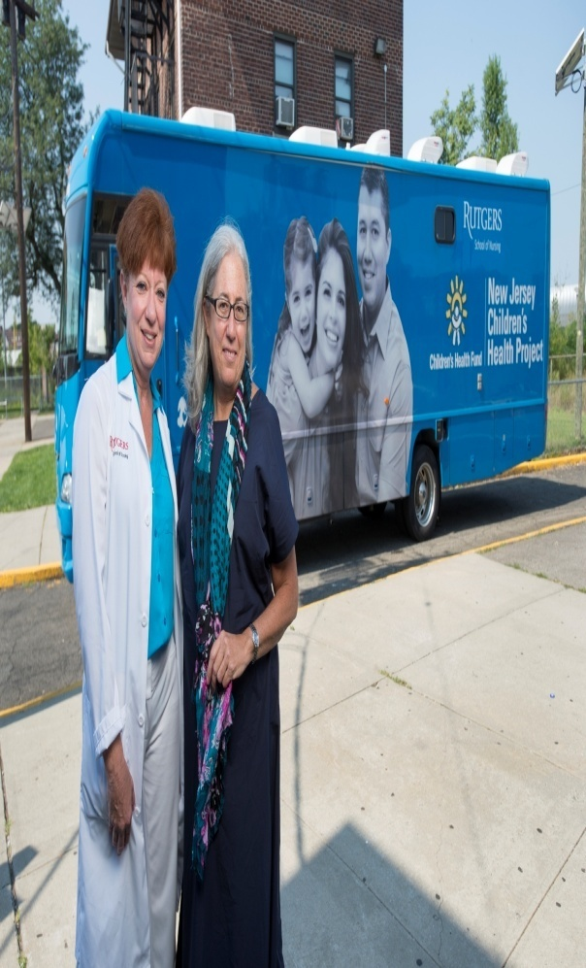
Mobile nursing practice:
SERVICES:
Patients discharged early from hospital
Patient suffering from chronic and acute medical problems.
Surgical patients
Patients requiring IV therapy
The elderly
Respiratory patients
The seriously ill.
Patients need medication management
Hospice concept
Ventilator dependent.

Slide 17
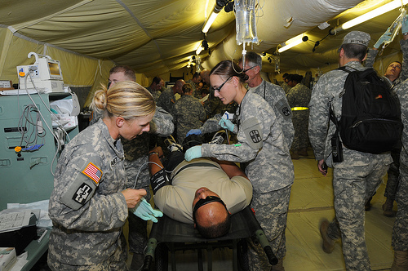
Military nursing services
Rank structure of military nurse:
Commissioned officers
Major-general
Brigadier
Colonel
Lieutenant –colonel
Major
Captain
Lieutenant

Slide 18

Tele nursing:

Slide 19

The nursing robot

Slide 20

Occupational health nurse

Slide 21
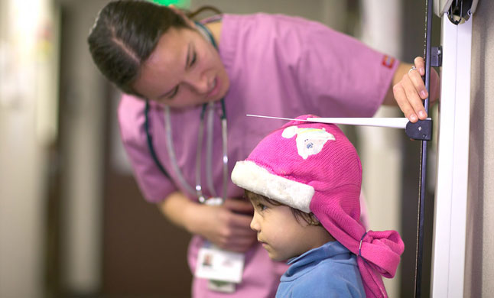
School health nursing

Slide 22
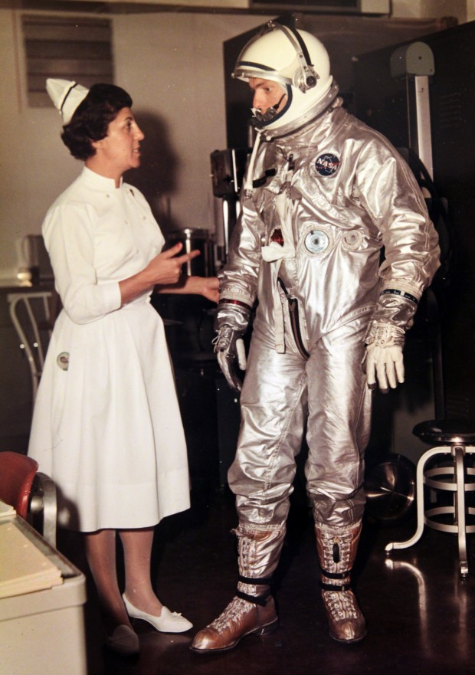
Space nursing society

Slide 23
Trends in nursing practice: broadening focus scientific basis technology indicators of increasing technology renewed focus on caring expansion on employment opportunity

Slide 24
Changing trends in nursing
Nursing has originated from the world nurturing, which mean nourishing, helping in growth and development of a human being. In past, nursing was family based work.
Modern nursing began in the 19th century under the leadership of Florence nightingale.
The aim of nursing was only to promote the recovery of patients.
The present day nurse provides care for the people in health and illness. Nursing is one of the health services which contributes to wellbeing of an individual, family and community.
Nursing process includes doing thinking and interaction component. It is mainly basically a problem solving approach of nursing care.

Slide 25
Morden trends in nursing practice
The public perception of alternatives, complimentary, treatment methods has been changing over the past few decades.
In the late 1960 and early 1970’s, “natural few age self-movement” During that time provide, there was a growing trend towards rejection of traditional medicine because it was perceived invasive, painful cost and effectiveness was perceived, invasive, painful, cost and ineffectiveness.
In 1993 landmark survey found that 1/3 of the US population had used some non-traditional alternatives methods of treatment in additional alternation to the standers medical treatment.
In 1992 the US government established an office of the alternative medicines (OAM) at the national institution of health.

Slide 26


Role of professional nurse
Care provider
Communication/helper
Teacher
Counselor
Client advocate
Change agent
Leader
Manager
Researcher
Expanded nursing roles
Nurse generalist
Nurse clinician
Nurse practioners
Nurse specialist.

Slide 27


