Slide 1
Colon Cancer
Ms Gagan Sharma
Assistant professor

Slide 2
Epidemiology
Colorectal cancer is the second leading cause of cancer-related deaths after lung cancer
5-year survival rate : 55%.
The most lethal GI malignant diseases in the Western world.
Is preventable and is highly curable if detected early
so public health initiatives have emphasized large-scale screening and surveillance.

Slide 3
Epidemiology
Rare in < 40y,
rapid increase at 50y.
At presentation:
37% localized,
37% regional,
20% metastatic.
IBD, FAP, HNPCC, FHX are at inc risk
75% sporadic, rest are in those at high risk.

Slide 4
Adenomatous polyps and adenocarcinomas arising from epithelial cells
anal carcinoma (squamous or transitional cell types)
Lymphoma
Leiomyosarcoma
carcinoid tumor
Kaposi's sarcoma .
Malignant diseases from adjacent sites: prostate, ovary, uterus, and stomach

Slide 5

Colon Polyp

Slide 6
Polyps of the Colon
Sessile or pedunculated
Rectal bleeding or partial bowel obstruction (rare) or because of their potential to become malignant
Non-neoplastic polyps:
hyperplastic,
inflammatory,
lymphoid,
juvenile polyps
Adenomatous polyps are relatively common,
particularly in elderly

Slide 7
Pathophysiology
sequence-specific accumulation of genetic lesions that cause an imbalance between epithelial cell proliferation and cell death.
As a result, cells accumulate at the luminal surface, where they remain undifferentiated and continue to undergo cell division, thus eventually leading to the abnormal development of a mass of adenomatous tissue.

Slide 8
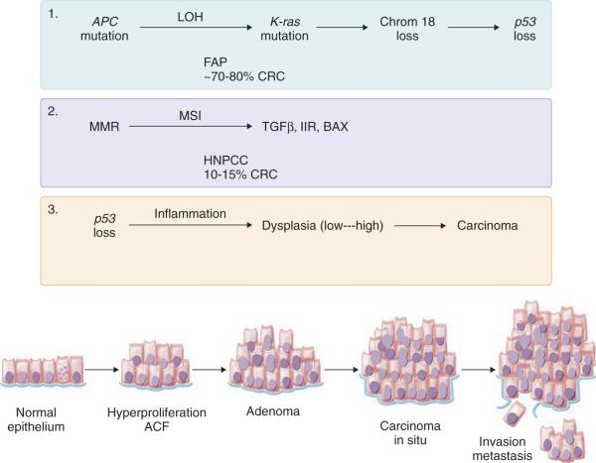

Slide 9
Risk Factors
Diet- red meat, animal fat, increased cholesterol in stool.
Folate is protective. (Decreased folate= Kras mutations.)
Calcium supplementation decrease new adenomas.
Fiber- use not supported yet for protection from cancer.
HRT, ASA, NSAIDS, COX2 protective and in some cases cause regression of polyps.
Alcohol consumption increases risk.

Slide 10
Polyps
Polyps-Most cancers arise from them.
Classified as:
1) neoplastic (adenomatous)which are benign or malignant,
2) nonneoplastic (hyperplastic, mucosal, inflammatory, hamartomaous).
Adenomatous polyps found in 33% of people by age 50, 50% by age 70.
Most lesions <1cm,
60% single, 40% multiple
Invasive cancer will develop in 24% when untreated.

Slide 11
Polyps
Adenomatous polyps:
Tubular(75-87%)
Tubulovillous (8-15%)
Villous(5-10%).
Tubulovillous, villous(most in rectum) have most increased risk of cancer (20% and 40% respectively.)
Size, degree of dysplasia (46% cancer >2cm, 34% in severe dysplasia).

Slide 12
Polyps
Prognosis:
Poor differentiation
lymphovascular invasion
Submucosal
Positive margin.
8-17% of polyps with invasive carcinoma will have + nodes.
A negative margin of resection associated with decreased adverse outcome (0.8%).
27% of patients with positive margins will have adverse outcomes.

Slide 13
Treatment
Endoscopic removal, surveillance every three years.
Biopsy if it can’t be removed.
Surgery for those not amenable to safe polypectomy (large sessile villous lesions).

Slide 14
Treatment
Fungation, ulceration, distortion are contraindications for polypectomy.
Colectomy indicated for residual carcinoma, those at high risk for +LN despite complete polypectomy.
+margin, poor diff, level 4, vascular, lymphatic invasion.
Sessile polyp with invasive cancer should be considered for resection even if no high risk pathologic features.
Weigh all against pts medical condition of course.

Slide 15
Hereditary Polyposis Syndromes
All have this in common: Multiple intestinal polyps, extraintestinal manifestations.
FAP: 1-2% of colon cancer patients. A point mutation of APC gene on chromosome 5, band q21.
Polyps found throughout the GI tract but most in colon. Symptoms manifest by ages 16-50.
Cancer will develop in all by age 50.

Slide 16
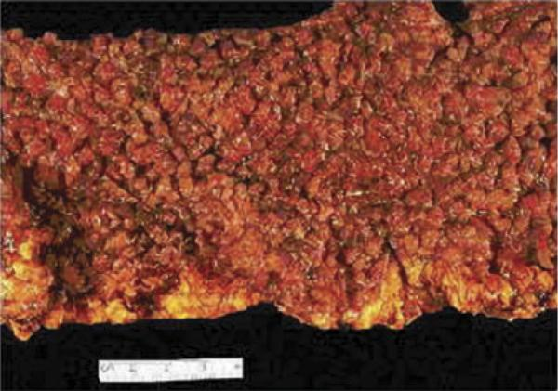

Slide 17
Hereditary Polyposis Syndromes
Gardner’s Syndrome: Variant of FAP. Colonic and extracolonic manifestations.
Periampulary lesions, duodenal lesions, gastric polyps.
Ocular, cutaneous, skeletal (retinal, mandible, jaw, teeth, sebaceous cysts).
Desmoids, hepatoblastoma, thyroid cancer, Turcot’s syndrome (brain).

Slide 18
Hereditary Nonpolyposis Syndromes
Lynch I and II. Occurs five times more frequently than familial polyposis. 1-5 % of colon cancers. Lynch I just colon, Lynch II also involves endometrium, ovary, stomach, small bowel, biliary, pancreas, ureter, renal pelvis.
85% lifetime risk of colon cancer, more right sided cancers (60-70%), earlier (45y), lower stage, better survival, but 20% risk of metachronous, synchronous lesions.

Slide 19
Inflammatory Bowel Disease
Ulcerative colitis carries a risk of colorectal carcinoma 30 times greater than general population.
Risk increases with duration of disease.
After 30 years, risk increases to 35%
Crohn’s disease associated with 10-20 fold increased risk of cancer.
Need to do surveillance in these population.

Slide 20
Previous Colon Cancer
A second primary colon cancer is three times more likely to develop in patients with a history of colon cancer.
Metachronous lesions develop in 5-8% of patients.

Slide 21
History of First-Degree Relatives
People with first-degree relatives with colorectal cancer have a 1.8-8 fold increase risk of colorectal cancer.
Risk is higher if more than one relative affected.
Risk is higher if developed in the relative at a young age.

Slide 22
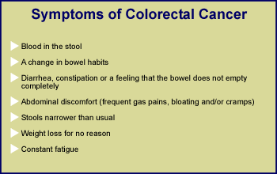

Slide 23
Clinical manifestations
Bleeding,
Pain,
Change in bowel habits.
Symptoms typically vary depending on where the lesion resides.

Slide 24
Neoplasms in the proximal colon, where intestinal contents are relatively liquid, do not generally cause the abdominal pain or change in bowel habits characteristic of obstructive lesions.
These lesions often ulcerate and cause chronic blood loss; patients commonly present with complaints of fatigue, palpitations, or even angina pectoris.
Physical examination often reveals Hemoccult-positive stools, and laboratory testing demonstrates hypochromic, microcytic anemia characteristic of iron deficiency

Slide 25
Thus, the presence of unexplained iron deficiency anemia in any adult male patient or postmenopausal female patient should prompt a rigorous evaluation for colorectal cancer, that is, endoscopic and/or radiographic visualization of the entire colon.

Slide 26
In contrast to right-sided lesions, cancers in the distal colon may bleed, but they often cause constriction of the gut wall and can manifest with abdominal cramping, stool obstruction, or even perforation.
Tumors of the rectosigmoid region may manifest with hematochezia, tenesmus, and narrowing of the caliber of the stool.
The differential diagnosis for rectal bleeding should include: hemorrhoids, angiodysplasia, diverticulosis, and other benign and malignant tumors

Slide 27
Hepatomegaly
If disease has spread to the abdomen, both ascites and bowel obstruction may occur.
Metastatic spread to the pelvic region may become evident as bladder dysfunction, sacral or sciatic nerve pain, and vaginal discharge or bleeding.
Lesions that have spread to the lung or bone marrow can remain silent until very advanced disease is present.

Slide 28
Diagnosis
The history, physical examination, and judicious use of both laboratory and radiologic tests are important
Pertinent history include:
prior history of colorectal cancer or adenomatous polyps
inflammatory bowel disease
inherited colorectal cancer syndromes
any first-degree relatives with colorectal cancer.

Slide 29
On physical examination,
extraintestinal lesions characteristic of Peutz-Jeghers may be noticed
Metastatic disease is suggested by:
Hepathomegaly
Umbilical mass
Ascites.
The digital rectal examination may reveal a distal rectal cancer or the spread of tumor to the rectal shelf
Lab Data
The stool shows evidence of frank or occult blood (in 40 to 80% of advanced cases. )
Iron deficiency anemia
Elevation in liver enzymes

Slide 30
Methods for diagnosing colorectal cancer are similar to those used to detect polyps.
Colonoscopy is the procedure of choice for all patients who have occult blood in their stools or who present with signs and symptoms characteristic of colorectal cancer
Colonoscopy is more accurate than radiographic studies for the detection of colorectal neoplasms of all sizes and has the advantage of enabling the clinician to obtain tissue for histologic analysis.

Slide 31
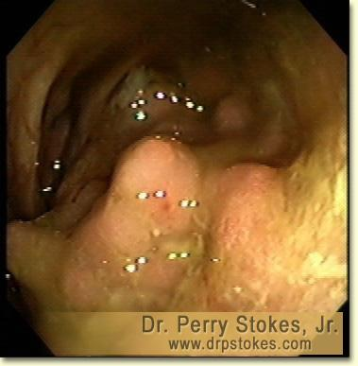
Colon Cancer

Slide 32
Screening
FOBT, DCBE, endoscopy most useful screening methods.
FOBT detects cancer at an earlier stage, with reduction in cancer deaths.
Flexible sigmoidoscopy and polyp clearance has resulted in decreased colon cancer.
Value of full colonoscopy is noted since 40% of colon cancers occur proximal to splenic flexure.
DCBE used if pt refuses scope, or poor scope, etc.

Slide 33
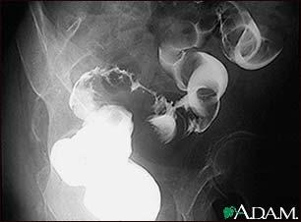
Barium Enema Sigmoid Cancer

Slide 34
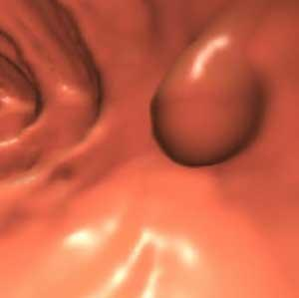
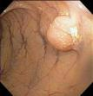
Virtual Colonoscopy

Slide 35
Screening
CEA has no role in in screening for primary lesions. False positives occur in benign disease(lung, liver, bowel) as well as malignancies of pancreas, breast ovaries, prostate, head and neck, bladder, kidney.
CEA increased in smokers.
60% of tumors will be missed by CEA alone.

Slide 36
Recommendations
Age>50 asymptomatic, average risk.
FOBT yearly, scope if positive
Flex sigmoidoscopy every 5y (full colon if +)
Increased risk: Same but start age 40.

Slide 37
Recommendations
Hx of HNPCC: Full colon every 1-2y (20-30y) then full colon yearly after 40y.
Hx Aden Polyps: repeat in 3y, second exam normal repeat 5y.
Hx Colon cancer: Full colon within 1y, if second normal repeat 3y, if next normal every 5y.
FAP: Counseling, Flex Sigmoid every 12 months.

Slide 38
Pathology
>90% adenocarcinomas.
Four morphologic variants:
Ulcerative (most common)
exophytic (polypoid, fungating)
annular (classic applecore)
submucosal infiltrative(linnitus type).
Grading system 1-3. Most developed to least differentiated glandular structures.

Slide 39
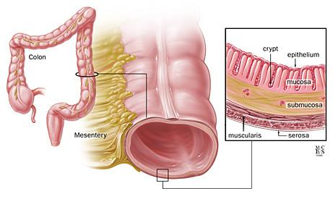
The Layers of the Wall

Slide 40
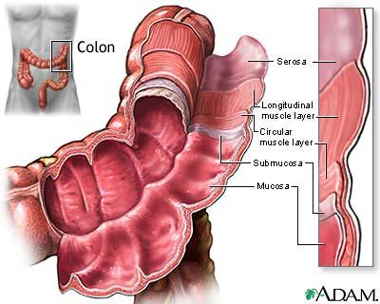
Colon Wall

Slide 41
Staging- Aston Collier
A- to submucosa only
B1- to muscularis only
B2- thru wall, not adjacent.
B3- Adjacent organs involved.
C1- B1 plus LN
C2- B2 plus LN
C3- B3 plus LN
D- Distant mets

Slide 42
Staging-TNM
T1 invades submucosa
T2 invades muscularis
T3 invades subserosa
T4 invades organs outside
N1- 1-3 nodes
N2- 4 or more nodes
N3- central nodes
M0- no mets
M1- distant mets

Slide 43
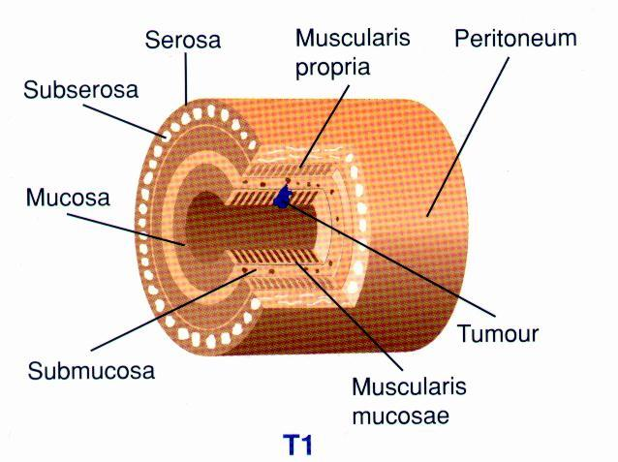

Slide 44


Slide 45
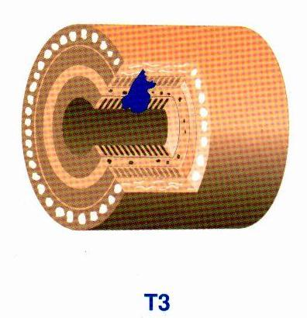

Slide 46
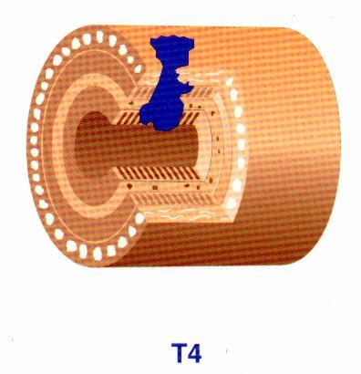

Slide 47
Clinical Presentation
Bleeding, pain, bowel habit changes, weight loss, anorexia, nausea, vomiting, fatigue, anemia.
Right upper quadrant pain, fevers sweats, hepatomegaly, ascites, effusions, adenopathy(METS).
Obstruction(5-15%) increases risk of death 1.4 fold.
Perforation (6-8%) increases it 3.4 fold.
Stage I 15%, Stage II 30%, Stage III 20%, Stage IV 25%.
Obstruction less common on right side.

Slide 48
Diagnosis
Scope, CXR, CBC, CEA, U/A, LFTs.
Preop CT scan? Some get it for abnormal LFTs only (but only 15% of liver mets have abnormal LFTs). Others will get it if large bulky tumors to see about adjacent organs, LN.
10% of mets are missed with preoperative and operative evaluations, IOUS best for this.

Slide 49
Diagnosis
15-20% liver mets not palpable.
Preop CEA reflects prognosis, disease extent (over 10-20 poor)
CEA may not be elevated in poorly differentiated or rectal cancers.
CEA really only good for follow up.

Slide 50
Rectal Cancer
In addition to H&P, CXR, CBC, LFTs, U/A, EUS, Proctoscopic exam, full colonoscopy, CT scan should be done for rectal cancer.
Accurate preoperative staging critical because stage may influence treatment decisions such as trans anal excision, preop chemoradiation.

Slide 51
Rectal Cancer
EUS is most accurate tool in determining tumor stage with all layers identified with 67-93% accuracy.
Differentiating T1 from T3 easy but T2 from T3 harder.
Limitations of EUS: operator experience, differentiating LN vs.blood vessels, post radiation changes, stenotic lesions, overstaging (10-15%), understaging (1-2%).
Superior to CT or MRI for depth of tumor.

Slide 52
Rectal Cancer
Lymph node staging more difficult. EUS 62-83% accurate, CT scan 35-73% accurate.
All these tests pick up size of LN only.
50-75% of involved LN are normal in size, so may not be picked up. Similarly, enlarged LN may be inflammatory, so false negative.
LN> 3mm and hypoechoic are likely to have malignancy, also FNA might help under EUS guidance.

Slide 53
Rectal Cancer
CT scanning of abdomen and pelvis is important for other organ involvement, and distant spread.
CT is better than EUS for contiguous organ involvement.

