Slide 1
Heart failure and heart block
Prepared by:
Ms. Gagan sharma

Slide 2
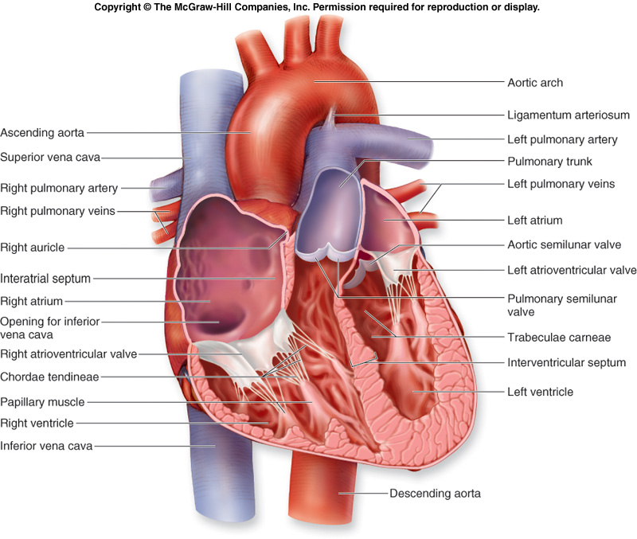
Anatomy and physiology of heart

Slide 3
Heart failure

Slide 4
introduction
Heart failure or cardiac failure is the inability of heart to maintain adequate cardiac output to meet the metabolic need of the body because of impaired pumping ability.

Slide 5
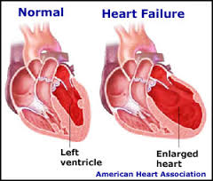

Slide 6
Etiological factor
Conditions that increase preload
    Abnormal loading function
    Abnormal muscle function
    Limited ventricular filling

Slide 7
Preload is the initial stretching of the cardiac myocytes (muscle cells) prior to contraction. It is related to ventricular filling. Afterload is the force or load against which the heart has to contract to eject the blood. Also known as systemic vascular resistance (SVR).

Slide 8
1.Abnormal Loading Condition
Regurgitation Of Mitral Or Tricuspid Valve
Congenital Defects (Left To Right Shunt)
Ventricular Septal Defect
Atrial Septal defect
Patent Ductus Arteriosus

Slide 9
2.Abnormal Muscle Function
Myocardial Infarction
Myocarditis
Cardiomyopathy
Ventricular Aneurysm
Long Term Alcohol Consumption
Coronary Heart Disease

Slide 10
3.Limited Ventricular Filling
Mitral Or Tricuspid Stenosis
Constrictive Pericarditis
Hypertrophic Obstructive Cardiomyopathy

Slide 11
Conditions that increase after-load
ABNORMAL LOADING CONDITION
    Hypertension Pulmonary Or Systemic
    Aortic Or Pulmonary Stenosis
    High Peripheral Vascular Resistense

Slide 12
Risk factors
Dysrhythmias especially tachycardia
Systemic infection (sepsis)
Anaemia
Thyroid disorder
Pulmonary embolism
Thiamine deficiency
Chronic pulmonary disease
Physical or emotional stress
Endocarditis, myocarditis or pericarditis
Fluid retention from medication or salt intake

Slide 13
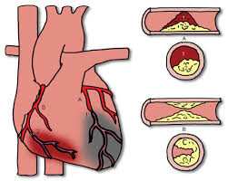
Classification
Acute heart failure (pulmonary oedema)
Chronic heart failure (right and left sided heart failure)

Slide 14
Types of heart failure
Left ventricular versus right ventricular failure
Backward versus forward failure
High output versus low output failure
Systolic versus diastolic failure

Slide 15
1. Left ventricular versus right ventricular failure
Because the two ventricles of the heart represent two separate pumping systems.
Most heart failure begins with left ventricular failure and progresses to failure of both ventricles.

Slide 16
Left sided heart failure
Left heart failure occurs, pulmonary congestion occurs when left ventricle can’t effectively pump blood into systemic circulation.
The blood volume and the pressure in the left atrium increases, which decreases blood flow from the pulmonary vessels.
Pulmonary venous blood flow and pressure increase leads to impaired gas exchange.

Slide 17
Right sided heart failure
When the right ventricular fails, congestion in the peripheral tissue and the viscera predominates.
This occurs because the right side of the heart can’t eject blood and can’t accommodate all the blood that normally returns to it from the venous circulation.
Increase venous pressure throughout the venous system.

Slide 18
2. Backward versus forward failure
In forward failure an inadequate output of affected ventricle causes decreased perfusion to vital organs.
In backward failure blood backs up behind the affected ventricles.

Slide 19
3. High output versus low output failure
In low output failure not enough cardiac output is available to meet demands of body.
High output failure occurs when a condition causes the heart to work harder to make demands of body.

Slide 20
4. Systolic versus diastolic failure
Systolic failure – poor contractility of the myocardium resulting in decreased cardiac output increase in the afterload
Diastolic failure – stiff myocardium, which impairs the ability of left ventricle to fill up with blood.

Slide 21
Pathophysiology
Myocardial dysfunction
Activation of RAAS
Activation of baroreceptor
Decrease CO, BP and kidney perfusion

Slide 22
Activation of RAAS
Activation of Angiotensinogen in liver
Angiotensine I into II
Increase aldosterone
Vasoconstriction

Slide 23
Activation of baroreceptor
Stimulation of vasomotor centre in medulla
Activation of sympathetic nervous system
Increase catecholamine
Vasoconstriction

Slide 24
Vasoconstriction
Ventricular remodelling
Heart Failure

Slide 25
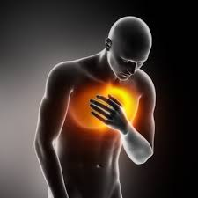
Clinical manifestation
Right sided heart failure
Dependent edema (legs and secrum)
Jugular venous distension
Abdominal distension
Hepatomegaly
Splenomegaly
Anorexia and nausea
Weight gain
Swelling of the fingers and hands
Increased blood pressure

Slide 26
Left sided heart failure
Sign of pulmonary congestion
Dyspnea
Tachypnea
Crackles in the lungs
Dry cough
Increased blood pressure or decreased blood pressure

Slide 27
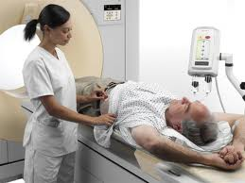
Diagnostic test
History collection
Physical examination
Echo cardiaography
2-D with Doppler flow studies
Chest X-ray
ECG
Cardiac catheterization
Blood studies
ABG studies show hypoxemia

Slide 28

Medical management
ACE INHIBITOR
ANGIOTENSINE II RECEPTOR BLOCKERS
BETA ADRENERGIC BLOCKERS
DIURETICS (PRELOAD REDUCTION)
POSITIVE INOTROPIC AGENT
VASODILATOR THERAPY

Slide 29
Nutritional therapy
Low sodium diet (2-3 g/day)
Avoid excessive fluid
Sodium restriction diet

Slide 30
Surgical management
Implantable cardioverter defibrillator
Cardiac transplantation
Intra-aortic balloon pump

Slide 31
Complication
Cardiac dysrhythmias.
Myocardial failure and cardiac arrest.
Digoxin toxicity - from decreased renal function and potassium depletion.
Pulmonary infarction, pneumonia, and emboli

Slide 32
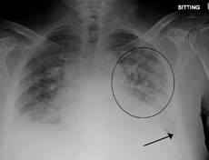
Definition
Pulmonary edema
Pulmonary edema is the abnormal accumulation of fluid in the lungs. The fluid may accumulate in the interstitial spaces and alveoli.

Slide 33
Etiology
  Heart disease
  Circulatory overload Lung injuries,
  head trauma
  Infection and fever
  Post cardio version, post-anaesthesia,
  post cardiopulmonary bypass
  Opioid overdose

Slide 34
Pathophysiology
Due to MI or exacerbation of chronic heart failure
Myocardial scarring
Ischemia can limit the distensibility of ventricle and sudden increase workload

Slide 35
Resistance into ventricular filling and blood back up into pulmonary circulation
Quickly develop pulmonary edema
Blood volume overload into the lungs and left ventricle

Slide 36
Increase arterial and pulmonary venous pressure
Pulmonary congestion
Pulmonary edema

Slide 37
Clinical manifestation
Restlessness and anxiety
Frothy pink and mucoid sputum
Breathlessness as a sense of suffocation
Cold and moist hand

Slide 38
Distended neck veins
Nail beds become cyanotic
Oxygen saturation decrease.
Noisy breathing

Slide 39
Diagnostic finding
Chest x-ray
Echocardiogram
Measurement of pulmonary artery wedge pressure by Swan-Ganz catheter .
Blood cultures
Cardiac markers in suspected MI
Arterial blood gas (ABG) analysis

Slide 40
Medical management
Oxygen therapy given.
Morphine (IV in small doses (2-5mg)) : to decrease pain and anxiety.
Diuretics(lasix)
Vasodilator therapy (NTG)

Slide 41
Complication
Dysrhythmias
Respiratory failure

Slide 42
Heart block

Slide 43
INTRODUCTION
Heart block is a disease or inherited condition that causes a fault within the heart's natural pacemaker due to some kind of obstruction (or "block") in the electrical conduction system of the heart.

Slide 44
Types of Heart Block
First-degree AV block
Second-degree AV block
  Type I second-degree AV block (Mobitz I), also known as Wenckebach block^{[3]}
  Type 2 second-degree AV block (Mobitz II) - due to a block in or below the bundle of His^{[3]}
Third-degree AV block (complete heart block)

Slide 45
First-Degree Heart Block
In first-degree heart block, the heart's electrical signals are slowed as they move from the atria to the ventricles (the heart's upper and lower chambers, respectively). This results in a longer, flatter line between the P and the R waves on the EKG (electrocardiogram).
First-degree heart block may not cause any symptoms or require treatment.

Slide 46
Second-Degree Heart Block
In this type of heart block, electrical signals between the atria and ventricles are slowed to a large degree. Some signals don't reach the ventricles. On an EKG, the pattern of QRS waves doesn't follow each P wave as it normally would.
If an electrical signal is blocked before it reaches the ventricles, they won't contract and pump blood to the lungs and the rest of the body.
Second-degree heart block is divided into two types: Mobitz type I and Mobitz type II.

Slide 47
Mobitz Type I
In this type (also known as Wenckebach's block), the electrical signals are delayed more and more with each heartbeat, until the heart skips a beat. On the EKG, the delay is shown as a line (called the PR interval) between the P and QRS waves. The line gets longer and longer until the QRS waves don't follow the next P wave.

Slide 48
Mobitz Type II
In second-degree Mobitz type II heart block, some of the electrical signals don't reach the ventricles. However, the pattern is less regular than it is in Mobitz type I. Some signals move between the atria and ventricles normally, while others are blocked.
On an EKG, the QRS wave follows the P wave at a normal speed. Sometimes, though, the QRS wave is missing (when a signal is blocked).

Slide 49
Third-Degree Heart Block
In this type of heart block, none of the electrical signals reach the ventricles. This type also is called complete heart block or complete AV block.
When complete heart block occurs, special areas in the ventricles may create electrical signals to cause the ventricles to contract. This natural backup system is slower than the normal heart rate and isn't coordinated with the contraction of the atria. On an EKG, the normal pattern is disrupted. The P waves occur at a faster rate, and it isn't coordinated with the QRS waves.
Complete heart block can result in sudden cardiac arrest and death. This type of heart block often requires emergency treatment. A temporary pacemaker might be used to keep the heart beating until you get a long-term pacemaker.

Slide 50
CAUSES
Damage to the heart from a heart attack.
Coronary heart disease, also called coronary artery disease.
Myocarditis or inflammation of the heart muscle.
Heart failure
Rheumatic fever.
Cardiomyopathy

Slide 51
Signs and symptoms
Signs and symptoms depend on the type of heart block you have. First-degree heart block may not cause any symptoms.
Signs and symptoms of second- and third-degree heart block include:
Fainting
Dizziness or light-headedness
Fatigue (tiredness)
Shortness of breath
Chest pain

Slide 52
management
Treatment depends on the type of heart block you have. If you have first-degree heart block, you may not need treatment.
If you have second-degree heart block, you may need a pacemaker. A pacemaker is a small device that's placed under the skin of your chest or abdomen. This device uses electrical pulses to prompt the heart to beat at a normal rate.
If you have third-degree heart block, you will need a pacemaker. In an emergency, a temporary pacemaker might be used until you can get a long-term device. Most people who have third-degree heart block need pacemakers for the rest of their lives.

Slide 53
NURSING DIAGNOSIS WITH INTERVENTION
1. Decreased cardiac output related to heart failure or dysrhythmias.
Intervention
Assess blood pressure and respiratory rate.
Document heart rhythm.
Report for dysrhythmias.
Monitor lung sound.
Monitor intake output chart.
Assess for changes in mental status.
Encourage patient to eat small meal and rest afterwards.
Encourage physical and psychological rest.

Slide 54
2. Excess fluid volume related to reduce glomerular filtration rate, decrease cardiac output, increase antidiuretic hormone and aldosterone production, sodium and water retention.
Intervention
Monitor I/O chart.
Daily weight monitoring.
Assess for jugular vein distension, hepatomegaly and abdominal pain.
Follow low sodium diet and fluid restriction.
Auscultate breath sound.
Administer diuretic therapy as ordered.

Slide 55
3. Impaired gas exchange related to fluid in alveoli.
Intervention
Auscultate breath sound
Encourage client to turn, cough and deep breath and use for incentive spirometry.
Administer oxygen as ordered.
Assess respiratory rate and rhythm.
Assess for cyanosis.
Position the client to facilitate breathing.
Monitor pulse oxymetry.
Obtain arterial blood gas if ordered.

Slide 56
4. Ineffective tissue perfusion related to decrease cardiac output.
Intervention
Note colour and temperature of the skin.
Monitor peripheral pulse.
Provide a warm environment.
Encourage active range of motion.
Protect the skin from trauma.

Slide 57
5. Risk for activity intolerance related to decreased cardiac output.
Intervention
Schedule for rest period.
Monitor for client’s response to activity.
Increase activity as ordered or according to the directions.
Instruct the client to avoid activities that increase cardiac activities.

Slide 58
6. Risk for impaired skin integrity related to decreased tissue perfusion and activities.
Intervention
Reposition the client every 2 hourly.
Provide proper bed and mattress while client is in bed.
Assess especially bony prominence, for redness. Use protective devices if redness is noted.
Float the heal from the bed if the client has little spontaneous leg movement.
Assist the client with morning care and lubricate the skin.

Slide 59
7. Risk for anxiety related to decrease cardiac output, hypoxia, diagnosis of heart failure, and fear of death or debilitation.
Intervention
Provide a calm environment.
Explain in advance all procedures and routine regimens.
Encourage the client to ask questions.
Provide emotional support to client and their significant others.
Encourage the client to use additional support system.

Slide 60
SUMMARY
HEART FAILURE
PULMONARY EDEMA
HEART BLOCK

Slide 61


