Slide 1
SEMINAR ON COMMUNICABLE DISEASES
HIV AIDS
DENGUE
SWINE FLU

Slide 2
HIV AIDS

Slide 3
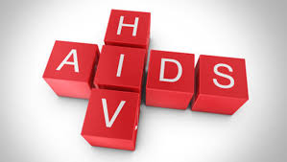

Slide 4
INTRODUCTION
HIV~ (Human Immunodeficiency Virus) The virus compromises the body’s ability to handle disease and causes AIDS.
AIDS~ (Acquired Immune Deficiency Syndrome) It is related to HIV, but they are not one in the same. A person has AIDS only in the final stages of HIV, after the immune system becomes unable to defend itself against foreign invaders like bacteria, other viruses, and allows the development of certain cancers.

Slide 5
The human immunodeficiency virus (HIV) is a lentivirus (a subgroup of retrovirus) that causes HIV infection and over time(AIDS). AIDS is a condition in humans in which progressive failure of the immune system allows life-threatening opportunistic infections.

Slide 6
According to research, the origins of HIV date back to the late nineteenth or early twentieth century in west-central Africa. AIDS and its cause, HIV, were first identified and recognized in the early 1980s.
There is currently no cure for HIV or AIDS. Treatments can slow the course of the condition - some infected people can live a long and relatively healthy life.
HIV is the virus which attacks the T-cells in the immune system.
AIDS is the syndrome which appears in advanced stages of HIV infection.
HIV is a virus.
AIDS is a medical condition.

Slide 7
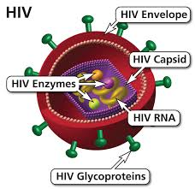

Slide 8
CAUSES OF HIV/AIDS
HIV is a retrovirus that infects the vital organs of the human immune system. The virus progresses in the absence of antiretroviral therapy. The rate of virus progression varies widely between individuals and depends on many factors (age of the patient, body's ability to defend against HIV, access to health care, existence of coexisting infections, the infected person's genetic inheritance, resistance to certain strains of HIV).

Slide 9
MODE OF TRANSMISSION
HIV can be transmitted through:
1. Sexual transmission. It can happen when there is contact with infected sexual secretions (rectal, genital or oral mucous membranes). This can happen while having unprotected sex, including vaginal, oral and anal sex or sharing sex toys with someone infected with HIV.

Slide 10
2. Perinatal transmission. The mother can pass the infection on to her child during childbirth, pregnancy, and also through breastfeeding.
3. Blood transmission. The risk of transmitting HIV through blood transfusion is nowadays extremely low in developed countries, thanks to meticulous screening and precautions. Among drug users, sharing and reusing syringes contaminated with HIV-infected blood is extremely hazardous.

Slide 11
COMMON MYTHS ABOUT HIV AND AIDS
There are many misconceptions about HIV and AIDS. The virus CANNOT be transmitted from:
shaking hands
hugging
casual kissing
sneezing
touching unbroken skin
using the same toilet
sharing towels
sharing cutlery
mouth-to-mouth resuscitation
or other forms of "casual contact"

Slide 12
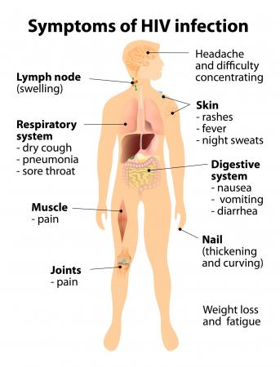

Slide 13
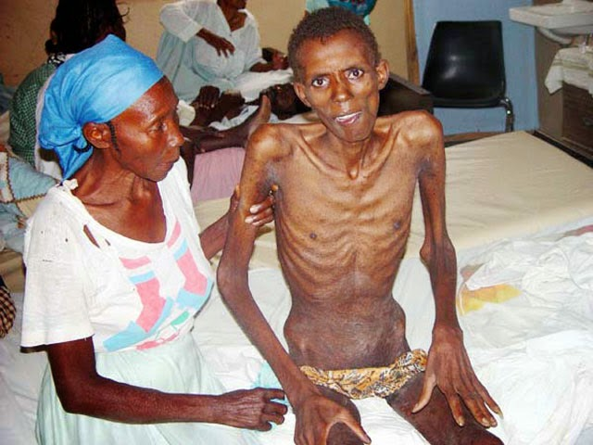

Slide 14
BLOOD TEST
Diagnosis is made through a blood test that screens specifically for the virus.
If the HIV virus has been found, the test result is "positive". The blood is re-tested several times before a positive result is given to the patient.

Slide 15
MEDICAL TREATMENTS FOR HIV/AIDS
Earlier HIV antiretroviral treatment is crucial - it improves quality of life, extends life expectancy and reduces the risk of transmission, according to the World Health Organization's guidelines issued in June 2013.
When an HIV-positive adult's CD4 cell count is 500 cells/mm³ or lower they should start treatment immediately.

Slide 16
HIV PREVENTION
1. Unprotected sex
Having sex without a condom can put a person at risk of being infected with HIV and other sexually transmitted infections (STIs). HIV can be spread by having unprotected sex (vaginal, oral and anal sex). It can also be caught from sharing sex toys with someone infected with HIV.

Slide 17
2. Drug abuse and needle sharing
Intravenous drug use is an important factor in HIV transmission in developed countries. Sharing needles can expose users to HIV and other viruses, such as hepatitis C.
Strategies such as needle-exchange programs are used to reduce the infections caused by drug abuse.

Slide 18
3. Body fluid exposure
Exposure to HIV can be controlled by employing precautions to reduce the risk of exposure to contaminated blood. At all times, health care workers should use barriers (gloves, masks, protective eyewear, shields, and gowns). Frequent and thorough washing of the skin immediately after being contaminated with blood or other bodily fluids can reduce the chance of infection.

Slide 19
4. Pregnancy
Anti-HIV medicines can harm the unborn child. But an effective treatment plan can prevent HIV transmission from mother to baby. Precautions have to be taken to protect the baby´s health. Delivery through caesarean section may be necessary. Breastfeeding may have to give way to bottle-feeding if the mother is infected.

Slide 20
A study by scientists from Columbia University, New York, found that breastfeeding for 6+ months with antiretroviral therapy could help reduce mother-to-child HIV transmission as well as improve chances of infant's survival.
5. Education
Health education is an important factor in reducing risky behavior.

Slide 21
NURSING CARE
Assess patient’s ability to chew, taste, and swallow.
Auscultate bowel sounds.
Weigh as indicated. Evaluate weight in terms of premorbid weight. Compare serial weights and anthropometric measurements.
Note drug side effects.

Slide 22
Plan diet with patient and include, suggesting foods from home if appropriate. Provide small, frequent meals and snacks of nutritionally dense foods and non acidic foods and beverages, with choice of foods palatable to patient. Encourage high-calorie and nutritious foods, some of which may be considered appetite stimulants. Note time of day when appetite is best, and try to serve larger meal at that time.

Slide 23
Limit food(s) that induce nausea and/or vomiting or are poorly tolerated by patient because of mouth sores or dysphagia. Avoid serving very hot liquids and foods. Serve foods that are easy to swallow like eggs, ice cream, cooked vegetables.
Schedule medications between meals (if tolerated) and limit fluid intake with meals, unless fluid has nutritional value.
Encourage as much physical activity as possible.
Provide frequent mouth care, observing secretion precautions.

Slide 24
Provide rest period before meals. Avoid stressful procedures close to mealtime.
Remove existing noxious environmental stimuli or conditions that aggravate gag reflex
Encourage patient to sit up for meals
Record ongoing caloric intake.
Insert or maintain nasogastric (NG) tube as indicated.
Vitamin supplements

Slide 25
DENGUE

Slide 26
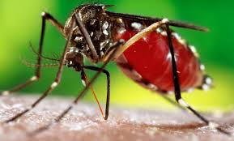

Slide 27
INTRODUCTION
Dengue fever is a mosquito-borne tropical disease caused by the dengue virus. Symptoms typically begin three to fourteen days after infection.

Slide 28
In a small proportion of cases, the disease develops into the life-threatening dengue hemorrhagic fever, resulting in bleeding, low levels of blood platelets and blood plasma leakage, or into dengue shock syndrome, where dangerously low blood pressure occurs.

Slide 29
Dengue is spread by several species of mosquito of the Aedes type, principally A. aegypti. The virus has five different types; infection with one type usually gives lifelong immunity to that type, but only short-term immunity to the others. Subsequent infection with a different type increases the risk of severe complications.

Slide 30
CAUSES
Dengue fever virus is an RNA virus of the family Flaviviridae; genus Flavivirus. Other members of the same genus include yellow fever virus, West Nile virus, St. Louis encephalitis virus, Japanese encephalitis virus, tick-borne encephalitis virus, Kyasanur forest disease virus, and Omsk hemorrhagic fever virus. Most are transmitted by arthropods (mosquitoes or ticks), and are therefore also referred to as arboviruses (arthropod-borne viruses)

Slide 31
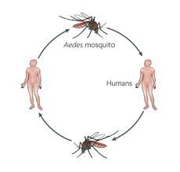

Slide 32
MODE OF TRANSMISSION
Dengue virus is primarily transmitted by Aedes mosquitoes, particularly A. aegypti. These mosquitoes usually live between the latitudes of 35° North and 35° South below an elevation of 1,000 metres (3,300 ft). They typically bite during the early morning and in the evening, but they may bite and thus spread infection at any time of day. Other Aedes species that transmit the disease include A. albopictus, A. polynesiensis and A. scutellaris. Humans are the primary host of the virus, but it also circulates in nonhuman primates.

Slide 33
An infection can be acquired via a single bite. A female mosquito that takes a blood meal from a person infected with dengue fever, during the initial 2- to 10-day febrile period, becomes itself infected with the virus in the cells lining its gut. About 8–10 days later, the virus spreads to other tissues including the mosquito's salivary glands and is subsequently released into its saliva. The virus seems to have no detrimental effect on the mosquito, which remains infected for life. Aedes aegypti is particularly involved, as it prefers to lay its eggs in artificial water containers, to live in close proximity to humans, and to feed on people rather than other vertebrates.

Slide 34
Dengue can also be transmitted via infected blood products and through organ donation.

Slide 35
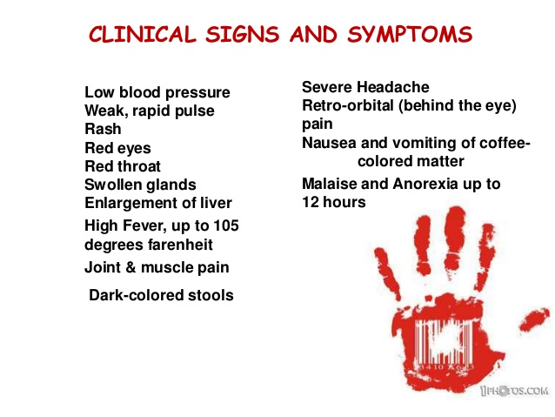

Slide 36
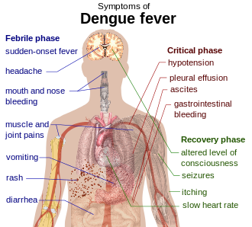

Slide 37
LAB TESTS
These laboratory tests are only of diagnostic value during the acute phase of the illness with the exception of serology. Tests for dengue virus-specific antibodies, types IgG and IgM, can be useful in confirming a diagnosis in the later stages of the infection. Both IgG and IgM are produced after 5–7 days.

Slide 38
MEDICAL MANAGEMENT
There is no effective anti viral therapy for dengue fever.The treatment is entirely symptomatic.
Analgesic drugs other than aspirin may be required for relief of headache, ocular pain and myalgia.
Initial phase may require intravenous infusion to prevent dehydration and replacement of plasma.
Blood transfusion is indicated in patient with severe bleeding.
Oxygen therapy is indicate to all patient in shock.
Sedatives may be needed to alloy anxiety.

Slide 39
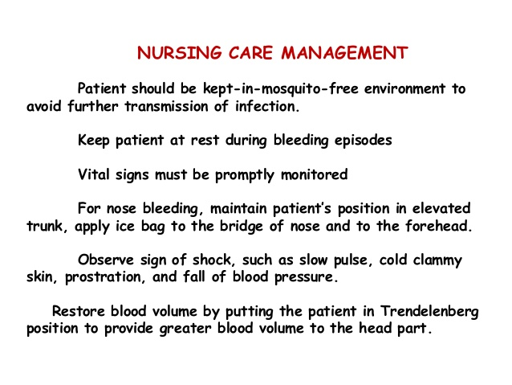

Slide 40
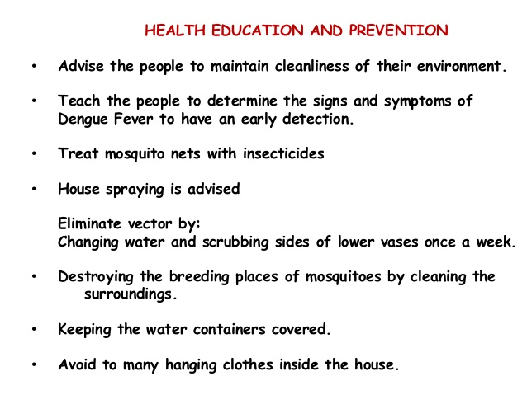

Slide 41
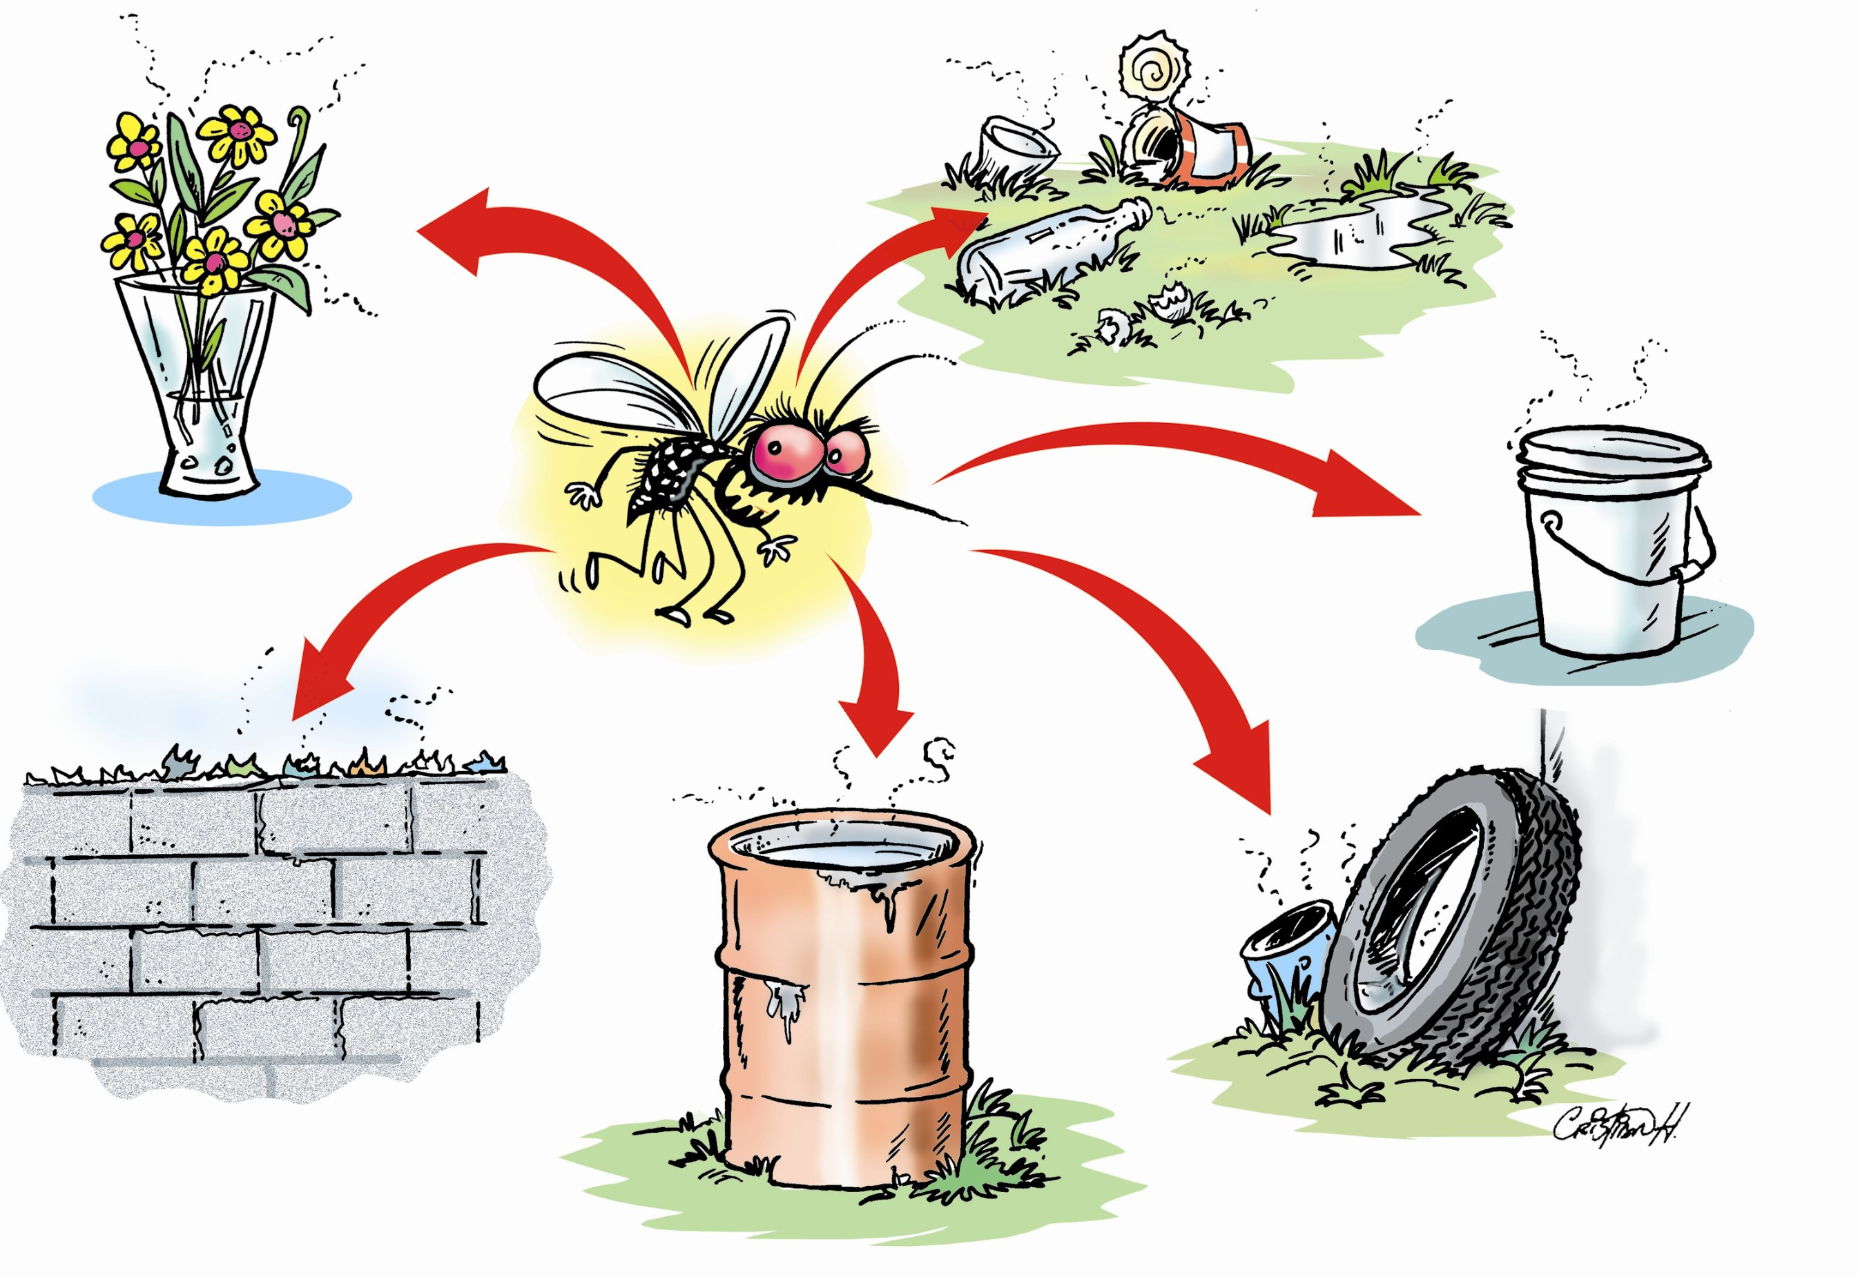

Slide 42
SWINE FLU

Slide 43
INTRODUCTION
Swine flu (swine influenza) is a respiratory disease caused by viruses (influenza viruses) that infect the respiratory tract of pigs, resulting in nasal secretions, a barking cough, decreased appetite, and listless behavior.
Swine flu produces most of the same symptoms in pigs as human flu produces in people. Swine flu can last about one to two weeks in pigs that survive. Swine influenza virus was first isolated from pigs in 1930 in the U.S. and has been recognized by pork producers and veterinarians to cause infections in pigs worldwide.

Slide 44
Investigators decided the 2009 so-called "swine flu" strain, first seen in Mexico, should be termed novel H1N1 flu since it was mainly found infecting people and exhibits two main surface antigens, H1 (hemagglutinin type 1) and N1 (neuraminidase type1).

Slide 45
CAUSES
The cause of the 2009 swine flu was an influenza A virus type designated as H1N1. In 2011, a new swine flu virus was detected. The new strain was named influenza A (H3N2)virus.

Slide 46
INCUBATION PERIOD
The incubation period for swine flu is about one to four days, with the average being two days; in some people, the incubation period may be as long as about seven days in adults and children.

Slide 47
MODE OF TRANSMISSION
Swine flu is transmitted from person to person by inhalation or ingestion of droplets containing virus from people sneezing or coughing.

Slide 48
SIGNS AND SYMPTOMS
Symptoms of swine flu are similar to most influenza infections.
Fever (100 degree F or greater)
Cough
Nasal secretions
Headache
Fatigue
Sore throat

Slide 49
Rashes
Muscles pain
Chills
Nausea
Vomitting
Diarrhoea
Some patients develop severe respiratory symptoms, such as shortness of breath
Patients can get pneumonia and some can get seizures

Slide 50
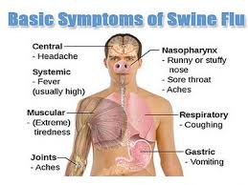

Slide 51
DIAGNOSIS
Swine flu is presumptively diagnosed clinically by the patient's history of association with people known to have the disease and their symptoms listed above. Usually, a quick test (for example, nasopharyngeal swab sample) is done to see if the patient is infected with influenza A or B virus. Most of the tests can distinguish between A and B types. The test can be negative (no flu infection) or positive for type A and B. If the test is positive for type B, the flu is not likely to be swine flu. If it is positive for type A, the person could have a conventional flu strain or swine flu.

Slide 52
MEDICAL TREATMENT
If a person becomes sick with swine flu, antiviral drugs can make the illness milder and make the patient feel better faster.
They may also prevent serious flu complications.
For treatment, antiviral drugs work best if started soon after getting sick (within two days of symptoms).
Beside antivirals, supportive care at home or in a hospital focuses on controlling fevers, relieving pain and maintaining fluid balance, as well as identifying and treating any secondary infections or other medical problems.

Slide 53
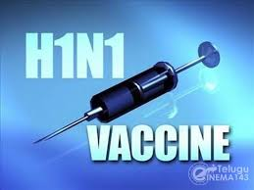

Slide 54
RISK FACTORS FOR SWINE FLU
All children 6 months to 4 years (59 months) of age
All people 50 years of age and older
Adults and children who have chronic pulmonary (including asthma) or cardiovascular (except isolated hypertension), renal, hepatic, neurological, hematologic, or metabolic disorders (including diabetes mellitus)
People who have immunosuppression (including immunosuppression caused by medications or by HIV)

Slide 55
Women who are or will be pregnant during the influenza season
Children and adolescents (6 months to 18 years of age) who are receiving long-term aspirin therapy and who might be at risk for experiencing Reye's syndrome after influenza virus infection
Residents of nursing homes and other long-term-care facilities
American Indians/Alaska natives
People who are morbidly obese (BMI ≥40)
Health-care professionals (doctors, nurses, health-care personnel treating patients)

Slide 56
Household contacts and caregivers of children under 5 years of age and adults 50 years of age and older, with particular emphasis on vaccinating contacts of children less than 6 months age
Household contacts and caregivers of people with medical conditions that put them at higher risk for severe complications from influenza

Slide 57
NURSING CARE
Assess respiratory status for rate, depth, ease, use of accessory muscles, and work of breathing
Auscultate the lung fields for the presence of wheezes, crackles, rhonchi, or decreased breath sounds.
Administer oxygen as ordered. Monitor oxygen saturation by pulse oximetry, and notify physician of readings <90% or as prescribed by physician.
Assess patient for pallor or cyanosis, especially to nail beds and around mouth.

Slide 58
Monitor patient for cough and production of sputum, noting amount, color, character, and patient’s ability to expectorate secretions, and ability to cough.
Position patient in high Fowler’s or semi-Fowler’s position, if possible.
Turn patient every 2 hours
Administer bronchodilators as ordered
Encourage fluids, up to 3-4 L/day unless contraindicated.

Slide 59
Encourage deep breathing exercises and coughing exercises every 2 hours.
Suction patient if warranted.
Teach patient regarding splinting abdomen with pillow during cough efforts.
Instruct patient on deep-breathing exercises and use of incentive spirometry.
Instruct patient to avoid using milk, milk products, caffeinated drinks, and alcohol.

Slide 60
Instruct patient to avoid excessively hot or cold fluids or environmental temperature extremes.
Instruct patient to seek help and stop smoking if patient is a smoker.
Instruct patient/family to avoid crowds and persons with upper respiratory infections when possible.
Instruct patient/family in the use of inhalers, nebulizers, and medications.

Slide 61
SUMMARY

Slide 62
THANK YOU

