Slide 1

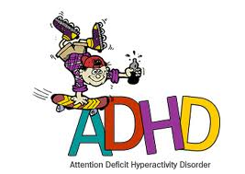
Prepared by:
Mr. Suresh V.
Associate Professor
Department of Mental health nursing
Sumandeep Nursing college

Slide 2

INTRODUCTION:
ADHD, also Known as AD/HD is the acronym for Attention deficit hyperactivity disorder. It is also known as hyper-kinetic disorder.
it is one of the best-understood disorders in the medical community, it is one of the most misunderstood disorders in the general community.

Slide 3
If not treated properly, it increases the risk of delinquency, drug abuse and academic poor performance, etc.
there are often associate emotional, behavioral and social problems. There is high prevalence of low self-esteem in children with ADD/ADHD.
Learning disabilities including dyslexia (difficulty in reading) are often a common.

Slide 4

DEFINITION:
“ADHD is a persistent pattern of inattention and hyperactivity more frequent and severe than is typical of children at a similar level of development.”
The syndrome was first described by Heinrich Hoff in 1854.

Slide 5
EPIDEMIOLOGY
It is four to nine times more common in boys than in girls and may occur in as many as 3 to 7 percent of school-age children.
In about 60 to 70 percent of the cases, ADHD persists into young adulthood, and about 25 percent will subsequently meet the criteria for antisocial personality disorder as adults.

Slide 6
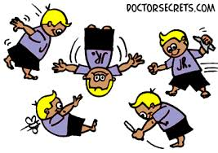
CHARCTERISTICS:
Marked by developmentally inappropriate inattention, impulsiveness and, in some cases, hyperactivity.
May progress to conduct disorder.

Slide 7

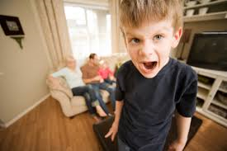

Slide 8
PREDISPOSING FACTORS
Biological Influences
Genetics: Siblings of hyperactive children have about twice the risk of having the disorder as does the general population.
Biochemical Theory: Deficit of dopamine and norepinephrine has been attribute in the over activity seen in ADHD
Prenatal, Perinatal, and Postnatal Factors: Prenatal toxic exposure, prenatal mechanical insult to the fetal nervous system.
-prematurity, fetal distress, prolonged labor, perinatal asphyxia

Slide 9
Environmental Influences.
Food additives, coloring preservatives and sugar are also causes but no definite evidence.
Psychosocial Influences.
-Prolonged emotional deprivation
-Stressful psychic events
-Disruption of family equilibrium

Slide 10
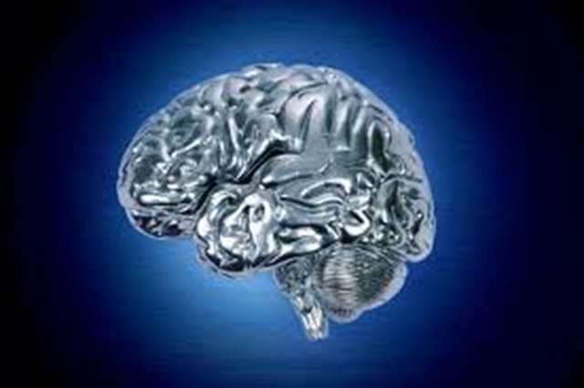
Risk factors:
Drug exposure in utero
Low birth weight
Lead poisoning
Birth complications

Slide 11
Types:
1.) Predominantly Hyperactive-Impulsive
Greater than 6 symptoms would fall under the Hyperactive-Impulsive
Less than 6 symptoms are seen in Impulsive
2.) Predominantly Inattentive
Greater than 6 symptoms would fall under the Impulsive
Less than 6 symptoms are seen in Hyperactive-Impulsive
This classification finds children who are less likely to act out.
They may be sitting quietly, but not paying attention
These children are often overlooked.

Slide 12
3.) Hyperactive-Impulsive and Inattentive
Has greater than 6 symptoms in both areas.
Most children with this diagnosis are found in this classification.

Slide 13

SYMPTOMS OF ADHD
The symptoms of ADHD can be clubbed into three broad categories
inattention,
hyperactivity and
impulsivity.

Slide 14
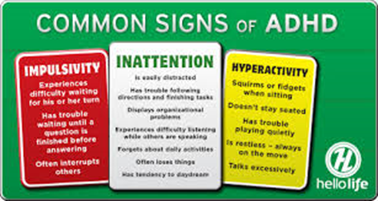

Slide 15


Inattention:
The child easily get distracted easily by the noises and other distracters in the environment
Frequent off tasks behaviors like talking to other children in class.
Problems in staying focused at one activity, like- study tasks and play
Often fails to pay close attention to details of the tasks at hand or makes careless mistakes in schoolwork and/or other activities
When spoken to directly, seems as not listening
Frequently looses or forgets things

Slide 16


Cont…
The child has difficulty in following through on instructions and often fails to finish schoolwork, chores or other tasks
Often The child has problems organizing tasks or activities
The child is often forgetful
Avoids or dislikes the activities that require mental efforts.
The child has difficulty in completing the tasks and often leaves the tasks incomplete.
The child needs close supervision to finish the tasks

Slide 17

hyperactivity
Continuously doing something or the other
Problem in remaining seated even in which it is expected as in classroom and social gatherings
Excessively talking and at an inappropriate time or occasion or situation
Often runs or climbs at places not expected
Constantly on the go as driven by a motor
Problem in engaging in leisure activities or play quietly

Slide 18

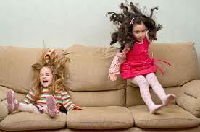
Impulsivity
Butts or intrudes into conversation of others
Answers the question even before the question is completed
The child has difficulty in waiting for his/her turn in games or in queues.
Making decisions without giving it a thought
The symptoms of impulsivity are clubbed with symptoms of hyperactivity in Attention deficit hyperactivity disorder, predominantly hyperactive type.

Slide 19
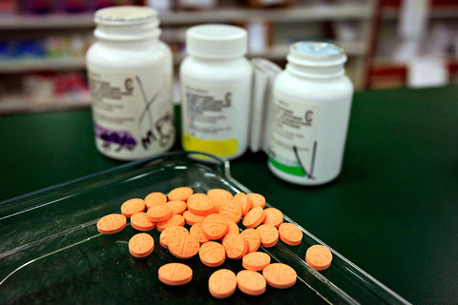
PSYCHOPHARMACOLOGICAL INTERVENTION FOR ADHD
CNS Stimulants
Amphetamines (dextroamphetamine, methamphetamine, and mixtures): cause the release of norepinephrine.
Methylphenidate and dexmethylphenidate:
block the reuptake of norepinephrine and dopamine.
Non stimulants: atomoxetin

Slide 20
Side effects include restlessness, insomnia, headache, palpitations, weight loss, increased blood pressure, abdominal pain, anxiety, tolerance.

Slide 21

PSYCHOLOGICAL THERAPIES:
social skills
family education
cognitive behavior therapy
behavior modification techniques

Slide 22
THERAPY:
Children and adults with ADHD often greatly benefit from counseling or behavior therapy,
which may be provided by a psychologist or other mental health care professionals.
Some people with ADHD may also have other conditions such as anxiety disorder or depression.
In these cases, counseling may help both ADHD and the coexisting problem.

Slide 23
Behavior therapy :
for increasing adaptive behavior:
positive reinforcement,
token economy
To teach new behavior
Shaping.

Slide 24
For decreasing behavior:
ignoring,
punishment,
time out,
response cost,
Assertiveness and social skill training

Slide 25
Care of children at home:
Show your child lots of affection.
Be patient
Take time to enjoy your child.
Try to keep a regular schedule for meals, naps
and bedtime
Make sure your child is rested
Identify difficult situations
Use timeouts to discipline your child

Slide 26
Work on organization.
Find ways to enhance your child's self-
esteem and sense of discipline
Use simple words and demonstrate when
giving your child directions
Take a break yourself.

Slide 27


Slide 28
NURSING INTERVENTION:
Developeing trusting relationship
provide safe environment.
ensure client’s attention by calling his name
ask the patient to repeat instructions before beginning a task.
help him learn how to take his turn, wait in line and follow rules.
assess parenting skill level, considering intellectual, emotional and physical strengths and limitations.

Slide 29
be sensitive to their needs as there is often exhaustion of parental resources due to prolonged coping with a disruptive child.
explain and demonstrate positive parenting techniques to parents or caregivers, such as identifying the child’s behavior and responding positively to that behavior.
co-ordinate overall treatment plan with schools,collateral personnel, the child and the family.

Slide 30
Multiple choice questions:
1. ADHD is also known as...
A) hyper-kinetic disorder C) A & D
B) knowledge D) adoptive functioning
2. Onset of the disorder is difficult to diagnose in children younger than age..
A) 4 C) 6
B) 8 D) 10
3. which is the sign of conduct disorders among given below?
A) use of a weapon C) robbery
B) burglary D) all of above

Slide 31
4. which is the characteristic of ADHD among given below?
A) inappropriate inattention, impulsiveness C) agitated depression
b) impulsiveness d) low self esteem
5. presence of three of the following criteria in the past 12 months, with at least one criterion present in the past 6 months indicates conduct disorders...
A) Aggression to people and animal C) Deceitfulness or theft
B) lying D) A&C

Slide 32
NURSING DIAGNOSIS:
● Risk for injury related to impulsive and accident-prone behavior and the inability to perceive self-harm.
● Impaired social interaction related to intrusive and immature behavior.
● Low self-esteem related to dysfunctional family system and negative feedback.
● Noncompliance with task expectations related to low frustration tolerance and short attention span.

Slide 33
Positive reinforcement occurs when an event or stimulus is presented as a consequence of a behavior and the behavior increases.
Example: A father gives candy to his daughter when she picks up her toys. If the frequency of picking up the toys increases, the candy is a positive reinforcer (to reinforce the behavior of cleaning up).
Negative reinforcement occurs when the rate of a behavior increases because an aversive event or stimulus is removed or prevented from happening.[
A person puts ointment on a bug bite to soothe an itch. If the ointment works, the person will likely increase the usage of the ointment because it resulted in removing the itch, which is the negative reinforcer.

Slide 34

THANK YOU….

