Slide 1

ELECTRO CONVULSIVE THERAPY
Prepared by:
Mrs. Bhoomika Patel
Assistant lecturer
Department of Mental health nursing
Sumandeep Nursing college

Slide 2
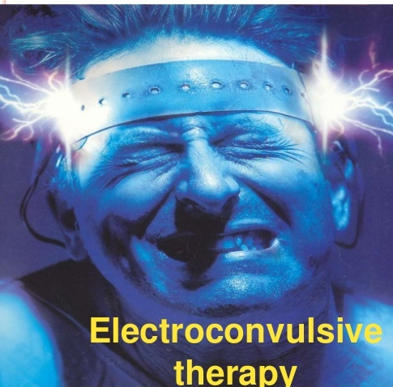

Slide 3
INTRODUCTION
Earlier Electroconvulsive therapy (ECT) has had very bad press, as a physically and emotionally brutal procedure imposed on unwilling clients in order to calm them.
Despite its controversial image, ECT has been used continuously for more than 50 years, longer than any other physical treatment available for mental illness. It has achieved this longevity because when administered properly, for the right illness, it can help as much as or more than any other treatment (Popolos, 2007)

Slide 4
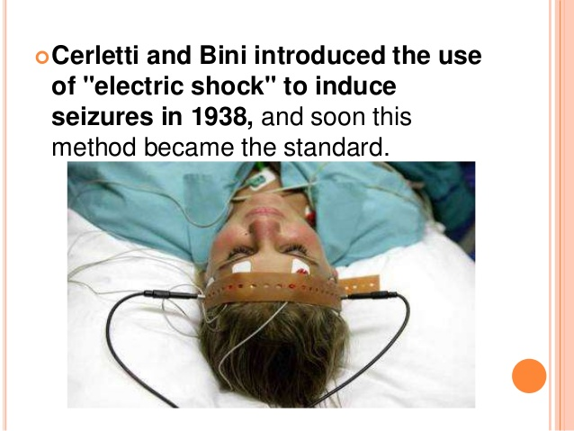

Slide 5
ECT is type of somatic treatment first introduced by Bini and Cerletti in April 1938.
From onwards ECT is being considered as unique Psychiatric treatment.

Slide 6
Purposes
When drugs are not available or turns out to be ineffective.
For quick recovery of patient.
When the patient needs to get back to work quickly.

Slide 7
DEFINITION
Electroconvulsive therapy is a physical therapy, in which there is an application of electrical current to the temporal region of the brain to produce grand mal type seizure, for bringing about therapeutic effects.

Slide 8
Historical Perspectives of ECT
Initially, Meduna used pharmacological methods to induce seizure activity. He began with intramuscular injections of camphor, which was known to be a stimulant at lower doses. However, since camphor was painful and variable in its effect, he switched agents to pentylenetetrazol (Metrazol), a more refined synthetic substance.
In 1937, the Italian neuropsychiatrists Ugo Cerletti and Lucio Bini began to induce seizures experimentally with electricity . They found that seizures could be more easily induced and regulated with electricity than with pharmacological agents.

Slide 9
Continued….
Electroconvulsive therapy (ECT) quickly replaced pentylenetetrazol as the method of inducing convulsions, and within a few years, ECT became the dominant somatic treatment not only for schizophrenia but also for major mood disorders.
In 1974, the American Psychiatric Association’s council on research and development appointed a task force on ECT. The APA Task Force on ECT, in 1976, gave its report which provided clear guidelines for use of ECT and declared it to be safe and effective method of treatment when used by professionals trained in the technique.

Slide 10
The 1990 the APA Task Force Report on ECT redefined the indications , gave guidelines for obtaining consent and set standards for training ,treatment and privileging of ECT. The most recent version of this task force repoirt became available in 2001.

Slide 11
Indications for ECT
Major Depression with or without psychotic features
Bipolar disorder - manic or depressed phase
Psychosis: schizophrenia and mania.
Catatonic schizophrenia
Post partum psychosis
Organic mental disorders.
OCD and Neuroses.

Slide 12
Major Depression:
attempted suicide
strong suicidal ideas or plans
life-threatening illness because of the patient’s refusal of food or fluids.
With psychotic features
With unsatisfactory response to drug therapy.
Electroconvulsive therapy may be considered for the treatment of severe depressive illness associated with:
stupor
marked psychomotor retardation
depressive delusions or hallucinations.

Slide 13
MANIA:
life-threatening physical exhaustion
treatment resistance (i.e. mania that has not responded to the treatment of choice).
patient choice and a previous experience of ineffective or intolerable medical treatment, or previous recovery with ECT, are again relevant.

Slide 14
Acute schizophrenia:
The treatment of choice for acute schizophrenia is antipsychotic drug treatment. ECT may be considered as a fourth-line option, that is, for patients with schizophrenia for whom clozapine has already proven ineffective or intolerable.

Slide 15
Catatonia:
Catatonia is a syndrome that may complicate several psychiatric and medical conditions. The treatment of choice is a benzodiazepine drug; most experience is with lorazepam. ECT may be indicated when treatment with lorazepam has been ineffective.

Slide 16
Organic mental disorders:
- organic mood disorders
- organic psychosis.
Other Conditions
neuroses.
obsessive–compulsive disorders.
personality disorders. Little evidence exists to support the efficacy of ECT in the treatment of these conditions.

Slide 17
ECT is preferred to antidepressant therapy in some cases such as for clients with cardiac diseases when tricyclics are contra indicated because of the potential for dysarrythmias and congestive heart failure and for pregnant woman in whom anti depression place the feature at risk for congenital defects.

Slide 18
Contraindications for ECT
A) Absolute:-
Increased ICP (mass)
B) Relative:-
Cerebral haemorrhage
Brain tumour
Unstable angina
Recent MI
Recent stroke
Retinal detachment

Slide 19
Types of ECT
A) Direct
B)Modified

Slide 20
Patient Preparation
The patient should
Have their initial weight recorded on the ECT Checklist.
Be NPO.
Remove jewellery, hair accessories, contact lens, glasses, hearing aids, and dentures. Local policy can state whether glasses or dentures can be kept for transport.
Receive pre-ECT medications (if ordered) and most routine a.m. medications 1 hour before ECT,with sips of water if oral.

Slide 21
Void his or her bladder and bowels.
Be wearing an incontinence pad if he or she has bladder or bowel instability.
Have pre-ECT vital signs and, if diabetic, blood sugars recorded on the chart before each treatment.
Have clean hair if at all possible.
The physician should be alerted to any change in medication and patient status if notable since the last treatment.

Slide 22
Psychotropic Medications:
A careful review of medication is essential before starting a course of ECT. Existing medications for medical illness can usually be continued throughout the ECT course and given one hour before the ECT with sips of water, or after the treatment when the patient is fully awake. Diabetic patients should be given priority if several patients receive ECT on the same day. Insulin and hypoglycemic agents are usually given after the treatment. Medical consultations may be requested for patients with poorly-controlled blood sugars or with respiratory or cardiovascular illnesses.

Slide 23
Consideration should also be given whether to continue psychotropic medications throughout an ECT course. As a general rule, it is favorable to discontinue as many medications as possible to decrease the risk of delirium and minimize cognitive side effects. This is particularly applicable to those bearing anticholinergic effects.
On the other hand, in bipolar patients, it may be necessary to maintain mood stabilizers throughout the ECT course; for example, to reduce the risk of iatrogenically shifting a patient’s depressed state into mania.

Slide 24
Skin Preparation:
For electrical current from an ECT device to reach the brain, it must flow between two metallic electrodes. Since blood is a conductor, the brain’s vascular system carries the current. Skin inherently resists electrical current, so careful site preparation is a key component in ECT delivery. Inadequate cleansing or sloppy use of conductant gel can result in an inadequate or aborted seizure, and in skin burns. Skin or scalp preparation involves

Slide 25
Thoroughly cleansing the chosen electrode sites with alcohol-soaked gauze squares to remove oil, makeup, gel from previous treatments, hair sprays, dead skin cells, etc. Note that shaving the hair is not required. If a parietal site is used for unilateral ECT, hair can be parted and cleaned as described.
Massaging an abrasive conductive such as that used in EEG labs into the skin with fingertips, in a circular motion.
Removing the abrasive gel with a cloth or dry gauze (not with alcohol), to create a dry, clean, mildly-abraded area.

Slide 26
Applying a conductive ECT gel (non abrasive), onto the electrode surfaces.
Firmly pressing the electrodes against the skull, which is imperative to minimize impedance.

Slide 27
Electrode Placement
Bilateral (BL) - most common, most effective, most cognitive dysfunction
Each electrode is placed 2.5 -4 cm(1-11/2 )above the mid point on a line joining the tragus of ear & the lateral canthus of the eye.
Right unilateral (RUL) - less cognitive effect, may be less clinically effective
Electrodes are placed only on one side of head usually non –dominant side (right side of head in a right handed individual

Slide 28
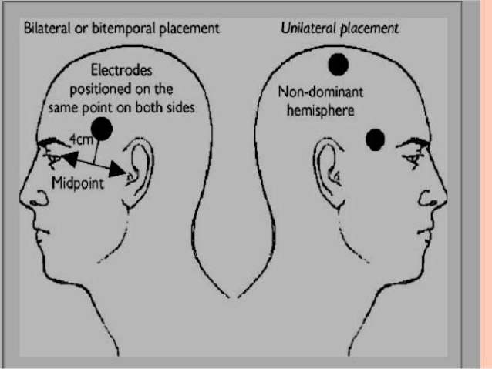

Slide 29
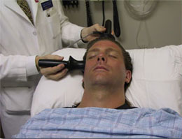

Slide 30
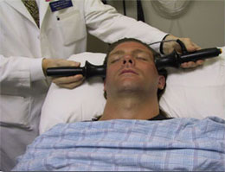

Slide 31
Parameters of electrical current applied
According to American Psychiatric Association
Voltage:- 70-120 volts
Duration:- 0.7-1.5sec

Slide 32
Types of Seizure Produce
Grandmal seizure- tonic phase lasting for 10-15 second
Clonic phase: lasting for 30-60 second

Slide 33
Number & Frequency Of ECT Treatment:
It depends on the condition of the patient
Peak response is attained between five and ten treatments for patients with bipolar disorders, manic type, schizoaffective disorders, or catatonic schizophrenia. 20 to 25 treatments may be required for chronically ill schizophrenic patients.

Slide 34
ECT treatment is most often given three times a week. The frequency of treatment can be reduced if the patient shows a severe confusional state. With an extremely agitated, psychotic or suicidal patient it may be useful to give the first few treatments on a daily basis.
ECT does not prevent relapse. So maintenance treatment should be with drugs and psychotherapy.

Slide 35
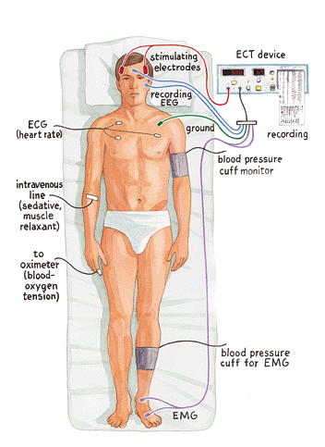

Slide 36
MECHANISM OF ACTION
The exact mechanism of action is not known.
Theories :-
1)Neurotransmitter theory
2) Neuro endocrine theory
3)Anticonvulsant theory

Slide 37
Side effects
Memory impairment
Drowsiness
Confusion
anxiety
Hypertension
Headache
Weakness
Dryness of mouth
Tongue bite

Slide 38
Risk Factors
Mortality
Permanent memory loss
Brain Damage
Myocardial infarction
Cerebrovascular accident
Aortic or cerebral aneurysm,
Severe underlying hypertension,
Congestive heart failure.

Slide 39
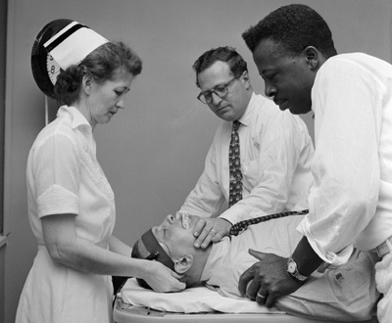
ECT TEAM
Psychiatrist
Anesthesiologist
Trained nurse
Aids

Slide 40
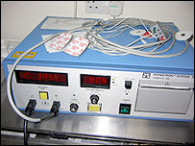
Articles required
Common instruments
ECT machine
Electrodes well padded
Normal saline
Endotracheal tubes
Suction and Oxygen catheter
Mouth wipes
Cotton balls

Slide 41
Cont…
Clean tray
All emergency drugs and Syringes
Spirit swabs
A trolley
Ambu bag
BP Apparatus
Mouth gag well padded
Tongue depressor
Other
Kidney tray
Paper bag
Throat swab
A pillow

Slide 42
In recovery room
A floor or low level bed
All emergency drugs
Mouth wipes
An extra sets of clothes to change if soiled
Toilet facilities

Slide 43

ROLE OF NURSE

Slide 44
ROLE OF NURSE
Assessment
A complete physical examination must be completed by the appropriate medical professional prior to the initiation of ECT. This evaluation should include a thorough assessment of cardiovascular and pulmonary status as well as laboratory blood and urine studies. A skeletal history and radiographic assessment should also be considered.

Slide 45
The nurse may be responsible for ensuring that informed consent has been obtained from the client. If the depression is severe and the client is clearly unable to consent to the procedure, permission may be obtained from family or other legally responsible individual. Consent is secured only after the client or responsible individual acknowledges understanding of the procedure, including possible side effects and potential risks involved. Client and family must also understand that ECT is voluntary, and that consent may be withdrawn at any time (American Psychiatric Association, 2001; Hall & Bensing

Slide 46
Nurses may also be required to assess:
The client’s mood and level of interaction with others.
Evidence of suicidal ideation, plan, and means.
Level of anxiety and fears associated with receiving ECT.
Thought and communication patterns.
Baseline memory for short- and long-term events
Client and family knowledge of indications for, side effects of, and potential risks associated with ECT
Current and past use of medications
Baseline vital signs and history of allergies
The client’s ability to carry out activities of daily living

Slide 47
Pre-procedure care:
ECT treatments are usually performed in the morning. The client is given nothing by mouth (NPO) for 6 to 8 hours before the treatment. Some institutional policies require that the client be placed on NPO status at midnight prior to the treatment day. Nursing interventions before the treatment include:
Ensure that the physician has obtained informed consent and that a signed permission form is on the chart.
Ensure that the most recent laboratory reports (complete blood count, urinalysis) and results of electrocardiogram (ECG) and x-ray examination are available.
Withhold night doses of drugs ,which increase seizure threshold like diazepam, barbiturates and anticonvulsants and Withhold oral medication in the morning.

Slide 48
Hair shampooing in the morning because oil causes impedance of passage electricity to brain.
Approximately 1 hour before treatment is scheduled, take vital signs and record them. Have the client void and remove dentures, eyeglasses or contact lenses, jewelry, and hairpins. Following institutional requirements, the client should change into hospital gown or, if permitted, into own loose clothing or pajamas. Client should remain in bed with side rails up.
Approximately 30 minutes before treatment, administer the pretreatment medication as prescribed by the physician. The usual order is for atropine sulfate or glycopyrrolate (Robinul) given intramuscularly. Either of these medications may be ordered to decrease secretions (to prevent aspiration) and counteract the effects of vagal stimulation (bradycardia) induced by the ECT.
Stay with the client to help allay fears and anxiety. Maintain a positive attitude about the procedure, and encourage the client to verbalize feelings.

Slide 49
Intra –procedure care:
Place the patient comfortably on the ECT table in supine position .
Stay with patient to allay anxiety and fear.
Assist in administering the anesthetic agent .
Since the muscle relaxant paralyzes all muscles including respiratory muscles, patent airway should be ensured and ventilator support should be started.
Mouth gag should be inserted to prevent possible tongue bite.

Slide 50
The place of electrode placement should be cleaned with normal saline or 25 percent bicarbonate solution,or a conducting gel applied.
Monitor voltage, intensity and duration of electrical stimulus given.
Monitor seizure activity using cuff method.
100 percent oxygen should be provided.
During seizure monitor vital signs, ECG, oxygen saturation, etc.
Record the findings and medicine given in the patient‘s chart.
Observe and record the type and amount of movement induced by the seizure.
Provide support to the client’s arms and legs during the seizure.

Slide 51
Post procedure care:
Monitor pulse, respirations, and blood pressure every 15 minutes for the first hour, during which time the client should remain in bed.
Continue oxygenation till spontaneous respiration starts.
Assess for post–ictal confusion and restlessness.
If there is severe post–ictal confusion and restlessness, IV diazepam may be administered.
Take safety precautions to prevent injury (side lying position and suctioning to prevent aspiration of secretions, use of side rails to prevent falls)
Orient the client to time and place.

Slide 52
Describe what has occurred.
Provide reassurance that any memory loss the client may be experiencing is only temporary.
Allow the client to verbalize fears and anxieties related to receiving ECT.
Stay with the client until he or she is fully awake, oriented, and able to perform self-care activities without assistance.
Provide the client with a highly structured schedule of routine activities in order to minimize confusion.

Slide 53
NURSING DIAGNOSIS
Anxiety (moderate to severe) related to impending therapy.
Deficient knowledge related to necessity for and side effects or risks of ECT.
Risk for injury related to risks associated with ECT

Slide 54
Risk for aspiration related to altered level of consciousness immediately following treatment
Decreased cardiac output related to vagal stimulation occurring during the ECT.
Disturbed thought processes related to side effects of temporary memory loss and confusion.

Slide 55
Self-care deficit related toincapacitation during post-ictal stage.
Risk for activity intolerance related to post-ECT confusion and memory loss

Slide 56
MCQ
1.Ect was first introduced by whom?
a) Meduna
b) Healy
c) Accornero
d) Bini &Cerletti
2. What does the ECT stands for?
a). Electrical converting technique
b). Electroconvulsive therapy
c). Electric current treatment
d). Energy consumption therapy

Slide 57
3. Which among the following are the most wide used technique in ECT?
a)Direct
b) Modified
c) Both a & b
d) Only A
4.In which technique is the ECT given with prior muscle relaxation and anesthesia?
a) Direct
b) Modified
c) unilateral
d) Bilateral

Slide 58
5. In which method of electrode placement is the electrodes being placed on Non Dominant hemispher for giving ECT?
a) Bilateral
b) Unilateral
c) Bifrontal
d) Bitemporal
6. In which kind of ECT can we observe grimace or blemero spasm?
a) Direct
b) Modified
c) Both
d) None

Slide 59
7. What is the actual amount of current passed to the patient in ECT?
a) 70-130 volts
b)200 to 300volts
c) 60 to 50 volts
d) 120 volts
8. How many theories are associated with the mechanism of action of ECT?
a) Three
b) Four
c) Five
d) Six

Slide 60
9.What is the foremost step carried out before preparing a client for ECT?
a) Skin Preparation
b) Keeping patient NPO
c) Getting consent
d) Planning for after cre
10 . The hair must be washed of before giving ECT?
a) To remove oil
b) To make the hair free of germs
c) To remove all the related factors that impend the electrical impulse.
d) To make the hairs free from bacteria

Slide 61
EVIDENCE BASED STUDY ON ELECTROCONVULSIVE THERAPY
PROBLEM STATEMENT:
Effects of stimulus intensity and electrode placement on the efficacy and cognitive effects of electroconvulsive therapy.

Slide 62
ABSTRACT:
A double blind study was conducted to assess the efficacy of high and low dose of electrical stimulus in ECT. 96 depressed patients were randomly assigned to receive right unilateral or bilateral ACT at either lower dose (just above the threshold) or high dose ( 25 times the threshold). Symptoms of depression and cognitive functioning were assessed before , during, immediately after & two months later therapy. Patients who responded to treatment were followed for 1year to assess the relapse rate. The response rate for low dose unilateral ACT was 17% compared to 43% high for high dose unilateral therapy. 65% for low dose bilateral therapy 63% for low dose bilateral therapy.

Slide 63
Regardless of the electrodes placement high doseage resulted in more rapid improvement. Compared with low dose unilateral group the high dose unilateral group took 83 longer to recover orientation after seizure induction, whereas the combined bilateral groups took 252% longer .Increasing the electrical dosage increases the efficacy of right unilateral ECT although not to the level of Bilateral ECT.High electrical dosage is associated with more rapid response and unilateral treatment is associated with less sever cognitive side effects after treatment.

Slide 64
P (Population) | I (Intervention) | C(Comparison) | O(Outcome)
96 Depressed patients | High and low dose of electrical stimulus in both Unilateral & Bilateral ECT |  | Increasing the electrical dosage increases the efficacy of right unilateral ECT although not to the level of Bilateral ECT

Slide 65
BIBLIOGRAPHY
Allan .I.F.Scott, “THE ECT HANDBOOK”, 2nd Edition, 2004, British library Cataloguing Publications, Pg. No-119-214 by INB COLUMBIA
Dr. Bimla Kapoor, “PSYCHIATRIC NURSING”, Vol-II, 1st Edition, 2008, Kumar publishing, Pg. No 114-127
Gail .W. Stuart & Michele T. Laraia, “PRINCIPLES AND PRACTICE OF PSYCHIATRIC NURSING, 8TH Edition, Mosby Publication, Pg. No 602-610.
K Madhav Naidu, “MENTAL HEALTH NURSING”, 2009, Gen Next Publication, Pg. No 132

Slide 66
Mary C. Townsend, “PSYCHIATRIC MENTAL HEALTH NURSING”, 8th Edition, Jaypee Publications, Pg. No 310-315.
N.K Anand & Shikha Goel , “ESSENTIALS OF MENTAL HEALTH AND PSYCHIATRIC NURSING”, 2ND Edition, 2011, AITBS Publishers , Pg. no 307-313.
Niraj Ahuja, “A SHORT TEXTBOOK OF PSYCHIATRY”, 6th Edition, Jaypee Publications, Pg. No 212-214.
Patricia D. Barry, “MENTAL HEALTH AND MENTAL ILLNESS, 7TH Edition, Lippincott Williams & Wilkins Publications , Pg. no- 420-423.

Slide 67
Stuart GW, “PRINCIPLES AND PRACTICE OF PSYCHIATRIC NURSING”, Mosby Publications, 1991, Pg. No 688-693
www.health.gov.bc.ca/library/publications/.../MHA_ect_guidelines.pdf

Slide 68


