Slide 1

Cephalo Pelvic Disproportion
Ms. Vruti Patel
Asst. Professor,
Dept. of OBG. Nursing
SNC, SVDU.

Slide 2
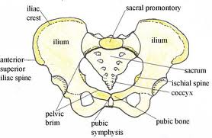

Slide 3
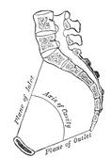

Slide 4
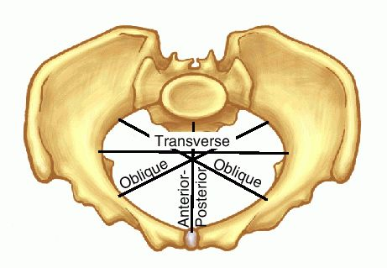
Pelvis | Diameter ( cm)
 | Anteroposterior | Transverse | Oblique
Pelvic inlet | 11 | 13 | 12
Pelvic cavity | 12 | 12 | 12
Pelvic Outlet | 13 | 11 | -

Slide 5
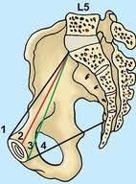

Slide 6
CEPHALO PELVIC DISPROPORTION and
CONTRACTED PELVIS

Slide 7

To define CPD and contracted pelvis.
To describe the causes and degree of CPD and contracted pelvis
To discuss the classification of contracted pelvis.
To explain the diagnosis of CPD and contracted pelvis
To enumerate the effects of contracted pelvis.
To describe the management of the CPD and contracted pelvis.
To enlist the complication of the CPD.

Slide 8
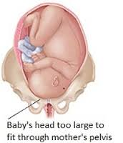
Cephalo Pelvic Disproportion

Slide 9
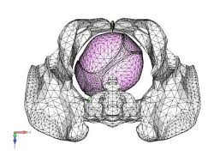
Definition
Cephalo pelvic disproportion is the disparity in relation between the head of baby and the mother’s pelvis.
It is a pelvis in which one or more of its diameter is reduced below the normal by one or more centimeter

Slide 10
Degree of disproportion
It is based on clinical findings and pelvimetry:-
Severe disproportion:- when the obstetric conjugate is less than 7.5 cm (3”) then it is said to be severe disproportion.
Borderline disproportion:- when the obstetric conjugate is between 9.5 and 10 cm. In inlet the anterior posterior diameter is less than 10 cm and transverse diameter is less than 12 cm.

Slide 11
Incidence
According to American College of Nursing Midwives, occur 20 out of 250 pregnancy.
“It has been seen through studies that 65% of women who have been diagnosed with CPD in previous pregnancies, deliver vaginally in subsequent pregnancies.”

Slide 12
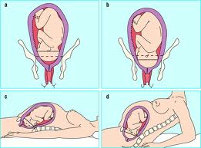
Causes
Nutritional deficiency
Disease / injury to pelvic bones
Developmental defects
A large size baby
Abnormal fetal position
Problem with genital tract

Slide 13
Classification of causes
Absolute causes:- it is a true mechanical obstruction due to:-
Permanent maternal cause such as contracted pelvis, anterior sacrococcygeal tumor.
Temporary fetal causes such as hydrocephalus, large baby etc.
Relative cause:- the relative cause includes brow presentation, face presentation, mento posterior, occipito posterior position, deflexed head in vertex presentation

Slide 14
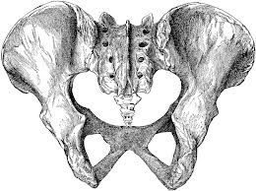
      CONTRACTED PELVIS

Slide 15
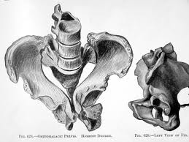
Definition
Anatomical - It is a pelvis in which one or more of its diameters is reduced below the normal by one or more centimeters.
Obstetric - It is a pelvis in which one or more of its diameters is reduced so that it interferes with the normal mechanism of labor.

Slide 16
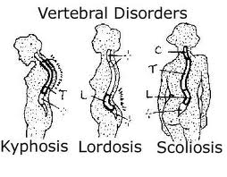
Etiology
Common causes of contracted pelvis are:-
Nutritional and environmental defects:-
minor variation;- common
major :- rachitic and osteomalacic –rare
Disease or injury affecting the bone of the pelvis:- fracture ,tumors, tubercular artheritis.
spine:- kyphosis, scoliosis, coccygeal deformity
lower limbs:- poliomyeitis, hip joint disease
Developmental defects:- naegele’s pelvis,
robert’s pelvis

Slide 17
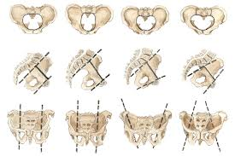
Classification
Classified by:-
A) type of distortion of pelvic architecture
B) degree of contraction

Slide 18
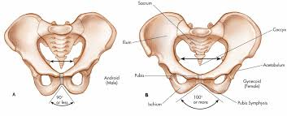
A) Classification by Pelvic Architecture
1. Pelvis aequabiliter justo minor
Characterized by general reduction of all diameters; equally shortened usually by 1-2cm
Occurs in short. Also occurs in women with massive skeletal bones and developed muscles, the pelvis has masculine features such as narrow sacrum, narrow pubic outlet {funnel-shaped)

Slide 19
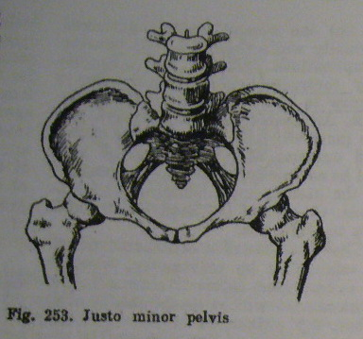

Slide 20
2. Flat Pelvis
reduced anteroposterior diameters with normal transverse and oblique diameters
Has 2 types of contracture
  a) Simple flat (or platypellic) pelvis
Entire sacral platform is dislocated toward the symphysis hence all the anteroposterior diameters of all pelvic planes are reduced

Slide 21
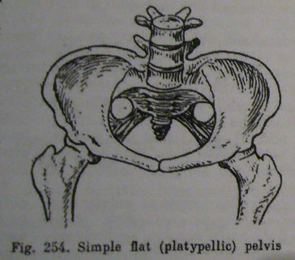

Slide 22
  b) Flat rachitic
Anteroposterior diameter of the pelvic inlet only is reduced
3. Generally Contracted Pelvis
All diameters reduced, but the anteroposterior diameters are shortened greater then the others
Usually connected with rickets of the childhood

Slide 23
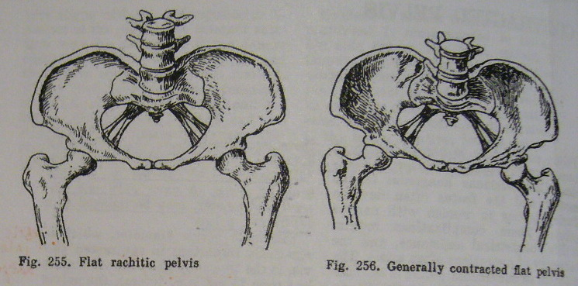

Slide 24
Rare forms of contracted pelvis
Otto’s pelvis – develop as result of inflammatory process in the hip or knee
Beaked (rostrate) pelvis – under development of both sacral wings
Spondylolithetic pelvis – formed due to partial dislocation of last lumbar vertebra in front of 1st sacral vertebra
Osteomalacic pelvis
Scoliotic pelvis – only the lumber region cause deformity of the pelvis. The acetabulum is pushed inwards on the weight bearing side.

Slide 25
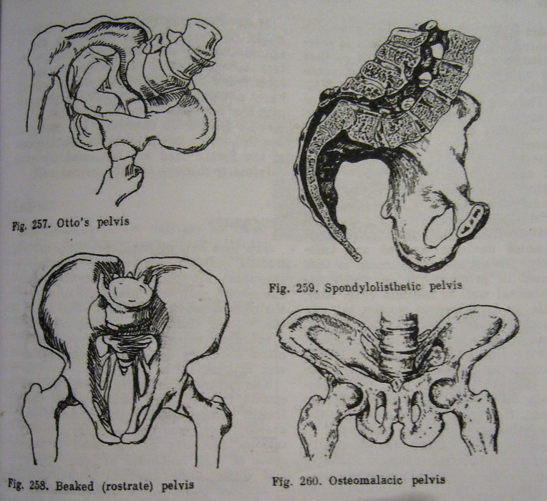

Slide 26
B) Classification by degree of contracture
4 degrees
First degree: true conjugate <11cm but not <9cm, spontaneous delivery is possible
Second degree: true conjugate = 9-7.5cm spontaneous delivery possible but complications may arise
Third degree: true conjugate 7.5-6cm spontaneous delivery impossible, use C-section
Fourth degree: true conjugate <6cm, impossible delivery, only way is C-section ; also known as absolutely contracted pelvis

Slide 27
Diagnosis
History
Rickets: is expected if there is a history of delayed walking and dentition.
Trauma or diseases: of the pelvis, spines or lower limbs.
Infantilism
Previous tuberculosis of bones and joints

Slide 28
Bad obstetric history: e.g. prolonged labour ended by;
  difficult forceps,
  caesarean section or
  still birth.
  Weight of the baby,
  Evidence of maternal injuries such as complete perineal tear, vesico vaginal istula, recto vaginal fistula

Slide 29
General examination
Abnormal gait :-
Assess woman for stockily built with bull neck.
Broad shoulder and short thigh
Obese and male distribution of hair
Stature :women < 150 cm or 5 feet

Slide 30
Abdomen examination
Pendulous abdomen in primigravida
fetal head fails to enter a contracted pelvis at the end of pregnancy and floats high above inlet, failed growth of uterus deviates upward and anteriorly
Non engagement in last 3-4 wks in primigravida

Slide 31
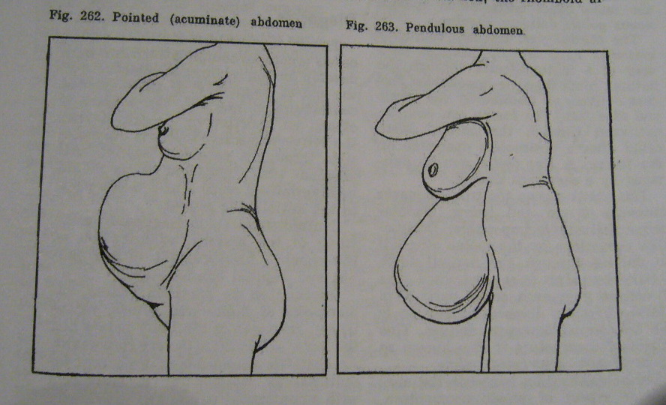
2 shapes of abdomen
Acuminate (pointed)abdomen in primigravida with a resilient abdominal wall
Pendulous abdomen in multiparous women

Slide 32
Abdominal method in CPD
Patient is placed in dorsal position with thigh flexes and separated.
The head is grasped by the left hand.
2 fingers (index and middle) of theright hand are placed above the symphysis pubis to note the degree of overlapping. If when the head is pushed downward and backward.

Slide 33
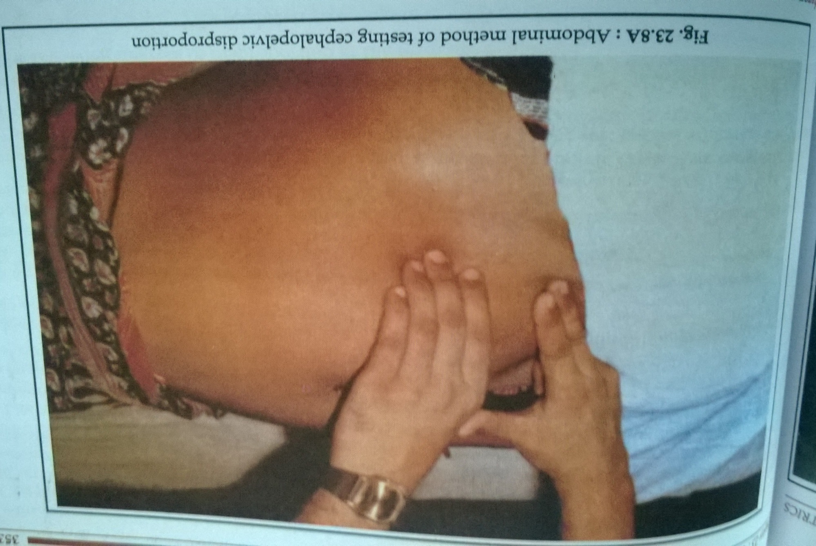

Slide 34
The head can be pushed down in the pelvis without overlapping of the parietal bone on the symphysis pubis:- no disproportion
Head can be pushed down a little but ther is slightly overlapping of the parietal bone evidence by touch on the under surface of finger overlapping by 0.5cm:- moderate disproportion

Slide 35
Head can not be pushed down and instead the partial bone overhangs the symphysis pubis displacing the finger – sever disproportion
Some times the degree of disproportion is difficult to found by this method because of:-
Deflexed head
Thick abdominal wall
Irritable uterus
High floating head

Slide 36
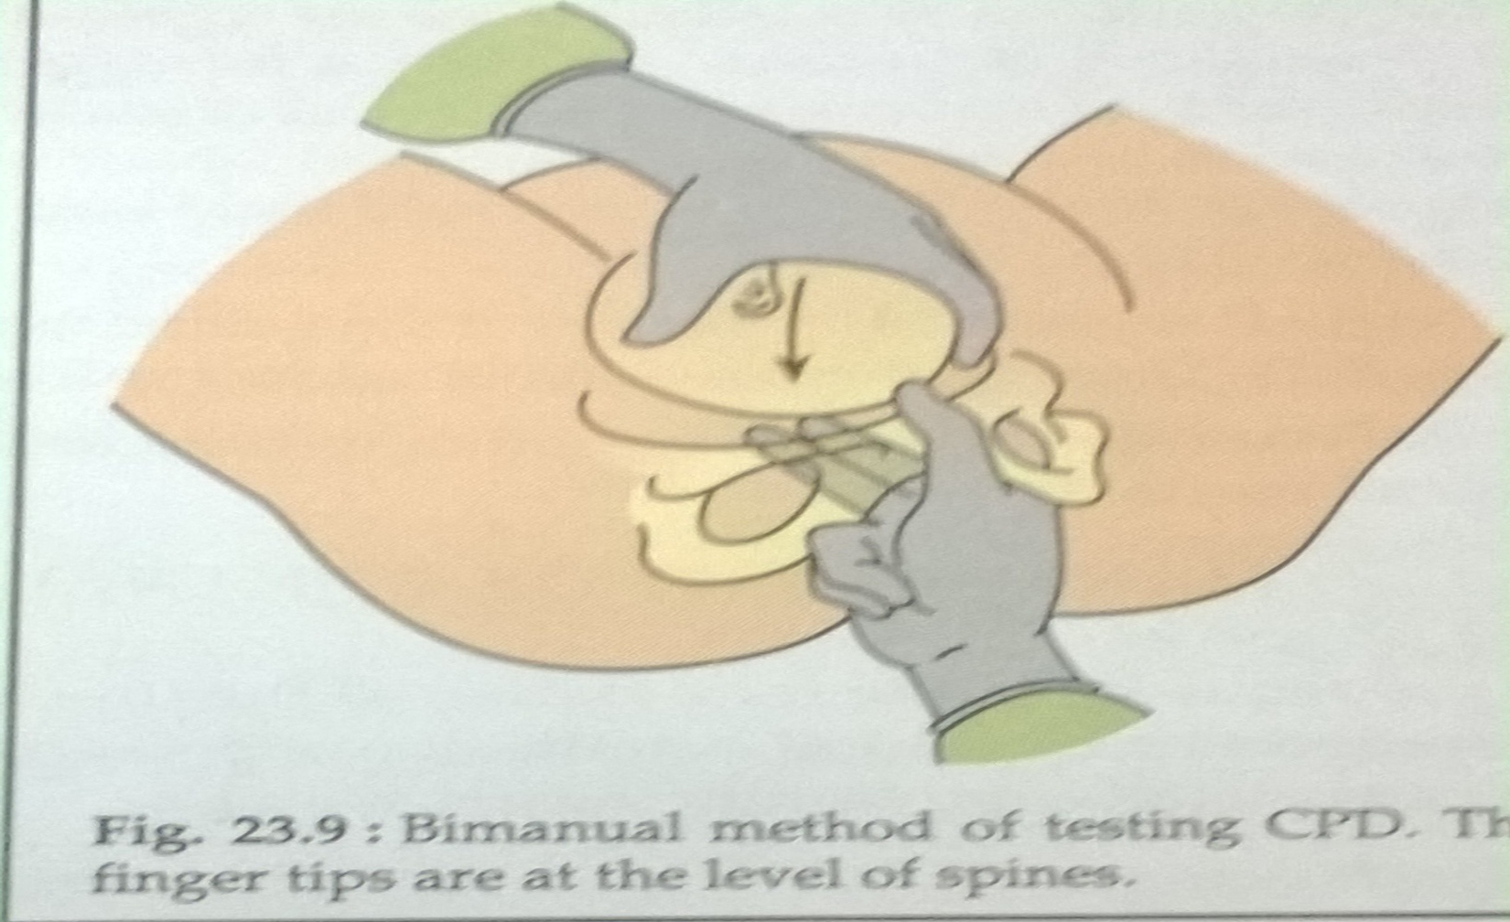
Abdominal – vaginal method
It is also called as MULLER – MUNRO KERR
It is bimanual method.

Slide 37
Results :-
the head can be pushed down up to the level of ischial spines and there is no overlapping of the parietal bone over the symphysis pubis:- no disproportion
The head can be pushed down a little but not up to the level of ischial spine and ther is slight overlapping of the parietal bone:- slight or moderate disproportion
The head can not be pushed down and instead the parietal bone overhangs the symphysis pubis displacing the thumb:- sever disproportion.

Slide 38
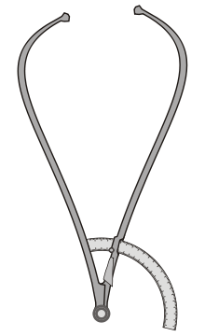
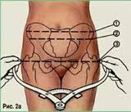
Pelvimetry
It is assessment of the pelvic diameters and capacity done at 38-39 weeks. It includes:
Clinical pelvimetry:
  Internal pelvimetry for:
    inlet,
    cavity, and
    outlet.
  External pelvimetry for:
    inlet and
    outlet.
Imaging pelvimetry:
  X-ray.
  Computerised tomography (CT).
  Magnetic resonance imaging (MRI) .

Slide 39
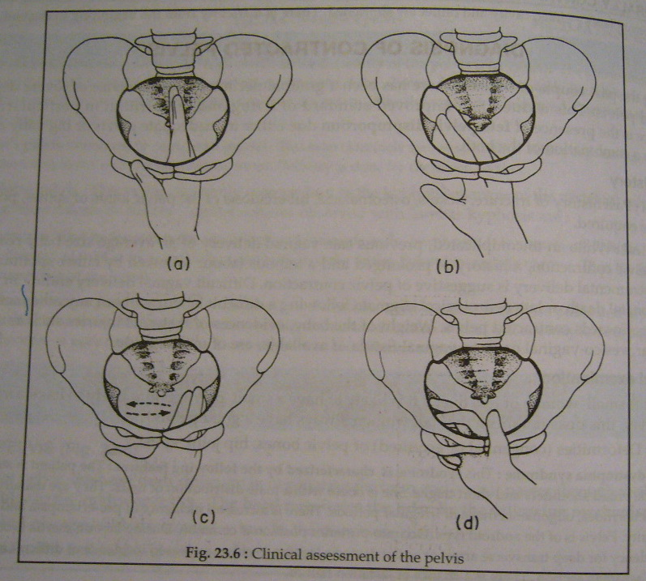

Slide 40
Effect of contracted pelvis

Slide 41
Management:-
disproportion
Moderate degree
Sever degree

Slide 42
Preterm labor
Term labor
Induction of labor
Cesarean section
Trial labor

Slide 43
Caesarean section
Elective cesarean section at term is indicated in:-
Major degree of contraction
Major disproportion
Absolute contraction
Dead fetus
Patient not fit for trial labor
The operation is done in planned way any time during last week of pregnancy.
Emergency:-
when trial labor is failed

Slide 44
Trial labor:-
It is the conduction of spontaneous labor in a moderate degree of disproportion, in an institution under supervision with watchful expectancy hoping for a vaginal delivery
or
Trial of labor is a test of labor allowing the patient to enter into active labor putting all variable
( power, passage and passenger) into test and determine whether vaginal delivery is possible or not.

Slide 45
Conduction of a trial of labor:-
Careful fetal and maternal monitoring by electronic fetal monitoring and non stress test
Oral feeding remain suspended and hydration is maintained by intravenous drip
Adequate analgesic is administered
Augmentation of labor by pitocin

Slide 46
The progress of labor is mapped with partograph:-
i) progressive descent of the head
ii) progressive dilatation of the cervix
After the membrane rupture, pelvic examination is to be done:-
i) to exclude cord prolapse
ii) to note the color of liquor
iii) to assess the pelvis once or more
iv) to note the condition of the cervix including pressure of the presenting part of the cervix

Slide 47
in favorable cases, end spontaneously, low forcep and low ventose.
In unfavorable cases, do caesarean section.
Successful trial:-
A trial is called successful, if a healthy baby is born vaginally, spontaneous or by forcep or ventose with the mother in good condition
Failure of trial labor:-
Delivery is by cesarean section or delivery of a dead baby spontaneously or by craniotomy is called failure of trial labor

Slide 48
Advantages of trial labor
Lower incidence of cesarean section.
A successful trial ensures the women a good future obstetrics.

Slide 49
disAdvantages of trial labor
May end before full cervix dilatation
Increased fetal mortality and morbidity
In failed trial operative risk increases.

Slide 50
Nursing management:-
Check vitals every 4 hourly
Monitor both contraction and fetus continuously
Report immediately the sign of fetal distress
Position the mother in ways to increase the pelvic diameter such as sitting or squatting which increase the outlet diameter and also aid in fetal descent
Assess the fetus for hypoxia
Provide support to the client and the family members in coping with stress of a complicated labor

Slide 51
Complications:-
First stage
Fetal distress
Prolonged labor

Slide 52
Second stage
Delayed second stage
Shoulder dystocia

Slide 53
Third stage
Retained placenta
Maternal injury
PPH

Slide 54
summary

