Slide 1

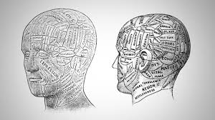



Presented By:
Rachana Joshi
Assistant Professor, Sumandeep Nursing College
SOCIAL BEHAVIOUR, INDIVIDUAL AND GROUP, GROUP AND INDIVIDUAL HUMAN RELATION IN CONTEXT OF NURSING

Slide 2

HUMAN RELATIONS

Slide 3

INTRODUCTION
Human relations are fundamental in a civil society & in each profession.
Nurses are one of the largest groups in health care workforce & are constantly interacting with patients, their relatives, colleagues as well as other members of the health care team inside & outside the health care organization.

Slide 4
DEFINITIONS OF HUMAN RELATIONS
Human relation is an area of
management practice which is concerned with the integration of people into a work situation in a way that motivate them to work productively, cooperatively & with economic, psychological & social satisfaction.
- Keith Davis

Slide 5
DEFINITION
Human relation is a study of
human behaviour at work and
efforts to better acting on
producing better goals.

Slide 6

MEANING OF HUMAN RELATIONS
Is a connection between people;
peoples behaviour towards
one another.

Slide 7
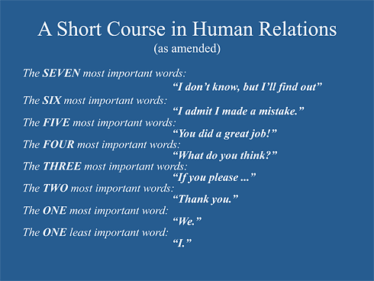

Slide 8
EFFECTIVE TOOLS OF HUMAN RELATIONS
1,A sound organizational structure
2. Adequate wages /salaries good working
3. Suitable and uniform policies
4. Training and education for all
5.Equal opportunity for advancement for all employees.
6. Two way communication between management and workers.

Slide 9
CONCEPTS OF HUMAN RELATION
MUTUAL INTEREST
INDIVIDUAL DIFFERENCES
MOTIVATION
HUMAN DIGNITY

Slide 10

STRATEGIES TO MAINTAIN AND PROMOTE HUMAN RELATION IN HOSPITALS
Promote honesty among individual.
Be frank Openness clears misunderstanding and restores good relations.
Help and respect all professionals of all departments when they visit other departments.

Slide 11
Treat the subordinates with dignity and respect.
Speak about own mistakes before criticizing others.
Prove to be a good leader and a manager.
Effective communication in a way improves human relation.

Slide 12

List of do and don’t in human relation
Don’t injure the dignity of the staff
in any manner
Set the target of their assignment of work, in consultation with them and
place your confidence and trust in them.
Allow staff to represent any current issues

Slide 13
THE FACTORS IMPROVING EFFECTIVENESS HUMAN RELATIONS
Using silence
Being specific and tentative
Using open ended questions
Using therapeutic touch
Restating and doing
Seeking clarifications

Slide 14
HUMAN RELATIONS IN HOSPITAL
The primary aim of hospitals is to provide patient care of the highest quality .
Is developed not from modern medical equipment and drug alone but from the work force, a group of well –rewarded and motivated medical, paramedical ,and skilled personnel.
Effective Patient care

Slide 15
Hospital….
A part of social system
Dealings with
Professionals – Nurses, doctors, technicians, paramedics
Other personnel – housekeeping, dietary, laundry, supplies, accounts…
Clients, relatives, friends visitors, other customers
All lead to public relations within the hospital

Slide 16
Public relations spring from human relations
Client – bundle of expectations, anxieties, hopes and fears
- Wants effective & satisfactory services
- Forms impressions of the hospital set up
Health workers – Have personal and professional needs
- Want job satisfaction & recognition of their efforts
Hospital administration – Wants efficiency and maximum satisfaction of staff and patients
The ultimate outcome depends on ‘Human Relations’

Slide 17
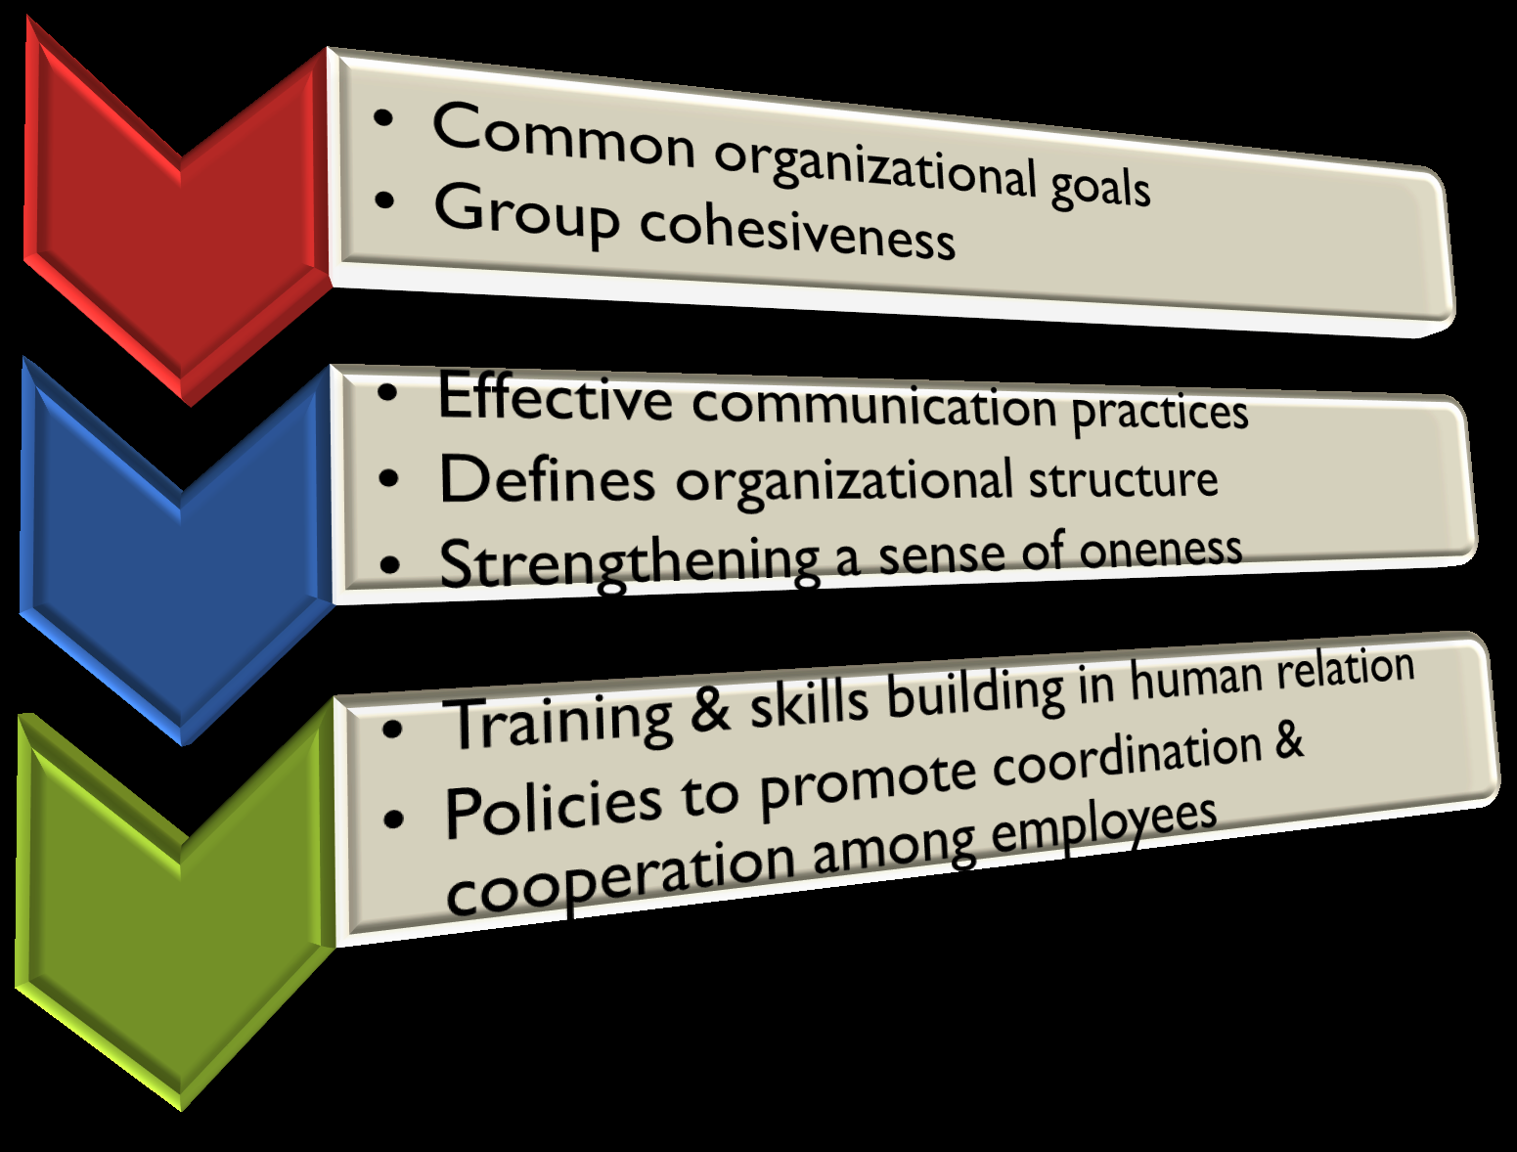
Strategies to promote cardinal human relations

Slide 18

HUMAN RELATIONS IN NURSING

Slide 19
PROFESSIONALS IN HEALTH TEAM
Nursing team
Physicians
Nutritionist
Physical therapist
Occupational therapist
Immunologist
Dietician
Social workers
Radiologist
Pharmacist
Lab technologist
Respiratory therapist
Spiritual advisors

Slide 20
HUMAN RELATIONS IN NURSING
Human relation in nursing refer to the relationship of nurses with colleagues & other department of personnel & with patient.
It is interdepartmental & interpersonal relationship to provide the quality care to their patients.
Human relations in nursing also develop when two health care personnel interact with each other to achieve the primary goal of maximum patient satisfaction & health promotion.

Slide 21
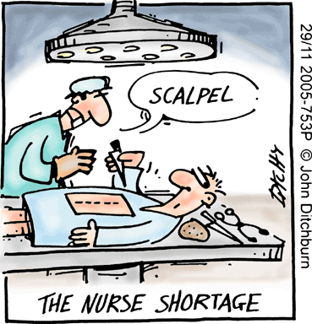
The nurse in the health team
Health team - A group of people who coordinate their particular skills in order to assist a client or his family, to achieve optimum health
The quality and quantity of personnel in the health team will depend upon the needs of the client
The nurse is an important member of the health team

Slide 22
Relationship of nurse with the members of health team

Slide 23


Nurse and the Physician
Have team spirit & co-worker relationship
Be loyal, honest and dependable
Carry out instructions intelligently
DO NOT take verbal orders.

Slide 24
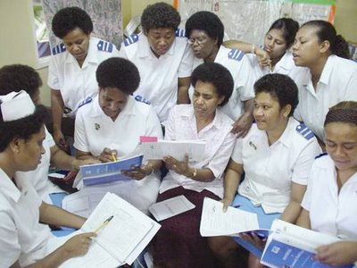
Nurse & Nursing superintendent
Respect & cooperate
Reporting punctually
Maintain courtesy when taking ward rounds
Take assistance for problem solving

Slide 25

Nurse and the Head nurse
Head Nurse is the team leader
Respect & support her
Cooperate intelligently
Reporting on duty and leaving off duty
Hand over & take over important issues

Slide 26
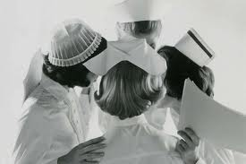
Nurse and fellow nurses
Treat seniors with respect
Maintain good team work/ spirit
Share information to achieve best care of the sick
Correctly hand over and take over patient concerning information

Slide 27

Nurse and other hospital personnel
Maintain good relationship with all departments
Maintain smooth coordination between patient unit and the departments

Slide 28

Nurse and the non professional workers
Be decent & considerate
Maintain good relationship
Provide guidance and teaching

Slide 29

Nurse and the Client
Treat as an individual
Understand and help
No discrimination.
Do not accept any gifts/ favors.
Help to adjust, cooperate and accept treatments
Create confidence.
Establish good N-Pt relationship. Call by name.. Be pleasant, cheerful and courteous
Do not get too familiar. Do not discuss personal affairs.

Slide 30

IMPORTANCE OF HUMANRELATION IN HEALTH CARE
IMPORTANCE OF HUMAN RELATIONS IN HEALTH CARE SETTING
> It facilitates effective and authoritative communication.
>To gain persons confidence and co. operation
>To reduce medical errors and
poor health outcome
>To improve quality patient care

Slide 31
HUMAN RELATION IN THE CONTEXT OF NURSING PRACTICE:
A WHO expert committee defined nursing as “the conscious practice of human relationships”. This definition itself signifies the importance of human relation in the nursing practice.
The relationships like nurse-patient relationship, nurse-family relationship, nurse-community relationship and nurse –health team relationship are based in human relationships.
Nursing is regarded as the most caring one among health care profession.

Slide 32

LIMITATIONS
LIMITATION:
These kinds of human relations if maintained professionally helps to solve the problems of patient but
all the time it is not possible for the nurse to solve his/her problems due to professional limitations

Slide 33
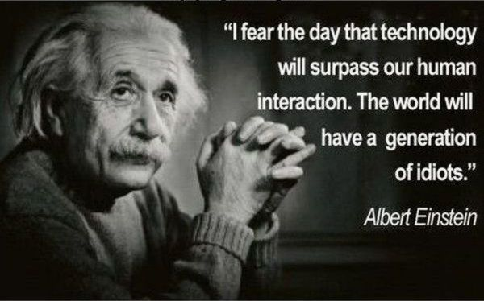

Slide 34
SOCIAL BEHAVIOUR
The interaction that takes between members of the same species or the behavior directed towards the society is known as social behavior.
In a sociological hierarchy, social behavior is followed by social actions, is directed at other people & designed to provoke a response.
Antisocial behavior refers to behavior that may cause harm to the society.

Slide 35
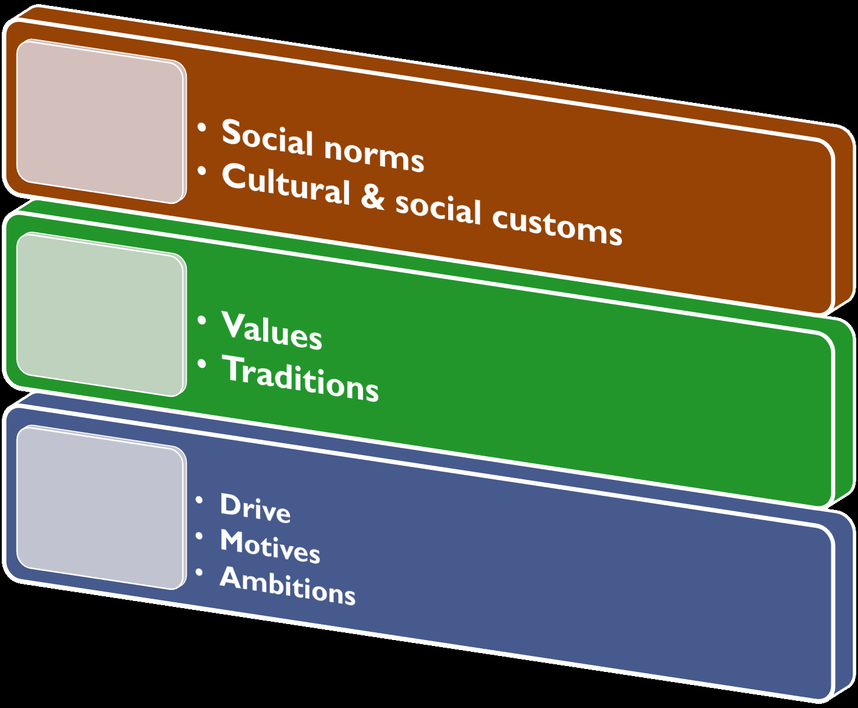
Factors influencing social behavior

Slide 36
INDIVIDUAL AND GROUPS
An individual is a single unit in a group &
a group is a collection of many individuals with a common purpose.
Individuals & groups are reciprocal to each other because without individuals groups cannot be formed & individuals have no existence or cannot meet their physical, psychological, social & spiritual needs without groups of other individuals.

Slide 37
Definition of group
A social group is a aggregate of people, playing inter-related roles & recognized by themselves or others as a unit of interaction.

Slide 38
Characteristics of a group
Each group has its own identity & structure.
A group includes at least two or more people.
Group members have a shared purpose or goal.
Group members have a conscious identification with each other.
Group members need each other’s help to accomplish the purposes for which they have organize.
Group members influence, interact with each other.
Every group has its own rules & norms members are supposed to follow.

Slide 39

Tasks or roles of an individual in a group
Initiator
Information seeker
Information giver
Opinion seeker
Elaborator
Coordinator
Orienteer
Evaluator
Energizer
Procedural technician
Recorder
Group-building
maintenance roles

Slide 40
GROUP DYNAMICS
Group dynamics is the study of groups & also a general term for a group process.
Group dynamics is the study of activities or processes that are responsible for various group phenomena.

Slide 41
Stages of group development
1. Forming phase
Stages of group formation
2. Storming phase
3. Norming phase
4. Performing phase

Slide 42

Principles/strategies to build a successful team
Clear expectations
Commitment
Competence
Control Communication
Collaboration
Coordinator

Slide 43
Questions:
What you mean by Human relations? &
How can you develop a good relations with others?

Slide 44
Is Human relation is important in Hospital setting?

Slide 45
How can a Nurse develop a good relation ship with client/patient

Slide 46
State the Roles of individual in a group?

Slide 47

ASSIGNMENT
Identify different strategies that can promote human relations in our hospital
(Submit on 10-7-2014)

Slide 48



