Slide 1



SUBJECT: EDUCATION IN NURSING
TOPIC: EXHIBITION

Slide 2
Teaching Method:
“Teaching method is the stimulation, guidance, direction and encouragement for learning”
- Burton

Slide 3
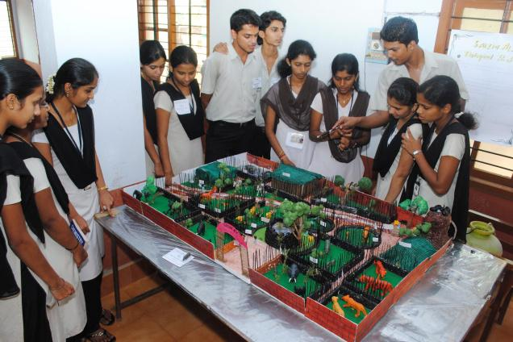
Exhibition journey will be:
Introduction
Definition
Types
Purposes
Requisites
Advantages
Conclusions

Slide 4
What is Exhibition?..
Synonyms:
Display, Showing, Presentation, Demonstration, Showcase.
In Hindi -प्रदर्शन करना
“An Exhibition is a public display of works of art or items of interest, held in an art gallery or museum or at a trade fair
A display or demonstration of a skill.”

Slide 5
Exhibitions: an effective method of teaching
Educational ideas and practices change over time.
Method of imparting education has been undergoing various changes.
Though there are many ways to impart quality education to students, one of the important effective ways is to hold exhibitions in their subjects.
Exhibitions provide students with the skill and attitude to locate, define and analyses problems in their subject.

Slide 6
INTRODUCTION
Exhibition = collection of items
"exhibit“ = a single item being exhibited within an exhibition.
Exhibition can work as an excellent teaching aids.
Exhibitions may be permanent displays or temporary.
Exhibitions usually occur within museums, galleries and exhibition halls.

Slide 7
Cont..
many exhibitions are shown in just one venue.
some exhibitions are shown in multiple locations and are called travelling exhibitions, and some are online exhibitions.

Slide 8

DEFINITION
AN EXHIBITION IS AN ORGANIZED PRESENTATION AND DISPLAY OF A SELECTION OF ITEMS.

Slide 9
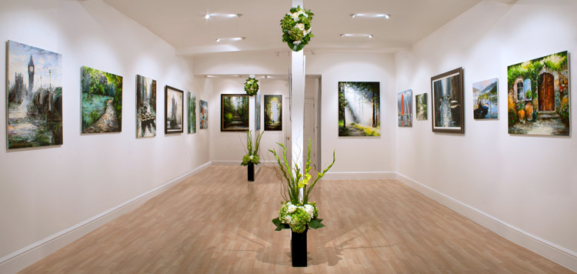
TYPES
OF
EXHIBITION

Slide 10
Video of Exhibition

Slide 11

ART EXHIBITION
Art exhibitions include an array of artifacts like paintings, drawings, crafts, video installations, sound installations, performances, interactive art.
Art exhibitions may focus on one artist, one group, one category, one theme or one collection.
Organized by conservator, selected by juries.

Slide 12
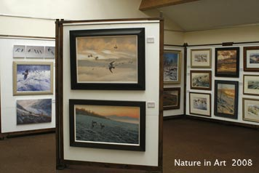
ART EXHIBITIONS

Slide 13
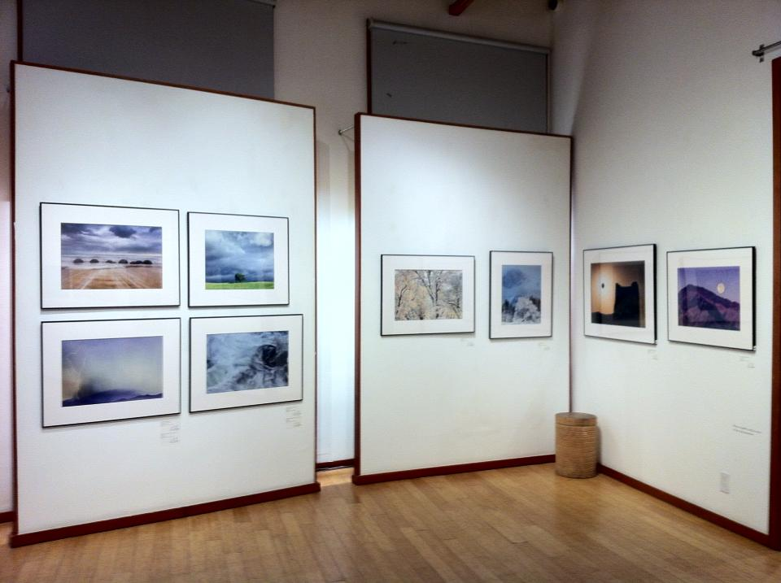

THANK YOU

Slide 14

INTERPRETIVE EXHIBITION
Interpretive exhibitions are exhibitions that require more context to explain the items being displayed.
Interpretive graphics cover a wide range including anthropology, ethnology, history, science, technology and natural history.

Slide 15
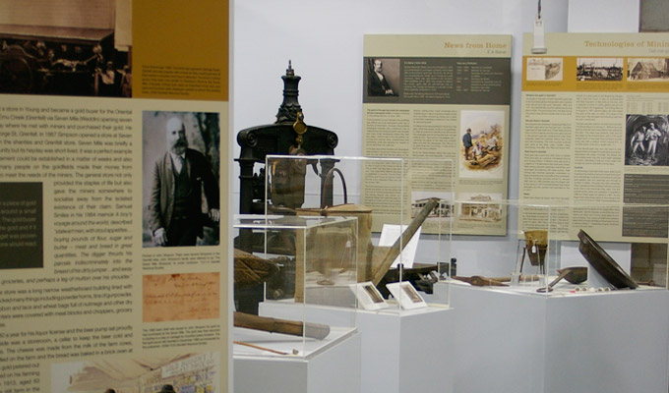
Cont..
Interpretive exhibitions generally require more text and more graphics than fine art exhibitions do.
Examples of such exhibitions may be found at the Natural History Museum, the American Museum of Natural History and the Field Museum

Slide 16



Slide 17

COMMERCIAL EXHIBITION
Commercial exhibitions, generally called trade fairs, trade shows. Through this exhibition organizations or industry can showcase and demonstrate their latest products, service, study activities of rivals and examine recent trends and opportunities.
Some trade fairs are open to the public, while others can only be attended by company representatives (members of the trade) and members of the press.

Slide 18



Slide 19


Slide 20
PURPOSES
This is effective when initiated and carried to a conclusion by students they can improve their own creative and development thinking.
Study also may be used to summarize the work of a unit or course that has been attained over a period of days.
Exhibits may be used to introduce students to a new unit of work.

Slide 21
REQUISITES FOR EXIHIBITION
The exhibition should have a central theme.
The exhibits should be clean and labeled properly.
The exhibits should be placed so that most visitors can see them.

Slide 22
To capture interest and attention of visitors, both motion and sound should be utilized.
The exhibition must include a lot of demonstrations as they involve deeply the students and the visitors both.
The exhibition should be able to relate varies subjects areas to provide integrated learning.

Slide 23
MILESTONES IN EXHIBITION PLANNING
      Before you start
Time is the Key
Get an idea of the idea!
Some words about the theme
Back to the Time Key
Some words about money
Other things to talk about: -
Writing - designing - guiding - venues - helpful resources

Slide 24
ADVANTAGES OF EXHIBITION
Exhibition inspire the students to learn by doing things themselves and they get a sense of involvement.
Exhibitions give students a sense of achievement.
Exhibition develops social skills of communication, co-operative and co-ordination
Exhibitions foster better school- community relations and make community members conscious about the school.

Slide 25
Cont..
Exhibition foster creativity among students.
Through exhibitions, students strive to achieve specialized knowledge and aim to consider learning as an adventure.
Exhibitions help students develop their abilities in imagination and train them to focus on facts and figures in a manner that will attract the attention of viewers.

Slide 26
Cont…
Ideas that cannot be revealed effectively can be best presented through exhibitions.
Team spirit- They stimulate team spirit among students.
Tabulation in exhibitions makes many aspects clear for visitors to understand.
The most important sayings and messages relating to a subject can be effectively presented in exhibitions.

Slide 27
Now, try to answer this question

Slide 28
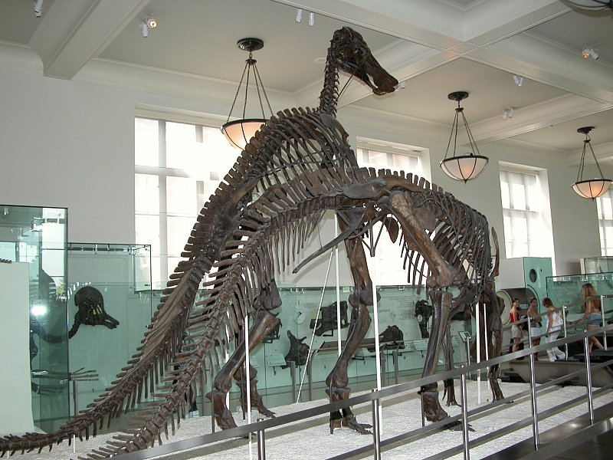


Slide 29


Slide 30
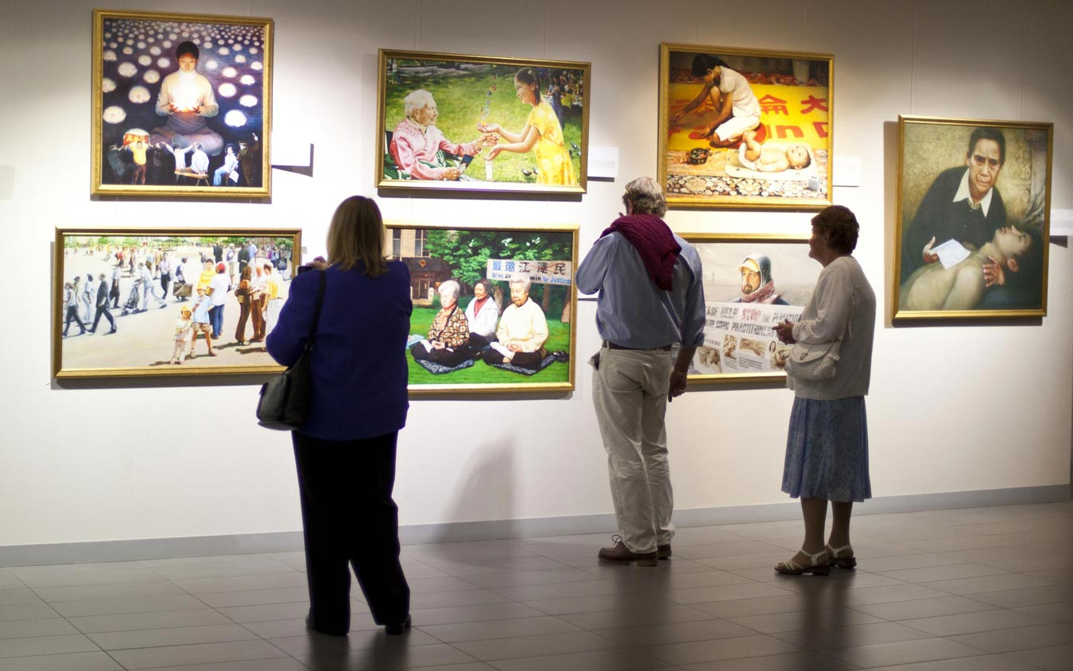

Slide 31
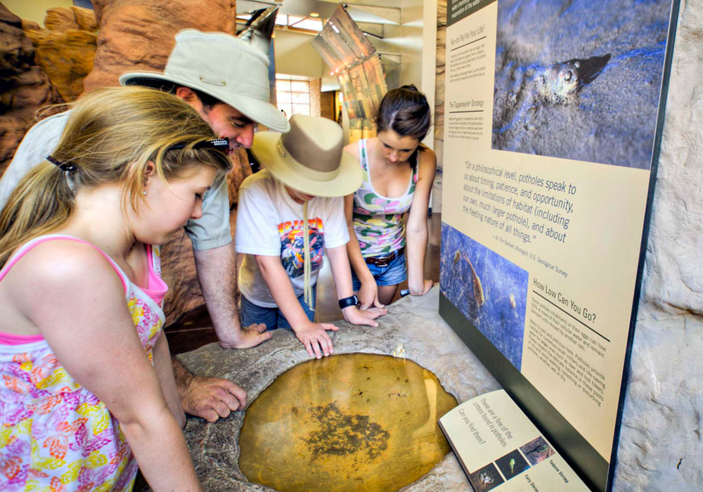

Slide 32
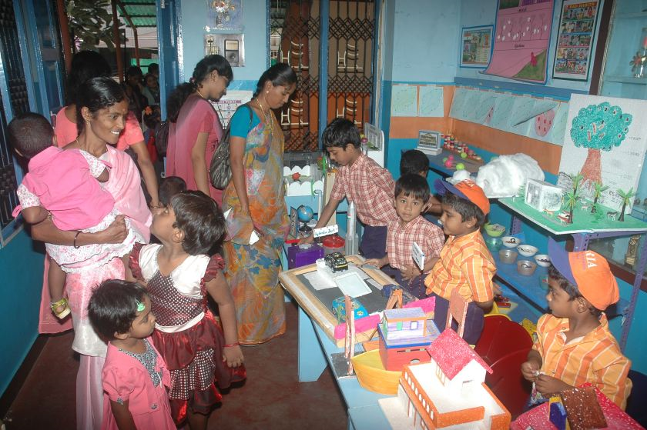
Certain points should be kept in mind while organizing an exhibition in school or college:
The exhibits should be prepared by the students themselves using readily available and low-cost materials.
Funds for exhibition are a problem, this can be overcome by raising contributions.

Slide 33
Cont…
The school can make use of classrooms, corridors for laying out the exhibits.
All kinds of audiovisual materials relevant to theme of the exhibition must be displayed.
It should be based on educational objectives.
Exhibits should be capable of communicating massage.

Slide 34
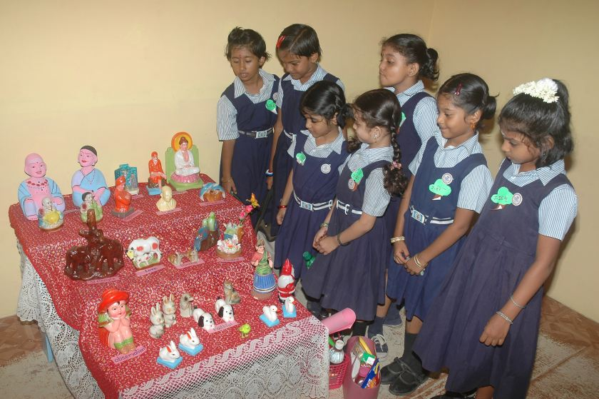
School Exhibition

Slide 35


Conclusion:
While planning an exhibition, you will learn a lot about your theme and the context. You will get in contact with experts from all over the world. You will have to show your creativeness in writing and designing.
Exhibition planning is pretty intense, but with a good project management from the very beginning, you will produce an awesome event and a remarkable experience for your visitors.
Remember to define your boundaries!

Slide 36
Let us join hands to plan an effective Exhibition program
Thank You
Any questions please?

Slide 37


ASSIGNMENT
Write the different types of exhibition &
How Exhibition in teaching can be helpful ?..... (in your words)

