Slide 1

NATIONAL POPULATION POLICY
Mr. Swamy PGN
Asst. Professor
SNC

Slide 2
National Health Policy
Mission is what an organization does
Vision is what an organization would like to happen as a result of the action that it does.
Mission equals the action; vision is the ultimate result of the action
Policy
Principle or rule to guide decisions and achieve rational outcome(s).
"Statement of Intent" or a "Commitment Set of Values
Assessment of current situation Image of a desired future situation.

Slide 3
Policy - A document describing…….
General Statement of understanding which guide decision making.
Set of Ideas or Plans that is used as a basis for decision making;
Attitude and actions of an organization regarding a particular issue;
It is more than mere statement of goals:
How the stated goals can be achieved?
Who will carry out the tasks?
In what manner?

Slide 4
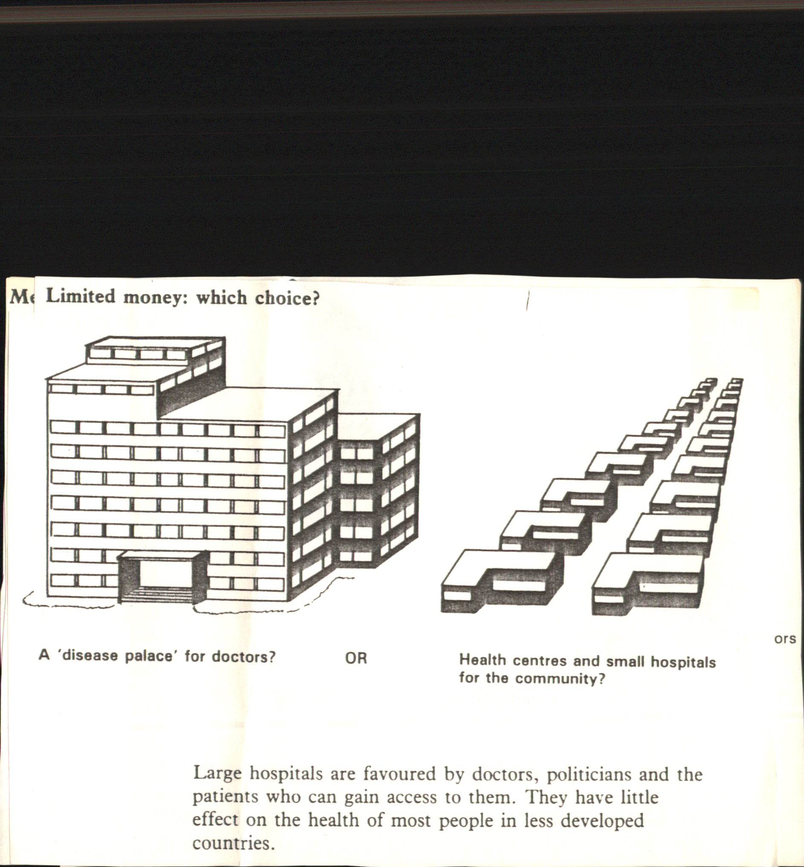

Slide 5
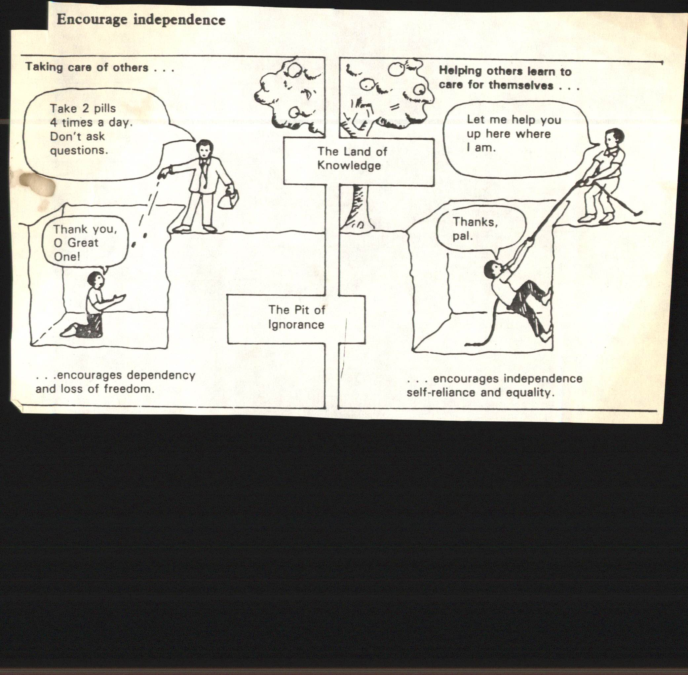

Slide 6
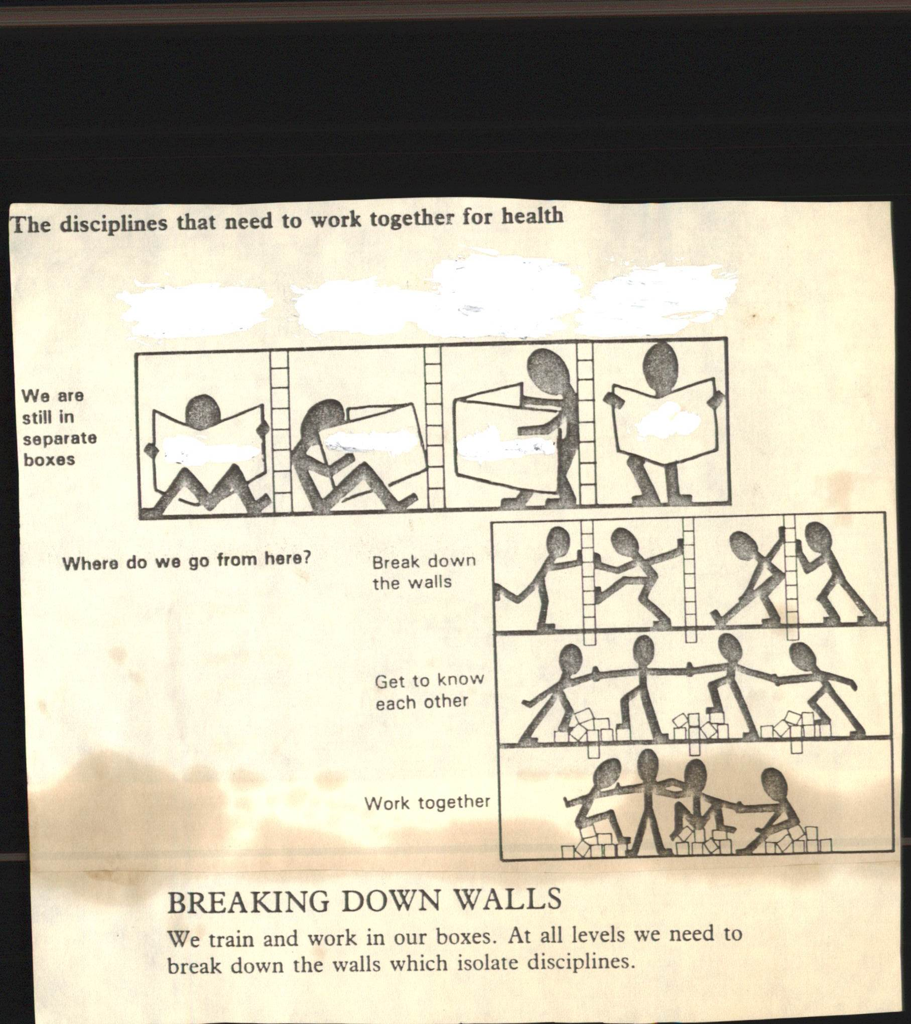

Slide 7
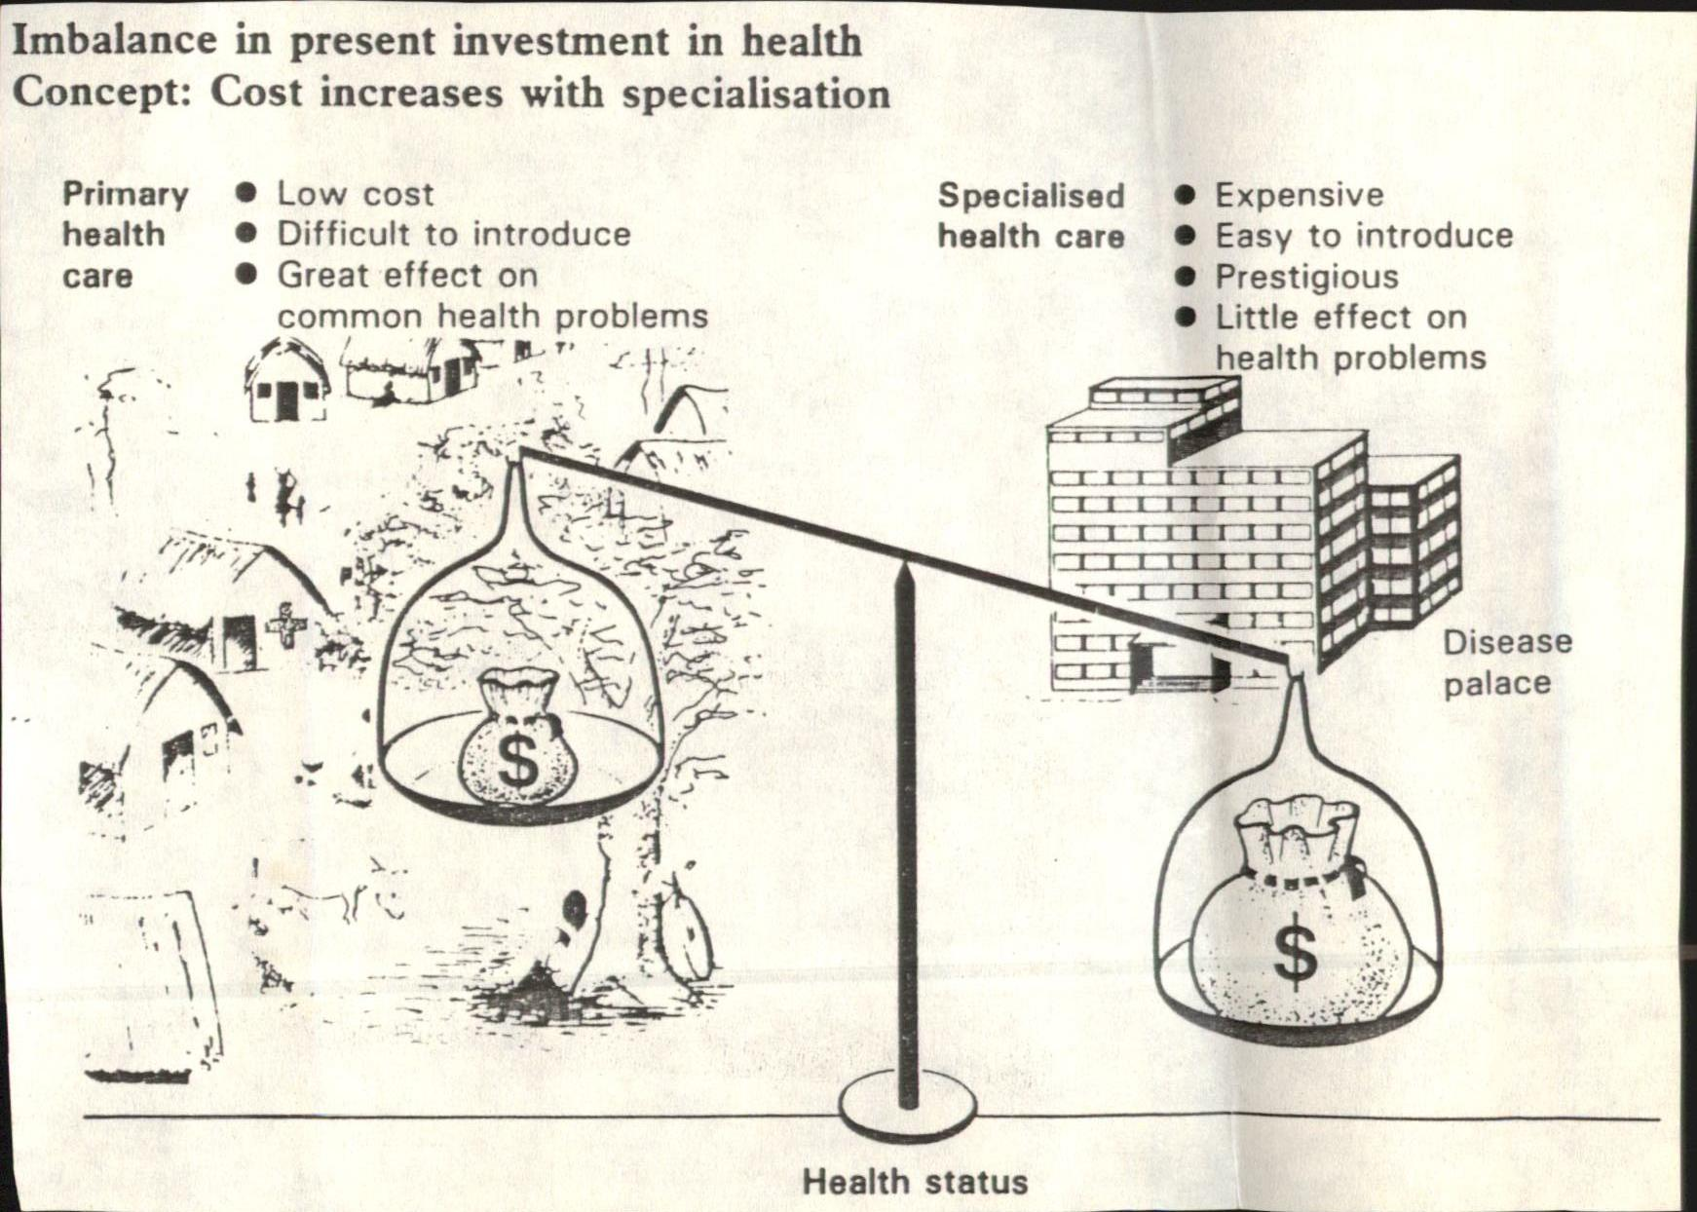

Slide 8
National Health Policy - Background
No specific health policy document 1948 to 1983
Fragmented approach
Joseph Bhore (1946) - Health Survey and Development Committee Foundation for Primary Health Care
Community Development Blocks-(1952)
Health policy through five year planning and Health Committees
Programme based approach and elaborate bearocracy

Slide 9
The Development Paradigm
Constitution- Welfare state based on equality, freedom, Justice and dignity of the individual
“Socialist” pattern of development
Limited entitlements approach
Support to private capital growth
The rural—urban planning divide
CDP and rural development
Social sectors neglected
Persistence of poverty

Slide 10
National Health Policy - Need
First National Health Policy in 1983 - 36 years after independence- Why?
30th World Health Assembly in May 1977 resolved- “Health for All by 2000 AD)
A joint WHO - UNICEF International Conference in 1978 at Alma Ata (USSR)- Called on all national governments to formulate health policies
Health for all by 2000 AD and “Primary Health Care as a way to achieve goal

Slide 11
National Health Policy - Need
In spite of progress, demographic and health picture of the country was cause of concern
Population explosion
High Mortality
Malnutrition
High prevalence of communicable diseases
Thorough overhaul of existing approaches required

Slide 12
National Health Policy – Areas of concern
Population stabilization
Medical and Health Education
Primary Health Care
Reorientation of existing health personel
Indigenous system of medicine
Management Information System
Medical Industry
Medical research
Inter-sectoral coordination
Health Insurance
Review of progress

Slide 13
National Health Policy – Focal Areas
Nutrition
Prevention of food adultaeraion and quality of drugs
Water supply and sanitation
Environmental protection
Immunization programme
Maternal and child health services
School health programme
Occupational health services

Slide 14
Strategies and Approaches
Right to Health and Healthcare
Awareness Raising and Participation of Civil Society Groups
Organizing and Educating Medical Profession
Healthcare as part of Social Security
Universal Access to Healthcare
New Public Management Systems and Governance Structures
Innovations in Health Financing
Notes:
Strategies and Approaches
An organised and universal healthcare system is possible only under a rights perspective. Right to health and healthcare is a fundamental social and economic right recognised by the International Covenant. But such a demand is not on the political agenda in India. The Peoples’ Health Assembly initiative (called Jan Swastya Abhiyan in India) has voiced such a demand but this requires a widespread awareness campaign and participation of many more civil society groups.
On the other end of the spectrum the medical profession needs to be educated not only about self-regulation and the need to organise for minimum standards for quality healthcare but also about the benefits of an organised public-private mix healthcare system.
Only such an approach can lead us closer towards a system that guarantees universal access. Healthcare will have to be viewed in the context of social security. The latter becomes even more urgent under the changing political economy. To support this new public management systems and innovations in health financing to raise additional resources will be needed.

Slide 15
Objectives:
Achieving an acceptable standard of good health of Indian population
Decentralizing public health system by upgrading infrastructure in existing institutions
Ensuring more equitable access to health services across the social and geographical expanse of India
Notes:
Strategies and Approaches
An organised and universal healthcare system is possible only under a rights perspective. Right to health and healthcare is a fundamental social and economic right recognised by the International Covenant. But such a demand is not on the political agenda in India. The Peoples’ Health Assembly initiative (called Jan Swastya Abhiyan in India) has voiced such a demand but this requires a widespread awareness campaign and participation of many more civil society groups.
On the other end of the spectrum the medical profession needs to be educated not only about self-regulation and the need to organise for minimum standards for quality healthcare but also about the benefits of an organised public-private mix healthcare system.
Only such an approach can lead us closer towards a system that guarantees universal access. Healthcare will have to be viewed in the context of social security. The latter becomes even more urgent under the changing political economy. To support this new public management systems and innovations in health financing to raise additional resources will be needed.

Slide 16
CONT….
Enhancing contribution of private sector in providing health service for people who can afford to pay
Giving priority for prevention and first line curative initiative
Rational use of drugs
Increasing access to tried system of traditional medicine
Notes:
Strategies and Approaches
An organised and universal healthcare system is possible only under a rights perspective. Right to health and healthcare is a fundamental social and economic right recognised by the International Covenant. But such a demand is not on the political agenda in India. The Peoples’ Health Assembly initiative (called Jan Swastya Abhiyan in India) has voiced such a demand but this requires a widespread awareness campaign and participation of many more civil society groups.
On the other end of the spectrum the medical profession needs to be educated not only about self-regulation and the need to organise for minimum standards for quality healthcare but also about the benefits of an organised public-private mix healthcare system.
Only such an approach can lead us closer towards a system that guarantees universal access. Healthcare will have to be viewed in the context of social security. The latter becomes even more urgent under the changing political economy. To support this new public management systems and innovations in health financing to raise additional resources will be needed.

Slide 17
NHP-2002 Policy Prescription
Financial resource
Increase in health sector expenditure to 6% of GDP, with 2% by public health investment by 2010
Existing 15% of central government contribution is to be raised to 25% by 2010
Per capita expenditure from Rs.200 to Rs.2000
Attainment of health indices has been very uneven across rural-urban divide
Equity -an increased allocation of 55% total public health investment for the primary health sector, 35% for secondary sector and 10% for tertiary sector.
Notes:
Strategies and Approaches
An organised and universal healthcare system is possible only under a rights perspective. Right to health and healthcare is a fundamental social and economic right recognised by the International Covenant. But such a demand is not on the political agenda in India. The Peoples’ Health Assembly initiative (called Jan Swastya Abhiyan in India) has voiced such a demand but this requires a widespread awareness campaign and participation of many more civil society groups.
On the other end of the spectrum the medical profession needs to be educated not only about self-regulation and the need to organise for minimum standards for quality healthcare but also about the benefits of an organised public-private mix healthcare system.
Only such an approach can lead us closer towards a system that guarantees universal access. Healthcare will have to be viewed in the context of social security. The latter becomes even more urgent under the changing political economy. To support this new public management systems and innovations in health financing to raise additional resources will be needed.

Slide 18
NHP-2002 Policy Prescription
Public health projects suited to the local situation.
The policy recognizes the need for more frequent in - service training.
NHP 2002 noted that improvement of public health indices is linked with quantum and quality of investment through public funding in public health sector
Notes:
Strategies and Approaches
An organised and universal healthcare system is possible only under a rights perspective. Right to health and healthcare is a fundamental social and economic right recognised by the International Covenant. But such a demand is not on the political agenda in India. The Peoples’ Health Assembly initiative (called Jan Swastya Abhiyan in India) has voiced such a demand but this requires a widespread awareness campaign and participation of many more civil society groups.
On the other end of the spectrum the medical profession needs to be educated not only about self-regulation and the need to organise for minimum standards for quality healthcare but also about the benefits of an organised public-private mix healthcare system.
Only such an approach can lead us closer towards a system that guarantees universal access. Healthcare will have to be viewed in the context of social security. The latter becomes even more urgent under the changing political economy. To support this new public management systems and innovations in health financing to raise additional resources will be needed.

Slide 19
S.no | goals to be achieved by 2015 | Year
1 | Eradicate Polio and Yaws | 2005
2 | Eliminate Leprosy | 2005
3 | Eliminate Kala-azar Eliminate Lymphatic Filariasis | 2010 2015
4 | Achieve zero level growth of HIV / AIDS | 2007
5 | Reduce mortality by 50% on account of TB | 2010

Slide 20
S.no | goals to be achieved by 2015 | Year
6 | Malaria and other vector and water borne diseases | 2010
7 | Reduce prevalence of blindness to 0.5% | 2010
8 | Reduce IMR to 30/100 And MMR to 100/Lakh | 2010
9 | Increase utilization of public health facilities from current level of < 20% to > 75% | 2005

Slide 21
S.no | goals to be achieved by 2015 | Year
10 | Establish an integrated system of surveillance, National Health Accounts and Health Statistics. | 2010
11 | Increase health expenditure by Government as a % of GDP from the existing 0.9% to 2.0% | 2010

Slide 22
National Health Policy –
Critical Review
Large gap -1983 to 2002
Health is a state subject as per our Constitution. Policy foisted upon us by bureaucrats sitting in Nirman Bhavan.

Slide 23
NATIONAL POPULATION POLICY

Slide 24
INTRODUCTION:-
Population policy in general refers to policies intended to decrease the birth rate or growth rate. Statement of goals, objectives and targets are inherent in the policy.

Slide 25
In April 1976 India formed its first-
National Population Policy.” It called for
an in increase in the legal minimum age of marriage from 15 to 18 in female and from 18 to 21 in male. However, for the most part, the 1976 statement became irrelevant and the policy was modified in 1977.

Slide 26
The national health policy of 1983 emphasized the need for securing the small family norm and moving towards the goal of population stabilization and changed the programme title to “Family Welfare Programme.” The national health policy approved by the parliament in 1983 and set the long term demographic goals of achieving a Net Reproduction Rate (NRR) of one by the year 2000. (Which was not achieved.)

Slide 27
In ’93-’94 a draft of NPP was prepared by an expert group headed by Dr. M. S. Swaminathan. It was approved by the cabinet directed to place the document before the parliament. However it could not be placed because of political reason.

Slide 28
In 1998 another draft of NPP was finalized after consultation. It was approved by the cabinet by group of Ministers headed by Deputy Chairman Planning Commission.
The group of consultants experts from among academics, public health professionals, demographers, social scientist and women representatives.
It was adopted by the Govt. of India on 15th February, 2000.

Slide 29
National Population Policy 2000” is the latest in this series. It reaffirms the commitment of the government towards target free approach in administering family planning services.

Slide 30
The new NPP 2000 deals with-
Women education, empowering for improved health and nutrition;
child survival and health;
unmet needs for family welfare services;
health care for under-served population groups like urban slums, tribal community, hill area population and displaced and migrant population;
adolescent’s health and education;
collaboration with NGOs.

Slide 31
DIMENSIONS OF POPULATION PROBLEM:-
Population problem has three dimensions:-
The number of people versus limited amount of material resources.
People versus cultural resources.
Society’s ability to satisfy man’s total needs, physical mental and social.

Slide 32
EFFECTS OF OVER POPULATION:-
Effect of country-low standard of living, unemployment & overcrowding.
Effect on family – demands of food, clothing and educations will not be satisfied and thus leads to less happiness and insecurity.
Effect on the Mother- general health gets impaired with increased number of pregnancies.
Effect on Child – If pregnancies occur too frequently in a family, the child gets very little attention, malnutrition.

Slide 33
OBJECTIVES OF NPP – 2000:-
1.The immediate objectives of the NPP 2000 are :-
  To address the unmet needs for contraception, health care infrastructures, and health personnel.
  To provide integrated service delivery for basic reproductive and child health care.

Slide 34
2.The medium term objectives is :-
To bring the Total Fertility Rate to replacement levels by 2010, through vigorous implementation of intersectoral operational strategies.

Slide 35
The long term objectives is :-
To achievement a stable population by 2045, at a level consistent with the requirements of sustainable socio economic growth and developments and environment protection programme,.

Slide 36
NATIONAL SOCIO-DEMOGRAPHIC GOALS FOR 2010:-
  1.Address the unmet needs for basic reproductive and child health services, supplies and infrastructure.
  2.Make school education up to age of 14 free and compulsory, and reduce drop outs at Primary and secondary levels to bellows 20 percent for both boys and girls

Slide 37
Continue….
  3.Reduce infant mortality rate to below 30 per 1000 live births.
  4.Reduce maternal mortality ratio to below 100 per 100,000 live births.
  5.Achieves universal immunization of children against all vaccine preventable diseases.
  6. Promote delayed marriages of girls, not earlier than age 18 and preferably after 20 years of age.

Slide 38
Continue…
  7. Achieve 80% Institutional deliveries and 100% deliveries by trained person.
  8. Achieve universal access to IEC services for fertility regulation and contraception
  9. Achieve 100% registration of birth, death, marriage and pregnancy.
  10.Integration between the management of reproductive tract infections and sexually transmitted infections and the National AIDS Control Organization.

Slide 39
Continue….
  11. Prevent and control communicable disease.
  12. Integrate Indian System of medicine in the prevision of RCH services
  13. Promote the small family norm to achieve replacements level of TFR.
  14. Implementation of related social sector programs so that the family welfare becomes a people centered.

Slide 40
STRATEGIC THEMES : -
1. Decentralized planning and programme implementation.
2. Convergence of service delivery at village
levels.
3. Empowering women for improved health and
nutrition.
4. Child survival and child health.

Slide 41
Continue….
5. Meeting the unmet needs for family welfare services.
6. Under served populations groups like urban slums, tribal communities, hill area population, displaced and migrant populations and adolescents with increased participation of men in Planned Parenthood.
7. Diverse health care providers.
8. Collaboration with and commitments from non-government organizations and the private sector.

Slide 42
Continue….
9. Mainstream Indian System of Medicine and Homeopathy.
10.Contraceptive technology and research on reproductive and child
health.
11.Providing for the older population.
12.Information, Education and Communication.

Slide 43
PROMOTIONAL AND MOTIVATIONAL MEASURES:-
Panchayats and Zila parishads will be awarded and honoured for exemplary performance in universalizing the small family norm, achieving reductions in infant mortality and birth rates and promoting literacy with completion of primary schooling.

Slide 44
Continue….
Balika Samridhi Yojana run by the Department of Women and Child Development, to promote survival and care of the girl child, will continue. A cash incentive of Rs. 500 is awarded at the birth of the girls child of birth order 1 or 2.
Maternity Benefit Scheme run by the Department of Rural Development will continue. A cash incentive of Rs. 500 is awarded to mothers who have their First child after 19 years of age, for birth of first and second child only.

Slide 45
Continue….
Insurance Plan will-Couples BPL, who undergo sterilization with not more than two living children, would become eligible for health insurance not exceeding Rs. 5000 and a personal accident insurance cover for the spouse undergoing sterilization.
Couple BPL, who marry after the legal age of marriage, register their marriage, have their first child after the mother reaches the age of 21, accept the small family norm, and adopt a terminal method after the birth of the second child, will be rewarded.

Slide 46
CONT….
A revolving fund will be set up for income-generation activities by village level self help groups, who provide community level health care services.
Creches and childcare centers will be opened in rural areas and urban slums. This will facilitate and promote participation of women in paid employment.

Slide 47
Continue….
A wider and affordable choice of contraceptives will be made accessible at diverse delivery points with counseling services to enable acceptors to exercise voluntary and informed consent.
Facilities for safe abortion will be strengthened and expanded.
Strict enforcement of Child Marriage Restraints Act, 1976.
Strict enforcement of the Pre-Natal Diagnostic Techniques Act, 1994.

Slide 48
Continue….
Products and services will be made affordable through innovative social marketing schemes.
Local entrepreneurs art village level will be provided soft loans and encourage to run ambulance service to supplement the existing arrangements for referral transportation.
Increased vocational training schemes for girls, leading to self employment, will be encouraged.

Slide 49
IMPLEMENTATION OF NPP2000:-
The population policy emphasizes on
People centered approach.
Decentralization Planning and implementation through panchayats and Nagarpalikas.
Integrated package for health, MCH, and family planning.
Informed choice of contraceptives.
Concerns for gender issues.

Slide 50
Continue….
Focus on underserved population groups and adolescents.
Community participation with increased participation of men in planned family and parenthood.
Implementation of the population policy is monitored by National Commission on Population [NCP]. The NCP is headed by prime Minister and comprised of Chief Minister of states

Slide 51
If the NPP is fully implemented
YEAR | Crude Birth Rate | Infant Mortality Rate | Total Fertility Rate
1997 | 27.2 | 71 | 3.3
1998 | 26.4 | 72 | 3.3
2002 | 23.0 | 50 | 2.6
2010 | 21.0 | 30 | 2.1

Slide 52
National Policy on AYUSH and Plans

Slide 53
Establishment of dispensaries
Sr. no. | System of medicine | Year
1. | Ayurveda | 1964
2. | Homoeopathy | 1967-68
3. | Unani | 1974-75
4. | Siddha | 1980-814.

Slide 54
Objectives
To promote good health and expand the outreach of health care to our people
To ensure affordable services & drugs which are safe
To improve the quality of teachers and clinicians by revising curriculum
Integrate in health care delivery system and National Programs

Slide 55
Continue…..
To facilitate availability of raw drugs which are authentic and contain essential components
To ensure optimal use of the vast infrastructure
Create awareness about the strengths of these systems in India, abroad and stakeholders
To provide full opportunity for the growth and development of these systems and utilization.

Slide 56
Components:
National Policy of AYUSH
Medical Education
Drug Standards, Regulation & Enforcement
Policy support
Financing ISM & H
Medicinal Plants
Intellectual Property Rights (IPR) of ISM

Slide 57
National Policy of AYUSH
Revitalization of Local Health Traditions
Ancient Medical Manuscripts
Research in ISM
Medical Tourism and Export of ISM Practitioners
Access to information
Veterinary Medicine

Slide 58
Strategies of National Policy of AYUSH:
The Medicinal Plants Board would address all issues &also acquire Statutory status.
creation of a Digital Library
The course curriculum would be reviewed and revised
Legislative measures
Priority would be accorded to research covering
integrate and mainstream ISM&H in health care delivery systems
Allopathic hospitals would be encouraged to set up AYUSH health facilities.

Slide 59
Strategies National Policy of AYUSH:
Establish panchkarma and ksharshutra facilities within the hospital
Consolidate the ISM &H infrastructure and health services.
Operational use of ISM in reproductive and child health would be encouraged
AYUSH would included in medical and paramedical curriculum
Awareness program on the utility and effectiveness of ISM &H launched
National institute of AYUSH was establish
India's traditional medicinal knowledge, digital library has been created in five international languages

Slide 60

ANY
?
THANK U

