Slide 1

HIV-AIDS
Mr. Swamy PGN.
Assistant Professor
SNC

Slide 2
INTRODUCTION
Human immunodeficiency virus (HIV) is a lent virus (a member of the retrovirus family) that causes acquired immunodeficiency syndrome (AIDS). A condition in humans in which progressive failure of the immune system allows life threatening opportunistic infections and cancers to thrive.
HIV infection in humans is considered pandemic by the world health organization.

Slide 3
DEFINITION:-
HIV:-HIVstandsfor human immune deficiency virus.
HIV is the virus that causes AIDS
HIV positive (H+) means the person who carries the virus, the person who
Has AIDS, a person infected with HIV.
.

Slide 4
AIDS:-
AIDS stand for acquired immune deficiency syndrome
Acquired means you can get infected with it
Immune deficiency means a weakness in the body’s system that fight Disease.
Syndrome means a group of health problem that make up a disease

Slide 5

MODE OF TRANSMISSION:-
Sexual transmission
Multiple sexual partner

Slide 6
Every single act of unprotected intercourse with an HIV infected person exposes the uninfected partner to the risk of infection
Presence of sexual transmitted disease
The sex and age of the uninfected partner
The stage of the illness of the infected partner

Slide 7
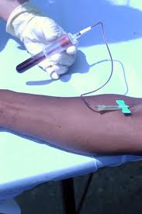
Blood contact:-
Unsafe blood and blood product
Include body fluid such as semen, vaginal secretion and breast milk.
Improper sterilized needle and syringe

Slide 8
Maternal and fetal transmission:-
HIV may pass from infected mother to her fetus through the placenta or to her infant during delivery or by breastfeeding
mother to child transmission -

Slide 9
(D)Unsafe syringe and needle
- Injecting drug users.
Penetrate broken skin.
- It should only enter the body through naturally moist places.
NOTE: -If the person infected with HIV may live for many years after infection or ultimately dies because of AIDS.

Slide 10

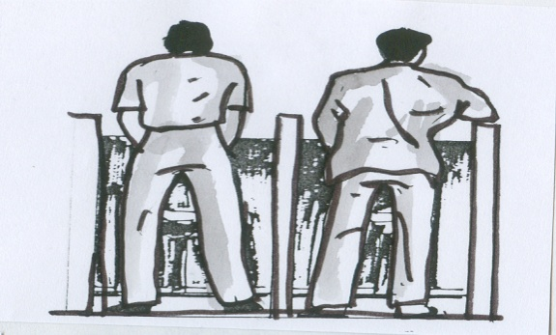


HIV/AIDS has not transmitted by:-
Kissing
Hand washing
Casual relationship such as hugging
Mosquito bite
Taking food together
Participation in sports

Slide 11
INCUBATION PERIOD:-
It may few months to several years 75% of HIV infection develop within 10 years, it may be as long as 20 Years
The period between the date of infection and the appearance of Symptoms of infectious disease.6 to 14 years in children. In child birth to 8 months. 15 to 24 years in adult
Today half of all new infection is in people between the ages of 15-24 years.

Slide 12
SIGN AND SYMPTOMS:-
CHILDREN(UPTO 13 YEARS)
Stage-1:- asymptomatic
Persistent generalized lymphadenopathy
Stage-2:- unexplained chronic diarrhea
Severe persistent or recurrent candidiasis outside the neonatal Period
Weight loss or failure to thrive
Stage-3:- AIDS-defining opportunities infections
Severe failure to thrive
Progressive encephalopathy
Malignancy

Slide 13
ADULT(13 years or older)
Stage-1:- asymptomatic (without symptoms)
Persistent generalized lymphadenopathy
Stage-2:- weight loss <10% of body weight
Stage-3:- weight loss>10% of body weight
Unexplained chronic diarrhea for more than 1
month,Unexplained prolonged fever for more than 1 month
Severe bacterial infection e.g., pneumonia
Stage-4:- HIV wasting syndrome
Herpes virus infection. Mucocutaneous for more than 1 month

Slide 14
DIAGNOSTIC EVALUATION:-
History collection
Physical examination
Laboratory investigation
(

Slide 15
1)ELISA: - Enzyme linked immunosorbent assay
Screening test for HIV infection to avoid false positive results, repeatedly reactive results must be confirm with western blot

Slide 16
(2) Western blot: - confirmatory test for HIV, it is based on detecting specific antibody to viral core protein and envelop glycoprotein

Slide 17
CBC
CD4 lymphocyte percentage:-
Risk of progression to an AIDS opportunistic infection is high with CD4< 200 cells/ul
Urine analysis

Slide 18
MANAGEMENT:-
Antiretroviral therapy
PREVENTION & CONTROL :-
(A)Education
(B)Prevention of blood borne HIV transmission
(C)Preventing perinatal transmission of HIV
(D)Primary health care
(E)Providing voluntary testing & counseling
(F) Mass media

Slide 19
ABSTRACT:
A systematic review of HIV/AIDS-related stigma and discrimination in India: current understanding and future needs.
HIV/AIDS-related stigma is recognised as a major barrier to HIV prevention efforts and an impediment to mitigating its impact on individuals and communities. This paper reviews the existing research literature on AIDS stigma in India with the objective of documenting the current status of research, highlighting major findings and identifying key gaps remaining. Thirty publications were identified through a careful search of which a majority focused on stigma assessment and very few on stigma measurement, conceptual aspects of stigma or stigma reduction interventions. A few standardised stigma measures are available but more are required to assess causes of stigma among general population and compounded and internalised stigma among positive people. Research exploring linkages between stigma and HIV services uptake or the effect of HIV care and treatment programs on stigma levels are largely missing and need to be prioritised. In addition, more research is needed to advance conceptual understanding of stigma within the cultural context of the country including research on the neglected groups such as, transgender people. Context-specific (health care, community) interventions are needed to address various forms of stigma - enacted, perceived, internalised and layered - including structural approaches besides inter-personal and information-based approaches. A major gap relates to meager research on developing and evaluating stigma reduction interventions and needs priority focus. Overall, the review recommends developing a national agenda on AIDS stigma research and interventions to help realise the government's goal of stigma reduction.

Slide 20
P | I | C | O | L
A systematic review of HIV/AIDS-related stigma and discrimination in India: current understanding and future needs. | Thirty publications were identified through a careful search of which a majority focused on stigma assessment and very few on stigma measurement, conceptual aspects of stigma or stigma reduction interventions. | - | Research exploring linkages between stigma and HIV services uptake or the effect of HIV care and treatment programs on stigma levels are largely missing and need to be prioritised | V

Slide 21
Ref: http://www.ncbi.nlm.nih.gov/pubmed/23237728

Slide 22

THANK YOU

