Slide 1

Rural health care in India
Mrs.Bhumika Chaudhari
Asst. Professor
Sumandeep Nursing College
Sumandeep Vidyapeeth Deemed To Be University
(Accredited ‘A’ Grade By Naac With A Cgpa Of 3.53 Out Of Four Point Scale)
Piparia, Waghodia, Vadodara, Gujarat

Slide 2
Introduction
In 1977, GoI launched Rural Health Scheme based on the
principle of “placing people’s health in people’s hand”
Subsequently in the international conference of Alma- Ata(1978)the goal of “Health for all” by 2000 through primary health care approach was set.
Keeping in view WHO “Health for all” by 2000 GoI formulated National health policy 2002

Slide 3
Cont….
More recently GoI formulated NRHM and Indian Public Health
Standards (IPHS) in this regards
In order to provide quality care in the public health agencies of health care delivery IPHS are being prescribed.
These standards provides basic promotive, preventive and curative primary health care to the community and……
…….achieve and maintain an acceptable quality of care
These standards would help monitor and improve functioning of the health care delivery system

Slide 4
Rural Health care system in India
Community Health Centre (CHC)
A 30 bedded Hospital/ Referral unit for 4 no. of PHCs with specialized Health Services
Primary Health Centre (PHC)
A Referral unit for 4-6 Subcentres; 4-6 bedded manned with a Medical Officer in-charge and 14 subordinate paramedical staff no. of PHCs with specialized Health Services
Sub Centre (SC)
Most peripheral contact point of community with Primary Health
Care system; manned with one MPW(M) and MPW(F)

Slide 5


Rural Health care system in India
The health care infrastructure in rural areas has been developed as a three tier system and is based on the above population norms.
Health Facility | Population Norms
 | Plain Area | Hilly/Tribal/Difficult Area
Sub-Centre | 5000 | 3000
Primary Health Centre | 30,000 | 20,000
Community Health Centre | 1,20,000 | 80,000

Slide 6
Sub Center
The most peripheral and first contact point between the primary health care system and the community.
The Ministry of Health & Family Welfare is providing 100% Central assistance
They are established on the basis of
  One SC for every 5,000 pop in general and…
  One SC for every 3,000 pop in hilly, tribal and backward areas
Each Sub-Centre is manned by one Male and one female Health
Worker.
One Lady Health Worker (LHV) is entrusted with the task of supervision of six Sub-Centers.

Slide 7
Cont….
Sub Centre are
assigned tasks relating to
interpersonal communication
…..in order to bring about behavioral change and provide services in relation to….
Maternal and child health,
Family welfare,
Nutrition,
Immunization,
Diarrhea control and
Control of communicable diseases programmes.
The sub centre are provided with basic drugs for minor ailments.

Slide 8
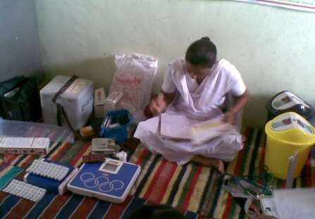
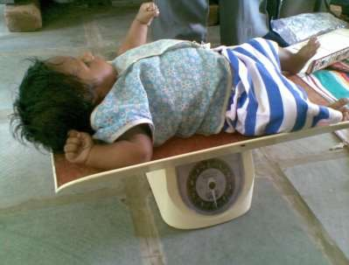
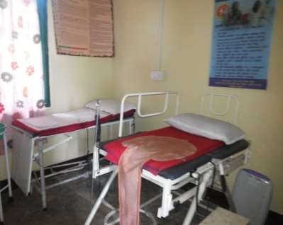
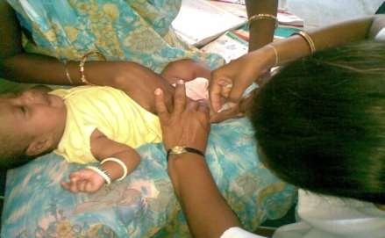
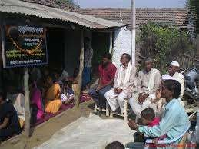

Slide 9
Primary Health Center
PHC is
the first contact point between village
community and the Medical Officer.
The PHCs were envisaged to provide an integrated curative and preventive health care to the rural population with emphasis on preventive and promotive aspects of health care.
The PHCs are established and maintained by the State Governments.
At present, a PHC is manned by a Medical Officer supported by 14 paramedical and other staff.

Slide 10
Cont….
It acts as a referral unit for 6 SubCentres.
It has 4 - 6 beds for patients.
The activities of PHC involve curative, preventive, primitive and Family Welfare Services.
National Health Plan (1983) proposed reorganization of PHCs on the basis of….
  One PHC for every…..30,000 pop in Rural areas
  One PHC for every…..50,000 pop in Urban areas

Slide 11
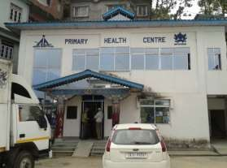
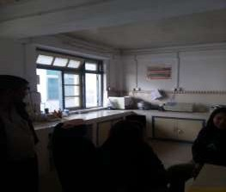
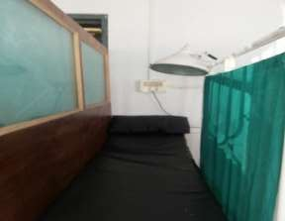
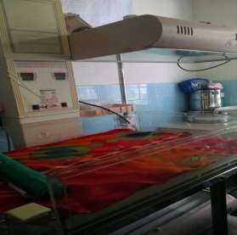
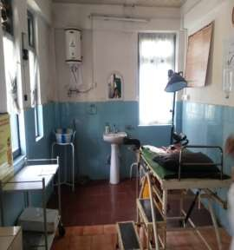
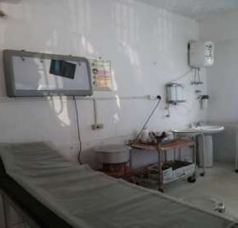
PHC Pakyong

Slide 12
Functions of PHCs
Medical care
Health programmes
MCH care and family planning
Health education and training
Referral services
Safe water supply and basic sanitation
Prevention and control of locally endemic diseases
Collection and reporting of vital events
Basic laboratory services

Slide 13
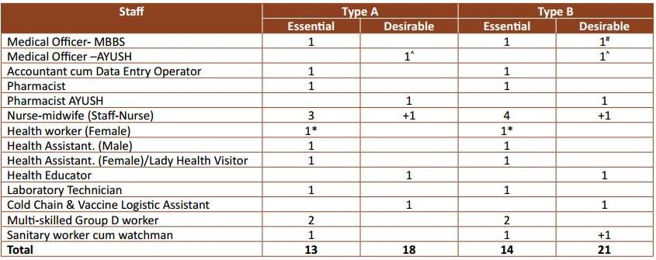
Staffing of PHCs
Source: IPHS 2012

Slide 14
Community Health Center (CHC)
These were established by upgrading the primary health centers
CHCs are being established and maintained by the State Government.
centers,each community health center should cover a population of 8000 to 1.2 lakh
It is manned by four medical specialists i.e.
Physician, Gynecologist and Pediatrician and….
……supported by paramedical and other staff.
Surgeon,
It has 30 in-door beds with one OT, X-ray, Labour Room and Laboratory
facilities.
It serves as a referral centre for 4 PHCs and also provides facilities for obstetric care and specialist consultations.

Slide 15
Functions of CHCs
Care of Routine and Emergency Cases in Surgery
  Dressings, I&D, and surgery for Hernia, Hydrocele, Appendicitis etc.
  Emergencies like Intestinal Obstruction, Haemorrhage, etc.
  Other management including nasal packing, tracheostomy,
foreign body removal etc.
  Fracture reduction and putting splints/plaster cast.
  Conducting daily OPD.
Care of Routine and Emergency Cases in Medicine
  Daily OPD
  Handling all the emergency and routine cases

Slide 16
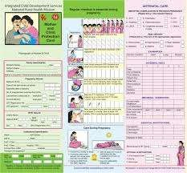
Cont…
Maternal Health
  Minimum 4 ANC check ups including Registration &
associated services
    1st visit: Within 12 weeks—preferably as soon as pregnancy
    2nd visit: Between 14 and 26 weeks
    3rd visit: Between 28 and 34 weeks
    4th visit: Between 36 weeks and term
  24 hr delivery services including normal and assisted
delivery and cesarean section
  Managing labour using Partograph.
  Minimum 48 hours of stay after delivery, 3-7 days stay post delivery for managing Complications

Slide 17
Cont….
Newborn Care and Child Health
  Essential Newborn Care and Resuscitation
  Counseling on Infant and young child feeding
  Routine and emergency care of sick children
  Full Immunization of infants and children against VPDs
  Management of Malnutrition cases.
Family Planning
  Counseling, provision of Contraceptives, NSV,
Laparoscopic Sterilization Services and their follow up.
  Safe Abortion Services

Slide 18
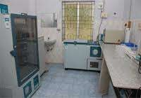
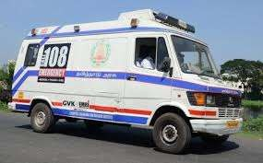
Cont….
All National Health Programmes delivered through CHCs
School health services
Others
  Blood storage facility
  Essential laboratory services
  Referral (transport) services
Maternal Death review (MDR)

Slide 19
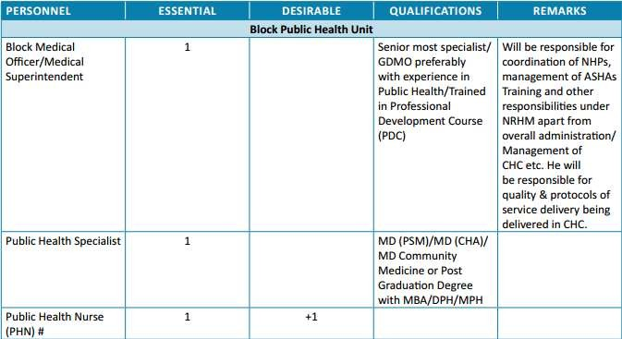
Staffing of CHCs

Slide 20
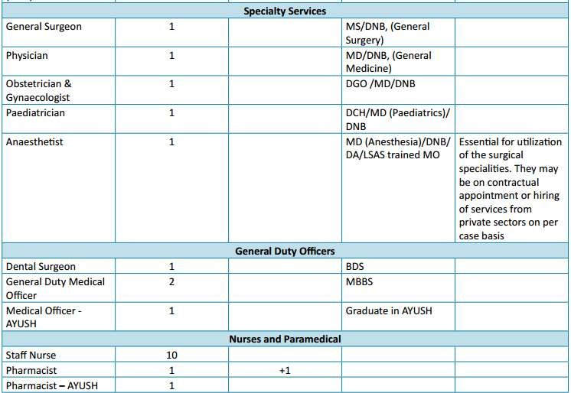
Cont…

Slide 21
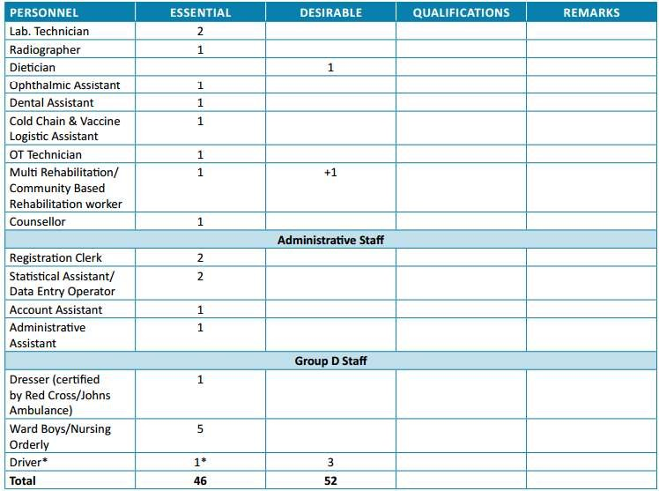
Cont….

Slide 22
Thank you

